Slide 1

Obesity Research and Therapy Unit
Alkindy College of Medicine
University of Baghdad

Slide 2


Slide 3
World Obesity Day was established in 2015 as an annual campaign with the goal of stimulating and supporting practical actions that will help people achieve and maintain a healthy weight and reverse the global obesity crisis.

Slide 4


Slide 5


Slide 6

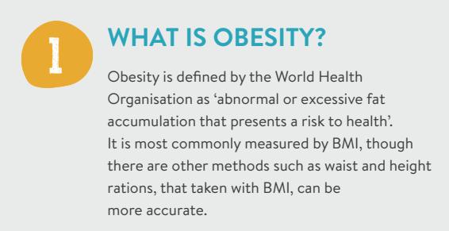

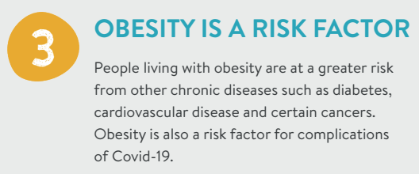


Slide 7



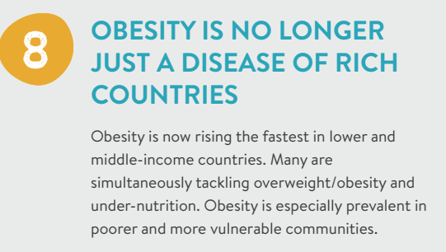

Slide 8



Slide 9



Slide 10
وحدة بحوث وعلاج السمنة
Founded 2009
Aim
Dignosis and Treatment of Obesity and its comorbidities
Research

Slide 11

14.450 patients

Slide 12
Research
> 25 published papers
10 Msc Thesis
5 PhD
Undergraduate research projects

Slide 13
Iraqi campaign for Obesity 2012-2014
Lectures , workshops and conferences

Slide 14
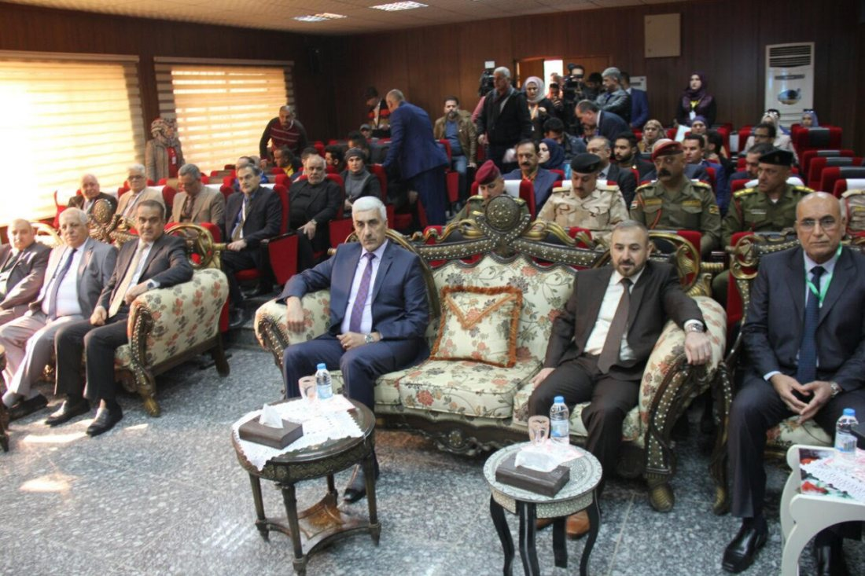

Slide 15
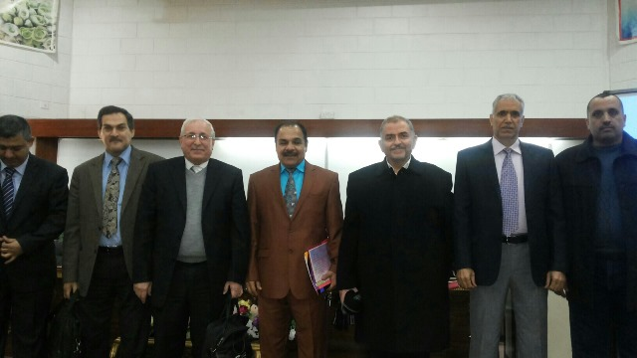

Slide 16
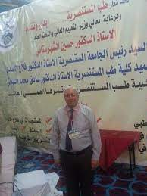
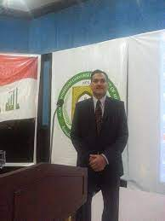

Slide 17
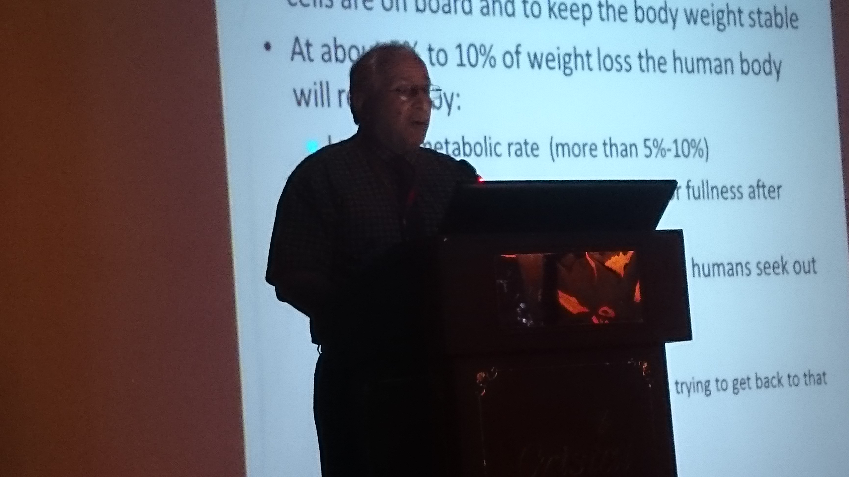

Slide 18
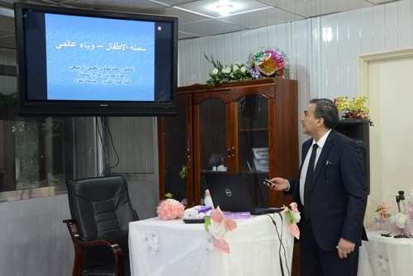

Slide 19
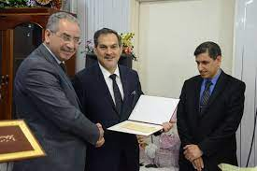

Slide 20
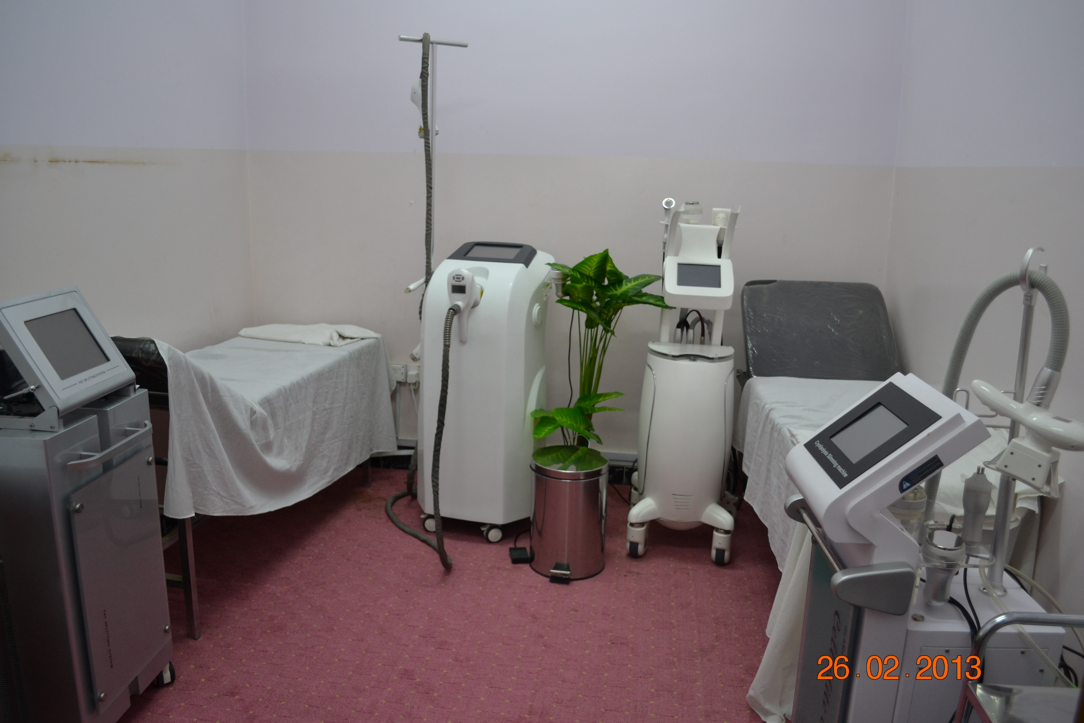

Slide 21
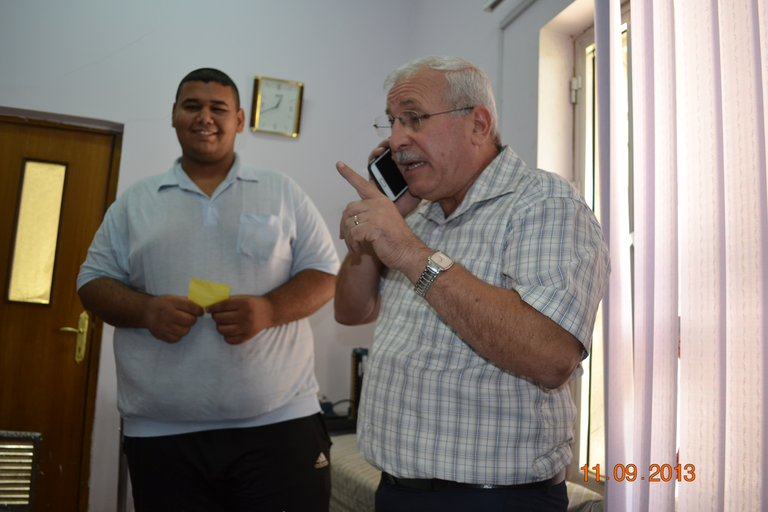

Slide 22
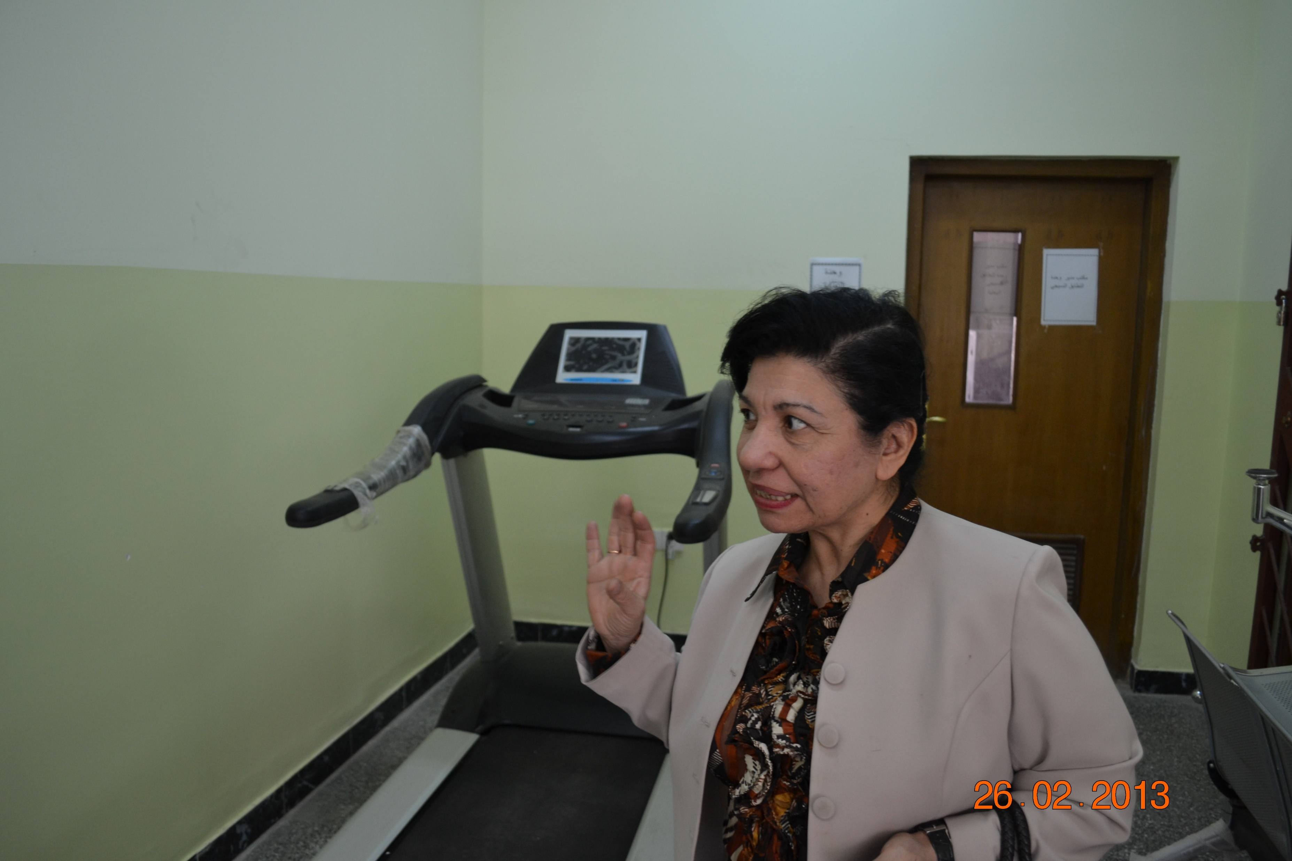

Slide 23
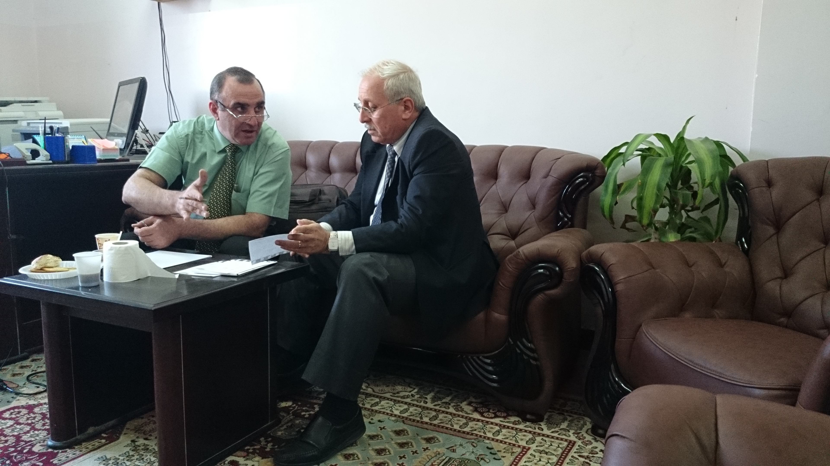

Slide 24
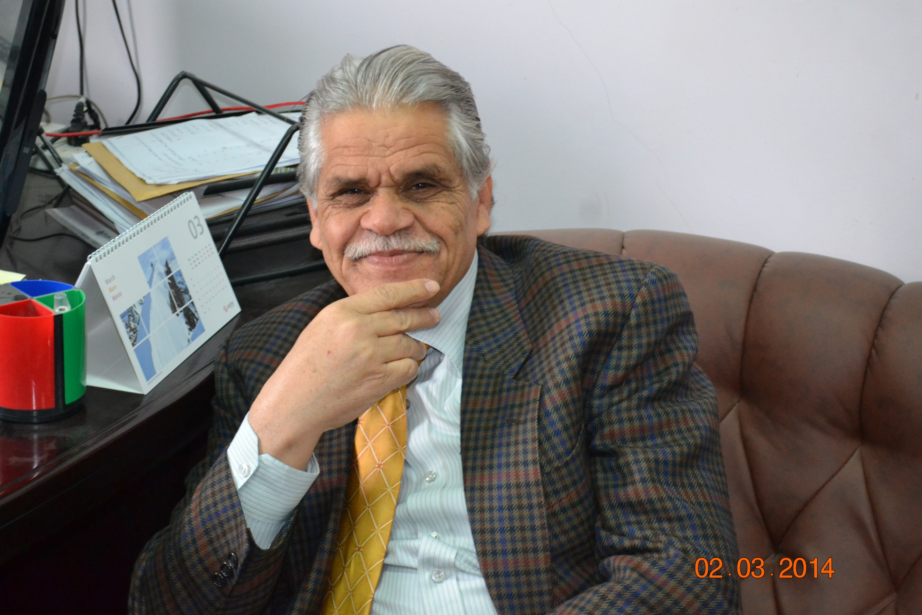

Slide 25
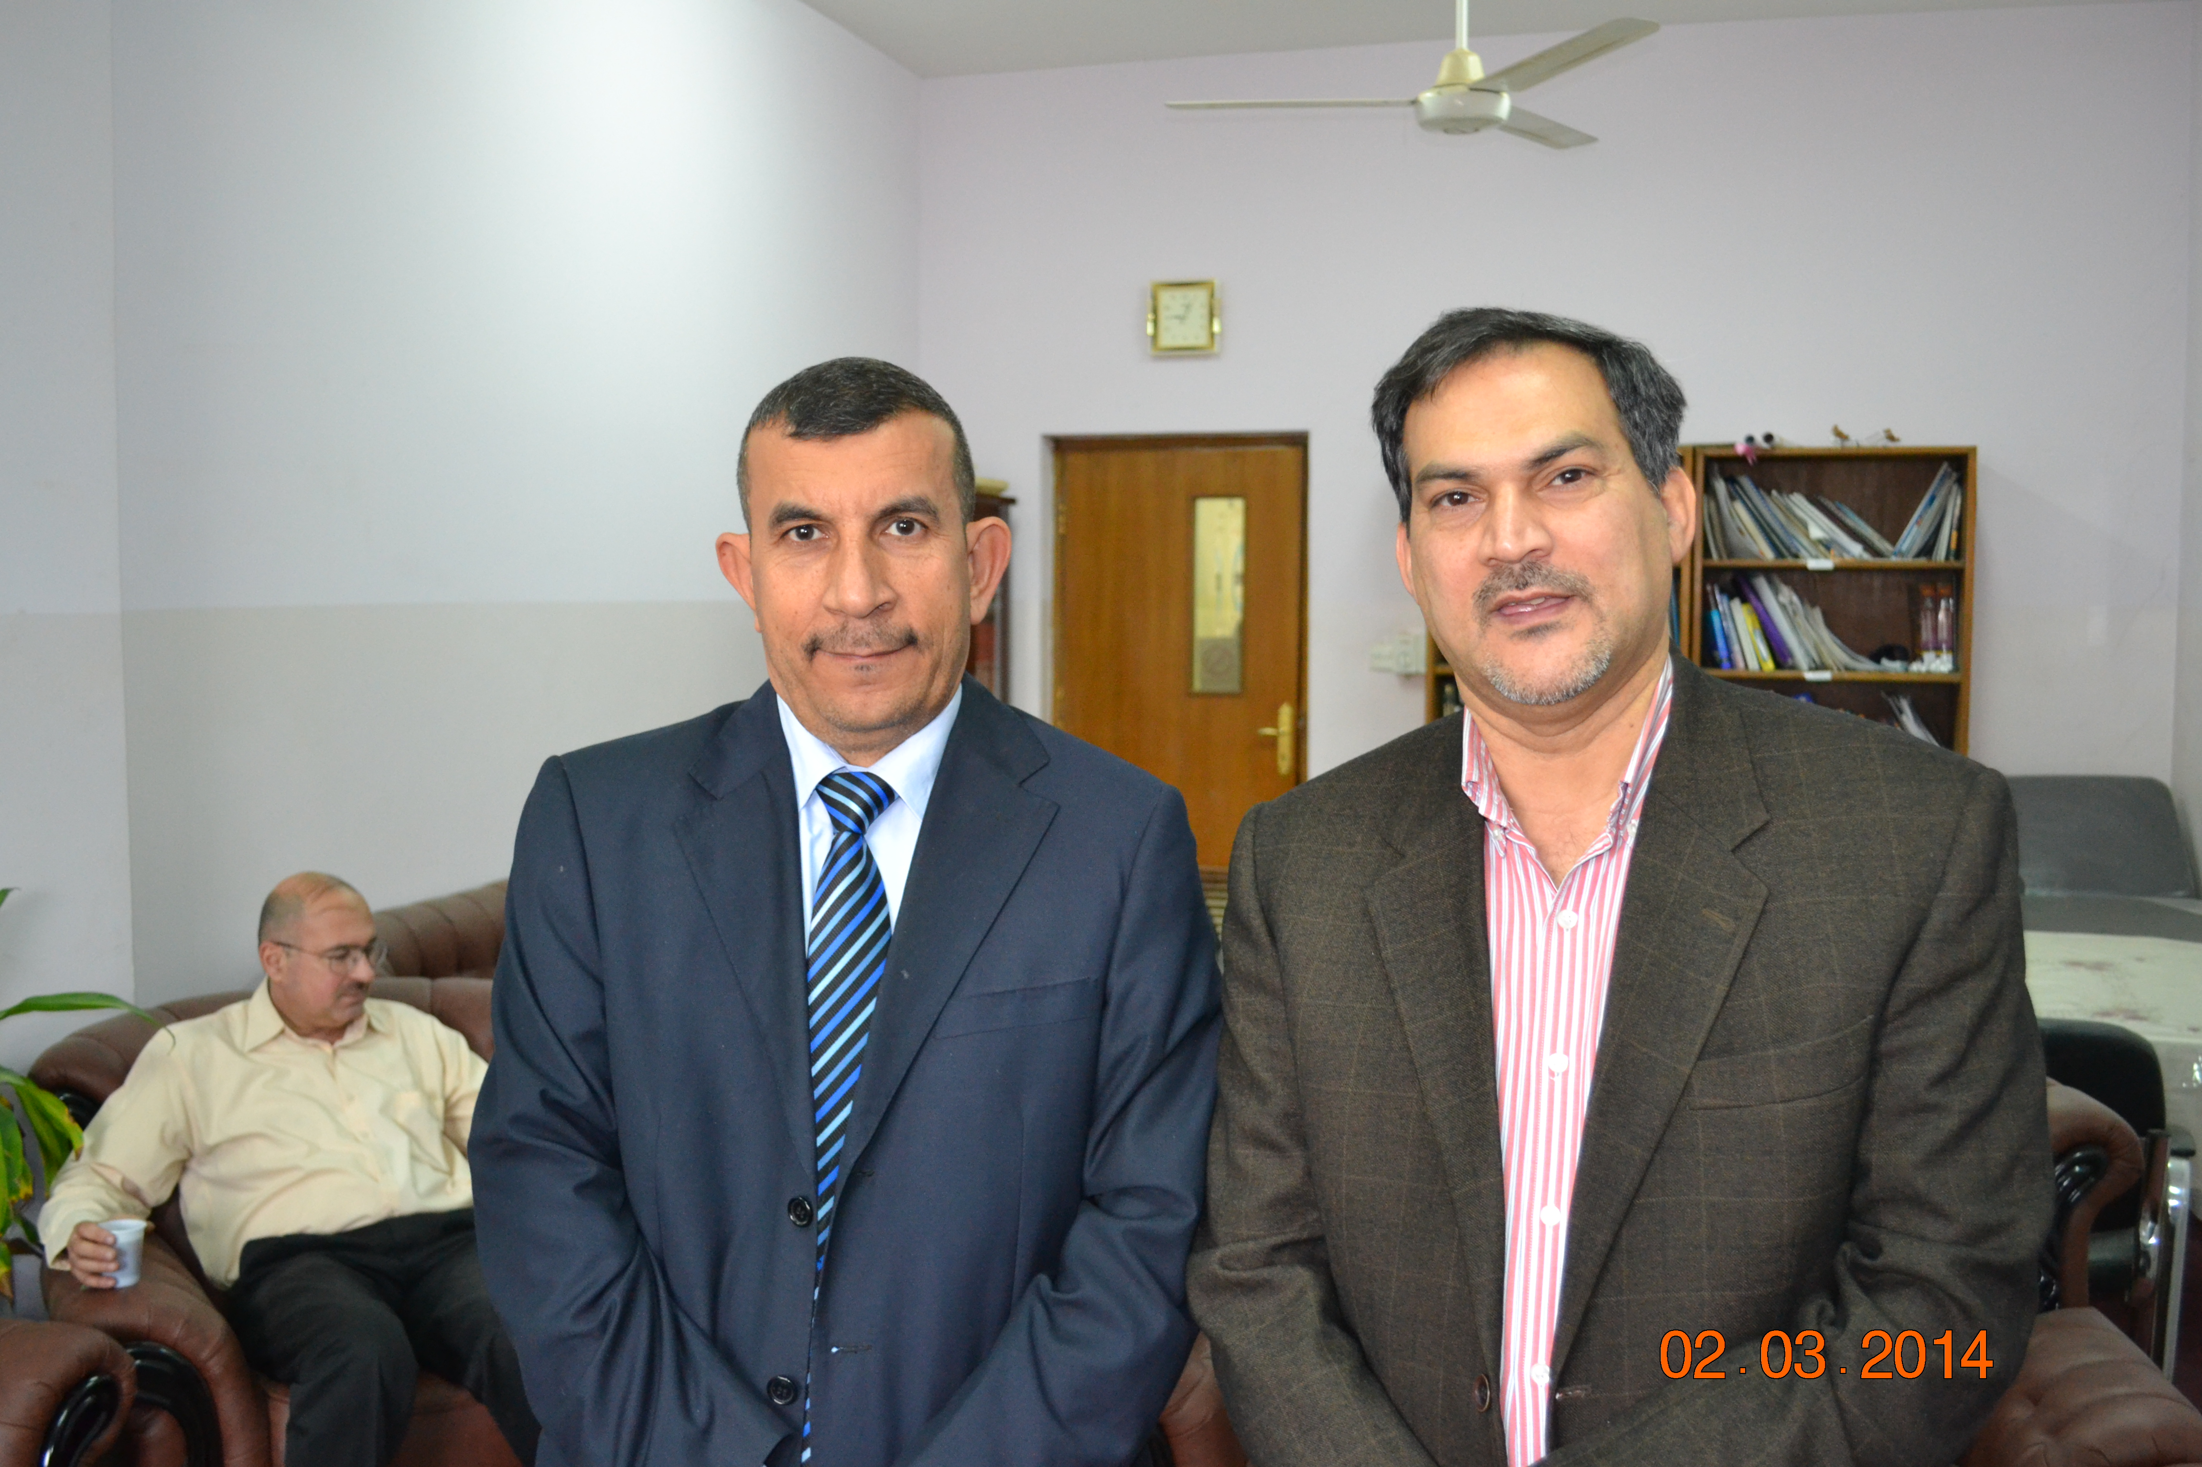

Slide 26
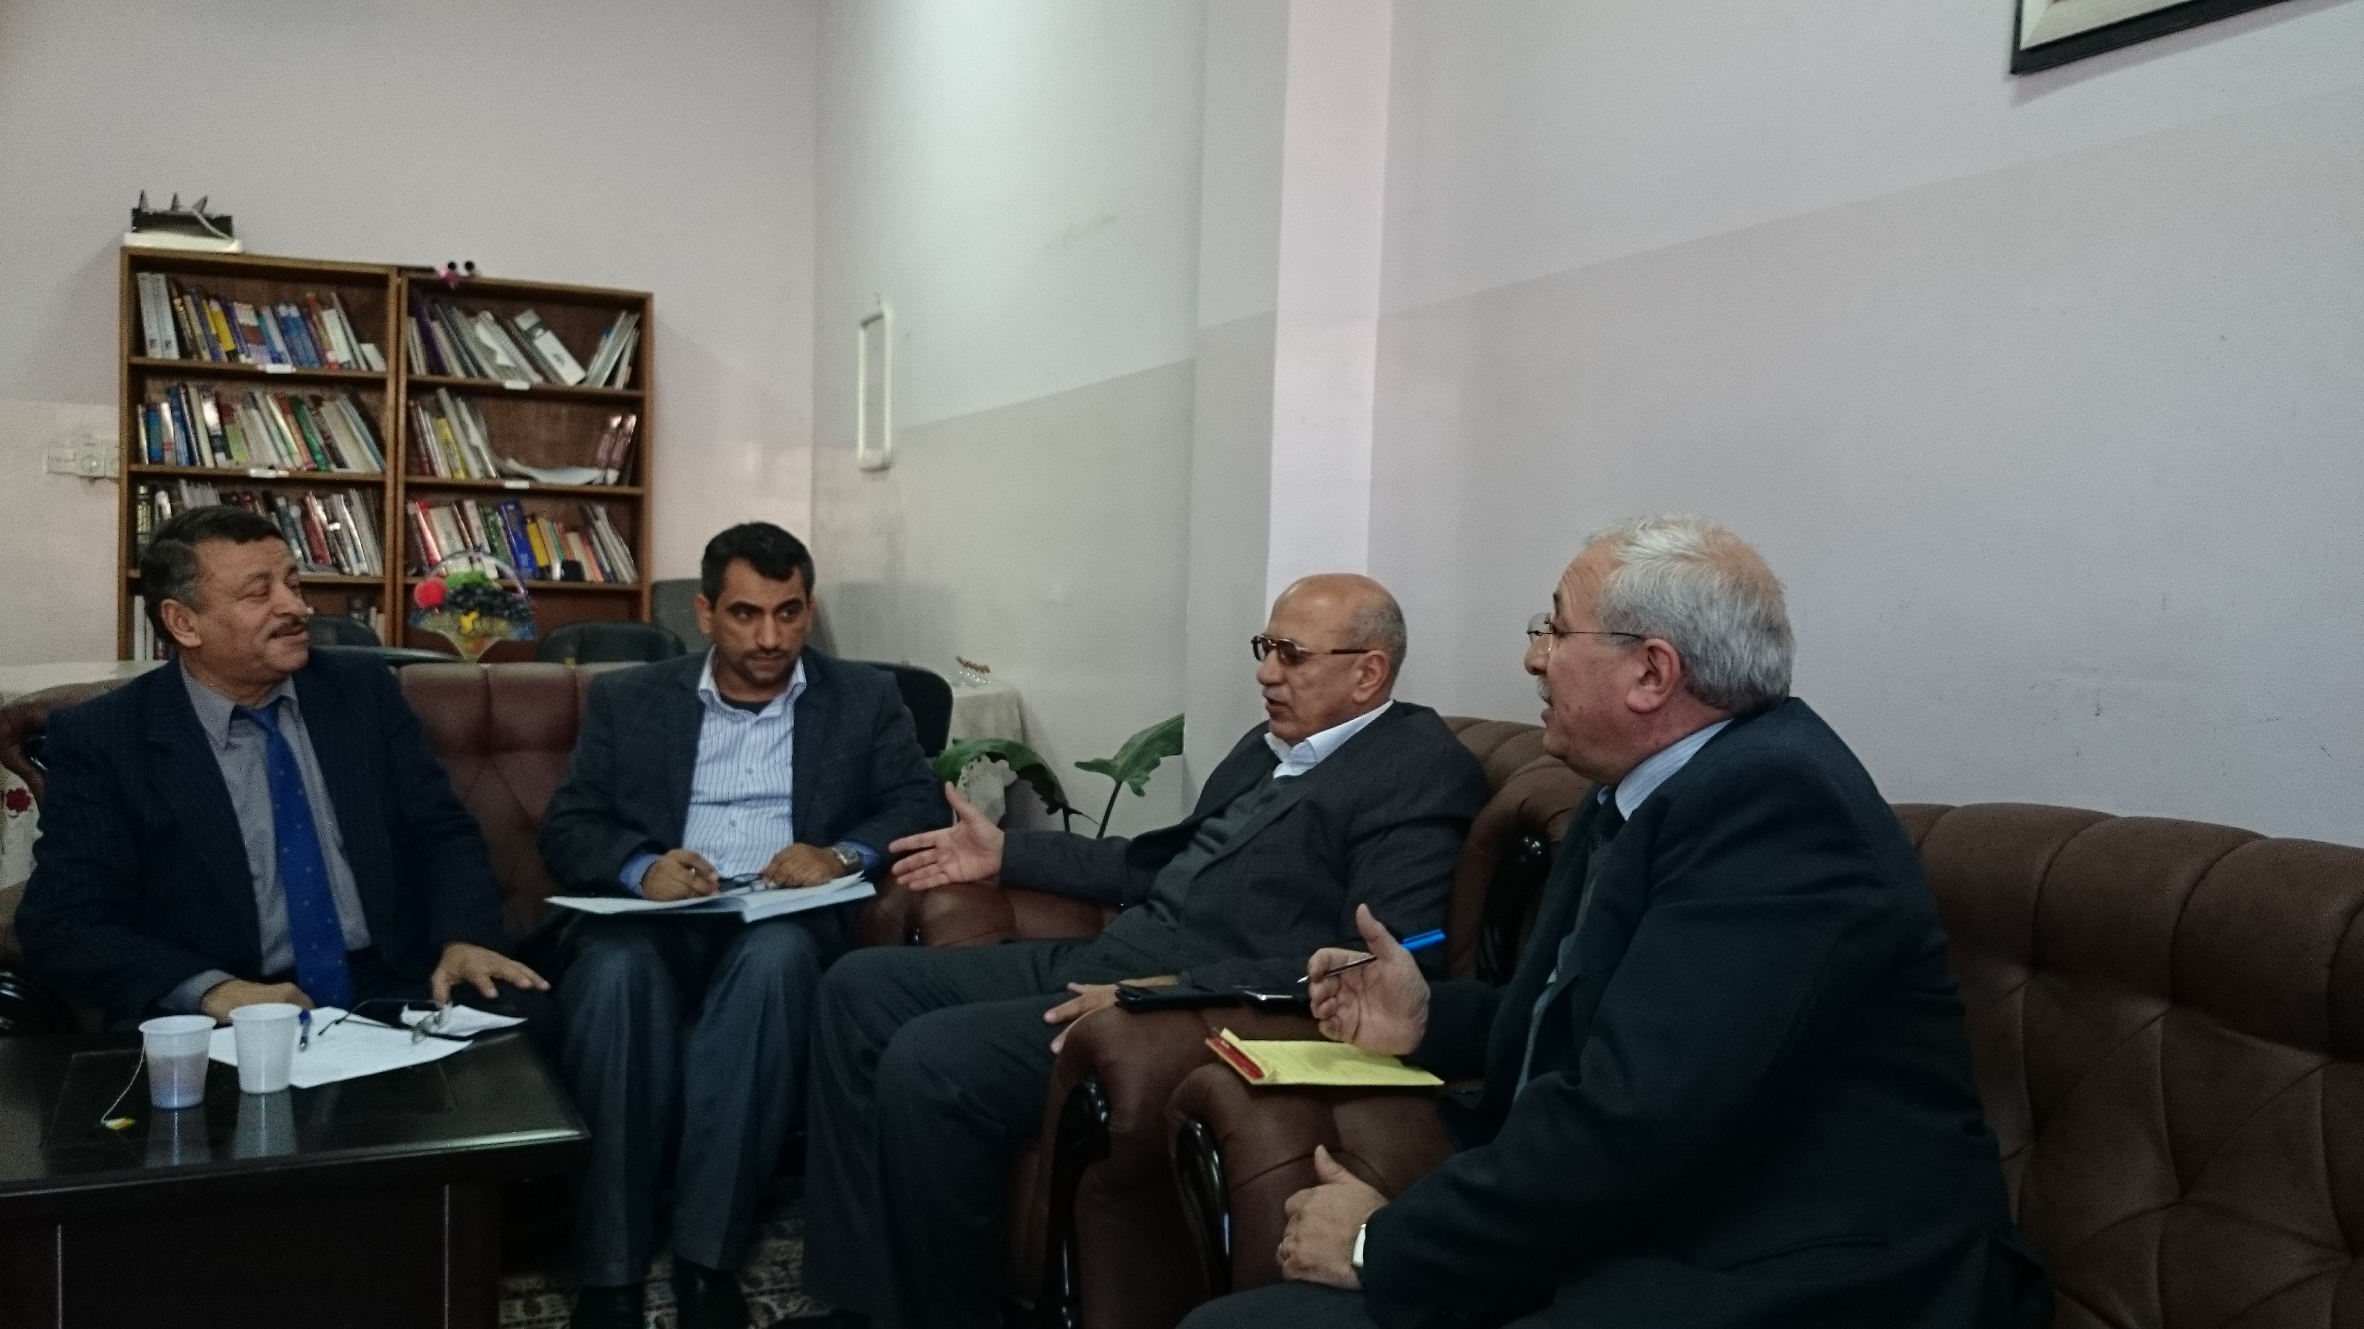

Slide 27


