Slide 1
Obesity as a disease
Dr. sama atta

Slide 3
On 4th of march the world celebrate the world obesity day
We want to seize this opportunity to view obesity as a complex disease not only as cosmetic concern

Slide 4
Causes of obesity
1) calories input/output imbalance
2) drugs: glucocorticoids, antipsychotic drugs (eg, risperidone) and some antiepileptic medications.
3) Endocrine causes: insulin resistance, PCOS, cushing, hypothyroidism.
4) syndromic: prader willi, Aldstrom
5) genetic : Monogenic obesity .MC4R mutation, POMC mutation, Leptin
6) neurological: irradiation, hypothalamic, brain injury
7) psychological : Emotional eating, binge eating , impulsive eating.

Slide 5
Complications of obesity

Slide 6
Obesity and covid

Slide 7
From the earliest days of the pandemic, it’s been known that obesity is a risk factor for severe COVID-19, but a study recently released by the Centers for Disease Control and Prevention (CDC) demonstrated just how nonlinear this relationship is. The vast majority—78%—of U.S. patients hospitalized with COVID-19 were overweight or had obesity. The numbers for intensive care, invasive mechanical ventilation and death were nearly the same.
Potential mechanisms include decreased lung compliance,FRC , increased inflammatory markers ,

Slide 8
Treatment
1) Lifestyle modifications
Low calorie diet
Micronutrients
Not indicated in children

Slide 9
Pharmacological management

Slide 10
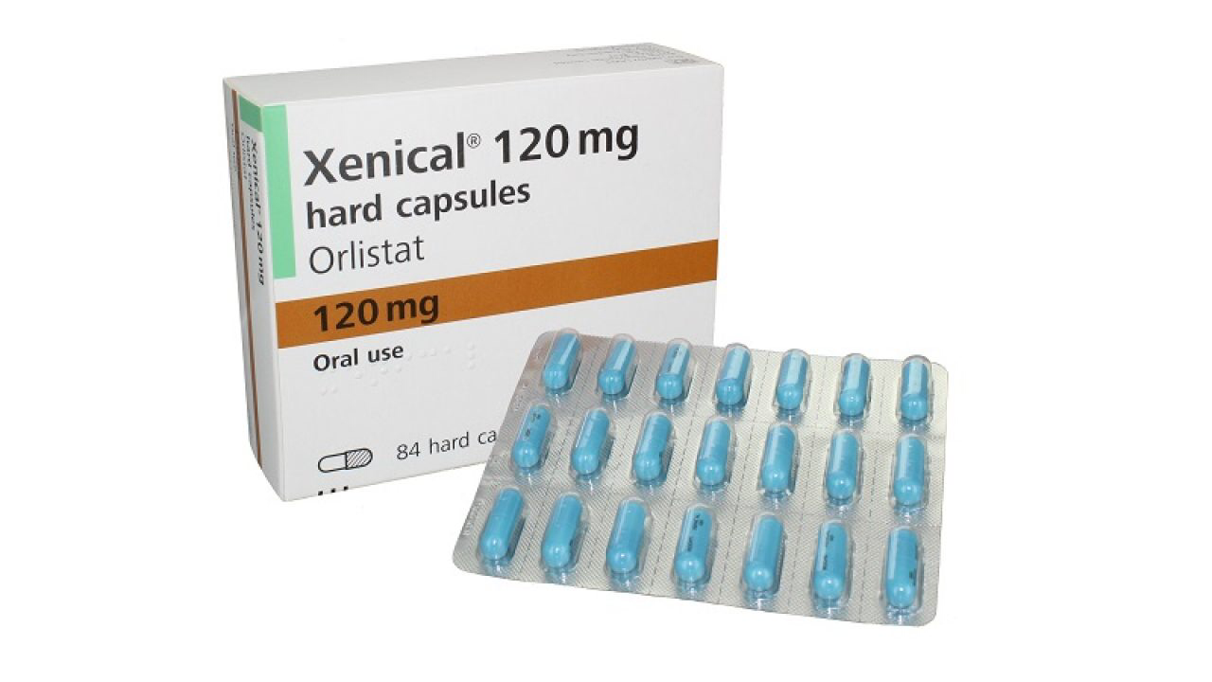
Drugs acting peripherally On the GIT
Orlistat

Slide 11
Orlistat
gastric and pancreatic lipase inhibitor that reduces dietary fat absorption by approximately 30%
FDA approved
The most commonly reported adverse effects of Orlistat include steatorrhoea, bloating, fecal urgency and fecal incontinence. The percentage of patients experiencing at least one of these side effects appears to be around 16% to 40%
Fat soluble vitamins deficiency
Colon cancer
Interaction with drugs: warfarin , decreased absorption of amiodarone and cyclosprin

Slide 12
GLP-1 agonists
GLP-1 receptor agonists have been used for years to treat type 2 diabetes.
Weight loss was observed as secondary (and welcome) side effect

Slide 14
Liraglutide ( saxenda) was FDA approved in 2014 for weight-management in adults with overweight and obesity (non diabetics)
In 2020, Saxenda was approved for children and adolescents 12 years and older with obesity or overweight with an associated health problem, such as high blood pressure.

Slide 15
In 2021, the GLP-1 agonist semaglutide also was approved for this indication, based on impressive weight loss in industry-sponsored studies.

Slide 16
The most common symptoms associated with the use of GLP-1 receptor agonists are gastrointestinal symptoms, mainly nausea. Other common adverse effects include injection site reactions, headache, and nasopharyngitis, but these effects do not usually result in discontinuation of the drug.
it may be prudent that GLP-1 receptor agonists should not be given to patients with several risk factors for pancreatitis, such as severe hypertriglyceridemia or alcohol intake.

Slide 17
Dopamine and appetite Centrally acting weight loss agents
Synaptic dopaminergic neurons in the brain participates in food reward so low dopamine increases emotional eating , binge eating and hyperphagia .
Methylphenidate inhibits dopamine transport and reuptake, therefore increasing both synaptic dopamine and norepinephrine levels in brain areas responsible for appetite.
Methylphenidate was first used for Attention-Deficit Hyperactivity Disorder (ADHD), in which anorexia and weight loss were identified as side effects .
Topiramate is an antiepileptic that increase dopamine levels in the body and cause weight loss
Buprion

Slide 18
Melanocortin system
Key regulator of appetite and energy expenditure
Hypothalmus neurons circuits
produce POMC (appetite suppressant) in response to leptin
POMC derived MSH expressed on MC4R receptor in the hypothalamus
Interruption of the circuit in certain genetic autosomal recessive disorders lead to hyperphagia , morbid obesity in children and adolscents
Monogenic obesity
Leptin receptor deficiency
MC4R mutation
POMC mutation

Slide 20
Setmelanotide
melanocortin-4 (MC4) receptor agonist developed for the treatment of obesity arising from monogenic obesity
The drug has received its first approval in the USA for chronic weight management in patients 6 years and older with monogenic obesity
. Setmelanotide is also being developed in other rare genetic disorders associated with obesity including prader willi Syndrome, Alström Syndrome, POMC and other MC4R pathway heterozygous deficiency obesity.

Slide 23
Obesity Is
A complex disease.
A worldwide health concern.
Multifactorial.
Treatable and manageable.
Obesity Is Not
Only patient’s fault.
Just about food.
Cured by a miracle treatment.

