Slide 1

GENETICS OF
Attention deficit hyperactivity disorder

Slide 2
What is ADHD?
ADHD is one of the most common neurodevelopmental disorders of childhood. It is usually first diagnosed in childhood and often lasts into adulthood. Children with ADHD may have trouble paying attention, controlling impulsive behaviors (may act without thinking about what the result will be), or be overly active.

Slide 3
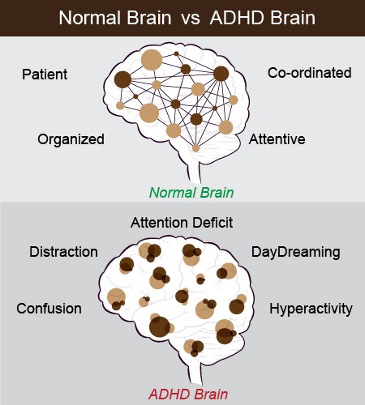

Slide 4
Signs and Symptoms
It is normal for children to have trouble focusing and behaving at one time or another. However, children with ADHD do not just grow out of these behaviors. The symptoms continue, can be severe, and can cause difficulty at school, at home, or with friends. A child with ADHD might:
daydream a lot
forget or lose things a lot
squirm or fidget

Slide 5
Signs and Symptoms
talk too much
make careless mistakes or take unnecessary risks
have a hard time resisting temptation
have trouble taking turns
have difficulty getting along with others

Slide 6
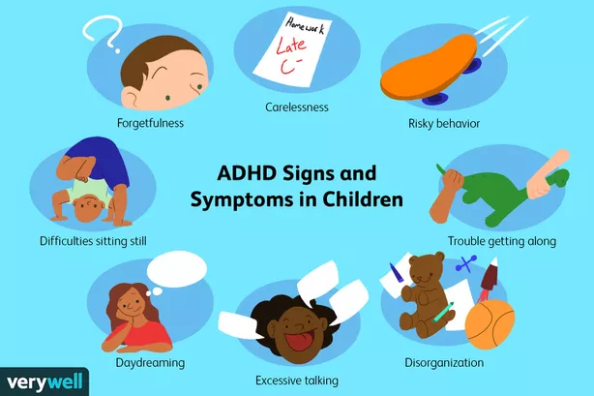

Slide 7
Types of ADHD
There are three different types of ADHD, depending on which types of symptoms are strongest in the individual:
Predominantly Inattentive Presentation: It is hard for the individual to organize or finish a task, to pay attention to details, or to follow instructions or conversations. The person is easily distracted or forgets details of daily routines.
Predominantly Hyperactive-Impulsive Presentation: The person fidgets and talks a lot. It is hard to sit still for long (e.g., for a meal or while doing homework). Smaller children may run, jump or climb constantly. The individual feels restless and has trouble with impulsivity. Someone who is impulsive may interrupt others a lot, grab things from people, or speak at inappropriate times. It is hard for the person to wait their turn or listen to directions. A person with impulsiveness may have more accidents and injuries than others.
Combined Presentation: Symptoms of the above two types are equally present in the person.

Slide 8
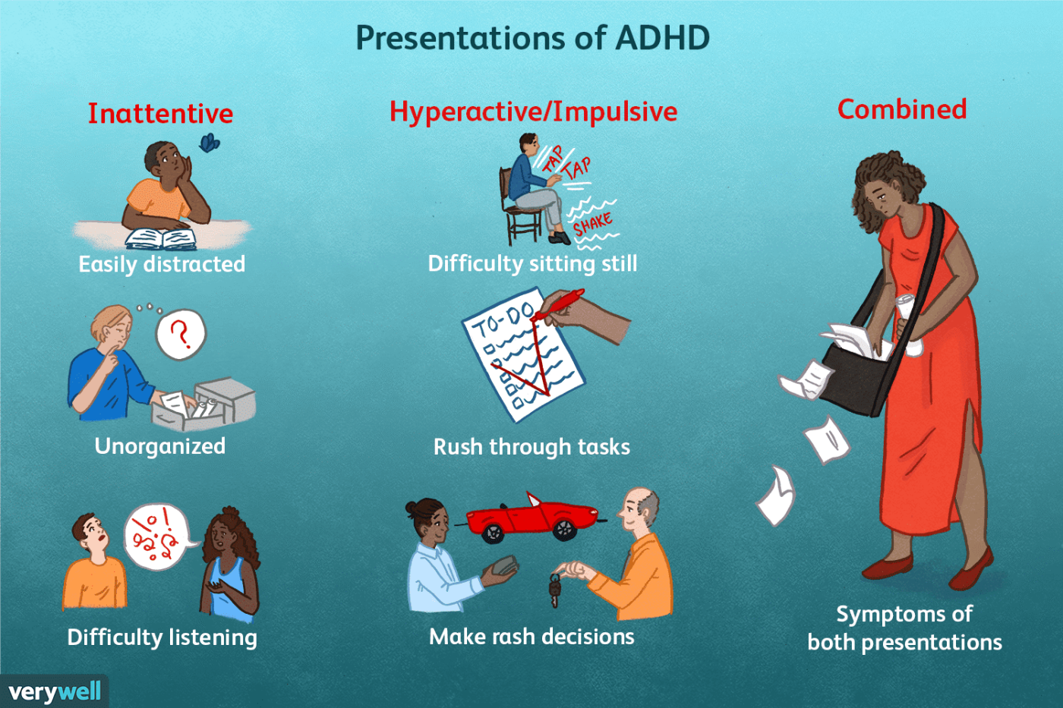

Slide 9
Causes of ADHD
The cause(s) and risk factors for ADHD are unknown, but current research shows that genetics plays an important role. Recent studies link genetic factors with ADHD.
In addition to genetics, scientists are studying other possible causes and risk factors including:
Brain injury
Exposure to environmental risks (e.g., lead) during pregnancy or at a young age
Alcohol and tobacco use during pregnancy
Premature delivery
Low birth weight

Slide 10
Causes of ADHD
Research does not support the popularly held views that ADHD is caused by eating too much sugar, watching too much television, parenting, or social and environmental factors such as poverty or family chaos. Of course, many things, including these, might make symptoms worse, especially in certain people. But the evidence is not strong enough to conclude that they are the main causes of ADHD.

Slide 11
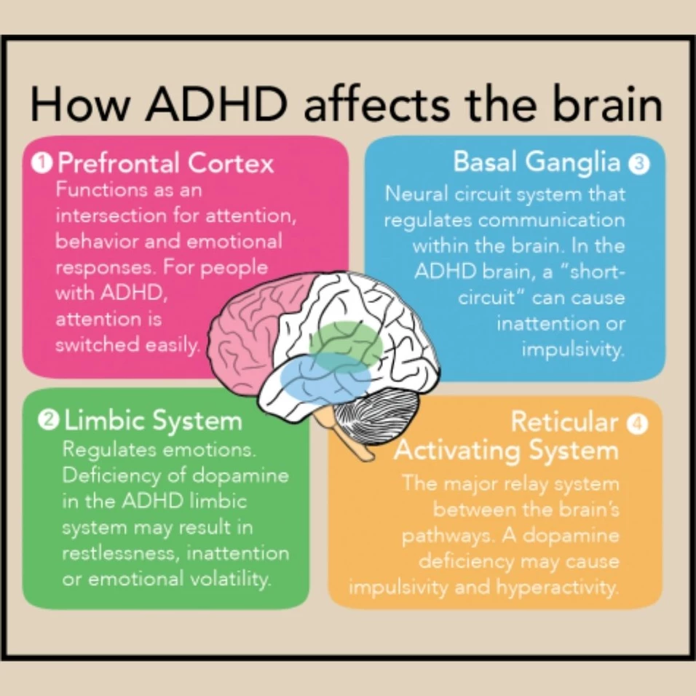

Slide 12
Diagnosis
There is no single test to diagnose ADHD, and many other problems, like anxiety, depression, sleep problems, and certain types of learning disabilities, can have similar symptoms. One step of the process involves having a medical exam, including hearing and vision tests, to rule out other problems with symptoms like ADHD. Diagnosing ADHD usually includes a checklist for rating ADHD symptoms and taking a history of the child from parents, teachers, and sometimes, the child.

Slide 13
Diagnosis
Healthcare providers use the guidelines in the American Psychiatric Association’s Diagnostic and Statistical Manual, Fifth edition (DSM-5), to help diagnose ADHD. This diagnostic standard helps ensure that people are appropriately diagnosed and treated for ADHD. Using the same standard across communities can also help determine how many children have ADHD, and how public health is impacted by this condition.

Slide 14
DSM-5 Criteria for ADHD
Inattention: Six or more symptoms of inattention for children up to age 16 years, or five or more for adolescents age 17 years and older and adults; symptoms of inattention have been present for at least 6 months, and they are inappropriate for developmental level:
Often fails to give close attention to details or makes careless mistakes in schoolwork, at work, or with other activities.
Often has trouble holding attention on tasks or play activities.
Often does not seem to listen when spoken to directly.
Often does not follow through on instructions and fails to finish schoolwork, chores, or duties in the workplace (e.g., loses focus, side-tracked).

Slide 15
DSM-5 Criteria for ADHD
Often has trouble organizing tasks and activities.
Often avoids, dislikes, or is reluctant to do tasks that require mental effort over a long period of time (such as schoolwork or homework).
Often loses things necessary for tasks and activities (e.g. school materials, pencils, books, tools, wallets, keys, paperwork, eyeglasses, mobile telephones).
Is often easily distracted
Is often forgetful in daily activities.

Slide 16
DSM-5 Criteria for ADHD
Often talks excessively.
Often blurts out an answer before a question has been completed.
Often has trouble waiting their turn.
Often interrupts or intrudes on others (e.g., butts into conversations or games)

Slide 17
Hyperactivity and Impulsivity: Six or more symptoms of hyperactivity-impulsivity for children up to age 16 years, or five or more for adolescents age 17 years and older and adults; symptoms of hyperactivity-impulsivity have been present for at least 6 months to an extent that is disruptive and inappropriate for the person’s developmental level:
Often fidgets with or taps hands or feet, or squirms in seat.
Often leaves seat in situations when remaining seated is expected.
Often runs about or climbs in situations where it is not appropriate (adolescents or adults may be limited to feeling restless).
Often unable to play or take part in leisure activities quietly.

Slide 18
Is often “on the go” acting as if “driven by a motor”.
Often talks excessively.
Often blurts out an answer before a question has been completed.
Often has trouble waiting their turn.
Often interrupts or intrudes on others (e.g., butts into conversations or games)

Slide 19
Diagnosing ADHD in Adults
ADHD often lasts into adulthood. To diagnose ADHD in adults and adolescents age 17 years or older, only 5 symptoms are needed instead of the 6 needed for younger children. Symptoms might look different at older ages. For example, in adults, hyperactivity may appear as extreme restlessness or wearing others out with their activity.

Slide 20
Treatments
In most cases, ADHD is best treated with a combination of behavior therapy and medication. For preschool-aged children (4-5 years of age) with ADHD, behavior therapy, particularly training for parents, is recommended as the first line of treatment before medication is tried. What works best can depend on the child and family. Good treatment plans will include close monitoring, follow-ups, and making changes, if needed, along the way.

Slide 21
Managing Symptoms
Being healthy is important for all children and can be especially important for children with ADHD. In addition to behavioral therapy and medication, having a healthy lifestyle can make it easier for your child to deal with ADHD symptoms. Here are some healthy behaviors that may help:
Developing healthy eating habits such as eating plenty of fruits, vegetables, and whole grains and choosing lean protein sources
Participating in daily physical activity based on age
Limiting the amount of daily screen time from TVs, computers, phones, and other electronics
Getting the recommended amount of sleep each night based on age

Slide 22
MOLECULAR GENETICS
Association with the DRD5 Gene on Chromosome 4p16
Kustanovich et al. (2004) genotyped a large multiplex sample of ADHD-affected children and their parents for polymorphisms in genes reported to be associated with ADHD and analyzed the results using the transmission disequilibrium test. A dinucleotide repeat polymorphism near the DRD5 gene (126453.0002) showed an association with ADHD and with biased nontransmission of the 146-bp allele, and a trend toward excess transmission of the 148-bp allele. The DRD5 146-bp allele and the DRD4 240-bp allele of the promoter polymorphism showed estimated genotype relative risks of 1.7 and 1.37, respectively.

Slide 23
Association with the DAT1 (SLC6A3) Gene on Chromosome 5p15
Cook et al. (1995) used the haplotype-based haplotype relative risk (HHRR) method to test for association between a VNTR polymorphism at the DAT1 locus and ADHD in 49 individuals, as well as in 8 cases of undifferentiated attention-deficit disorder (UADD). All cases were studied in trios composed of father, mother, and affected offspring. A significant association was found between ADHD/UADD and a 480-bp DAT1 allele. When cases of UADD were dropped from the analysis, similar results were found.

Slide 24
Waldman et.al.(1998)used 4 analytic strategies to examine association and linkage of the DAT1 gene and ADHD in a sample of 122 children referred to psychiatric clinics for behavioral and learning problems that included but were not limited to ADHD. Within-family analyses of linkage disequilibrium, using the transmission disequilibrium test (TDT), confirmed the 480-bp allele as the high-risk allele. In between-family association analyses, levels of hyperactive-impulsive symptoms but not inattentive symptoms were related to the number of DAT1 high-risk alleles. Sibs discordant for the number of DAT1 high-risk alleles differed markedly in their levels of both hyperactive-impulsive and inattentive symptoms, such that the sibs with the higher number of high-risk alleles had much higher symptom levels. Within-family analyses of linkage disequilibrium, using the TDT, suggested association and linkage of ADHD with DAT1, with the relationship being especially strong with the combined but not the inattentive subtype.

Slide 25
Using multivariate analyses of predictors of hyperactive-impulsive and inattentive behavior, including prenatal smoking and DAT polymorphism, Kahn et al. (2003) conducted a prospective cohort study of the Connors Parent Rating Scale Revised Long Version (CPRS-R:L) scales in 161 children. They found that hyperactivity-impulsivity and oppositional behaviors, but not inattention, were associated with homozygosity for the 480-bp DAT allele only in the presence of maternal prenatal smoking.
Langley et al. (2005) tested the DAT1 3-prime VNTR and 3 putative DAT1 promoter SNPs for association with ADHD in 263 parent-proband trios using family-based association methods. No evidence of association with any of the promoter region SNPs or the VNTR was seen. Haplotype analysis was also nonsignificant, and no association was found between the VNTR and response to stimulant medications. By case-control analysis of the VNTR in 263 cases and 287 controls, the 10-repeat allele showed no significant association compared to all other alleles combined.

Slide 26
Feng et.al.(2005) investigated whether the DAT1 3-prime UTR contributed to ADHD by genotyping DNA variants around the VNTR region in a sample of 178 ADHD families. Variants included an MspI polymorphism (rs27072), a DraI T-C transition reported to influence DAT1 expression levels, and a BstUI polymorphism (rs3863145), in addition to the VNTR. They found an association between the G allele of the MspI SNP and ADHD (P = 0.009) but not with alleles of the VNTR polymorphism or the BstUI polymorphism. Feng et al. (2005) screened the VNTR region by direct sequencing to determine if there were additional variants within the repeats that could account for association with ADHD and found no variation in the VNTR region for either the 10- or 9-repeat alleles in the probands screened.
In both a Taiwanese ADHD sample and an English ADHD sample, Brookes et al. (2006) identified association with the DAT1 3-prime UTR VNTR and a novel DAT1 intron 8 repeat polymorphism. A risk haplotype composed of the 2 repeat polymorphisms was also associated with ADHD in both populations, and the authors found that the risk haplotype showed significant interactions with maternal use of alcohol during pregnancy in the English sample.
Bakker et al. (2005) conducted a family-based study of 236 Dutch children with ADHD to investigate previously described associations between VNTR polymorphisms and 2 additional microsatellites at the DAT1 and DRD4 loci. DRD5 was also investigated using a microsatellite previously found to be associated with ADHD. Transmission disequilibrium tests did not show preferential transmission for alleles or 2-marker haplotypes to affected offspring, suggesting that these genes do not contribute to ADHD in the Dutch population.

Slide 27
Association with the HTR1B Gene on Chromosome 6q13
Smoller et al. (2006) examined the haplotype structure of the 5HTR1B (HTR1B; 182131) gene in reference to ADHD by genotyping 21 SNPs in and around the gene in 12 multigenerational CEPH pedigrees. A haplotype block encompassing the gene was identified and single-marker association analyses for 8 SNPs within this block was performed in 229 families of ADHD probands to include association with inattentive and combined ADHD subtypes. Although Hawi et al. (2002) and Quist et al. (2003) had reported association of the G861 variant (861G-C) with ADHD, Smoller et al. (2006) observed only nonsignificant overtransmission of the G861 allele to ADHD offspring (one-tailed p = 0.07). Single-marker and haplotype tests of a haplotype block encompassing 5HTR1B revealed no other associations with ADHD. However, the haplotype block was associated with the inattentive subtype (global p less than 0.01). Additionally, 3 polymorphisms in this block were nominally associated with the inattentive subtype, but the associations did not remain significant after correction for multiple testing (p less than 0.05). Paternal overtransmission of G861 alleles to offspring with ADHD was observed and was largely attributable to inattentive cases.

Slide 28
Association with the ADRA2A Gene on Chromosome 10q24
In a Brazilian sample of 92 ADHD patients and their biologic parents, Roman et al. (2003) studied the -1291C-G SNP (rs1800544) of the ADRA2A gene (104210). No association was observed through the Haplotype Relative Risk method, although an influence of the GG genotype on inattention and combined ADHD scores was detected. To further investigate the -1291C-G SNP, Roman et al. (2006) studied a new sample of 128 Brazilian ADHD probands. Patients were genotyped and symptoms for each ADHD cluster (inattention, hyperactivity/impulsivity, and combined) were obtained. An association with inattention symptoms was again detected in individuals with the GG genotype (p = 0.017).

Slide 29
Association with the DRD4 gene on Chromosome 11p15
Manor et al. (2002) noted that polymorphisms (specifically the short allele in exon 3) of the dopamine D4 receptor gene (DRD4; 126452) have been associated with ADHD in some studies but not in others. They studied 178 Israeli triads using the transmission disequilibrium test (TDT). Preferential transmission of the short allele was associated with ADHD. Study of the same triad using the Test of Variables of Attention (TOVA) revealed that individuals with the short allele of the exon 3 repeat performed significantly worse on the TOVA measured both by errors of commission and response time variable. A dosage effect was observed in that increasing repeat size was accompanied by a reduced number of errors of commission and a significant difference was observed between the 2 versus 7 repeats.

Slide 30
Langley et.al.92004)found that in children with ADHD, possession of the DRD4 7-repeat (7R) allele appeared to be associated with an inaccurate, impulsive response style on neuropsychologic tasks that was not explained by ADHD symptom severity. Children with the 7R allele had significantly more incorrect responses, shorter mean reaction times for incorrect responses, and displayed higher activity levels as measured by actigraphy compared to children without the allele.
Kustanovich et al. (2004) genotyped a large multiplex sample of ADHD-affected children and their parents for polymorphisms in genes reported to be associated with ADHD and analyzed the results using the transmission disequilibrium test. The DRD4 120-bp insertion/deletion promoter polymorphism (126452.0003) displayed a significant bias for transmission of the insertion (240-bp allele). A dinucleotide repeat polymorphism near the DRD5 gene (126453.0002) showed an association with ADHD and with biased nontransmission of the 146-bp allele, and a trend toward excess transmission of the 148-bp allele. The DRD5 146-bp allele and the DRD4 240-bp allele of the promoter polymorphism showed estimated genotype relative risks of 1.7 and 1.37, respectively. The 7R allele of the DRD4 48-bp repeat polymorphism was not significantly associated with ADHD, nor was there evidence for associations with polymorphisms in the DRD2 (126450) or DAT1 (SLC6A3; 126455) genes in this sample.

Slide 31
Lynn et.al.(2005)investigated the link between ADHD in adults, novelty-seeking temperament, and the DRD4 7R allele in 171 parents from 96 families with ADHD-affected sib pairs. Of the parents, 56 (33%) had a lifetime history of ADHD with 28 (50%) continuing to meet DSM-IV criteria. Novelty seeking and 7R variant were associated with a lifetime history of ADHD; however, novelty seeking and ADHD did not appear to be due to the DRD4 7R variant.
Leung et al. (2005) noted that the DRD4 7-repeat allele associated with ADHD varies in prevalence across ethnic groups and is very low in Asian populations. Leung et al. (2005) studied 32 Han Chinese children with a confirmed ADHD diagnosis and normal IQ who were methylphenidate responders and observed no evidence of 7R alleles. Instead, they found a 2-repeat (2R) allele in this clinical sample (33%) compared to ethnically matched controls (20%) (p = 0.015). This 1.65-fold increase in the 2R allele was close to the increase of the 7R allele observed in ADHD children of European ancestry. Leung et al. (2005) postulated that an increased frequency of any non-4R allele may define the association of the DRD4 gene with ADHD.

Slide 32
Association with the SCN8A Gene on Chromosome 12q13
Trudeau et al. (2006) identified heterozygosity for a 2-bp deletion in the SCN8A gene (600702.0001), which maps to chromosome 12q, in 4 members of a family. In 3 of the individuals cognitive and behavioral deficits including ADHD were found, while 1 patient had cerebellar atrophy, ataxia, and mental retardation.
Association with the SNAP25 Gene on Chromosome 20p11.2
Feng et al. (2005) screened polymorphisms of the SNAP25 gene (600322) in 186 Canadian families with 234 ADHD children, some of whom were previously reported by Barr et al. (2000), and in an independent sample of 99 families with 102 ADHD children from southern California. Significant results were observed for 4 markers in the Canadian sample but not in the independent sample. Quantitative analysis of hyperactivity/impulsivity and inattention dimensions in the Canadian sample found that both behavioral traits were associated with SNAP25. Feng et al. (2005) noted that the different results may have been due to differences in selection criteria, ethnicity, medication response, and other clinical characteristics of the samples.

Slide 33
Association with the COMT Gene on Chromosome 22q11
Thapar et al. (2005) noted that early-onset antisocial behavior accompanied by ADHD is a clinically severe variant of antisocial behavior with a poor outcome. In 240 British children with ADHD or hyperkinetic disorder, they studied the COMT val158-to-met variation (116790.0001) and the effects of birth weight, which is an environmentally influenced index. A comprehensive standardized assessment including measures of antisocial behavior and IQ was conducted. The val/val genotype (P = 0.002) and lower birth weight (P = 0.002) were associated with increased symptoms of conduct disorder and a significant gene-environment interaction (P = 0.006) was also confirmed.

Slide 34
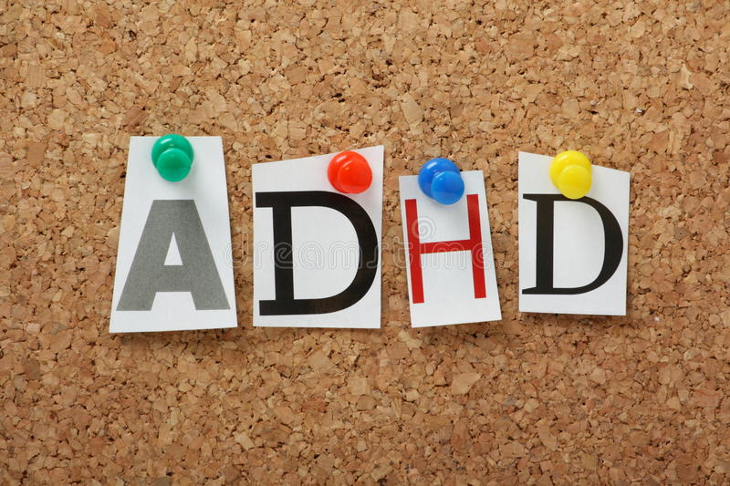
THANKS FOR YOUR ATTENTION

