Slide 1
Focused abdominal sonography in trauma patient (FAST)
A workshop
Submitted in Alkindy teaching hospital
On Monday 14.3.2022
For the surgery postgraduate Iraqi & Arab board candidates
&
6th class surgery rota student of Alkindy college of medicine
BY
Dr. Raed Rassam consultant surgeon
Dr. Saja Ali Ahmed specialist in diagnostic imaging

Slide 2
Learning objectives
To identify the role of US examination in abdominal emergency .
To identify the indications, contraindications and limitations of the FAST study .
To identify the relevant local anatomy
To identify the technique of the exam.
To identify normal and abnormal scans.
To identify pitfalls of the study.
To Perform practical training .

Slide 3
ULTRASONOGRAPHY IN ABDOMINAL EMERGENCIES
The FAST (Focused Assessment with Sonography in Trauma) examination looks for the presence of fluid—presumed to be blood in the appropriate clinical setting—visualizing 10 structures or spaces in four areas:
Pericardial
Perihepatic
Perisplenic
Pelvic
The E-FAST (Extended-FAST) additionally surveys the anterior and lateral pleural spaces (thoracic view) to evaluate for a pneumothorax or pleural effusion, assumed to be a hemothorax in trauma patients.
Point-of-care ultrasound (POCUS) for hypotensive non-injured patients to identify free fluid with other causes (eg, ruptured ectopic pregnancy, ruptured abdominal aortic aneurysm).

Slide 4
ULTRASONOGRAPHY IN ABDOMINAL EMERGENCIES
Indications:
Evaluation of injury, hypotension, and/or shock of unknown etiology in a trauma patient to determine need for interventions
Evaluation of unexplained hypotension or shock in the non-trauma patient
To identify rupture of an ectopic pregnancy

Slide 5
ULTRASONOGRAPHY IN ABDOMINAL EMERGENCIES
contraindications:
Absolute → Clear need for time-sensitive definitive care (which would be delayed by doing ultrasonography)
Relative → None
Complications → unlikely

Slide 6
ULTRASONOGRAPHY IN ABDOMINAL EMERGENCIES
Additional consideration :
The E-FAST examination should be completed in < 5 minutes.
The pericardial sac is evaluated first, especially after penetrating trauma, because pericardial fluid after trauma can be immediately life-threatening and supersede treatment of other injuries.
The E-FAST examination maximizes sensitivity by imaging dependent positions in the peritoneal cavity where fluid preferentially accumulates. This fluid appears as anechoic (black) areas filling the potential spaces. The examination also focuses on interfaces between solid organs in order to maximize fluid visibility.

Slide 7
ULTRASONOGRAPHY IN ABDOMINAL EMERGENCIES
Relevant anatomy :
The right paracolic gutter is deeper and less obstructed than the left. Fluid preferentially flows to the right. Thus, this area should be the first in the peritoneum to be evaluated (normally after the pericardium has been imaged).
A potential space is formed by the reflection of the peritoneum from the rectum to the bladder in males or from the rectum to the uterus in females. Fluid preferentially flows into this area from the right or left paracolic gutters. The pelvis is one of the most dependent and easily visualized portions of the peritoneal cavity; thus, fluid collections are visible here earlier than in other areas.

Slide 8
Equipment:
Bedside ultrasound machine.
Low-frequency ( 2 to 5 MHz) probe ,either curvilinear or phased-array
High-frequency (5 to 10 MHz) linear probe, for examining the pleura
Ultrasound gel (nonsterile) or, often, water-based surgical lubricant.
Glove.

Slide 9
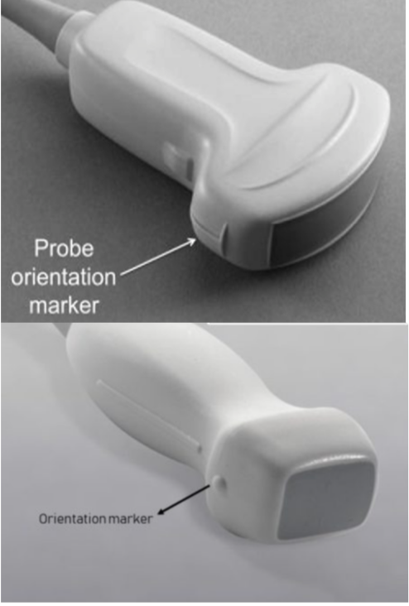
Step-by-step description of the procedure :
Standard probe orientation probe orientation marker should be to the right side of patient on the transverse(axial) view. probe orientation marker should be to the head of patient on the longitudinal (sagittal) view.

Slide 10

What are we looking for ?
To detect free fluid( anechoic _black_) in appearance with sharp edges …..
Normal intra visceral fluid usually rounded with curved edges…

Slide 11
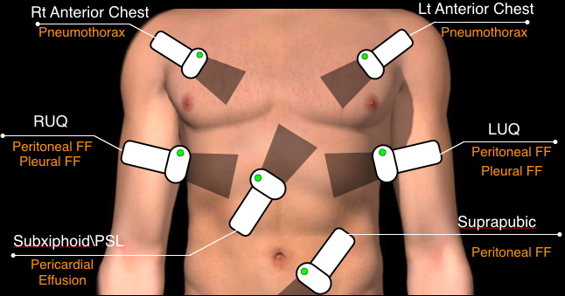
Where to scan?

Slide 12
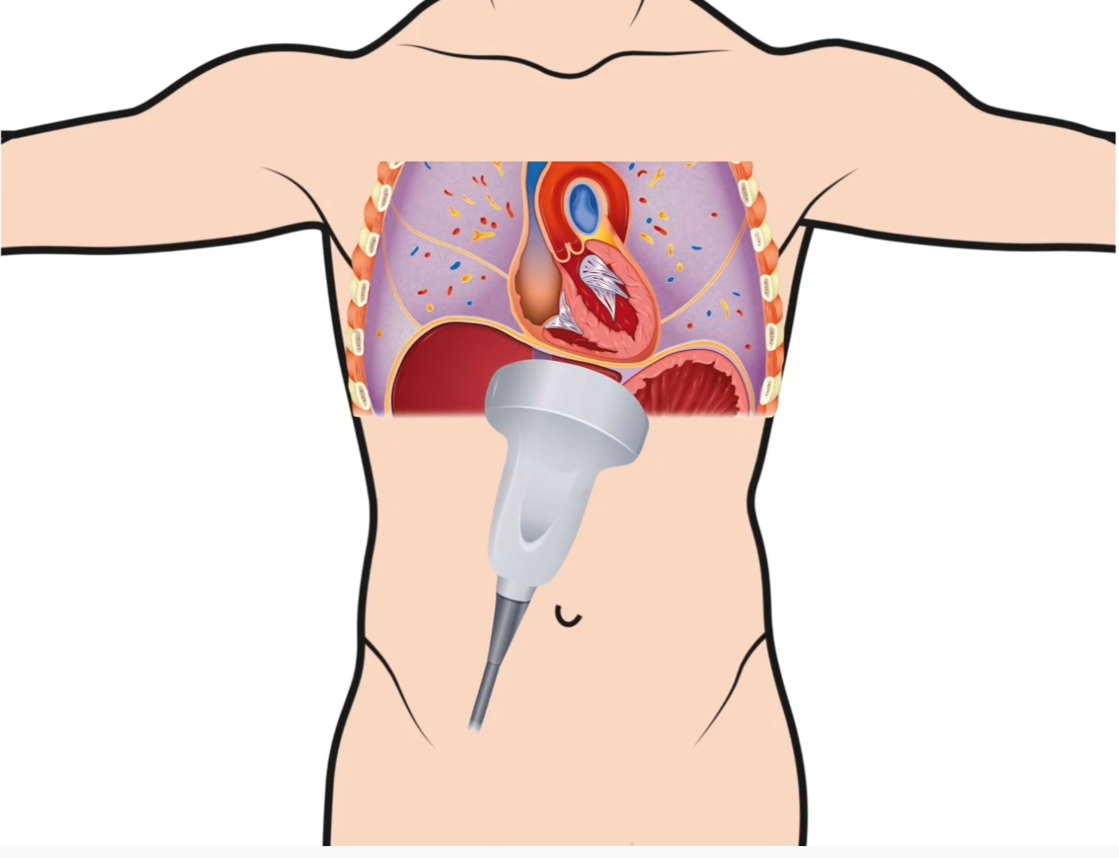
Pericardiac view (cardiac) :
Transducer:
Low frequency(curvilinear, phased array )
Subxiphoid, transverse.
Directed towards patient left shoulder.
May need to increase depth.
Liver as acoustic window.
On the ultrasound monitor, from top to bottom, observe the liver, right ventricle, and left ventricle. The right ventricle is adjacent to the liver because it is more anterior than the left ventricle. The two ventricles are up and to the right side of the monitor and the atria are down and to the left.
Review for :Pericardial effusion wich appears as a black (anechoic) space between the white lines of the pericardium.
Pitfalls
Pleural effusion.
epicardial fat pad.

Slide 13
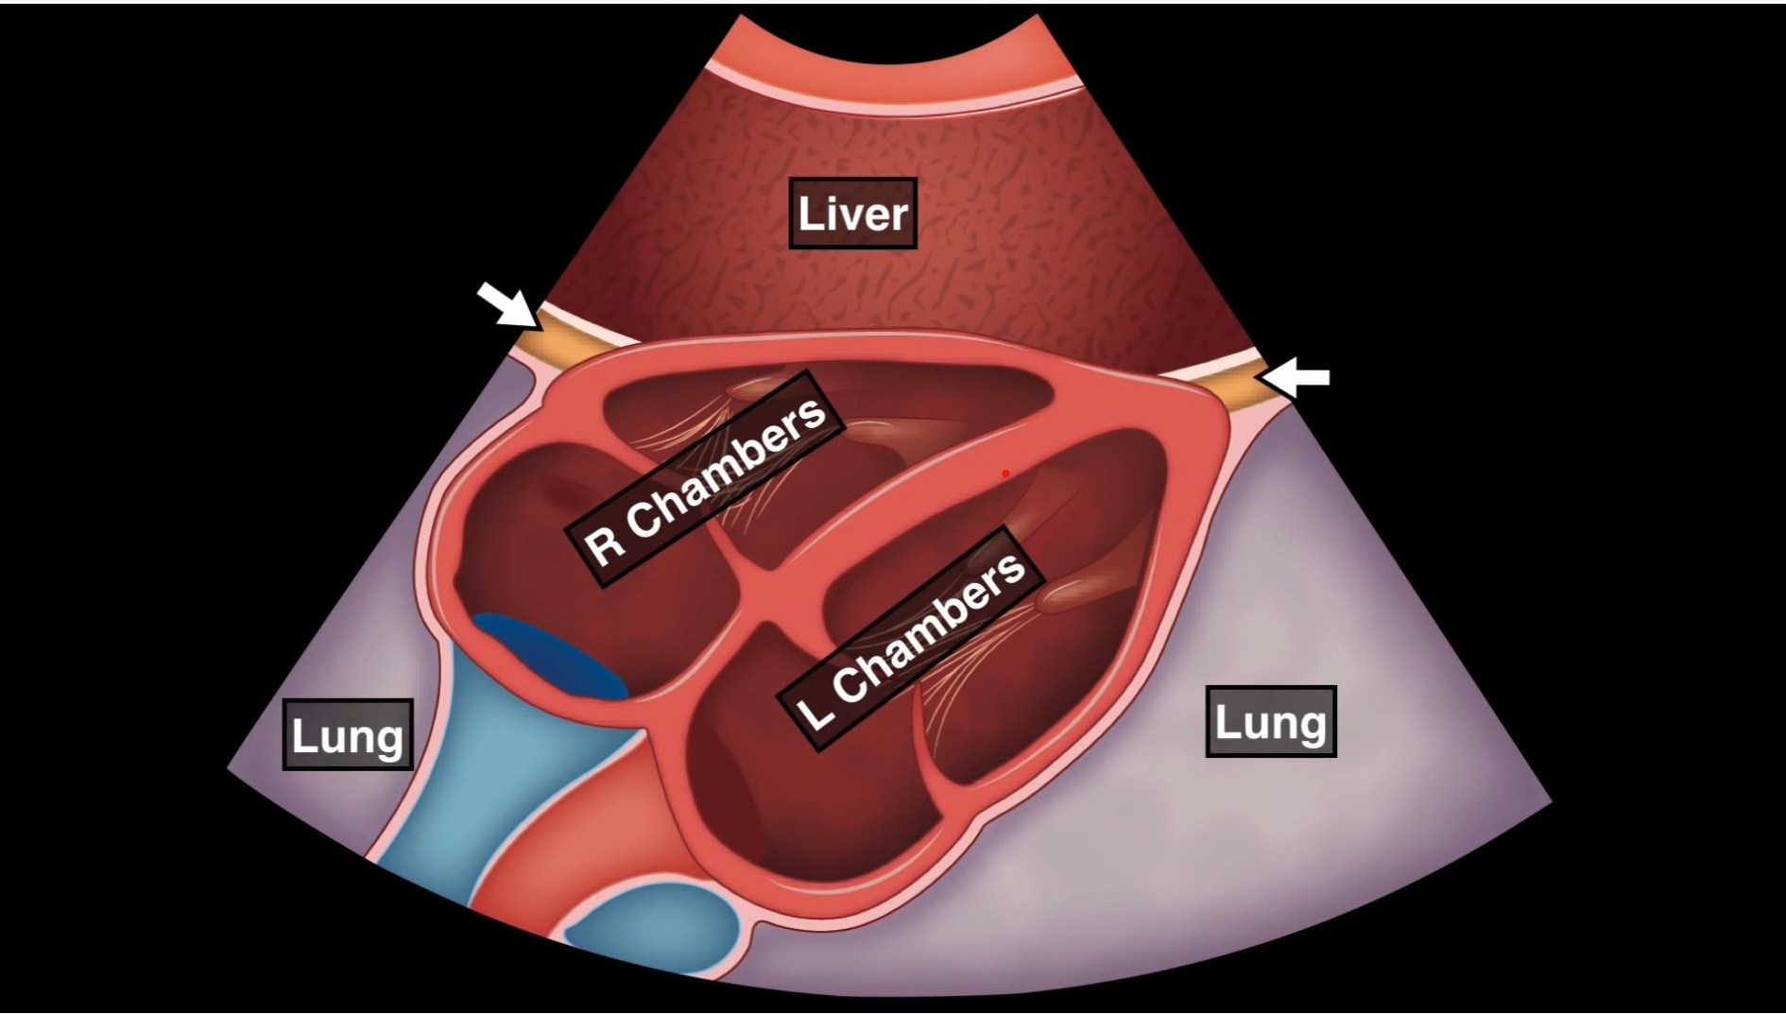
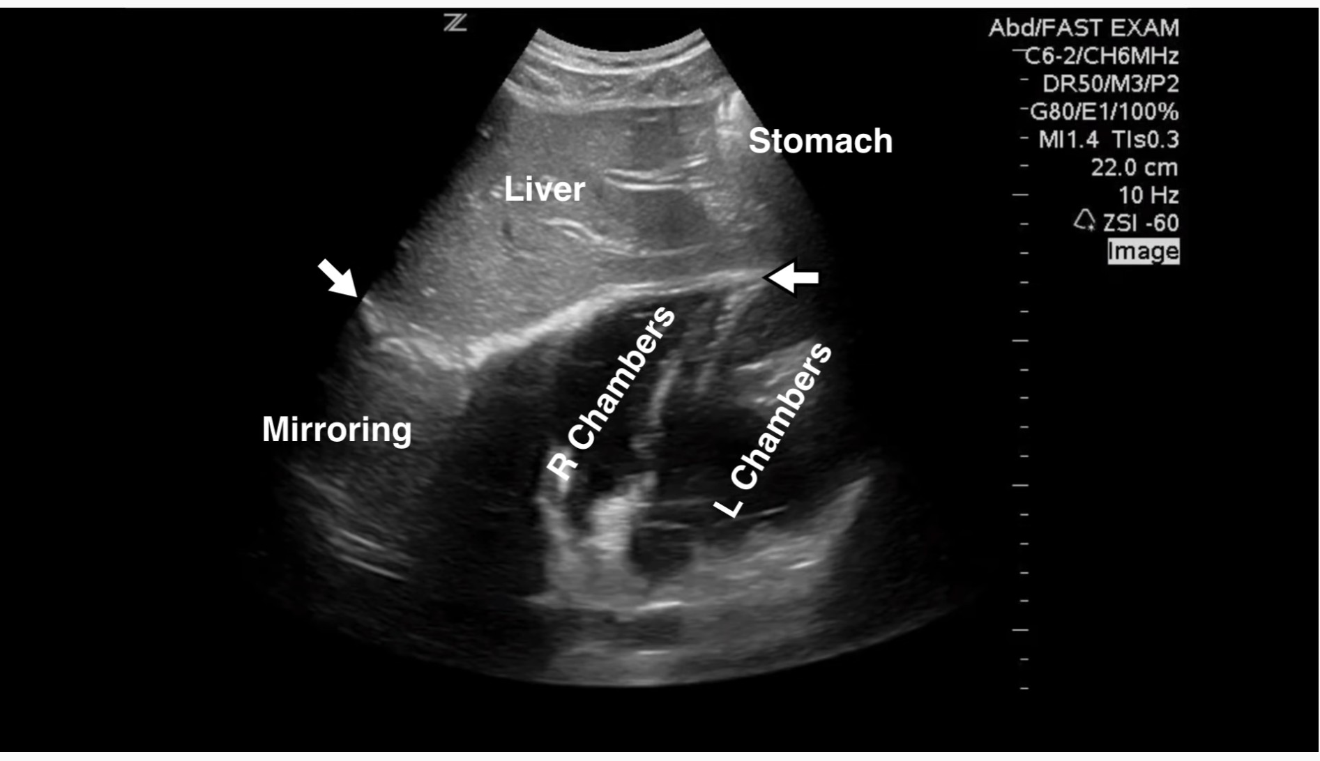
Normal subxiphoid scan:

Slide 14
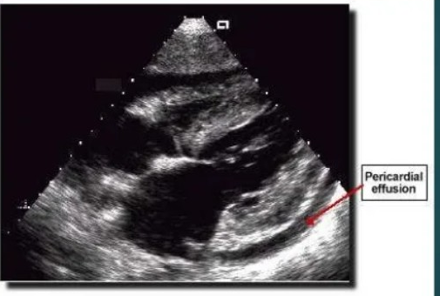
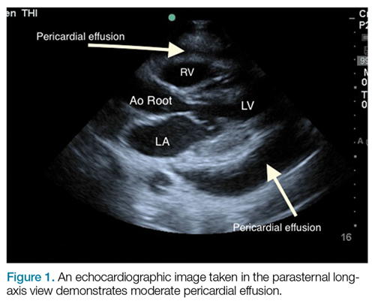

Slide 15
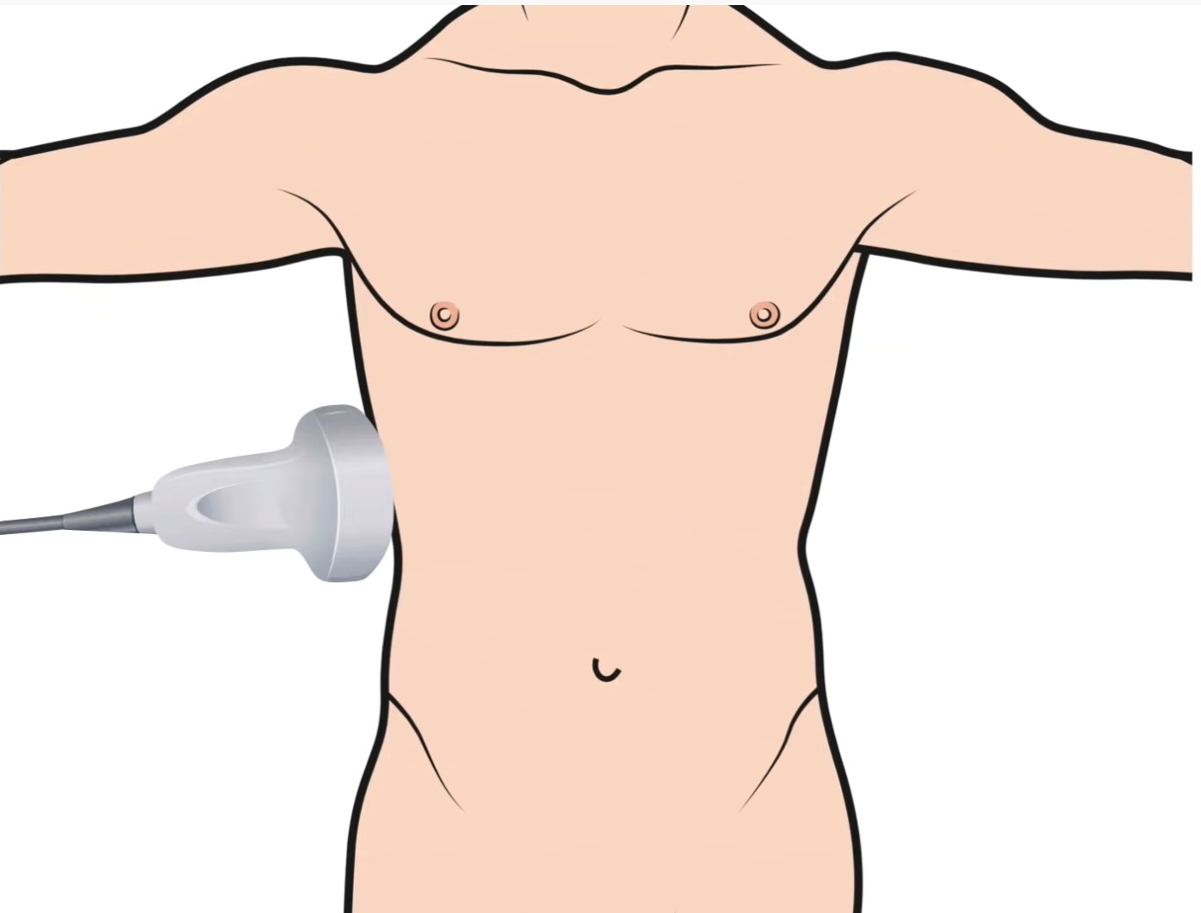
Perihepatic view (right upper quadrant) :
Transducer:
Low frequency(curvilinear)
Coronal(longitudinal),marker toward patient head.
Mid_axillary line,Lower ribs.
Slide, rotate and fan.
4 areas to evaluate for “free fluid”:
hepato_renal recess (Morison’s pouch)
Pleural cavity.
Sub-diaphragmatic space
Inferior pole of the right kidney/right paracolic gutter
Pleural effusion ( haemothorax ) also indicated by :
the "spine sign", abnormal continuation of the spinous line
Absence of mirror artifact.
Pitfalls:
Perinephric fat is a mimic for hematoma
Duodenal fluid, the gallbladder, and the IVC are all mimics for free fluid.

Slide 16
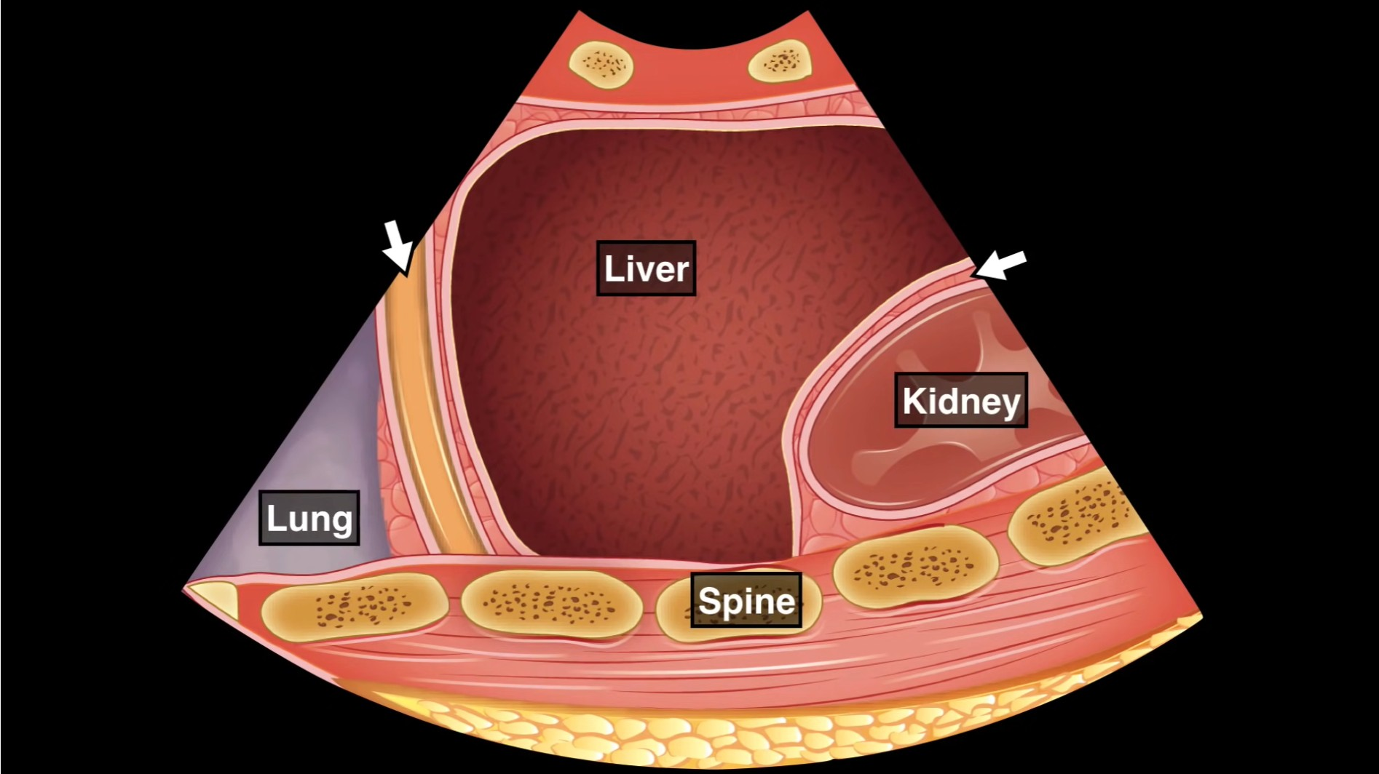
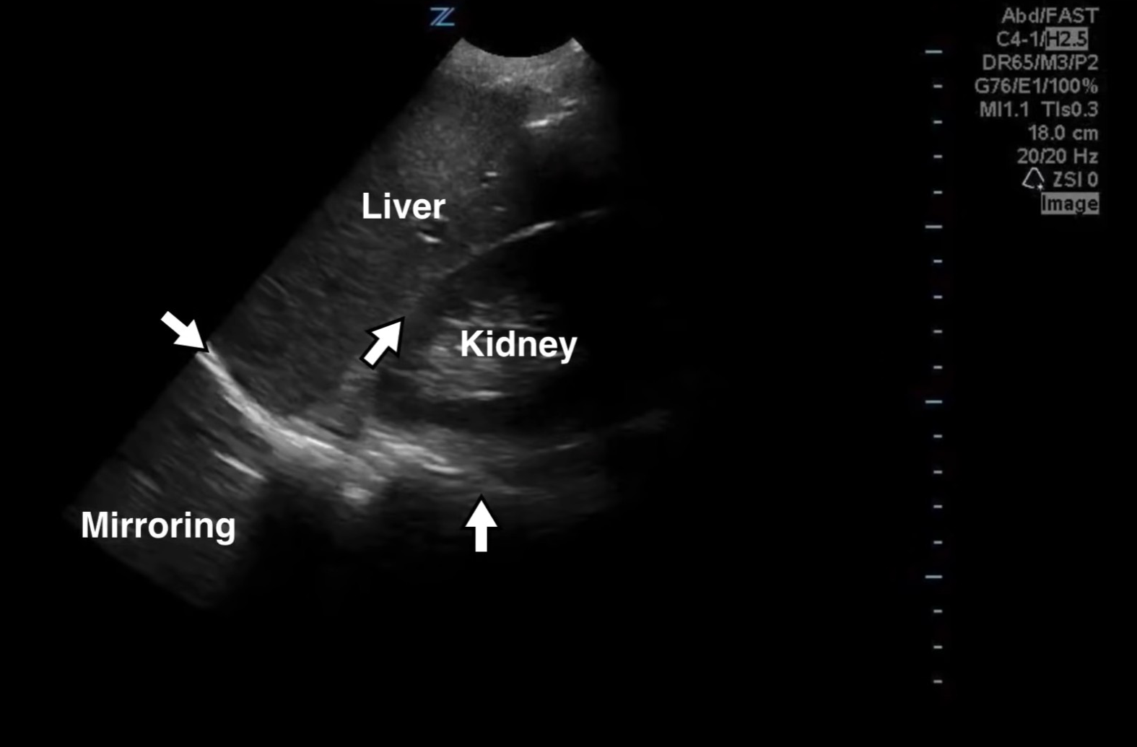
Normal RUQ scan

Slide 17
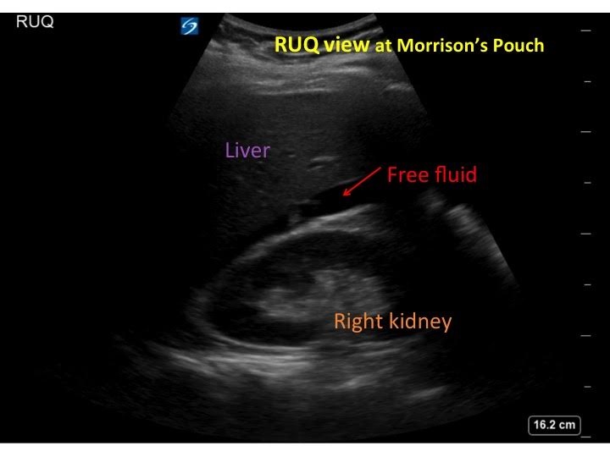
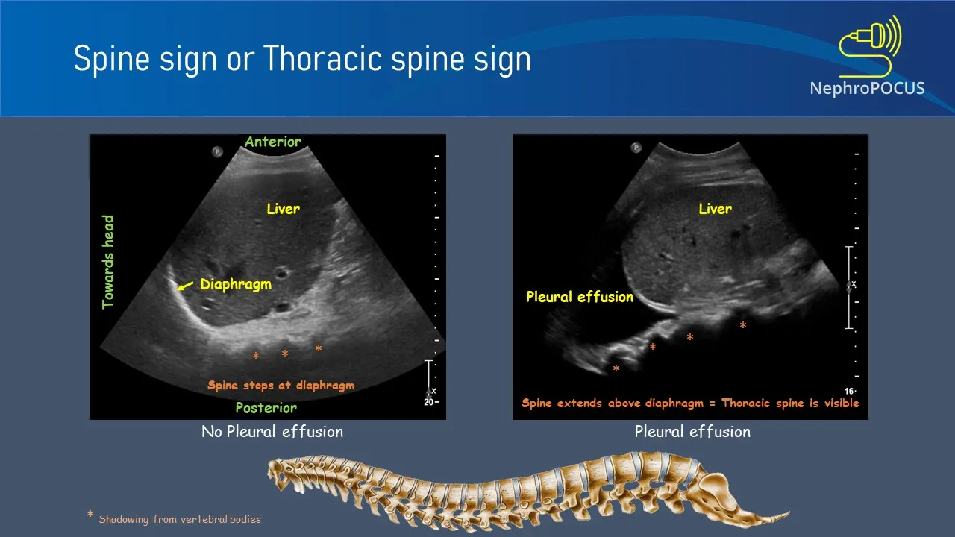

Slide 18
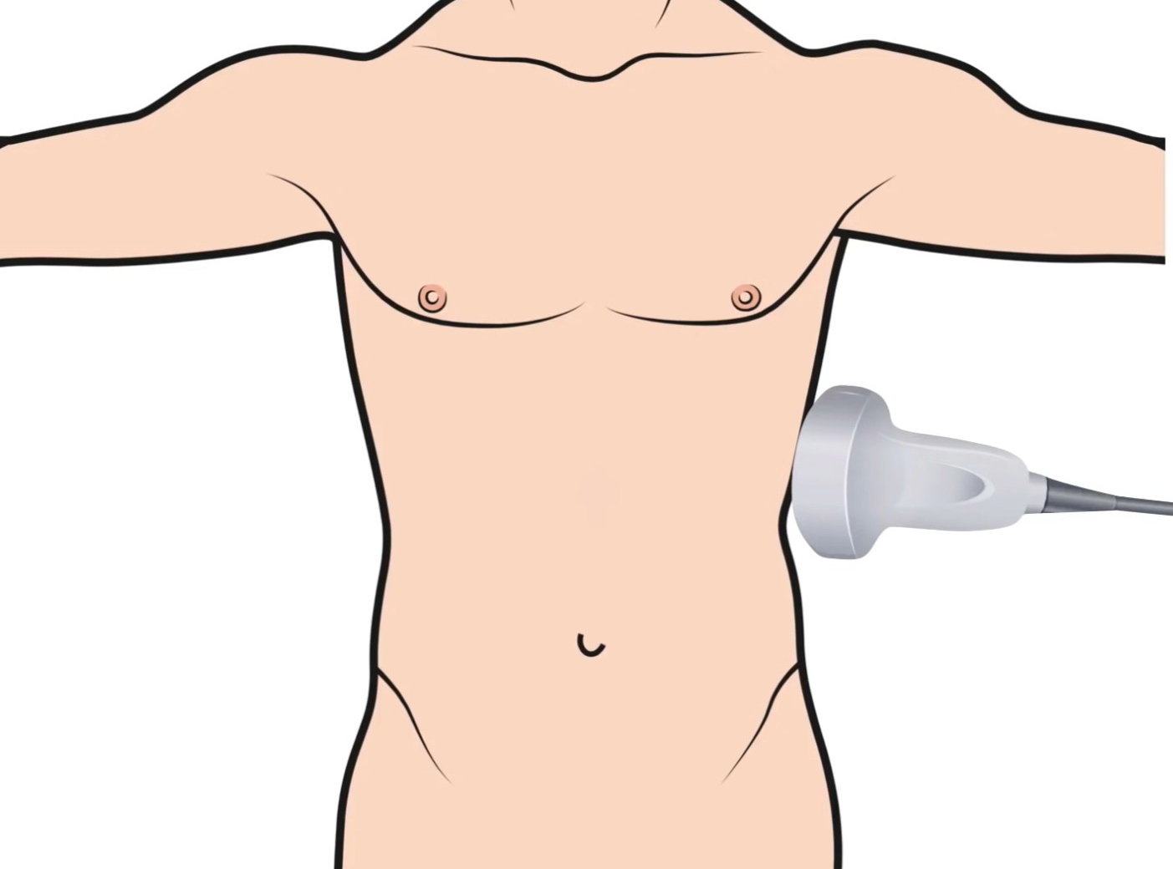
Perisplenic view (left upper quadrant) :
Transducer:
Low frequency(curvilinear)
Coronal(longitudinal)
Marker toward patient head.
More cephalad than RUQ (6^{th_9) intercostal spaces)}
More posterior than RUQ(posterior axillary line).
4 areas to evaluate for “free fluid”:
Pleural cavity.
Sub-diaphragmatic space(perisplenic)
Between spleen and left kidney.
Inferior pole of the left kidney/left paracolic gutter
Pitfalls:
Fluid-filled stomach can mimic fluid, as can loops of bowel
perinephric fat.

Slide 19
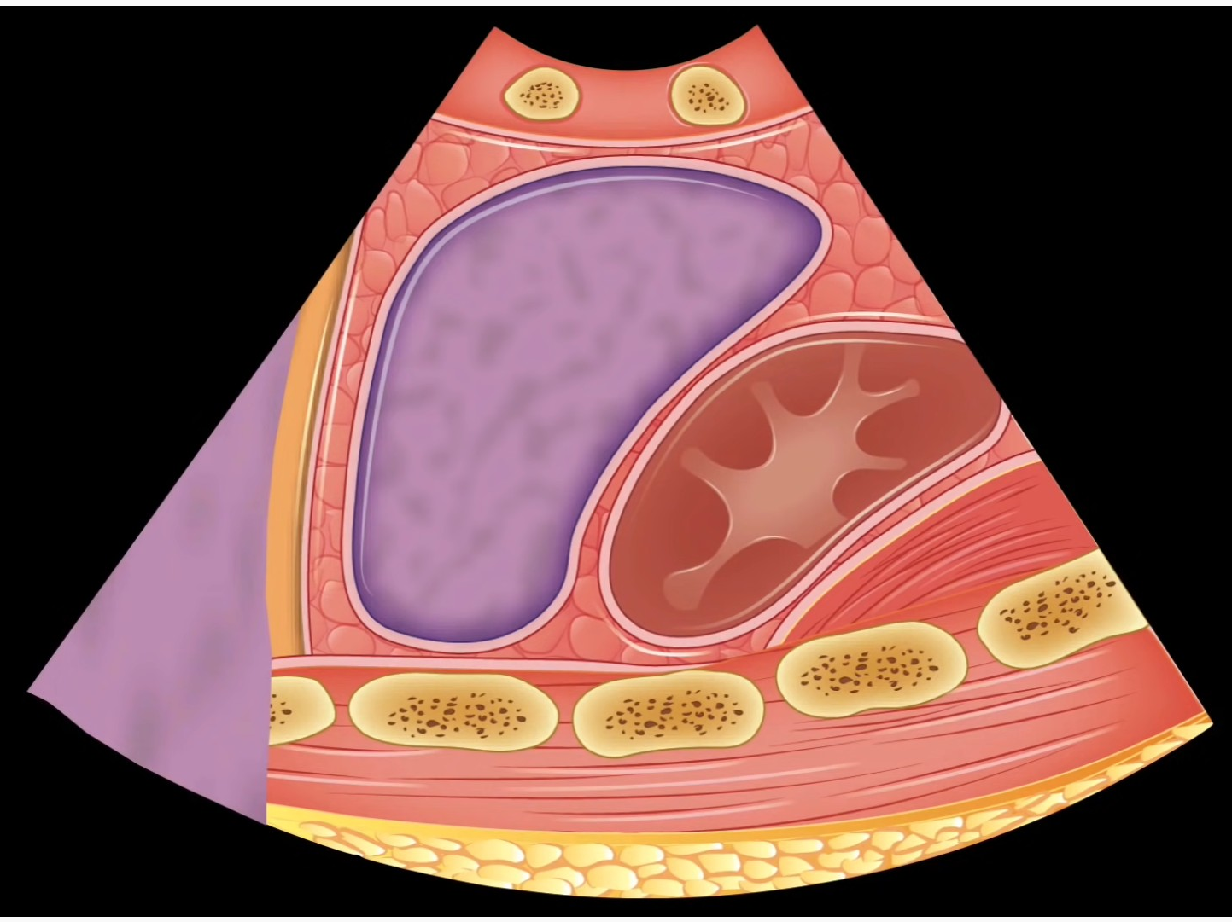
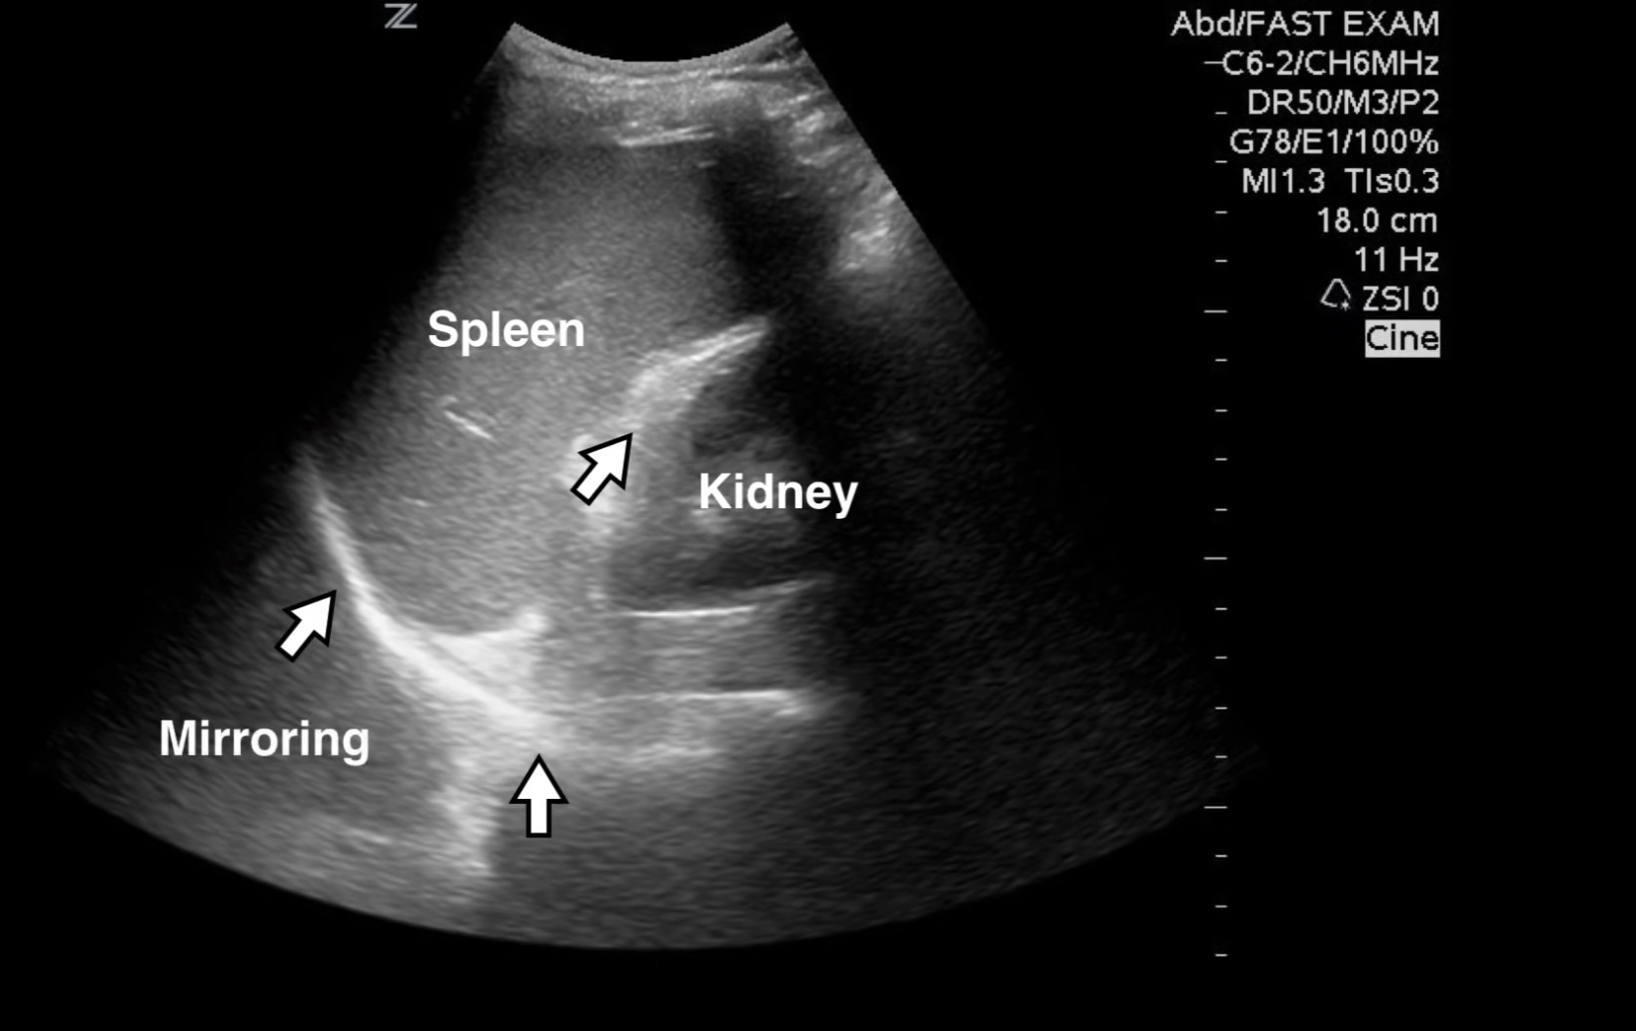
Normal LUQ scan:

Slide 20
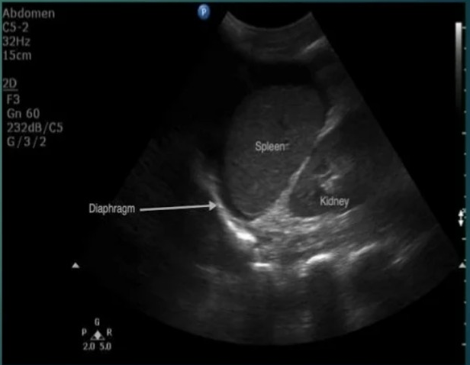
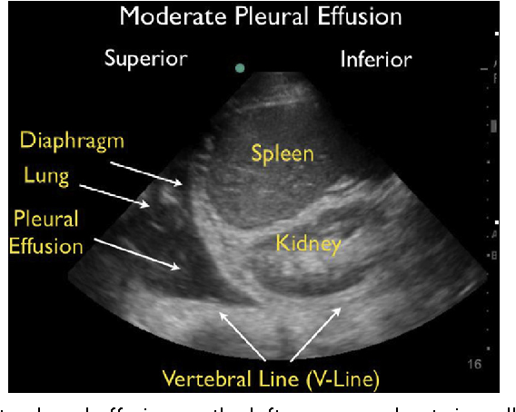

Slide 21
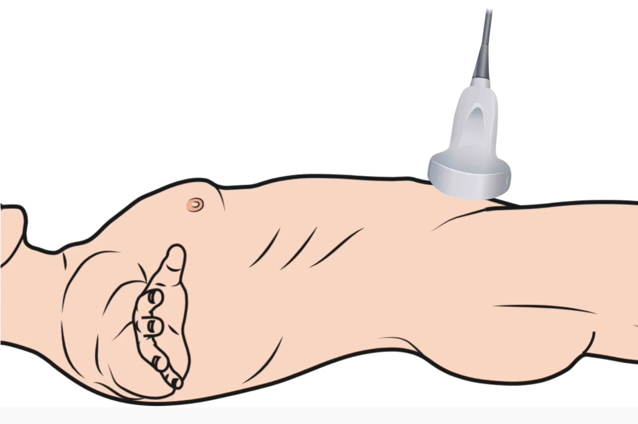
Suprapubic view (longitudinal):
Transducer:
Low frequency(curvilinear)
Midline.
Marker toward patient head.
Caudal end of probe just superior to symphysis pubis.
Fan left to right.
Review area:
* men: rectovesical space.
*women:1.vesicouterine space.
2.retrouterine pouch(pouch of douglas)

Slide 22
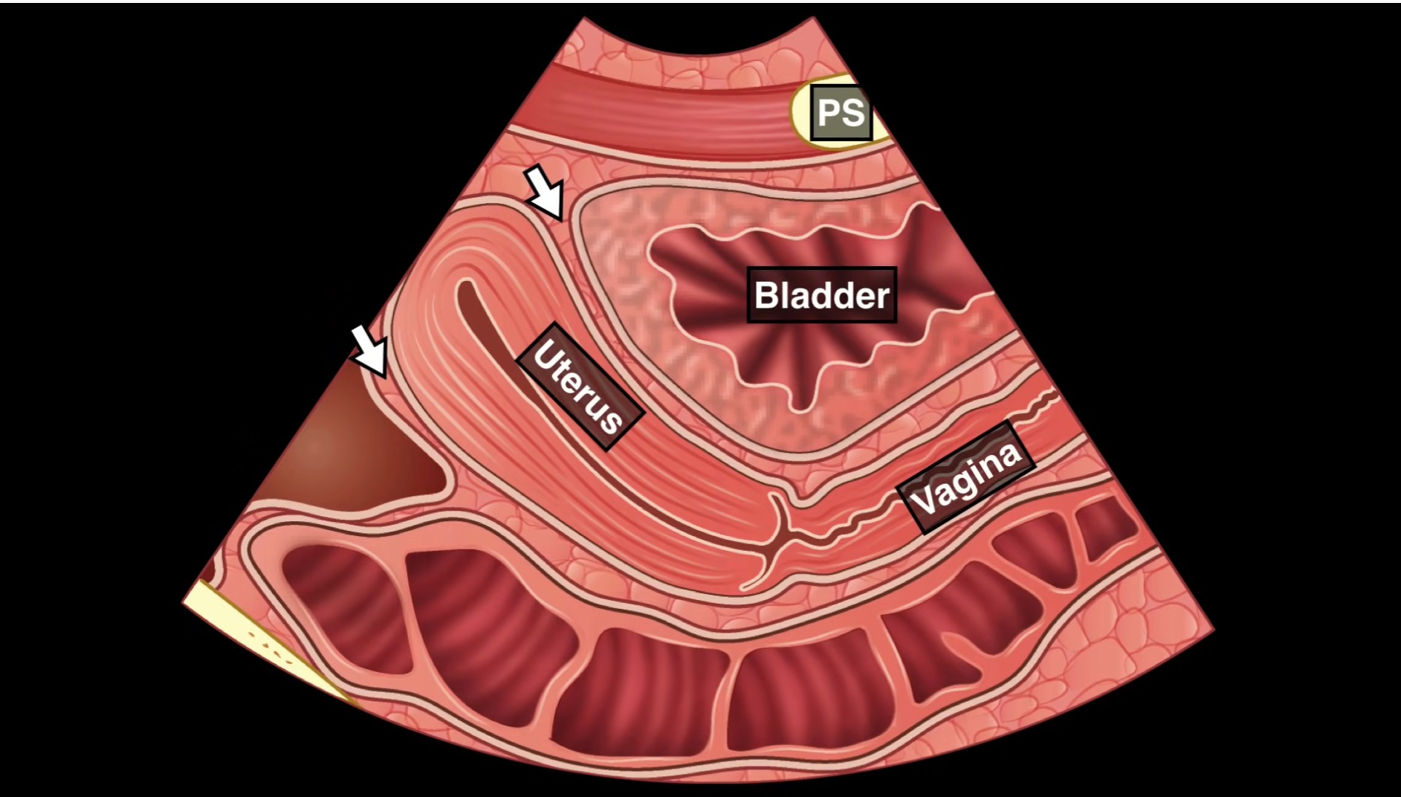
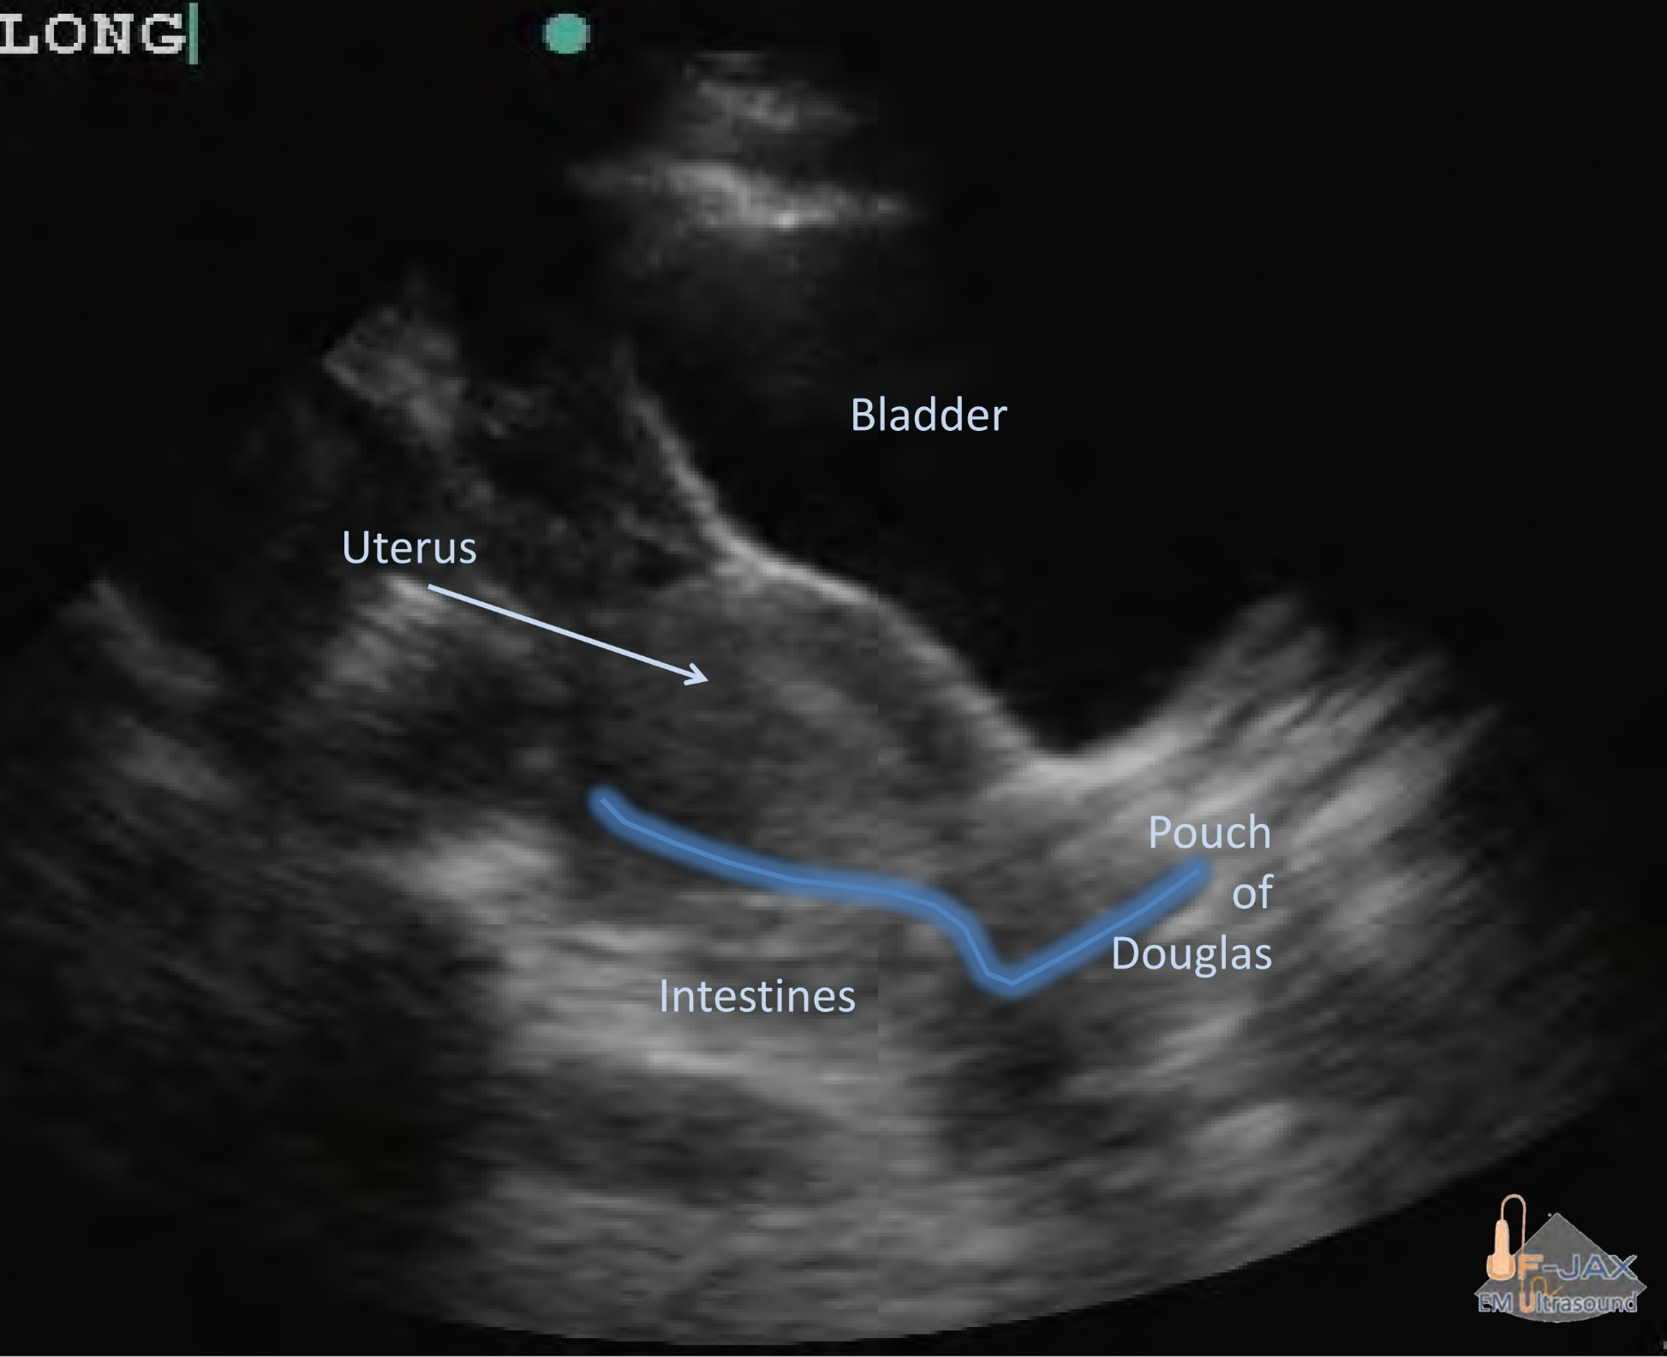
Normal suprapubic view (longitudinal )_female_

Slide 23
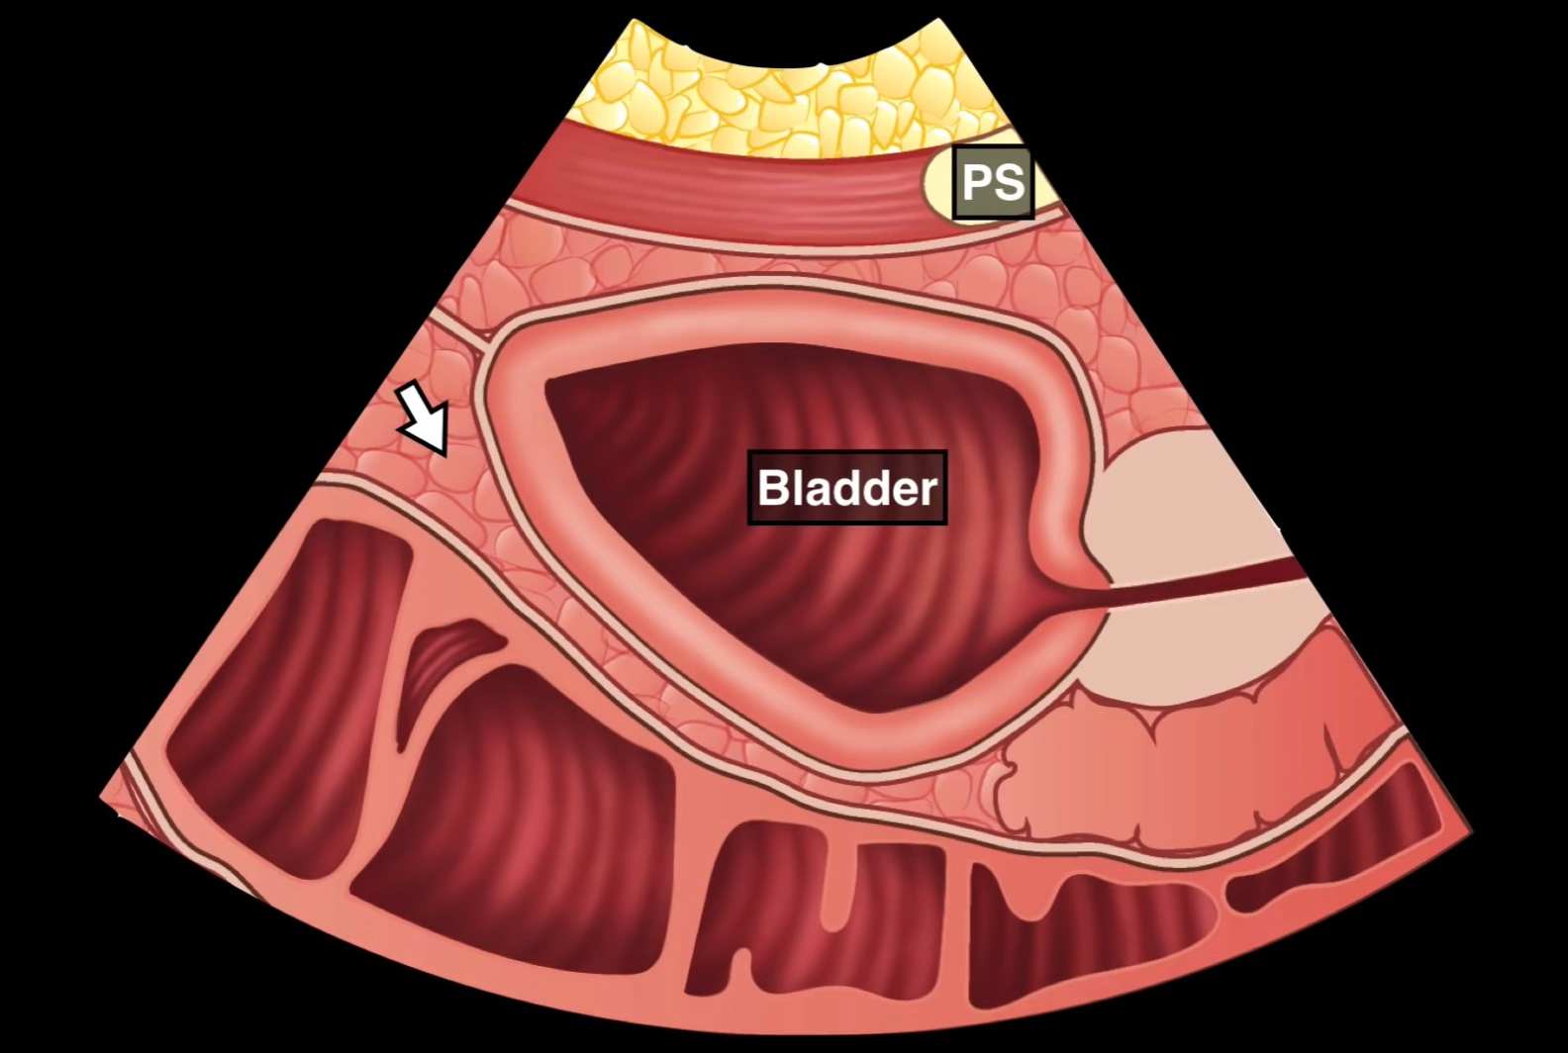
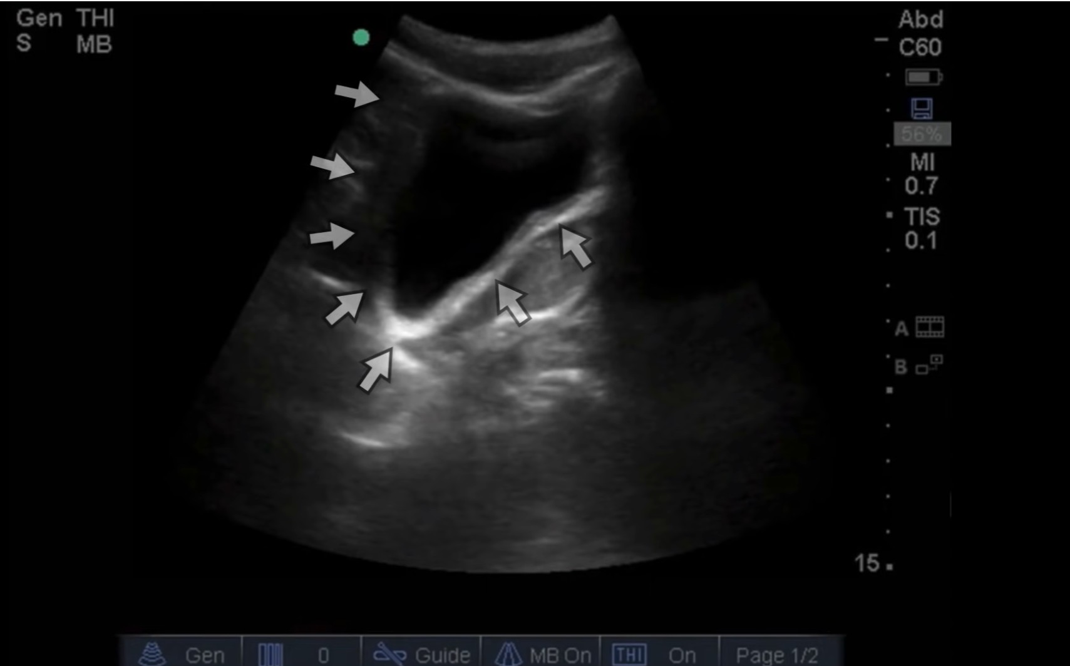
Normal suprapubic view (longitudinal ) male

Slide 24
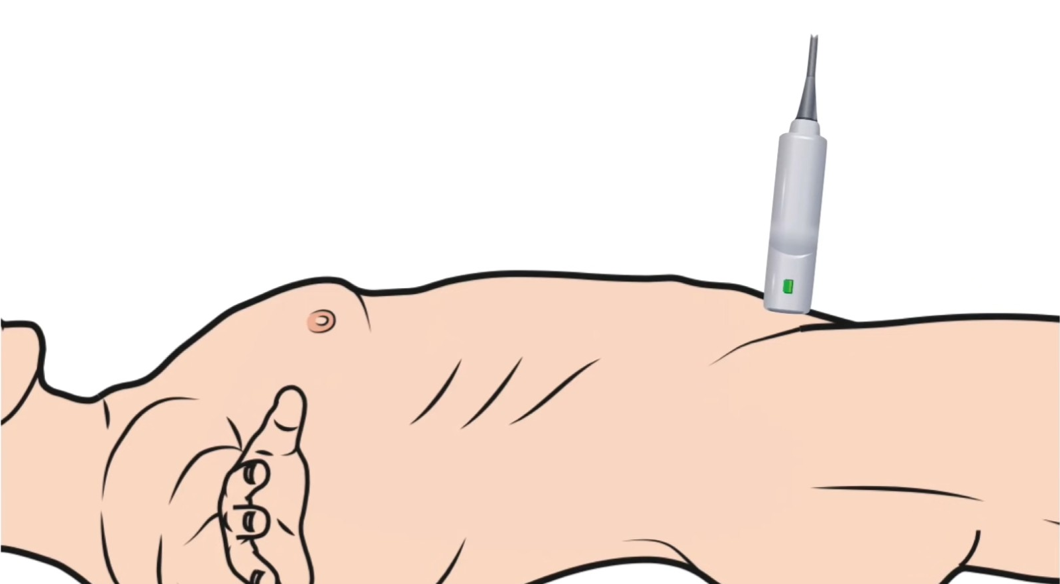
Suprapubic view (transverse):
Transducer:
Low frequency(curvilinear)
Midline.
Transverse.
Marker toward patient right side.
Fan superior to inferior.
Review area:
Posterior wall of the bladder.
Pitfalls:
Fluid within a collapsed bladder .
ovarian cyst may
Seminal vesicles may also be incorrectly identified as free fluid
Premenopausal females may normally have a small amount of free fluid in the pouch of
Douglas.
Bowel fluid.

Slide 25
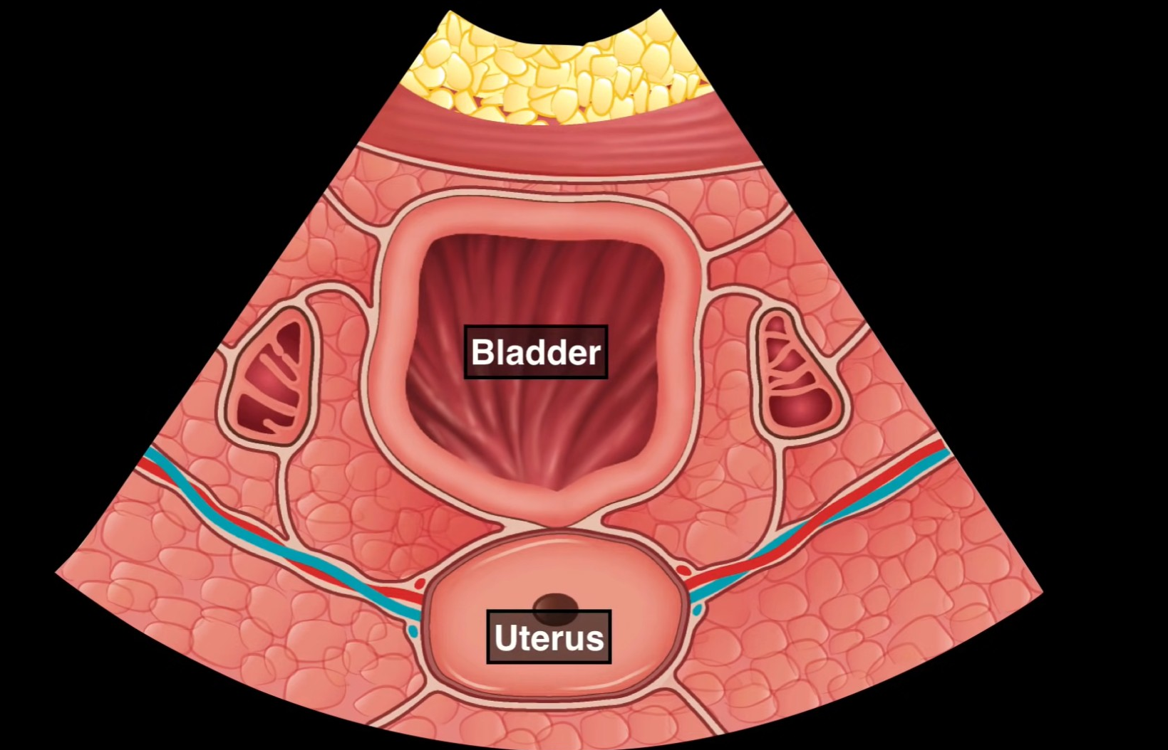
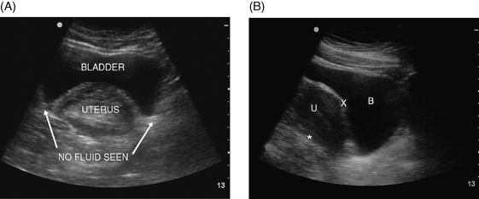
Normal suprapubic view (transverse ) female

Slide 26
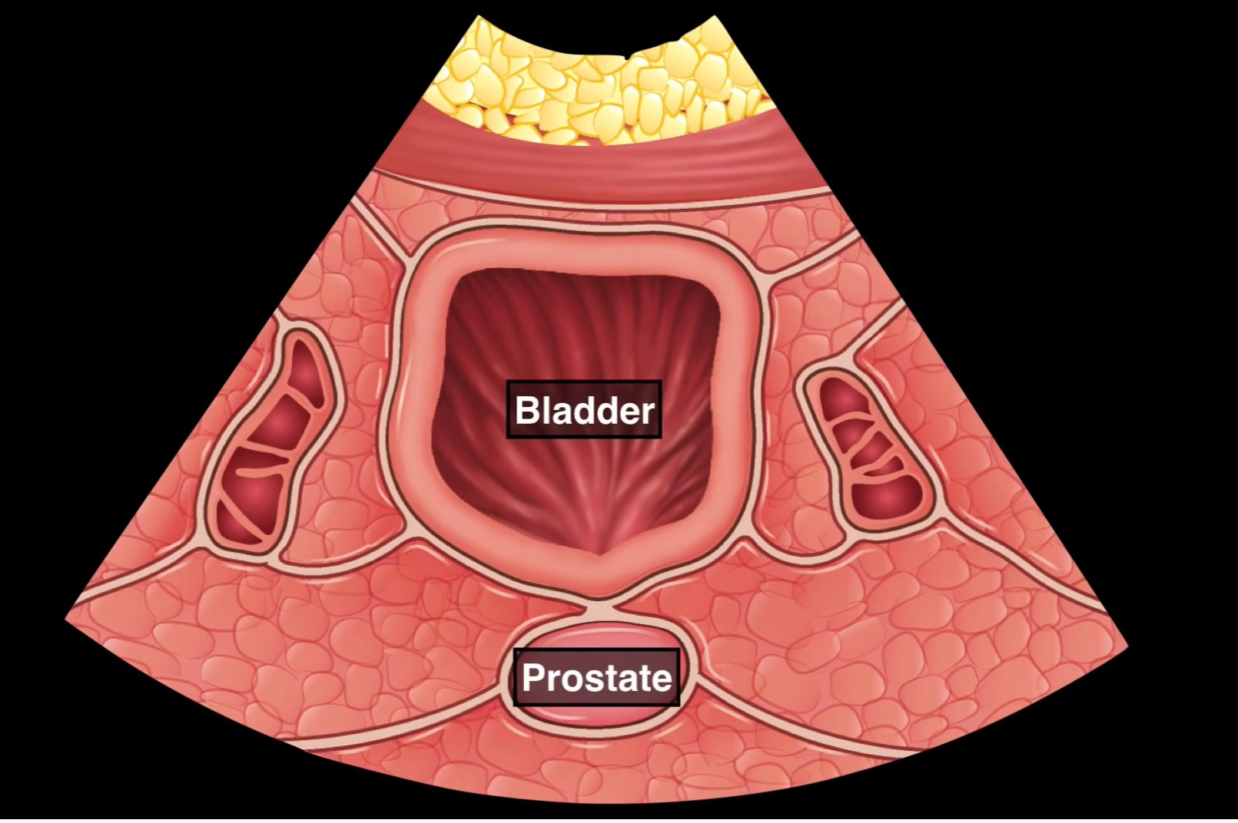
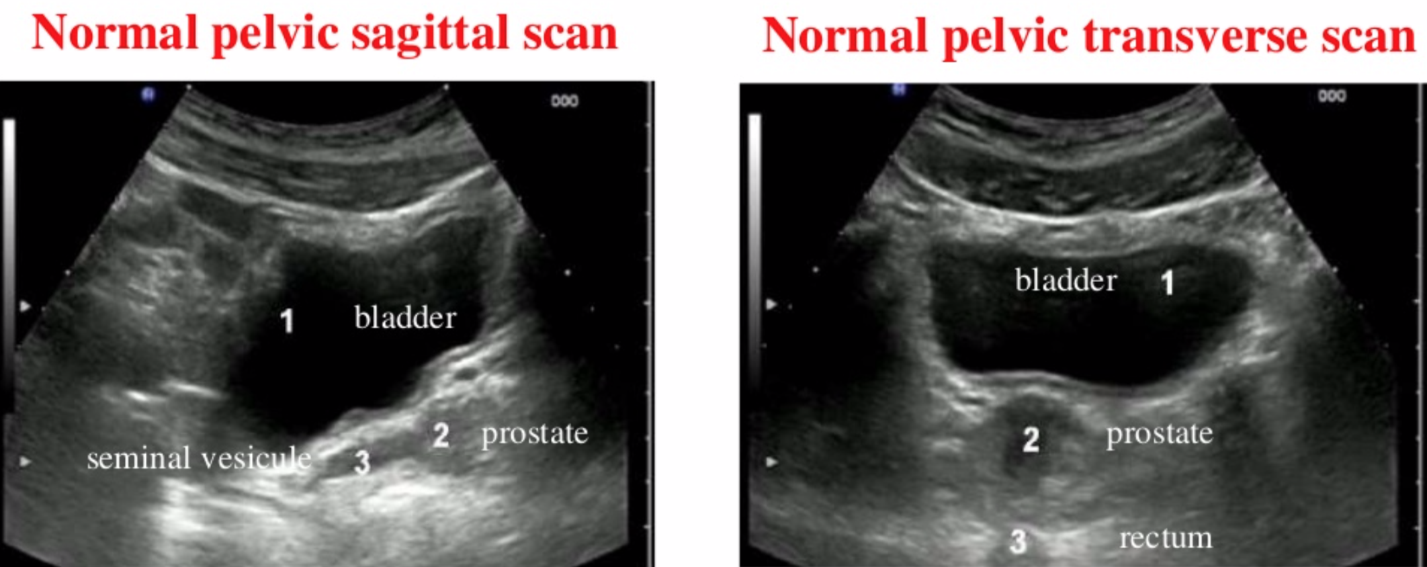
Normal suprapubic view (transverse ) male

Slide 27
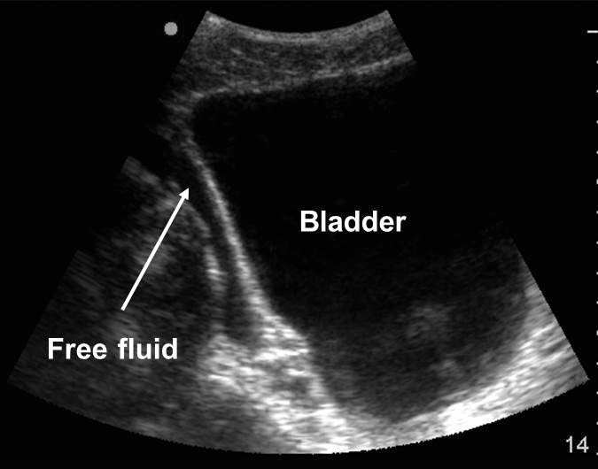
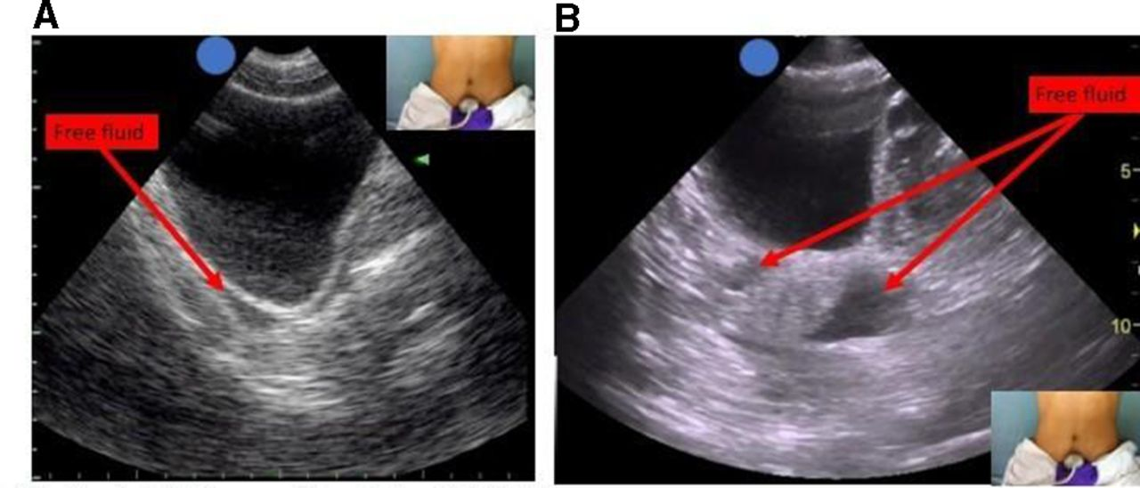

Slide 28
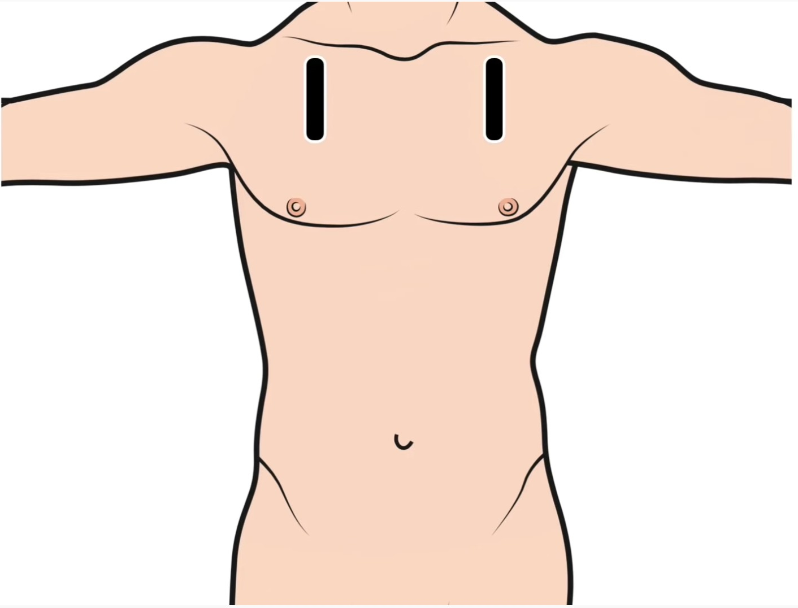
Thoracic view(right and left):
Transducer:
high frequency probe(linear)
Anterior chest wall ,midcalvicular line.
longitudinal.
Marker toward patient head.
Fan to the lateral axillary line and infeiorly .
Review for:
pneumothorax.
Three normal findings which absence indicate pneumothorax;
rib sliding.(shimmering below pleura , ants on a log)
comet tails.
A lines.
M-Mode
Place cursor on the pleura
Normal lung: “sandy beach”
Pneumothorax: “bar code sign”

Slide 29
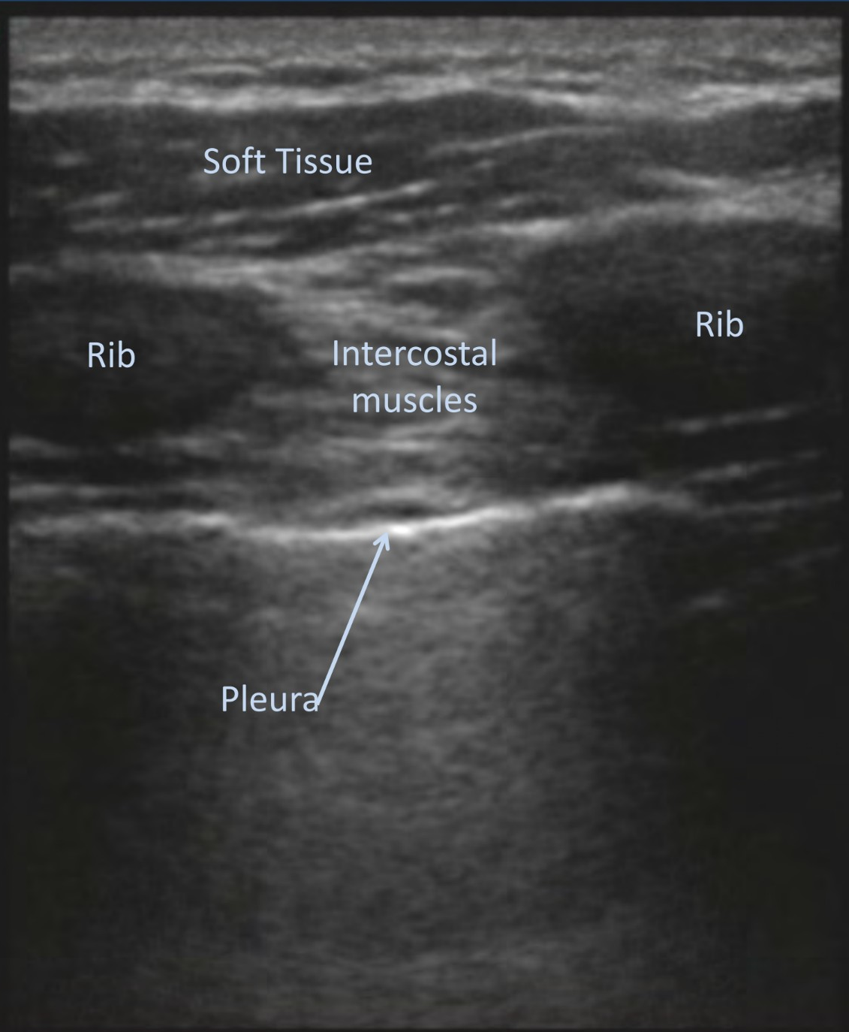
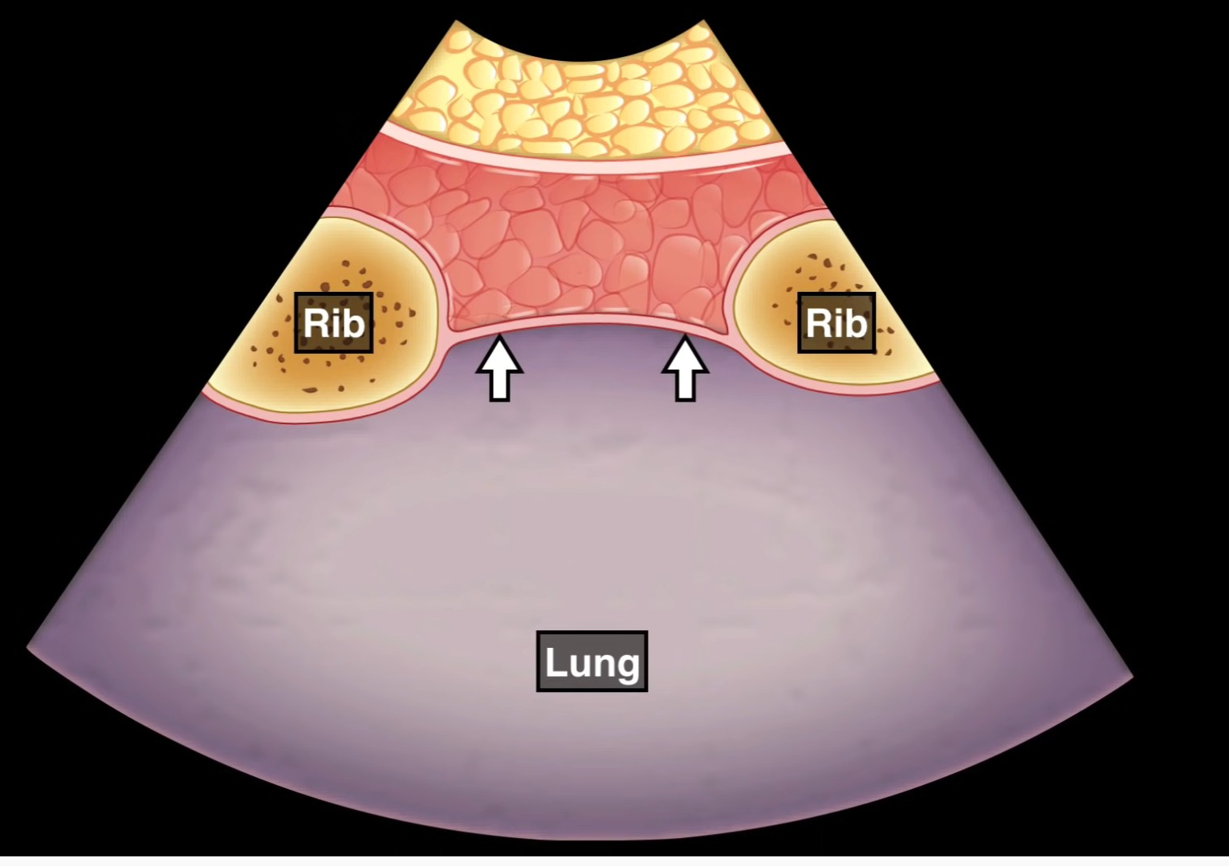
Normal transthoracic view

Slide 30
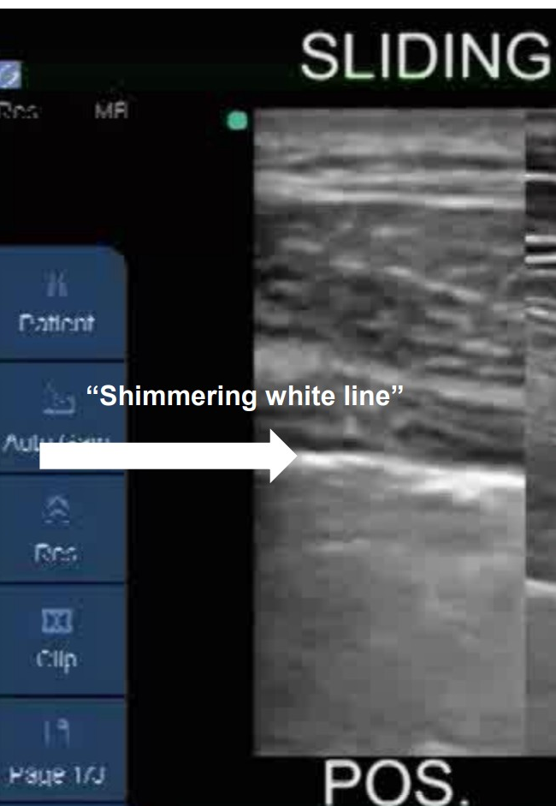
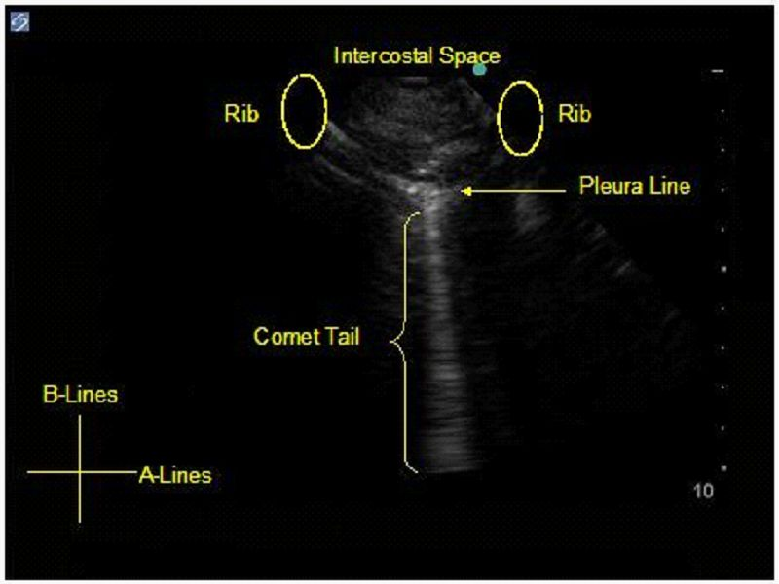
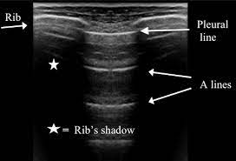
Normal transthoracic view

Slide 31
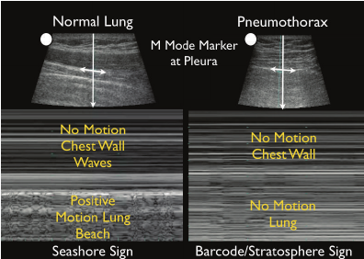

Slide 32
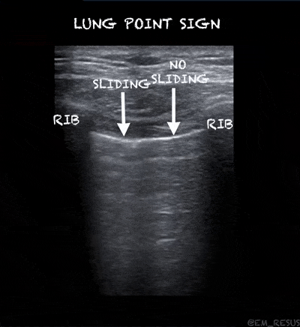
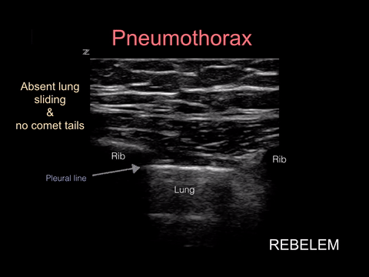

Slide 33
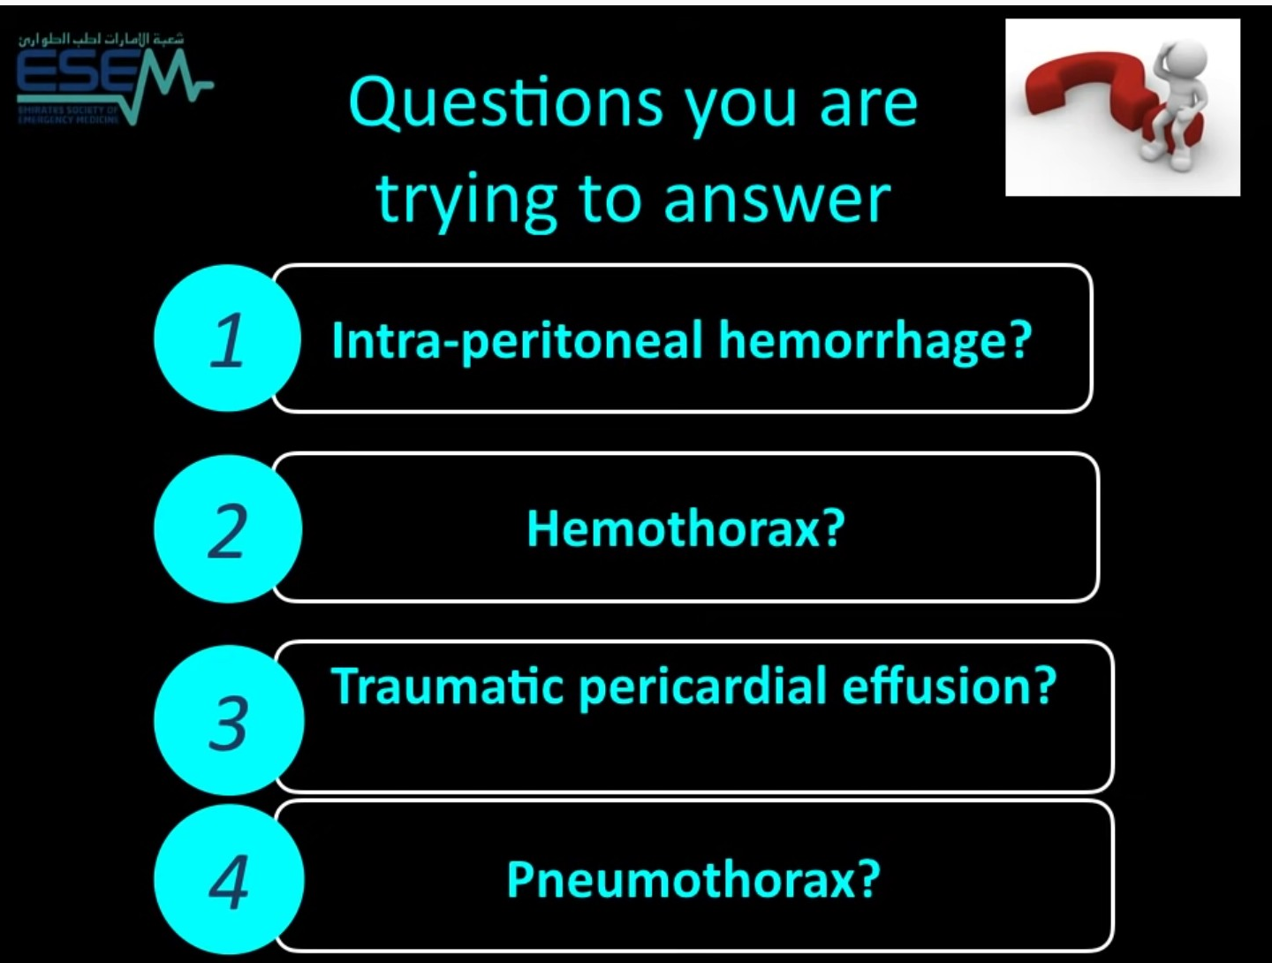

Slide 34
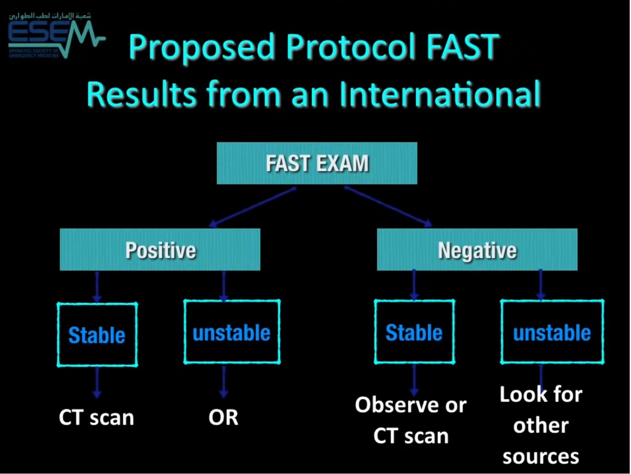

Slide 35
Limitation :
Operator dependent.
Obesity.
Subcutaneous emphysema.
Non-specific(type of fluid, origin of the fluid).
Generally require greater than 250ml free fluid to be detected.

Slide 36
Warnings and Common Errors
Knowledge of surface and underlying anatomy is crucial in determining initial proper placement of transducer.
A normal E-FAST examination does not rule out traumatic intra-abdominal injury.
Be aware of anatomical variants.

Slide 37
Tips and Tricks
Dim the lights if possible to help increase contrast and assist gain adjustment.
Decrease the depth when switching from the cardiac to abdominal and then to thoracic views.
Remember that not all fluid appears anechoic (e.g, clotted blood may have mixed echogenicity).

Slide 38
REFERENCES
Introduction to Bedside Ultrasound: Volume 1 ,Matthew Dawson & Mike Mallin.
www.ultrasoundvillage.com
Dorothy Habrat, How To Do E-FAST Examination, MSD Manuals, Mar 2021.

Slide 39


