Slide 1
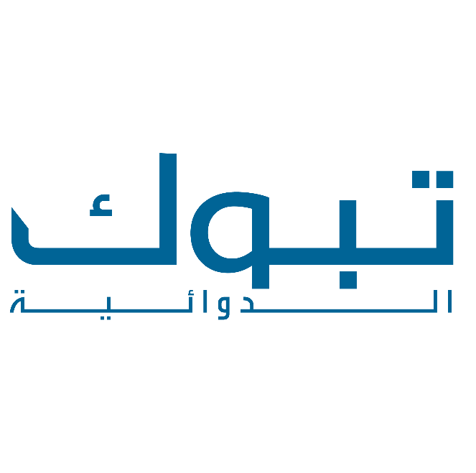
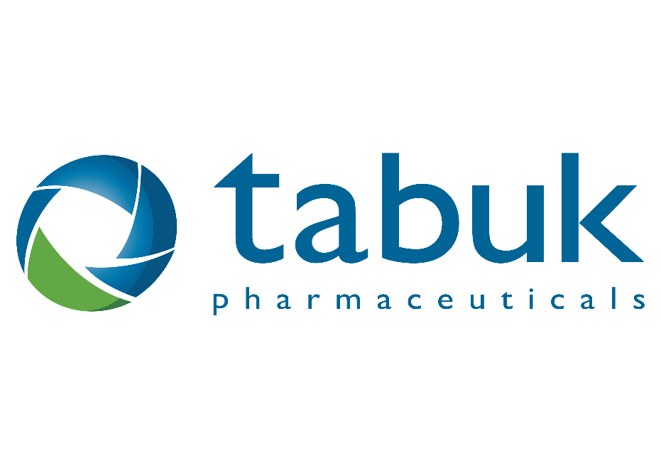

Slide 2
Tabuk Pharmaceuticals: A journey started in 1994
Founded in 1994 in Riyadh, The Kingdom of Saudi Arabia
Grew from being a family owned business to the largest private Saudi Pharmaceutical Company
Develops, manufactures, markets and distributes branded generic pharmaceutical and under-licensed products, with a strong focus on the Middle East and Africa
Operates in 17 countries in the Middle East and Africa, supported by four active manufacturing sites and over 2,400 employees

Slide 3
Diversified business models and services in the pharmaceutical field
Business models
Developing and marketing a wide range of branded generic and under-licensed products in various dosage forms.
Manufacturing high-quality products at sterile and non-sterile cephalosporin and non-cephalosporin plants.
Distributing pharmaceutical products in 17 countries in Middle East and Africa.
Services
Manufacturing products for Multinational companies and partners at our manufacturing sites in Saudi Arabia.
Out licensing some of Tabuk’s products to local, regional and International partners.

Slide 4
Tabuk Pharmaceuticals key strengths
Strong manufacturing capabilities
Four state of the art manufacturing sites in Saudi Arabia, Sudan, and Algeria.
Talented Research and Development center
Experienced R&D team responsible for injecting new products to Tabuk’s portfolio through adopting the latest technologies.
Growing and diversified portfolio
Wide diversified portfolio in major therapeutic areas and several partnerships with global players for under licensed products.
Leading position in Saudi Arabian market
Ranked as the largest privately owned pharmaceutical company in Saudi Arabia with a leading position in both private and public sectors.
Strong regional presence
Dedicated sales and marketing teams in 17 countries in Middle East and Africa and several future geographical expansion plans in the region.

Slide 5
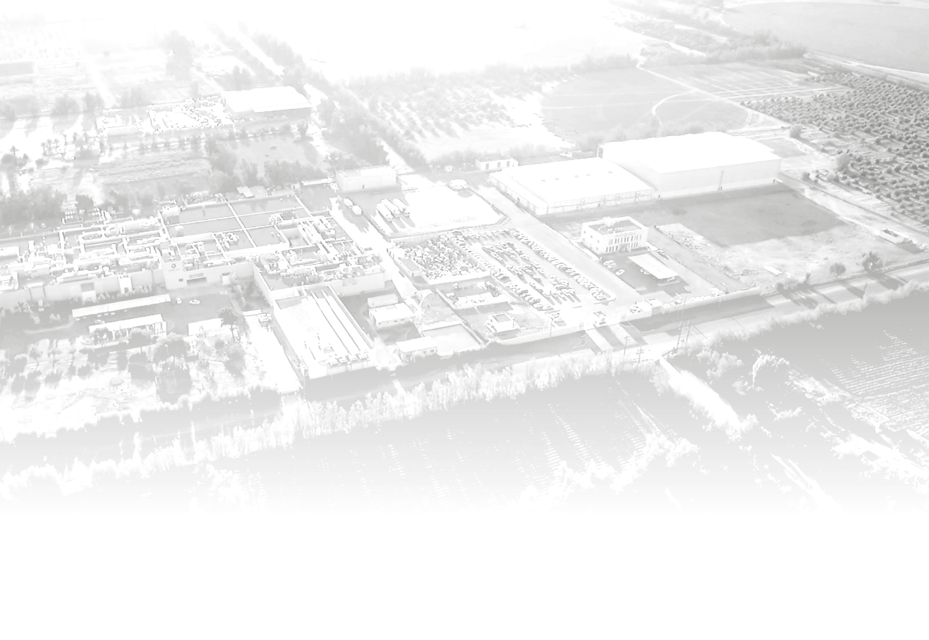
A sustained growth momentum over the past years
Consistent growth over years (USD, millions)
A leading market position (Saudi Arabia)
12%
CAGR
Rank
2
Rank
5
Rank
10
Rank
26
Source
Tabuk Data
IMS data MAT Q3/2019: Saudi Arabia Retail Market
5

Slide 6
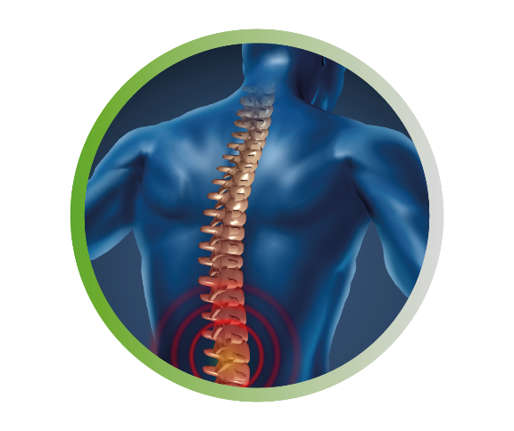
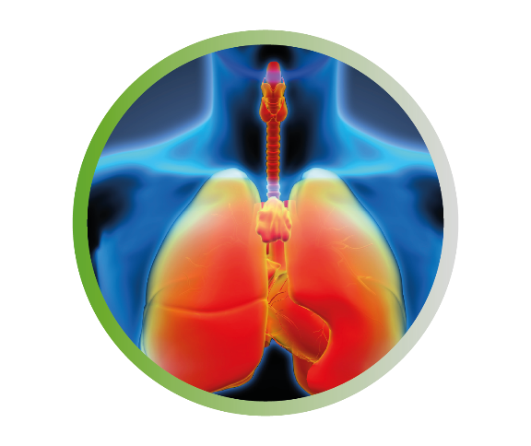
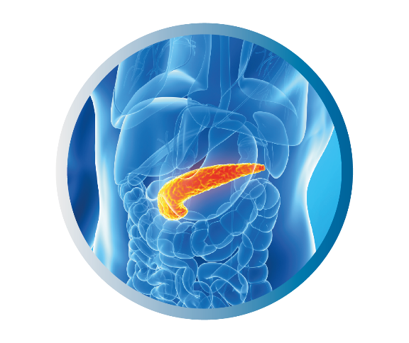
A rich and diversified portfolio in key therapeutic areas
Infectious Diseases
Cardiovascular System
Musculoskeletal System
Respiratory System
Gastrointestinal System & Diabetes
Central Nervous System

Slide 7
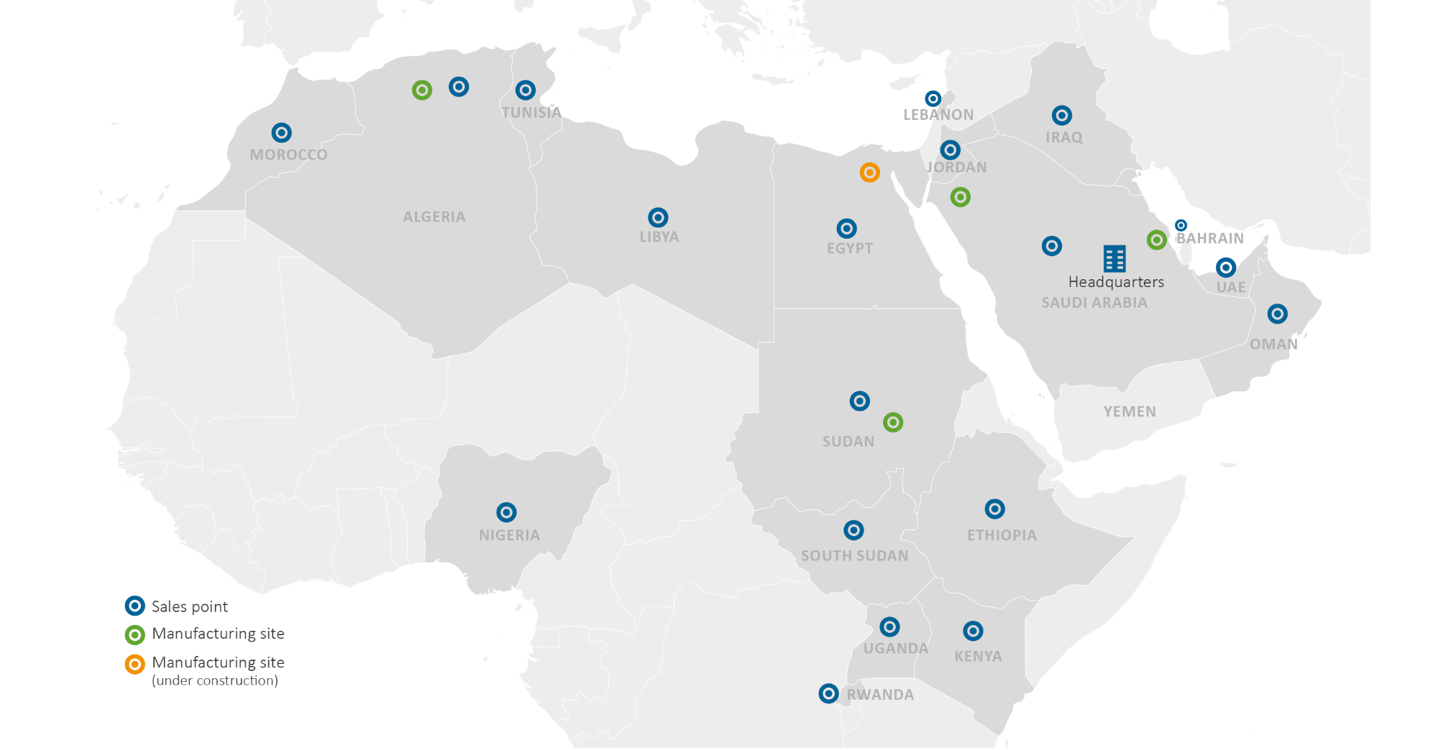
A strong regional presence in Middle East and Africa

Slide 8
Clear future aspirations to augment our position as a leading pharmaceutical player in Middle East and Africa
Continue intensive development programs for highly sophisticated and differentiated products to be introduced to the region.
Establish a footprint in hard to develop pharmaceutical products.
Strengthen Tabuk’s position as the Partner of Choice in the region.
Enhance Tabuk access to patent products through alliances with multinational companies to produce and market patent products in the Middle East and Africa.
Strengthen Tabuk geographical existence in Middle East and Africa.

Slide 9
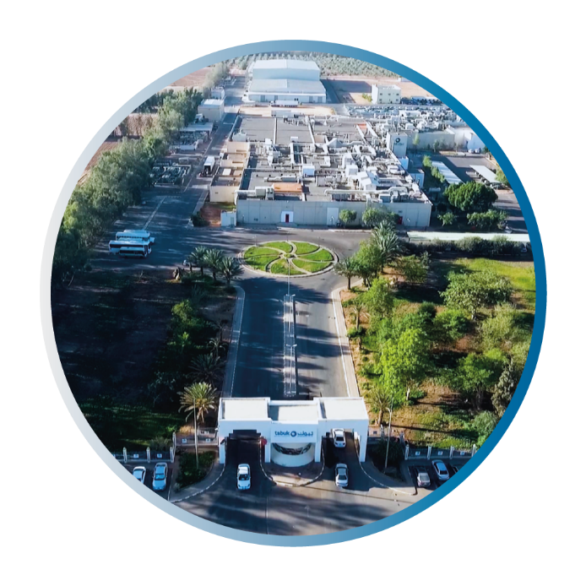
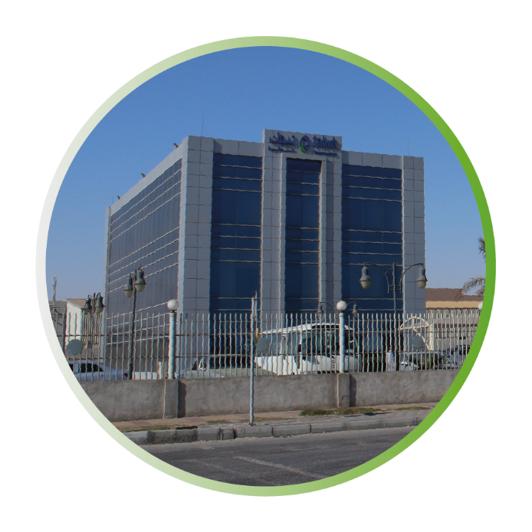
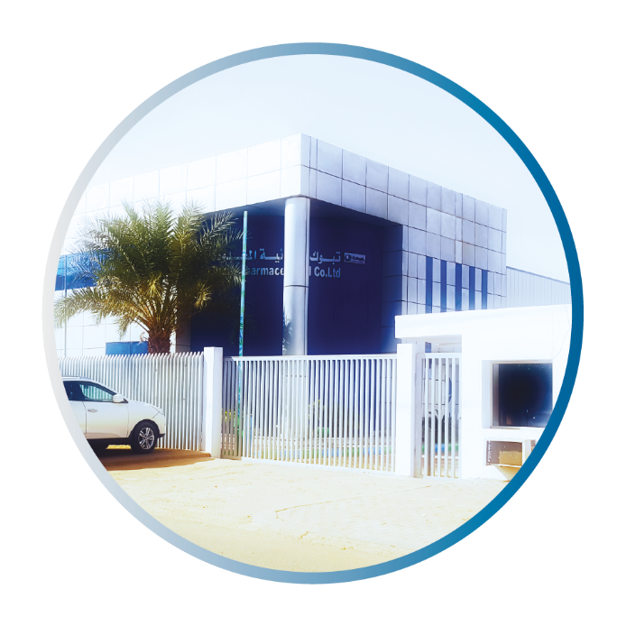
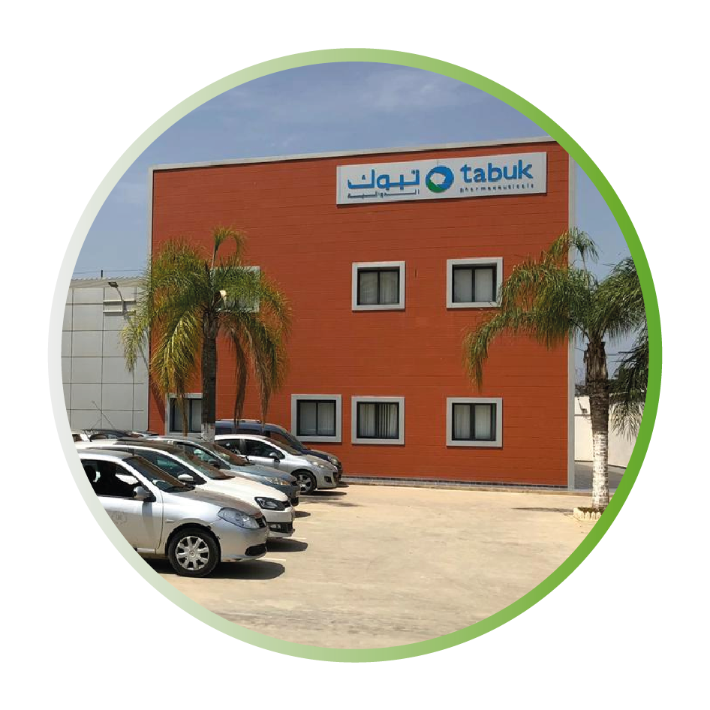
State of art manufacturing sites across Middle East & Africa
Tabuk
Manufacturing site
Dammam
Manufacturing site
Sudan
Manufacturing site
Algeria
Manufacturing site
9

Slide 10
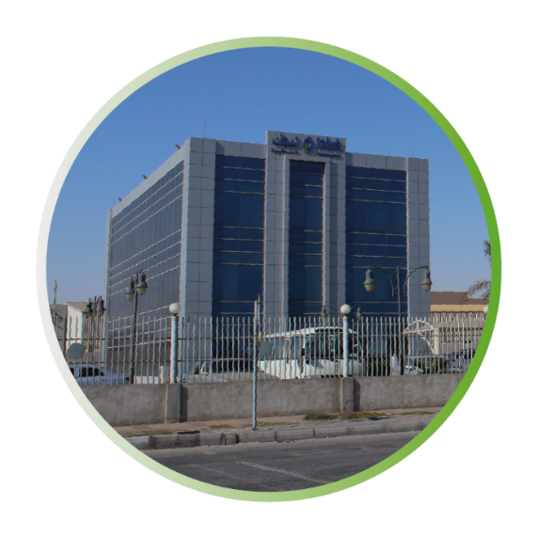
Manufacturing sites- Saudi Arabia
Tabuk manufacturing site
Located 20 Km away from Tabuk city in the north west region of Saudi Arabia
The total site area is 100,000 m². The facility covers an area of over 25,000 m²
Wide range of dosage forms and products including oral solids, dry oral suspensions, oral syrups, injectables, semi-solids (creams, ointments, lotions, & shampoos), and nasal sprays
Advanced technologies implemented such as aseptic manufacturing and pellet coating
Dammam manufacturing site
Located in the 2nd Industrial Zone, Dammam city in Saudi Arabia
Land space is around 14,000 m² and the total built floor area is 17,000 m²
Dedicated floor for general sterile injectables
Best in class automated and systemized machineries across all stages of manufacturing processes
Wide range of dosage forms including lyophilized vials, liquid vials, ampoules, oral liquids, nasal sprays, liquids and semisolids

Slide 11
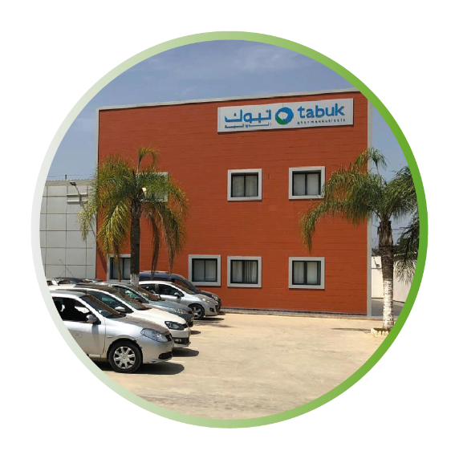
Manufacturing sites- Africa
Sudan manufacturing site
Located in Khartoum North industrial area in Sudan
Land space is around 8,500 m² and the total built floor area is 6,500 m²
Wide range of oral dosage forms including liquid syrups, powder oral suspensions, tablets and capsules.
Algeria manufacturing site
Located in Blida city in Algeria
Land space is around 6,200 m² with a facility area of 3,000 m²
Currently manufacturing oral solid dosage forms, with a future expansion plan to include wider range of dosage forms

Slide 12
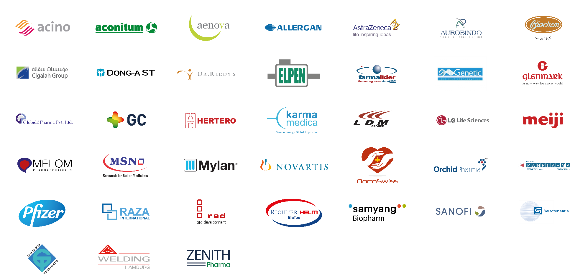
A global network of business partners

