Slide 1
استاذ مساعد احمد محي رشيد
FIBMS-Otolaryngology

Slide 2
Effect of Drug Addiction on Ear, Nose and Throat
Objectives
To take idea about some addictive drugs
Why snorting is used for drug adminstration?
How addicted drugs damaging the nose?
ENT related effects of drug addiction

Slide 3
Heroin
Is a highly addictive synthetic opiate drug made from morphine, a natural substance taken from the seed pod of the various opium poppy plants
Can be a white or brown powder.

Slide 4
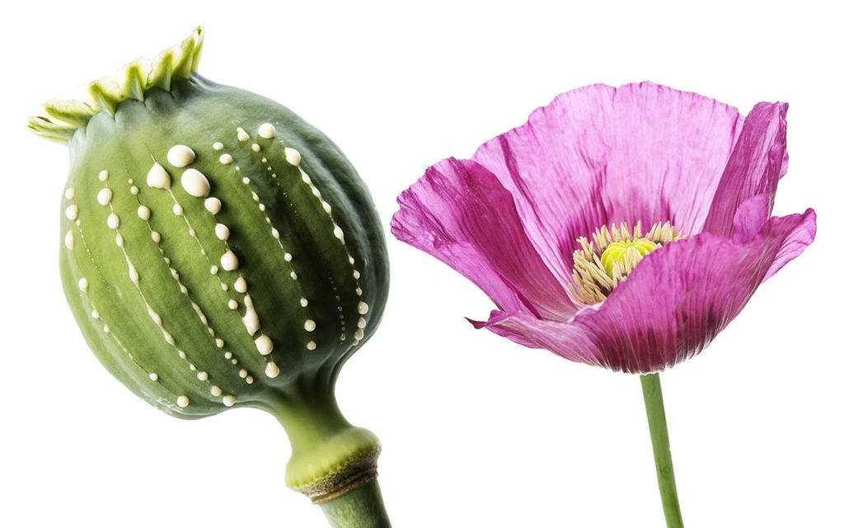
Poppy Plant

Slide 5
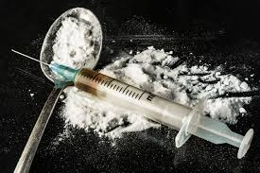
Heroin

Slide 6
Cocaine
Is a powerfully addictive stimulant white powder that comes from the dried leaves of the coca plant

Slide 7
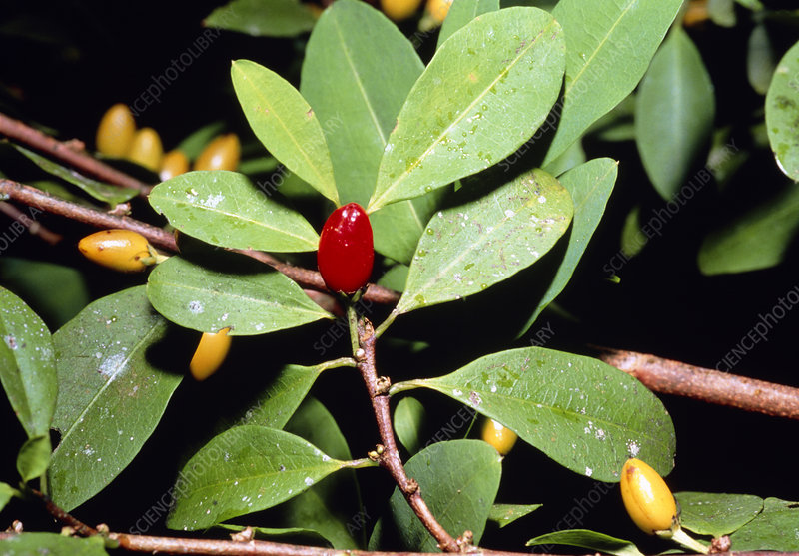
Coca Plant

Slide 8
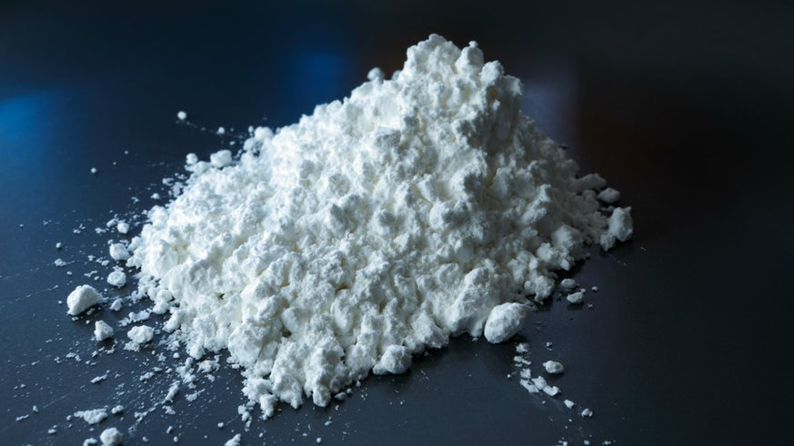
Cocaine

Slide 9
Routes of drud adminstration
Injections
Snorting (sniffing)

Slide 10
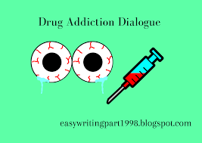
Injection

Slide 11
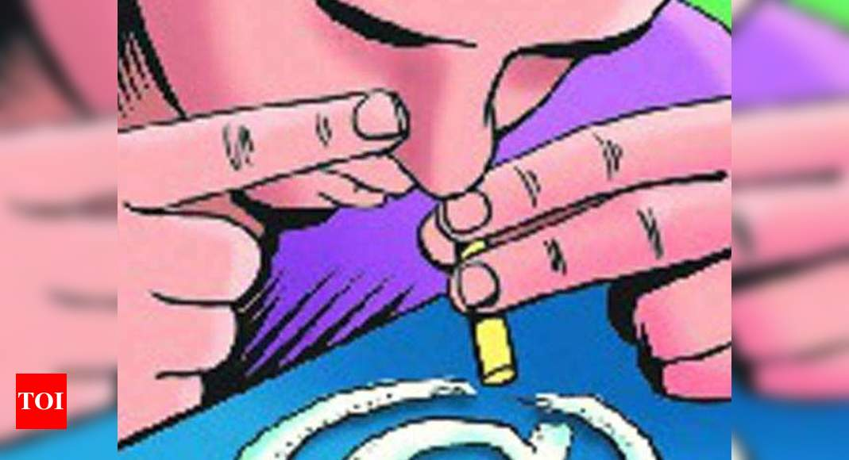
Snorting

Slide 12
Snorting drugs:Why do drug addicts do it?
Because the mucosa inside the nose is easily accessible, and provides rapid absorption of drugs introduced to it in powdered, liquid, or aerosol form, it offers many advantages as drug delivery system.
Bypassing the stomach and liver, where drugs may be degraded by digestive processes before being absorbed into the bloodstream, snorting provides a quick onset of effects.
Noninvasive, virtually painless and easy.

Slide 13
How dose damage to the nose occur?
Repeated snorting sets up a cascade of ischemia, inflammation, micronecrosis, infection, and then macronecrosis leading to septal perforation.
Cocaine constricts blood vessels, which occurs as a result of the inhibition of reuptake of the neurotransmitters epinephrine and norepinephrine→ tissue necrosis.
Heroin may csuse immune system suppression→ bacterial or fungal infection→damage to the nose.

Slide 14
Dr. Richard Leibowitz, an Otolaryngologist, statement
The nose conditions the air you breathe in, in addition to cleaning it. If it is not donig its job , the air you breathe into your lungs is not good for you.

Slide 15
Ear, nose and throat signs and symptoms in drug addicts
Severe nose itching
Nasal ulcers→ septal perforation
Nasa mucosal edema, obstruction and runny nose →Rhinosinusitis
Saddle-nose defrmity (collapsed dorsum)
Dry mouth → stomatitis and palatal perforation
Dry pharynx→ pharyngeal ulcers
Vestibular dysfunction
Sudden sensorineural hearing loss due to cochlear toxicity(rare)
Tinnitus
Chronic cough
Pulmonary edema and hemorrhage→difficult breathing

Slide 16
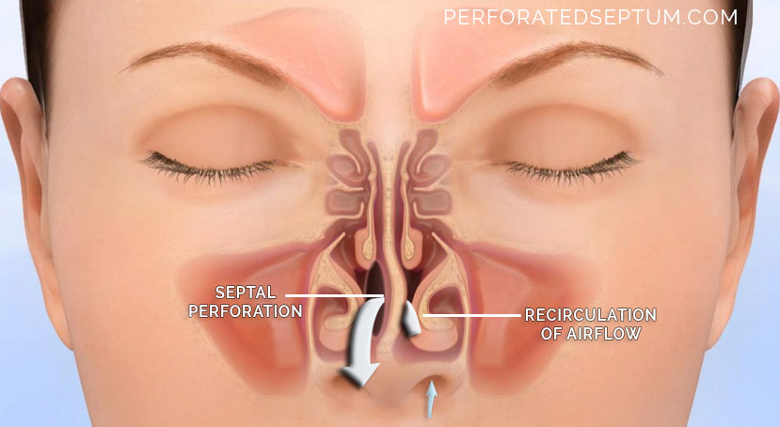
Septal perforation

Slide 17
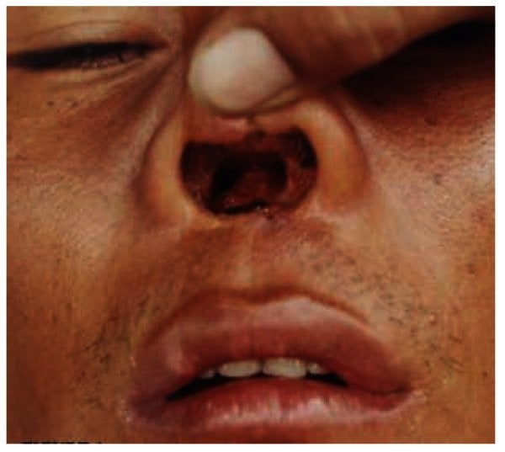
Septal perforation

Slide 18
Saddle nose

Slide 19
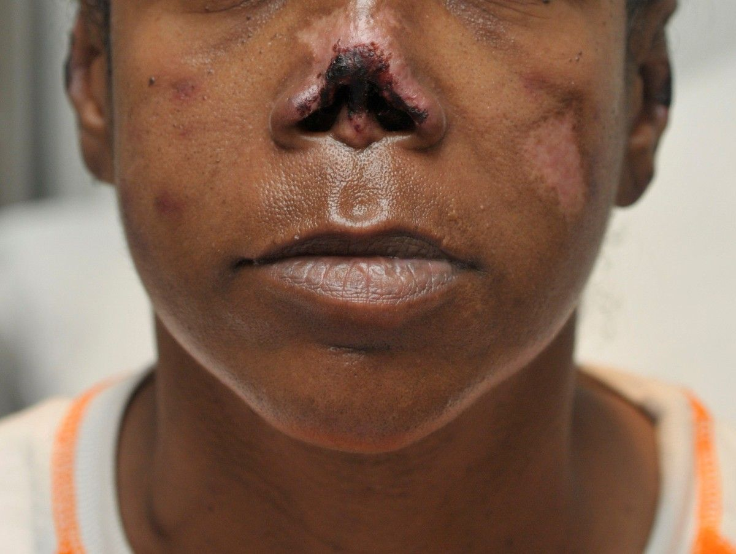

Slide 20
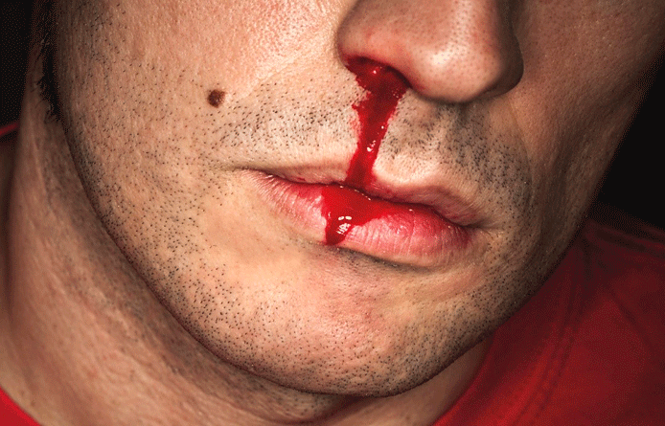
Epistaxis

Slide 21
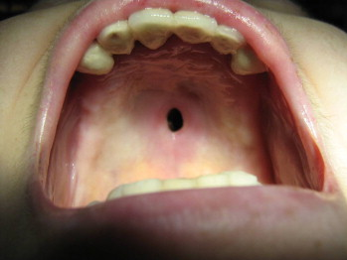
Palatal perforation

Slide 22
FINALLY
The effects of addictive drugs on ear, nose, and throat can be reversible or irriversible, depending on:
1- Type of addicted drug
2- Drug combination
3- Duration of addiction
4- Person health

