Slide 1
Professional Athlete
Prof. Ansam Yaroub

Slide 2
Definition
Athlete : is the person who practices sports as a profession.
He can be called sportsperson too

Slide 3
Classification

Slide 4
1. Age Group
Young/ Youth
Junior / senior
Masters
U + Age = U 17

Slide 5
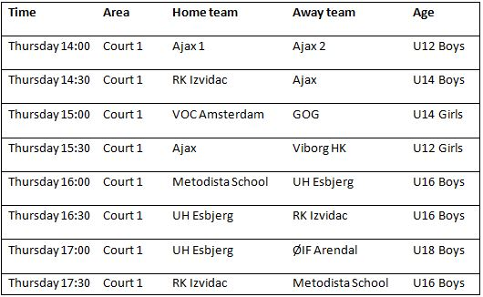

Slide 6
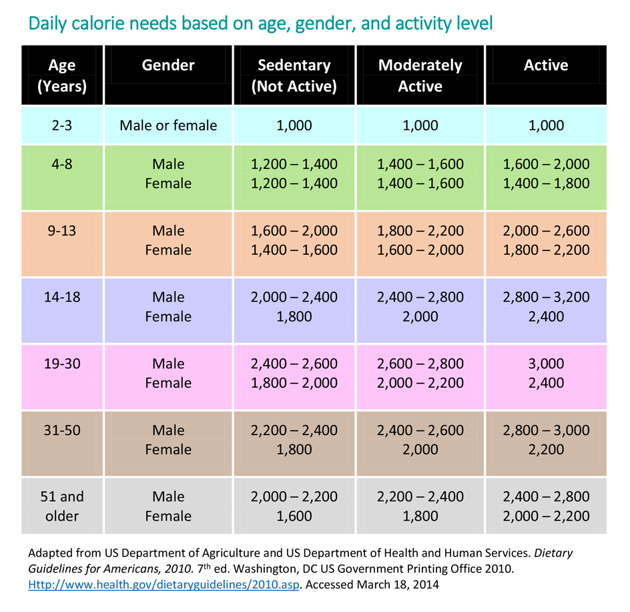

Slide 7
2. Level of skill
Novice (beginner/ rookie)
Amateur
Professional
Elite

Slide 8
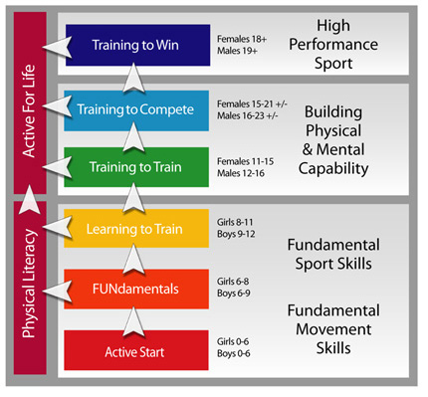

Slide 9
Physical Fitness & Training levels of skill
Starter or beginner
Intermediate
Advanced

Slide 10
3. Weight class
Weight in kilos Ex 56 Kg
Weight in Bounds Ex 123 IB
Terms describing weight Ex Heavyweight
Used in sports like boxing, wrestling and weightlifting.

Slide 11
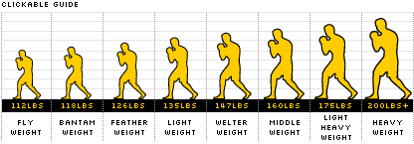

Slide 12
4. Records الارقام القياسية
World records
Olympic records

Slide 13
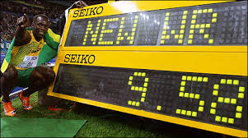

Slide 14
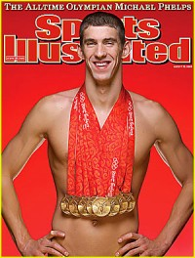

Slide 15
5. Trophies & Awards الكؤوس والجوائز
Trophies
All World Cups
Special Sports Cups like Wimbledon for tennis
Awards
Athlete of the year
MVP (must valuable player)
Mr./Mrs. X Sports

Slide 16
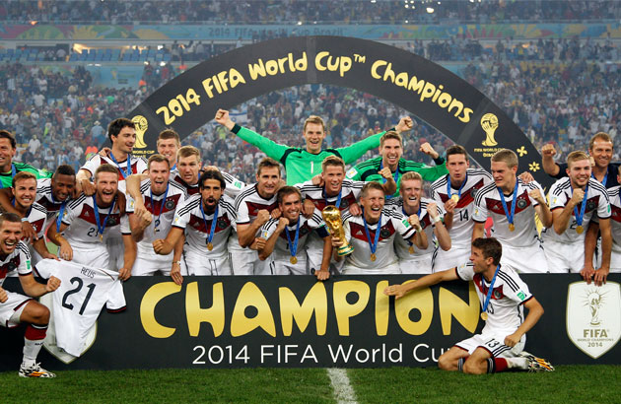

Slide 17
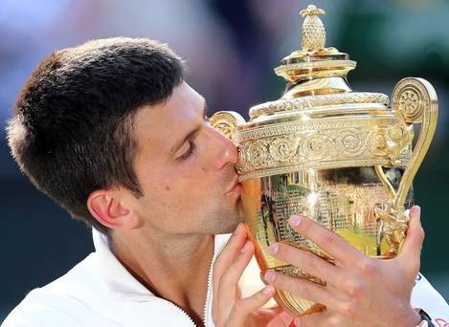

Slide 18
6. Medals المداليات
Olympic medals
Gold
Silver
Bronze
The Pierre De Coubertin Medal

Slide 19
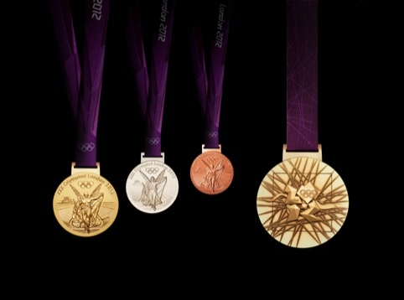

Slide 20
7. Performance & Abilities الاداء والقابليات
All – round athlete
World’s greatest athlete

Slide 21
8. Position/ specialization المركز والتخصص
In team sports
Volleyball (setter, hitter, libero, block, etc)
Soccer (goalkeeper, defense, midfield, offense)
Basketball (pivot, guards, etc)
In individual sports
Event or discipline (athletics, swimming, gymnastics)

Slide 22
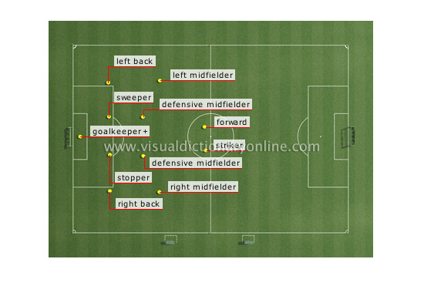

Slide 23
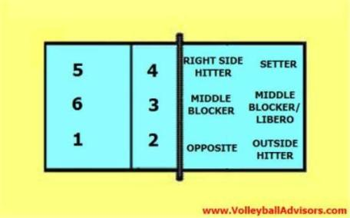

Slide 24
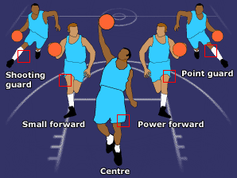

Slide 25
9.World rankings التصنيف العالمي

Slide 26
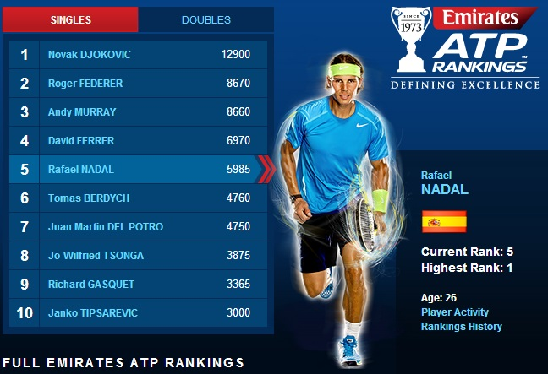

Slide 27
10. Gender & Nationality الجنس والجنسية

Slide 28
How to find an athlete in your sports?
Go to your International federation website and search for one of the classifications mentioned earlier
Examples

Slide 29
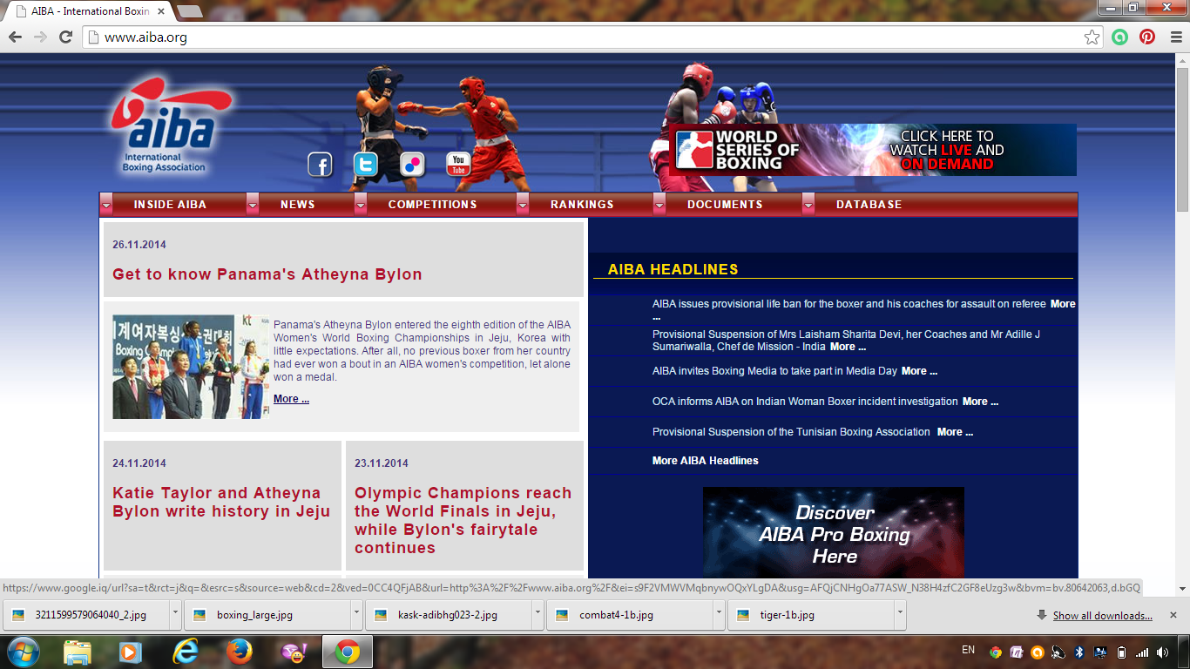

Slide 30
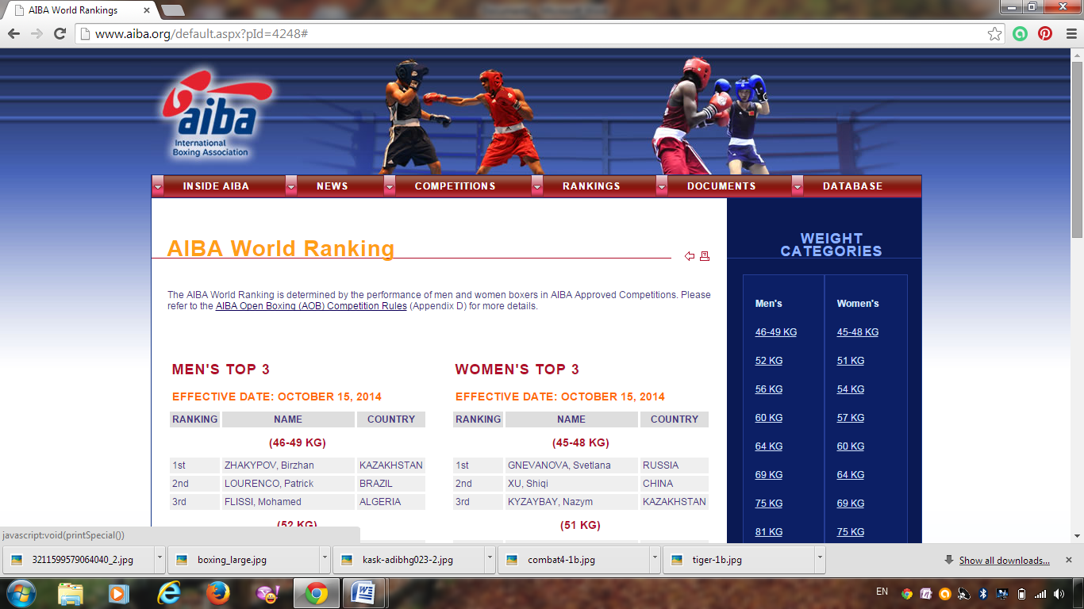

Slide 31
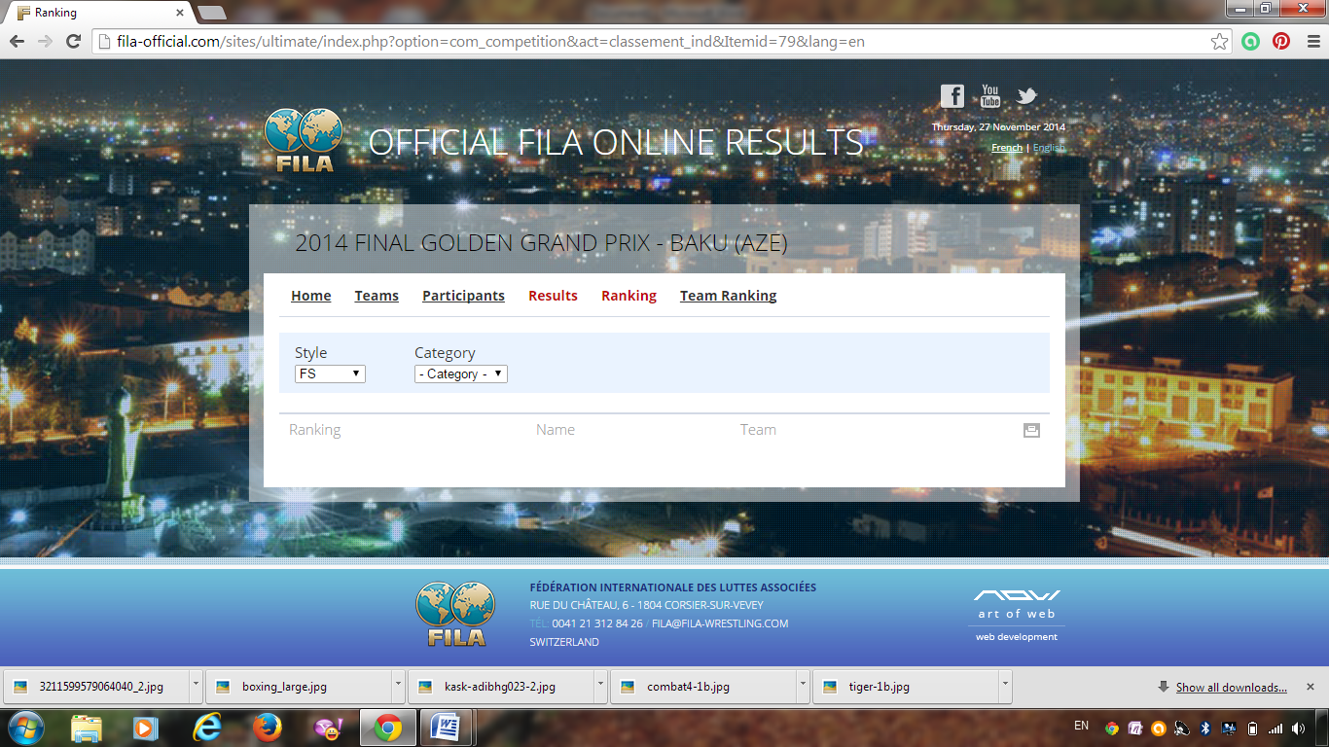

Slide 32
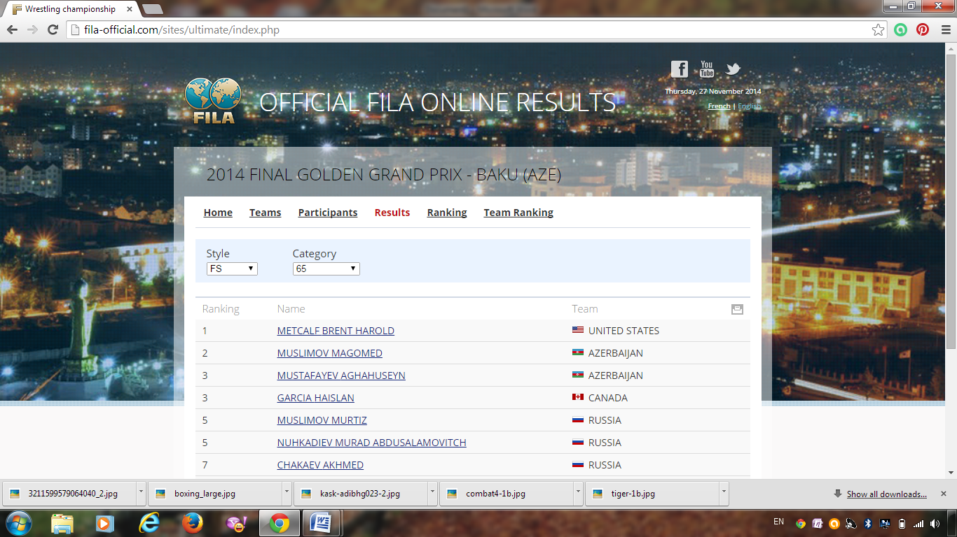

Slide 33
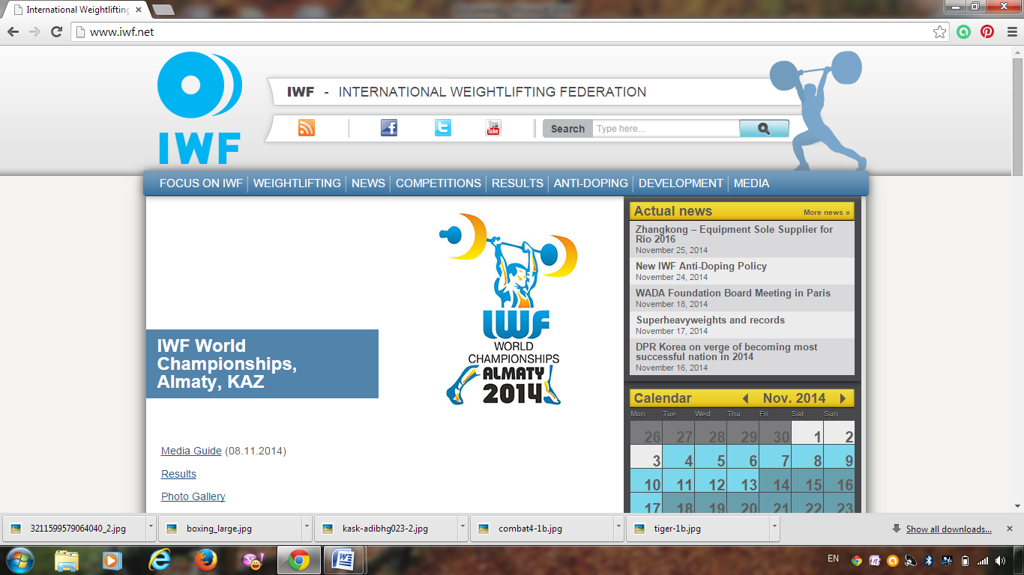

Slide 34
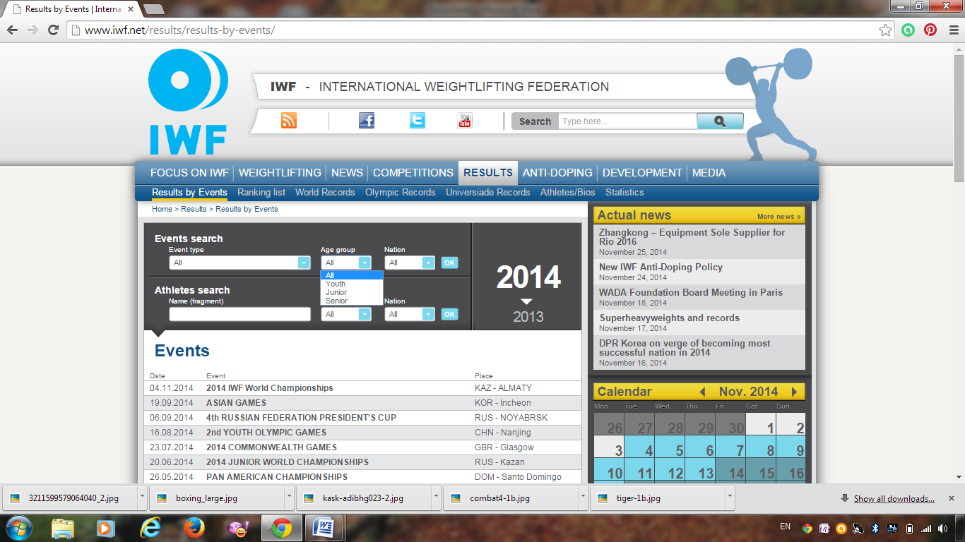

Slide 35
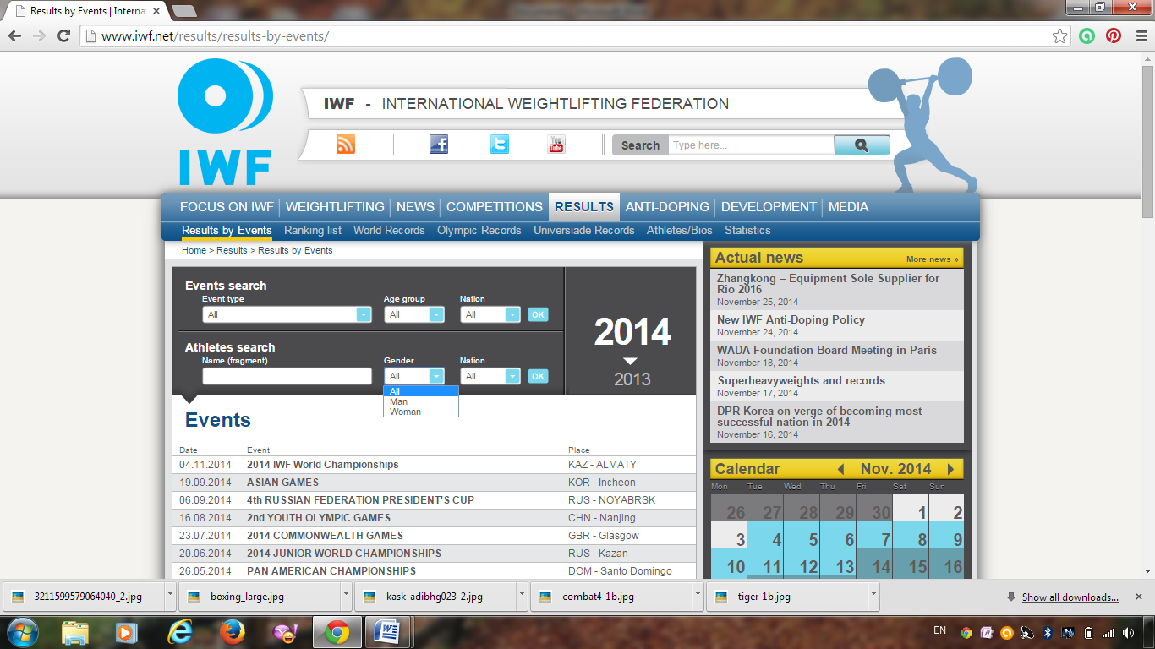

Slide 36
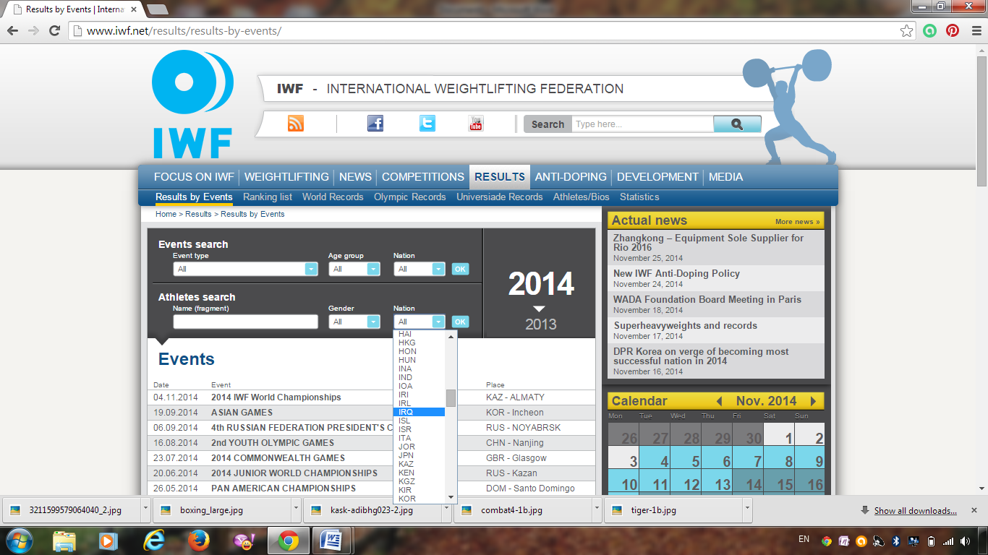

Slide 37
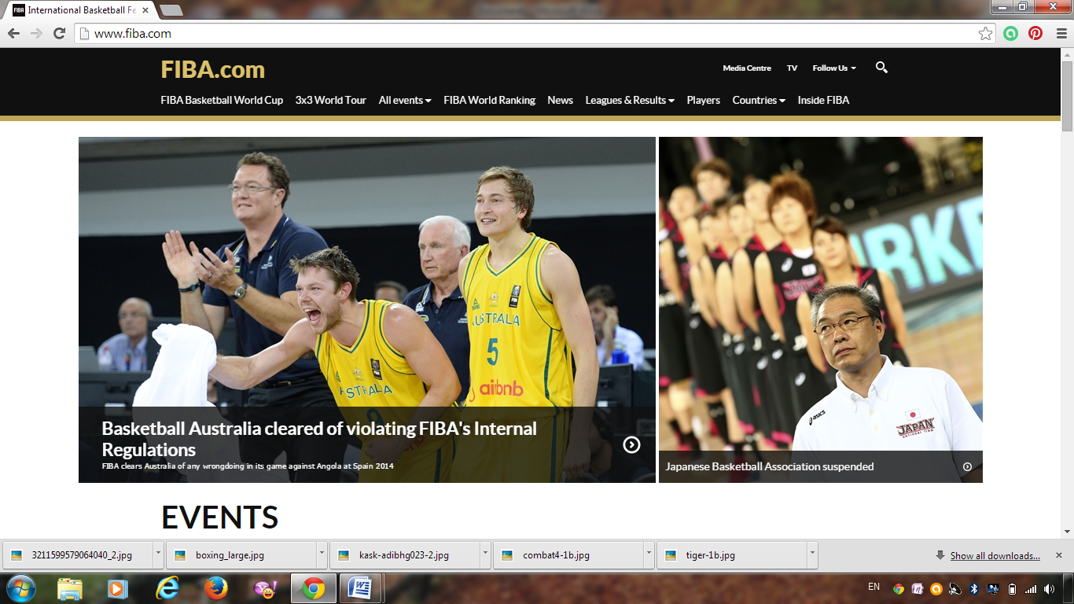

Slide 38
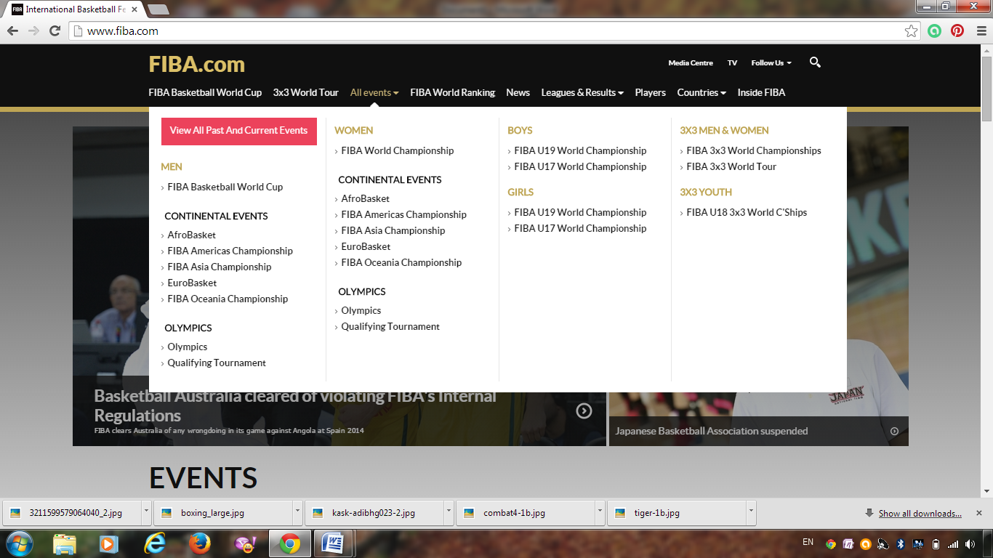

Slide 39
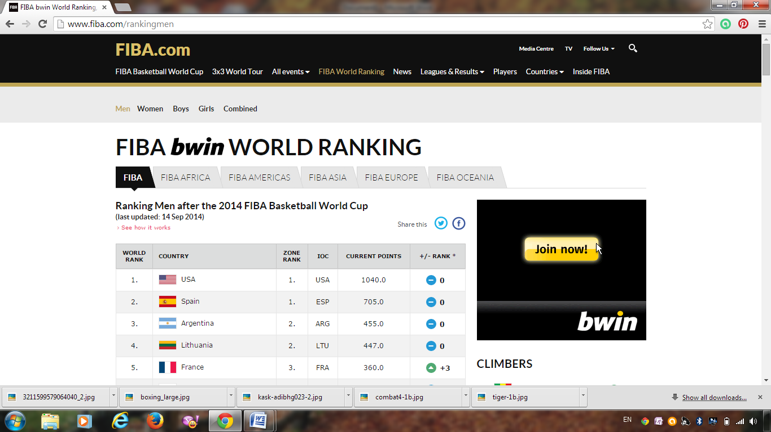

Slide 40
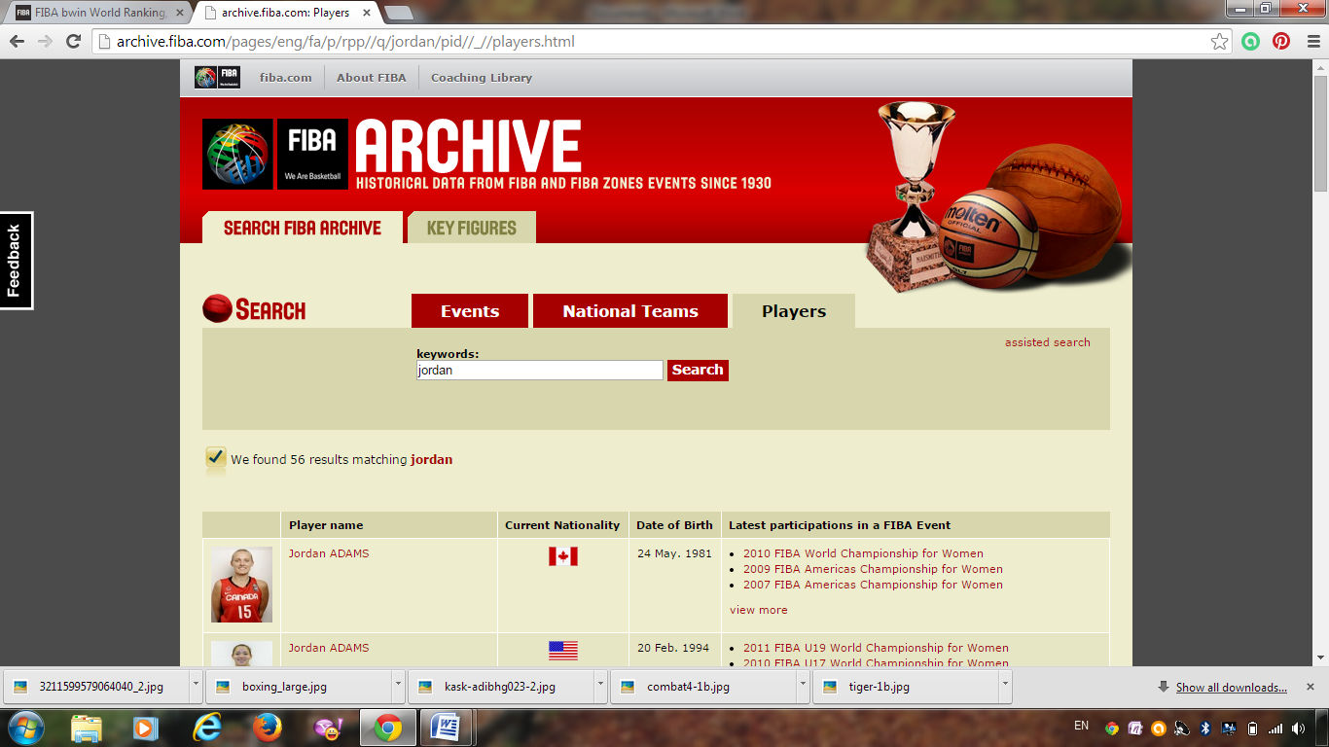

Slide 41
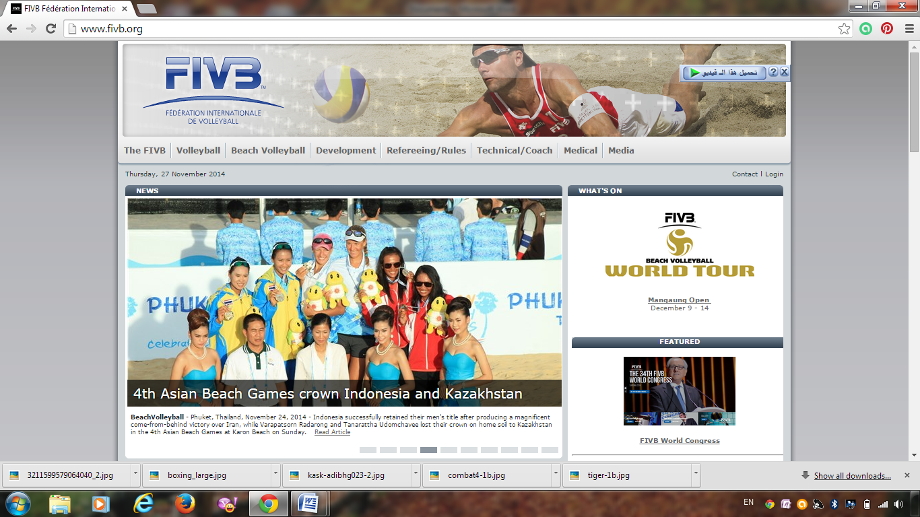

Slide 42
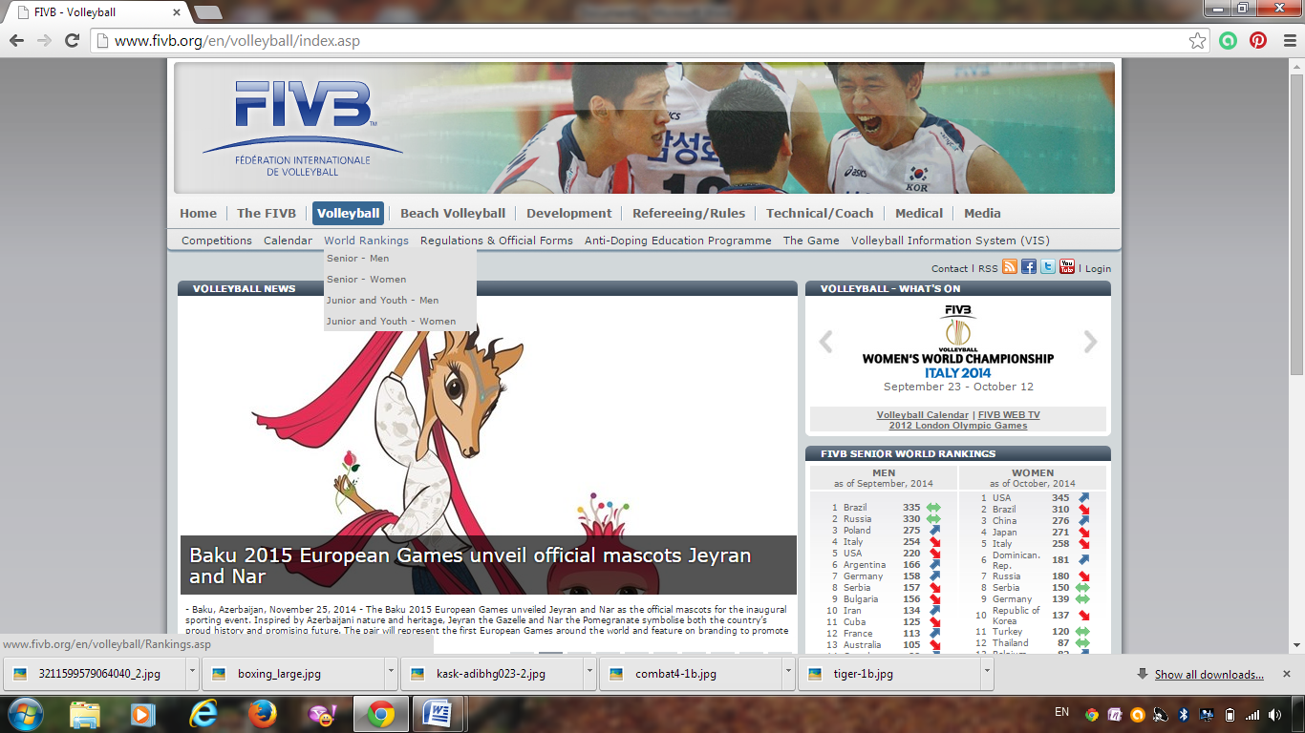

Slide 43
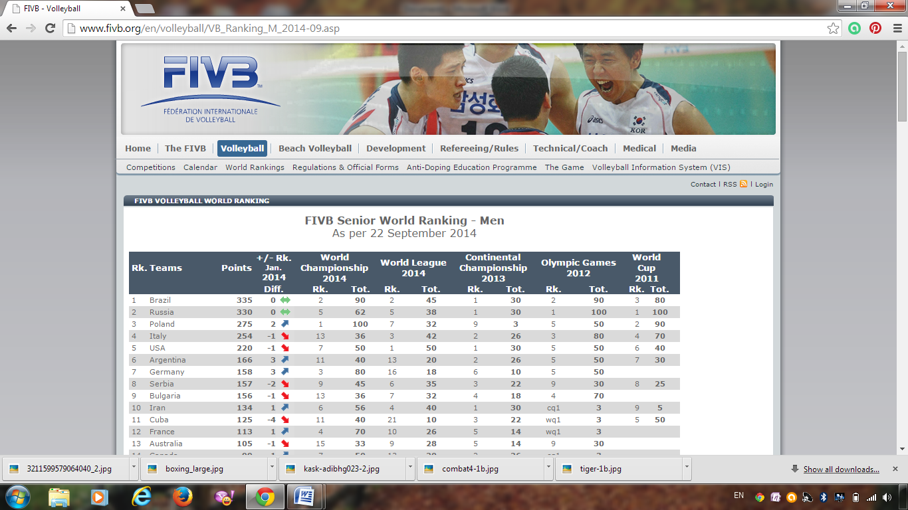

Slide 44
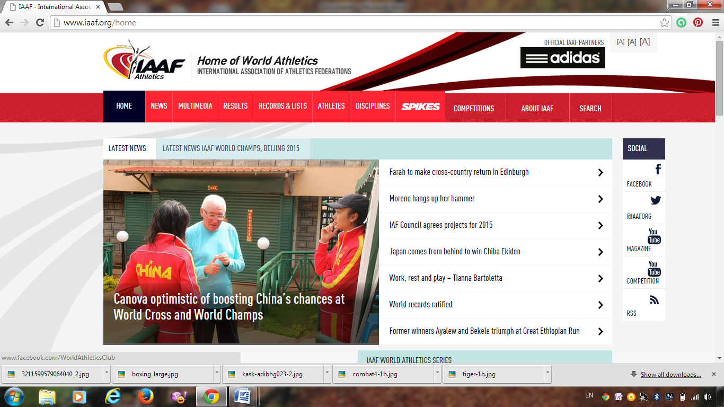

Slide 45
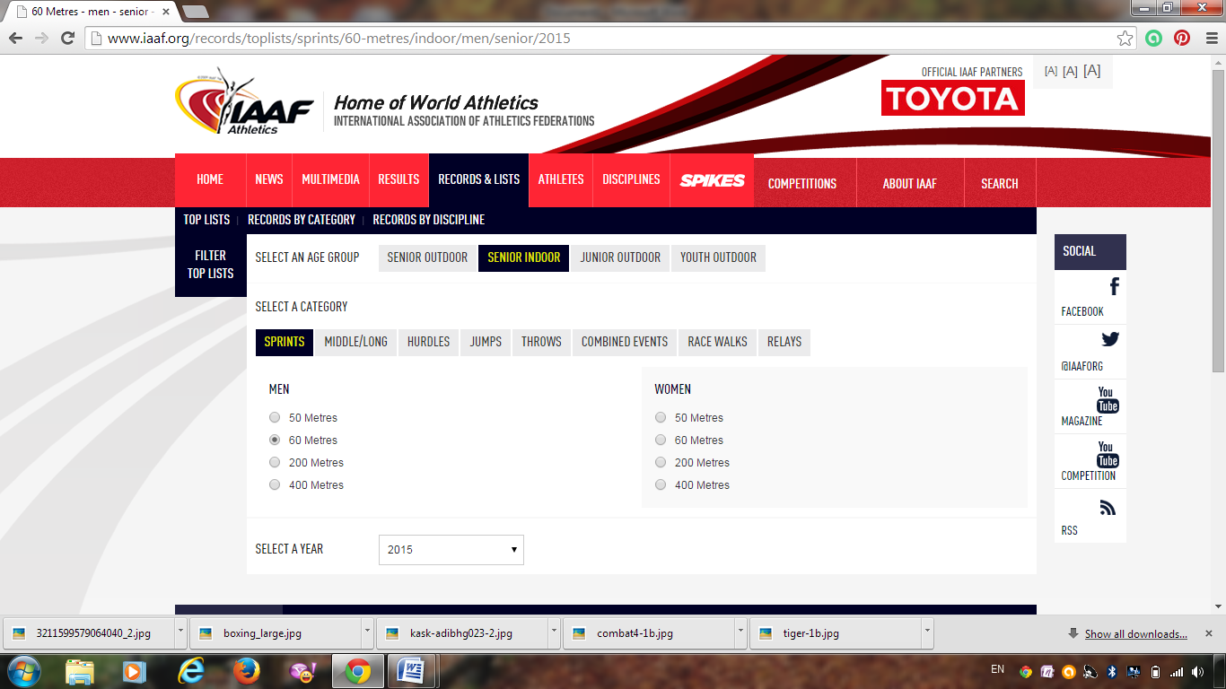

Slide 46
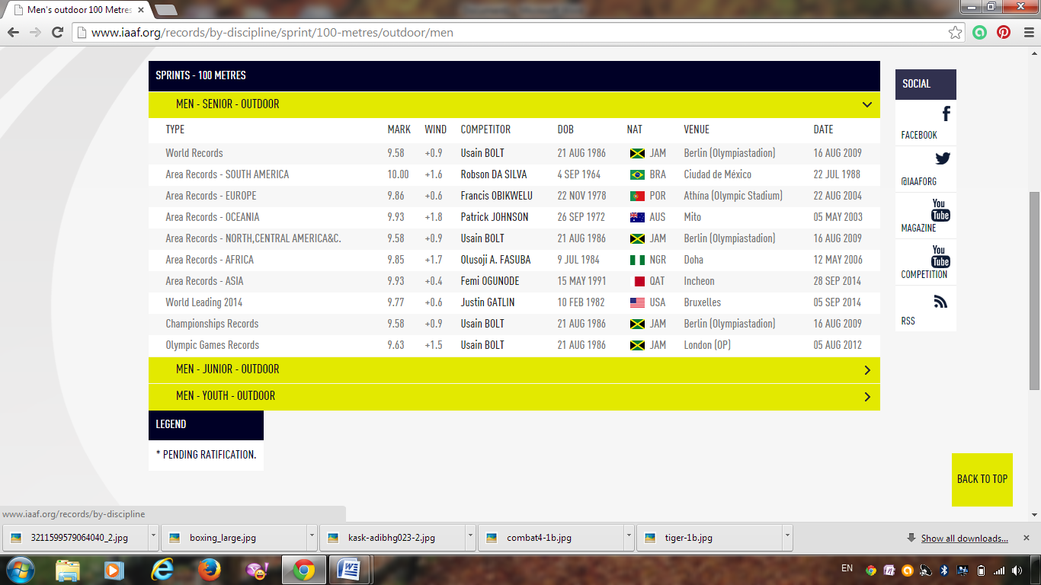

Slide 47
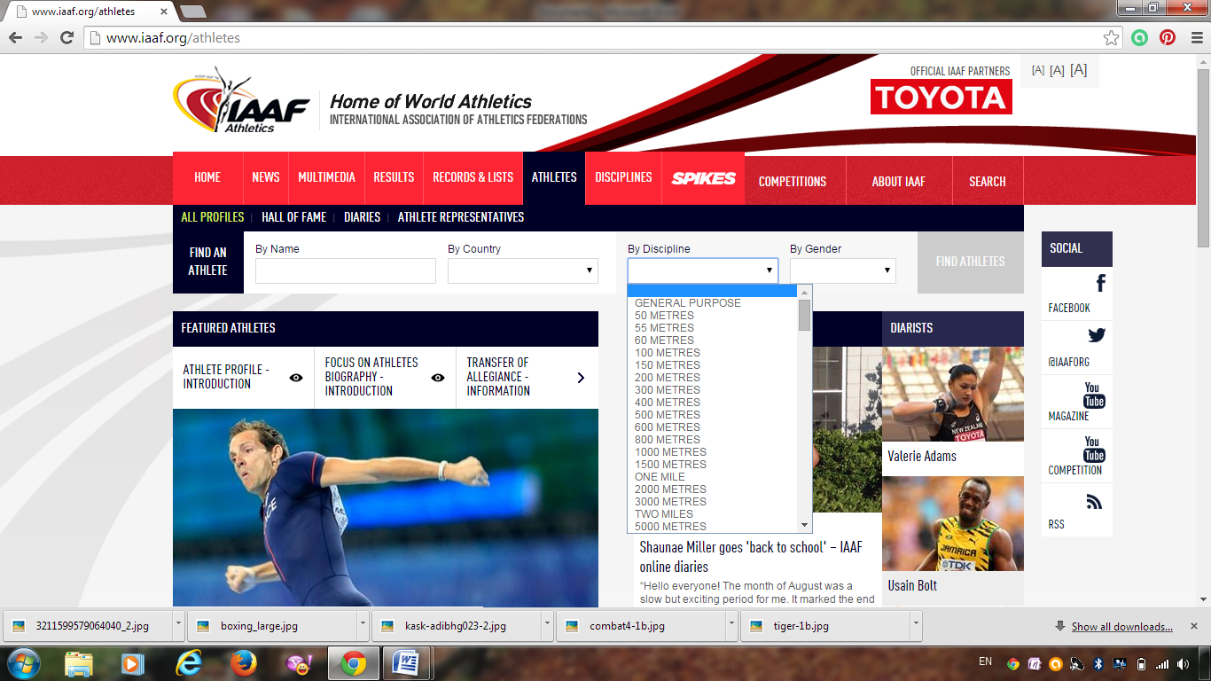

Slide 48
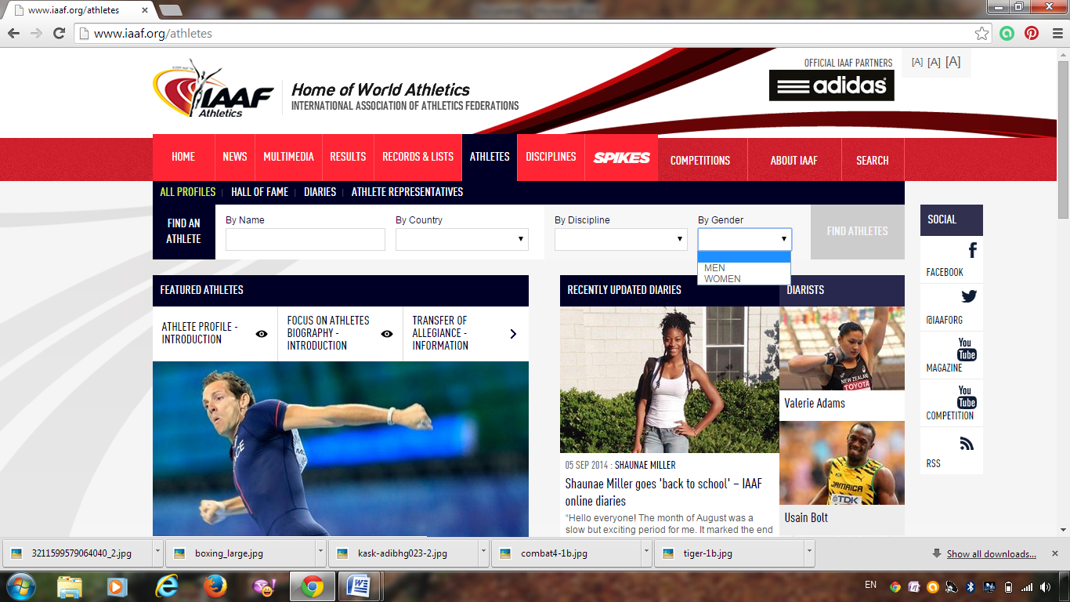

Slide 49
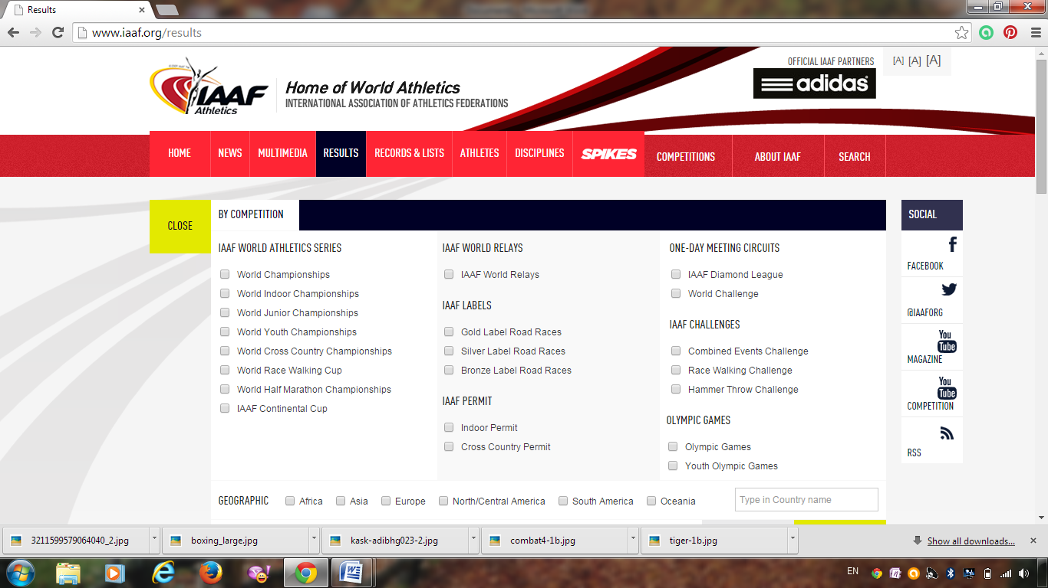

Slide 50
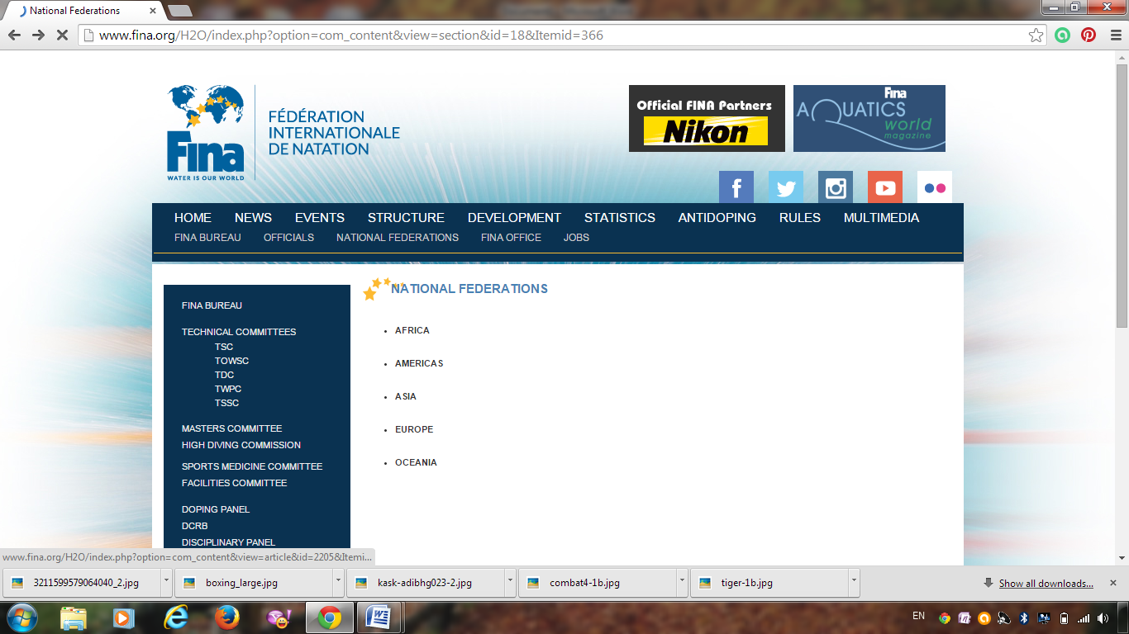

Slide 51
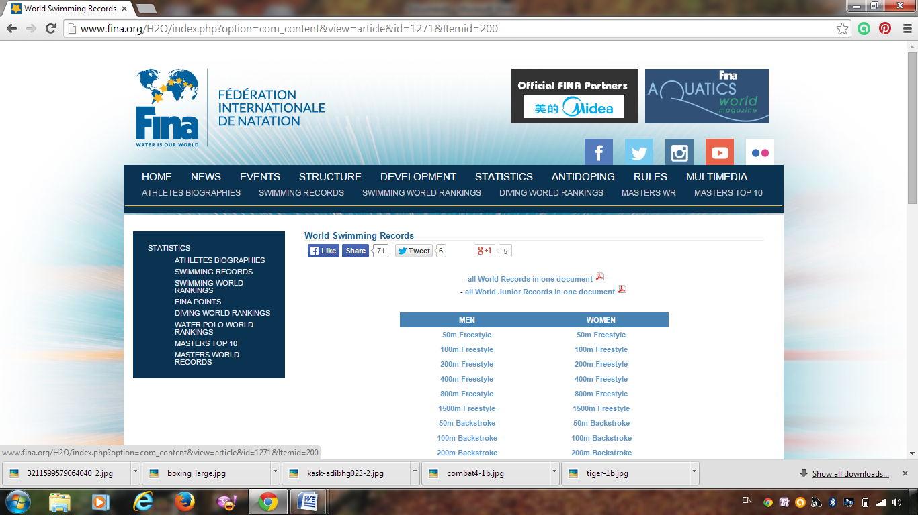

Slide 52
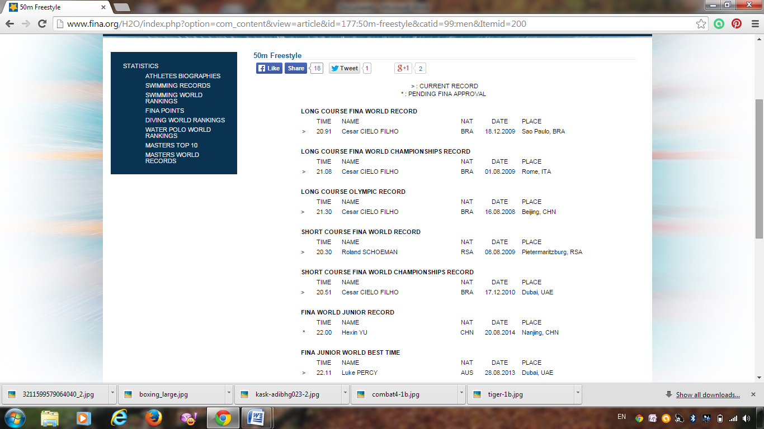

Slide 53
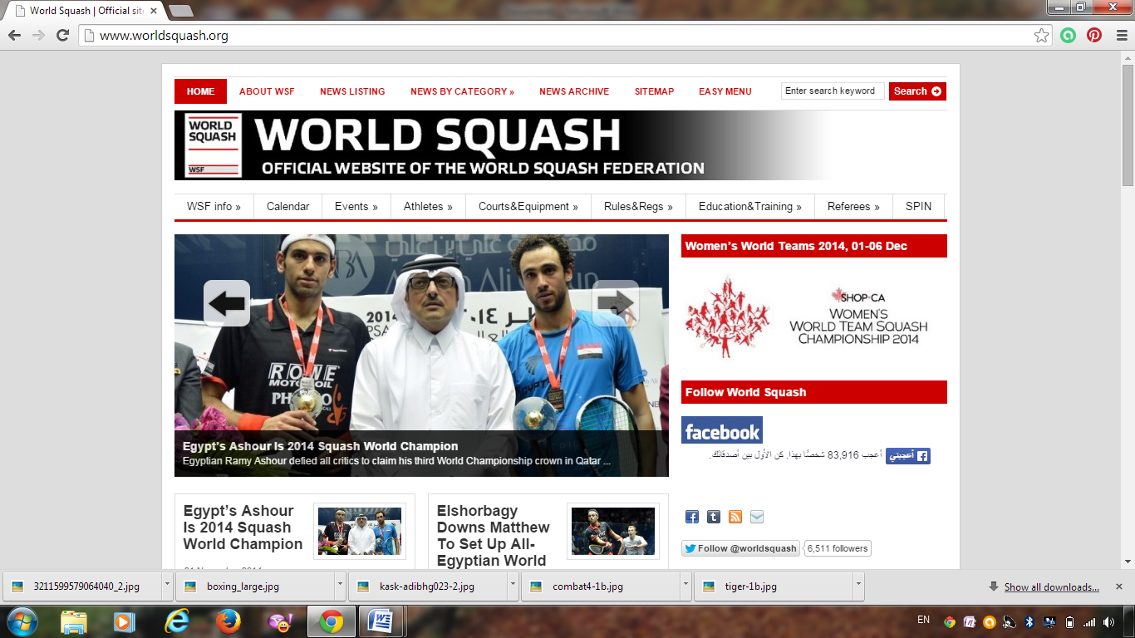

Slide 54
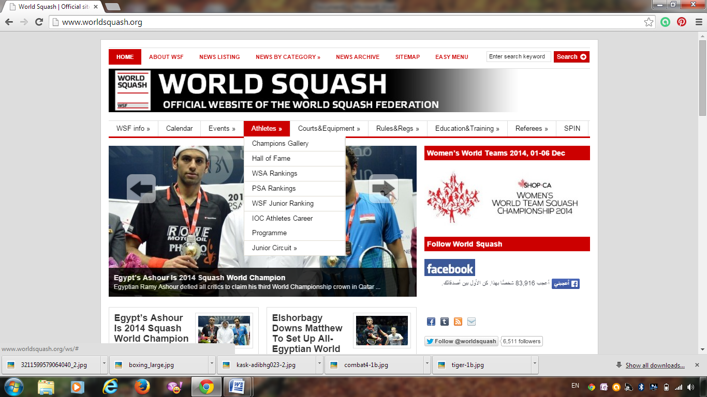

Slide 55
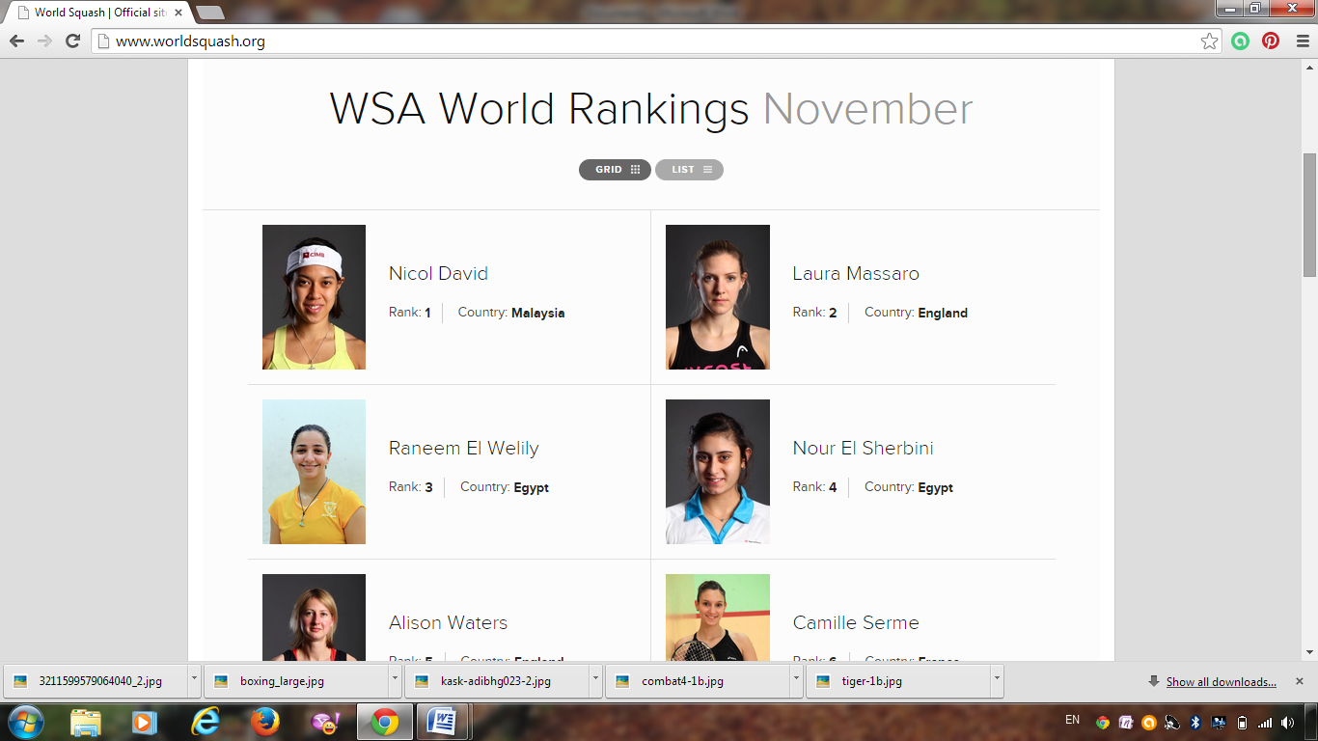

Slide 56
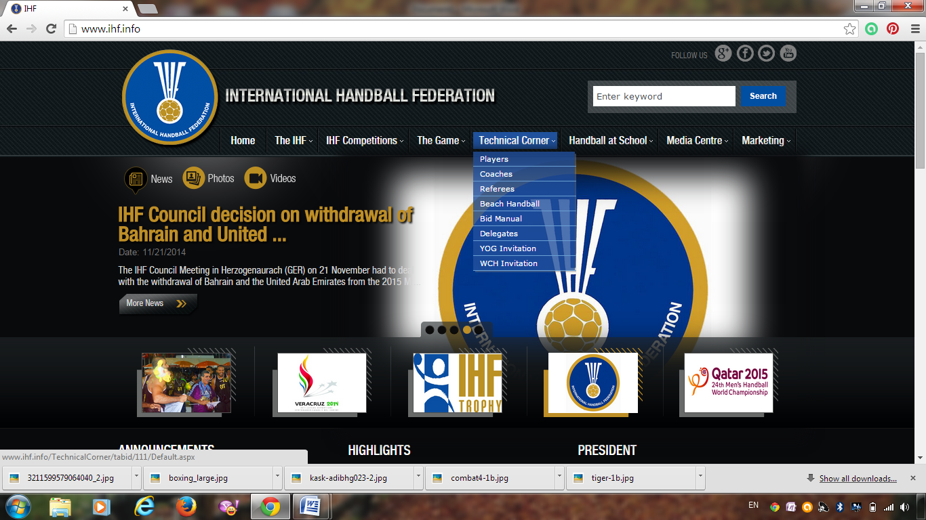

Slide 57
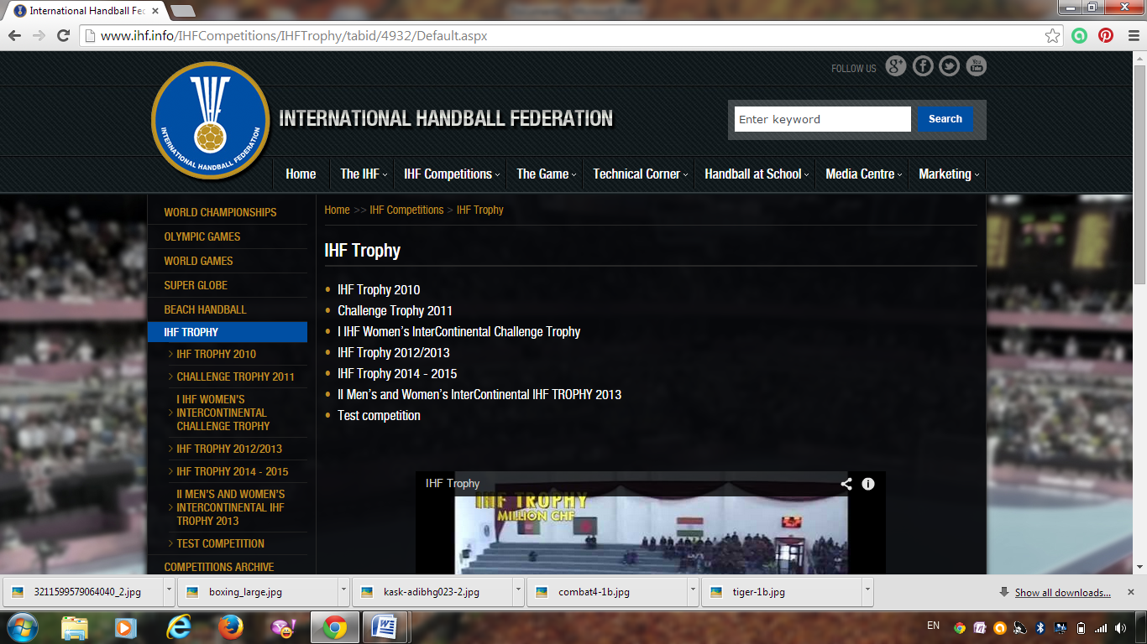

Slide 58
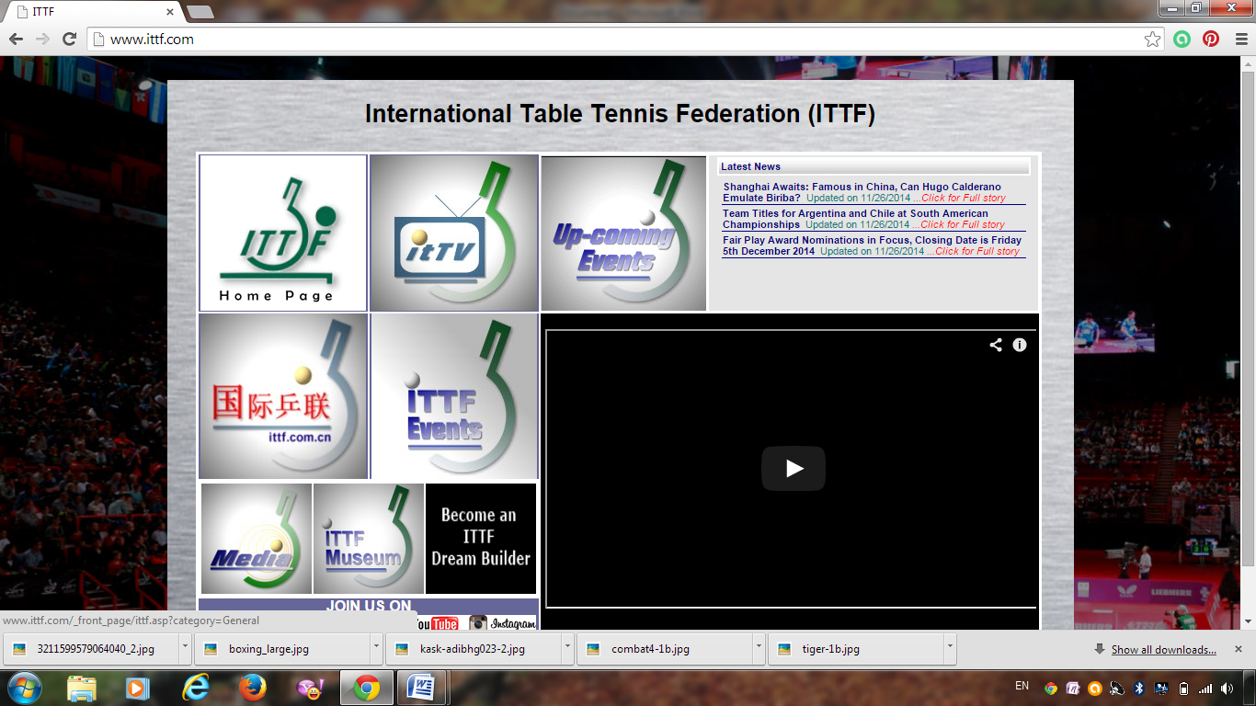

Slide 59
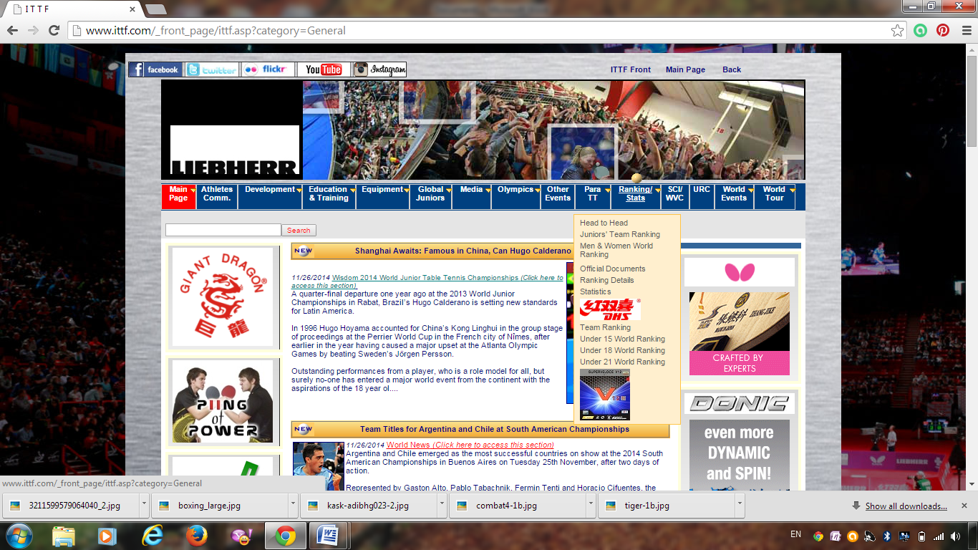

Slide 60
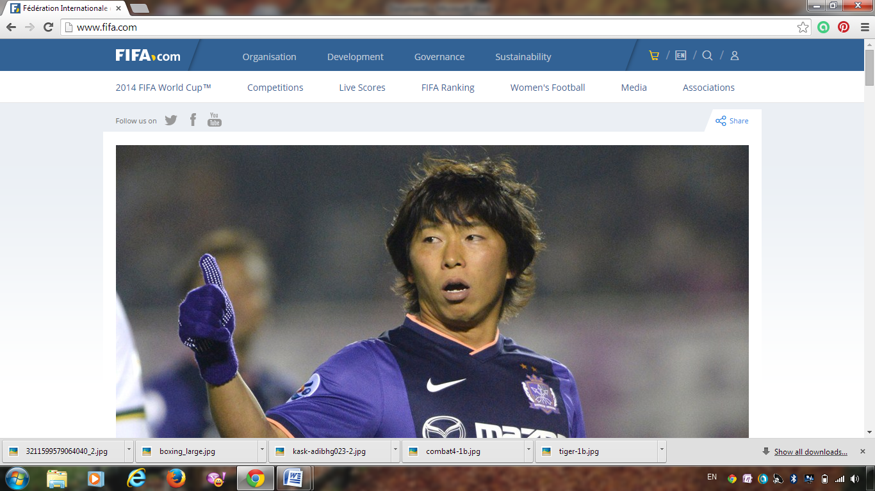

Slide 61
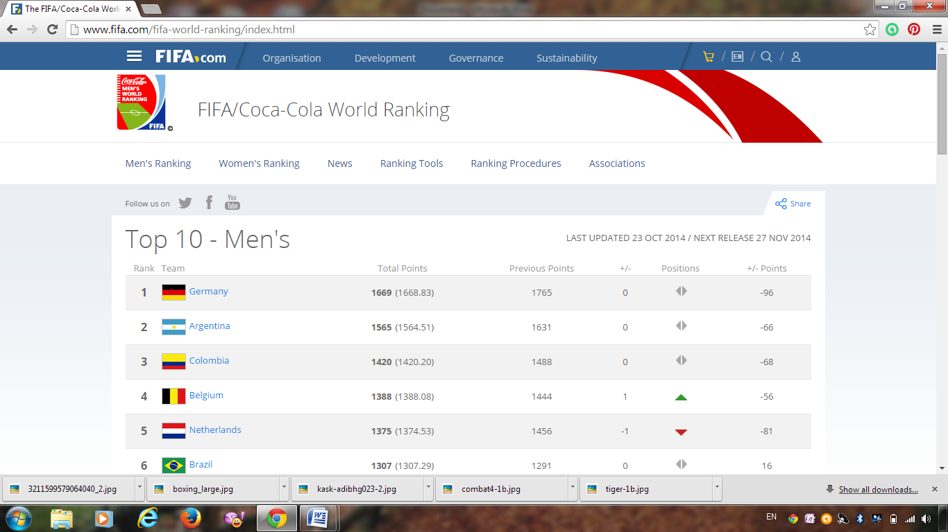

Slide 62
Or
Visit the Olympics Website

Slide 63
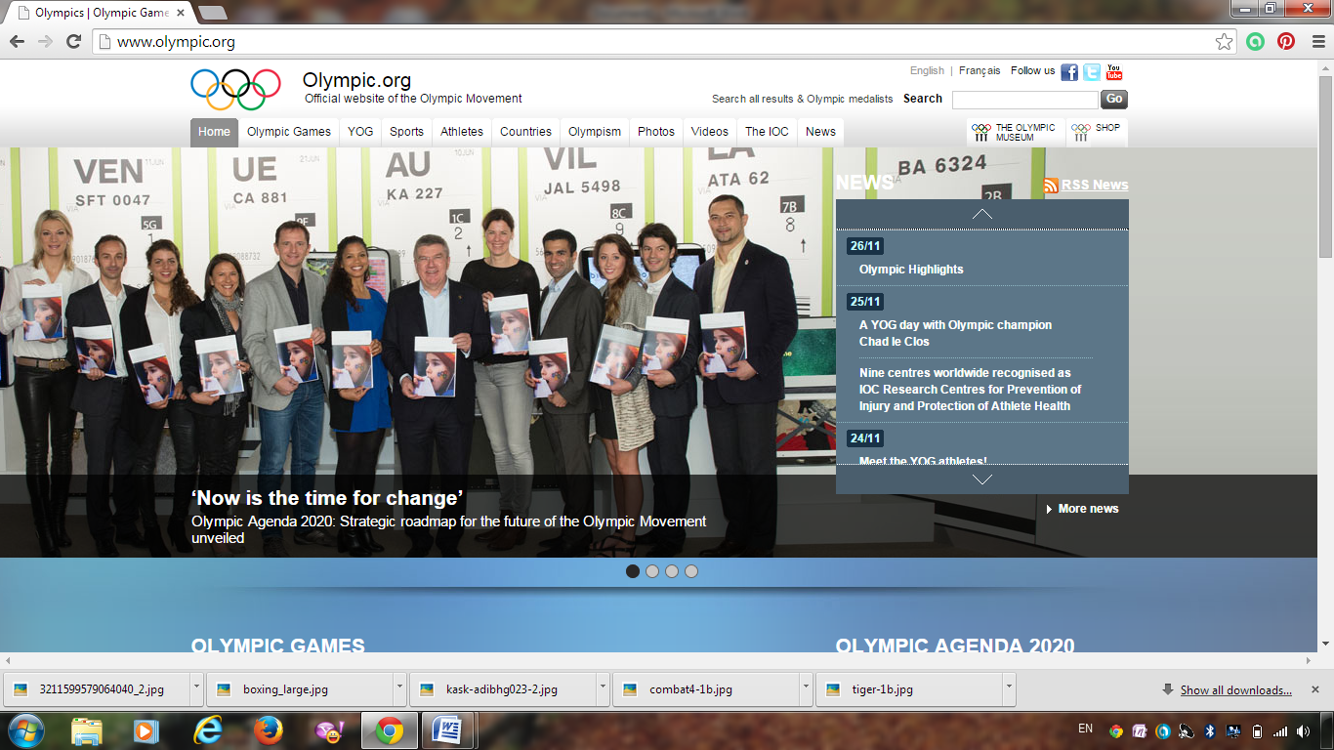

Slide 64
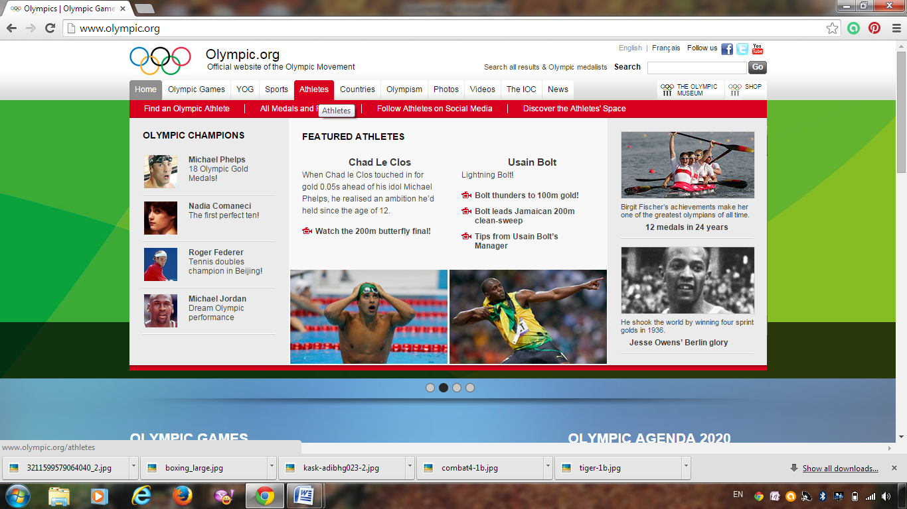

Slide 65
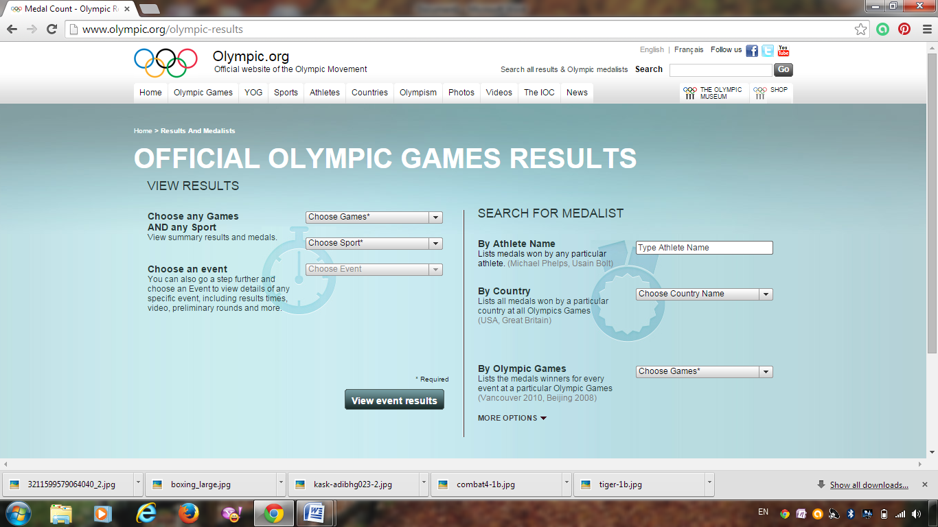

Slide 66
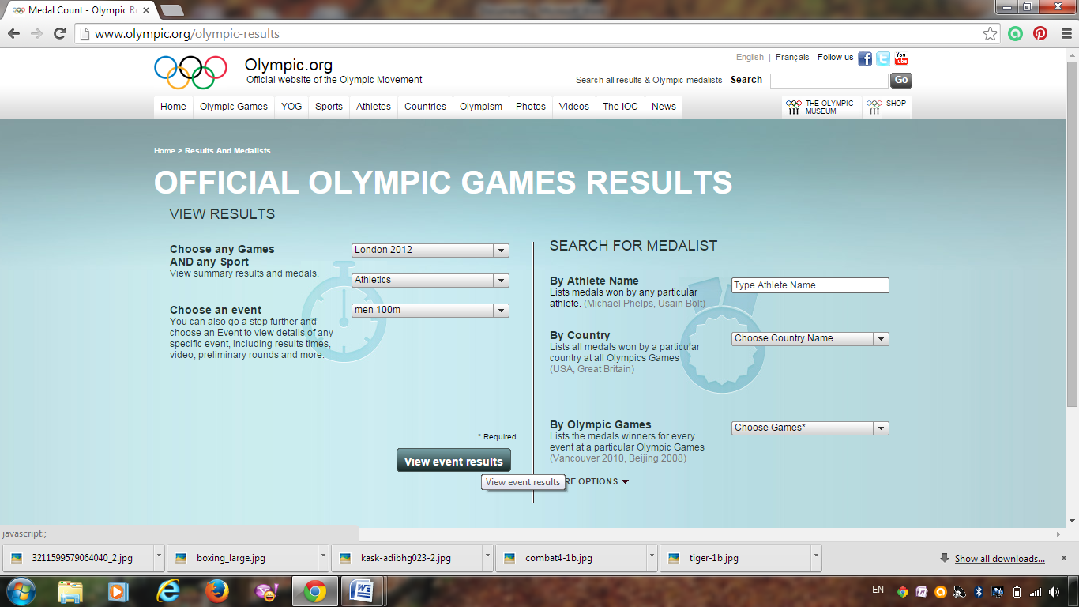

Slide 67


