Slide 1
Compound nouns
Prof.Ansam Yaroub

Slide 2
Compound nouns
can be closed (one word),
open (two words)
or hyphenated (two or more words connected by a hyphen).
Examples of each type of compound noun are:
closed compound nouns - toothpaste, schoolhouse, bedroom
open compound nouns - ice cream, root beer, coffee table
hyphenated compound nouns - four-door, daughter-in-law, six-pack
Compound nouns can be made up of a noun and an adjective as is the case with the word blackboard. Sometimes the compound noun will not have a noun within it at all, as in the word output. Even so, it will still be considered a compound noun, because it took the combination of two separate words to form this new word.

Slide 3


Slide 4
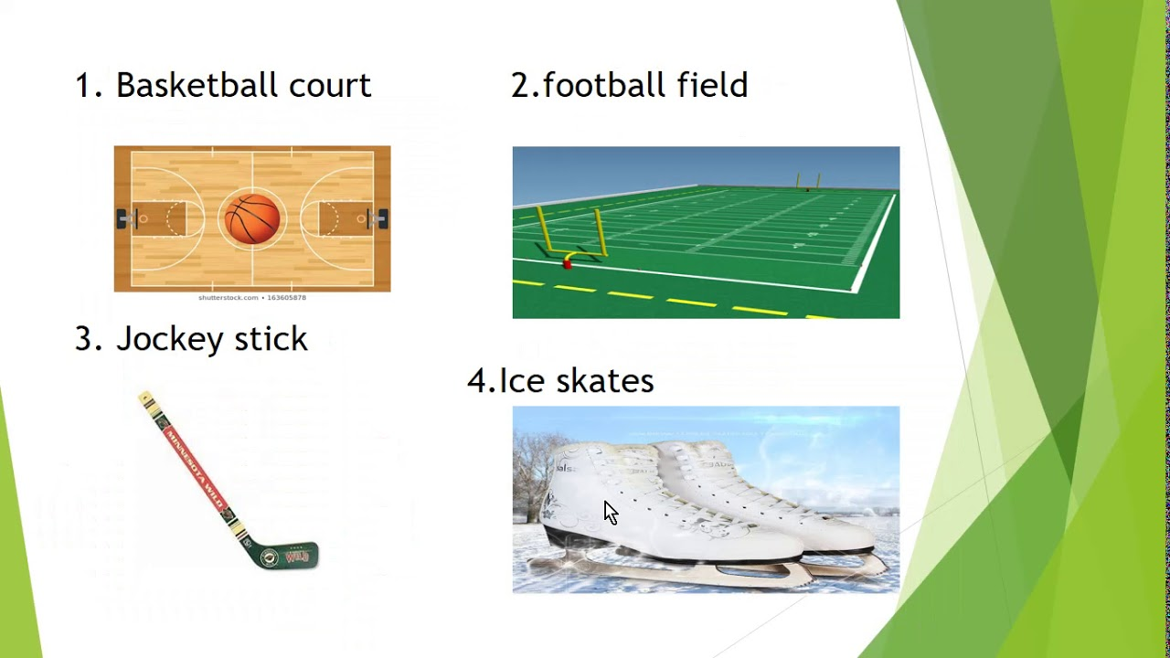

Slide 5
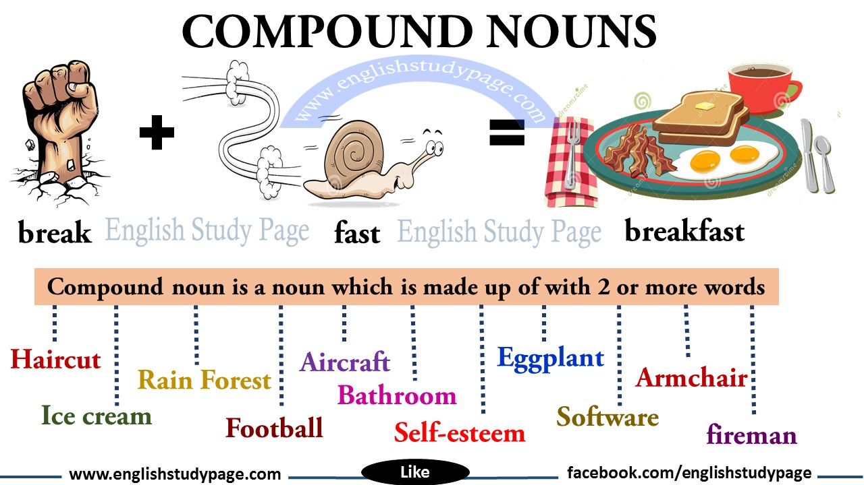

Slide 6
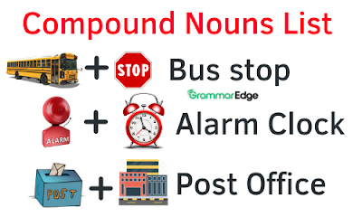

Slide 7
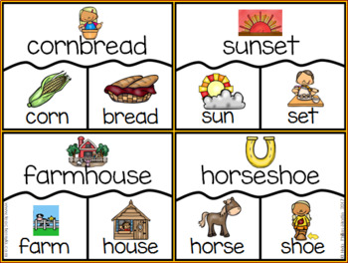

Slide 8
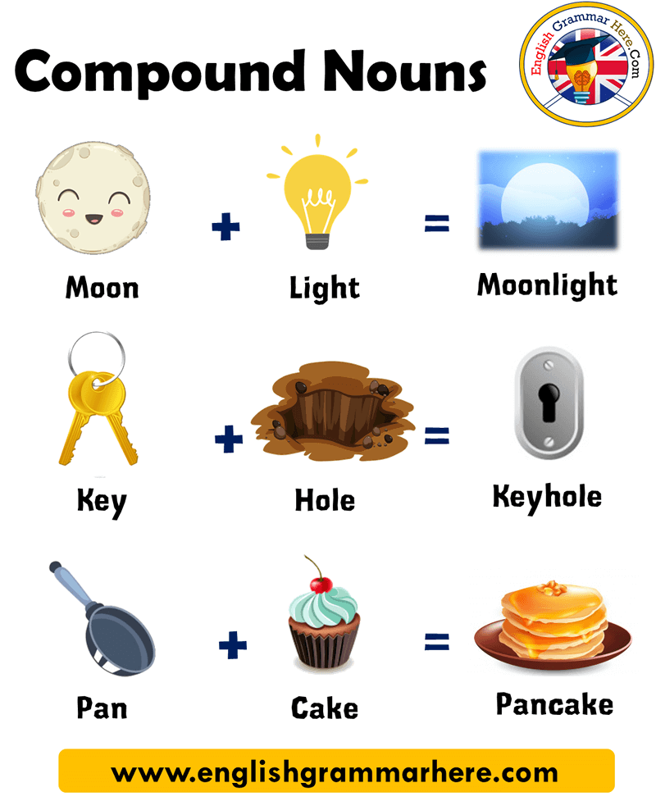

Slide 9
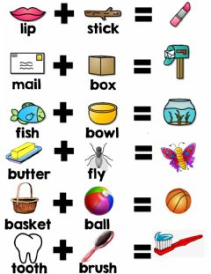

Slide 10
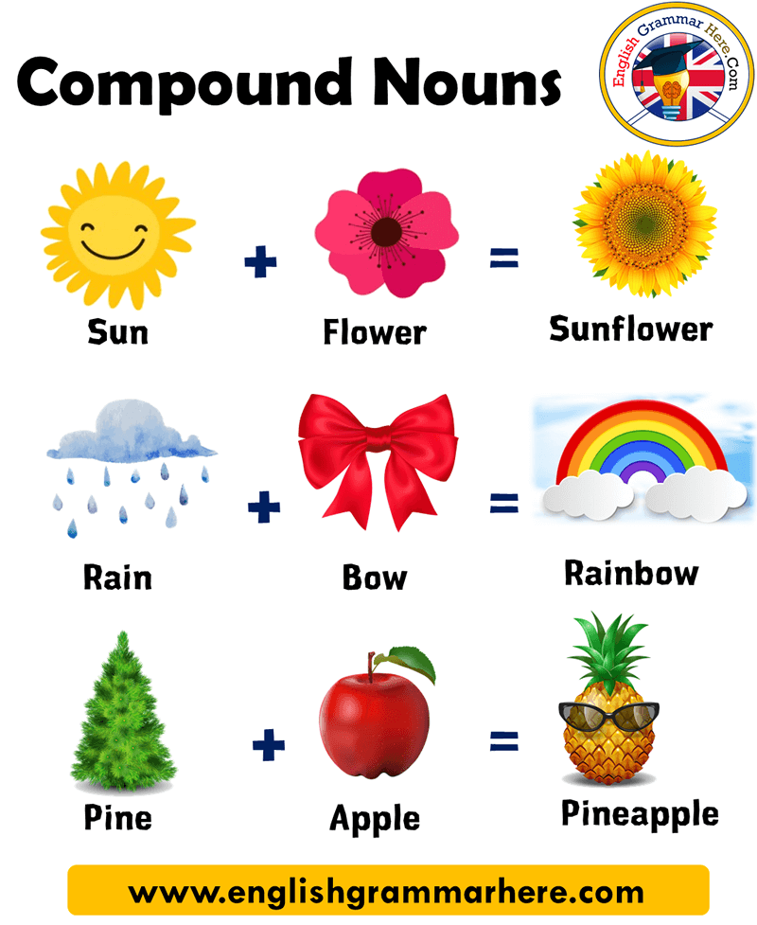

Slide 11
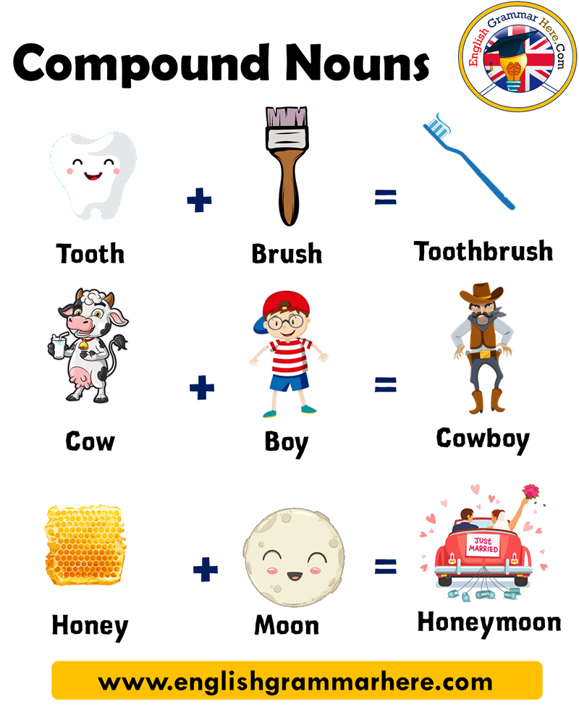

Slide 12
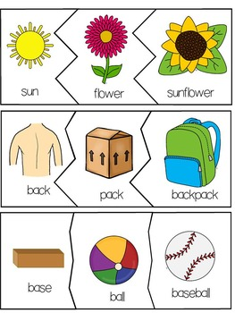

Slide 13
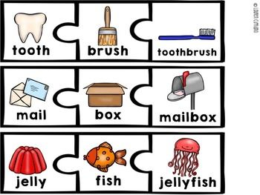

Slide 14
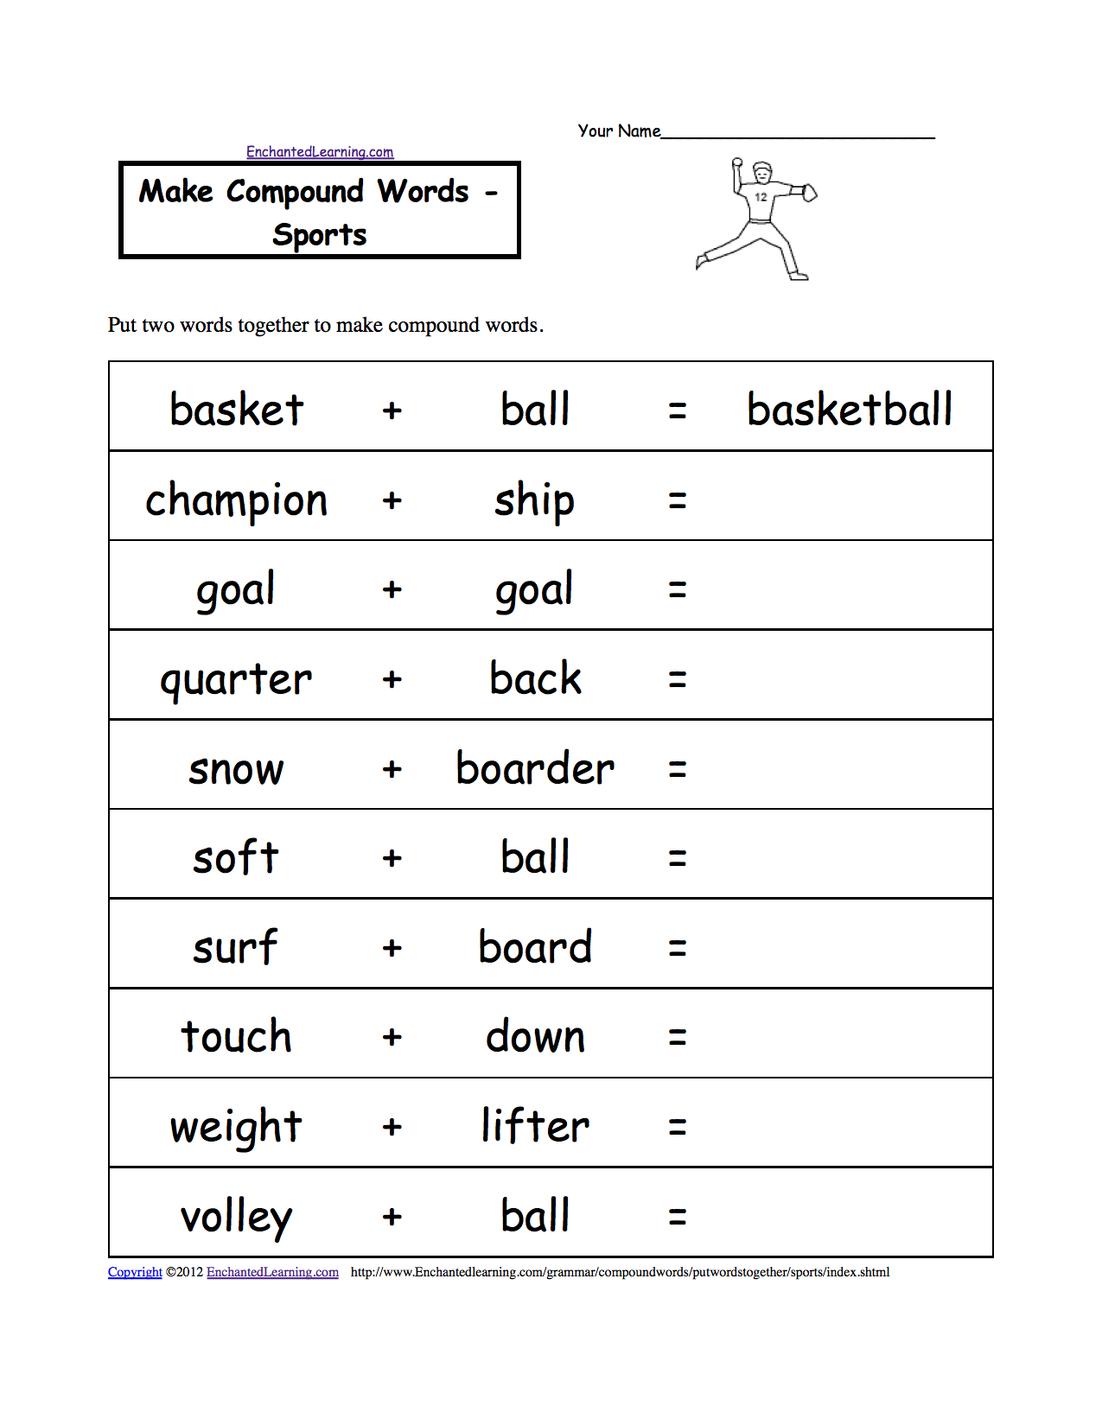

Slide 15
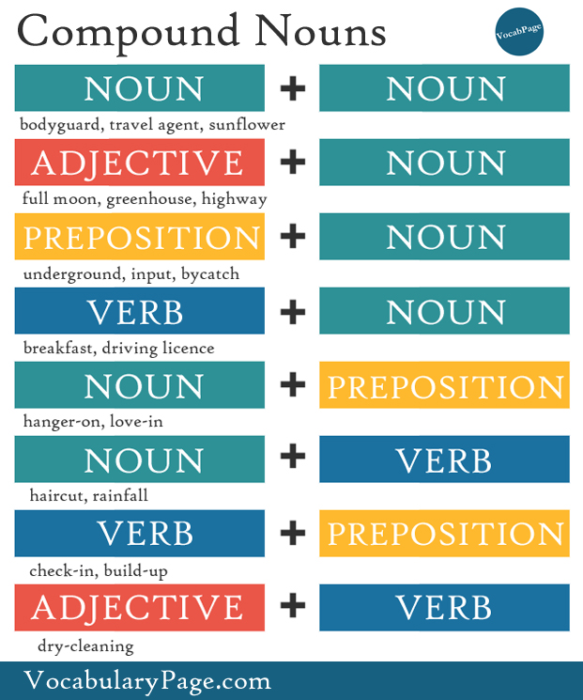

Slide 16
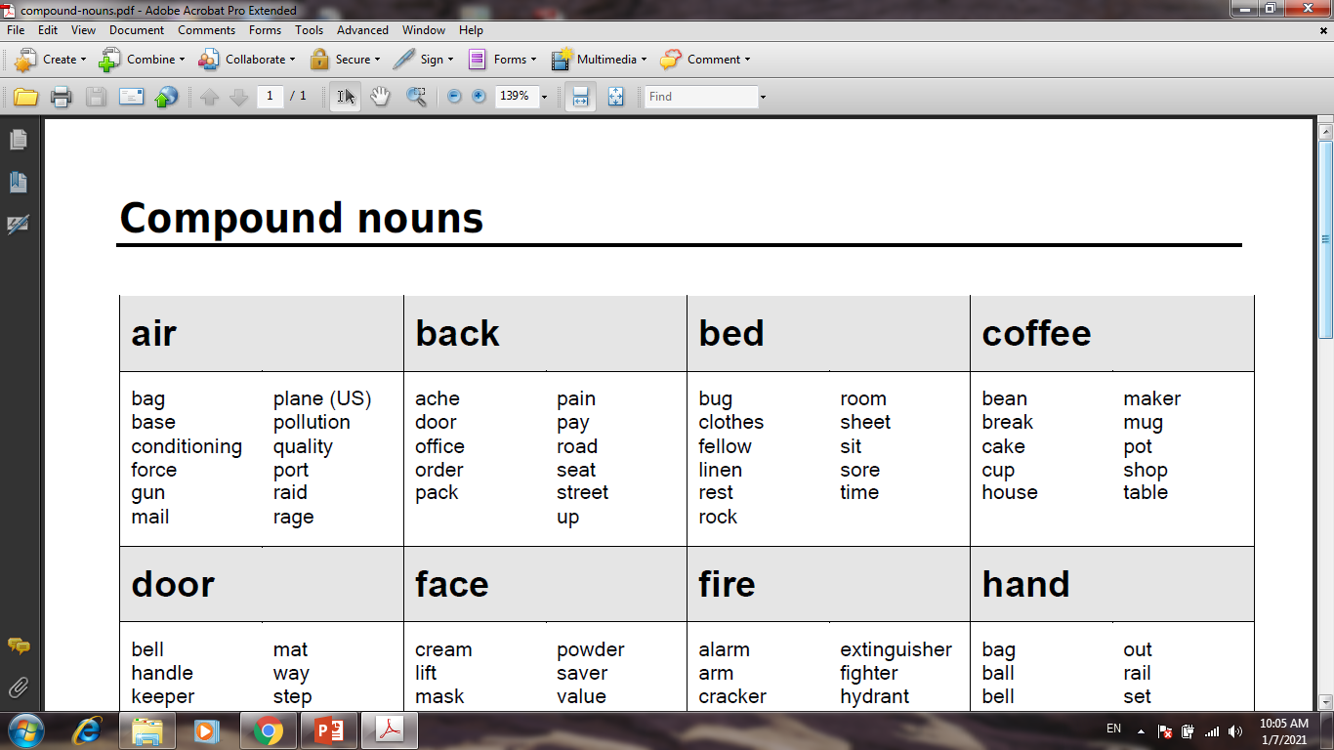

Slide 17
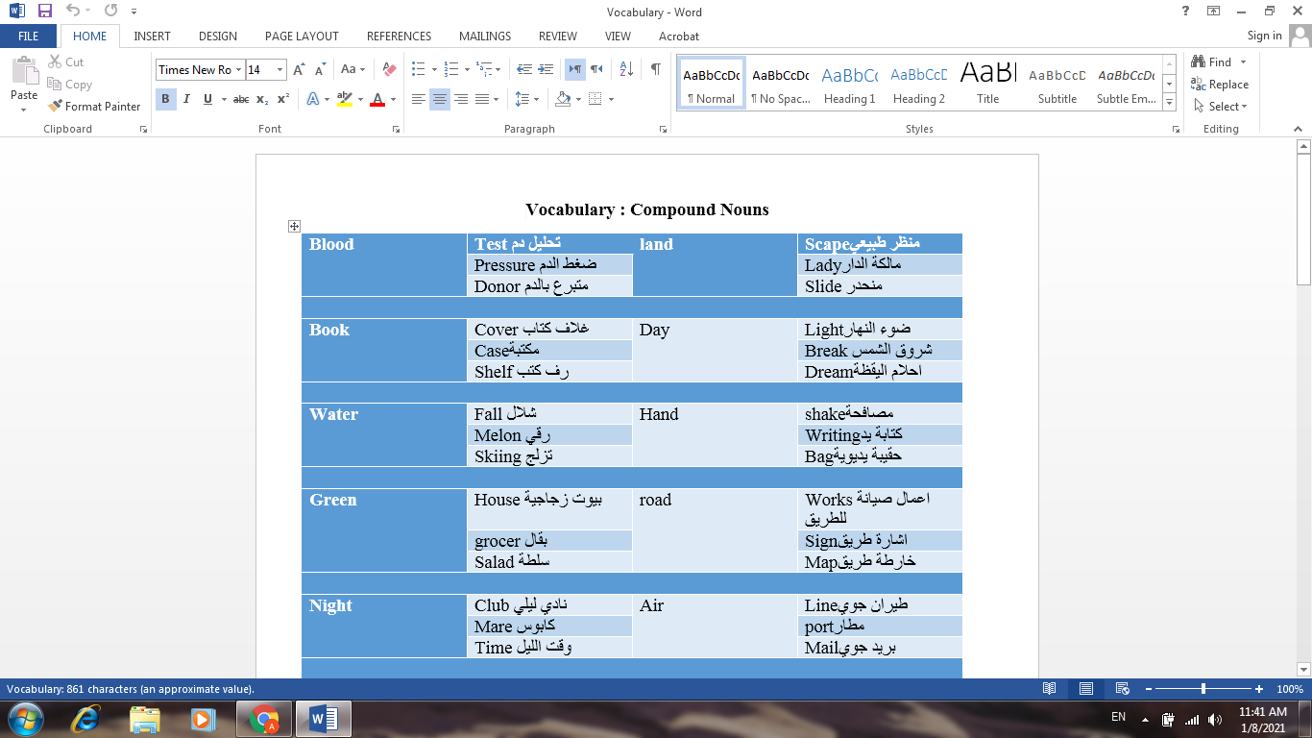

Slide 18
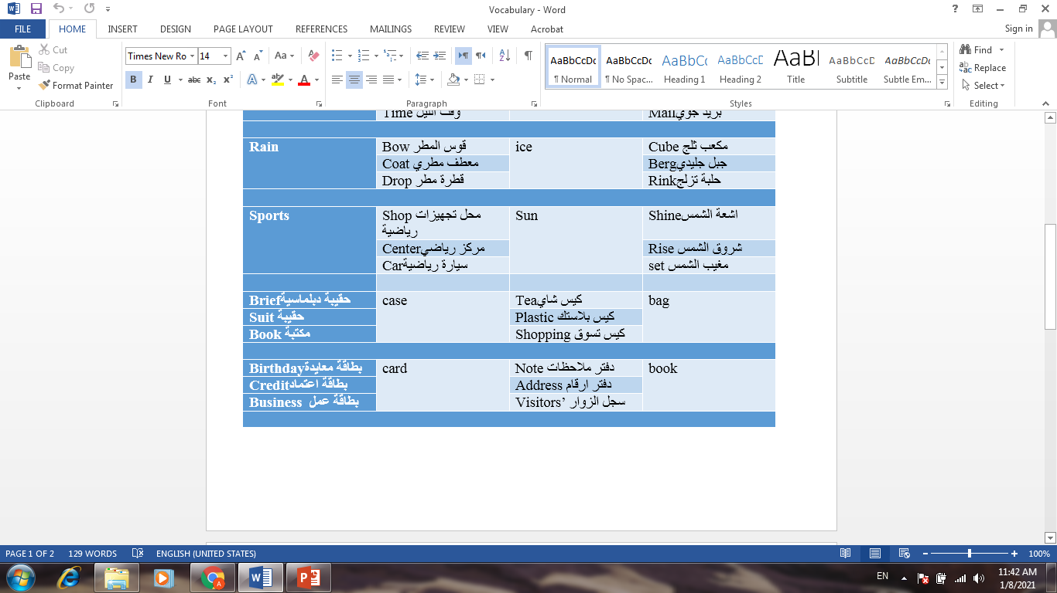

Slide 19
life
Lifestyle اسلوب حياة
Lifelongطوال الحياة
Life –sizeبحجم الحياة
Life expectancyتوقعات الحياة
Life insurance التامين على الحياة

Slide 20
Home
Homeworkواجب بيتي
Homegrown زرع في المنزل
Homepage الصفحة الرئيسية
Homelessمشرد
Homemadeصنع في المنزل
Hometownالمدينة مسقط الرأس
Homesick الحنين الى الوطن
Homecoming احتفال بالطلبة في مدارسهم الاعدادية بعد تخرجهم بسنوات

Slide 21
House
Housewifeربة بيت
Housewarming الترحيب بالساكن الجديد
House – proud معتزا بمنزله
Housebound محجوزفي المنزل
House plant نبات منزلي
House - made صنع في المطعم
Houseworkاعمال المنزل

Slide 22
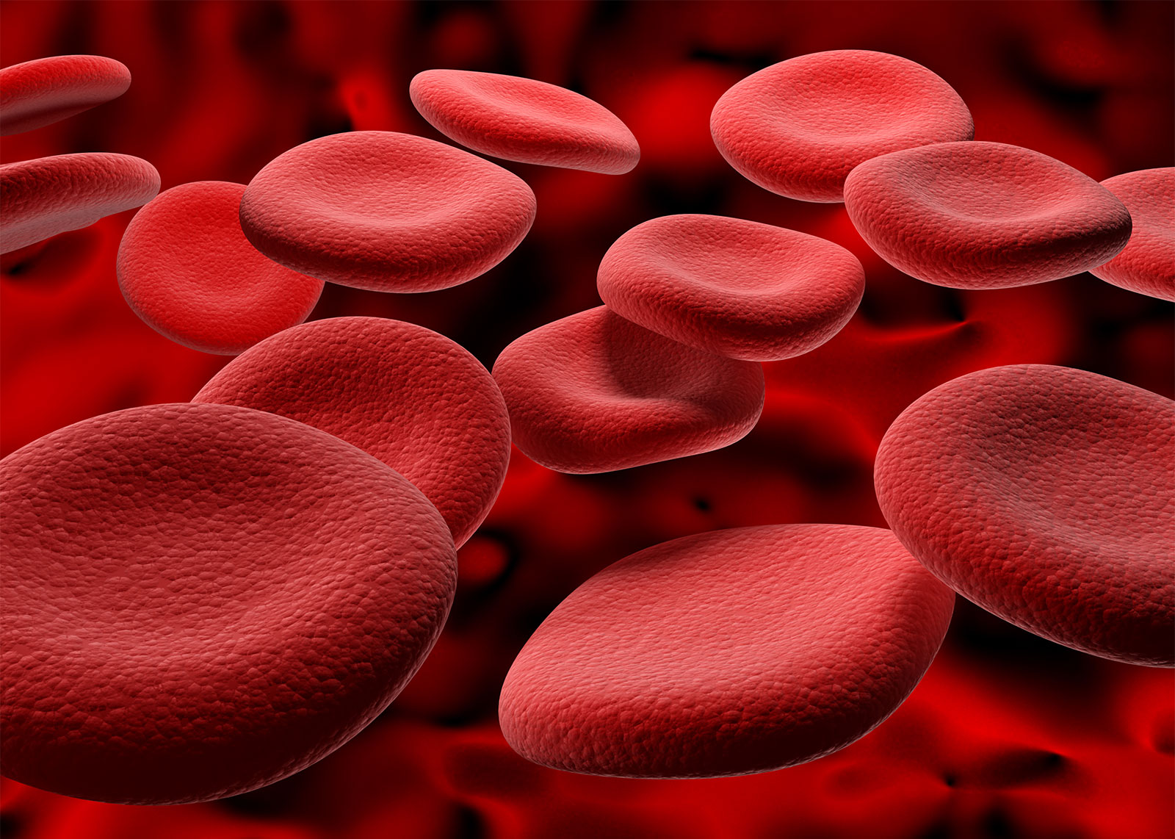
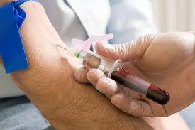
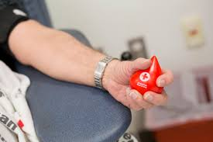

Blood
Blood tests
Blood pressure
Blood donor

Slide 23

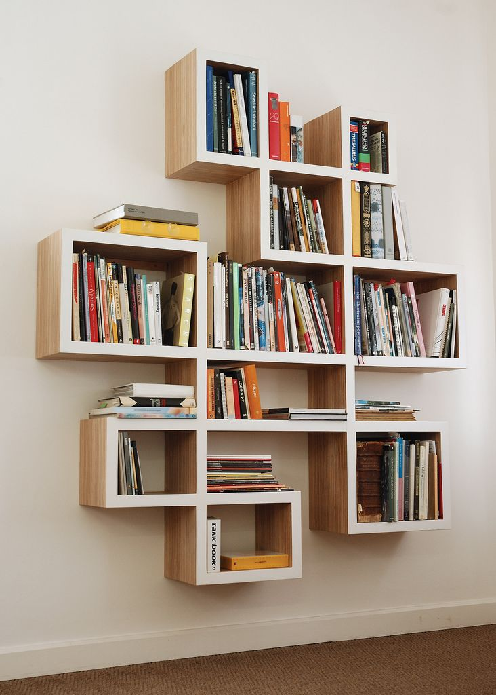
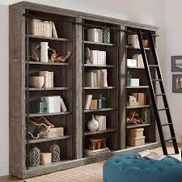

Book book cover bookcase book shelf

Slide 24
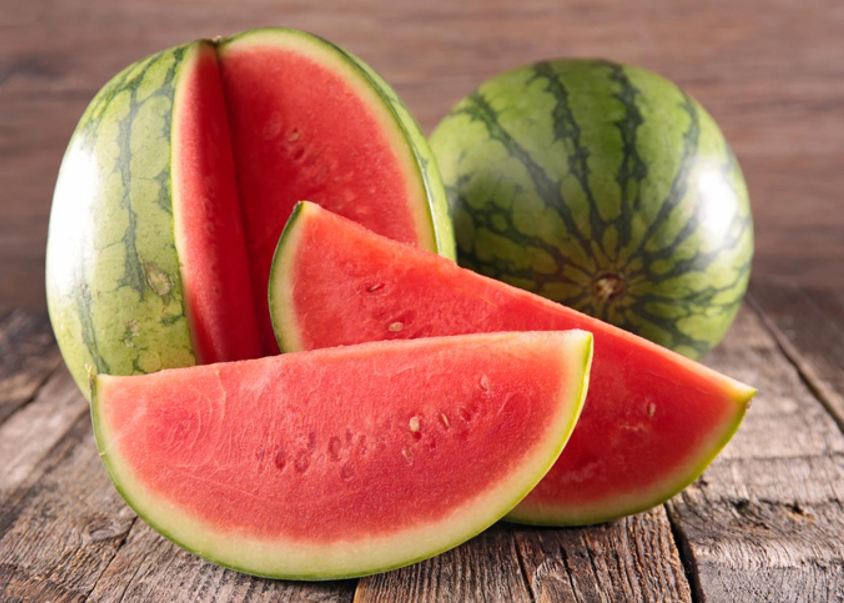



water
Waterfall
Watermelon
Water skiing

Slide 25

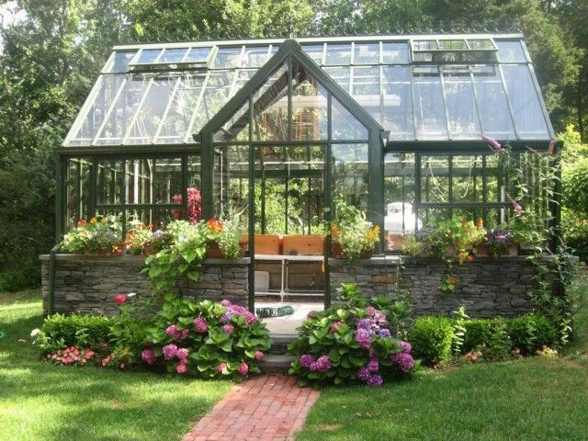
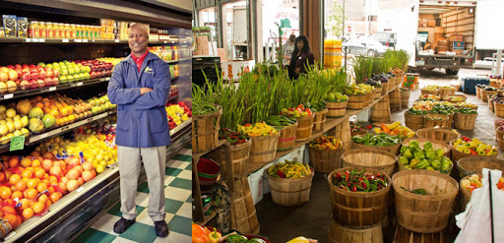
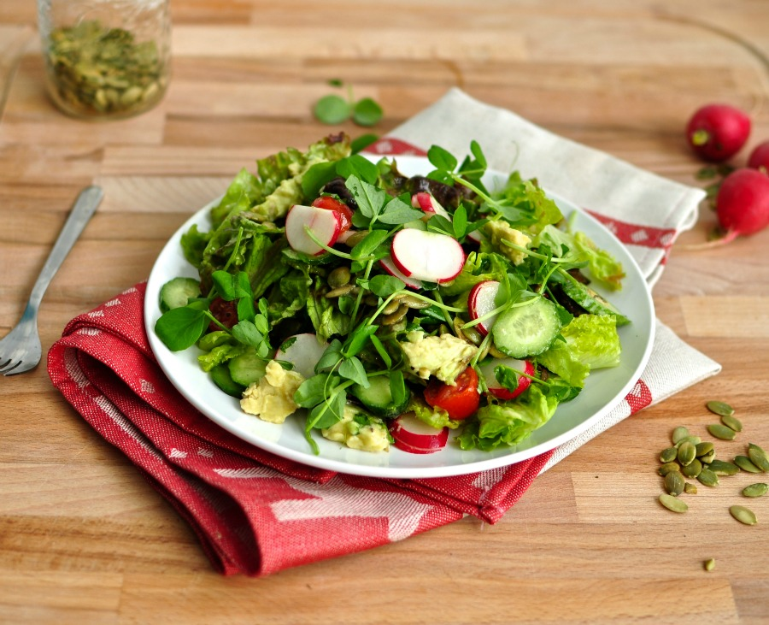
Green
Green house
Green grocer
Green salad

Slide 26
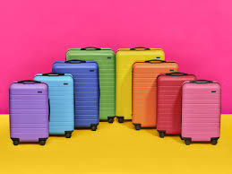
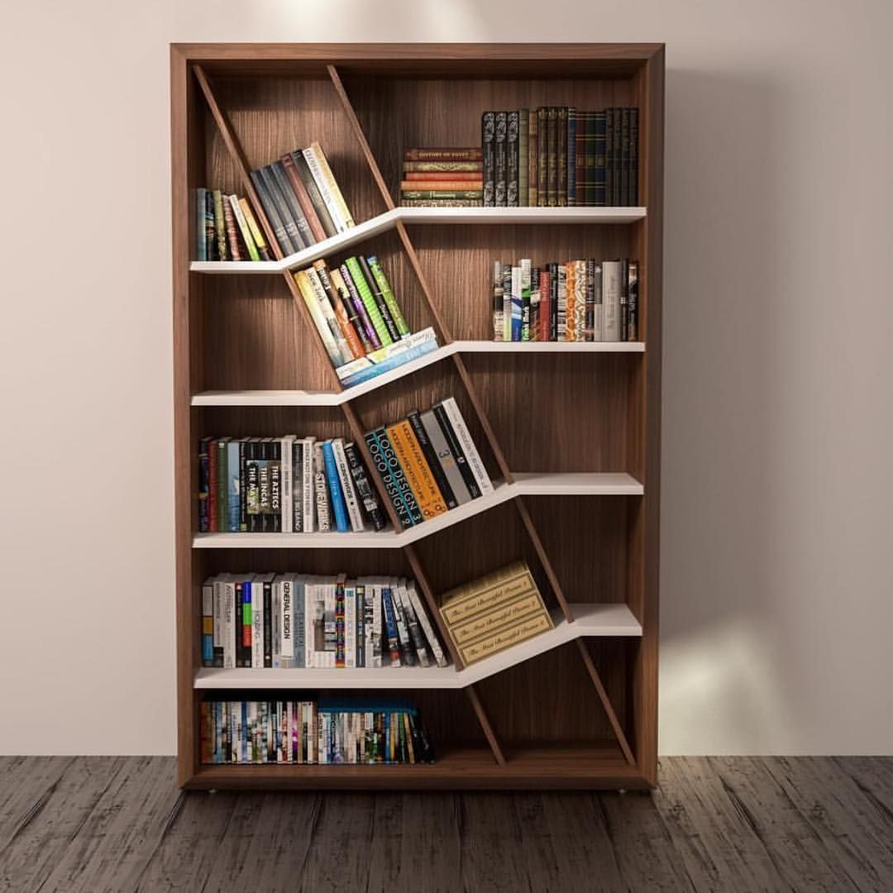
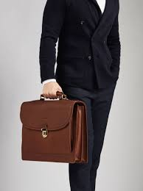
Case
Briefcase
Suitcase
Bookcase

Slide 27

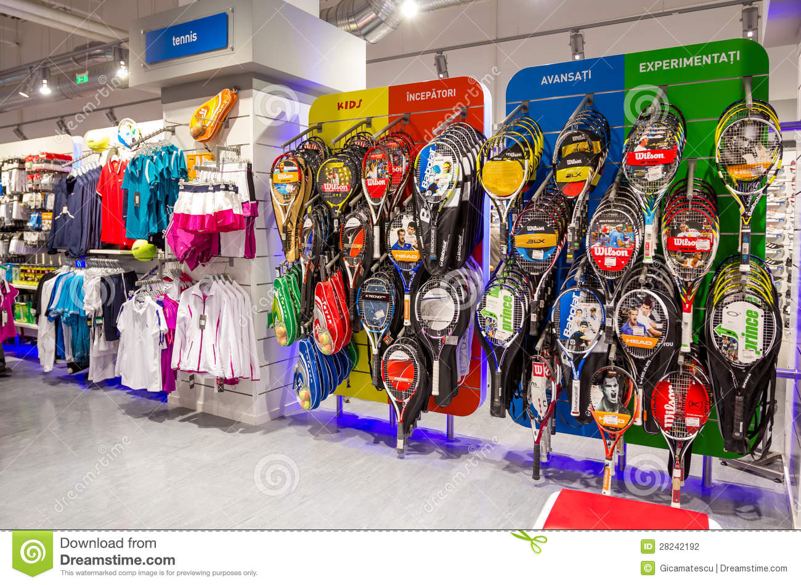
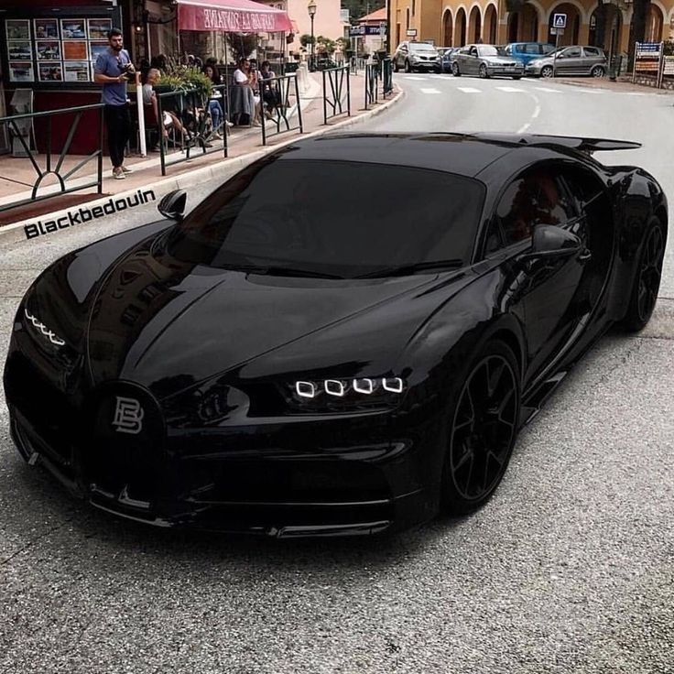

Sports
Sports car
Sport center
Sport shop

Slide 28


Slide 29
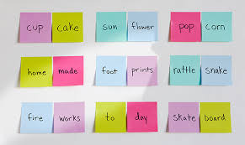

Slide 30
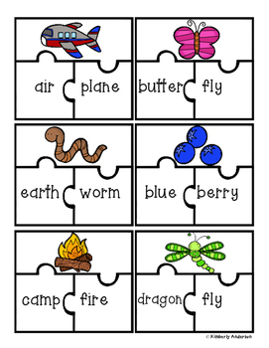
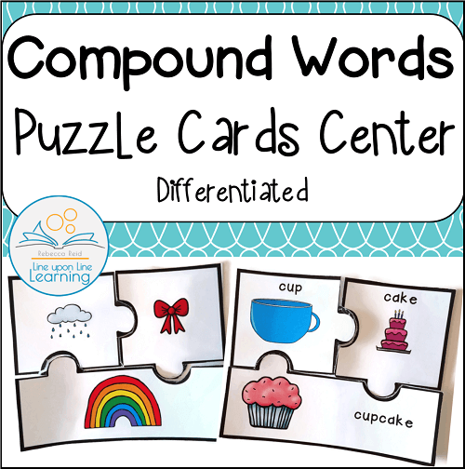

Slide 31

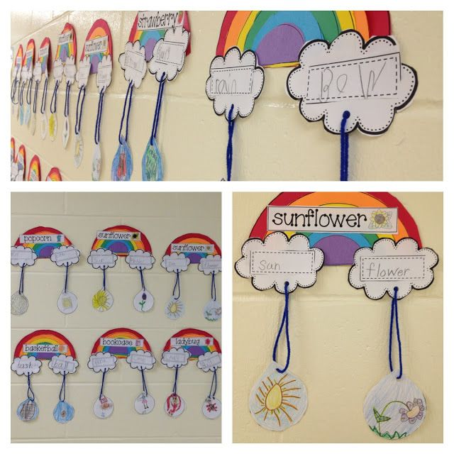
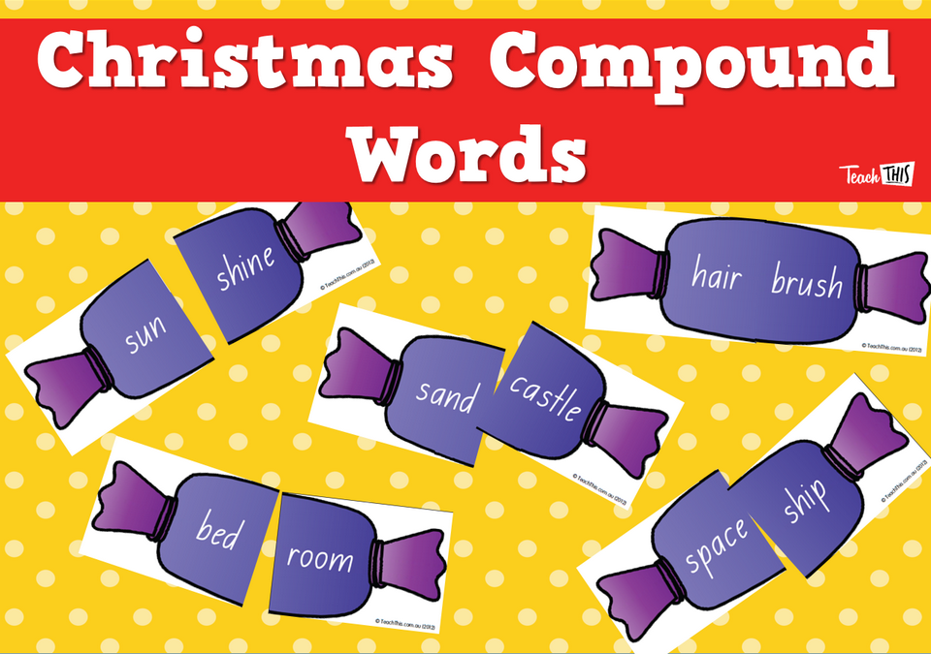

Slide 32
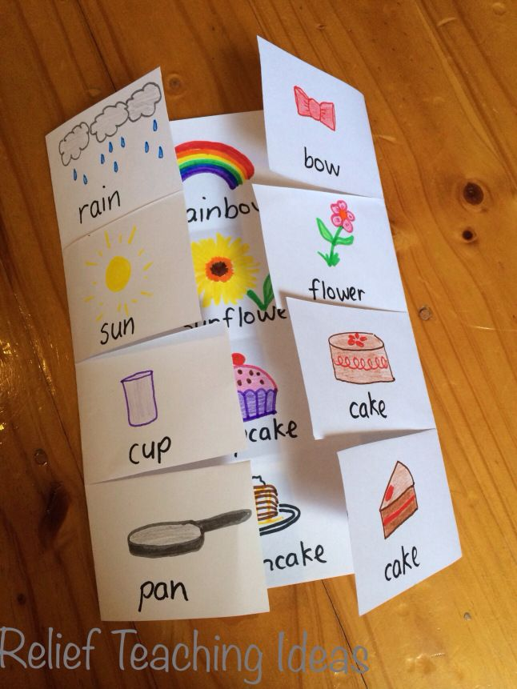

Slide 33
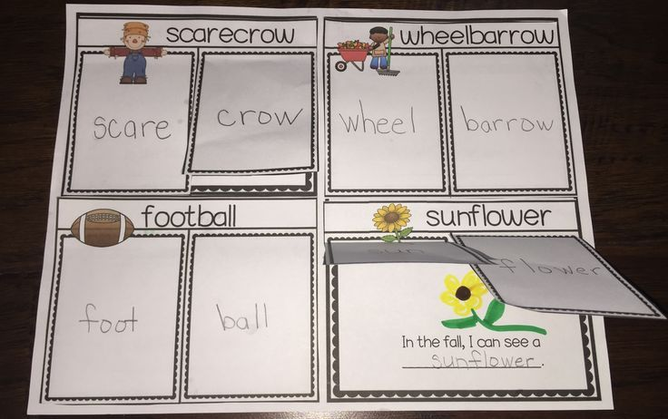

Slide 34


Slide 35
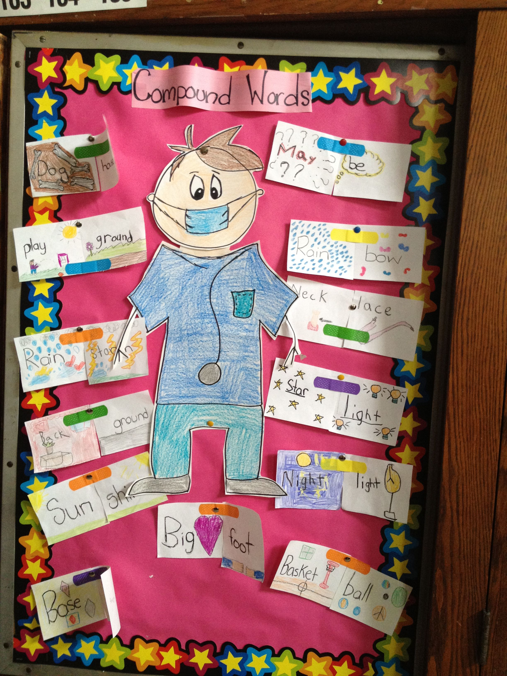

Slide 36
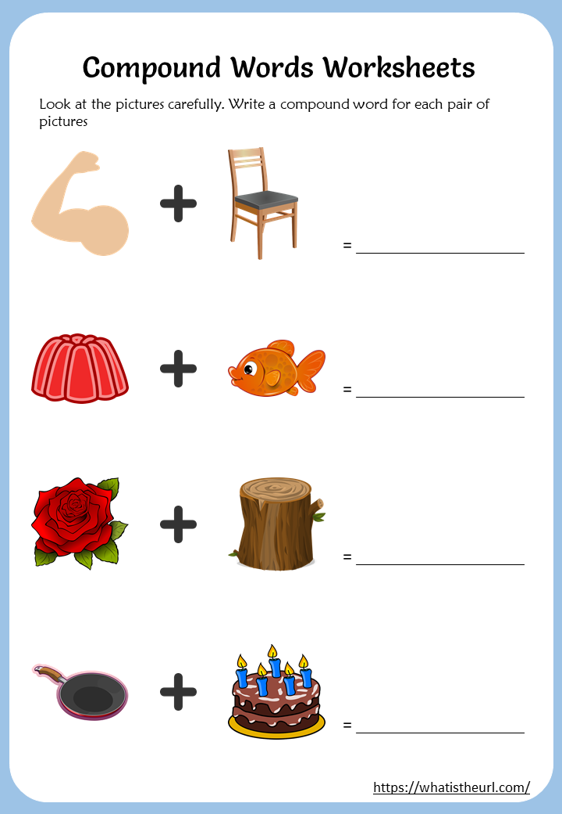

Slide 37


Slide 38


