Slide 1
Anatomy of Female Urogenital System And Clinical Application
Assistant professor
Dr. shaymaa Kadhim

Slide 2
GENITAL PROLAPSE
Common complaint of elderly woman
Mostly in post menopausal and multiparous women
In prolapse straining causes protrusion of vaginal walls at vaginal orifices
Extreme cases uterus may be protrude

Slide 3
Normal axis
Axis of the uterus and vagina: anteverted and anteflexed

Slide 5
PELVIC SUPPORTS
PELVIC FLOOR
Comprises
Pelvic diaphragm
Endopelvic fascia
Perineal membrane
Perineal body

Slide 6
PELVIC DIAPHRAGM

Slide 8
Uterine ligaments

Slide 9
PERINEAL BODY

Slide 10
The pelvic structures are divided into 3 compartments :
Anterior : urethra /bladder
Middle : uterus/vault
Posterior : rectum/anus

Slide 11
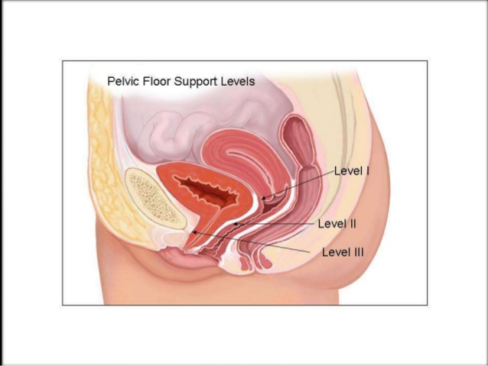
Levels of support of uterus DeLancey's three levels of support
3 levels

Slide 13
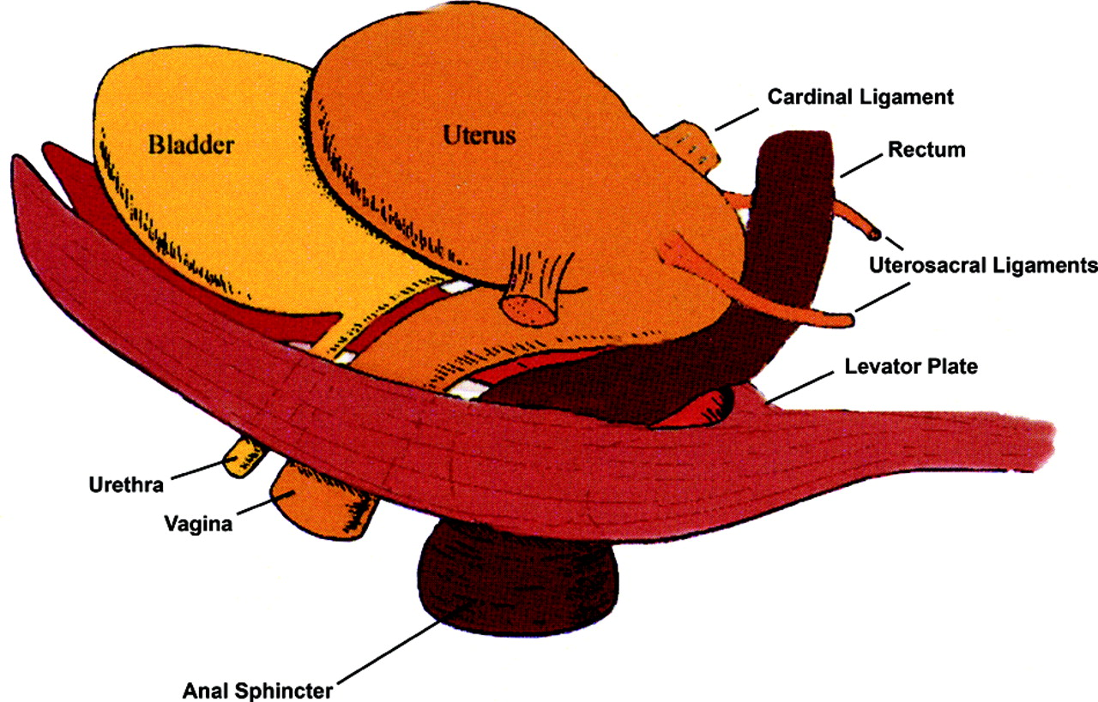
Level 1 (suspensory axis)
Level I- Uterosacral and cardinal ligaments
support the uterus and vaginal vault.

Slide 14
Round ligament
(mackenrodts lig / transverse/lateral cevical cervical ligament at the base of broad lig with uterine A & V

Slide 15
Defects in level 1
Uterovaginal UV prolapse
Enterocele
Vault prolapse

Slide 16
Level 2 (attachment axis)
Level II- Pelvic fascias and paracolpos
Fascial septae connects mid vagina to the pelvic sidewalls
Anteriorly
Pubocervical
Posteriorly
Rectovaginal facia
which connects the vagina to the white line on the lateral pelvic wall through arcus tendinous

Slide 18
Defects in level2
Paravaginal & para rectal defects

Slide 19
Level 3 (fusion axis )
Level III-Levator ani muscle
supports the lower one-third of vagina.
Anteriorly
Urethra
Urogenital diaphragm
Pubis
laterally
Levator ani fascia
Posteriorly
Perineal body

Slide 22
Etiology
birth injury
Prolonged bearing down in the second stage
Delivery of a big baby
Rapid succession of pregnancies
Lack of rest in peuperium
Peripheral nerve injury
raised intra-abdominal pressure
Surgeries
Congenital

Slide 23
prolapse of menopausal age when the pelvic floor muscles
d/t oestrogen deficiency and decreased collagen content in fascias→ atonicity and asthenia

Slide 24
Causes related to child birth
Birth injury
excessive stretching of the pelvic floor muscles and ligaments
overstretching causes atonicity
whereas torn muscle could be stitched or toned up
Perineal tear is less harmful than overstretching

Slide 25
Raised intra abdominal pressure
chronic bronchitis,
large abdominal tumours or
obesity
Smoking,
chronic cough and
constipation

Slide 26
Prolapse in unmarried or nulliparous women
spina bifida occulta and
split pelvis
Collagen vascular diseases

Slide 27
Surgeries
Abdominoperineal excision of the rectum and
radical vulvectomy
Operations for stress incontinence such as Stamey and Pereyra operations

Slide 28
Classification of prolapse
Anterior vaginal wall(anterior compartment)
Upper two-third-Cystocele
Lower one-third-Urethrocele
Middle compartment
Uterine descent
Posterior compartment
Upper one-third-Enterocele (pouch of Douglas hernia)
Lower two-third-Rectocele

Slide 30
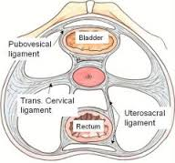
Cystocele
the vesical and vaginal fasciae are thinned out and fail to support the bladder, so that the bladder prolapses with the anterior vaginal wall.

Slide 31
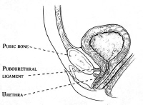
Urethrocele
When the urethra along with the lower one-third of the anterior wall prolapses (failure of pubocervical ligament
Rare
stress incontinence

Slide 32
Signs
Assessment of prolapse
In lithotomy position
Look for stress incontinence on a full bladder
patient is asked to strain / perform valsalva manoeuvre
Stress incontinence
Vulva examined for perineal laceration
Three compartments evaluated separately;
decubitus ulcer

Slide 33
Per speculum examination
Anterior compartment
Sim’s speculum retracting posterior vaginal wall
Middle compartment
Degree of descent
Posterior compartment
Sim’s speculum retracting anterior vaginal wall
Look for cystocele
Lateral cystocele or paravaginal defect
Urethrocele } stress incontinence
Ulceration of cervix
Vagina may show keratinisation
Vaginal examination – length of cervix,position and mobility of uterus,any adnexal mass
Cervical cytology
Enterocele – bulge appears from above downwards
Rectal examination – impulse on
tip of finger- enterocele
pulp - rectocele
Bimanual examination- r/o pelvic mass

Slide 34
Pelvic floor muscles
Pubococcygeus part of levator ani assessed at 4 and 8o’clock position
Perineal body
Rectal examination – tone of anal sphincter

Slide 35
Lab investigations
Hb
Urine examination,Urine culture,Xray,ECG
High vaginal swab in cases of vaginitis
RFT in long standing prolapse
Urodynamic investigations in case of incontinence
USG to pelvic mass and hydronephrosis
IVP }massive prolapse
CT/MRI}

Slide 36
Differential diagnosis
Vulval cyst or tumour
Cysts of anterior vaginal wall
Urethral diverticula
Congenital elongation of cervix
vaginal portion of the cervix is elongated and
no vaginal prolapse.
deep fornices
Cervical fibroid polyp
Chronic inversion

Slide 37
COMPLICATIONS OF PROLAPSE
Kinking of ureter with resulting renal damage
Surgical injury to ureter
Urinary tract infection (chronic) in large cystocele with residual urine
decubitus ulcer and keratinisation pigmentation
if ring pessary is left in over a long period malignancy

Slide 38
Prophylaxis
Antenatal physiotherapy ,relaxation exercises, attention to weight gain and anaemia
Proper supervision and management of second stage of labour
A generous episiotomy
Low forceps delivery if there is delay in second stage
Suture perineal tear
Postnatal exercises and physiotherapy
early postnatal ambulation
Adequate spacing of births
Avoid multiparity
Prophylatic HRT in postmenopausal women

