Slide 1
Post covid mucor mycosis
ا م د وفاق الوتار

Slide 2
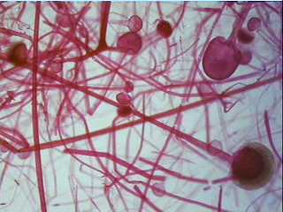

Slide 3
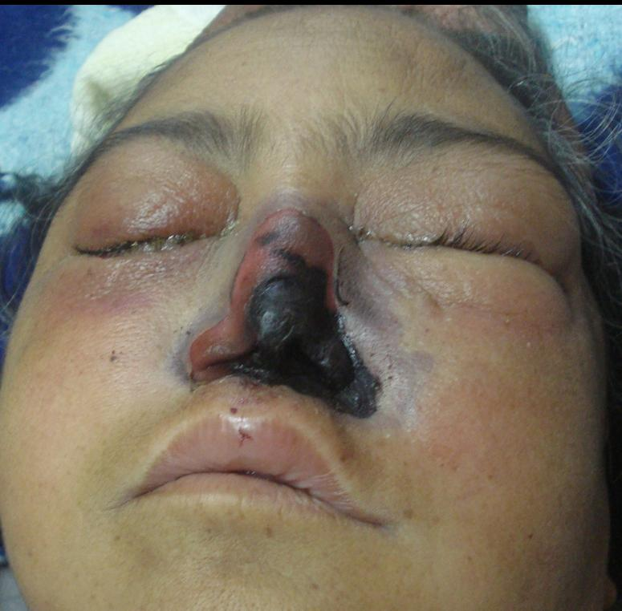

Slide 4
MUCOR MYCOSIS
Phycomycosis or zygomycosis was first described in 1885 by Paltauf
and later coined as Mucormycosis in 1957 by Baker ,] an American pathologist for an aggressive infection caused by Rhizopus. Mucormycosis is an uncommon but a fatal fungal infection that usually affects patients with altered immunity.
Mucormycosis is an angioinvasive disease caused by mold fungi of
genus Rhizopus, Mucor,
Rhizomucor,Cunninghamella
and Absidia of Order- Mucorales, Class- Zygomycetes.
The Rhizopus Oryzae is most common type and responsible for nearly 60% of mucormycosis cases in humans and also accounts for 90% of the Rhino-orbital-cerebral (ROCM) form.
Mode of contamination occurs through the inhalation of fungal spores.

Slide 5
There are increasing case reports of rhino-orbital mucormycosis in people with coronavirus disease 2019 (COVID-19), especially from India. Diabetes mellitus (DM) is an independent risk factor for both severe COVID-19 and mucormycosis.

Slide 6
Overall, 101 cases of mucormycosis in people with COVID-19 have been reported, of which 82 cases were from India and 19 from the rest of the world. Mucormycosis was predominantly seen in males (78.9%), both in people who were active (59.4%) or recovered (40.6%) from COVID-19. Pre-existing diabetes mellitus (DM) was present in 80% of cases, while concomitant diabetic ketoacidosis (DKA) was present in 14.9%. Corticosteroid intake for the treatment of COVID-19 was recorded in 76.3% of cases. Mucormycosis involving nose and sinuses (88.9%) was most common followed by rhino-orbital (56.7%). Mortality was noted in 30.7% of the cases.

Slide 7
Coronavirus disease 2019 (COVID-19) caused by severe acute respiratory syndrome coronavirus 2 (SARS-CoV-2) has been associated with a wide range of opportunistic bacterial and fungal infections. Both Aspergill us and Candida have been reported as the main fungal pathogens for co-infection in people with COVID-19. Recently, several cases of mucormycosis in people with COVID-19 have been increasingly reported world-wide, in particular from India.

Slide 8
The primary reason that appears to be facilitating Mucorales spores to germinate in people with COVID-19 is
an ideal environment of low oxygen (hypoxia), high glucose (diabetes, new-onset hyperglycemia, steroid-induced hyperglycemia),
acidic medium (metabolic acidosis, diabetic ketoacidosis [DKA]),
high iron levels (increased ferritins)
and decreased phagocytic activity of white blood cells (WBC) due to immunosuppression
(SARS-CoV-2 mediated, steroid-mediated or background comorbidities) coupled with several other shared risk factors:
including prolonged hospitalization
with or without mechanical ventilators.

Slide 9
PATHOGENISIS
These findings need a relook in the context of COVID-19 pandemic where corticosteroids are often being used. There has been a steep rise in case reports/series of mucormycosis in people with COVID-19 especially from India. Similarly, many cases are being reported from other parts of globe. Several anecdotal cases are also being reported in grey literature such as the print and electronic media. These finding are unprecedented and carry an immense public health importance, primarily because fatality rate with mucormycosis is pretty high. Especially the intracranial involvement of mucormycosis increases the fatality rate to as high as 90% [15]. Moreover, rapidity of dissemination of mucormycosis is an extraordinary phenomenon and even a delay of 12 h in the diagnosis could be fatal, the reason 50% of cases of mucormycosis have been historically diagnosed only in the post-mortem autopsy series

Slide 10
INDIAN Results
Mombain 17
Chandahare 1
Mangalare 11
puducheng 10
Bangalore38
jaipor 23 death 20
Others rcoverd or improved

Slide 11
Universal results
India | 82 (81.2) | Highest cases reported from India. ≈ denotes nearest rounded of value.
USA | 9 (8.9)
Iran | 3 (≈3.0)
UK | 1 (≈1.0)
France | 1 (≈1.0)
Italy | 1 (≈1.0)
Brazil | 1 (≈1.0)
Turkey | 1 (≈1.0)
Mexico | 1 (≈1.0)
 | Austria | 1 (≈1.0)

Slide 12
Symptoms and signs
Black, necrotic turbinate's easily mistaken for dried, crusted blood,
(ii) Blood-tinged nasal discharge and facial pain, both on the same side,
(iii) Soft peri-orbital or peri-nasal swelling with discoloration and induration,
(iv) Ptosis of the eyelid, proptosis of the eyeball and complete ophthalmoplegia and, (v) Multiple cranial nerve palsies unrelated to documented lesions

Slide 14
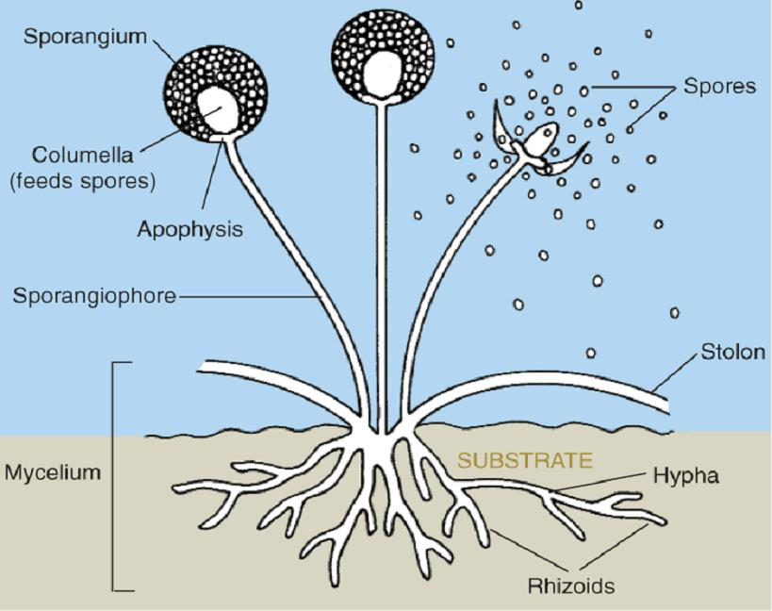
Structure of Rhizopus

Slide 15
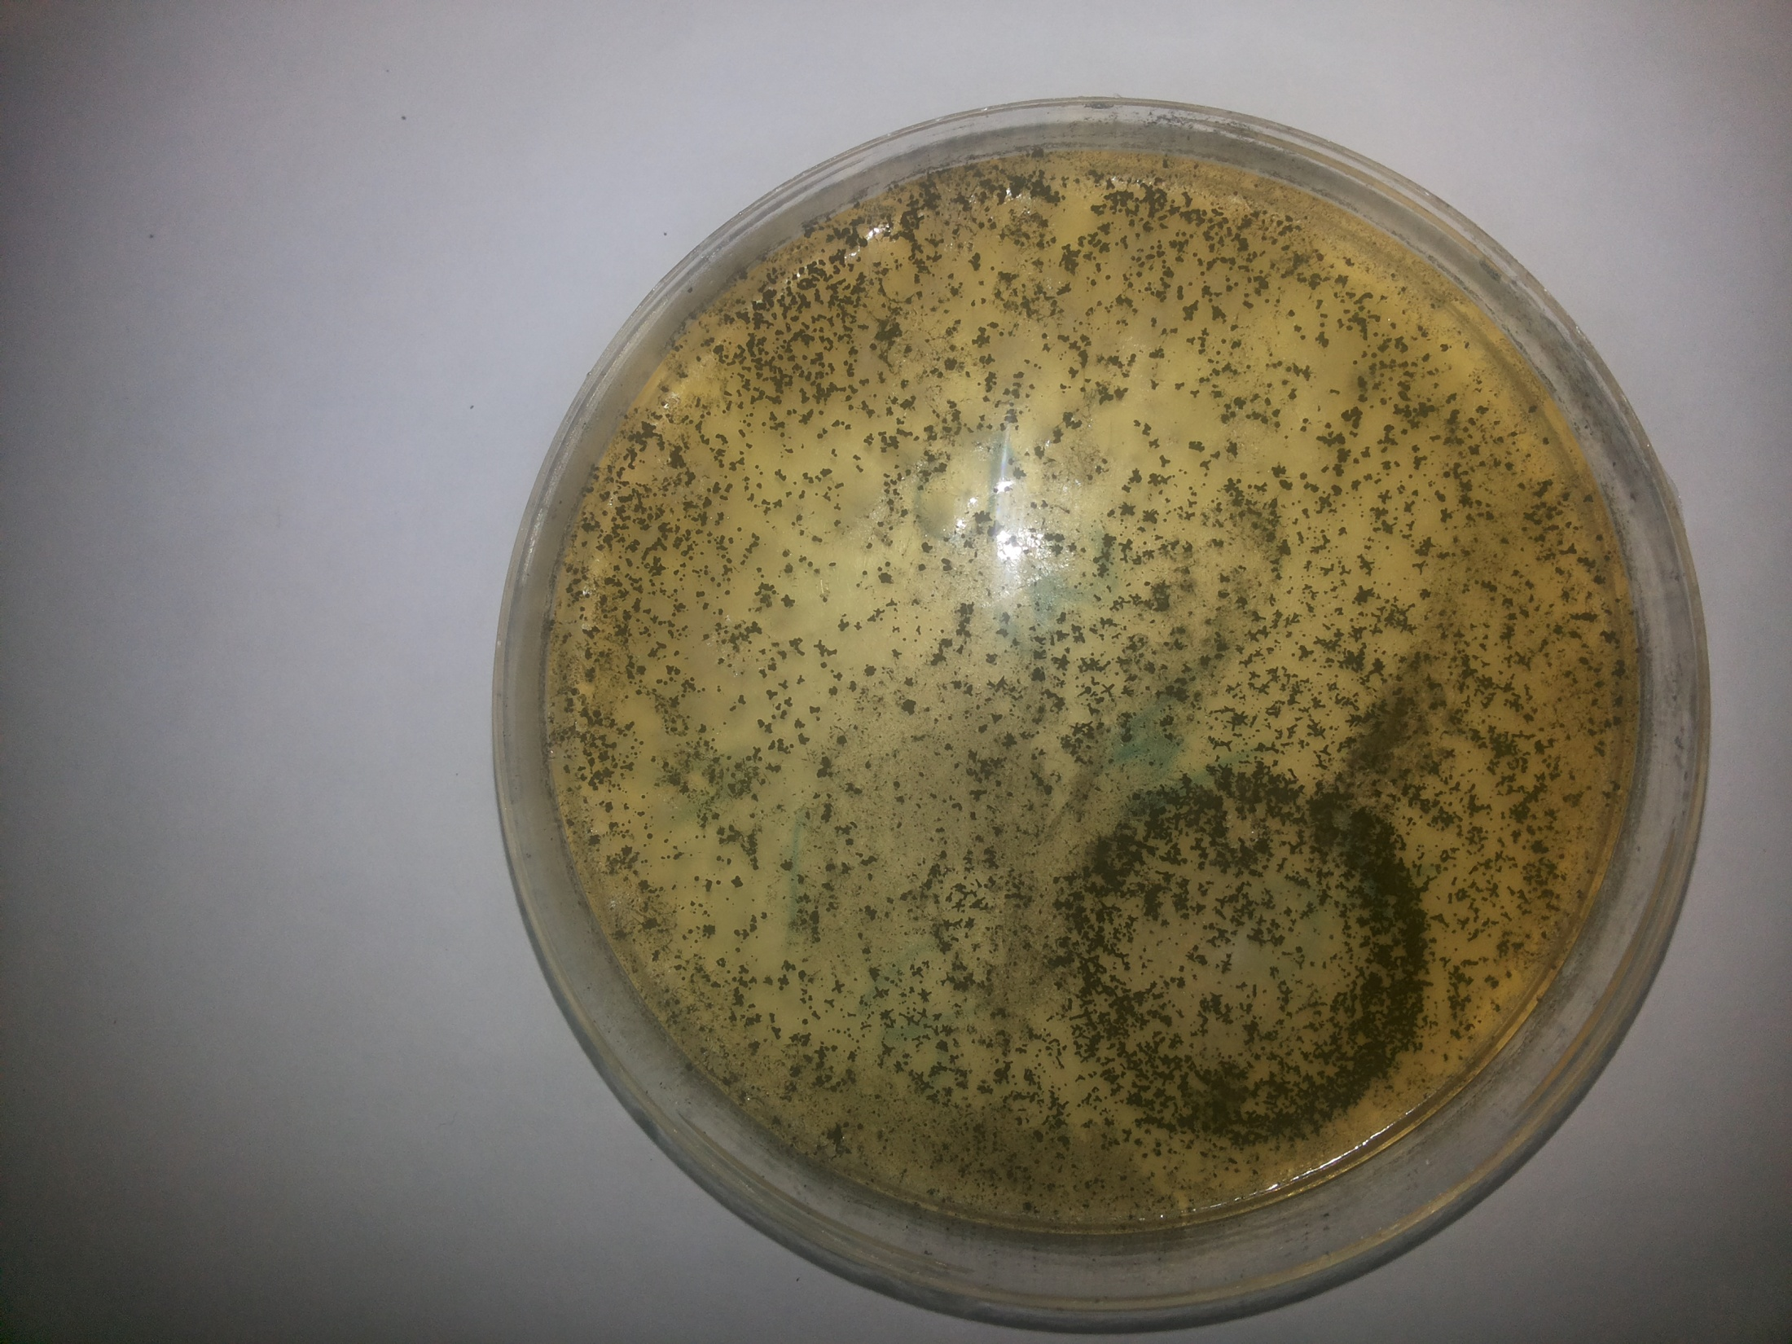
Rhizopus growing on agar

Slide 16
conclusion
Increase in mucormycosis in Indian context appears to be an unholy intersection of trinity of diabetes (high prevalence genetically), rampant use of corticosteroid (increases blood glucose and opportunistic fungal infection) and COVID-19 (cytokine storm, lymphopenia, endothelial damage). All efforts should be made to maintain optimal hyperglycemia and only judicious evidence-based use of corticosteroids in patients with COVID-19 is recommended in order to reduce the burden of fatal mucormycosis

Slide 17
Treatment
-Wound debridement.
-Amphotericin B.
-Control of underlying disease.

Slide 18
Thank you

