Slide 1



Linking Scenarios to Strategic Planning
أ.م.د يعرب عدنان حسين السعيدي

Slide 2
Sensitivity/Risk Assessment:
Strategy Evaluation
Strategy Development: Using a "Planning-Focus
Strategy Development: Without using a "Planning
Skills:

Slide 3
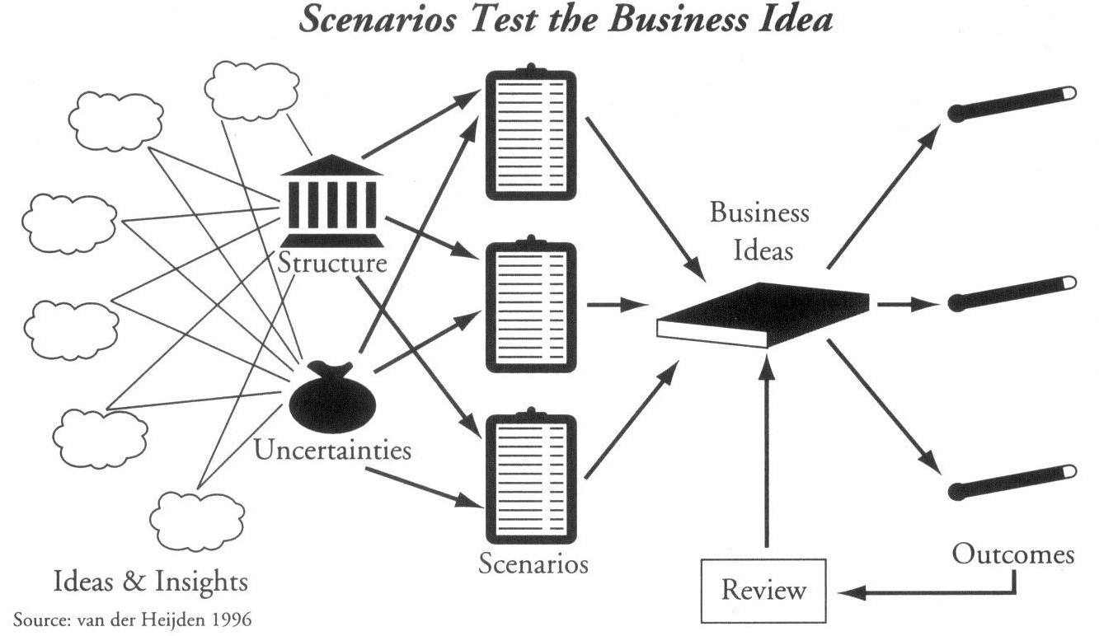

Slide 4
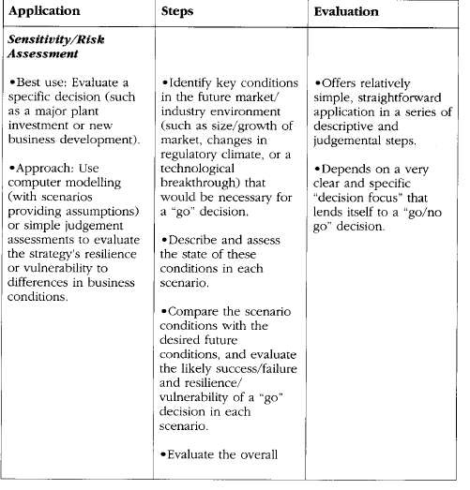

Slide 5
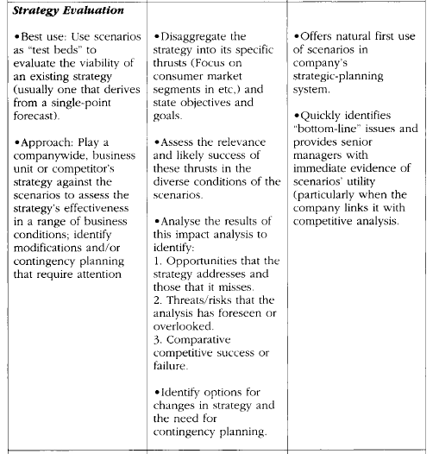

Slide 6
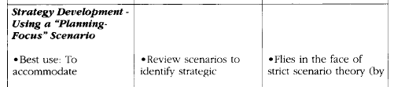
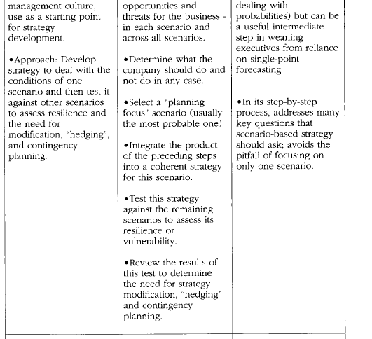

Slide 7
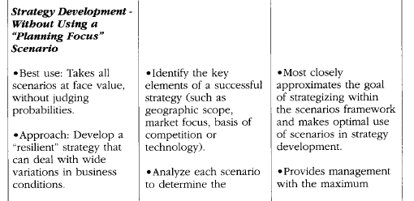
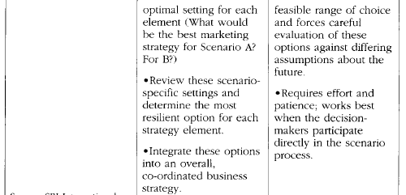

Slide 8
APPLYING THE SCENARIOS TO INFORMATION MARTTS
apply scenarios to the business portfolio
analysed the sectors of the digital Information Industry in 2005
the "innovative" and electronic Coral Reef scenario
less so under the risk-averse Deep Sea scenario.

Slide 9
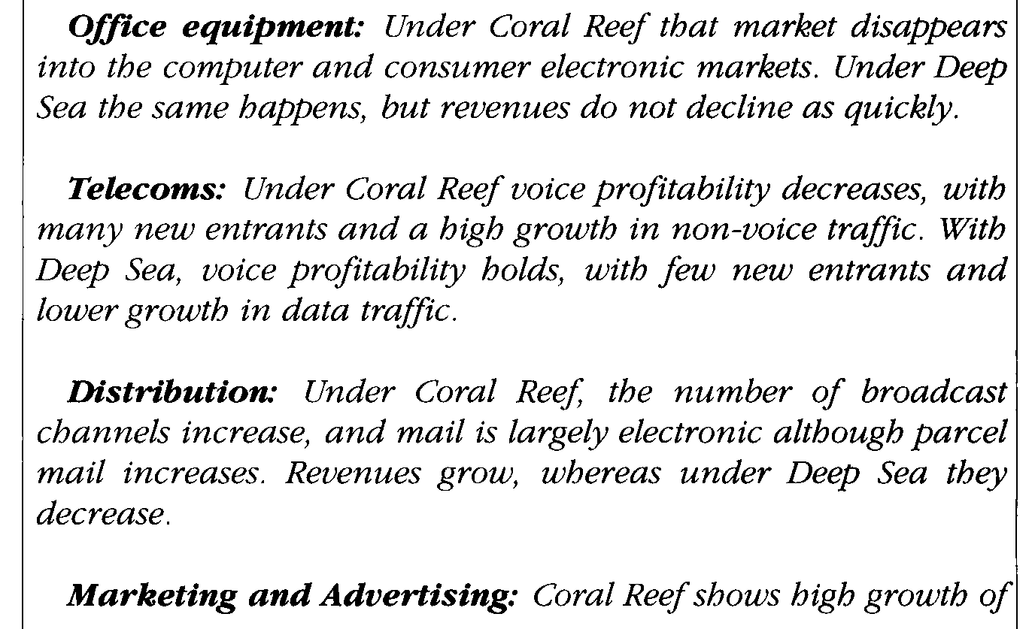
THE EFFECT ON THE INFORMATION INDUSTRY SECTORS

Slide 10
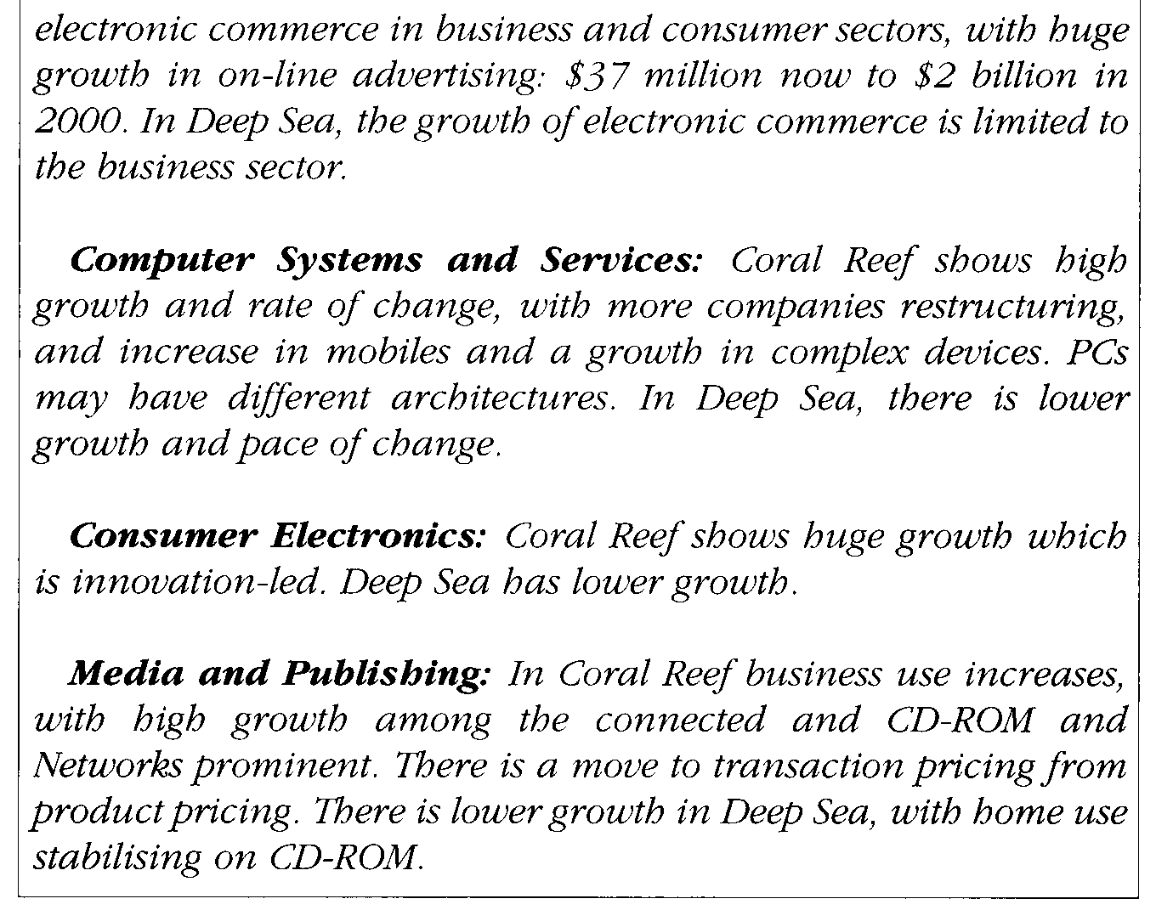

Slide 11
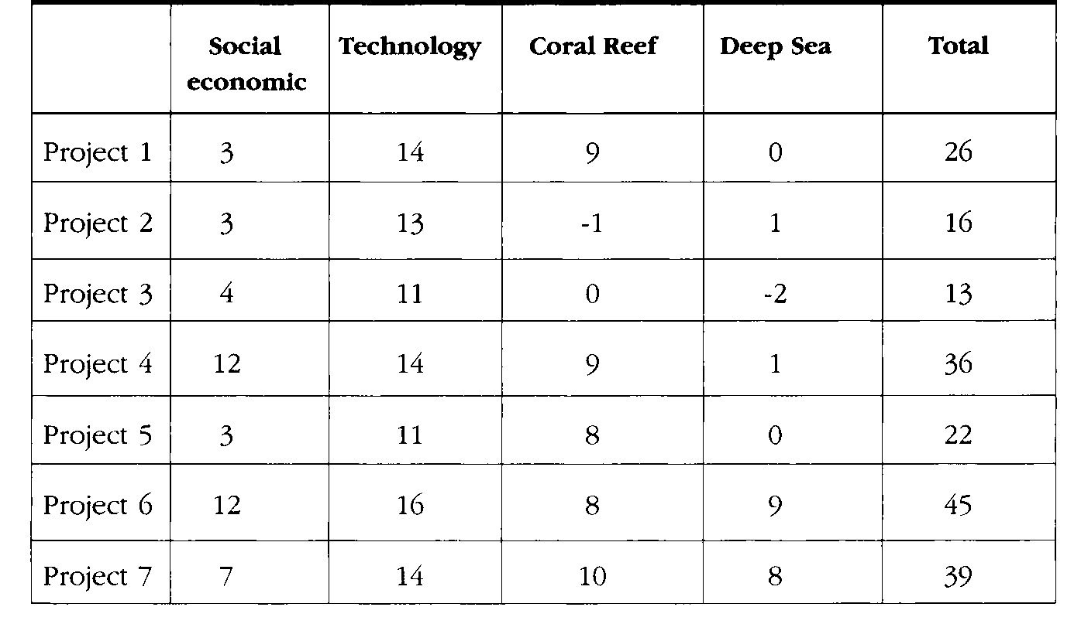
LINKING TO A NEW INVESTMENT PORTFOLIO

Slide 12
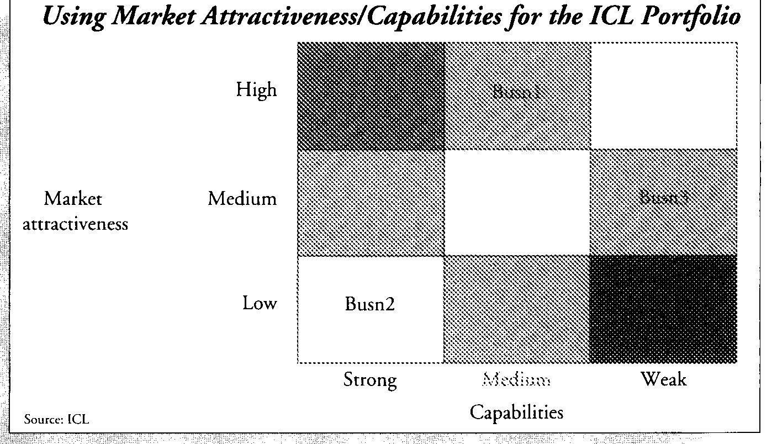
UNKOEG TO THE PIMS AND MA/C ANALYSIS

Slide 13
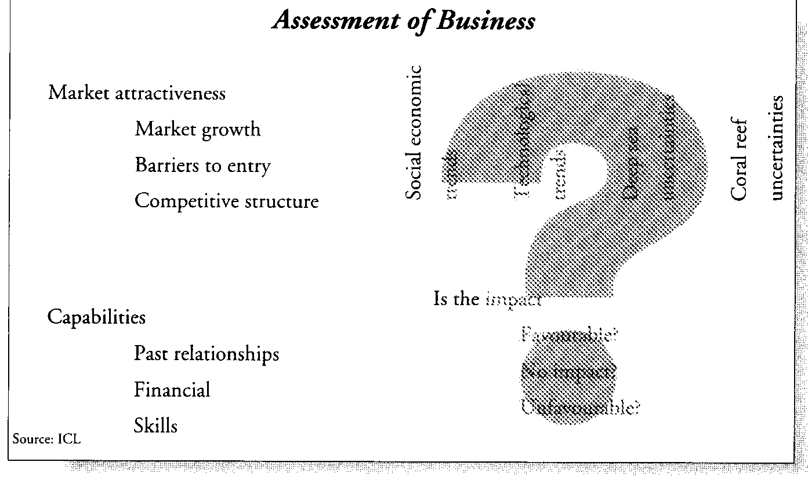
\

Slide 14
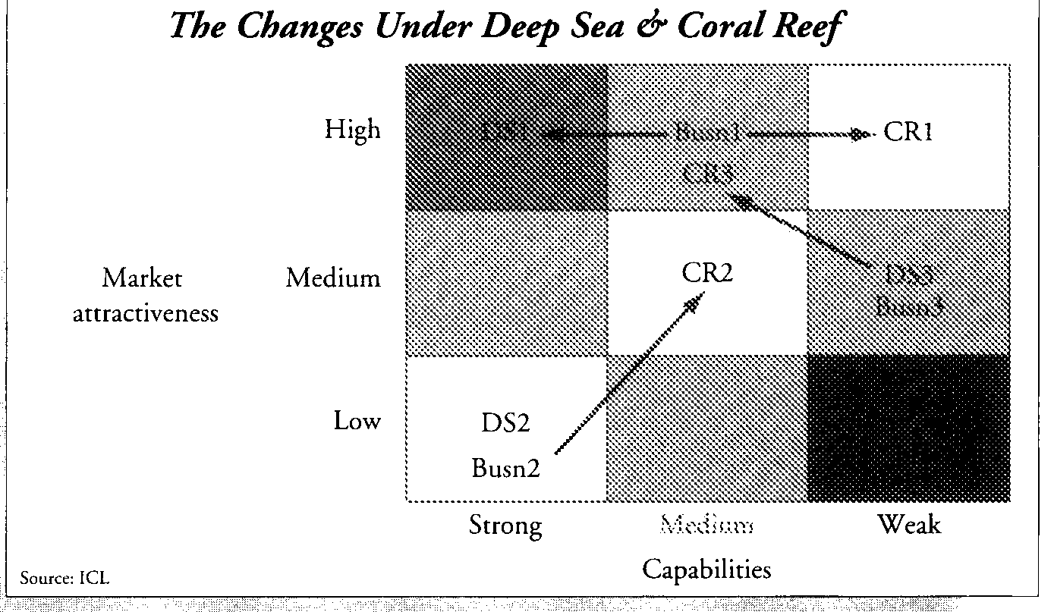

Slide 15
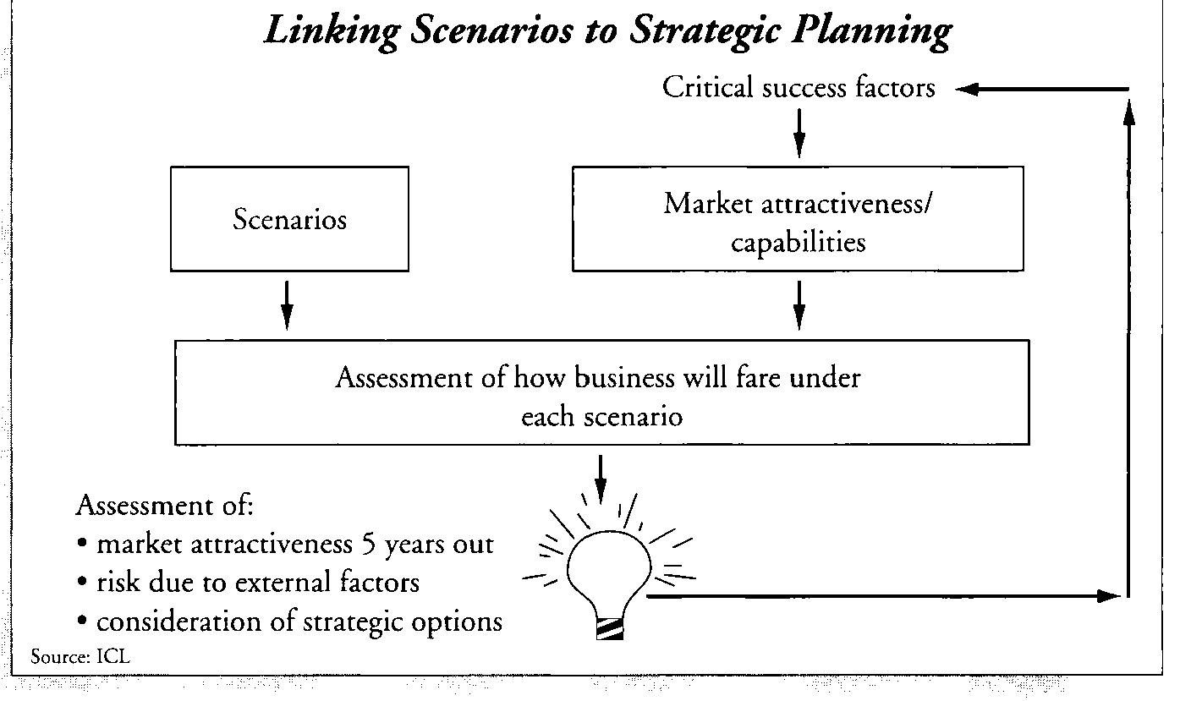

Slide 16
USING SCENARIOS TO BUILD A MORE ROBUST STRATEGY

Slide 17
