Slide 1


Blended Learning
DR. EBTISAM K. ABDULAH

Slide 2

what exactly is blended learning?
it is the the new learning system that combines between learning at home through the internet and computer or smart phones along with attending an institute.
Blended learning is also known by another name called ; hybrid learning which is an approach to online studying at home and making home as your classroom

Slide 3

why/when do we use blended learning
Firstly we start by example:
such as in Covid, students weren’t able attend schools
so online learning was used.
Also incase of tutoring it can be used
incase a person does not understand
something they can search it online
and widen their range of Info.

Slide 4

Advantages of Blended learning
1.Students can record lectures to re listen to them later.
2. students can leave a question in the comments and get reply before exam.
3. we can do seminars and conferences from our homes and attend them.
4.we can benefit of a meeting that is in a
different country and do it at home.

Slide 5

disadvantages of blended learning
1.students maybe not paying attention because
they maybe on social media apps
2. students may have bad internet and cause them to not fully understand lecture
3. students may not have sufficient devices at home or not be provided with them

Slide 6

how has it changed the world and students?
students overall al around the world have used blended learning as of 2022
it has helped however it has also had
a bad influence on learning as cheating and plagiarism become easier and more
accessible.

Slide 7
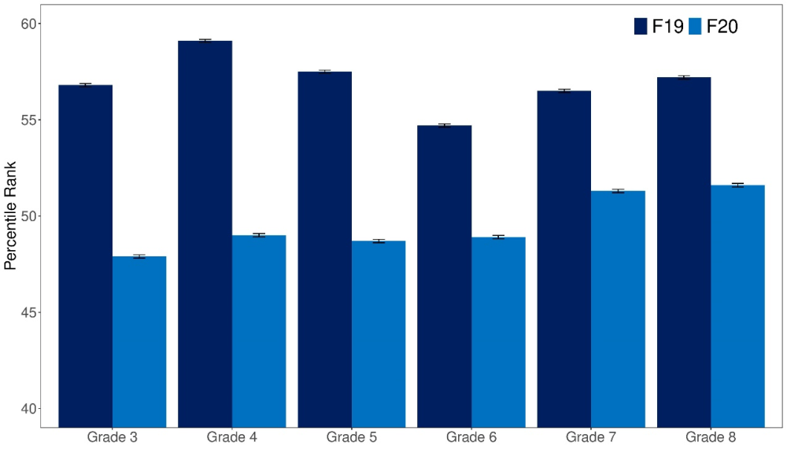
Students level before and after Covid-19 and covid-20
the graph below demonstrates students learning level before and after The pandemic
as we take it as an example because this period
greatly involved blended learning because of quarantine
it is clear that the learning level has decreased in schools greatly.

Slide 8

conclusion
Blended Learning remains a properly new concept at many educational organizations; though, recent research seems to suggest that blended learning can substantially enhance the student experience if it is implemented "appropriately". The purpose of the current study was to explore the effects of using blended learning on teaching and learning

Slide 9
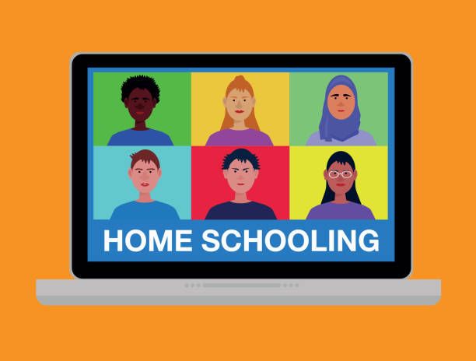
Thank you
any questions?

