Slide 1
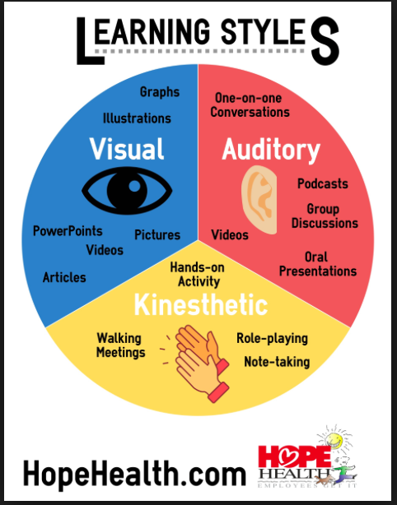
Teachers guide for English : Learning styles
Prof. Ansam Yaroub

Slide 2
Learning Styles
Most people follow a certain learning style that suits them wither visual, auditory or kinesthetic learning style. Our learning style starts from childhood yet as we grow up all three learning styles are mixed together. So in order to be a good learner you should know your learning style. Knowing your learning style will enable you to know your strengths, increase your memory and recall. In other words you can learn faster, recall more information accurately and smoothly

Slide 3

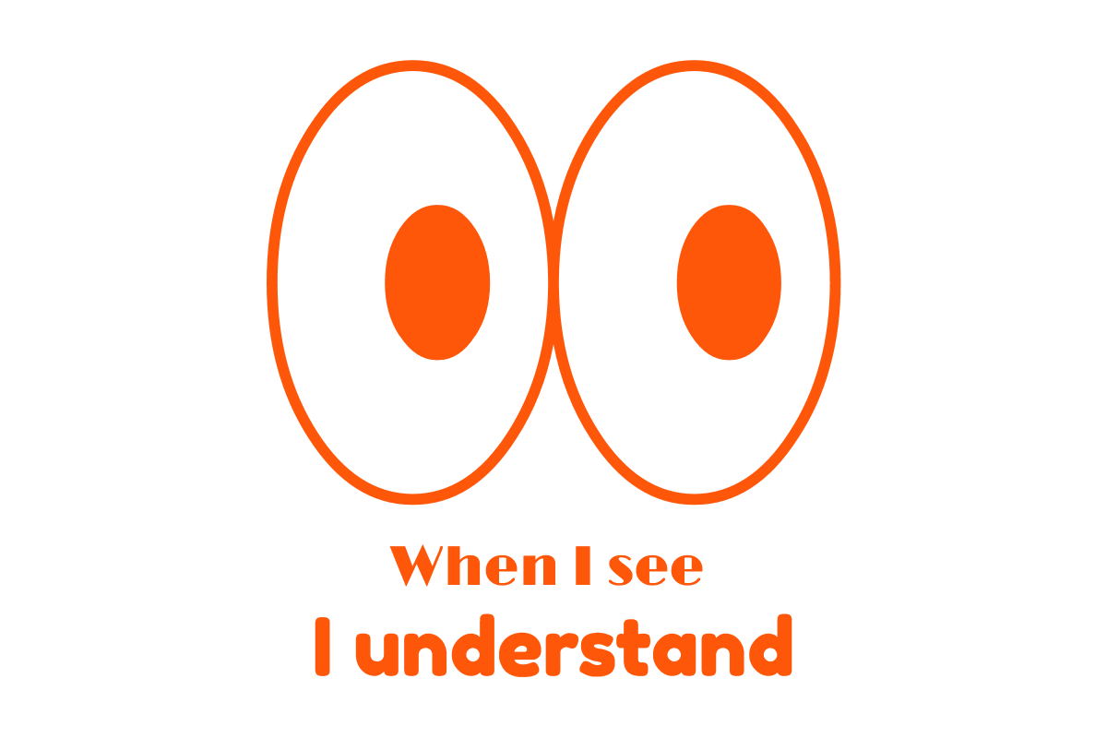
Visual learners
are learners who learn better through reading manuals to know how a new equipment works. They also learn through watching pictures, movies and films about a skill they want to learn.

Slide 4
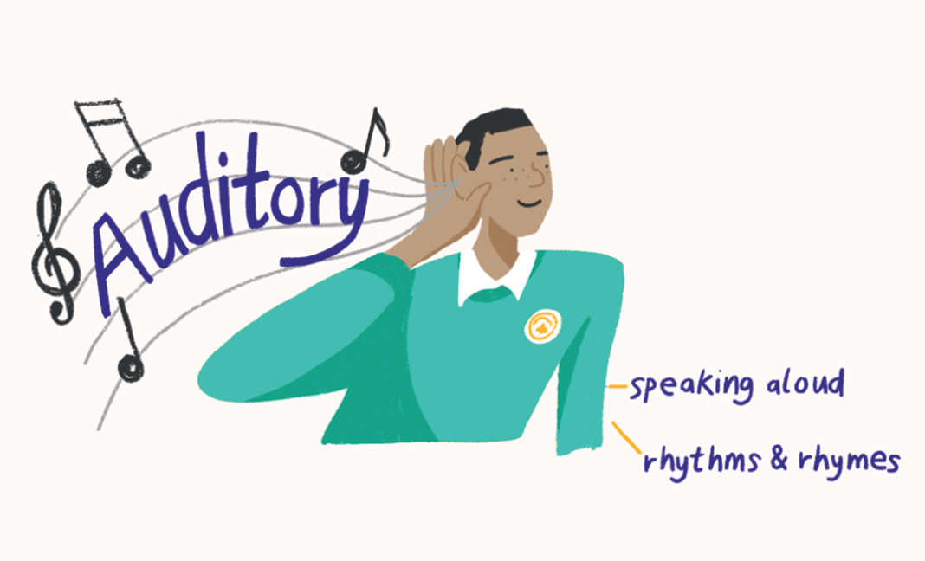

Auditory learners
on the other hand learn best through being told how equipment works or listening to a coach describing the skill. They learn best through listening.

Slide 5


Kinesthetic learner
prefers to learn through using body movement, small and large muscles. This learner prefers being shown how equipment works or how a skill is performed then he performs each step using his muscles thus creating a muscle memory (motor memory).

Slide 6

See – say – Do
There is a strategy called See – Say – Do Strategy that encourage students to use all models to learn a skill because it strengthens learning through using all senses in other words multisensory learning.

Slide 7
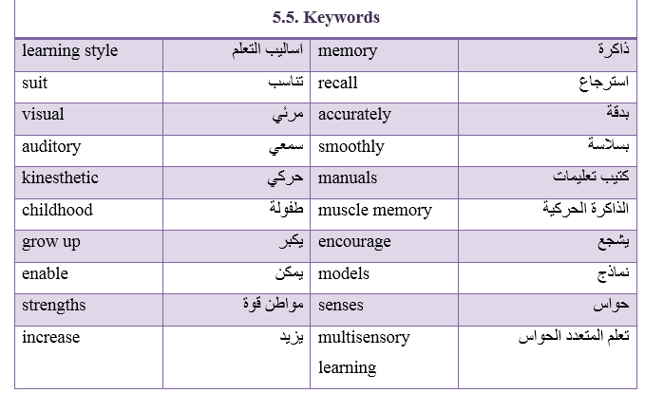

Slide 8
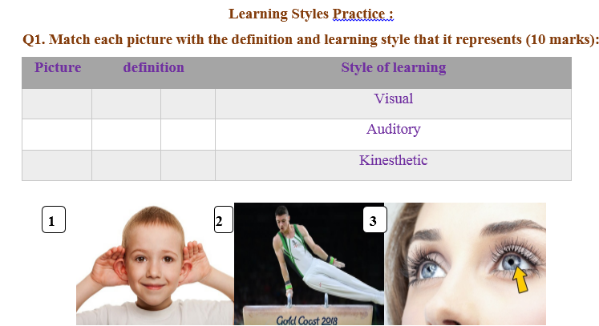

Slide 9
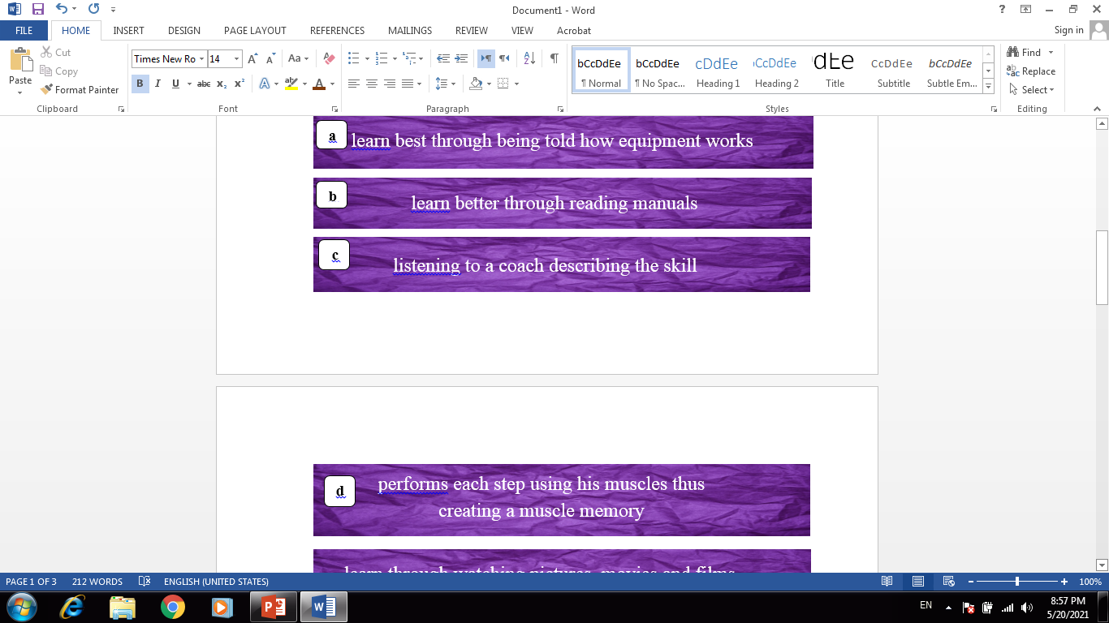

Slide 10
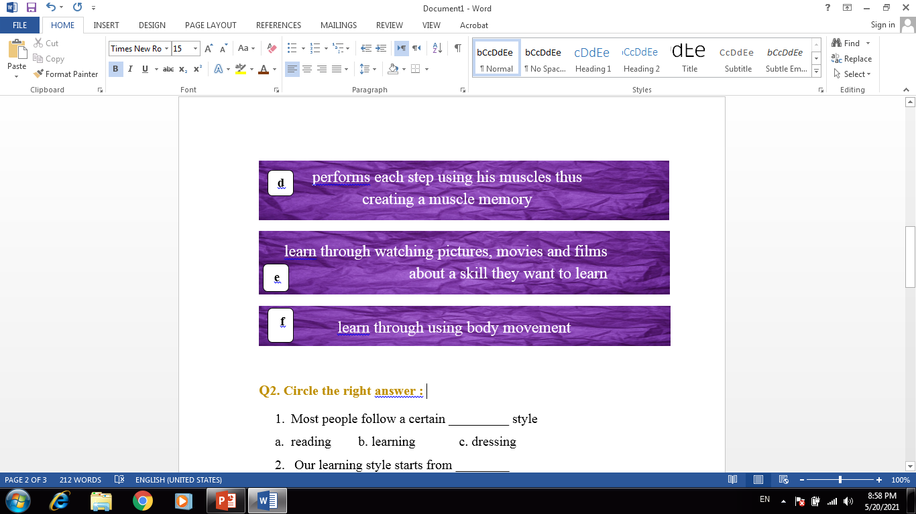

Slide 11
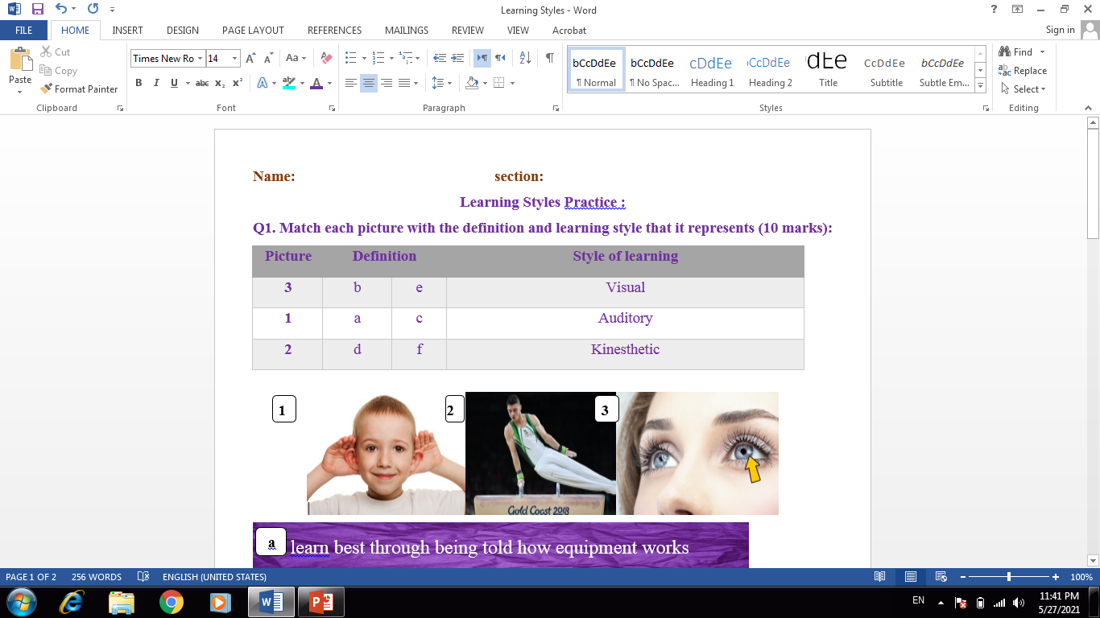

Slide 12
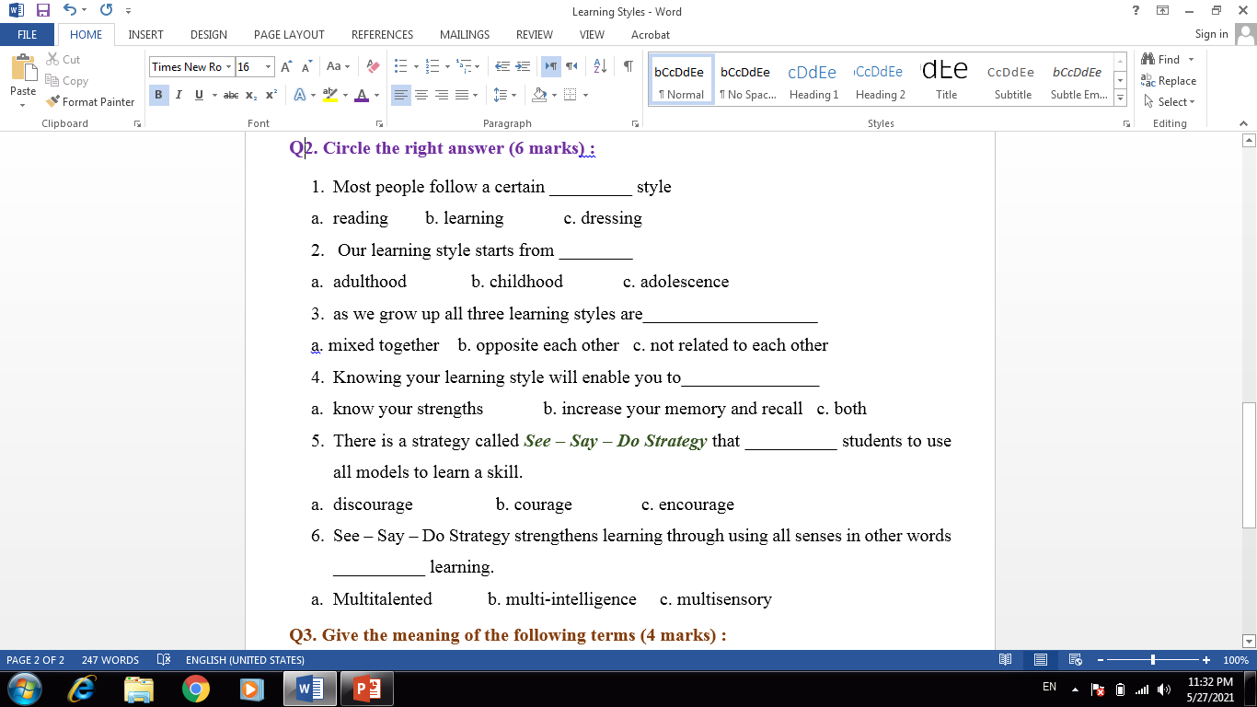

Slide 13
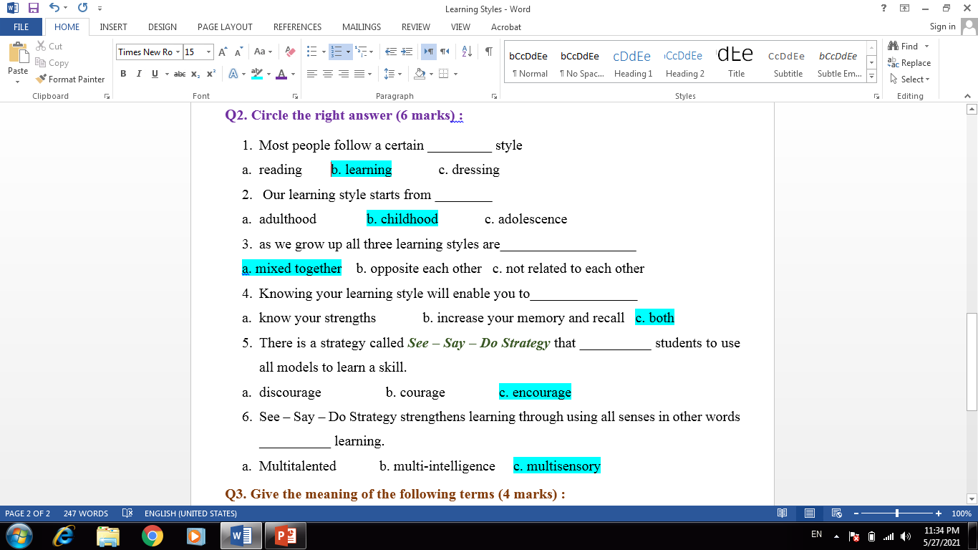

Slide 14
Thank you for listening

