Slide 1

A personal narrative on publishing “letter to editor” articles in the Scopus database journals
Prof.
Mahmood D. Subhi
Department of Pediatrics
Al- Kindy College of Medicine, University of Baghdad

Slide 2
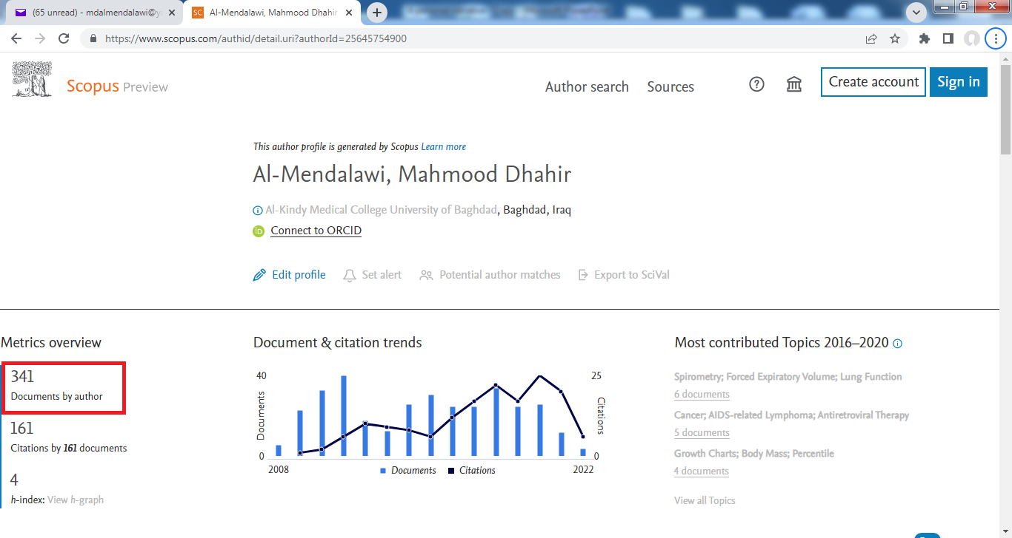

Slide 3
Scopus is the largest abstract and citation database of peer-reviewed literature: scientific journals, books and conference proceedings in the fields of science, technology, medicine, social sciences, arts, and humanities. It was set in 2004.
It covers nearly 36,377 titles from approximately 11,678 publishers, of which 34,346 are peer-reviewed journals in top-level subject fields.
Why do we publish in Scopus database journals?

Slide 4
 h- index:
. It measure both the productivity and impact of the published work of a researcher. Productivity is quantified by the number of articles, and impact by the number of publications citations.
It was invented in 2005 by Jorge Eduardo Hirsch, an Argentine-American professor of physics at the University of California, San Diego.
It is assigned automatically to every author who after publishing at least an article in the Scopus database journals.
It is calculated by the total number of articles published (Np) and the number of citations (Nc) for each article.

Slide 5
 h- index:
. The average citation per article is below 10. With ≥ 10 citations, your work is in the top 25% of the most cited work worldwide.
On average, assistant professors have h-index of 2-5, associate professors of 6-10, and full professors of 12-24.
If you wish to win a Nobel Prize, your h-index should be at least 35 and preferably closer to 70.

Slide 6
 Letter To Editor (Correspondence):
. It should provide new information that deserves publication, or alternative viewpoint to a previously published article.
It posses strict criteria, being short, concise, constructive, and purposeful with clear and specific points.
It has received very little attention from Iraqi researchers.
It might describe the scientific/academic proficiency of a researcher more faithfully.
It has a major disadvantage that is rarely cited as a reference.

Slide 7
in 2006 Saudi Medical Journal
A foreign contributor from Iraq
Limited contribution Section editor???
Issue of increasing interaction among researchers……… Correspondence (Letter to Editor)
In 2008 First publication
In 2009 Discontinuation. Reasons?

Slide 8
Questions :
 Is it interesting?
 Is it a simple or hard task?
Does it add something to the mental capacity?
 Does it matter the University of Baghdad/ Ministry of Higher Education and Scientific Research?
How can I increase further my citations and h-index?
“The more you publish, the more chances you have to increase citations and h-index”.

Slide 9
Collaborate with distinguished researchers in your field. Researches have shown that articles with famous first authors get more citations.
Take part actively in international conferences, symposiums, and workshops.
Choose a particular specialized journal with a high audience in your field.
Avoid publishing in predatory and faked journals.
Publish in open-access journals rather than paid journals.
Show up your articles on social media and blog.

Slide 10
 Conclusion:
Although publishing a “Letter to Editor” in Scopus database journals is laborious, it often yields positive rewards to a particular researcher and institution/university.

Slide 11
Recommendations:
Encourage researchers to actively participate in publishing this type of articles and make it an important requirement in the scientific academic promotion and annual assessment.
Prompt medical journals to introduce the section “ Letter to Editor” into the panel of publication types and offer certain measures to attract the interest of researchers.

Slide 12

T
H
A
N
K
Y
O
U

