Slide 1
H-Index of Scopus, Web of Sciences, and Google Scholar (Which One Should be Considered in Scientific Promotion)
Dr. Amal Yousif Al-Yasiri
College of Dentistry- University of Baghdad

Slide 2
h-index
Scopus h-index
Web of Science h-index
Google Scholar h-index

Slide 3
Scopus h-index
The h-index is an index that attempts to measure both the productivity and impact of the published work of a scientist or scholar. In Scopus, the h-index is not a static value; it is calculated live on a set of results each time you look it up.

Slide 4
How to find h-index in Scopus
Use the link below
https://www.scopus.com/sources?zone=&origin=NO%20ORIGIN%20DEFINED
1. Choose the author search tab
2. Write the author's last name and the first letter in the first name in different fields
3. Pick the right person from the author list
4. The h-index for the person appears in the author data. Note that the h-index of the researchers are available only from 1995 onwards in Scopus. Click "Analyze author output" if you want to exclude self-citations or refine years.

Slide 5
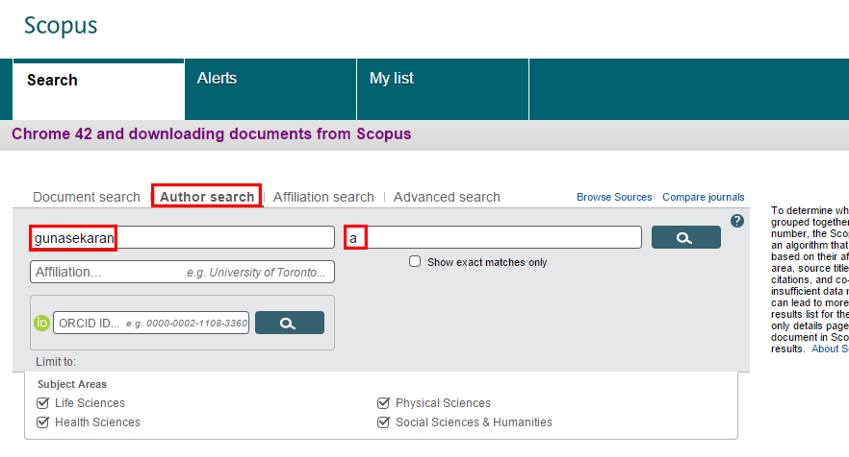

Slide 6
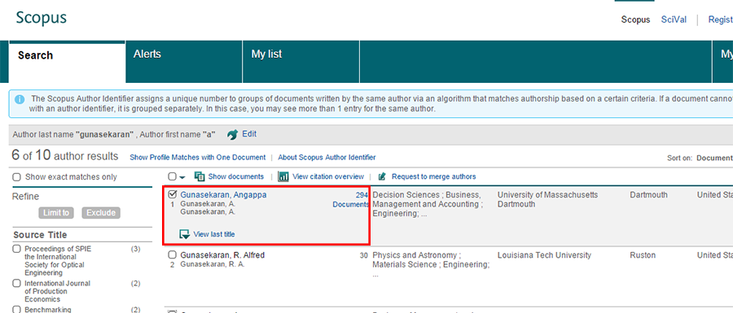

Slide 7
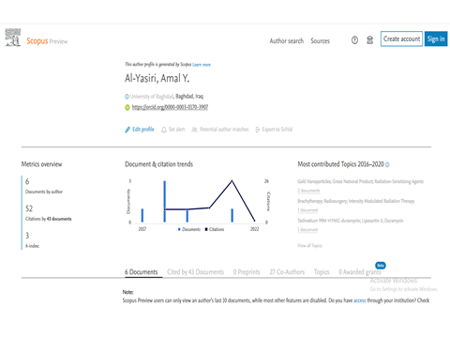

Slide 8
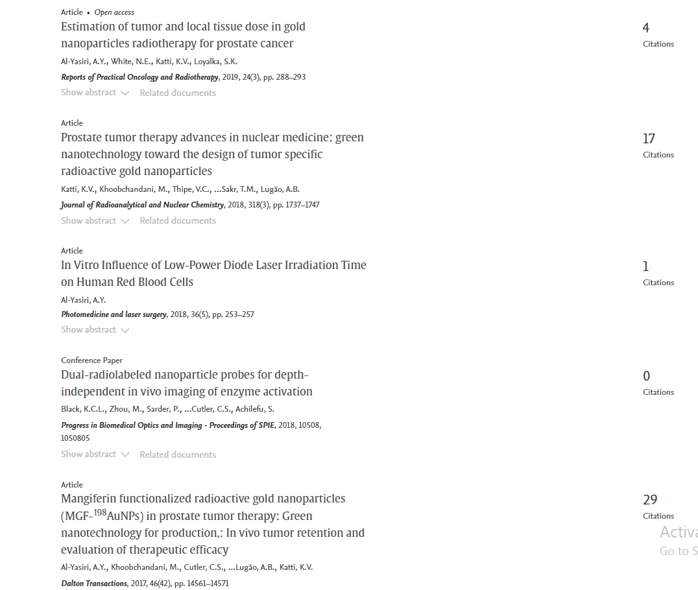

Slide 9
To be observed regarding the h-index
The advantage of the h-index is its stability, since a few publications that have been cited many times do not greatly affect the index value. Publications that have not been cited at all, or only a few times, do not affect the index value at all
The h-index varies in different disciplines, which means that researchers h-index of different disciplines are not usually comparable
The h-index is usually higher for researchers with a long career researching, than for young researchers at the start of their careers
The h-index can also be used when evaluating journals
The h-index is based on Times Cited data from the database. It will not include citations from non-indexed resources.

Slide 10
Web of Science h-index
H-index reflects the productivity of authors based on their publication and citation records.
The h-index is based on a list of publications ranked in descending order by the Times Cited. The value of h is equal to the number of papers (N) in the list that have N or more citations.
Advantages: The h-index reflects not just the number of papers, or the number of citations; it has some indication of the number of well-cited papers. This provides an interesting complement to other performance metrics, since it is not influenced by a single highly-cited paper.
The h-index is based on Times Cited data from the database. It will not include citations from non-indexed resources.

Slide 11
How to find h-index in Web of Science
On the Web of Science platform, the h-index can be found in the Journal Citation Reports feature. (But this website can not be used because it needs an subscription of your institution)

Slide 12
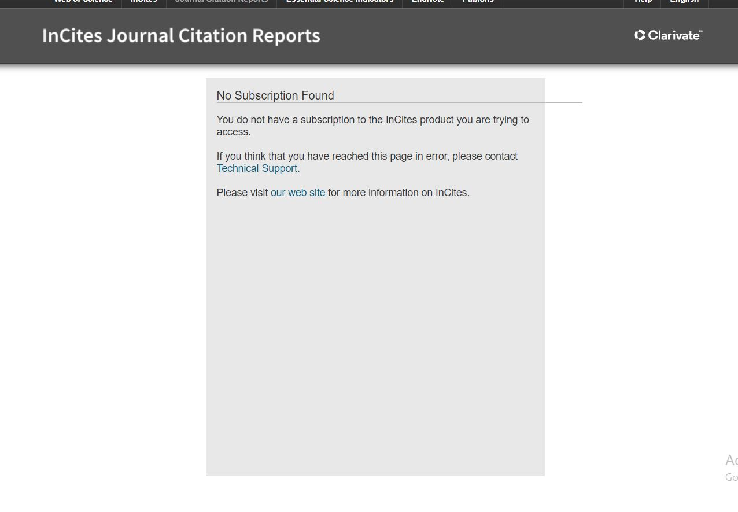

Slide 13
How to find h-index in Web of Science
Another way to find h-index of Web of Science
Via Publons account
Your h-index on Publons is calculated using citation data from Web of Science Core Collection, based on the publications you have imported to Publons.
For example, Researcher A has an h-index = 13 if they have published at least 13 documents for which they have received at least 13 citations.

Slide 14
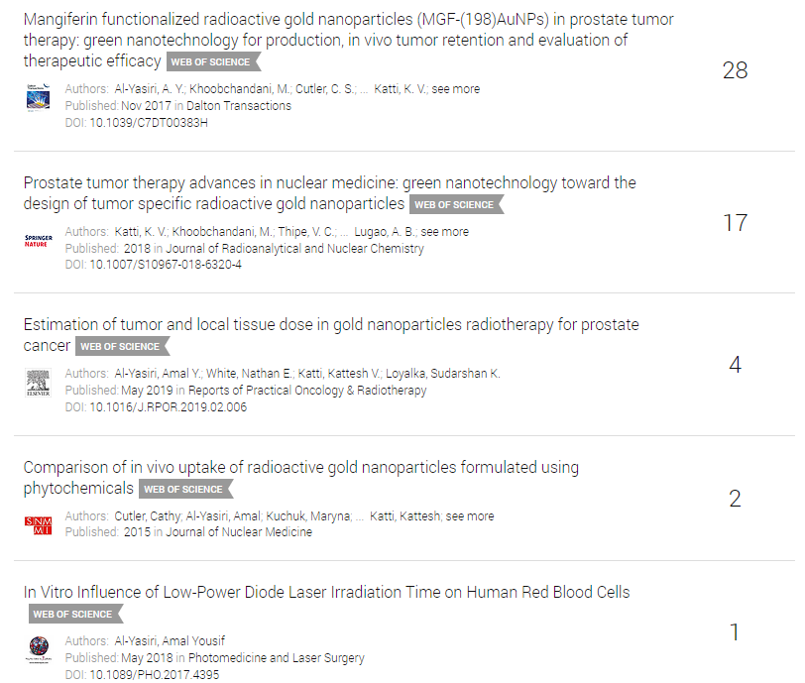

Slide 15
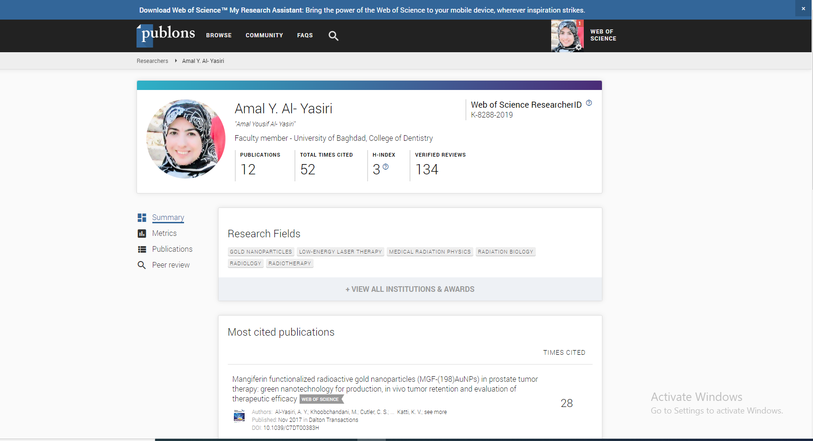

Slide 16
Google Scholar h-index
The h-index of a publication is the largest number h such that at least h articles in that publication were cited at least h times each. For example, a publication with five articles cited by, respectively, 17, 9, 6, 3, and 2, has the h-index of 3.
Scholar Metrics currently cover articles published between 2016 and 2020, both inclusive. The metrics are based on citations from all articles that were indexed in Google Scholar in July 2021.

Slide 17
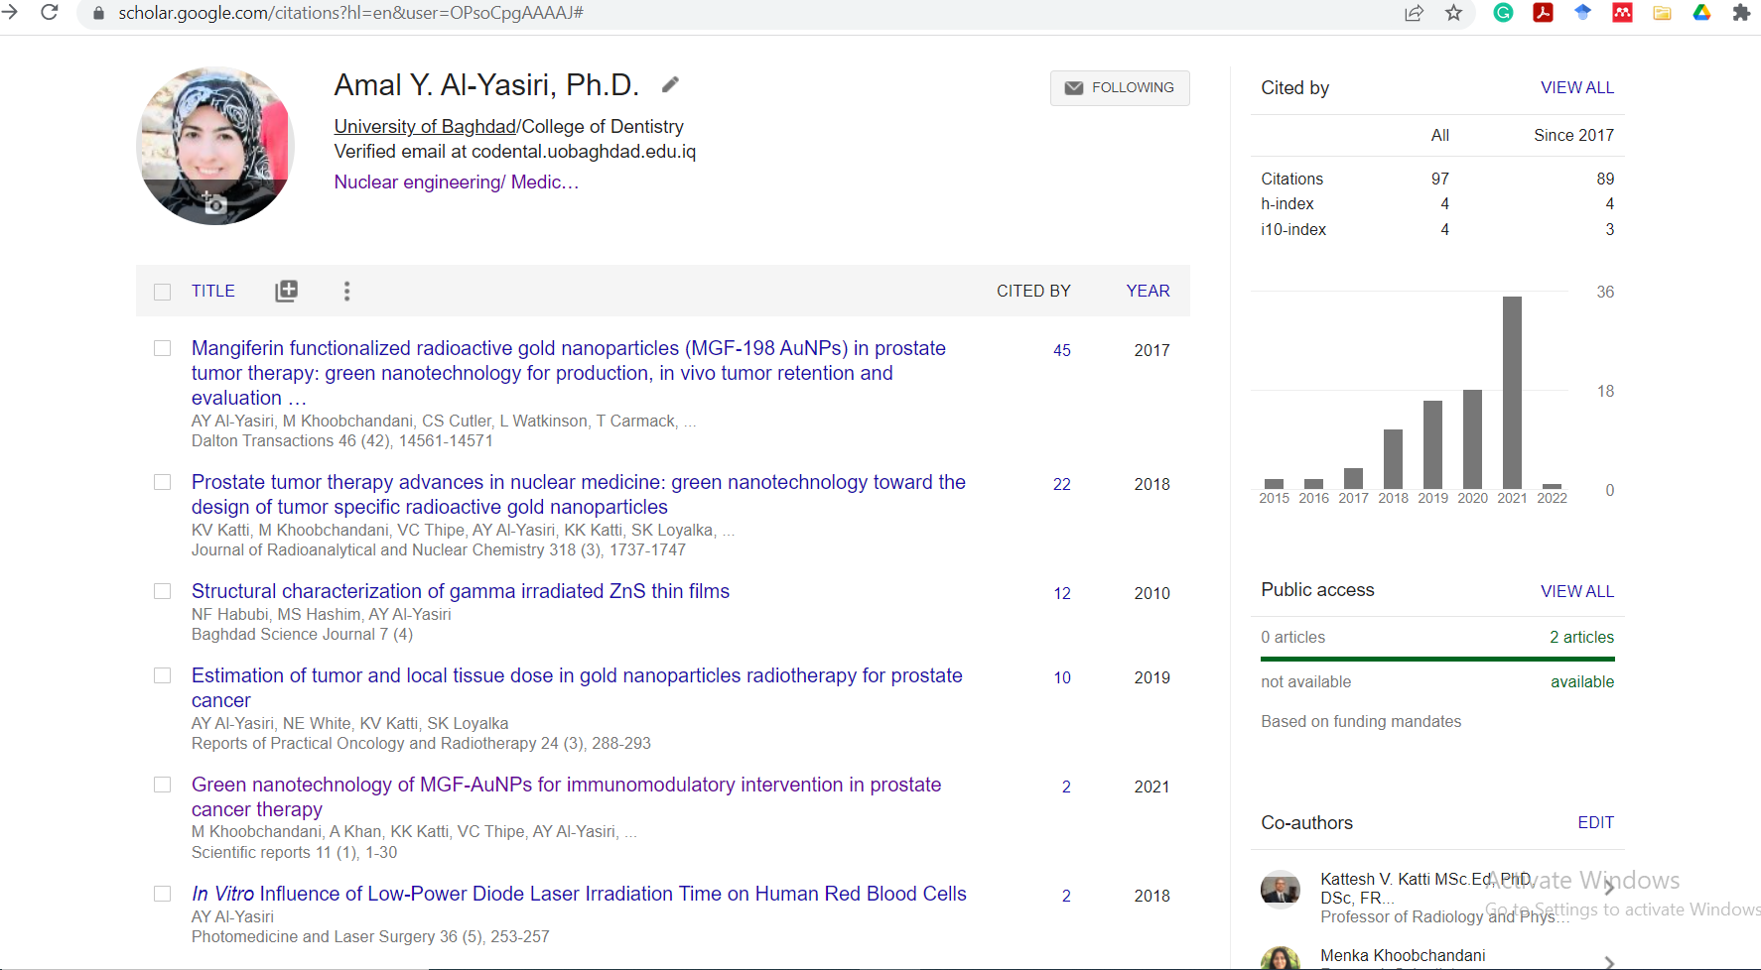

Slide 18
Which H-Index Should be Considered in Scientific Promotion
Because
1-the h-index of google scholar includes all articles published in both Scopus and Web of Sciences (Clarivate). While h-index of Scopus includes only articles published in Scopus and h-index of Web of Science includes only articles published in Web of Science
2- The h-index of google scholar includes all citations from Scopus and Web of Science. While Scopus and Web of Sciences include only citations by articles in their database
Therefore, the h-index of google scholar should be counted for scientific promotion and other scientific positions

Slide 19
Thank You For Your Attention

Slide 20
Time for Questions

