Slide 1
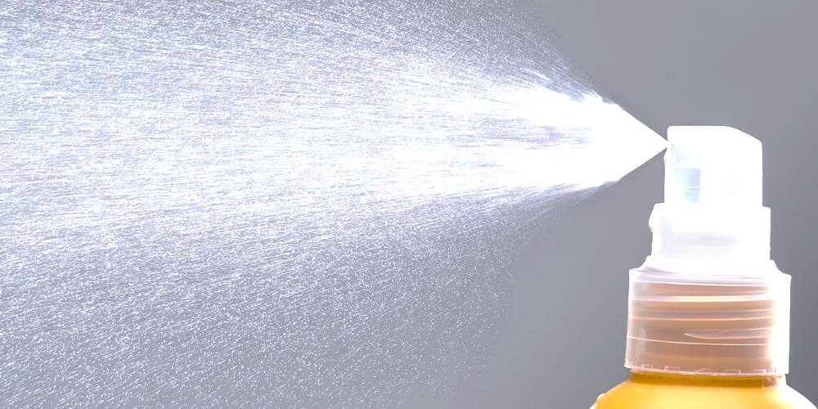
Methods of enhancing the infection control for students in prosthodontic department
By
Assis.lec.

Slide 2
Routinely dental care professionals are at an increased risk of crossinfection while treating patients.
This occupational potential for disease transmission becomes evident initially when one realizes that most human microbial pathogens have been isolated from oral secretions.
Because of repeated exposure to the microorganisms present in blood and saliva, the incidence of certain infectious diseases has been significantly higher among dental professionals than observed for the general population.

Slide 3
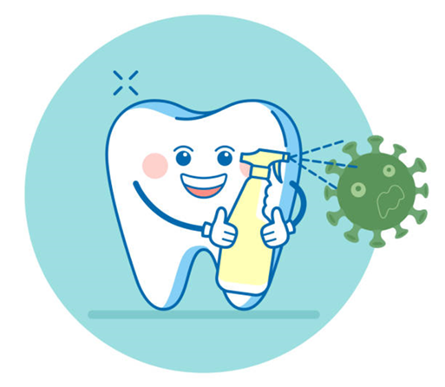
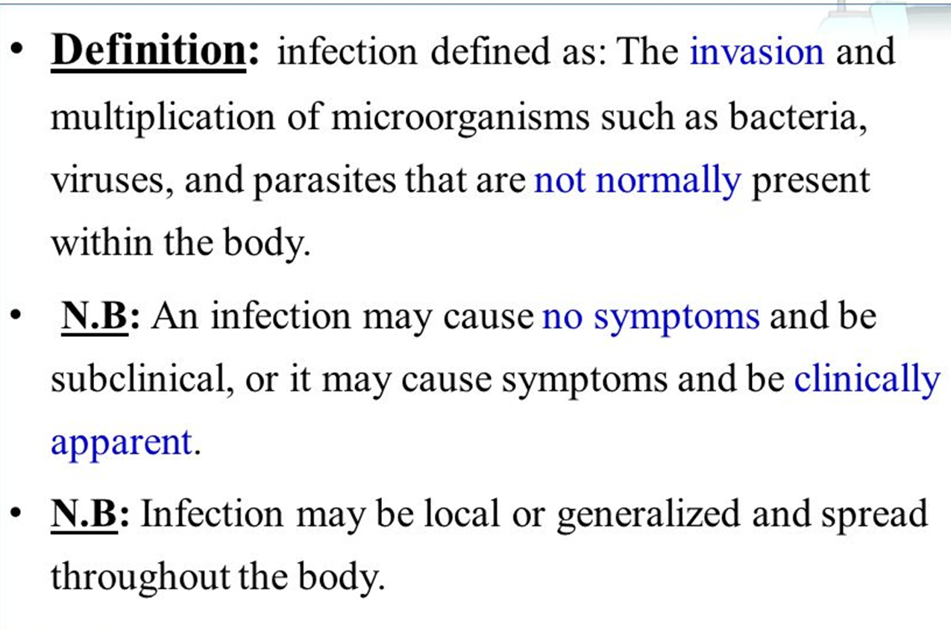
Infection

Slide 4
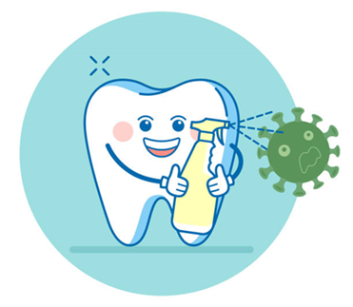
Infection control

Slide 5
The general routes for transmission
of microbial agents in dental medicine are as follows:
1) Direct contact with infectious lesions or infected saliva or blood.
2) Indirect transmission via transfer of
microorganisms from a contaminated intermediate object.
3) Splatter of blood, saliva / nasopharyngeal secretions directly into broken or intact skin or mucosa.
4) Aerosolization, the airborne transfer
of microorganisms.

Slide 6
Pathway of cross infection
Patient Dentist (common)
Dentist Family(not uncommon)
Dentist Patient(rare)
Patient 1 Patient 2

Slide 7
Disinfection describes a process that eliminates many or all pathogenic microorganisms, except bacterial spores, on inanimate objects
Sterilization: describes a process that destroys or eliminates all forms of microbial life and is carried out in health-care facilities by physical or chemical methods

Slide 17
Note!

Slide 18
Prosthetic instruments like rubber bowel ,spatula, wax knife , ruler ,fox bite … should be disinfected carefully before using because it come directly or indirectly in contact with patient saliva or blood
What about impression tray or impression?

Slide 19
Impression trays
Metal tray/ Cleaning to remove any adherent impression material , stone or plaster
Ultrasonic cleaner aid this cleaning
Then heat sterilization
Single use(disposable) tray/ discard after one use
Custom (special) tray/ can be disinfected by spray or immersion then rinsed

Slide 20
Variables affecting impression materials
*Composition and concentration of disinfectants
*Exposure time and compatibility of various disinfectant with specific impression material
*Physical/chemical properties can vary in a given category of material or disinfectant
*The ADA recommends the chemical disinfection of all impressions and dental prostheses . An acceptable disinfectant is sodium hypochlorite

Slide 21
Methods of disinfection
1. Spraying
2. Dipping/immersing
Advantages of spraying : uses less disinfectant, same disinfectant can be used
to disinfect environmental surfaces
Disadvantages : probably not as effective as immersion, can be released into air increasing occupational exposure

Slide 23
Other prosthetic steps

Slide 27
What happen in our
department clinics
??!

Slide 28
Students pour the impressions without even wash or disinfect it !
Our responsibility is to instruct the students not to pour any impression before washing and disinfection with any available spray disinfectant

Slide 29
Students take others instruments without even disinfection claiming that they forget to bring their instruments
Preparing a table pinned on clinics wall demonstrate the instruments needed for every step or visit

Slide 30
All students touch the same source of hot water without changing the gloves
Reduce the students needs for hot water by using other types of materials
Changing the gloves (costly)
Using chemical sterilizer (need observation)

Slide 31
The metal trays that belong to our department not sterilized by assistant and the student reuse it to other patient
Limit the use of trays to disposable type only
Autoclave the trays by assistant that should every day be done under observation
Using chemical sterilization

Slide 32
Students not disinfect the impressions or special trays or bite rims or trial dentures
Trying to instruct and encourage the students to do that by increasing their scores for example

Slide 33
Students not clean dental chair after finishing the visit
No senior signature ,no scores before cleaning his/her chair

Slide 35
Thank you

