Slide 1
RETENTION
Prepared by :
Assist.Prof. Sami kadhum

Slide 2
OUTLINE
Why Is Retention Necessary?
Removable Appliances as Retainers
Fixed Retainers
Active Retainers

Slide 3
WHY IS RETENTION NECESSARY?
Retention is necessary for three major reasons:
(1)The gingival and periodontal tissues are affected by orthodontic tooth movement and require time for reorganization when the appliances are removed
(2) the teeth may be in an inherently unstable position after the treatment, so that soft tissue pressures constantly produce a relapse tendency
(3) changes produced by growth may alter the orthodontic treatment result.
If teeth are in stable position
+ no further growth is expected
Is retention important ?

Slide 4
REMOVABLE APPLIANCES
AS RETAINERS

Slide 5
REMOVABLE APPLIANCES AS RETAINERS
Types
Hawley Retainers
Removable clip Retainers
Clear (vaccum formed) retainer
Positioners as Retainers
can serve effectively for retention against intra-arch instability.
useful as retainers in patients with growth problems.
Indications

Slide 6
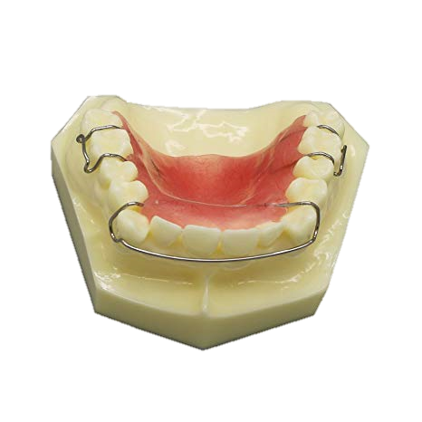
Hawley Retainers
the most common removable retainer
designed in the 1920s as an active removable appliance
Its components
Its ability to produce some tooth movement

Slide 7
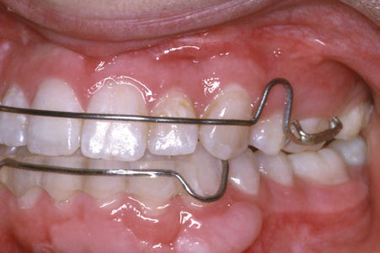
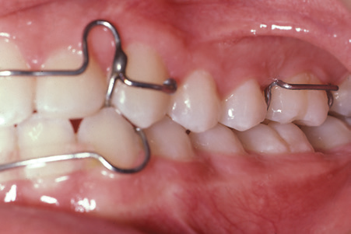
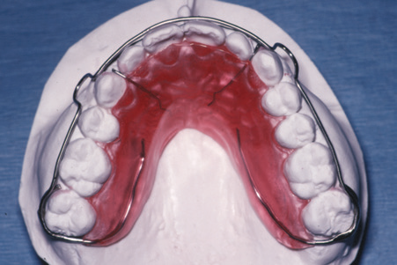
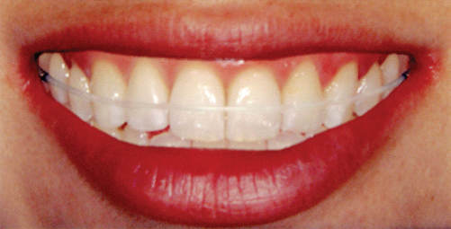
first premolars have been extracted
Good control of canine is needed
Alternative design
Clear outer bow
Notes:
A canine-to-canine anterior bow and clasps on molars are the
characteristic features of the Hawley retainer design. A, A Hawley retainer for a
patient with maxillary premolar extractions, with the anterior bow soldered to
Adams clasps on the first molars so that the extraction site is held closed. B,
The adjustment loop of the Hawley anterior bow often keeps the wire from
having full contact with the canines. If good control of the canines is needed,
as in this patient whose canines were facially positioned before treatment, a
wire that extends across the canines can be soldered to an anterior bow that
crosses distal to the lateral incisor. C, In a patient whose second molars have
erupted, a wraparound outer bow soldered to C-clasps on the second molars
provides a way to avoid interference as the retainer wire crosses the occlusion,
but a bow with such a long span will be quite flexible. D, For a mandibular
retainer, the wire Hawley bow is less effective than a wire-reinforced acrylic bar
that tightly contacts the lower incisors. This Moore design has almost
completely replaced the Hawley design for lower removable retainers that
extend to the posterior teeth. E, A removable maxillary retainer with a clear
outer bow, which fits more tightly than a metal wire and is better esthetically
but cannot be adjusted to modify tooth positions without starting over with a
new retainer.

Slide 8
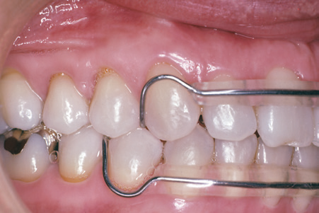
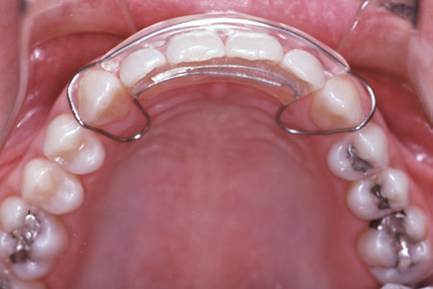
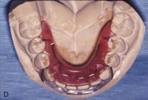
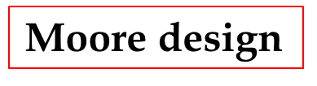
Removable clip Retainers
Second major type
full arch wraparound retainer hold each tooth firmly in position , is it advantage ?
In comparison with Hawley retainer ?
indicated primarily ….. Periodontal breakdown
Its variants
4 – 4 clip on retainer
3 -3 clip on retainer

Slide 9
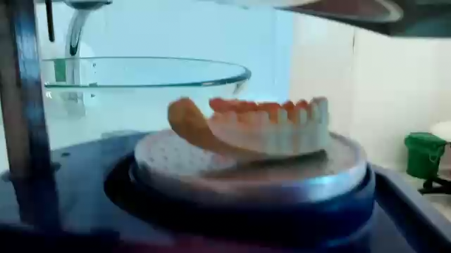
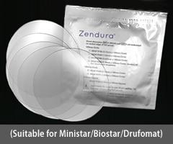
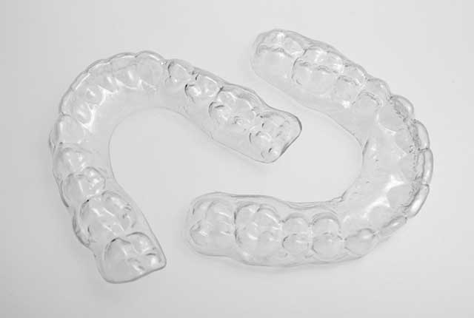
Clear (vaccum formed) retainers
Composition and fabrication
Effectiveness
Limitations :
thickness of the material over occlusal surface
dose not control deepening of the bite
after a few months , it tends to crack and discolor

Slide 10
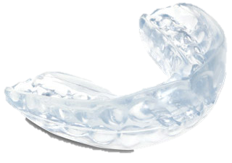
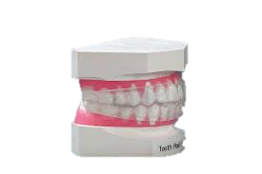
Positioners
It used mostly as excellent finishing devices
It does have one major advantage over a standard removable or wraparound retainer .
It does not make a good retainer. The major problems are:
The pattern of wear of a positioner does not match the pattern usually desired for retainers
Positioners do not retain incisor irregularities and rotations
overbite tends to increase while a positioner is being worn during finishing
Notes:
It is excellent finishing devices used in finishing stage for settleing of teeth . It can be continued from finishing stage as retainer or it can fabricated as retainer
A positioner does have one major advantage over a standard removable or wraparound retainer, however—it maintains the occlusal
relationships as well as intra-arch tooth positions.
it allows the fixed appliance to be removed
(2) it serves not only to reposition the teeth but also to massage the gingiva, which is almost always at least slightly inflamed and swollen after comprehensive orthodontic treatment

Slide 11
Fixed retainer

Slide 12
Fixed retainer
It normally used where intra-arch instability is anticipated and prolonged retention is planned.
There are four major indications:
Maintenance of lower incisor position during late growth
Maintenance of diastema closure
Maintenance of pontic or implant space
Keeping extraction spaces closed in adults

Slide 13
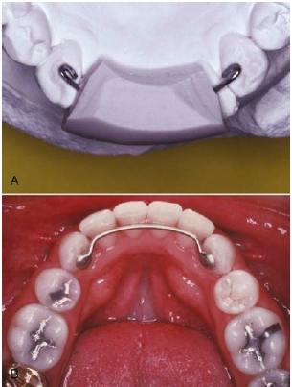
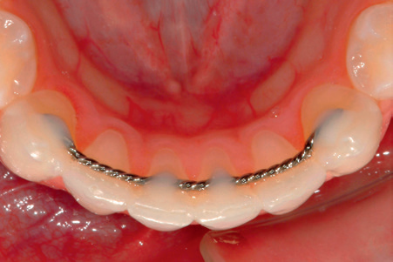
1- Maintaining of lower incisor position during late growth .
Notes:
Bonding a wire to all the mandibular anterior teeth (canineto-
canine or premolar-to-premolar) is indicated if spaces existed in the
lower anterior segment prior to treatment, or if severe rotations were
corrected.

Slide 14
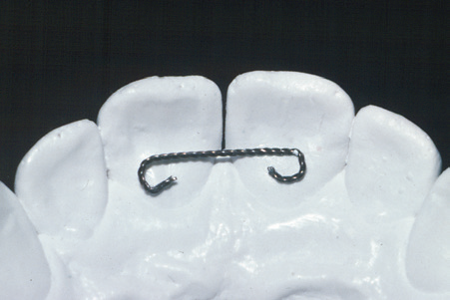
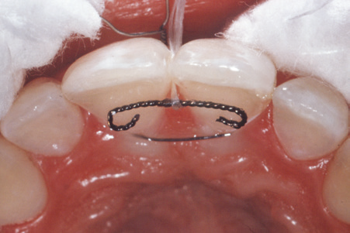
2 - Diastema maintenance

Slide 15
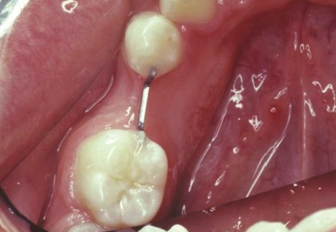
3 - Maintenance of pontic or implant space
It usually used for a few months reduces mobility of the teeth and often makes it easier to place the fixed bridge
it can be placed for several months or even years If further periodontal therapy is needed after the teeth have been positioned
Implants should be placed as soon as possible after the orthodontics is completed
Intracoronal fixed retainer(A- splint)

Slide 16
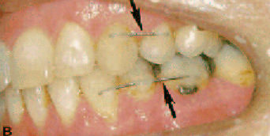
4- Keeping extraction spaces closed in adults
Fixed retainer is both more reliable and better tolerated than a full-time removable retainer, and spaces reopen unless a retainer is worn continuously

Slide 17
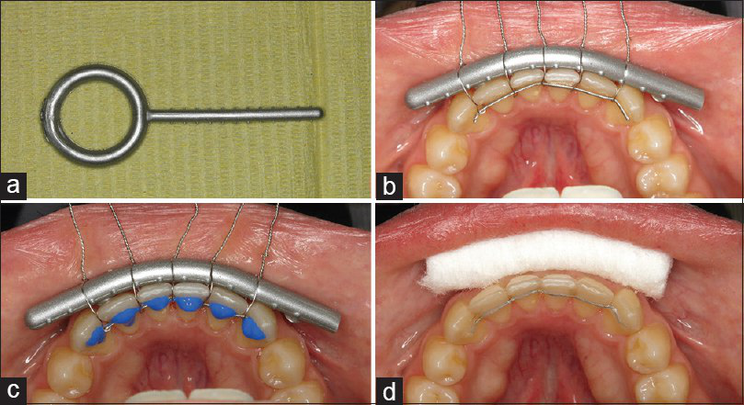
Placement of fixed retainer

Slide 18
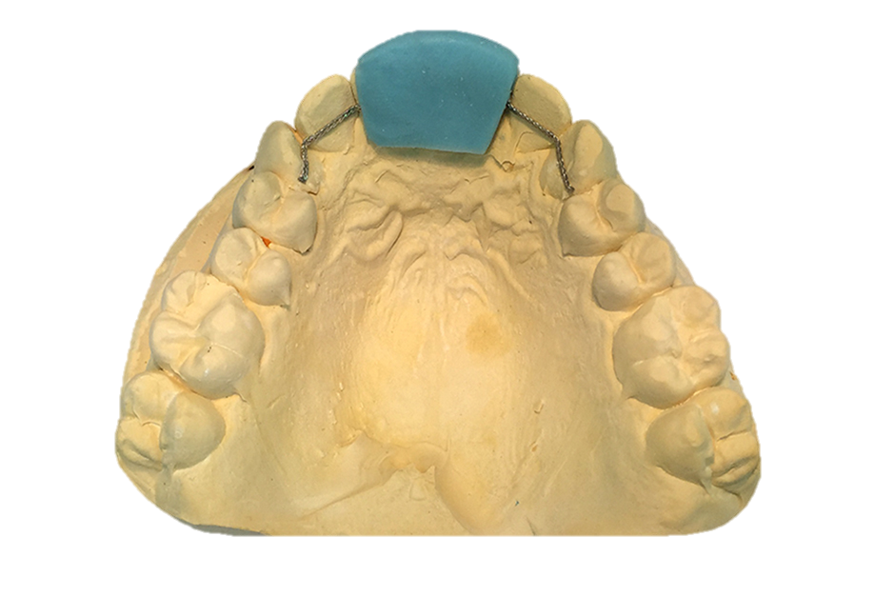
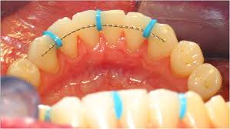
Placement of fixed retainer
Notes:
silicone putty splint for rapid placement of directly bonded retainer

Slide 19
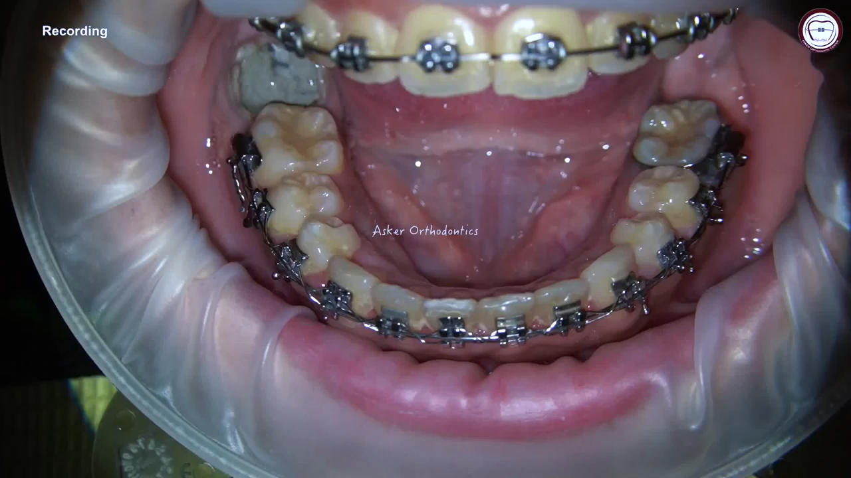

Slide 20
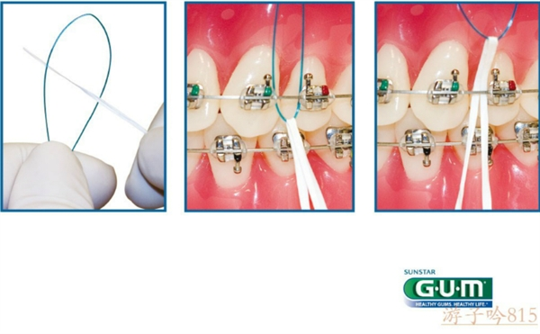
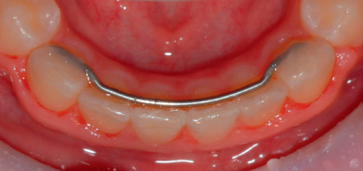
Fixed retainer
The major objection is that it makes interproximal hygiene procedures more difficult
there is both bad and good news
To overcome this problem >> use floss threading device
Less plaque buildup , less effective
Greater plaque buildup , More effective

Slide 21
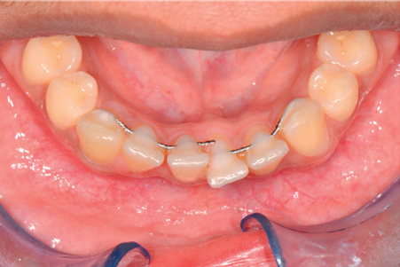
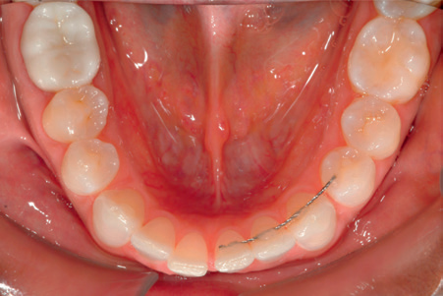
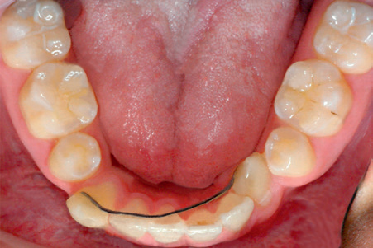
Long term complications
Breakage of wire
Loss of segment of wire
Debonding from some teeth
Distorted wire during bonding
Notes:
The complication become more sever when wire still attached to teeth than totally debonded from all tooth surface
So it requre regular observation by family dentist if not orthodontist

Slide 22
Active retainer
It is a contradiction in terms because a device cannot be actively moving teeth and serving as a retainer at the same time.
If the relapse or growth changes occur after orthodontic treatment, this lead to a need for some tooth movement during retention
A typical Hawley retainer, if used initially to close a small amount of band space, can be considered an active retainer
The term usually is reserved for two specific situations:
realignment of irregular incisors with spring retainers
management of Class II or Class III relapse tendencies with modified functional appliances.

Slide 23
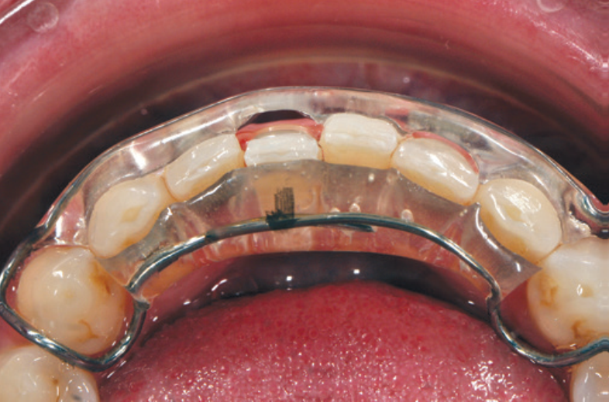
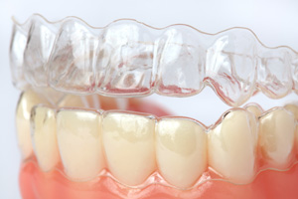
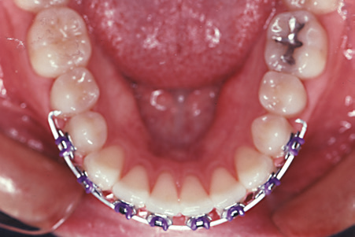
Realignment of Irregular Incisors : Spring Retainer
Re-crowding of lower incisors is the major indication for an active retainer to correct incisor position.
If the irregularity is modest, there is two option :
  an active canine to- canine clip-on device is used.
  or a short series of clear aligners.
there is more than a modest degree of relapse, however, a fixed appliance is indicated.
Permanent retainer is required

Slide 24
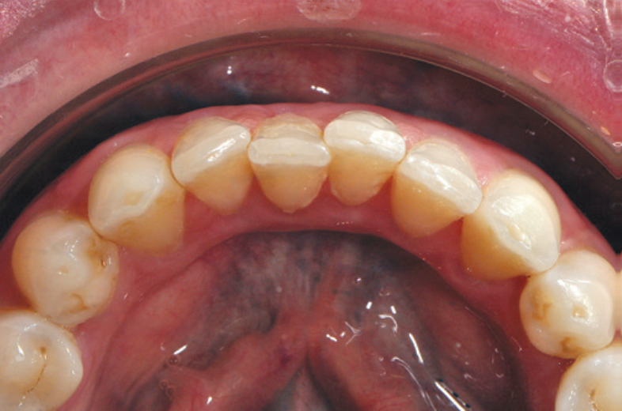
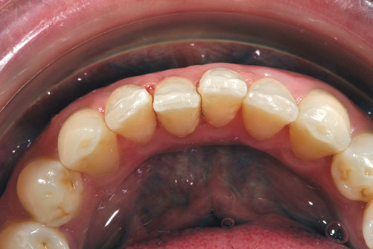
Steps in the fabrication of a canine-to-canine clip-on appliance

Slide 25
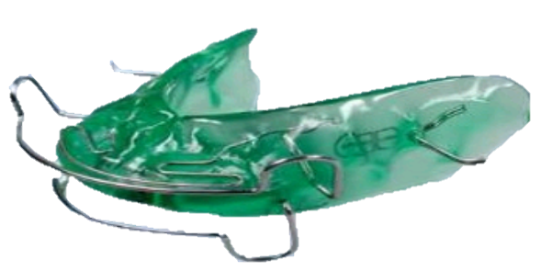
Correction of Occlusal Discrepancies:
Modified Functional Appliances as Active Retainers
Best description of modified functional appliances to simultaneously maintain teeth within arch while slightly altering occlusal relationship.
Functional appliance as passive or active retainer ??
Typical Example: if male adolescent slips back 2-3 mm into class II after early correction , so activator or bionator can be used to recover proper occlusion
some vertical growth is required to prevent downward and backward rotation of the mandible .
more than 3 mm of occlusal correction is needed , solution is …
Notes:
Differential anteroposterior growth is not necessary to correct a small occlusal discrepancy— tooth movement is adequate—but some vertical growth is required to prevent downward and backward rotation of the mandible. So activator or bionator are made with mand. Advancement for 2-3 mm
An activator or Bionator as an active retainer is indicated only if not more than 3 mm of occlusal correction is sought. Over this distance, correction can be achieved by restraining the eruption of maxillary teeth posteriorly and directing the erupting mandibular teeth anteriorly.

Slide 26
Thank you

