Slide 1
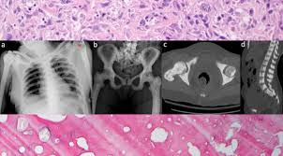
Assist.Lec Farah Abdul Salam
MSc. Oral & Maxillofacial Radiology

Slide 2
Contents
History
Definition
Clinical Features
Mutations associated with it
Primary Mechanism involved
It’s Clinical Variants
Therapeutic Options
Supportive Measures
Lab. Findings
Skeletal X-ray Findings
Conclusion

Slide 3
Osteopetrosis Disease History
Osteopetrosis was first described , by a German
radiologist Albers-Schönberg…

Slide 4
Osteopetrosis
A Hereditary skeletal disorder characterized by marked increase in bone density
Bone density is due to defect in remodeling caused by Abnormal Osteoclast Function
Defective osteoclast resorption with continued bone formation and endochondral ossification results →thickening of cortical bone and cancellous bone sclerosis

Slide 5
Signs & Symptoms:
Fractures
Low Blood Cell Production
Loss of Cranial Nerves Function
Frequent Infections of Teeth & jaws

Slide 7
Mechanism
-ATP ase : H⁺ proton pump
Carbonic anhydrase II

Slide 8
a deficiency of the
carbonic anhydrase enzyme encoded by
the CA2 gene.
Carbonic anhydrase is required by osteoclasts for proton production.
Without this enzyme hydrogen ion pumping is inhibited and bone resorption by osteoclasts is
defective,
as an acidic environment is needed to dissociate calcium hydroxyapatite from the bone matrix.
As bone resorption fails while bone formation continues, excessive bone is Formed.

Slide 10
CLINICAL TYPES
INFANTILE
i) malignant
ii) intermediate
iii) transient ADULT OSTEOPETROSIS

Slide 11
INFANTILE OSTEOPEtROSIS

Slide 12
Osteopetrosis Congenita Infantile
Severe disease at birth or early infancy→MALIGNANT
It is autosomal recessive
Diffusely sclerotic skeleton
Initial signs
Normocytic anemia with hepatosplenomegaly extramedullary hematopoiesis) granulocytopenia)
Increase Susceptibility to infection

Slide 13
INFANTILE OSTEOPETROSIS
Facial deformity(broad face, hypertelorism,sunb nose
Delayed tooth eruption
Narrowing of skull foramina (failure of resorption and remodelling)→ pressing on cranial nerves→optic nerve atrophy,blindness,deafness,facial paralysis.
Osteomyelitis jaw

Slide 15
Malignant infantile osteopetrosis
Bone in Bone appearance

Slide 16
INTERMEDIATE OSTEOPETROSIS
Less severe variant of infantile osteopetrosis
Affected patients asymptomatic at birth
Fractures exhibited by the end of first decade
Rarely marrow failure/hepatosplenomegaly

Slide 17
Transient osteopetrosis
Radiographic evidence of diffuse sclerosis
Marrow failure
Resolve without specific therapy
Most affected patients return to normal without sequelae

Slide 18
ADULT OSTEOPETROSIS
Less severe manifestations
Autosomal dominant trait---benign osteopetrosis
Sclerosis of axial skeleton
Long bones—little/no defect
40% patients— asymptomatic marrow failure rare

Slide 19
Adult osteopetrosis
Plain film radigraphs– reveal a diffuse increased radiopacity of medullary portions of bone
Symptomatic patients—bone pain Two major variants
with CN compression: rarely fractures occur
without CN compression: fractures common.
mandible osteopetrosis: complications:fractures and osteomyelitis after tooth extraction

Slide 20
TREATMENT
Adult osteopetrosis-mild severity-long term survival
Infantile osteopetrosis-poor prognosis-most deaths during first decade of life
Bone marrow transplantation only hope for cure
Other therapies: interferron gama-1b incombination with calcitriol-reduce bone mass,decrease infections, lowers nerve compressions
Others: corticosteroid administration(to increase circulating RBCS and platelets)
Parathormone
Macrophage colony stimulating factor
Erythropoietin
Limiting calcium intake

Slide 22
Supportive measures
Transfusions
Antibiotics
Osteomyelitis of jaws: drainage,debridement,culture with sensitivity,appropriate antibiotic therapy and reconstruction if necessary

Slide 23
Radiographic findings infantile osteopetrosis

Slide 24
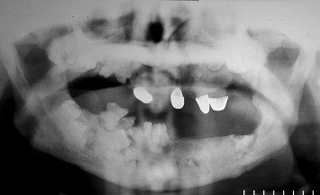

Slide 25
Lateral radiograph of the skull reveals diffuse thickening of the calvarium, most significant in the region of the occiput. The partially visualized upper cervical vertebrae and maxilla are also dense and thickened.

Slide 26
Sagittal T1-weighted MR image shows thickening of the calvaria and facial bones with hypointensity of skull and cervical vertebra, and cerebellar tonsillar ectopia.

Slide 27
Axial T2-weighted image shows optic canal stenosis and optic nerve
atrophy

Slide 28
Severe bilateral optic canal narrowing (arrows) in a 4yr-old patient with complete
loss of vision in the left eye and 20/80 visual acuity in the right eye.

Slide 29
Spine radiographs reveal the classic sandwich vertebrae of osteopetrosis (red arrows). This is manifested as thickening and sclerosis of the vertebral endplates, and of the bone adjacent to the endplates.
There is also marked thickening of the posterior vertebrae (yellow arrows), especially in the vertebral arch.

Slide 30
Chest radiograph obtained in an infant demonstrates overall increased density of the osseous structures due to the accumulation of immature bone.

Slide 31
Generalized increased density of the bones and alternating areas of increased and decreased density in the metaphysis (bone- within-bone appearance).

Slide 32
Densely sclerotic bone
,,,,, deformity of the femurs with under-
trabeculation.

Slide 33
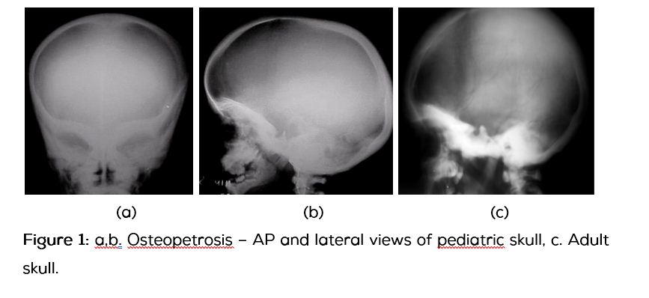

Slide 34
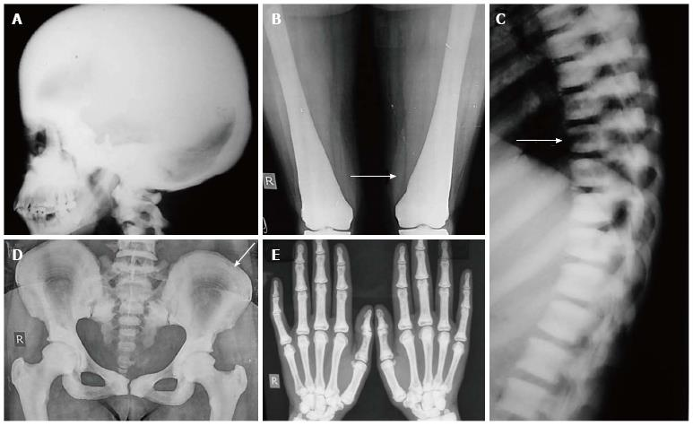

Slide 35
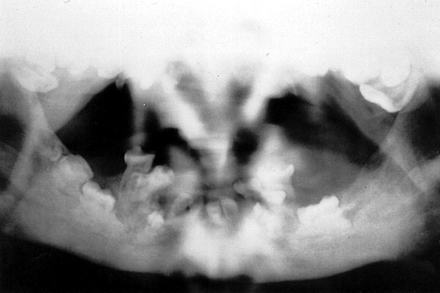

Slide 36
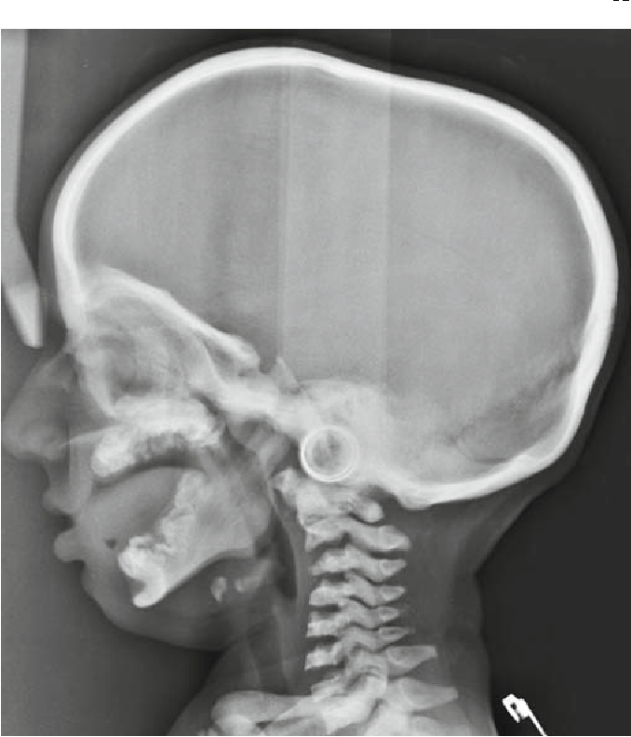

Slide 37
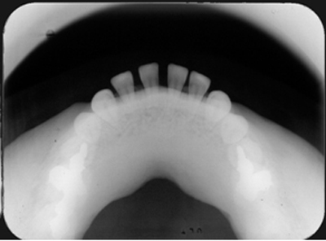

Slide 40
Differential Diagnosis
Heavy Metal Poisoning e.g. (Lead)
Melorheosis
Hypervitaminosis D ( Vit.D toxicity)
Pyknodysostosis
Fibrous Dysplasia of bones

Slide 41
Q/What is the difference between Osteoporosis & Osteopetrosis???

Slide 42
Conclusion
Osteopetrosis is a rare hereditary skeletal
disease that can be appeared early in life as (Infantile Congenita) or as an (Adult Osteopetrosis)
It’s Diagnosis is based on Thorough clinical evaluation, detailed pt. history, with a variety of specialized tests like [[ X-ray imaging,measuring of BMD]]
Skeletal X-ray Findings very specific & considered sufficient to make a diagnosis…

