Slide 1
Open Journal System OJS
College of medicine
University of Baghdad
Assistant Lecturer Sara Mohammed Abdullah

Slide 2
OJS Open Journal System
Open Journal Systems (OJS) is an open source software application for managing and publishing scholarly journals. Originally developed and released by Public Knowledge Project (PKP) in 2001 to improve access to research.
OJS is free and open source software. You are free to download, use, and modify it at no charge.
OJS is made freely available to journals worldwide for the purpose of making open access publishing a viable option for more journals, as open access can increase a journal’s readership as well as its contribution to the public good on a global scale

Slide 3
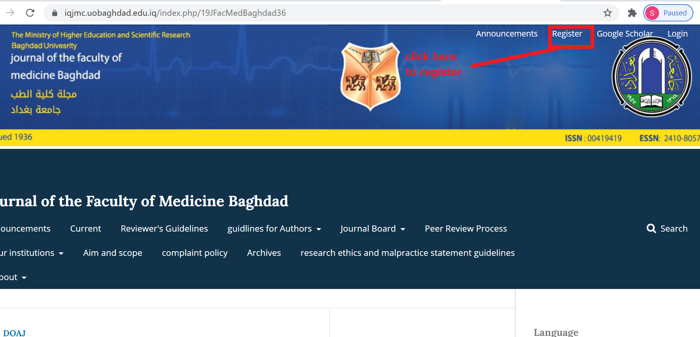
Registering with OJS
Unregistered visitors to a journal can normally register as a Reader, Author, and/or Reviewer.
To register with a journal, click the Register link on the upper right corner.

Slide 4
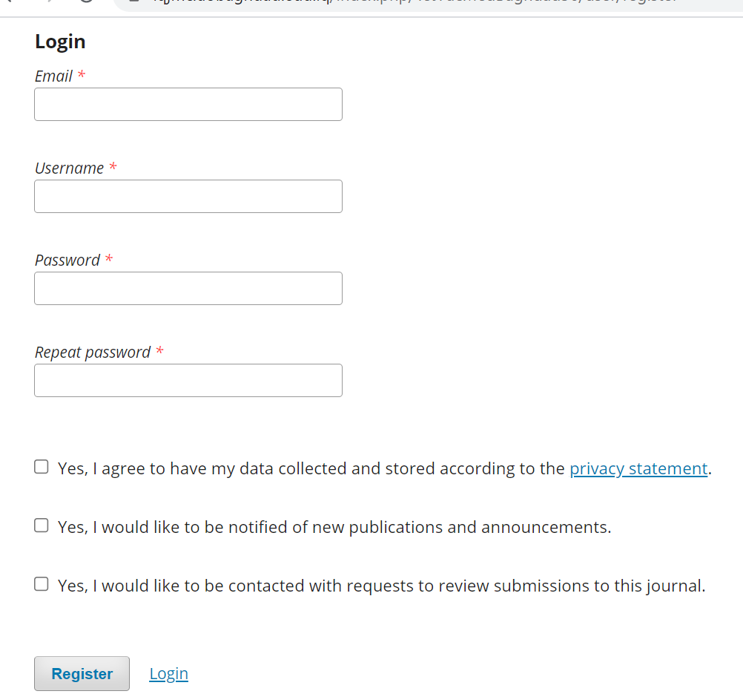
This will open the Registration Form for you to complete with all required information.

Slide 5
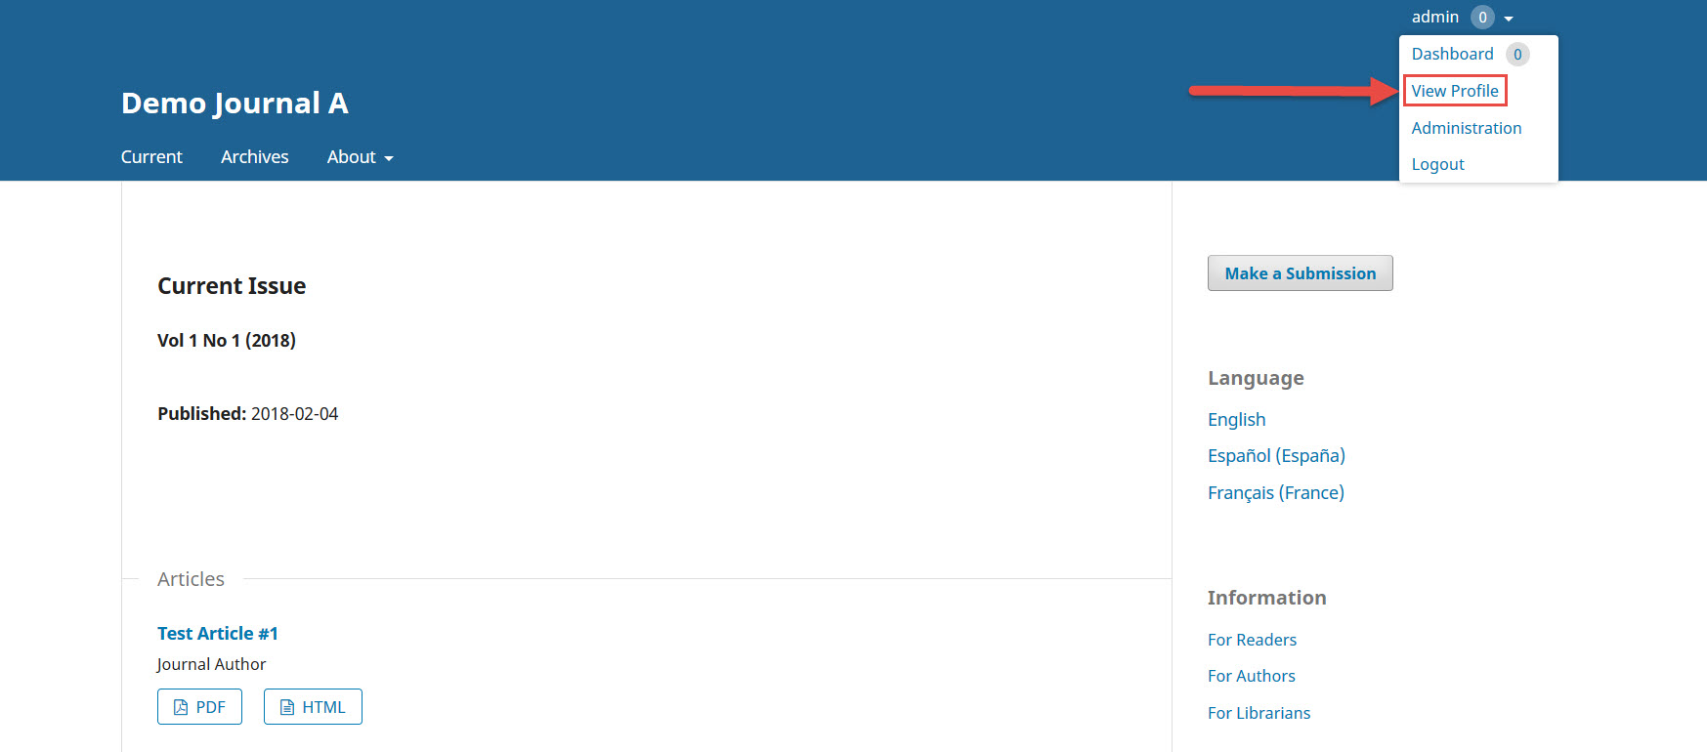
Viewing and Changing Profile
To view and edit your profile, log in and click your Username link from the upper right corner. Choose the View Profile link.

Slide 6
by choosing the different tabs, you can update your personal details, contact information, change your roles, add a personal image (which some journals may publish along with your article or on a list of editors), determine your notification settings, or update your password.

Slide 7
Resetting your password
You can reset your password by:
Logging into the journal
Selecting your username and View Profile from the upper right corner of the screen
Choosing the Password tab
Entering your current password and then your new password twice
Hitting Save – Your password is now changed.

Slide 8
Resetting your password

Slide 9
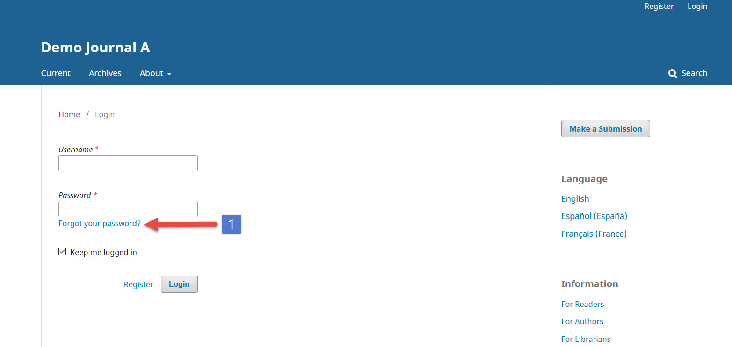
Forgetting your Password
If you have forgotten your password, you can simply go to the login page and click on the ‘Forgot your password’ link . Clicking on it takes you to password reset page where you can enter your user email address to reset the password. OJS 3.x will send a Password request confirmation link to the user’s email address. By clicking the link in the email a new password is generated and sent to the user’s email address.

Slide 10
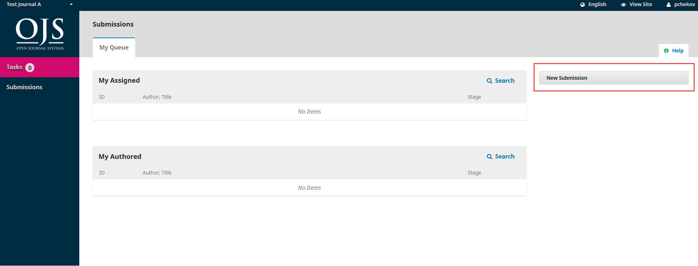
Submitting a paper
Start a new submission by clicking the New Submission button on the right side of the screen. You will be taken to Step 1 of a 5-Step process to upload and describe your submission.

Slide 11
In Step 1 you will provide preliminary information about your submission.

Slide 12
On Step 2, a window will open allowing you to upload your submission file.

Slide 13
First, you MUST select an Article Component. This lets the system know whether the file is the body of the manuscript, an image, a data set, etc. This must be selected before your file will upload.

Slide 14
Once you’ve made that selection, you can then upload your first file. It is important to note that you can only upload one file at a time. Additional files can be uploaded later in the process. Typically, this first file will be the body of your manuscript. Hit the Continue button once the file uploads.
After uploading the file, you will be asked to review the name of the file. Use the Edit link to make any changes.

Slide 15
Click the Continue button. Next, you have the option to repeat the process to upload additional files (e.g., a data set or an image). Once you have finished uploading all of your files, click Complete; this will close the upload window.

Slide 16
You will be brought back to the Submit an Article screen where you will see the files you’ve uploaded. If you need to make changes, expand the blue arrow to the left of your file and make any changes using the Edit link.

Slide 17
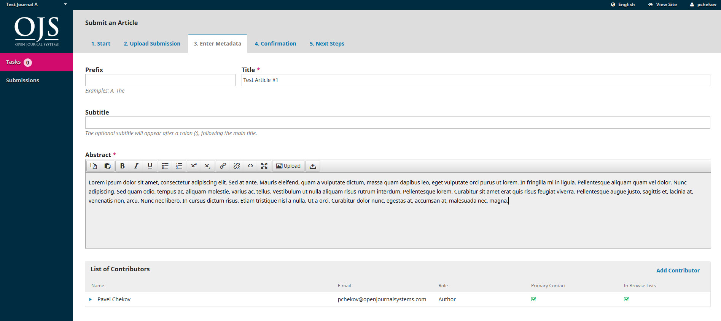
On Step 3, you will be asked to add more information about the submission, including the title of the submission (broken down into prefix, title, and subtitle), the abstract, and additional contributors.

Slide 18
You can add more contributors (e.g., co-authors), by clicking the Add Contributors link. This will open a new window with fields to enter their information.

Slide 19
Click Save, and the new contributor will appear on the screen.

Slide 20
Depending on the journal you are submitting to, you may see additional fields to complete, such as keywords.
Click Save and Continue to move forward.

Slide 21
On Step 4, you will be asked to confirm your submission. Click Finish Submission.

Slide 22
A box will pop up asking you to confirm you are finished. Click OK.

Slide 23
Step 5

Slide 24
Dashboard And here is your submission in your Dashboard. You can see that it is currently in the Submission stage.
And here is your submission in your Dashboard. You can see that it is currently in the Submission stage.

Slide 25
Reviewing process
As a reviewer, you will learn of the review request via email or by checking your dashboard:

Slide 26
From the My Assigned list, find the title and Review link. Notice the lack of any author information in this double-blind peer review process. Selecting the Review link will take you to the first review step in the submission record, which is much more limited than the editor’s view, and contains no author information.

Slide 27
Reviewing process-Step 1
This first step consists of the following sections:
Request for Review: provides some text inviting you to act as a reviewer.
Article Title: provides the title of the article.
Abstract: provides the abstract text.

Slide 28
you can decline or accept the review. If you decline, you will be dropped from the process. If you accept, you will move to review step 2, where you would be able to read any reviewer guidelines provided by the journal.

Slide 29
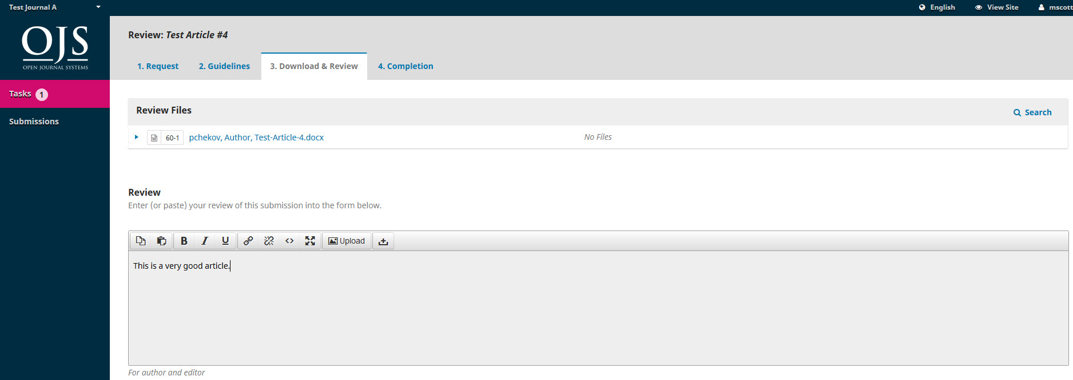
Click Continue to move to step 3. From here you can download a copy of the review files and enter your review comments.

Slide 30
Reviewing Step -3

Slide 31
Reviewing –Step3
Once you have read the paper and added your comments, scroll down the page to optionally upload a marked up copy of the review file (remember to strip any personal identification from the file before uploading it).
You must then make your recommendation using the dropdown menu.
Your choices include:
Accept Submission: it is ready to go to Copyediting as is.
Revisions Required: it requires minor changes that can be reviewed and accepted by the editor.
Resubmit for Review: it requires major changes and another round of peer review.
Resubmit Elsewhere: it doesn’t seem like a good fit for the focus and scope of this journal.
Decline Submission: it has too many weakness to ever be accepted.
See Comments: if none of the above recommendations make sense, you can leave a comment for the editor detailing your concerns.

Slide 32
Finally, Click the Submit Review button to complete your task. You’ll be asked to confirm.

Slide 33
Click OK. You will be taken the final confirmation screen thanking you for your work.

Slide 34
Thank You

