Slide 1


برعاية
السيد عميد كلية الهندسة الاستاذ الدكتور غسان حميد عبد المجيد المحترم وبالتعاون مع وحدة التأهيل والتوظيف ووحدة التعليم المستمر في كلية الهندسة يقيم قسم الهندسة الميكانيكية ورشة بعنوان
(الاعتبارات الأخلاقية في البحث)
والتي يلقيها أ.م. د علي إبراهيم حسن
10:30 في تمام الساعة 1\3\2026 وذلك يوم الاحد الموافق
تستهدف التدريسين وطلبة الدراسات العليا
في قاعة د. احسان يحيى داخل قسم هندسة الميكانيك
الدعوة عامة للجميع

Slide 2
Ethics Considerations in Research

Slide 3
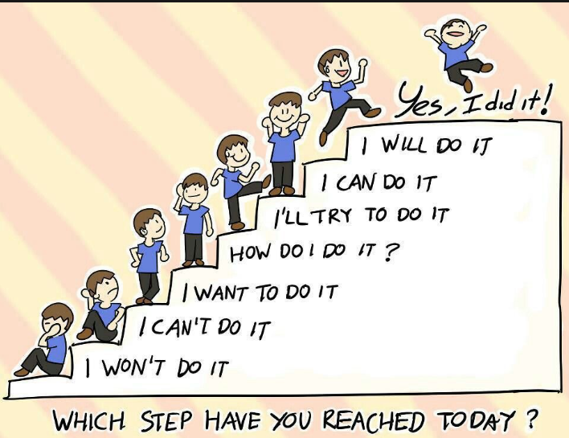
CONTENTS OF A RESEARCH PROPOSAL
Topic (title).
Abstract.
Introduction.
Review of literature. It refers to all sources of scientific evidence about the topic of interest. It is sometimes termed as a 'need for study ‘ or to find a knowledge gap......
Aims and objectives. ...
Research design and method. ...
Ethical considerations. ...
Budget. ...
Appendices. ...
Citations (References).

Slide 4

Ethical considerations
Most people learn ethical norms at home, at school, in church, or in other social settings. Although most people acquire their sense of right and wrong during childhood, moral development occurs throughout life, and human beings pass through different stages of growth as they mature.
Most societies also have legal rules that govern behaviour, but ethical norms tend to be broader and more informal than laws. Although most societies use laws to enforce widely accepted moral standards and ethical and legal rules, use similar concepts, ethics and law are not the same. An action may be legal but unethical or illegal but ethical. We can also use ethical concepts and principles to criticise, evaluate, propose, or interpret laws.

Slide 5
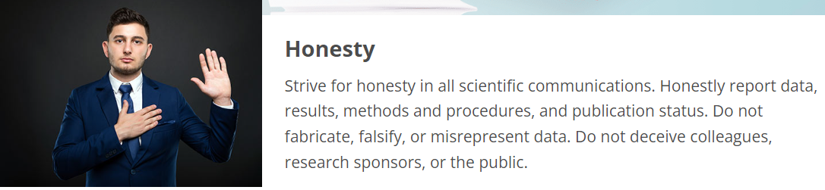
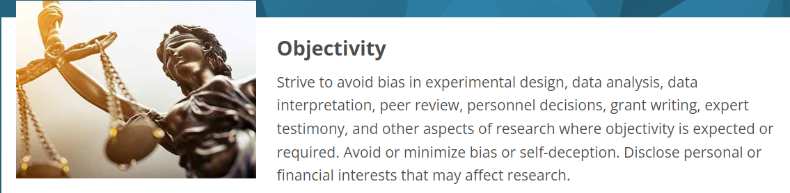
Ethical Principles
Adapted from Shamoo A. and Resnik D. 2015. Responsible Conduct of Research, 3rd ed. (New York: Oxford University Press).

Slide 6
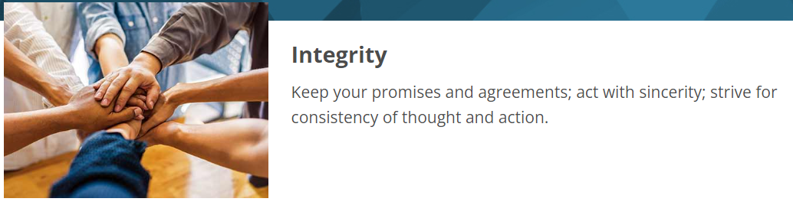
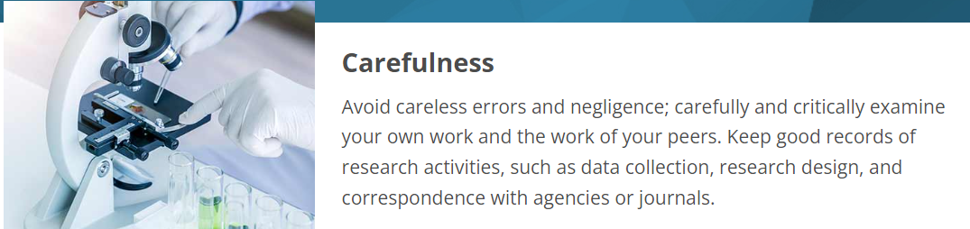

Slide 7



Slide 8
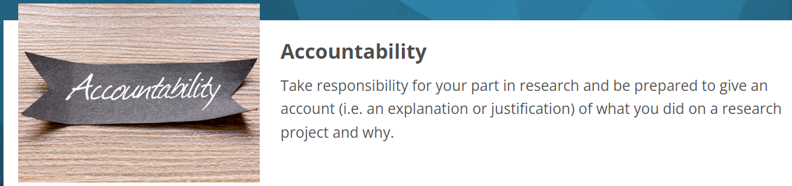


Slide 9



Slide 10



Slide 11
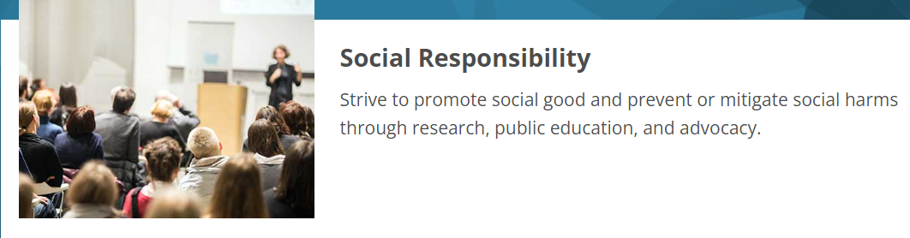
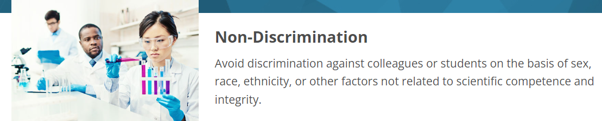

Slide 12



Slide 13
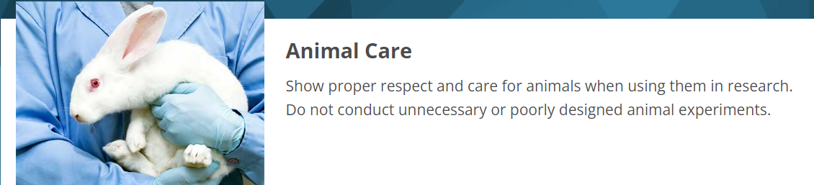
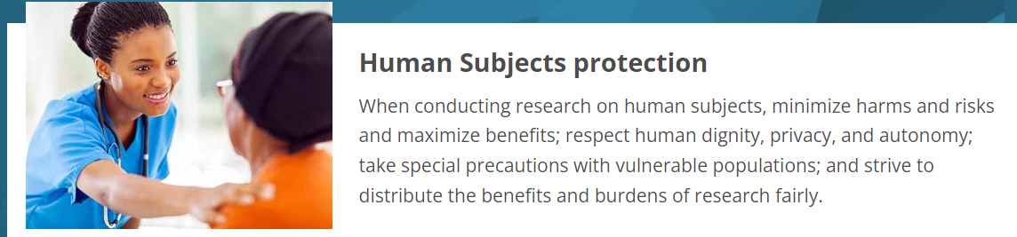

Slide 14
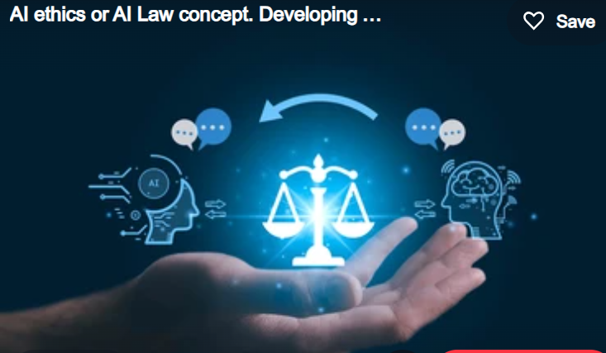
Ethical Decision-Making in Research
Although codes, policies, and principles are very important and useful, like any set of rules, they do not cover every situation, they often conflict, and they require considerable interpretation. Therefore, it is important for researchers to learn how to interpret, assess, and apply various research rules and how to make decisions to act ethically in various situations. The vast majority of decisions involve the straightforward application of ethical rules. For example, consider the following case,

Slide 15

Case 1:
Dr. T has just discovered a mathematical error in his paper that has been accepted for publication in a journal. The error does not affect the overall results of his research, but it is potentially misleading. The journal has just gone to press, so it is too late to catch the error before it appears in print. In order to avoid embarrassment, Dr. T decides to ignore the error.
Dr. T's error is not misconduct, nor is his decision to take no action to correct the error. Most researchers, as well as many different policies and codes, would say that Dr. T should tell the journal (and any coauthors) about the error and consider publishing a correction or errata. Failing to publish a correction would be unethical because it would violate norms relating to honesty and objectivity in research.

Slide 16

Keep going with your research without giving up…….
End of lecture

