Slide 1
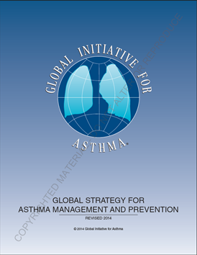
OBSTRUCTIVE SLEEP APNEA & HYPERTENSION
PROFESSOR: MUHAMMED WAHEEB SALMAN
FCCP, FRCPE
CONSULTANT CHEST PHYSICIAN
MEDICAL COLLEGE- UNIVERSITY OF BAGHDAD 2021

Slide 2
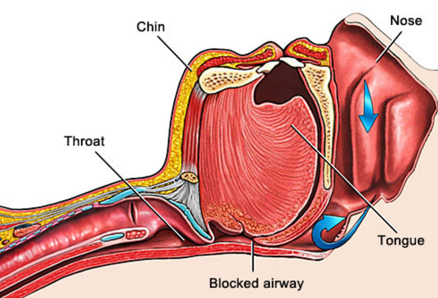
Definition of OSA
Hypopnea
Apnea
Recurrent episodes of partial or complete upper airway (UA) collapse during sleep.
Leading to a reduction in or complete cessation of airflow despite ongoing inspiratory efforts.
Resulting in significant O2 desaturation ± ↑PCO2.
The events are mostly terminated by arousals.
During sleep

Slide 3
Pathophysiologic Links Between OSA and HTN

Slide 4
PATHOGENESIS
(1) Reduced calibre of pharyngeal airway Obesity, Micrognathia ,Acromegaly, Hypothyroidism, Large tonsils& Large adenoids.
(2) Reduced pharyngeal dilator muscle tone REM sleep, Sedatives& Alcohol.
(3) Inspiratory effort in increased upper airway:
resistance Nasal polyps, Deviated nasal septum Large tonsils& Large adenoids.

Slide 5
Neural Circulatory Mechanisms
Repetitive OSA-induced hypoxemia and hypercapnia elicit reflex changes in both sympathetic and parasympathetic activation.
These autonomic derangements, with consequent increases in catecholamine levels, persist even into the daytime and could contribute to the development of HTN.
Effective OSA treatment with continuous positive airway pressure (CPAP) reduces urinary catecholamine levels, and this reduction seems to be especially evident in patients with more severe OSA.

Slide 6
Inflammatory and Cytokine-Mediated Effects of OSA
OSA correlates with an increased burden of systemic inflammation and higher concentrations of hs-CRP (high sensitivity C-reactive protein), interleukin-1, interleukin-8, interleukin-6, tumor necrosis factor-α, Rantes (Regulated on Activation, Normal T Cell Expressed and Secreted), and sICAM (soluble intercelular adhesion molecules).
Whether these markers truly signify a worse prognosis for patients with OSA, and to what degree a potential therapeutic intervention could alter their pathogenesis remains to be determined.
Encouraging data have been suggested by studies in a murine model, in which atorvastatin, which is known to reduce inflammation, prevented various adverse cardiovascular processes related to intermittent hypoxia.

Slide 7
Renin–Angiotensin–Aldosterone System
Evidence relating OSA to markers of the renin–angiotensin–aldosterone system, clearly of high interest in patients with HTN, is unfortunately limited.
A curious observation in patients with resistant HTN attributable to hyperaldosteronism suggested that dietary salt intake was related to the severity of OSA.
This raises the question of whether salt intake and aldosterone levels constitute yet other variables which we need to control for when assessing the OSA–HTN relationship.
In a broader sense, a clearer understanding of the role of renin–angiotensin–aldosterone in the OSA–BP relationship would be of considerable clinical significance, given the ready availability of medication groups affecting such targets.

Slide 8
Sleep Inefficiency
OSA is an important cause of impaired sleep quality. Sleep inefficiency and short sleep duration have been postulated as potential contributors to elevated BP.
A recent study identified chronic insomniacs with short sleep duration as being at increased risk of incident HTN, but this effect was largely explained by controlling for obesity.
On the contrary, several studies showed positive correlations between sleep deprivation and various adverse cardiovascular risk factors: arterial stiffness, endothelial dysfunction, sympathetic activity, nondipping nocturnal BP pattern and insulin insensitivity.

Slide 9
Prevalence of secondary causes of hypertension associated with resistant hypertension
Hypertension. 2014 Feb; 63(2): 203–209

Slide 10
Obstructive sleep apnea appears to be the most common condition associated with resistant hypertension. Age >50 years, large neck circumference measurement, and snoring are good predictors of obstructive sleep apnea in this population.
Pedrosa RP¹, Et al. Obstructive sleep apnea: the most common secondary cause of hypertension associated with resistant hypertension. Hypertension. 2011 Nov;58(5):811-7.

Slide 11
Sign and symptoms

Slide 14
OSA is a recognized cause of secondary hypertension
Identified as an independent risk factor for the onset of arterial HTN.
HTN Occur in 50% of OSA patients.
about 30% of HTN patients have OSA.
Clear dose_effect is evident:
The more apneas/hr of sleep' the higher the chance for becoming hypertensive.

Slide 15
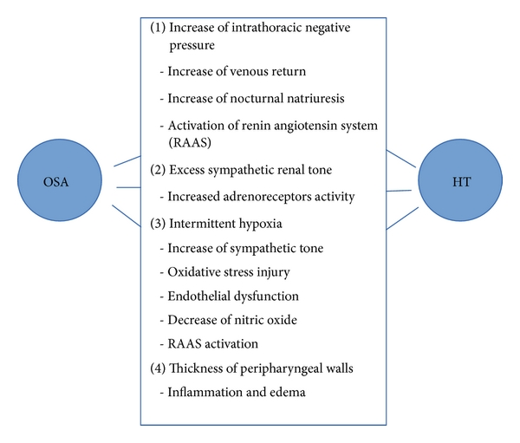
Pathophysiology

Slide 16
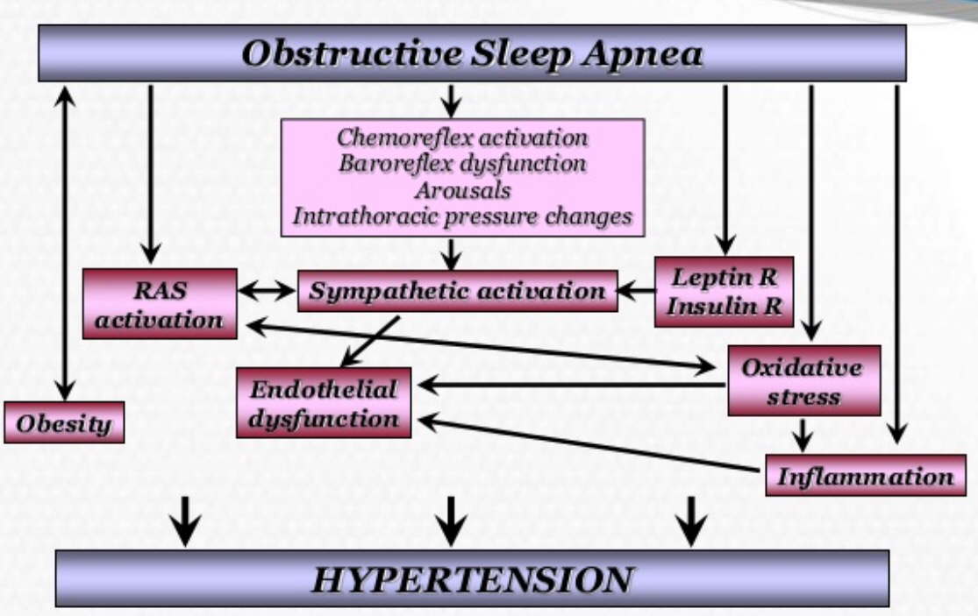

Slide 18
Cvd & other Serious Medical problems

Slide 19
Home messages
OSA & HT are:
2 common co-existing serious medical problems.

Slide 20
Home messages
1-Uncontrolled HT.
OSA
2- Resistant HT.

Slide 21
Daytime Sleepiness

Slide 22
Fatigue

Slide 24
Dry mouth or sore throat When you wake up in the morning

Slide 25
Morning Headache

Slide 27
Others
Night sweat
Nocturia
Restless during sleep
Lack of libido
Gasping & Chocking during sleep
Trouble getting up in the morning

Slide 28
Untreated OSA Is a risk factor for
1. High blood pressure,
2. Diabetes Mellitus,
3. Heart disease,
4. Stroke,
5. Is associated with overall decreased quality of life and wellbeing.

Slide 29
Is the diagnosis of OSA really difficult?
Toward a judicious use of diagnostic tools

Slide 30
Depends on guidelines, meta--analysis and recommendations
…… But not on a single study

Slide 31
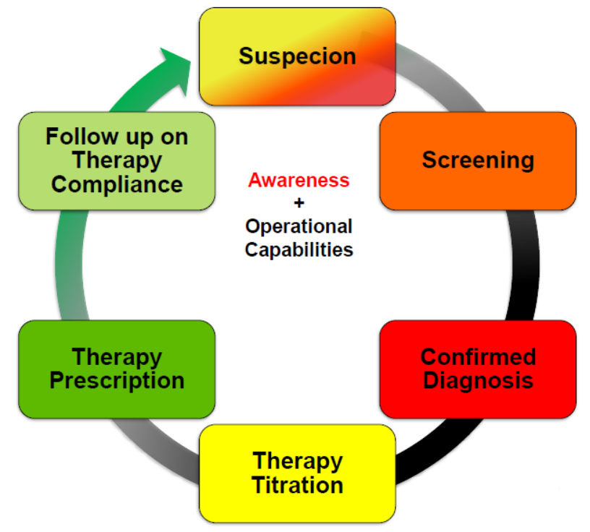
1
Cycle of the Diagnosis of Sleep Disordered Breathing
2
3

Slide 32
Challenges in the diagnosis of OSA
Raise awareness
Nonspecific symptoms
Keep high index of suspicion
Explore the meaning of symptoms
Concentrate on high specificity symptoms
Unfamiliar way of diagnosis
Polysomnography (PSG)
Types? Accuracy? guidelines?
CPAP?
Unfriendly treatment
Awareness? cost? Effectiveness?

Slide 33
Is the diagnosis of OSA really difficult?
Diagnosis depends on three levels:
Suspicion
Screening
Confirmation
SUSPICION
Risk Factors
At night: Loud snoring, awakenings due to choking and/or gasping, and witnessed apneic episodes
At day time: daytime hyper somnolence and difficulty in staying awake during the day
Comorbidities
suggestable symptoms

Slide 34
SCREENING
To pick up patients who are in need for doing polysomnography
The tools are usually questionnaire forms
Searching for the risk factors
All share the same principles:
Quantify its specific symptoms
Detecting comorbidities
They are many, all have limited sensitivity and specificity in comparison to AHI measure by PSG, so they are only used for screening of people

Slide 35
Definition of OSA
CONFIRMATION OF OSA
Hypopnea
Apnea
Recurrent episodes of partial or complete upper airway (UA) collapse during sleep.
Leading to a reduction in or complete cessation of airflow despite ongoing inspiratory efforts.
Resulting in significant O2 desaturation ± ↑PCO2.
The events are mostly terminated by arousals.
During sleep

Slide 36
So the ideal device ( PSG) used for confirmation should measure all the essentials for the complete of definition
1
To define Apnea/ hypopnea >>>>
measure flow (thermal and pressure)
To measure the effect of Apnea/ hypopnea:
2
3
Awakening >>>>>> EEG & EOG
Desaturation >>>> oximeter
4
To measure the presence of respiratory efforts >>>>
5
Thoracic and abdominal movement
During sleep >>>>> EEG (+ peripheral artery tone)
2
Others >>>>> snoring , ECG, EMG, Body position
6
7
8
9

Slide 37
Treatment modalities
CPAP
Oral appliances
Surgeries
Drugs
Life style modifications

Slide 38
Prevention and Treatment of HTN With CPAP
A possibly preventive role of CPAP in reducing incident HTN was suggested by the large prospective Zaragoza Sleep Cohort Study, which reported a lower incidence of newly diagnosed HTN in those patients with OSA who tolerated CPAP.
The decrease in systolic and diastolic BP of 2.58 and 2.01 mm Hg, respectively, favoring those treated with CPAP.

Slide 39
Anti hypertensive drugs
Although most elderly hypertensive respond to diuretics and calcium channel blockers, patients with OSA responded to β-1 adrenergic blockers, ACE inhibitors, and angiotensin II blocking drugs.
The response to a second drug is not known. However, many patients with OSA remain hypertensive on three antihypertensive agents, in which case the addition of spironolactone has been effective.
It is reasonable to prescribe shorter acting antihypertensive drugs at night to treat nocturnal hypertension.

Slide 40
Epidemiological evidence implicates OSA as one of the modifiable and highly prevalent factors in the development of HTN.
A nocturnal no dipping pattern of BP has been confirmed in older adults with OSA but not in children.
Patients with OSA have decreased exercise tolerance and higher diastolic BP during exercise testing.

Slide 41
Patients with resistant HTN may exhibit nocturnal rostral fluid shifts and decreased airway diameter.
Conflicting data exist regarding the role of CPAP in reducing incident HTN in patients with OSA.
Results of meta-analyses speak consistently to a modest 2-mm Hg antihypertensive effect of CPAP.

Slide 42
There is no definitive study on the use of specific antihypertensive medications for hypertensive patients with OSA.
Clonidine may decrease REM sleep and then reduce the episodes of apnea during this sleep phase and improve nocturnal hypoxemia.
Comparison between five classes of drugs commonly used (atenolol, amlodipine, Enalapril, losartan and hydrochlorothiazide) did not show any significant influence on the severity of OSA.
(

Slide 43
All drugs showed similar effects on daytime blood pressure, but atenolol reduced nighttime blood pressure more effectively in comparison to the other drugs) explained by its inhibitory action on the sympathetic system

Slide 44
Finally, the antagonism of the renin-angiotensin-aldosterone system by means of spironolactone may be beneficial to the treatment of blood pressure in patients with OSA and resistant SH.
This beneficial effect may be mediated by edema reduction in the upper airways, because recent evidences suggest that, during the night, there is increased venous return from the legs and consequent fluid accumulation in the airway tissues, which could be one of the factors responsible for the increased collapsibility of the airways, especially in men.

Slide 45
Wake up, I have finished
Thank you

