Slide 1


Impact of Laser in Modulating Epigenetic Marks
ا.د. فاضل محمد لفتة
معهد الليزر للدراسات العليا

Slide 2
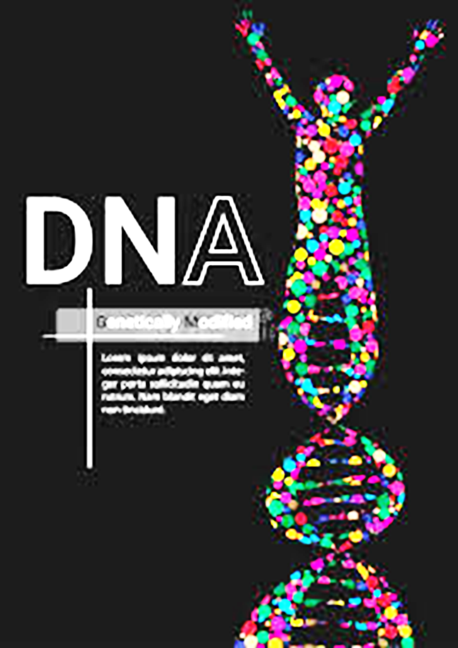
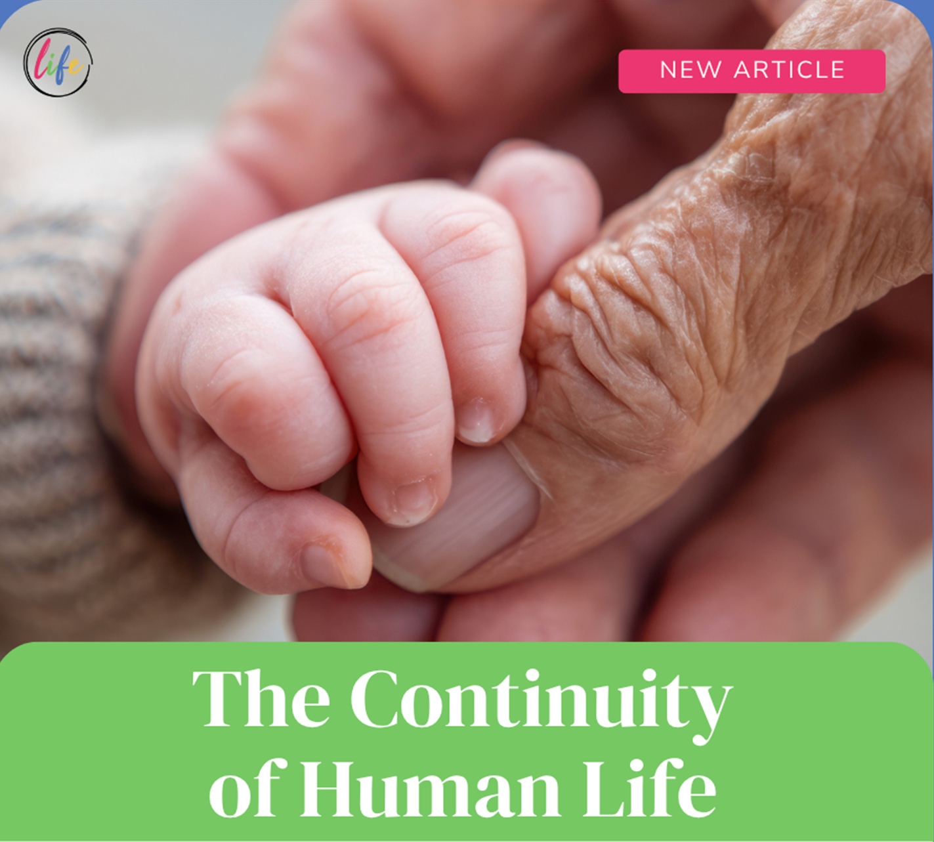

Genetics is the science of life continuity
علم الوراثة هو علم استمرارية الحياة

Slide 3
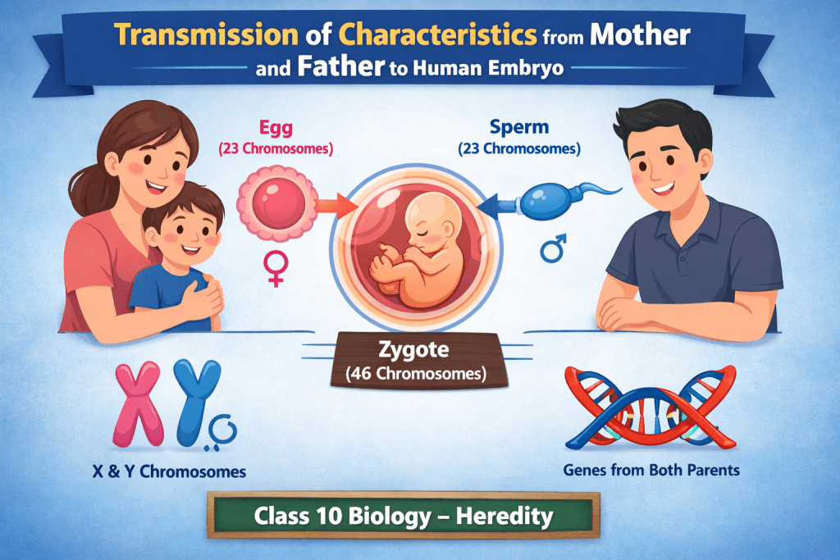
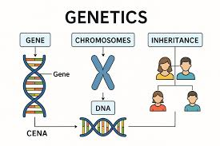

Slide 4
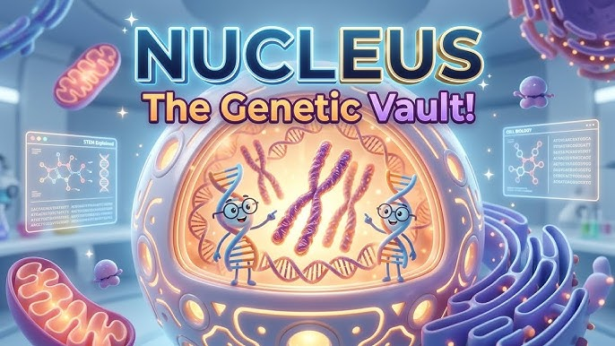
DNA is primarily housed within the nucleus of cells, which acts as the command center,
46 Chromosomes
30,000 Genes

Slide 5
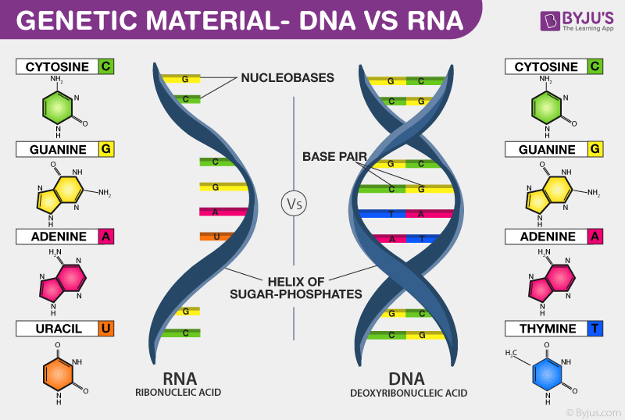
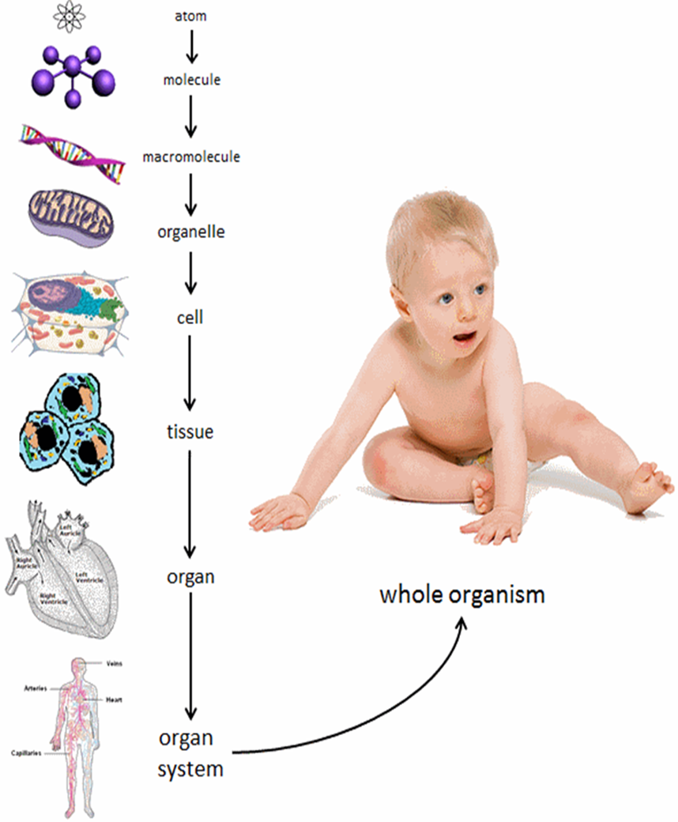

Slide 6


Genetics vs. Epi
genetics
Despite sharing identical DNA sequences(محتوى وراثي متماثل), identical twins often develop different diseases/health issues,
because expression of their genes diversified over lifetime as result of differences in their environments & lifestyle choices

Slide 7
Genetics vs. Epi
genetics
Differences between identical (monozygotic) twins cannot be interpreted based on genetics alone!!!
Despite sharing identical DNA sequences(محتوى وراثي متماثل), identical twins often develop different diseases/health issues,
because expression of their genes diversified over lifetime as result of differences in their environments & lifestyle choices

Slide 8
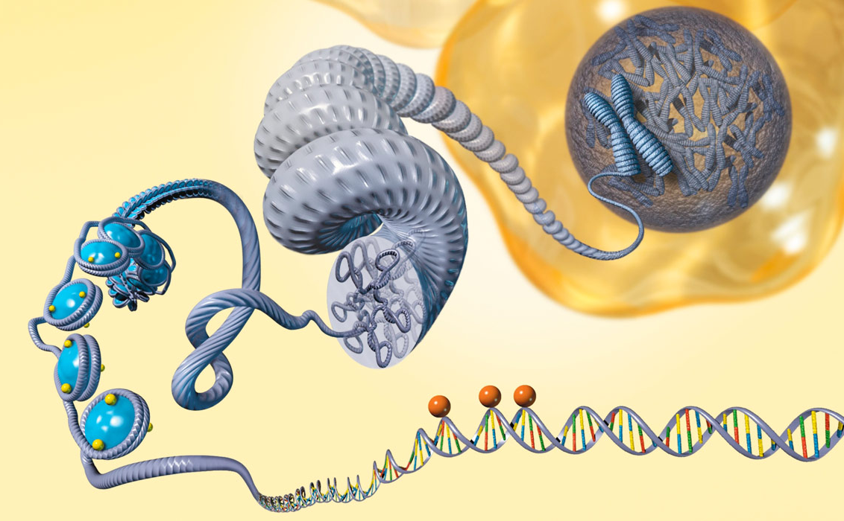
Genetics vs. Epi
genetics
What is Epigenetics?
Human genome
~30,000 genes
packaged in every human cell

Slide 9
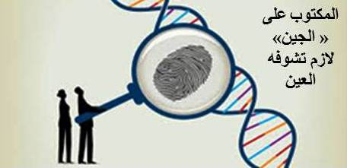
Genetics vs. Epigenetics

Slide 10
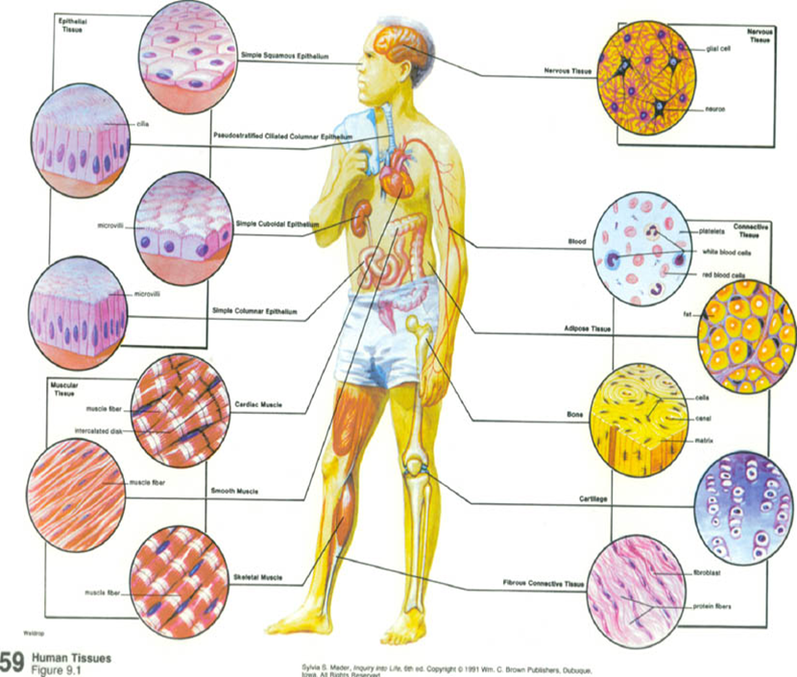
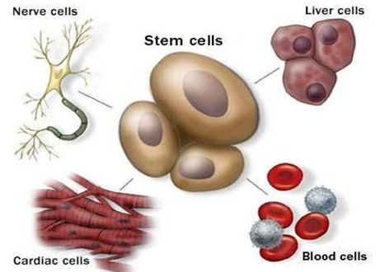
Genetics vs. Epigenetics
Although all cells in the body have the same genetic contents
Most cells do not produce all possible proteins, but a selection, depending on the type of cell.
على الرغم من ان كل الخلايا في الجسم تمتلك محتوى وراثي متماثل، الأ انا لا تعبر عن كل البروتينات المحتملة، وانما تعبر فقط عن بروتينات معينة وحسب نوع الخلية
Why?
How?
Cell-type specific & tissue specific gene expression

Slide 11
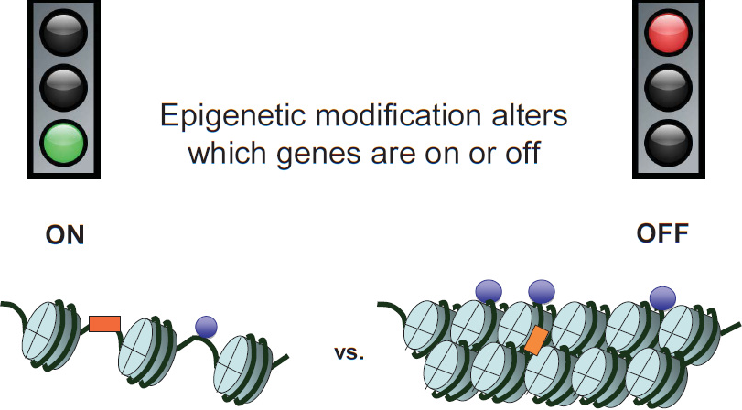
Genetics /Epigenetics
What is Epigenetics?
External modifications to DNA turn genes "on" or "off."
Do not change the DNA sequence.
التعديلات الخارجية على الحمض النووي تعمل على "تشغيل" أو "إيقاف تشغيل" الجينات، من دون ان تغير تسلسل قواعد الحمض النووي
DNA methylation, Histone modification, & ncRNA

Slide 12
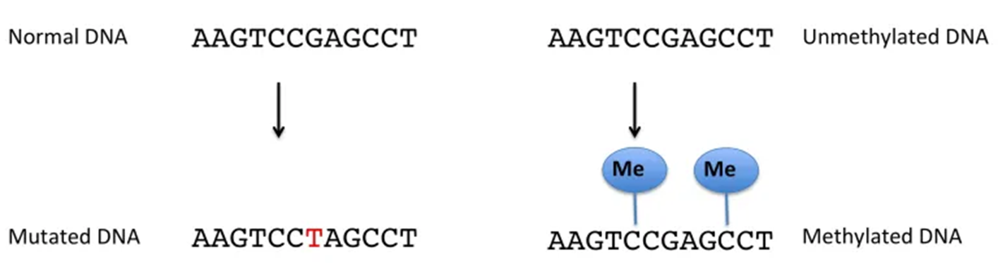
Genetics /Epigenetics
What is Epigenetics?
External modifications to DNA turn genes "on" or "off."
Do not change the DNA sequence.
التعديلات الخارجية على الحمض النووي تعمل على "تشغيل" أو "إيقاف تشغيل" الجينات، من دون ان تغير تسلسل قواعد الحمض النووي
Genetic change
Epigenetic change

Slide 13
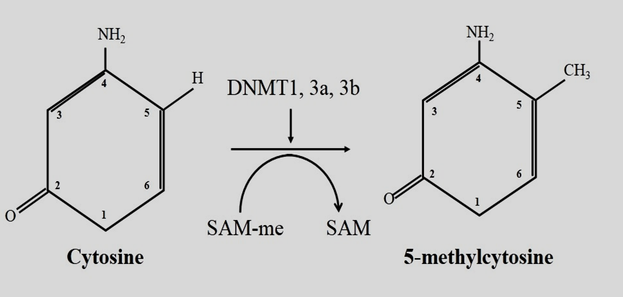
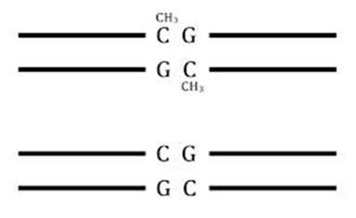
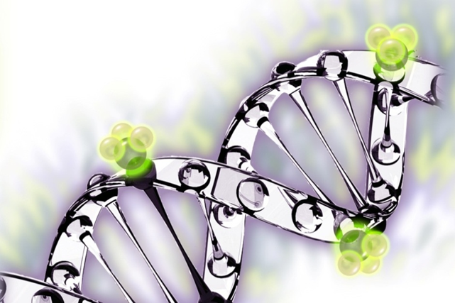
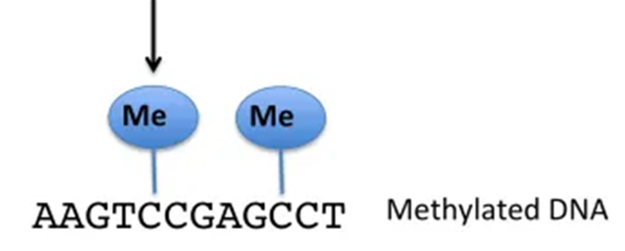
DNA Methylation مثيلة الدنا
DNA methylation a process by which a methyl group(CH3) is added to DNA nucleotides
CpG sites
Methyl-group
(SAM)S-adenosyl-methionine

Slide 14
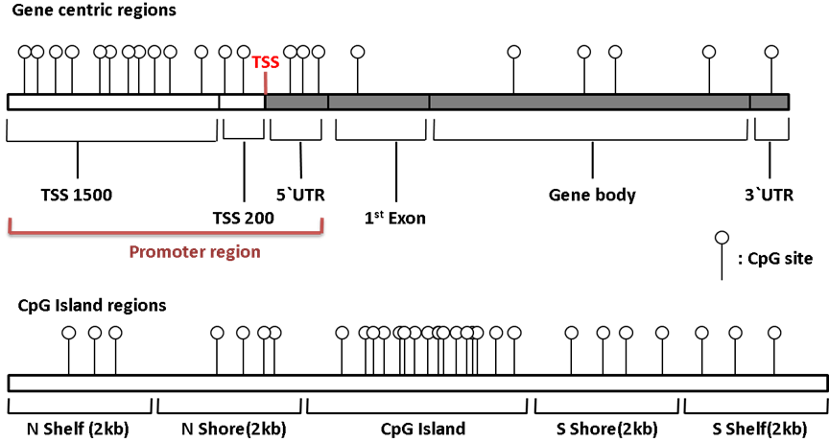
      DNA methylation across the genome
Up to 85% of CpGs are methylated in the genome repetitive regions

Slide 15


DNA Methylation - Normal Cells
Occurs at CpG sites
Up 85 % of CpGs are methylated
Pattern of methylation is stably inherited (DNMTs)
Genome is CpG poor
CpG islands are methylation-free associated with genes (60%)

Slide 16
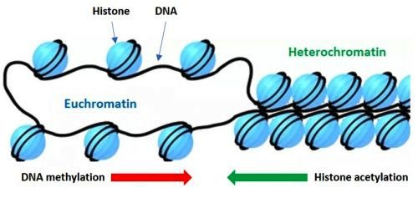
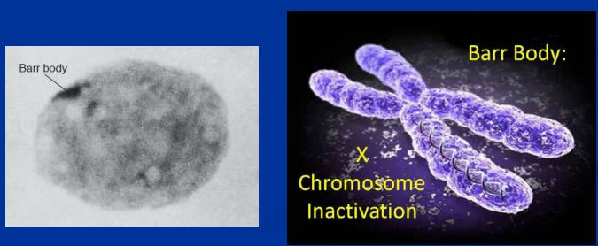
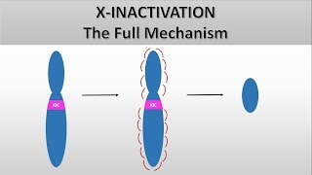
DNA methylation - Normal cells
1-Heterochromatin:
X-Chromosome Inactivation,

Slide 17
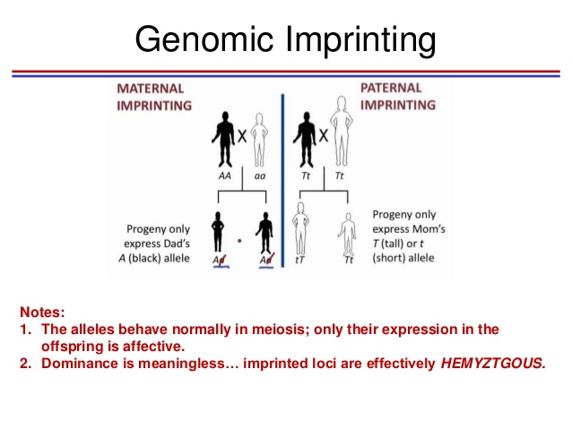
DNA methylation - Normal cells
2- Genomic Imprinting:
Genomic imprinting is an epigenetic phenomenon that causes genes to be expressed in a parent-of-origin-specific manner.

Slide 18

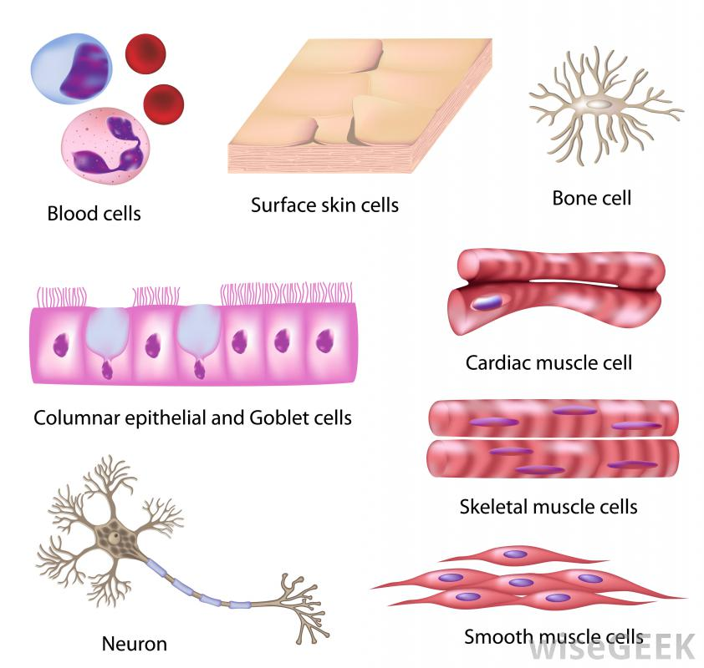
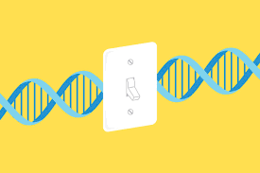
3-Cell type/Tissue Specific Gene Expression
Embryonic Development
Differentiation
and so on

Slide 19
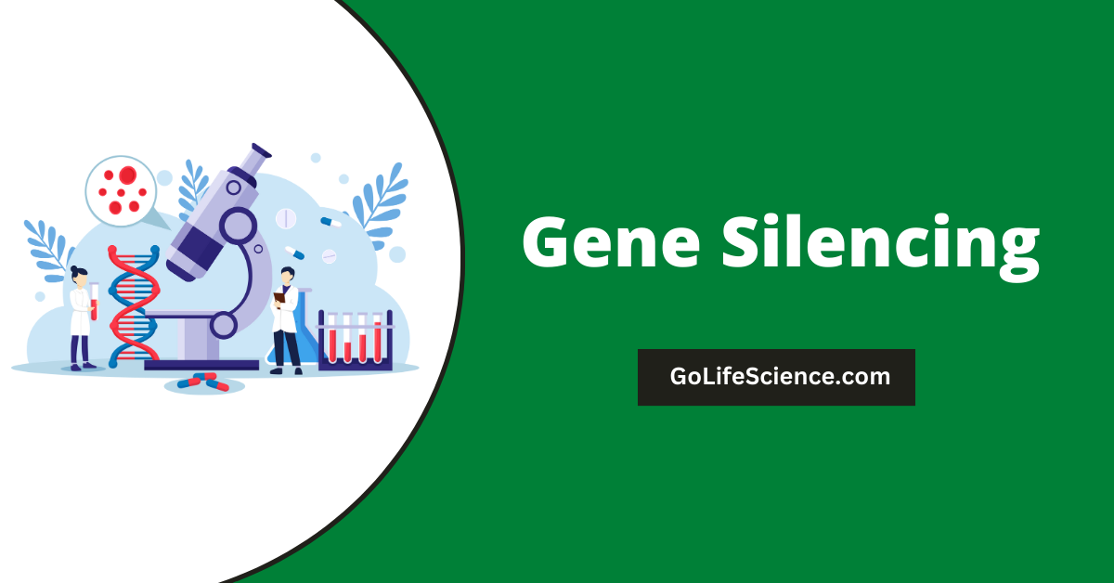
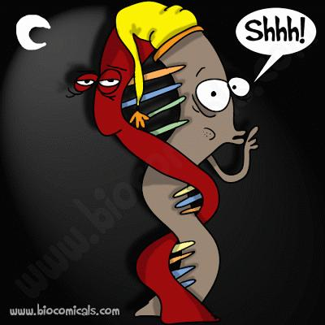
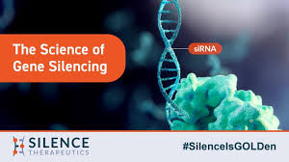
DNA Methylation
&

Slide 20
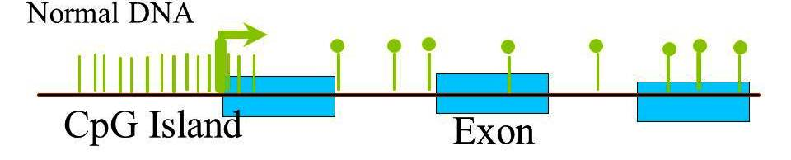

DNA methylation supress the expression of important genes
Active transcription
Gene promoter
Abnormal/Cancer DNA
Genes inactivated by DNA methylation
CpG Island
Exon
DNA methylation as a regulator of transcriptional processes in a nonpromoter methylation manner, but controlling regulatory elements such as enhancers

Slide 21

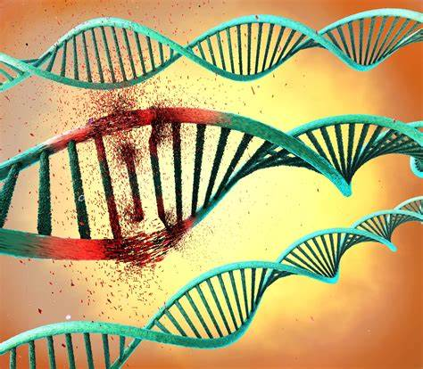
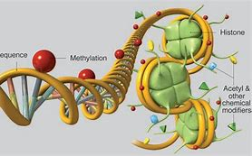
Genetic &Epigenetic Alterations: Two Sides of the Same Coin
Genetic and Epigenetic Alterations: Two Sides of the Same Coin
Genetic and Epigenetic Alterations: Two Sides of the Same Coin
Genetics
وجهان لعملة واحدة
Epigenetics
Lose function mutations
Gain function mutations
Hypermethyation
Hypomethyation

Slide 22
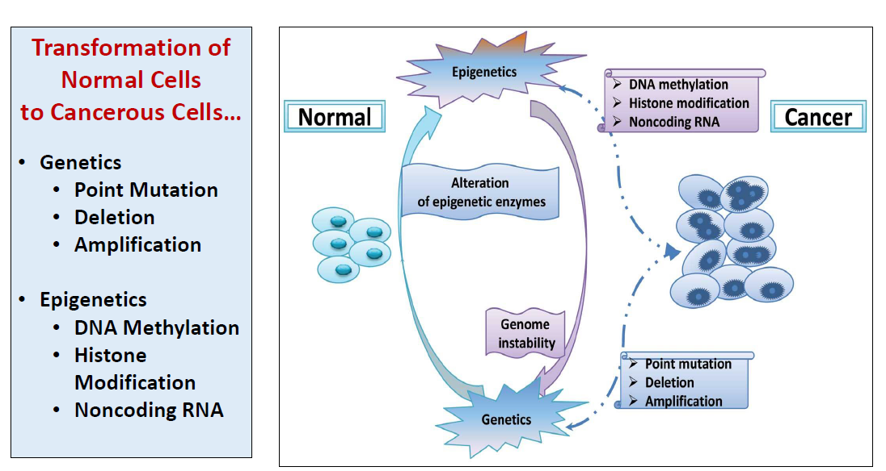
Epigenetics alternations is an alternative pathway to the mutations

Slide 23
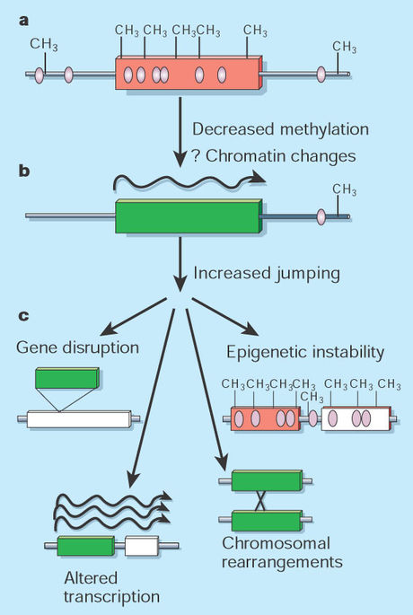
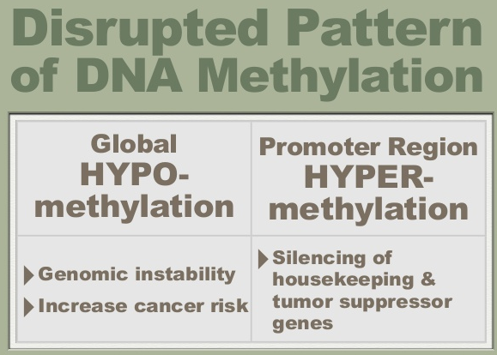
4-Genomic stability:
Inactivation of Transposons
=Mobile genetic elements
that can cause mutation and chromosomal rearrangement

Slide 24
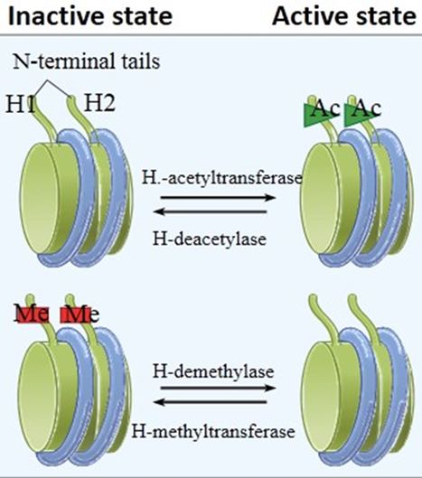
Histone modifications
Histones are not only DNA packaging molecules but are also crucial in the regulation of gene expression
HAT
HDAT
Acetylation-relaxed and transcriptionally active chromatin,
Heterochromatin -closed chromatin structures and the repression of transcriptional activity
HMT

Slide 25
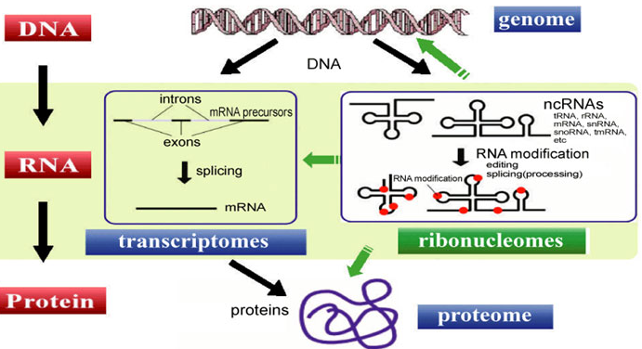
Non-coding RNAs (ncRNAs)
Key epigenetic regulators by modulating chromatin structure, DNA methylation, and histone modifications without altering the DNA sequence.
Direct enzymes to specific genomic locations to silence or activate gene expression.
Influencing cell differentiation, cancer progression, and inheritance.

Slide 26

    Epigenetic Modifications in Plant
Flowering,
Dormancy,
Germination,
Aging ,
Reinvigoration,
Stress response,
Genetic stability,
Cellular differentiation,
Cellular reprogramming processes.
Altering plant phenotypes
Drive natural variations

Slide 27
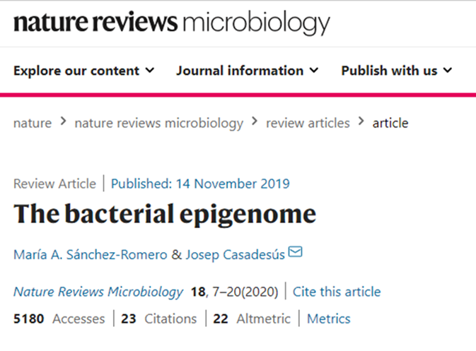
The Bacterial Epigenome
In bacteria, DNA methylation has roles in:
Genome defense,
Chromosome replication & segregation,
Nucleoid organization,
Cell cycle control,
DNA repair -Regulation of transcription (gene expression) .
Sporulation in any bacteria driven by epigenetics
In many bacterial species, DNA methylation controls reversible switching (phase variation) of gene expression, a phenomenon that generates phenotypic cell variants.
Epigenetic lineages enables the adaptation of bacterial populations to harsh /changing environments and modulates the interaction of pathogens with their eukaryotic hosts.

Slide 28
Epigenetics alternations is an alternative pathway to the mutations

Slide 29
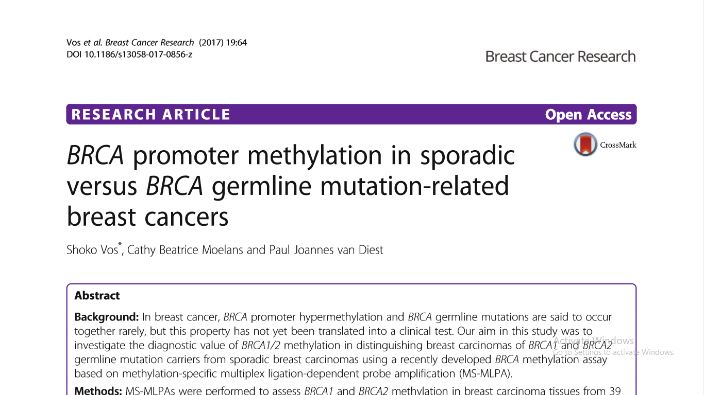
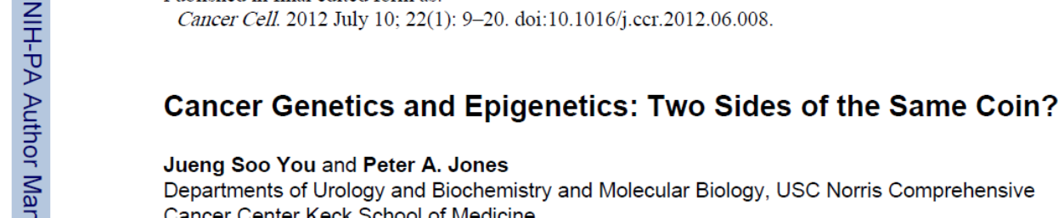
Cancer Epigenetics: Key issues
Epigenetic changes are of equal / greater importance than mutational changes in cancer development.
Most, if not all, cancers show aberrant DNA methylation
Epigenetic changes can cause mutations in genes, and, conversely, mutations are frequently observed in genes that modify the epigenome.

Slide 30
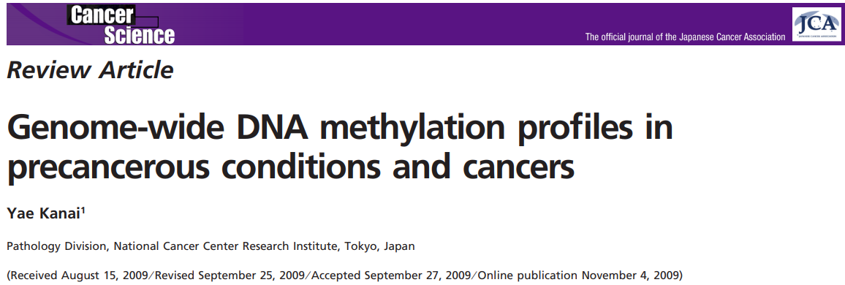
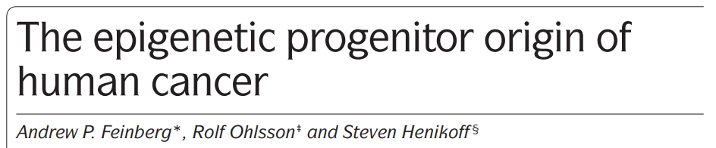
Which one comes first in cancer initiation epigenetic alterations of genetic mutations?
Aberrant DNA methylation of specific genomic regions occurs early in carcinogenesis

Slide 31
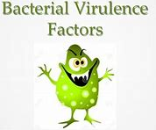
E. coli DNA adenine methyltransferase (Dam)
Dam plays several key roles in bacterial processes, including:
Mismatch repair,
Timing of DNA replication, and Gene expression.

Slide 32
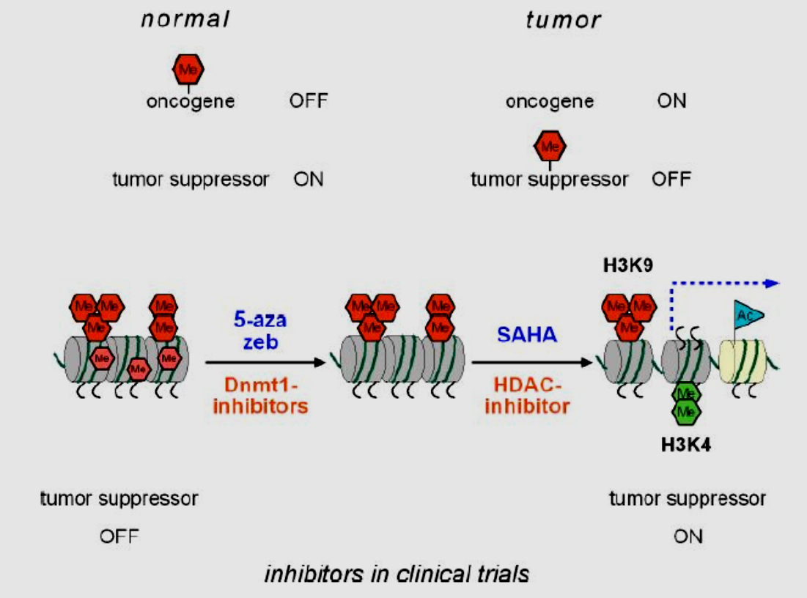
Pharmacoepigenomics
Reversible phenomena in response to environmental exposure
Epigenetic treatment is a new field that includes DNA demethylation and histone modification as targets, in the effort to re-establish epigenetic balance.
DNMT inhibitors, 2 HDAC inhibitors, and a Janus Kinase1/2 inhibitor

Slide 33
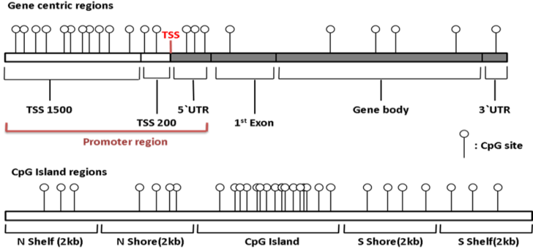
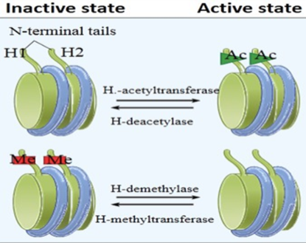
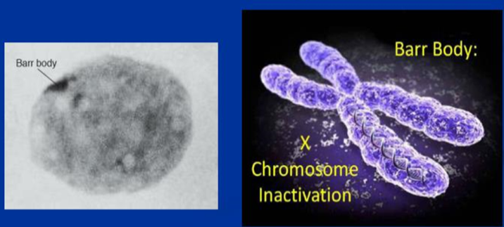

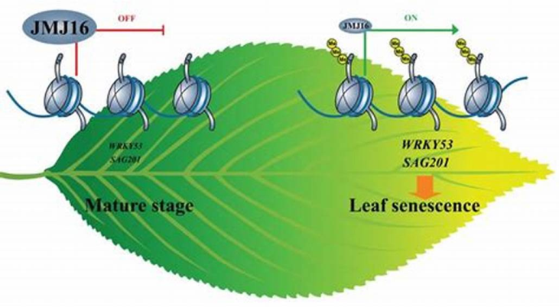
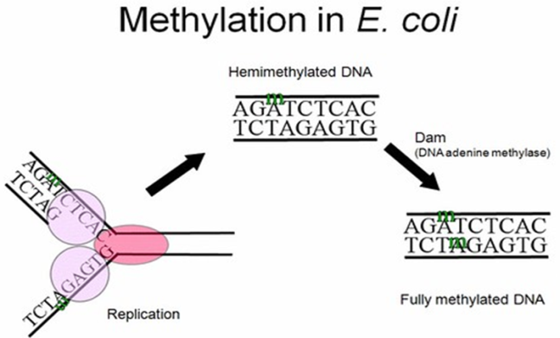
Summary: Epigenetic Modifications in Normal Cells
External modifications to DNA turn genes "on" or "off.“ Do not change DNA sequence.
DNA methylation, Histone Modification &ncRNA
DNA methylation : a methyl group CH3 is added to DNA nucleotides
Histone modifications (Acetylation-relaxed and transcriptionally active chromatin)
In normal cell:
Regulation cell/tissue specific gene expression,
Heterochromatin, X-Chromosome inactivation
Gene imprinting, Genomic stability
Development and Differentiation
Epigenetic alterations are reversible !!!
Equal / greater importance than mutational changes

Slide 34

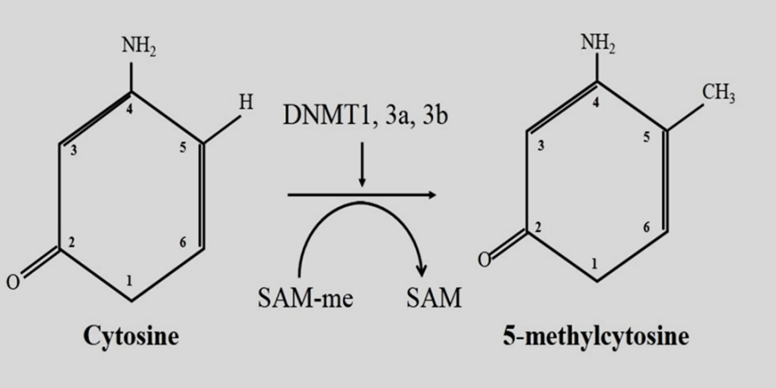

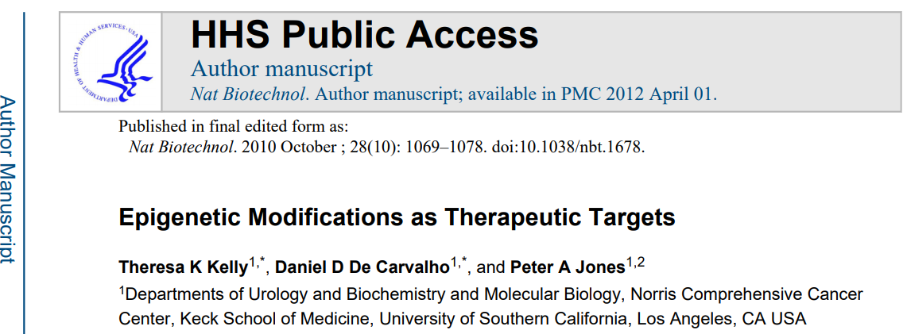
In contrast to germ line mutations,……..
Epigenetic alterations are reversible !!!

Slide 35

Epigenetic Reprogramming:
Can We Reverse the Aging Clock?
The concept of ‘epigenetic clock’, reflecting biological rather than chronological age, emerged as a powerful biomarker of tissue health and longevity.

Slide 36
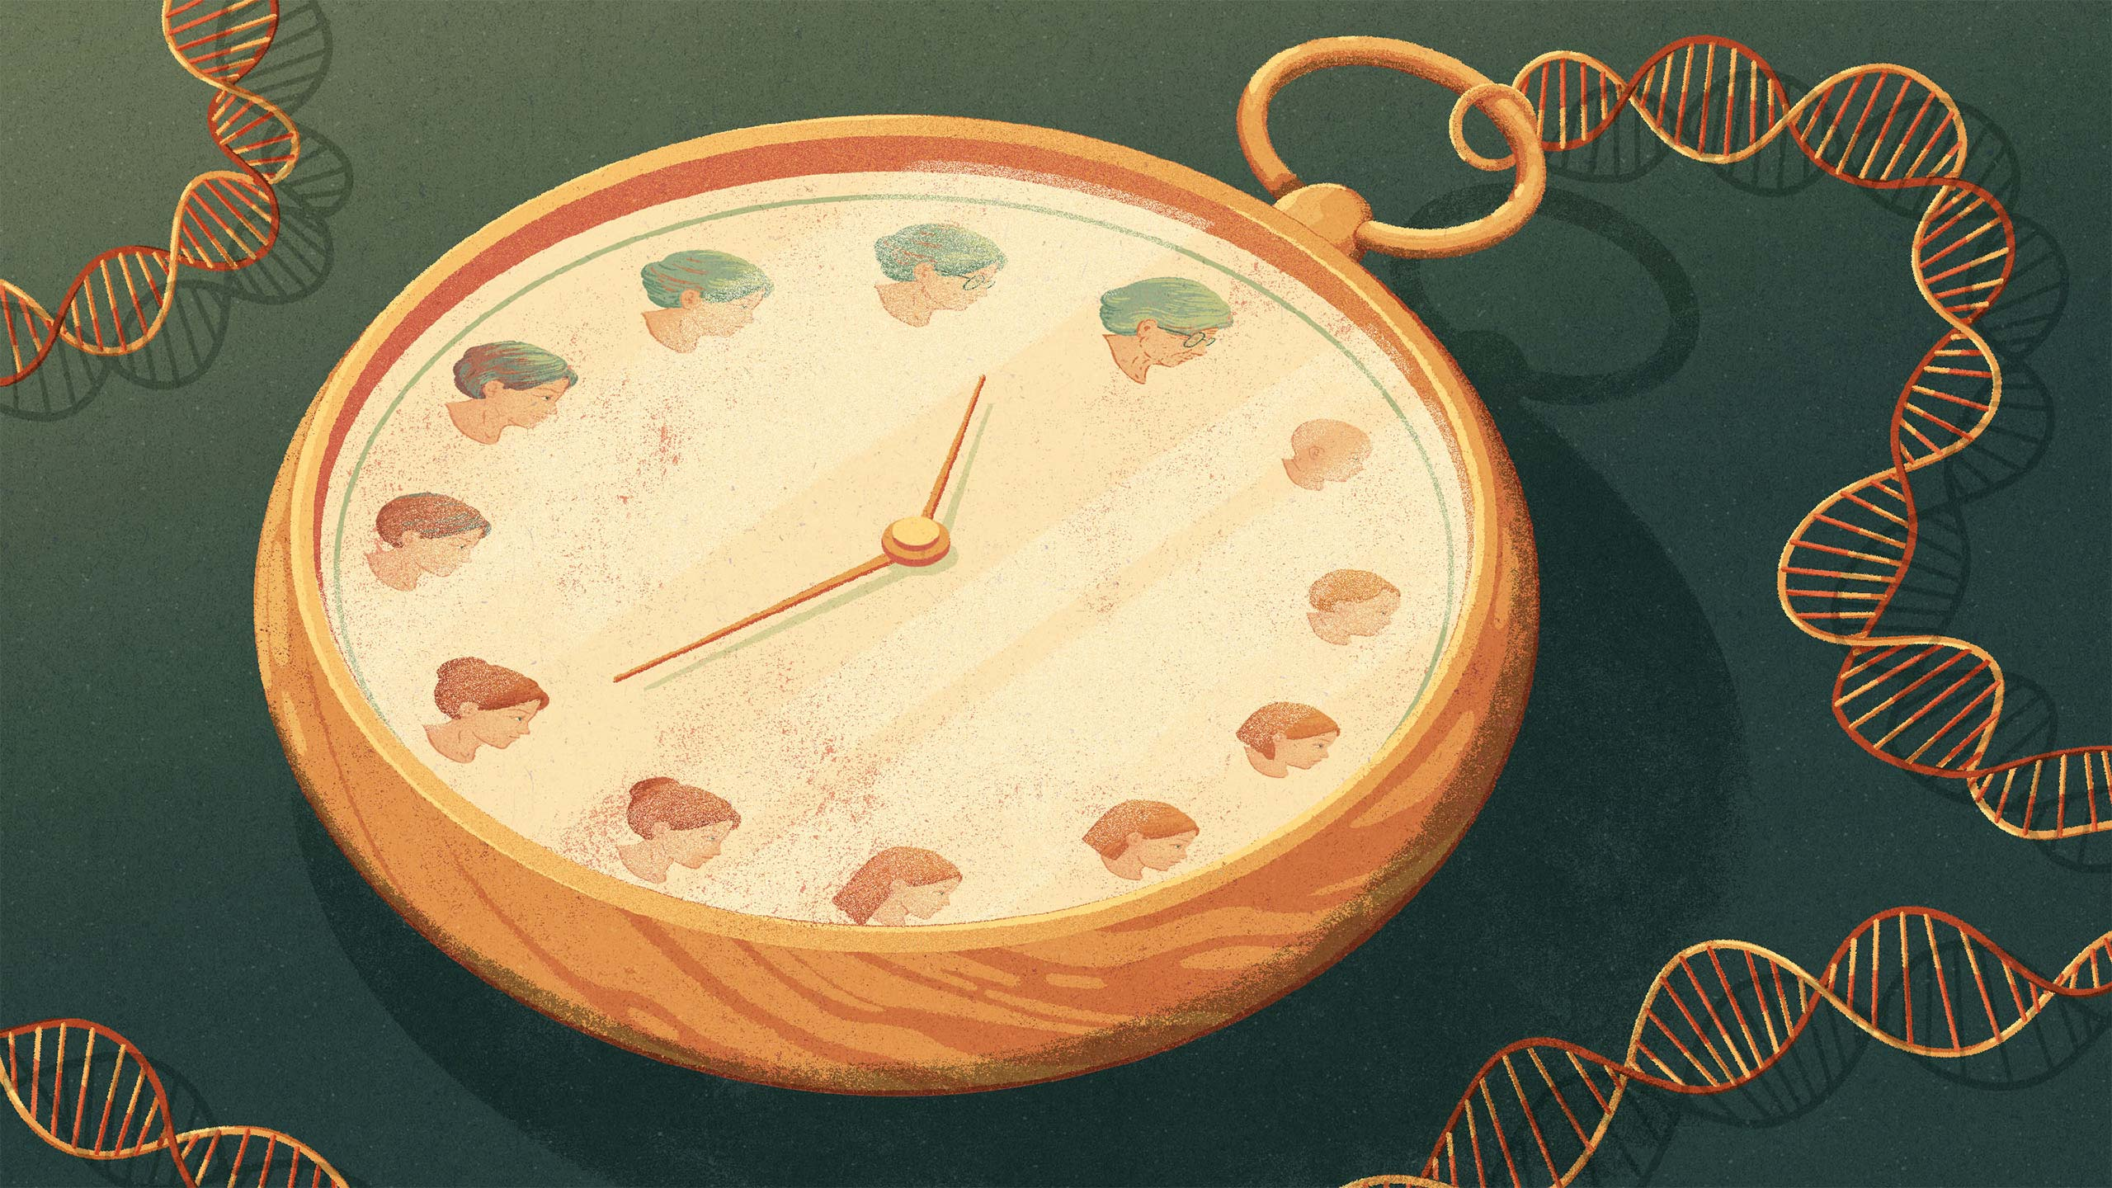
Good News….!!!
Lasers can "reset" epigenetic clocks in aging skin,
Restoring a more youthful profile of collagen/ elastin production

Slide 37
How laser modulate epigenetic marks?
Laser therapies, particularly fractional CO₂ and Low-Level Laser Therapy (LLLT/photobiomodulation), modulate epigenetic marks by:
1- Inducing cellular stress and
2- Promoting repair
,3-Acting as "molecular reset" devices that alter gene expression without changing the underlying DNA sequence.
This process works by causing:
controlled thermal injury or activating cellular metabolism, leading to changes in DNA methylation, histone remodeling, and non-coding RNA expression.

Slide 38





How laser modulates epigenetic marks
by inducing controlled cellular stress,
triggers a cascade of repair processes that "reprogram" gene expression.
These modifications do not change the DNA sequence itself but influence how genes are turned "on" or "off".

Slide 39

The Epigenetic Landscape of Skin
Skin is one of the most epigenetically dynamic organs, constantly adapting to environmental stimuli.
Its regenerative capacity & ageing trajectory are determined by both genetic predisposition and epigenetic regulation.

Slide 40

Epigenetic changes occur naturally as you age, but potentially reversible through proper environment stimuli
SKINTELLI test measures DNA methylation of genes strongly correlated to skin quality factors and ultimately cosmetic properties.
The degree of active or inactive states of your genes is dynamic and can be impacted by your skin’s exposure to the environment including the sun and, especially, the ingredients contained in skincare products.

Slide 41

The Epigenetic Landscape of Skin
DNA Methylation:
Methylation at CpG islands silences transcription. With age, methylation patterns become irregular, a process known as epigenetic drift.
Genes involved in collagen synthesis, elastogenesis, and antioxidant defense are progressively silenced, while pro-inflammatory pathways are activated.

Slide 42
The Epigenetic Landscape of Skin
Histone modifications:
Post-translational modifications such as acetylation and methylation influence chromatin accessibility.
Open chromatin promotes repair & regeneration,
whereas closed conformations inhibit these functions.
Altered histone states contribute to dermal thinning and impaired wound healing.

Slide 43
The Epigenetic Landscape of Skin
Non-coding RNAs:
MicroRNAs (miRNA) & long non-coding RNAs regulate mRNA translation.
Dysregulated miRNAs, such as upregulation of fibrotic
miR-21 or downregulation of antifibrotic miR-29, drive pathological processes including scarring, pigmentation disorders, and chronic inflammation.

Slide 44
The Epigenetic Landscape of Skin
DNA methylation, Histonmodification & Non-coding RNAs:
Taken together, these mechanisms make the skin’s epigenome both a record of environmental exposures and a determinant of its regenerative capacity.
تجعل هذه الآليات من جينوم الجلد سجلاً للتعرضات البيئية ومحدداً لقدرته على التجدد.

Slide 45

Laser-Induced Epigenetic Modifications
التعديلات اللاجينية المستحثة الليزر
Lasers deliver energy that induces microthermal injury, stimulating controlled wound healing.
This process is mediated by epigenetic reprogramming rather than mere collagen contraction.
Laser treatment can induce high expression of miR-146a, a microRNA known for its role in regulating inflammatory responses and promoting cellular recovery.
Laser injury or therapy (such as laser microdissection in models) can initiate a cascade that significantly increases miR-146a, often as a negative feedback loop to reduce inflammation

Slide 46

Laser-Induced Epigenetic Modifications
التعديلات اللاجينية المستحثة الليزر
DNA Methylation
Fractional CO₂ lasers reduce hypermethylation of promoters controlling extracellular matrix (ECM) related-genes, reactivating collagen & elastin production.
In fibroblasts from aged skin, post-laser treatment correlates with decreased ‘epigenetic age’, aligning cellular behaviour with a more youthful profile.

Slide 47

Laser-Induced Epigenetic Modifications
التعديلات اللاجينية المستحثة الليزر
Histone Remodelling
Laser-induced stress activates histone acetyltransferases, leading to chromatin relaxation and increased transcription of pro-regenerative genes.
Conversely, fibrotic genes undergo repressive histone modifications, decreasing pathological collagen deposition and improving scar remodelling.

Slide 48
Laser-Induced Epigenetic Modifications
التعديلات اللاجينية المستحثة الليزر
Non-coding RNAs
Studies demonstrated changes in miRNA profiles post-laser therapy.
miR 21, which promotes angiogenesis and fibroblast migration, is upregulated,
while miR-29, an inhibitor of collagen synthesis, is downregulated.
These coordinated shifts favour balanced ECM remodelling and tissue regeneration.
تساهم هذه التحولات المنسقة في إعادة تشكيل المصفوفة خارج الخلوية بشكل متوازن وتجديد الأنسجة

Slide 49
Laser-Induced Epigenetic Modifications
التعديلات اللاجينية المستحثة الليزر
Cellular Senescence
الشيخوخة الخلوية
Markers of senescence, e.g. p16 and β-galactosidase, decrease after fractional laser treatment.
By modulating senescence-associated secretory phenotype pathways, lasers not only rejuvenate fibroblasts but also reduce chronic inflammation, creating a more favourable regenerative microenvironment.

Slide 50

Laser-Induced Epigenetic Modifications
التعديلات اللاجينية المستحثة الليزر
Transcriptomic Insights
Transcriptome analyses post-laser reveal upregulation of growth factors, angiogenic mediators, and ECM regulators, many under epigenetic control.
These findings support the hypothesis that lasers function as molecular reset devices, orchestrating global gene expression changes via epigenetic remodelling.

Slide 51

Laser irradiation induces apoptosis
يؤدي التعرض لأشعة الليزر إلى موت الخلايا المبرمج
Key Aspects of Laser-Induced Apoptosis:
Mechanism: Laser exposure generates heat, leading to cellular damage and production of signaling molecules e.g. ceramide, that trigger apoptosis.
Medical Applications: High-energy lasers are effective in treating hypertrophic scars by promoting apoptosis of fibroblasts, thereby reducing collagen accumulation.
Impact of Dosage: While high-energy lasers induce apoptosis ,low-power laser irradiation (LPLI 810-nm) can actually reduce apoptosis (attenuate) in certain models.

Slide 52

Laser irradiation induces apoptosis
Key Research Findings:
Retinal Impact: Laser treatment in the eye can cause collateral apoptosis in the inner nuclear layer, highlighting the need for careful dosage control.
Laser-Tissue Interaction: The effectiveness of laser treatment is linked to the energy density, with higher doses leading to more significant apoptosis, as observed in studies of tissue healing.
Cancer Treatment: Combining lasers with gold nanoparticles can enhance the destruction of cancer cells by inducing apoptosis.

Slide 53

Factors affecting the epigenome
الأبيجينومepigenome لا يتأثير بالليزر فقط!!!

Slide 54


Thank You
For Listening

Slide 55





Genetics
2/3
الولد للخال
الولد سر ابيه
البنت لأمها

