Slide 1

Folic acid and cancer
Dr. Rana Ali

Slide 2
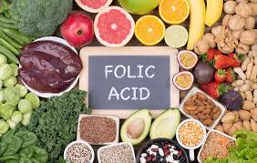
Folate is an essential water-soluble B vitamin found in foods, including dark-green leafy vegetables and legumes. Folic acid is the synthetic form of the vitamin present in supplements and fortified foods, namely grains and cereals. Dietary folate exists in a reduced state with polyglutamate side chains requiring oxidation and hydrolysis for absorption, whereas folic acid exists as the oxidized pteroylmonoglutamate form making it readily bioavailable.

Slide 3
Due to its role in one-carbon metabolism, folate has been studied extensively as a possible mechanism for cancer development. Folate as 5-Methyltetrahydrofolate (5-MTHF) and cobalamin are required for the conversion of homocysteine to methionine in the methionine pathway. Methionine is converted to S-adenosylmethionine (SAM). SAM is a chief methyl contributor to many reactions in the body, including DNA and RNA methylation.

Slide 4
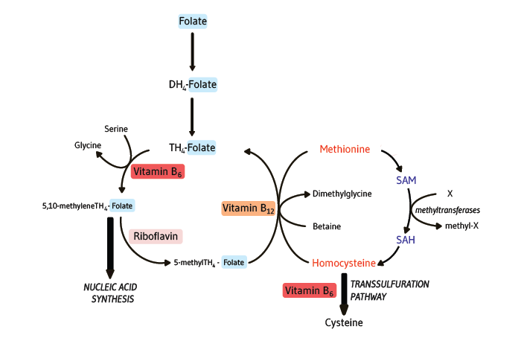

Slide 5
Inadequate production of SAM may lead to decreased methylation of CpG islands in DNA affecting gene transcription, altering expression of tumor suppressor genes and proto-oncogenes. Furthermore, folate deficiency can impair conversion of deoxyuridine monophosphate (dUMP) to deoxythymidine monophosphate (dTMP), the nucleic acid necessary for DNA synthesis and repair. The misincorporation of uracil for thymidine can eventually lead to unstable DNA, DNA strand breaks, and faulty DNA repair

Slide 6
Folic acid, found in fortified foods and supplements, is converted to tetrahydrofolate in the liver by dihydrofolate reductase (DHFR). It has been reported that folic acid in excess of 400 mcg may saturate the DHFR enzyme, resulting in unreduced folic acid, which has been hypothesized as a potential mechanism for carcinogenesis.

Slide 7
Just as overt folate deficiency and excess intake may interfere with cell replication and survival, reduced enzyme efficiency can also interfere with nutrient metabolism and influence disease risk. Methylenetetrahydrofolate reductase (MTHFR) is a key flavoenzyme that catalyzes the reduction of 5,10-methylenetetrahydrofolate to 5-methyltetrahydrofolate (5-MTHF). It is encoded by the gene MTHFR

Slide 8
There are two well-described MTHFR gene polymorphisms: C677T and A1298C. The C677T variant may occur in close to 20–40% of the population. Both variants are associated with reduced enzyme activity. Enzyme efficiency is reduced by up to 45% for the 677CT variant and by up to 70% for 677TT. The variated form of the enzyme has less affinity to its cofactor, flavin adenine dinucleotide. Cytosolic serine hydroxy methyl transferase (SHMT1) is another key enzyme in folate metabolism. It converts serine and tetrahydrofolate to glycine and 5,10-methylenetetrahydrofolate, respectively.

Slide 9
5,10methylenetetrahydrofolate is a substrate for purine and pyrimidine synthesis. The combination of folate deficiency and polymorphisms may result in DNA hypo- or hypermethylation.
Methylenetetrahydrofolate reductase (MTHFR) directly affects DNA synthesis and methylation and has been associated with increased risk of certain cancers.

Slide 10
Homozygosity for SHMT C1420T has been associated with a protective effect against colorectal cancer and overall cancer risk for Asian ethnicity. Another study found no association between colorectal cancer and SHMT; however, subgroup analysis showed a significant decreased cancer risk with low folate intake in the presence of SHMT1 variation. Folate intake level was not defined. A positive association was found between SHMT1 and risk for non-Hodgkin lymphoma

Slide 11
The presence of the MTHFR A1298C variant has been significantly associated with increased risk for cervical cancer, globally and among Asians. Homozygosity for A1298C in Asians has been associated with an increased risk of myeloid leukemia and non-Hodgkin lymphoma. Conversely, a decreased risk of liver cancer has been observed with the homozygous variant MTHFR 1298 CC overall and in Asian populations

Slide 12


