Slide 1
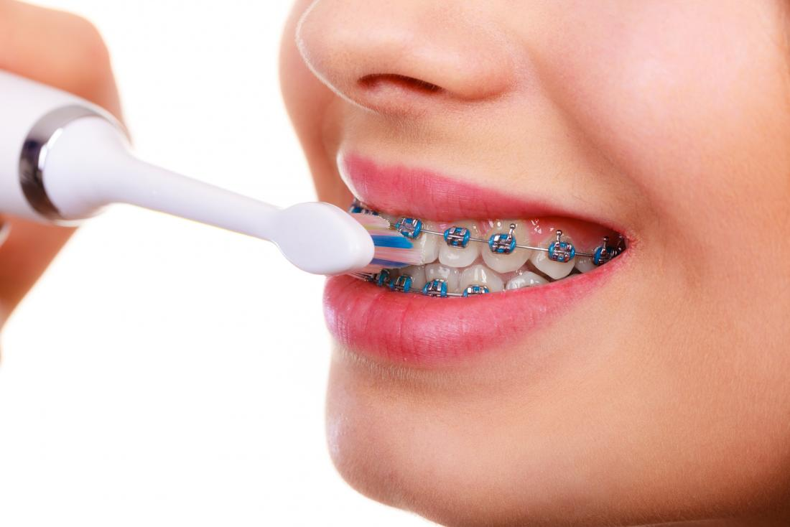
Oral hygiene care and management of oral and periodontal disease during orthodontic treatment

Slide 2
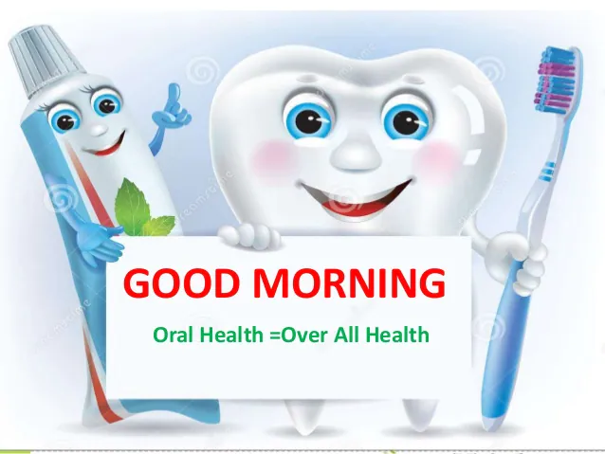
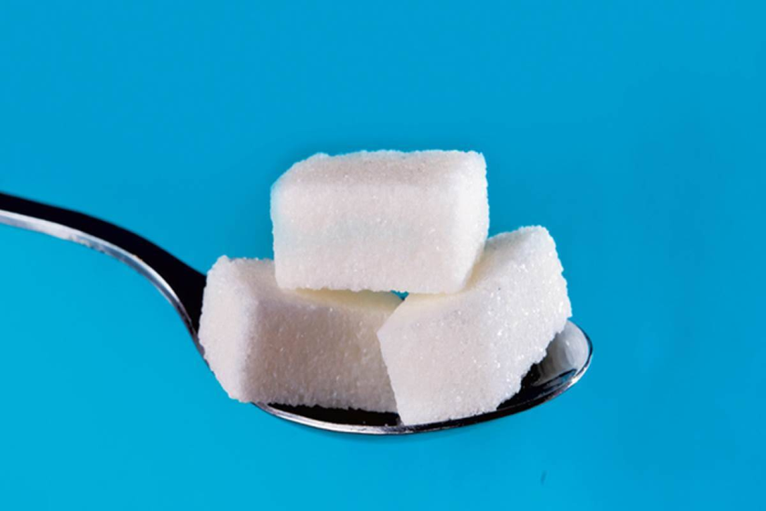
Oral hygiene care and management of oral and periodontal disease during orthodontic treatment
plaque control
bacteria in plaque digest the sugars
producing acids
teeth and irritate gums
cavities
gum disease
bad breath.
1. diet, 2.daily maintenance, 3.regularprofessional care.

Slide 3
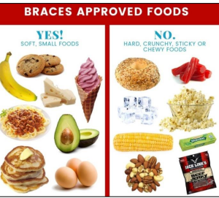
Oral hygiene care and management of oral and periodontal disease during orthodontic treatment:
1. Diet (Ibraheem M, Nahidh M, 2021)
1.Cutting down sugar
soda,stuck in your braces, toffee, gum
Dental Caries
brackets and bands
poor oral hygiene
elastics, arch wires, springs, attachments interferes with the patient's capability for brackets and teeth cleaning

Slide 4
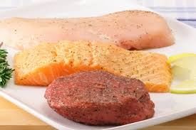

Oral hygiene care and management of oral and periodontal disease during orthodontic treatment:
protein in meat and calcium in milk
neutralize acids
Topical fluoride
dental caries
lemon
enamel surface erosion

Slide 5
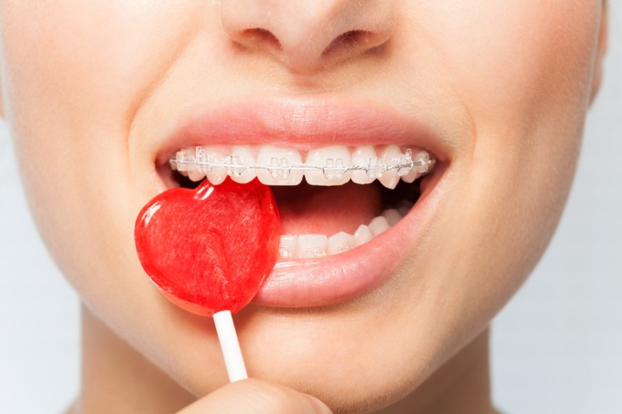
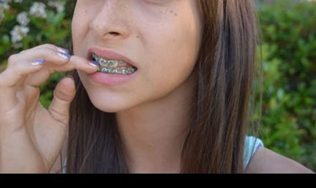
Oral hygiene care and management of oral and periodontal disease during orthodontic treatment:
1. Foods that are very hard or extremely sticky can also cause physical damage to orthodontic appliances.
hard candies
don’t chew on ice, pencils, or nails

Slide 6

Oral hygiene care and management of oral and periodontal disease during orthodontic treatment:
3. Plaque and calculus ,
soft diet,
fibrous
a surface cleansing effect
prevents plaque formation
Mouth wash

Slide 7
Oral hygiene care and management of oral and periodontal disease during orthodontic treatment:
Vitamins deficiency
hyperplasia of the gingiva
vitamin B Gingivitis
folic acid deficiency necrosis of the PDL
Scurvy collagen
Vitamin A synthesis of the collagen
Vitamin K blood clot formation

Slide 8
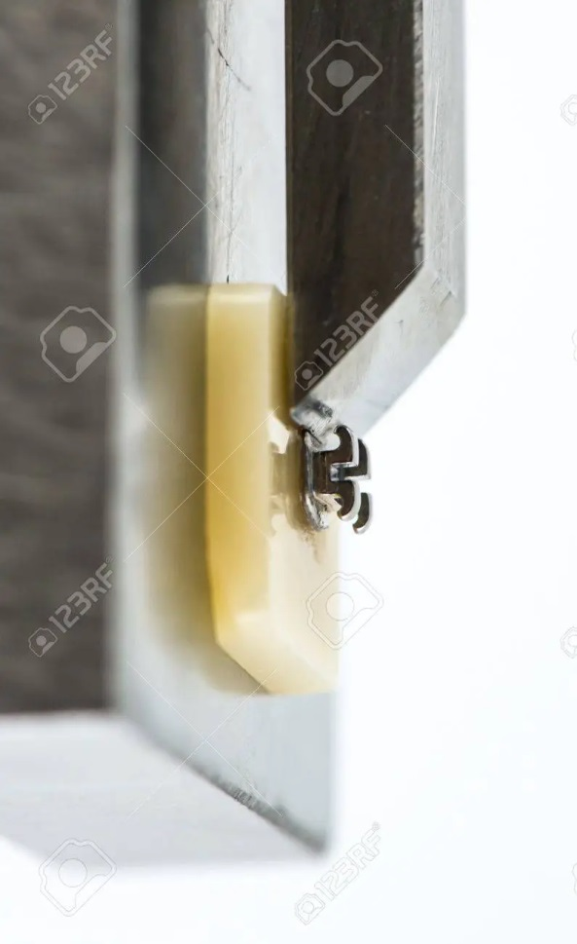

Oral hygiene care and management of oral and periodontal disease during orthodontic treatment:
4. Effect on the Shear Bond Strength
carbonated soft drinks on the shear bond strength
adhesive
microleakage of orthodontic brackets
erosive lesions

Slide 9
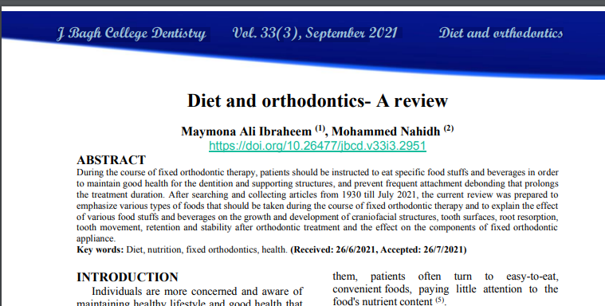
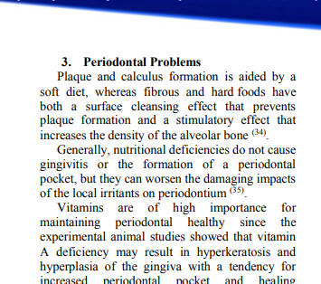
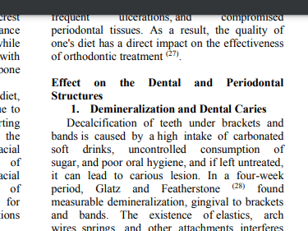

Slide 10
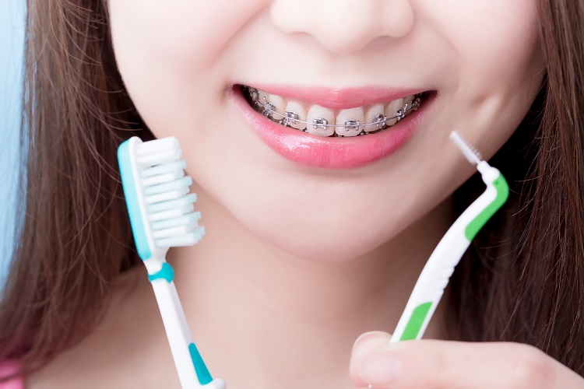
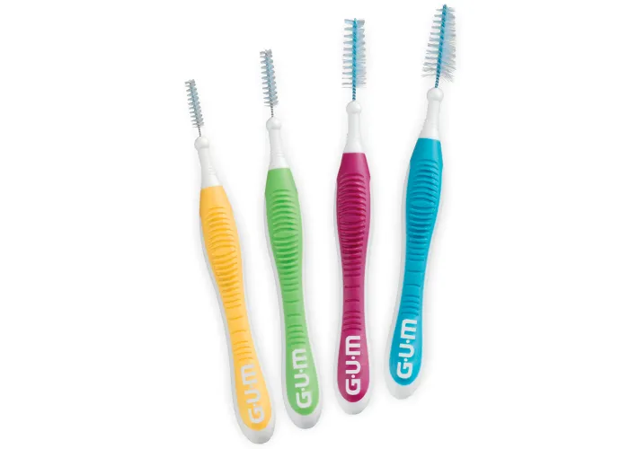
Oral hygiene care and management of oral and periodontal disease during orthodontic treatment:
B. Daily Maintenance:
A soft-bristle or a bi-level toothbrush (one with longer bristles on the edges and shorter ones in the middle)
For hard-to-clean areas, interdental brush, or proxabrush like pipe cleaner,
For between wires, brackets and teeth

Slide 11
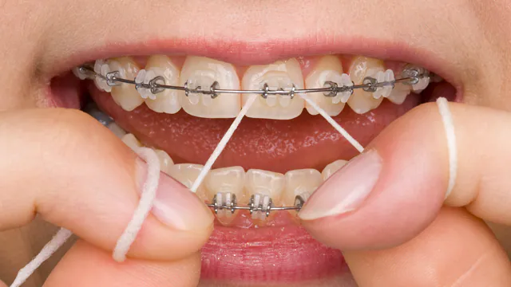
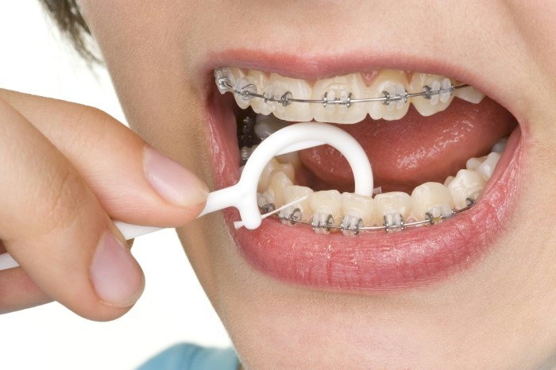
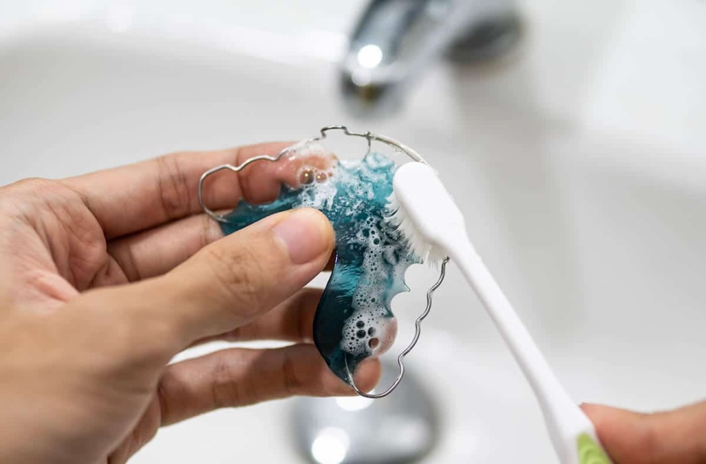
Oral hygiene care and management of oral and periodontal disease during orthodontic treatment:
The flossing
once a day
the retainer
brushed daily
hot water on retainer
distort the soft plastic and make it unusable

Slide 12
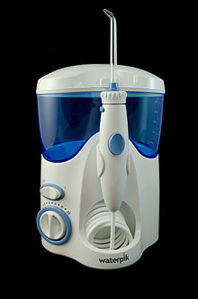
Dental water jet
oral irrigator home dental care device
stream of high-pressure pulsating water
dental plaque and food debris
teeth and below the gum lin
Regular use
improve gingival health cleaning for braces and dental implants
plaque biofilm removal

Slide 13
Oral hygiene care and management of oral and periodontal disease during orthodontic treatment:
C. Professional Care
1.ensure oral hygiene is good
2.Constant reminder therapy at weekly intervals
3.topical application of 2% chlorhexidine
4.Metronidazole selective antimicrobial

Slide 14
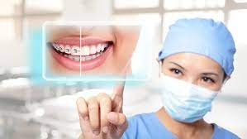
Oral hygiene care and management of oral and periodontal disease during orthodontic treatment:
Orthodontic therapy as simple as possible
proper periodontal therapy
removal of the orthodontic appliance
bands predispose to gingivitis, gingival enlargement
Buccal tubes are preferred
steel ligature wire instead of elastomeric
Remove excess composite
Teeth bonded with self-ligating brackets fewer bacteria
difficulty in maintaining oral hygiene with lingual appliance

Slide 15
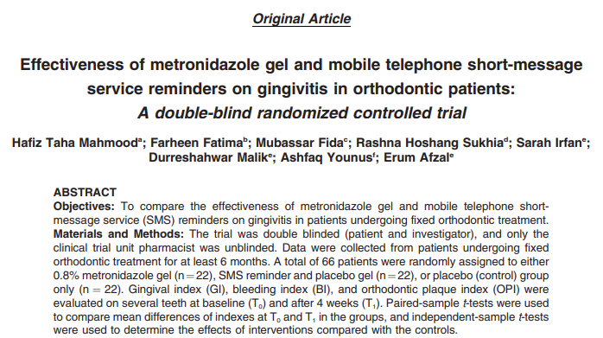
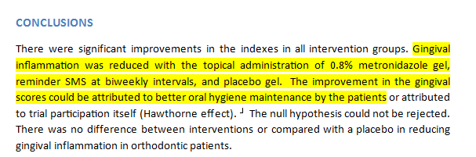

Slide 16


