Slide 1


Orthodontics and medically compromised patients
ا.د.شهباء عبد الغفور محمد

Slide 2


Introduction
In recent years, there has been an increase in the number of patients seeking orthodontic treatment. Some of them are medically compromised or on medications. Orthodontists need to be aware of these conditions and how to modify their protocol of treatment accordingly.

Slide 3

Hypertension
If it is controlled. Patients can complete their orthodontic treatment following the medical instruction under the supervision of a cardiologist and an orthodontist. However, in scenarios where the patient’s blood pressure is acute and uncontrolled, the majority of dentists and orthodontists refuse to perform orthodontic treatment.

Slide 4
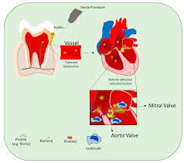
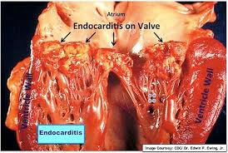
Infective endocarditis (IE)
Proper antibiotic prescription based on the risk level and orthodontic procedure intended Bonded brackets and elastomeric ties are preferable. All sharp edges should be smoothed and polished, and excess adhesives should be removed and cleaned. Fixed acrylic appliances, like Nance and acrylic rapid maxillary expanders, should be avoided.

Slide 5
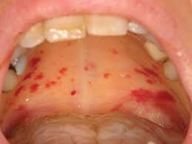
Thrombocytopenia
If the diagnosis of leukaemia is confirmed before the orthodontic treatment, orthodontic treatment should be delayed until chemotherapy is complete and at least two years after bone marrow transplantation If the diagnosis is confirmed during the orthodontic treatment, the orthodontist must remove all existing orthodontic appliances and a removable retainer can be used. Orthodontic treatment can be restarted after completion of all required therapy, and the patient has a minimum of two-year event-free survival Orthodontic mechanics should be simple and light The orthodontist needs to accept compromised results and treat the maxilla only Clear aligners might be the best choice to treat these patients Non-irritating orthodontic appliances are preferable Nickel-free brackets are recommended over stainless-steel brackets The use of aesthetic brackets or clear aligners is recommended since they cause minimal MRI distortion For cancer patients in general, orthodontic treatment should start at least 2 years after the anticancer therapy

Slide 6
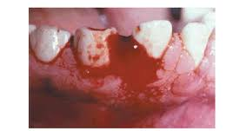
Haemophilia
Mucosal injury should be minimized.
Sharp edges need to be smoothed, and excess wires should be cut.
Self-ligating brackets are preferable over the conventional type.
Arch wires should be ligated with elastomeric rather than wire ligatures.
It is preferable to make an impression with a non-metal tray to minimize trauma.
During bonding, a saliva ejector is recommended to be placed on a gauze placed on the mouth's floor .
Minimal treatment time.
Fixed appliances are preferable over the removable ones.
Bonding over banding are advisable, if possible A non-extraction treatment plan is recommended.
For pain management, Acetaminophen is a safer than NSAIDs.
Clear aligners should be trimmed carefully to avoid gingival irritation.

Slide 7
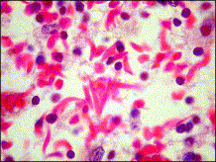
Sickle cell anaemia
Appointments should be scheduled early in the morning and during the chronic phase of the disease.
Emotional stress should be minimized.
A non-extraction treatment plan is preferable, if possible Light orthodontic forces are recommended Rest periods between activations should be included in the treatment plan to allow local microcirculation to be restored.
Bleeding should be avoided during orthodontic procedures.
Extra-oral anchorage is preferred over TADs or mini-plates.

Slide 8
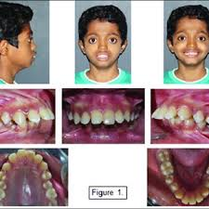
Thalassemia
Orthodontic interceptive treatment is recommended to begin at early age by using functional appliances and extra-oral appliances to treat dentofacial problems.
It is recommended to apply a medium force in short intervals.
Tooth movement must be monitored by the orthodontist for short intervals of time.
Lighter forces than usual are highly recommended

Slide 9
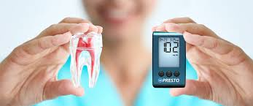
Diabetes mellitus (DM)
Appointments early in the morning are preferable, and the patient is encouraged to eat a regular meal and take usual medication before the visit Light orthodontic forces should be used .
A periodontist should be involved, especially with adult patients, to evaluate periodontal condition before and during orthodontic treatment.
Orthodontists and staff should be trained and ready to deal with any diabetic emergencies, especially sudden hypoglycaemia.

Slide 10
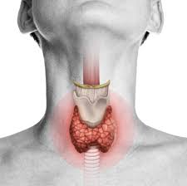
Thyroid disorders
A stress reduction protocol should be implemented.
NSAIDs and aspirin are not recommended, and alternative pain medication should be prescribed.
Patients with hyperthyroidism tend to have an increased amount of tooth movement .
Patients with hypothyroidism tend to have an increased risk of root resorption

Slide 11
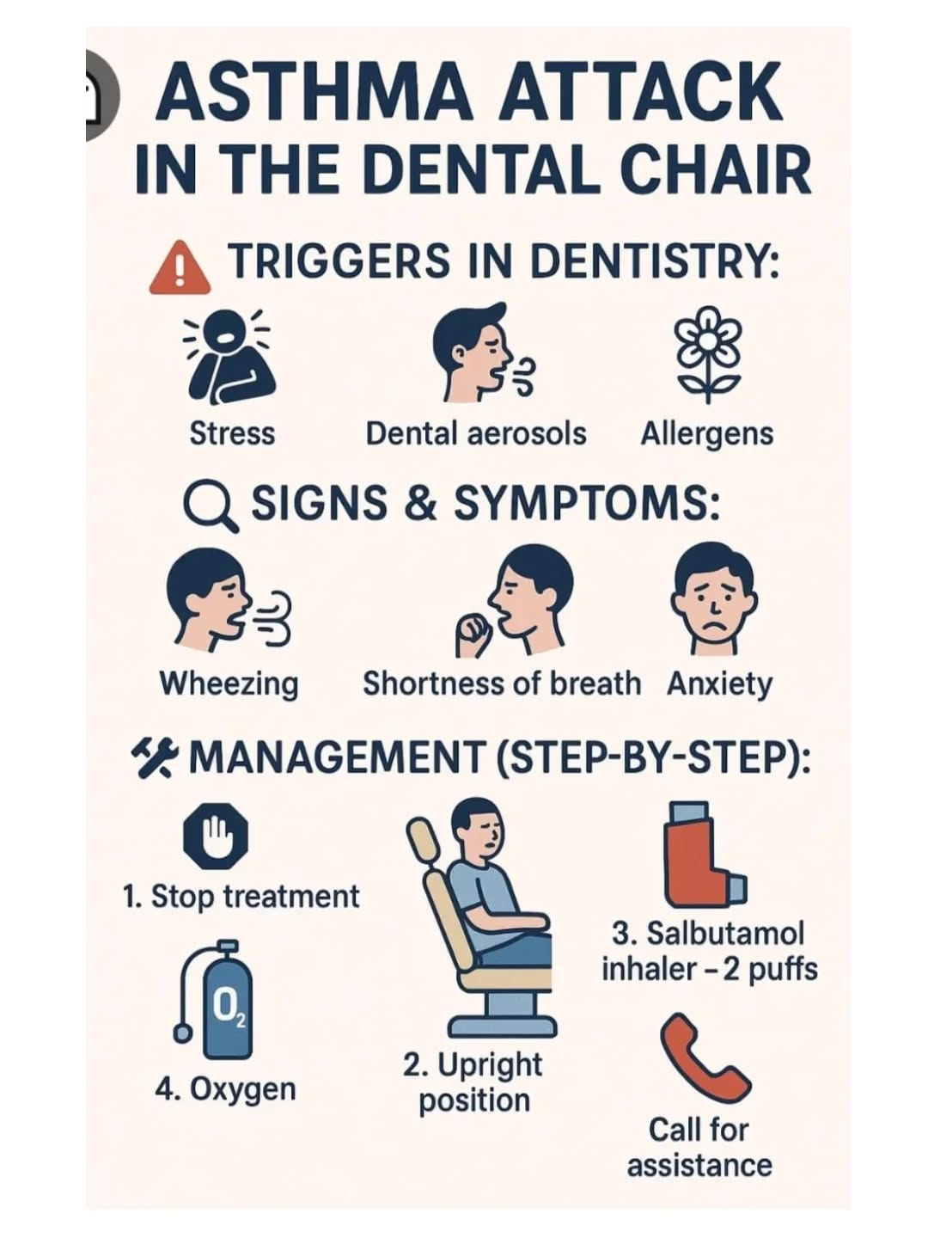
Asthma
Stress and anxiety should be minimized. Short morning appointments, short waiting times, and avoidance of the supine position, if possible are recommended The patient's usual medication should be used before the appointment, and an inhaler should be available to the patient during the appointment if needed Asthmatic patients tend to have an increased risk of external root resorption Acetaminophen is recommended over Aspirin and NSAID for pain management

Slide 12
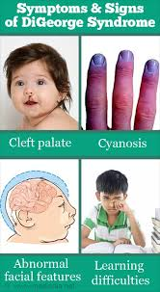
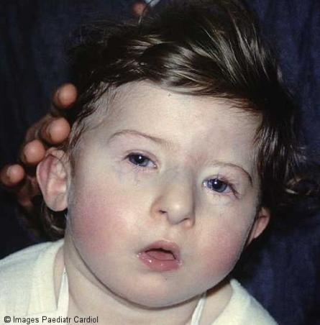
DiGeorge syndrome
Patient's physician should be consulted regarding prophylactic antibiotic.
In particular, if heart defects or immune deficiency exist.
Because of the vertical growth pattern, well-timed orthodontic intervention is recommended.
An open bite should be managed as early as possible by eliminating habits, including thumb sucking Light orthodontic force is recommended, especially in expansion.
The bonding durability of brackets and attachments might be challenging due to the wide spread of enamel hypoplasia Orthodontic treatment options and duration should be managed wisely, based on the expected degree of compliance.

Slide 13

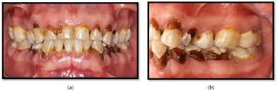
HIV/AIDS
An orthodontist can aid in detecting a possible HIV infection by recognizing the first oral manifestations of the disease HIV patients with no symptoms should be treated as regular patients.
These patients can receive regular orthodontic treatment after ruling out the possibility of neutropenia, immunosuppression, or thrombocytopenia If any oral lesion is detected during the treatment, an appropriate referral is recommended For pain management, Acetaminophen and aspirin should be used with caution

Slide 14

Organ transplantation
If the patient is seen before transplantation, he or she must be referred to the general dentist to treat and control all active dental problems In the case of chronic renal failure (CRF), orthodontic treatment can be executed in well-controlled patients. In the case of advanced renal failure and possible dialysis, orthodontic treatment should be postponed
Orthodontic treatment should not be initiated in the first six months following the transplantation Orthodontic treatment can be initiated after six months when the patient is in a stable condition, and there is no sign of transplant rejection .
A minimal duration of orthodontic treatment is preferable Long-term use of immunosuppressants may accelerate orthodontic movement. Therefore, orthodontic forces should be minimized, and the adjustment of orthodontic appliances should be performed more frequently .
The Essix retainer can be used but needs to be relieved around the gingival margins The treatment plan should be simple, and a non-extraction treatment option is preferable

Slide 15
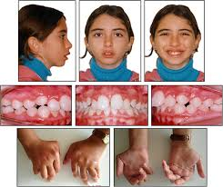
Juvenile idiopathic arthritis (JIA)
The treatment of JIA involves medications, physical therapy, and psychosocial support to counteract the progressive and long-term nature of the disease Joint inflammation should be controlled as early as possible with medications to prevent deteriorating effects on the mandibular growth .
Once the inflammation is under control, orthodontic treatment should aim at restoring optimal occlusion and function of the mandible .
Heavy class II elastics should not be used.
The use of functional appliances is controversial In the case of a moderate mandibular deficiency, headgear is recommended.
Orthognathic surgery should be performed when growth is complete except in case of TMJ's ankylosis, which mandates surgical intervention sooner Maxillary surgery and advancement genioplasty have been advocated to treat severe mandibular deficiency In case of severe deformity, distraction osteogenesis is recommended

Slide 16
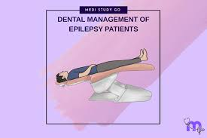
Seizure disorders
Well-controlled seizure is not considered a contraindication to orthodontic treatment.
Patients with poorly controlled seizures who have episodes of falling or uncontrolled movement of body parts are contraindicated to receive orthodontic treatment
Removable appliances should be used with caution and should be supplemented with extra means of retention and made with high-impact acrylic resin.
Thus, fixed orthodontic appliances are recommended.
Clear aligners should be trimmed carefully around the gingival margins.
Bonded retainers should be avoided MRI can be distorted by the metal in fixed orthodontic appliances.
Thus, it is recommended to remove any removable parts, including arch wires and ligature wires, to get an acceptable image Plastic, ceramic, or titanium brackets are recommended for these patients

Slide 17



Autism Spectrum Disorder (ASD)
The presence of parents, giving short and clear sentences, voice control, Tell-Show-Do technique, behaviour modification, and positive reinforcement can be utilized to improve communication and acceptance.
This must be done over several visits before starting the orthodontic treatment
Desensitization techniques can be used by gradually introducing the patient to the items used in the orthodontic office Some procedures can be conducted using behavior management and protective stabilization (restraint). Others might need sedation, or even general anesthesia Removable orthodontic appliances are recommended for autistic patients.
They should be as small as possible and be reinforced by wires.

Slide 18

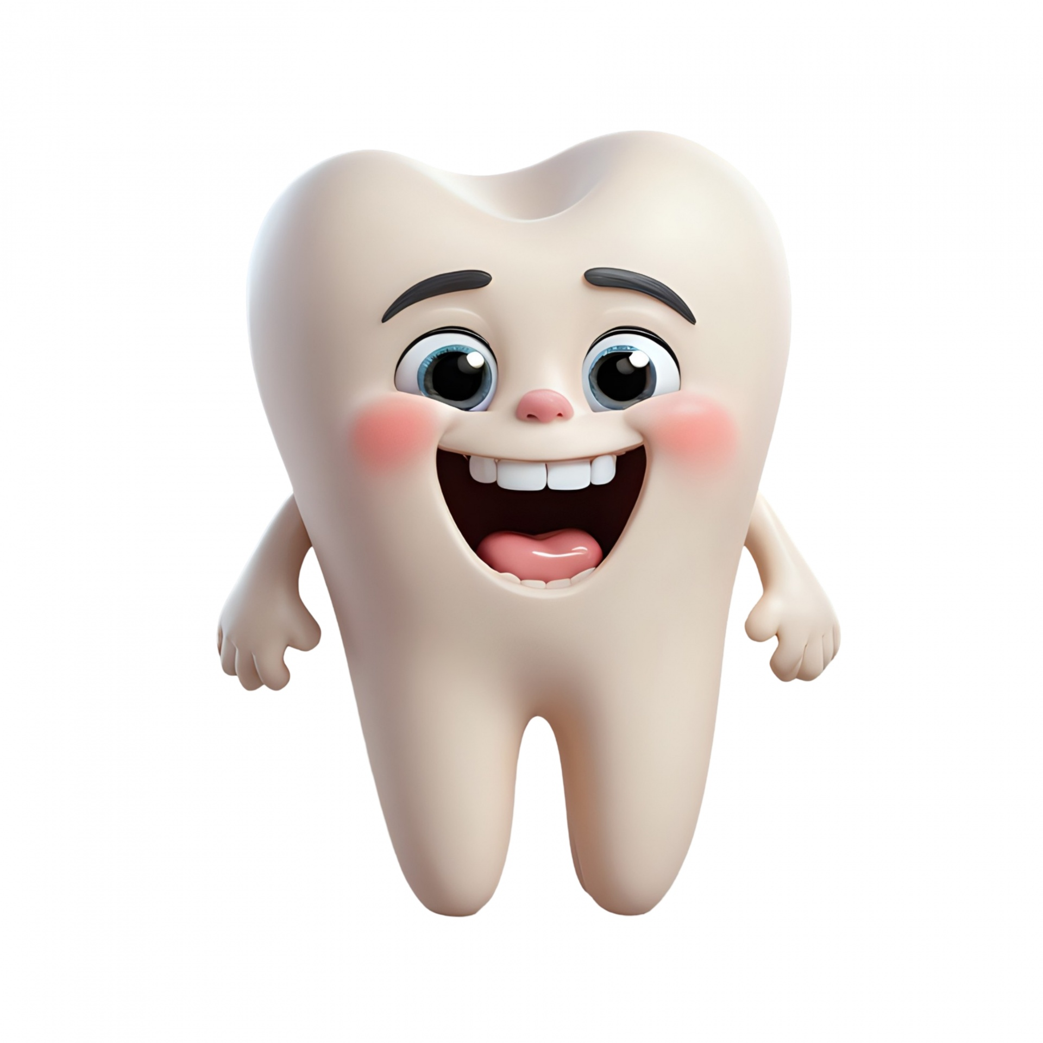
Mood disorders
Some medications used for the treatment of mood disorders might cause xerostomia, which increases the risk of caries.
Other medications might cause gingival hyperplasia, which impedes orthodontic treatment It is better to have these conditions under control before orthodontic treatment begins If a mood disorder develops during the orthodontic treatment, an immediate referral to a psychiatrist should be given and a decision should be made whether to continue the orthodontic treatment until the mental health issues are under control
Short efficient orthodontic treatment plan is recommended

Slide 19


Schizophrenia
As a result of antipsychotic medications, patients might have dystonia and tardive dyskinesia, which cause involuntary repetitive movements of body parts.
Thus, the use of removable appliances is not recommended Orthodontic treatment is not recommended for patients with florid schizophrenia

Slide 20


Attention-deficit hyperactivity disorder (ADHD)
Due to poor compliance, some orthodontic tasks, including activation of appliances and placement of elastics, need more follow-ups and the involvement of parents and other family members.
Strict oral hygiene is mandatory .
Short appointments scheduled early in the morning are recommended.
Frequent breaks during the appointment are beneficial to gain compliance and attention.
Instructions should be simple and clear.
The Tell-Show-Do method has a great impact on behaviour modification in these patients . Orthodontic treatment plans that require high compliance should be avoided .

Slide 21

Eating disorders
The orthodontist can be the first care provider who identifies signs of eating disorders. Thus, appropriate referral and confidential discussion are recommended

Slide 22
spending a lot of time worrying about your weight and body shape
avoiding socialising that involves food
eating very little food
losing control over your eating
making yourself sick or taking laxatives after you eat
exercising too much
having very strict habits or routines around food
changes in your mood
You may also notice physical signs, including:
feeling cold, tired or dizzy
problems with your digestion
loss of sexual interest
problems with your teeth
brittle hair and nails
problems sleeping
your weight being very high or very low for someone of your age and height
stopped or missed periods

Slide 23
Warning signs to look out for include:
dramatic weight loss
lying about how much and when they've eaten, or how much they weigh
eating a lot of food very fast
going to the bathroom a lot after eating, often returning looking flushed
exercising too much
avoiding eating with others
cutting food into small pieces or eating very slowly
wearing loose or baggy clothes to hide their weight loss

Slide 24


