Slide 1

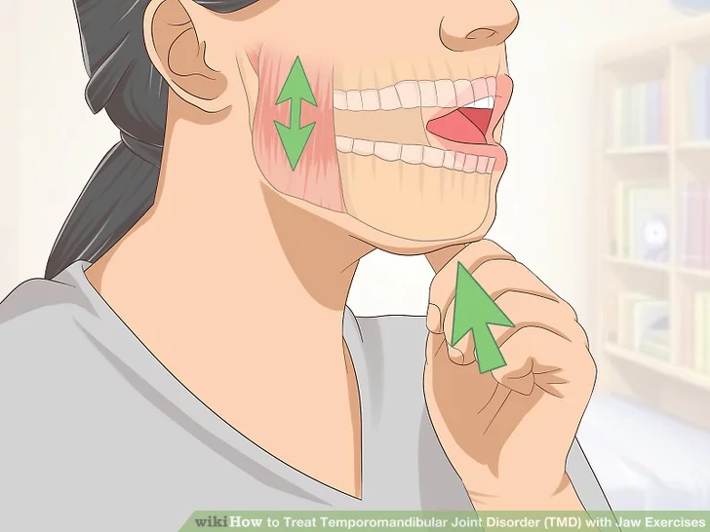
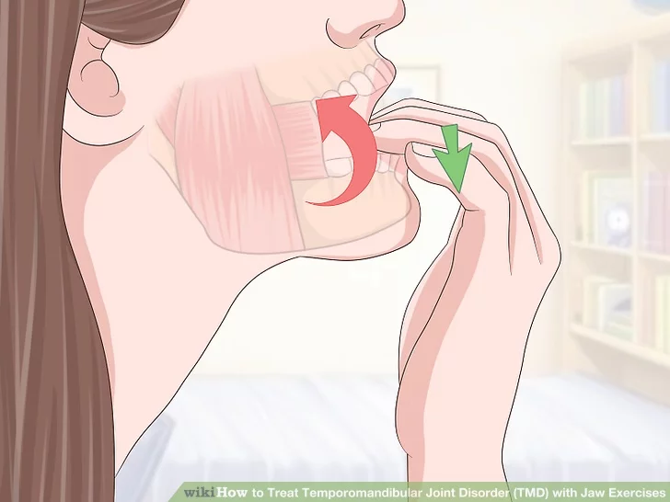
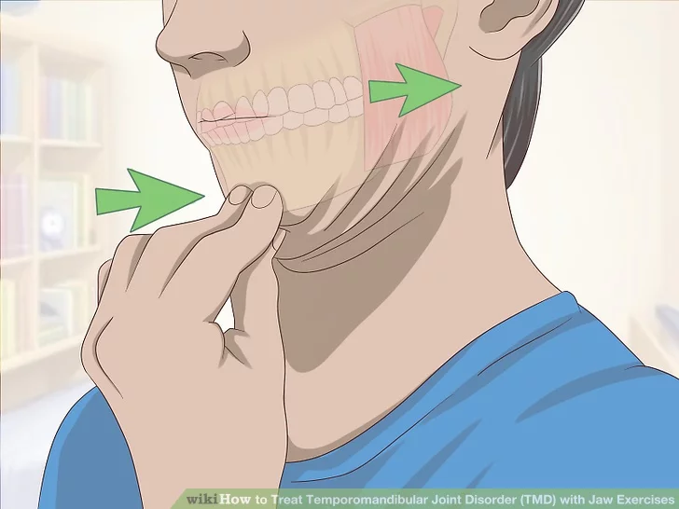
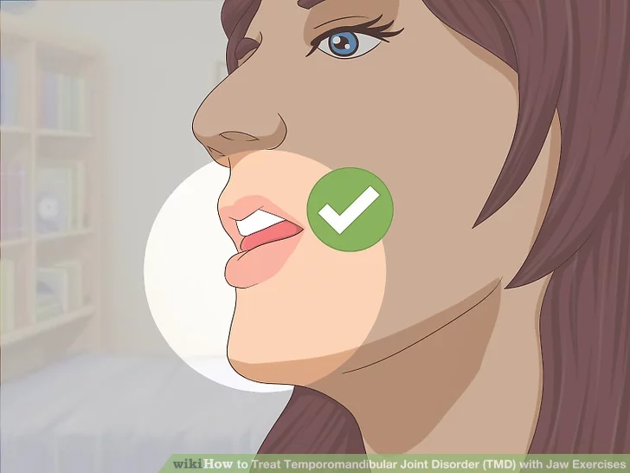
Management of TMD Signs and Symptoms in the Orthodontic Practice
Prepared by
Dr.Shahba AbdulGhafoor Mohammed

Slide 2
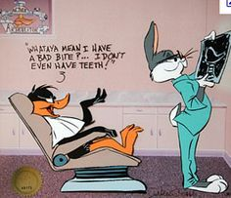
Introduction
Like all other dentists, orthodontists are likely to encounter some patients with TMD signs and symptoms in their practices that require some form of professional treatment.
1-referrals from other dentists, or
2-they may develop TMD problems while under the orthodontist’s care.
Notes:
Like all other dentists, orthodontists are likely to
encounter some patients with TMD signs and
symptoms in their practices that require some form
of professional treatment. These patients may
come into their offi ce as referrals from other dentists,
or they may develop TMD problems while
under the orthodontist’s care. While some benign
TMD signs and symptoms may be present in new
patients, or may arise in patients under treatment,
not all of these need to be treated (see Chap. 3 ).
However, as discussed in Chap. 2 , there are a number
of signifi cant TMD conditions that need to be
properly diagnosed and appropriately treated.

Slide 3
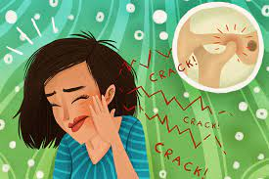
Introduction
Not all of these need to be treated.
However, there are a number of significant TMD conditions that need to be properly diagnosed and appropriately treated.

Slide 4

Introduction
The topic of TMD treatment can be quite complex,
and indeed whole books have been devotedكرست to
that subject.
Notes:
The topic of TMD treatment can be quite complex,
and indeed whole books have been devoted to
that subject. In this chapter, we will try to present a
commonsense approach to TMD management that
a practicing orthodontist can readily incorporate
into his or her practice. As repeatedly mentioned in
earlier chapters, the emphasis today is on conservative
treatment for the vast majority of TMD conditions,
especially during the early and acute stages.
Also, since orthodontic procedures per se are not
generally indicated as treatment modalities for
TMD patients, this chapter will not include any discussion
about those approaches.

Slide 5

Introduction
we will try to present a
commonsense approach to TMD management that
a practicing orthodontist can readily incorporate
into his or her practice.

Slide 6
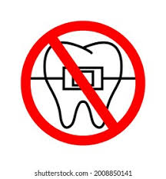
Introduction
the emphasis today is on conservative
treatment for the vast majority of TMD conditions,
especially during the early and acute stages.
Also, since orthodontic procedures are not
generally indicated as treatment modalities for
TMD patients, we will not include any discussion
about those approaches.

Slide 7
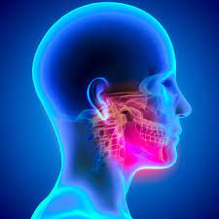
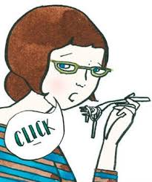
1-General Considerations
The two major clinical features of most temporomandibular disorders are:-
1- pain.
2- dysfunction.
Dysfunction usually is a consequence of the pain rather than its cause, so primary therapeutic attention should be directed at the pain.
When pain is relieved, improved function can be anticipated.
Notes:
8.1 General Considerations
The two major clinical features of most temporomandibular
disorders are pain and dysfunction.
While other signs and symptoms may also be
present and require attention, these two are the
main reason most people seek professional care.
As Lund and others have pointed out [ 1 , 2 ], the
dysfunction usually is a consequence of the pain
rather than its cause, so primary therapeutic
attention should be directed at the pain. When
pain is relieved, improved function can be anticipated.
If an orthodontist needs to provide a
patient with basic TMD treatment, i.e., conservative
management of their pain and dysfunction,
then the therapies administered should be supported
by science and evidence.

Slide 8


1-General Considerations
If an orthodontist needs to provide a patient with basic TMD treatment, i.e., conservative management of their pain and dysfunction, then the therapies administered should be supported by science and evidence.

Slide 9
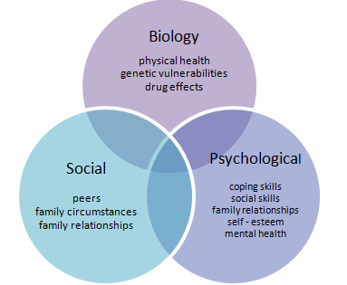
1-General Considerations
TMD treatments are now based on a biopsychosocial model rather than the historical, dental based model .
Altering the occlusion.✗
Biomedical and psychosocial sciences.✓

Slide 10
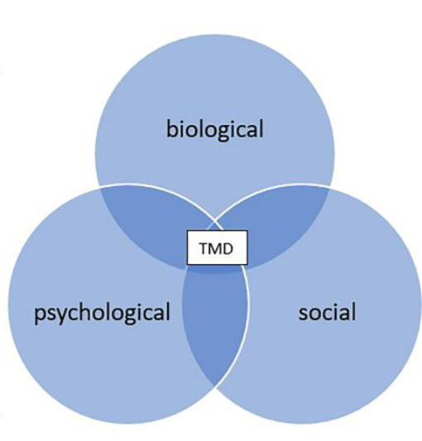
1-General Considerations
The contemporary biopsychosocial model attempts to integrate
clinical,
and behavioral factors
that may account for
the onset,
maintenance,
and remission of TMD .

Slide 11
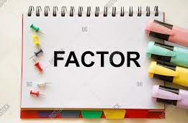
1-General Considerations
The factors that are receiving the most attention and research in the understanding of TMD today are:-
genetics (vulnerabilitiesحساسية related to pain),
imaging of the pain-involved brain,
endocrinology,
behavioral risk factors,
psychosocial traits and states .

Slide 12
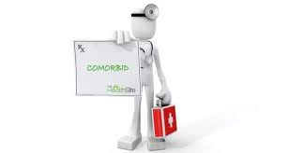
1-General Considerations
There also is considerable interest in the issue of الألم المصاحبcomorbid pain conditions, which are found in a large number of TMD patients, and a significant amount of research is focused on the problem of chronicity (who is at risk, and why?).

Slide 13

1-General Considerations
TMD signs and symptoms can develop in any individual at any time.
In many cases, these can be transient phenomena like a sore jaw muscle, a painful joint following a minor trauma, or limited opening after a dental appointment.
Also, many patients observed during a screening exam may have occasional jaw pain, or a painless TMJ click or an odd opening and closing pattern, but these do not rise to the level of being a clinical case of TMD.

Slide 14

1-General Considerations
When actual TMD problems do arise, that group of patients is often in their mid to late teens or they are young or middle-aged adults rather than children and the elderly.

Slide 15

1-General Considerations
Prevalence of TMDs in women is twice more common in woman than in men .

Slide 16

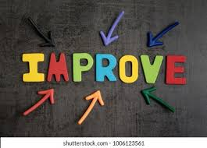
1-General Considerations
The likelihood of an orthodontic patient developing TMD signs or symptoms before, during, or after treatment is definitely a possibility.
It has been shown that over the long term most cases of TMD pain and dysfunction generally tend to resolve or improve .

Slide 17

1-General Considerations
This however does not obviate تجنبan orthodontist’s professional obligation ,واجب to recognize TMD problems when they do arise, to inform and educate those patients about the conservative treatment protocols, and if needed either engage in the treatment or effect the necessary referral to an appropriate specialist to manage the patient’s TMD.

Slide 18

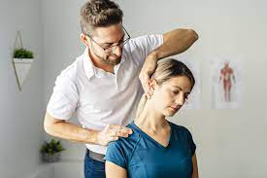
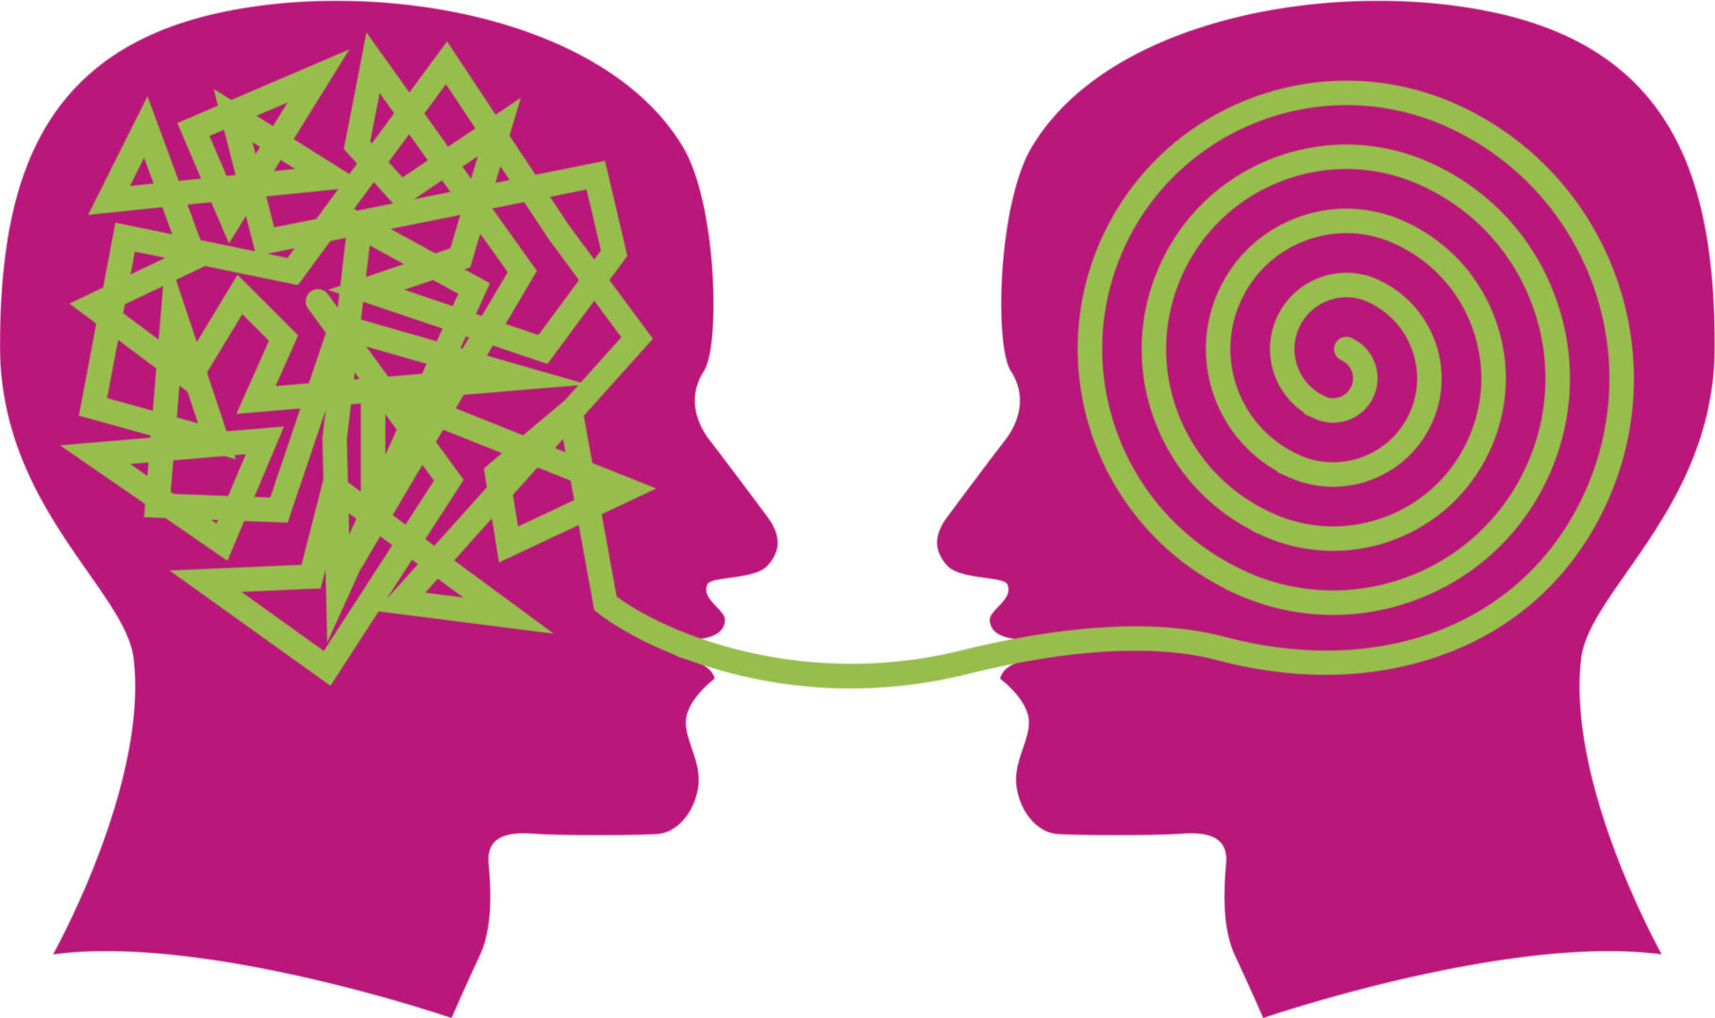
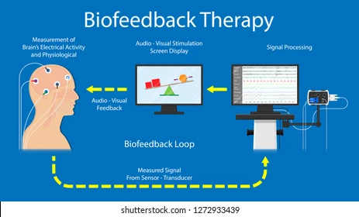


1-General Considerations
There are conservative and reversible TMD
treatments. These include:-
patient self-directed care,
physical therapies,
cognitive-behavioral therapies,
biofeedback,
pharmacologic agents,
and oral occlusal appliances .

Slide 19

1-General Considerations
TMDs are generally cyclic in nature, so symptoms often
gradually progress from mild to moderate to
severe, and then they can move toward a downward
phase which ends up as mild to no symptoms.
Therefore, practitioners may provide some
form of treatment during the downward side of
the cycle and get symptom relief.

Slide 20

1-General Considerations
The practitioner may then incorrectly assume that the treatment rendered تقديم العلاجwas responsible for this symptom improvement, but in fact it is possible that the patient was getting better on his or her own due to the cyclic nature of TMD

Slide 21


2-Patient Self-Directed Care and Education
Notes:
It is well known that patients experiencing TMD related
pain and dysfunction frequently are anxious
about what is happening to them, especially
if they have been led to believe that they have a
structural problem requiring irreversible treatment
procedures. Assuming that a preliminary
diagnosis of some type of TMD has been established,
it is important for the orthodontist to
reduce that anxiety by communication with the
patient.

Slide 22


2-Patient Self-Directed Care and Education
Notes:
For this phase of interaction to proceed
smoothly, however, the orthodontist must be
knowledgeable about current concepts of
TMD. Whereas previous concepts about these
disorders have included a heavy emphasis on
structural mal-alignments and functional bite disharmonies,
most modern authorities regard TMD
problems as benign musculoskeletal conditions
that are likely to be addressed successfully by
simple and reversible measures .

Slide 23
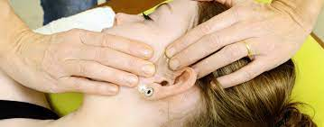

2-Patient Self-Directed Care and Education
It is not necessary to provide extensive (and oftentimes expensive) structural corrections in most cases.
Long-term studies have shown that 80–90 % of these patients can expect good short- term results with little or no long-term problems after conservative orthopedic therapy to reduce pain and restore normal function

Slide 24
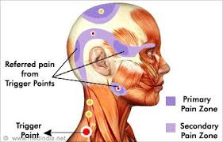
2-Patient Self-Directed Care and Education
The orthodontist who is aware of these positive data can easily allayتهدئة the anxiety of TMD
patients by reassuring the patients that:
1. Most TM problems are extra capsular (myofascial) rather than intra-capsular (derangement
and/or arthritis).
Therefore, they can be expected to respond to the same kinds of conservative
muscle treatment modalities that are used elsewhere in the body (e.g., for lower
back pain, sore shoulder, and others).
.
Notes:
The orthodontist who is aware of these positive data can easily allay the anxiety of TMD
patients by reassuring the patients that:
1. Most TM problems are extra capsular (myofascial) rather than intra-capsular (derangement
and/or arthritis). Therefore, they can be expected to respond to the same kinds of conservative
muscle treatment modalities that are used elsewhere in the body (e.g., for lower
back pain, sore shoulder, and others).
2. Even when intracapsular changes have occurred (such as a displaced disk or degenerative
changes), a good response to conservative treatment is likely [ 17 ]. For the few patients who require actual treatment inside the joint, there often are simpler measures
available today (arthrocentesis or arthroscopy, see Chap. 9 ) rather than the traditional openjoint
surgical operations.
3. Neither of these conditions will require irreversible
treatment procedures in most cases.

Slide 25
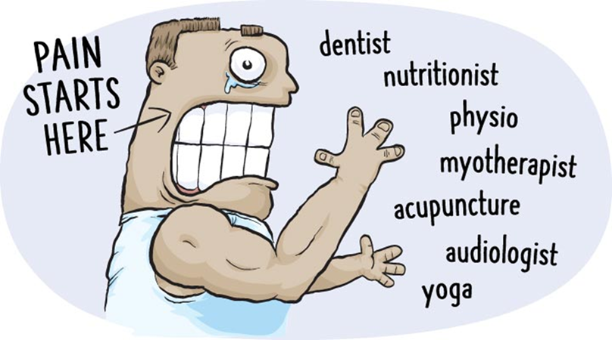
2-Patient Self-Directed Care and Education
The orthodontist who is aware of these positive data can easily allay the anxiety of TMD
patients by reassuring the patients that:
2. Even when intra capsular changes have occurred (such as a displaced disk or degenerative
changes), a good response to conservative treatment is likely .
For the few patients who require actual treatment inside the joint, there often are simpler measures
available today (arthrocentesis or arthroscopy. rather than the traditional open joint
surgical operations.

Slide 26
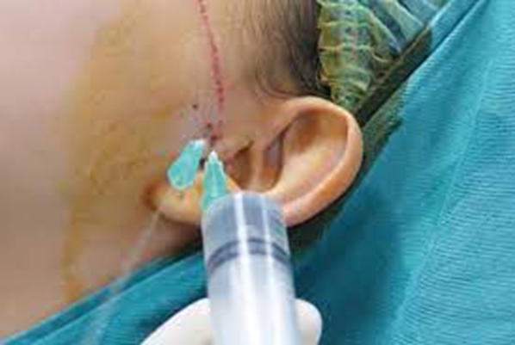
Arthrocentesis is commonly defined as the lavage of the TMJ without viewing the joint space using sterile needles and sterile irrigants so as to reduce the pain by removing inflammatory mediators from the joint or to increase the mandibular mobility by removing intra-articular adhesions by means of hydraulic pressure ...

Slide 27
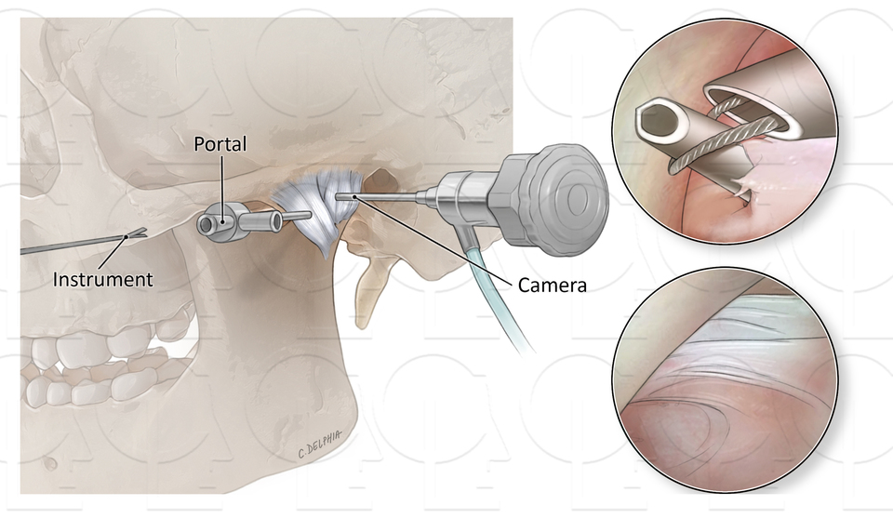
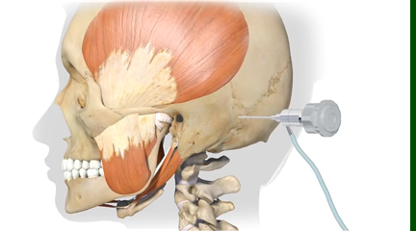
An arthroscopy (keyhole surgery) allows your surgeon to see inside your temporomandibular joint (TMJ) using a camera inserted through a small cut on your skin. Your surgeon can diagnose problems such as a torn cartilage and damage to the surface of the joint.

Slide 28

2-Patient Self-Directed Care and Education
3. Neither of these conditions will require irreversible treatment procedures in most cases

Slide 29

2-Patient Self-Directed Care and Education
While nobody can guarantee that things will work out easily and favorably for any individual patient, it is nice to be able to say that very positive treatment outcomes often will result when appropriate and conservative measures are taken.

Slide 30

2-Patient Self-Directed Care and Education
Some studies have reported that patients informed
of this prognosis sometimes get better without
any professional treatment simply because they
were relieved by the explanation, went home and
let some time pass .

Slide 31

3-Home Care Instructions
Patient self-directed care for TMD includes actions that the patient can take to limit jaw function and parafunctional activities.
Relying once again on the orthopedic medicine analogy, the orthodontist should advise and instruct the patient on home care practices .
Patients should limit or stop such activities as chewing gum, yawning, yelling, singing, cheerleading, and so on.

Slide 32
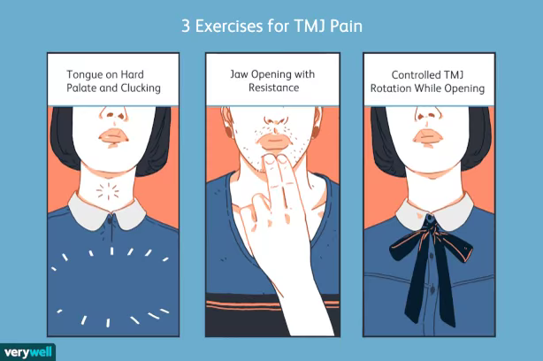
3-Home Care Instructions
They can support their mandible to limit opening when yawning, and they should avoid unnecessary
clicking maneuvers.
In addition, patients should maintain good posture by following good orthopedic
practices.

Slide 33
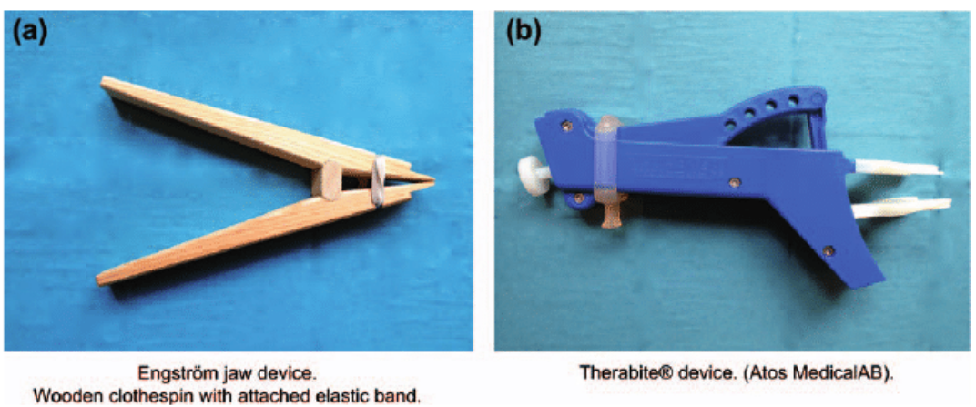
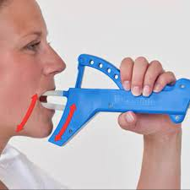
3-Home Care Instructions
This may involve using a headset when speaking on the phone, making sure their workstation is properly “fitted” for the body allowing for adequate posture, keeping their head in a neutral position while sitting and using an orthopedic pillow at night.
For acute symptoms which include limited mandibular opening, patients can perform “scissor jaw” exercises with their fingers or a ملقط غسيل clothespin.

Slide 34
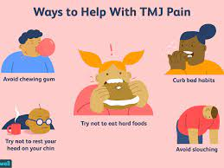

3-Home Care Instructions
Depending on their signs and symptoms, they can be advised to temporarily change their diet as follows: eat soft foods; avoid hard or chewy foods; avoid wide opening during meals; and grind or finely chop meats and other tough foods.

Slide 35
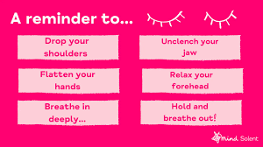
3-Home Care Instructions
TMD patients should be advised to relax their jaws and keep the teeth apart. Because stress and tension often are associated with musculoskeletal pain, patients should be informed about this connection, and instructed about relaxation procedures that can be practiced at home .

Slide 36


3-Home Care Instructions
In more complex cases, professional help in this area may be required from psychologists
or stress management specialists .
Home physical therapy procedures can be taught, such as using ice for acute pain and heat for more chronic pain.
Self- massage and jaw manipulation (controlled exercises) can be encouraged, hopefully supplemented with a printed instruction sheet to improve patient compliance.
In general, hot showers, saunas, or steam baths are known to be helpful for dealing with all types of musculoskeletal pain.

Slide 37


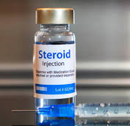
3-Home Care Instructions
Finally, non-prescription medications taken continuously around the clock for 2–4 weeks may be very effective in breaking a cycle of pain and inflammation.
Acetaminophen
Non-steroidal anti-inflamatory drugs (NSAIDs) including aspirin; the NSAIDs should be taken with stomach acid-prevention products.
For acute-onset pain, especially if related to some form of trauma, a tapering dosage of steroids can be prescribed over a 5–7 dayperiod.

Slide 38
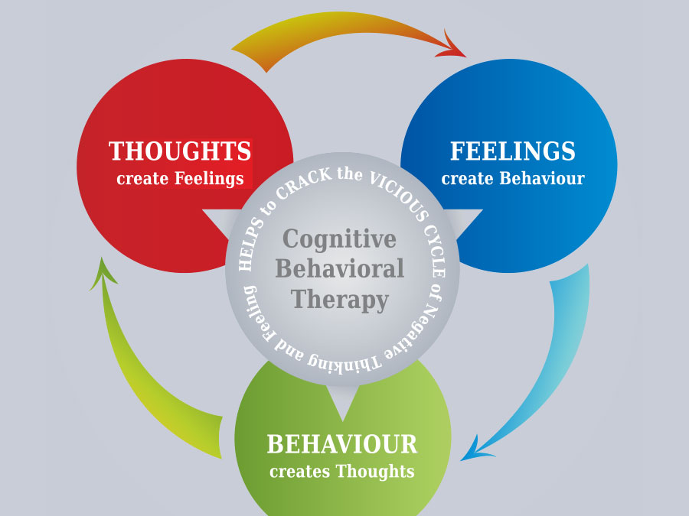

4-Psychological Approaches to Treatment
While stress and tension may play a role in the onset or continuance of TMD symptoms, these patients do not necessarily need to be referred to a professional psychologist.
Instead, consideration should be given to using a simpler method referred to as cognitive behavioral therapy (CBT) which can be used by all types of medical providers. CBT is based on the concept that your thoughts, feelings, physical sensations and actions are interconnected, and that negative thoughts and feelings can trap you in a negative cycle.
CBT aims to help you deal with overwhelming problems in a more positive way by breaking them down into smaller parts.
You're shown how to change these negative patterns to improve the way you feel.

Slide 39
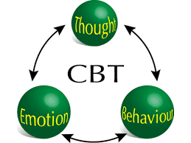
The purpose of cognitive behavioral therapies is to increase the patient’s awareness about the mind-body connection through education about stress management and the body’s reaction to stress.

Slide 40
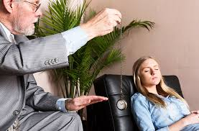
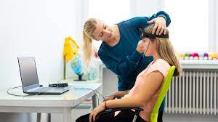

4-Psychological Approaches to Treatment
Some patients may need a referral for professional counseling, which also can include the use of
hypnosis,
biofeedback,
guided imagery training, etc.
Patients often are given workbooks with reading assignments, as well as homework assignments.

Slide 41
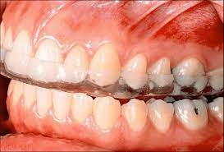
5-Oral Appliances (Splints)
Most orthodontists feel very comfortable about prescribing and using splints for the management of both bruxism and TMD patients.
They may not all realize that splints are capable of being both the best treatment modality and the worst thing ever to appear in the TMD field.
In one form or another, splints have been around for more than 75 years, and certainly many thousands of patients have been helped by their use

Slide 42

5-Oral Appliances (Splints)
Most modern authorities recommend splint therapy as a temporary orthopedic modality,
with the therapeutic goals being
relaxation of muscles,
reduction of oral habits,
altering joint loading,
and general relief of symptoms .

Slide 43

5-Oral Appliances (Splints)
The most important aspect of this conservative viewpoint is avoiding any protocols involving 24-hour wearing of splints.
With rare exceptions, the proper protocol for an oral appliance is night time usage only,
so that normal occlusal relationships can be maintained in the daytime.

Slide 44

Take Home Messages
• The contemporary approach to TMD treatment is centered on conservative and reversible therapies for the vast majority of TMD conditions, especially during the early and acute stages.
• Orthodontic procedures per se are not generally indicated as treatment modalities for TMD patients.

Slide 45

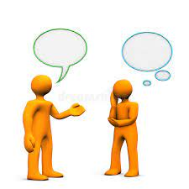

Take Home Messages
• Communicating with the patients about their TMD issues is the first step in the effective management of these conditions; this step plays an important role in
reducing their anxiety,
improving their compliance with treatment,
and in some cases improving their symptoms without professional treatment.

Slide 46


Take Home Messages
• Patient self-directed care for TMD includes actions that the patients can take to limit jaw function.
This may include
supporting their jaws in function,
limiting jaw movement,
soft diet,
massage,
relaxation,
stress management,
and medication to reduce the pain and/or infl ammation.

Slide 47


Take Home Messages
• Cognitive behavioral therapy is a highly effective modality in facilitating stress reduction and enhancing self management.
This involves educating the patient about the mind-body connection
and the body’s reaction to stress, and equipping the patients with techniques and skills to reduce both their stress and their symptoms.

Slide 48
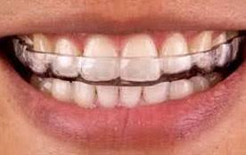

Take Home Messages
• Oral appliances have been shown to be effective in some TMD patients.
The key to effective splint therapy is its short term use as well as night time wear rather than 24 hour application.
Also, no irreversible occlusal changes or alterations of TMJ relationships should occur following splint wear.

Slide 49


Slide 50


