Slide 1
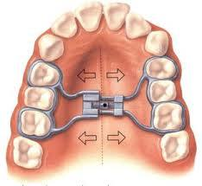
Maxillary expansion
Prepared by:
Dr,professot:Shahbaa AbdulGhafoor.

Slide 2
Content
Introduction
Anatomy
Crossbite types
Treatment types
Appliance types

Slide 3
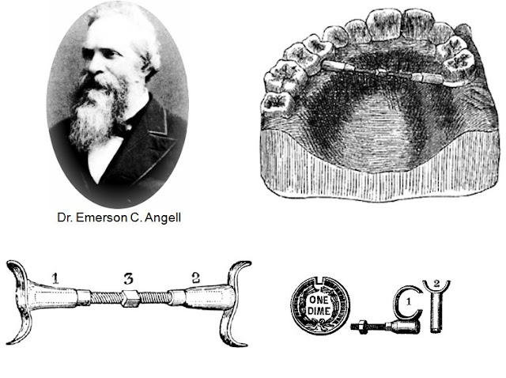
Introductionon
arch expansion was explained for the first time by Emerson C Angel

Slide 4
one of the methods of gaining space
Correction of the transverse discrepancy (phulari, 2011).

Slide 5


Three expansion treatment modalities are used today:
rapid maxillary expansion (RME),
slow maxillary expansion (SME)
and surgically assisted maxillary expansion.

Slide 6
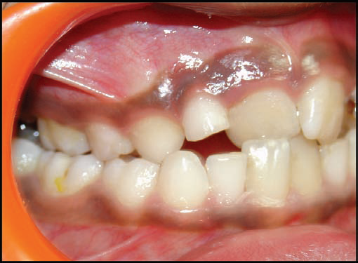
Cross bite
Singa,(2015)define Cross bites as a deviation of the normal bucco-lingual relationship of the teeth of one arch with those of the opposing arch.
Graber,(2017) defined cross bites as a condition where one or more teeth may be malposed abnormally, buccally or lingually or labially with reference to the
Opposing tooth or teeth.
Singa,(2015)

Slide 7
The clinical conditions indicating maxillary expansion include :
1.crossbites,
2. distal molar movement,
3. functional appliance treatment,
4. surgical cases.
(Anirudh Agarwal AND Rinku Mathur, 2010)

Slide 8
CLASSIFICATION OF CROSS BITES
according to their location (Singa,2015):

Slide 9
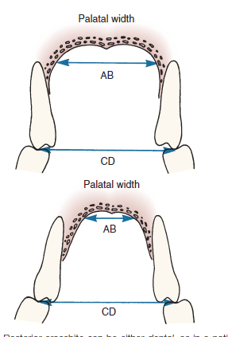
Posterior crossbite Classification according to etiology (proffit , 2019):
Dental
Skeletal

Slide 10
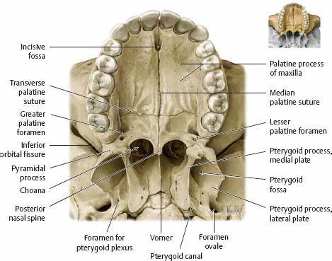
Hard palate anatomy

Slide 11
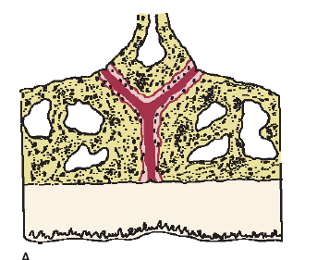
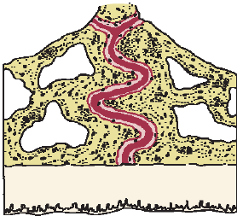
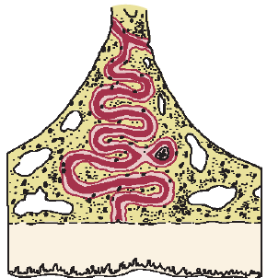
Midpalatine suture anatomy (proffit,2019)
Infancy – Suture
Juvenile
Adolescence

Slide 12

Rapid Maxillary Expansion (RME) (phullari, 2011) (Craber , 2017):
first used by Emerson C Angel in the year 1860.
orthopedic expansion
skeletal structures
used a jack screw
Affect MPS ,CIRCUMMAXILLARY ,CIRCUM ZYGOMATIC

Slide 13
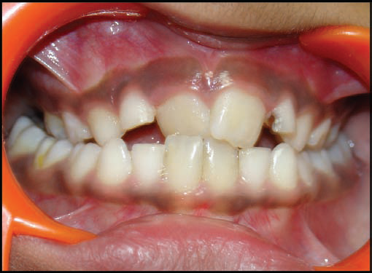
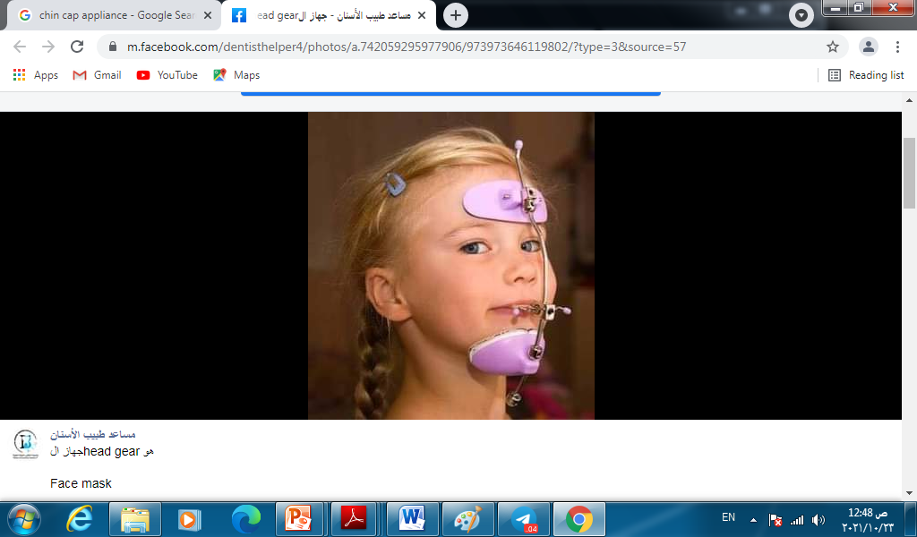
Indications of Rapid Maxillary Expansion (phullari, 2011):
Posterior cross bite
Cl III maloclusion
Face mask

Slide 14
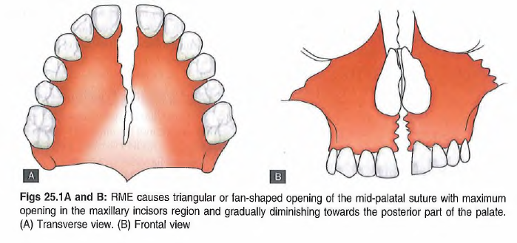
Effect of RME on Maxillary Skeletal Base ) (phullari, 2011):

Slide 15
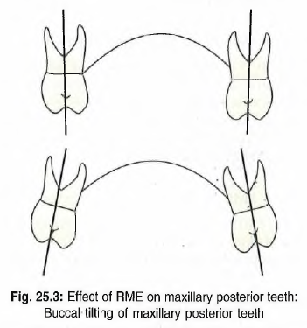
Effect of RME on Maxillary Posterior Teeth (phullari, 2011):

Slide 16
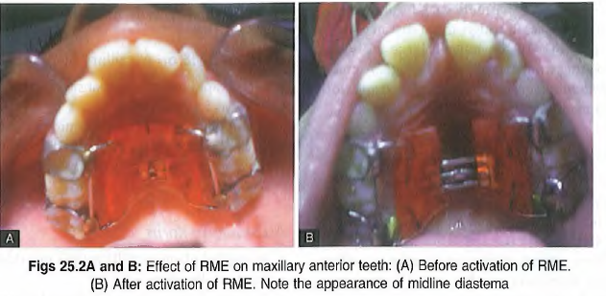
Effect of RME on Maxillary Anterior Teeth (phullari, 2011):

Slide 17
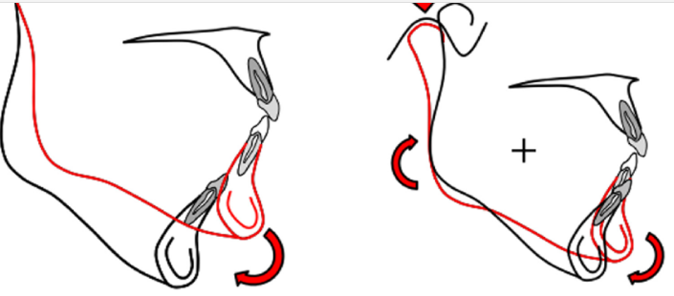
Effect of RME on Mandible
downward and backward rotation of the mandible due to
extrusion of maxillary posterior teeth.
(Helder B Jacob ,2014 )

Slide 18
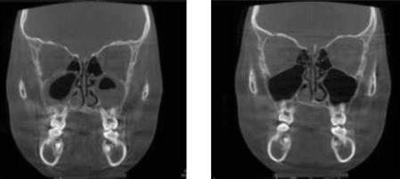
Effect of RME on Nasal Cavity
G. Dave Singh , 2021

Slide 19
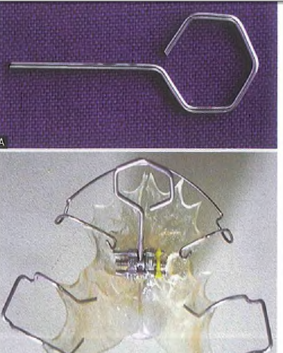
Types of Rapid Maxillary Expansion Appliances (phullari, 2011)
1.Removable Rapid Maxillary Expansion Appliances

Slide 20
Types of Rapid Maxillary Expansion Appliances (phullari, 2011)
2. Fixed Rapid Maxillary Expansion Appliances
cannot be removed by the patient.
classified into tooth and tooth tissue borne appliances.

Slide 21
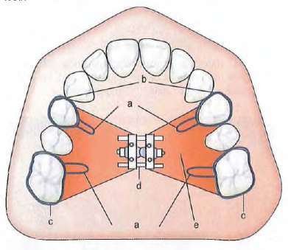
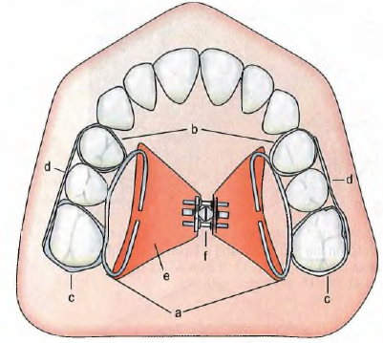
Types of Rapid Maxillary Expansion Appliances (phullari, 2011) 2. Fixed Rapid Maxillary Expansion Appliances
1. Derichsweiler type
2.Hass type

Slide 22
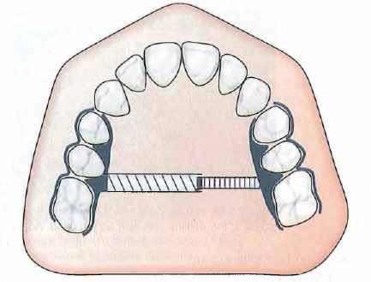
Fixed Rapid Maxillary Expansion Appliances (phullari, 2011)
3.Isaacson type of expansion appliance

Slide 23
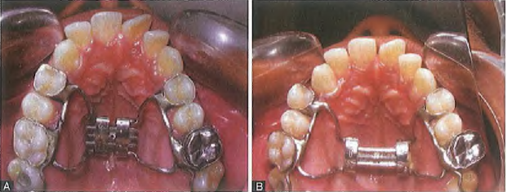
Fixed Rapid Maxillary Expansion Appliances (phullari, 2011)
4. Hyrax

Slide 24
Expansion Achieved Followed by RME
With rapid maxillary expansion, expansion up to 10 mm can be achieved with the rate of 0.2-0.5 mm/day.
rate of two-quarter turns (0.5 mm) per day after the appliance had been installed.
If a diastema did not appear within 8 days of expansion, the activation was changed to one-quarter turn every 3 days to minimize tissue damage,
Activation was discontinued when the lingual cusps of the upper first molars contacted the buccal cusps of the lower first molars.( Haichao Jiaa,2021)

Slide 25

Slow Arch Expansion
dento-alveolar expansion
More dental less skeletal
older adults ,deciduous or mixed dentition
mild force 2-4 pound
More stable
Less relapce

Slide 26
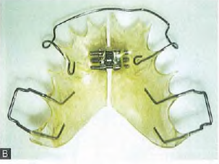
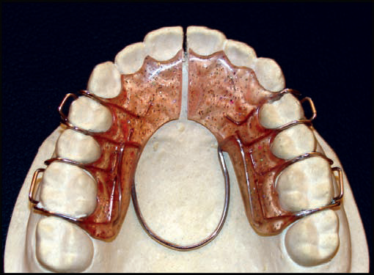
Appliances Used for Slow Arch Expansion
1. Jackscrew
2. Coffin Spring
3. A NiTi expander brings about slow expansion

Slide 27
Appliances Used for Slow Arch Expansion
4. Hinged expander that expand more anteriorly than posteriorly.
(proffit ,2019)

Slide 28
Appliances Used for Slow Arch Expansion ( proffit,2019)
5 .Quad Helix Appliance
bilateral maxillary constriction.
The lingual wire should contact the teeth involved in the crossbite
Activation at point 1 produces posterior expansion, whereas activation at point 2 produces anterior expansion.
The lingual wire should remain 1 to 1.5 mm away from the marginal gingiva and palatal tissue.
1
2

Slide 29
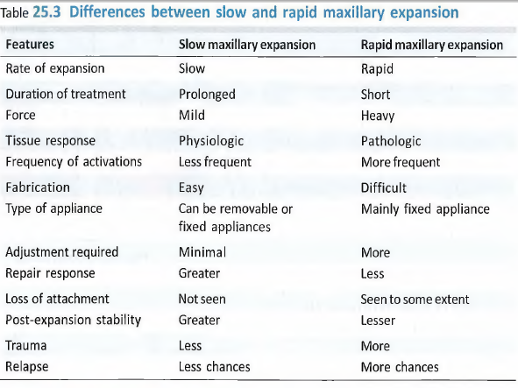
Phullari ,2011

Slide 30
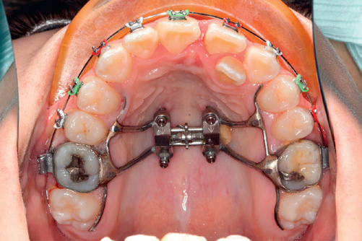
Implant-Supported Expansion (semi slow expansion) Or Miniscrew assisted raped maxillary expansion (MARPE):
Bone screw as temporary anchorage.
force can be applied directly to the maxilla
Avoid teeth movement
produce skeletal change
(de Oliveira et al, 2021).

Slide 31
Clinical approaches of (MARPE)(de Oliveira et al, 2021):
1.CBCT
2. orthodontic technician
3. contra-angle driver.
4.deep palatal vault, four custom stainless-steel tubes laser-soldered indirectly to the body of the jackscrew

Slide 32
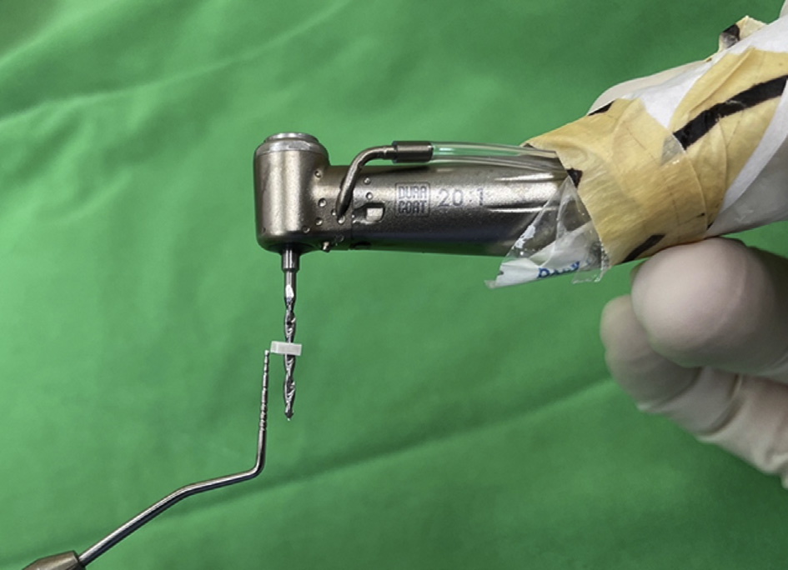

Slide 33
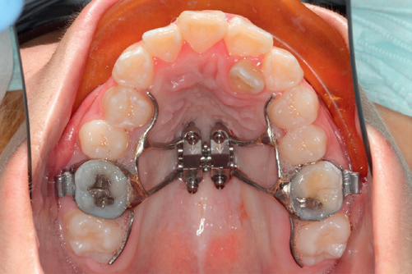
Clinical approaches of (MARPE)(de Oliveira et al, 2021):
5. Bicortical mini-implant anchorage (Cibele B., 2021)
6. The jackscrew was located between the maxillary second premolars and first molars
7. cementation and TAD insertion
8 . Activation 2/4 turn immediately after mini-implant placement

Slide 34
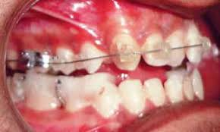
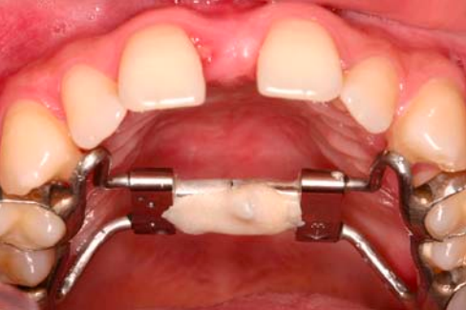
Clinical approaches of (MARPE)(de Oliveira et al, 2021)
9. bite blocks to disengage the occlusion .
10. End of treatment ligature wire or flowable composite as a passive retainer.
Nabeel Ahmad et al, 2014
Chrcanovic & Custódio , 2009

Slide 35
Where suitable sites for the insertion of orthodontic palatal mini-implants with MARPE?

Slide 36
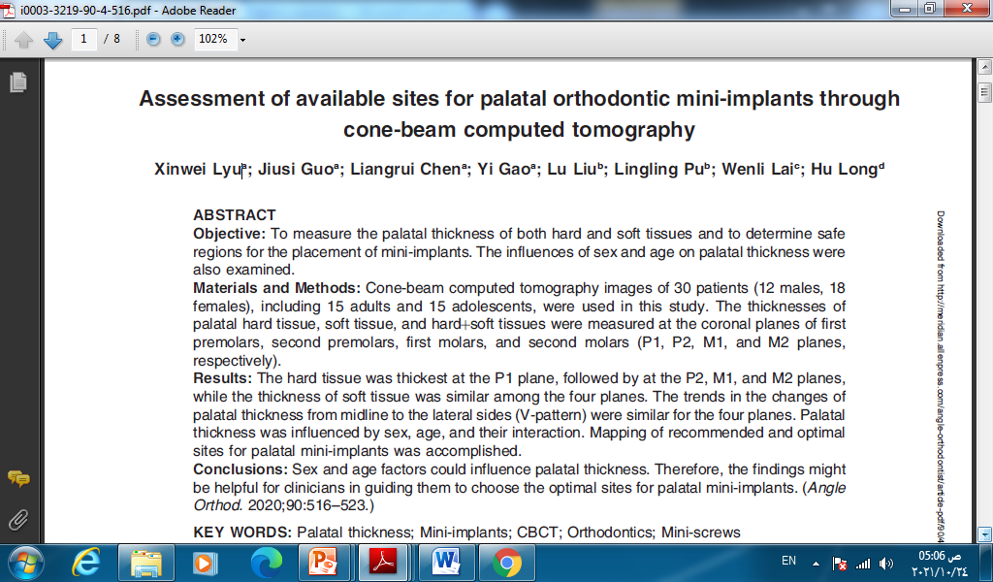
In this study (Xinwei Lyu,2020), palatal thicknesses of hard tissue, soft tissue, and hard‏soft tissues were evaluated to determine suitable sites for the insertion of orthodontic palatal mini-implants, they found that:

Slide 37
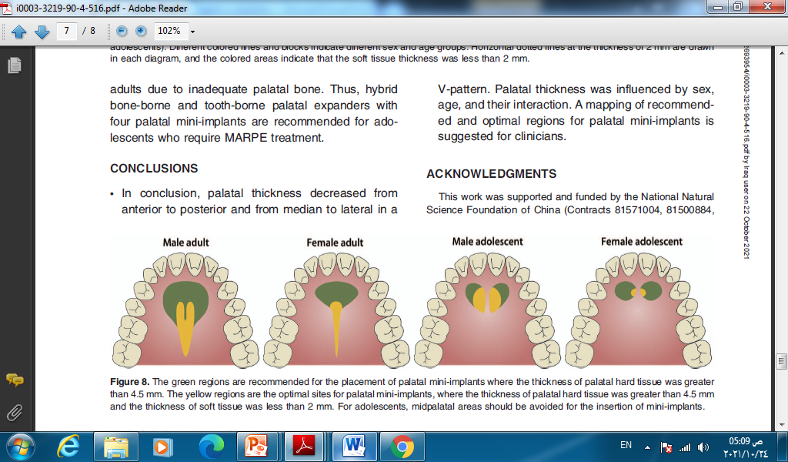

Slide 38
What about treatment difference for maxillary skeletal expansion between MARBE and tooth borne maxillary expansion appliance (hyrax) ?

Slide 39
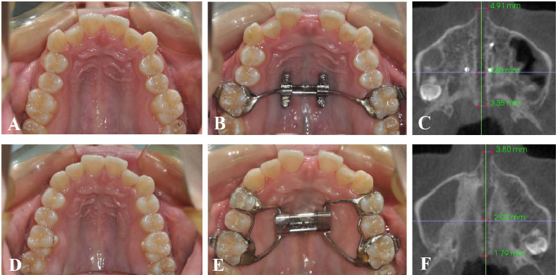
According to (Haichao Jiaa, 2021) The success rate of the midpalatal suture opening was higher in the MARPE group than in the Hyrax group.
The MARPE appliance separated the suture in a more parallel manner, compared to the Hyrax expander, because This discrepancy can be explained by the position of the expander. The center of resistance of the maxilla is located between the first and second molar.

Slide 40
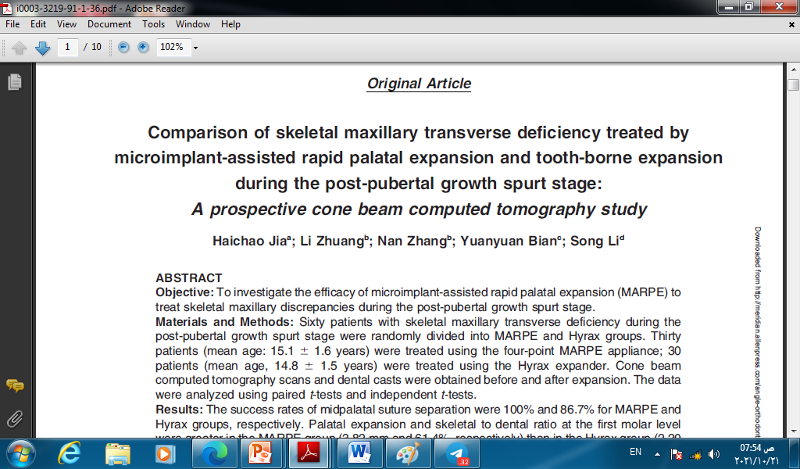
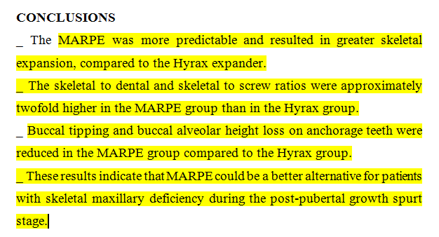

Slide 41
What about factors affect success rate of MARPE?

Slide 42
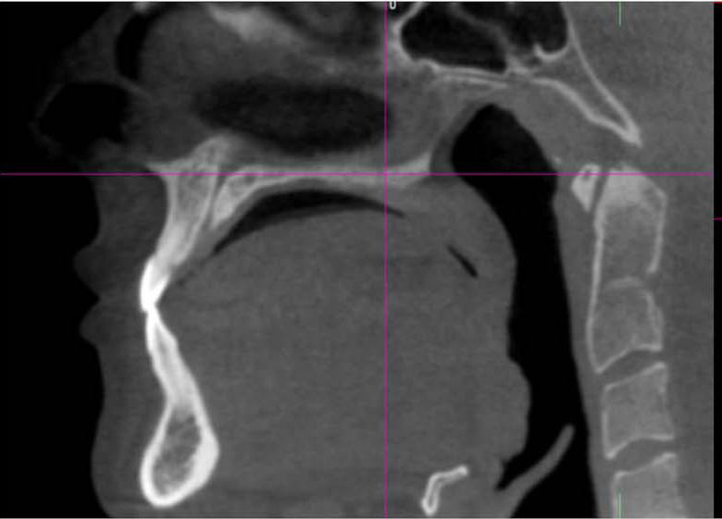
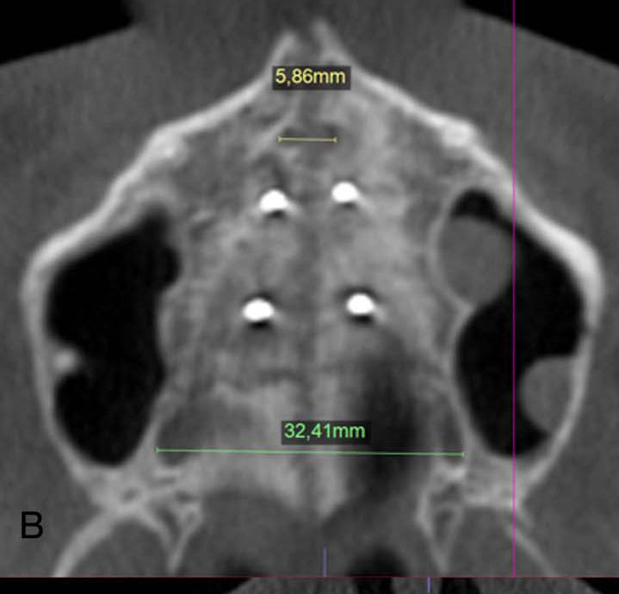
This research (Oliveira et al, 2021) evaluate whether the success of miniscrew-assisted rapid palatal expansion (MARPE), in patients with advanced bone maturation is effected by factors such as midpalatal suture (MPS) maturation, age, sex, or bicortical minimplant anchorage, and they conclude that:

Slide 43
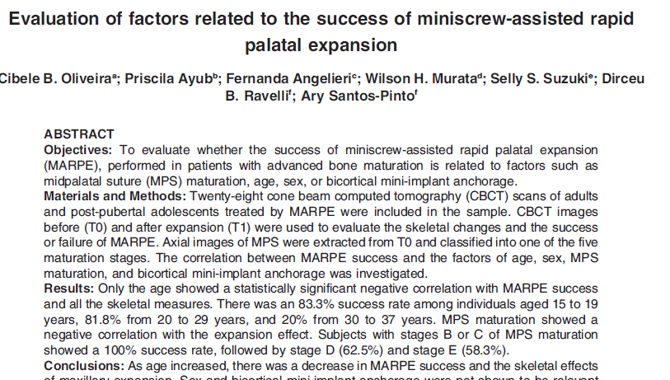
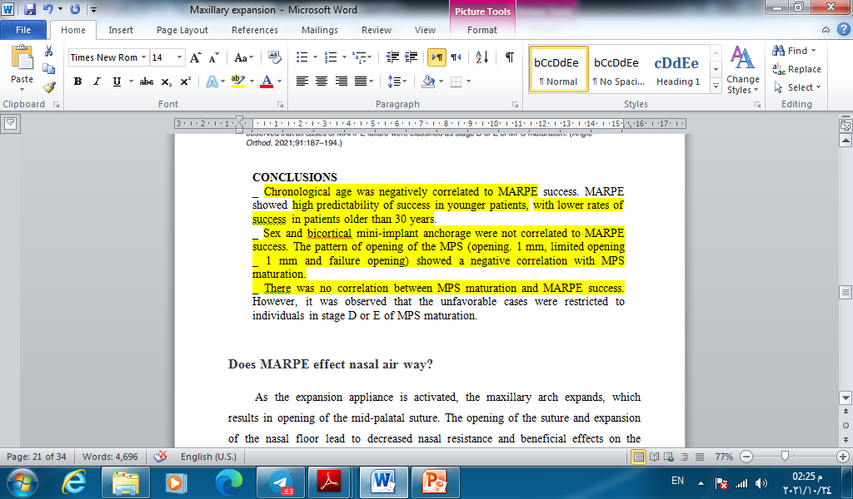

Slide 44
Does miniscrew assisted rapid palatal expansion have complication associated with its treatment?

Slide 45

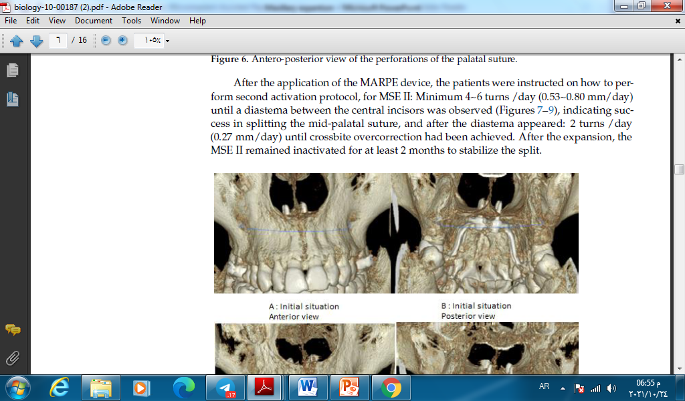
Does miniscrew assisted rapid palatal expansion have complication associated with its treatment?
Complications were registered from the patient´s records (Eugen Silviu Bud, 2021), (Huei-Rou Tsai,2021).
1. pain
2. Epistaxis

Slide 46
Does miniscrew assisted rapid palatal expansion have complication associated with its treatment?
3.Dental,
gingival irritation,
root resorption or damage,
gingival recession,
loss of vitality
4. tissue- (peri-implantitis, infection, ulceration) , Amoxicillin (500 mg every 8 h for 5 days) ,and the use of chlorhexidine mouth rinsing were suggested.

Slide 47
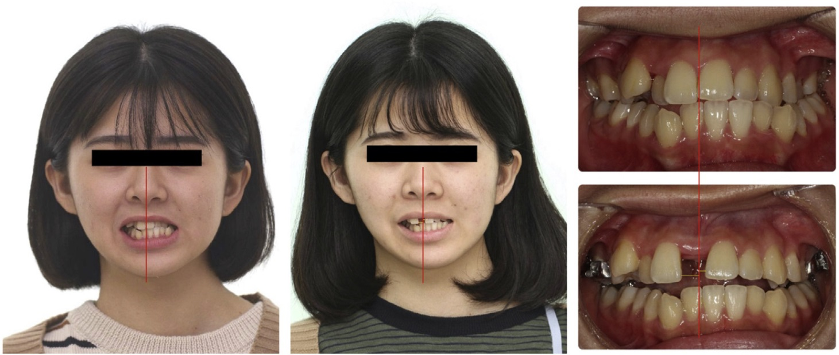
Does miniscrew assisted rapid palatal expansion have complication associated with its treatment?
5. hardware-related side effects (loosening or deformation of miniscrew , fracture or deformation of expansion screw), and
6. anatomical complications (asymmetric expansion, fracture of bone).

Slide 48
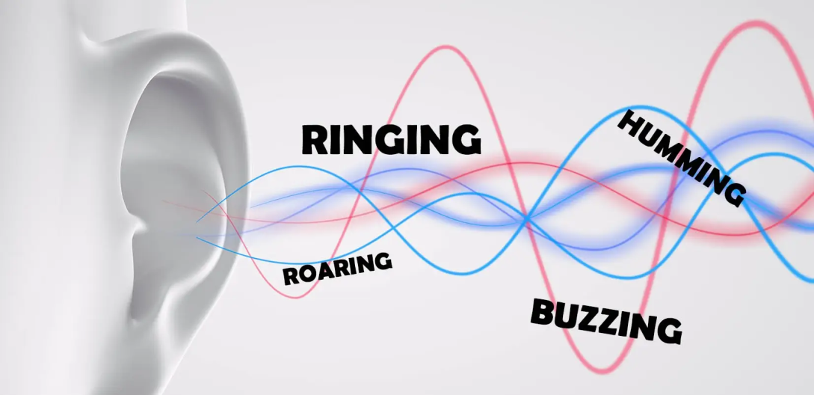
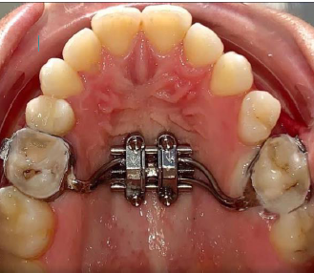
7. Tinnitus
8. micro-implants loosening,

Slide 49
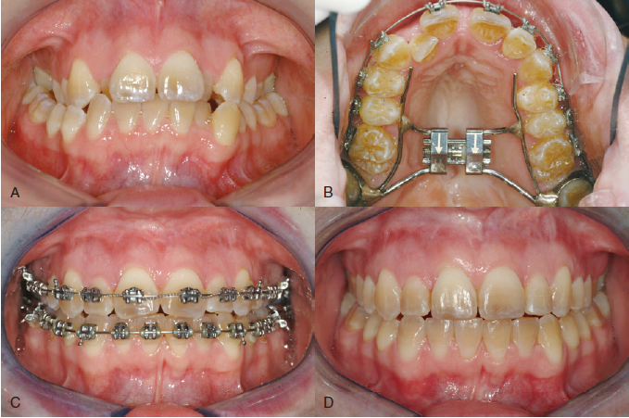
surgically assisted rapid palatal expansion (SARPE) (Proffit ,2019) :
Surgical technique used to allow transverse expansion
The modern surgical technique includes all the bone cuts for a LeFort I osteotomy except the downfracture.
(SARPE), using bone cuts to reduce the resistance followed by expansion of the jackscrew to separate the 2 halves of the maxilla

Slide 50
The primary indication for preliminary SARPE
severe maxillary constriction
Complication of conventional RPE.

Slide 51
SARPE PROTOCOL (de Oliveira et al, 2021):
The SARPE including LeFort I subtotal osteotomy in the lateral wall of the maxilla, pterygomaxillary suture, and midpalatal suture disruption performed under general anesthesia .
A hyrax expander was used with an activation protocol of 1/4 turns (0.2 mm) 2 times daily until crossbite correction.

Slide 52
Unfortunately, however, there is no guar­antee of symmetric expansion
one of the main disadvantages of this procedure.

Slide 53
Comparison dental and skeletal out come between MARPE and SARPE (de Oliveira et al, 2021):
MARPE showed significantly greater skeletal expansion than SARPE.

Slide 54
Comparison between MARPE and SARPE (de Oliveira et al, 2021):
SARPE | MARPE
1. Pyramidal opening of MPS 2. Low force action 3 More posterior teeth inclination 4. Less periodental health 5. Increase Nasal air way volume. | Parallel opening of MPS High force action Less posterior teeth inclination High periodental health Increase Nasal air way volume.

Slide 55
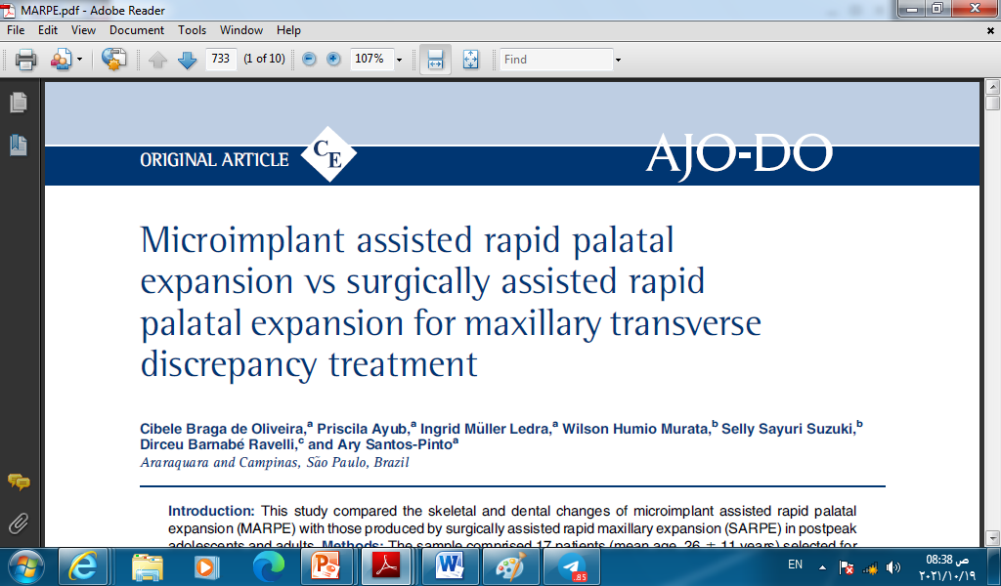
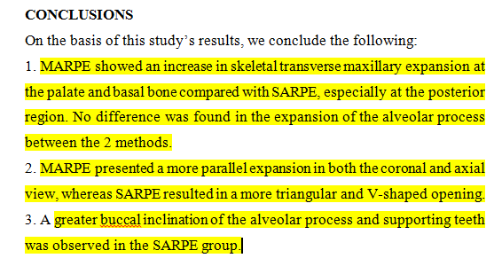

Slide 56
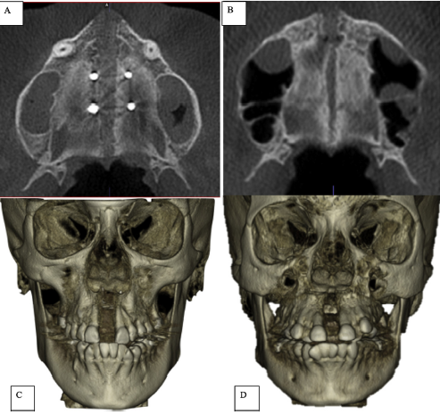

Slide 57
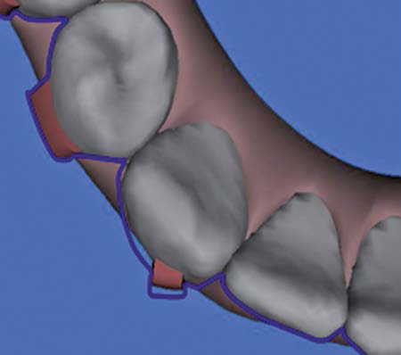
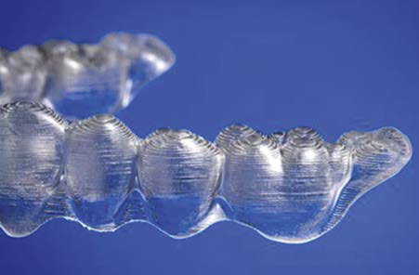
Clear aligner (ZHOU AND GUO,2020)
In 1946, Kesling proposed to manufacture a series of removable appliances called ‘‘aligners.’’
The underlying concept was to move teeth in a series of planned individual stages using positioners
fabricated thermoplastic material molding technology,
Its unique advantages over traditional appliances include esthetics, comfort, removal for better hygiene, shorter appointment times, and 3D control of tooth movement.
(Craber, 2017)

Slide 58
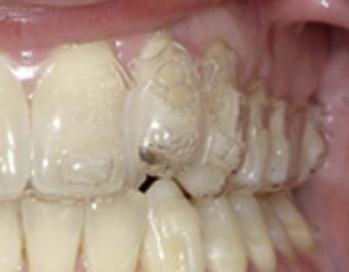
buccal expansion can be achieved by Invisalign to relieve dental crowding, to modify the arch form.
reported in 2013 that expansion using Invisalign is indicated when having to resolve 1–5 mm of crowding and is also recommended for blocked out teeth.
(Craber, 2017)

Slide 59
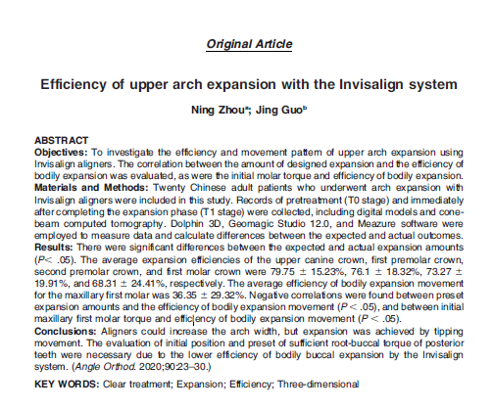
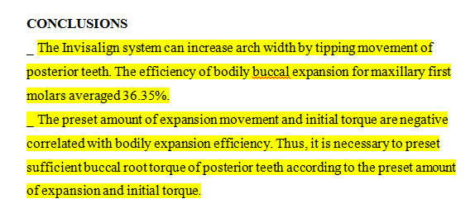
CLEAR ALIGNER

Slide 60


