Slide 1

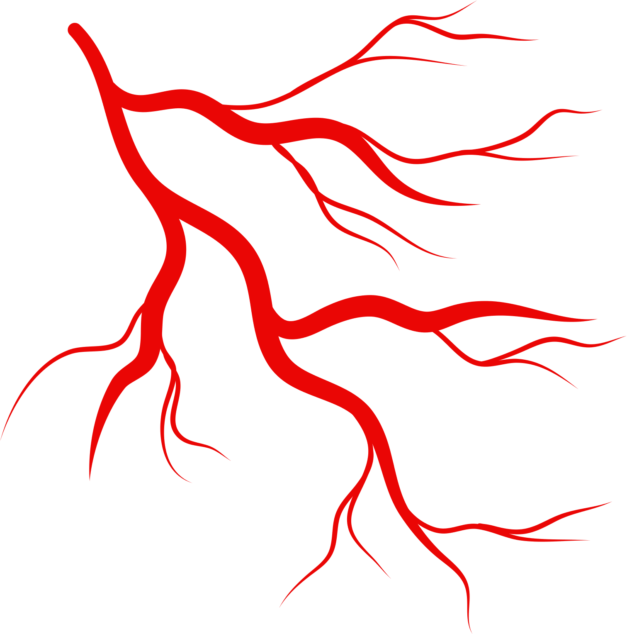

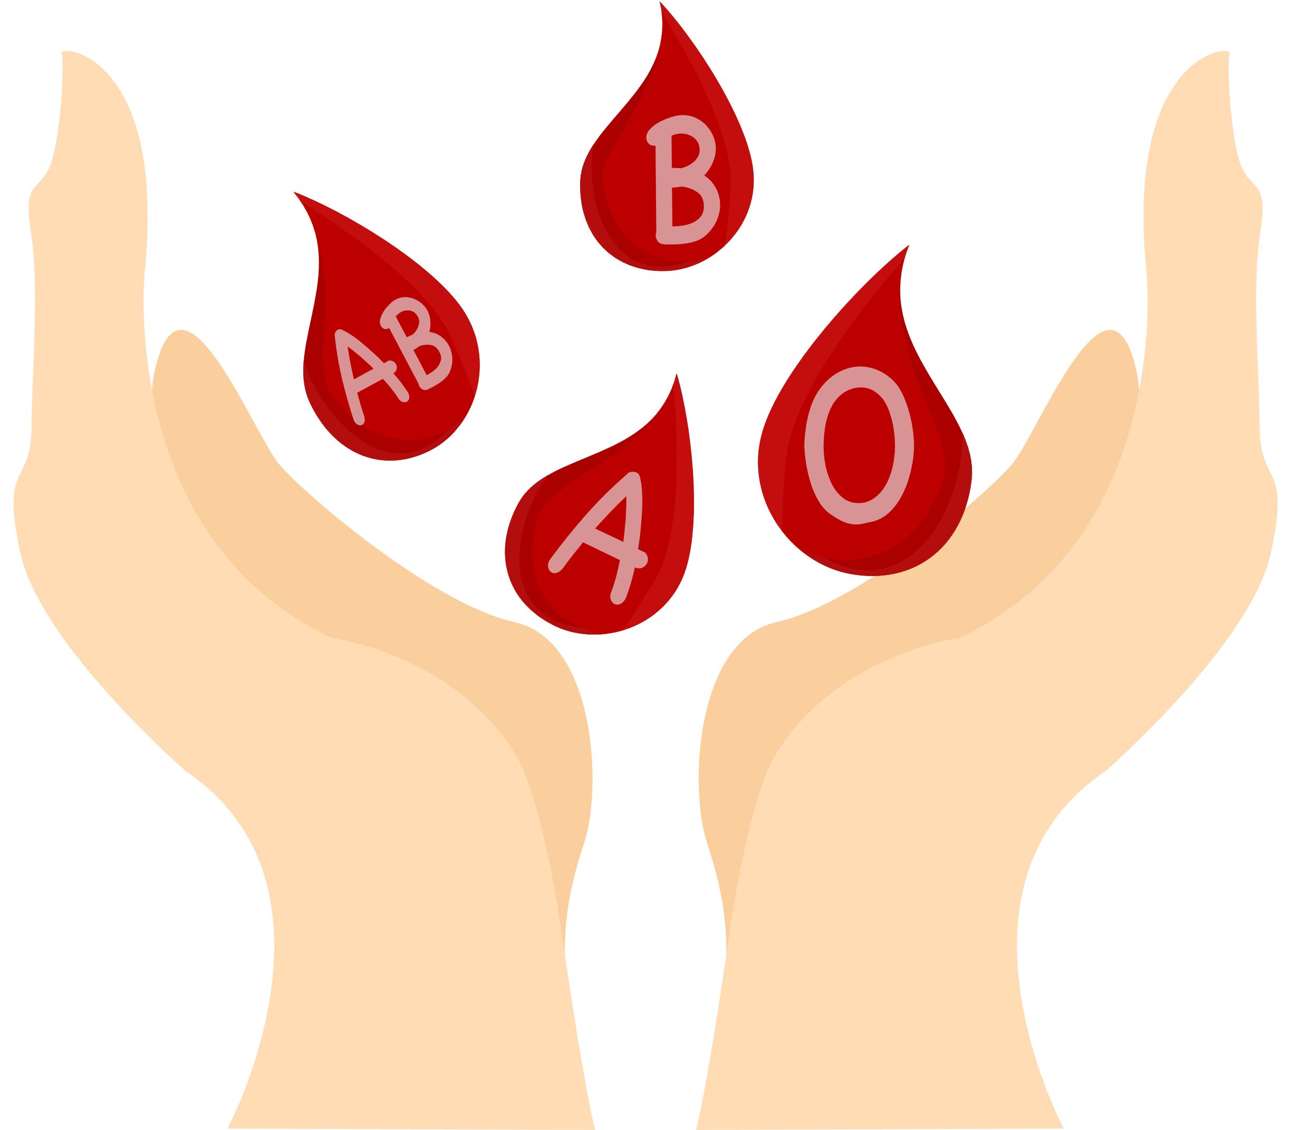

DIFFERENCE Between
GENERAL ANEMIA AND
PERNICIOUS ANEMIA
Presented By
م. مياسة عبدالله علي

Slide 2
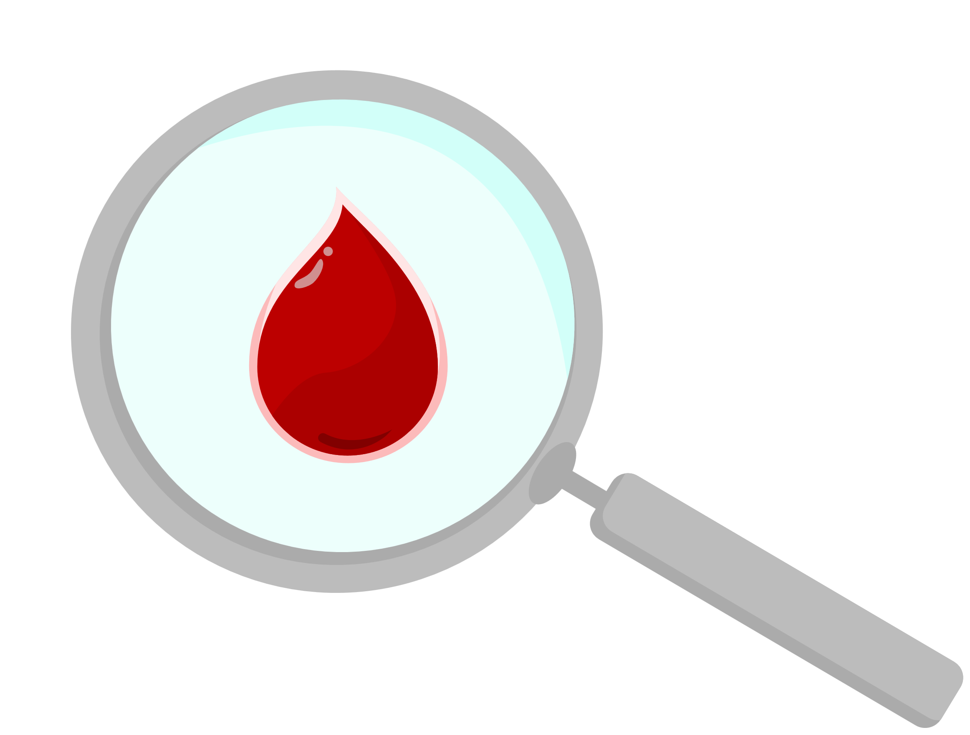
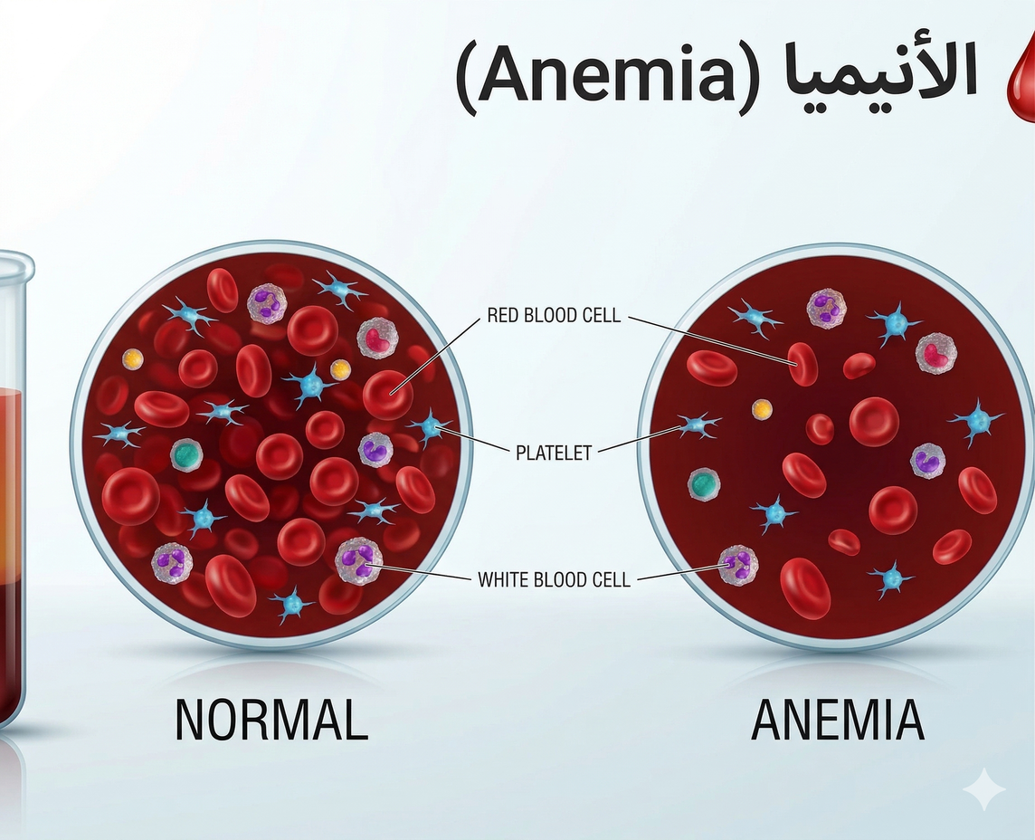

ANEMIA (GENERAL OVERVIEW)
Anemia is a condition characterized by a decrease in hemoglobin concentration, red blood cells (RBCs), or both, leading to reduced oxygen-carrying capacity of the blood.

Slide 3





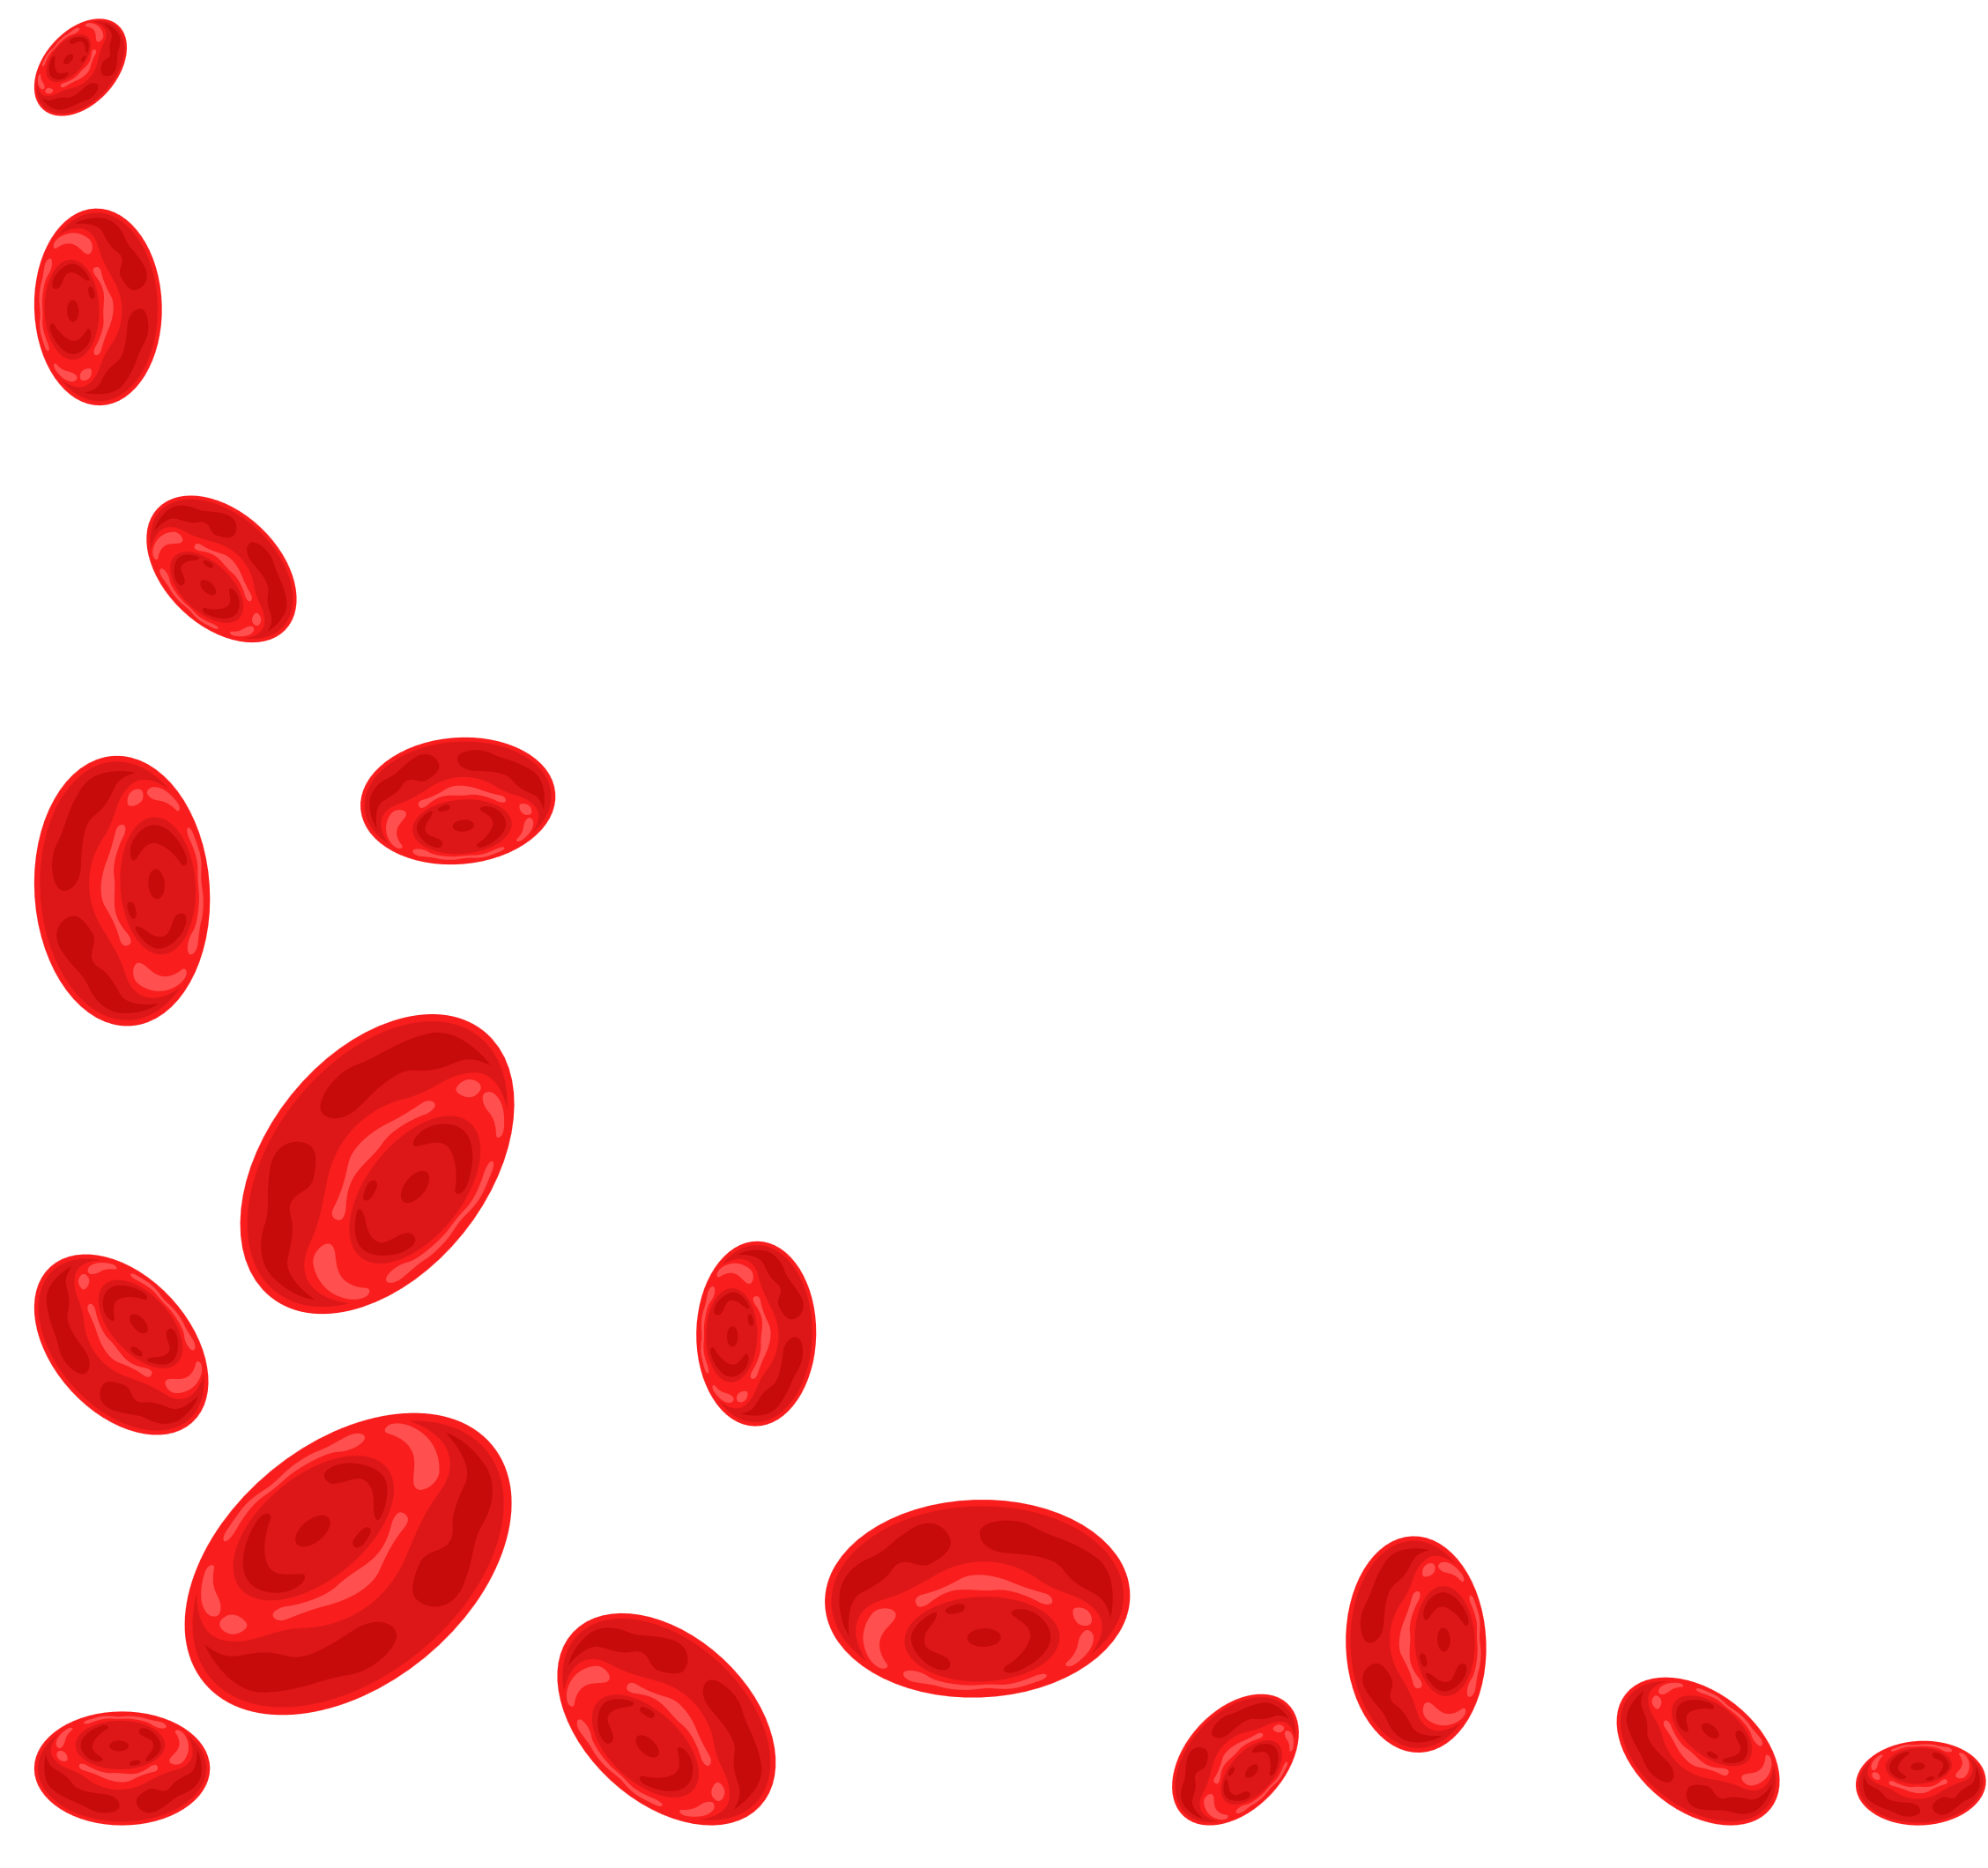

CAUSES (MAIN CATEGORIES)
Blood loss
Decreased RBC production
Increased RBC destruction (Hemolysis)
  Acute (trauma, surgery)
  Chronic (GI bleeding, menstruation)
  Iron deficiency
  Vitamin B12 or folate deficiency
  Bone marrow disorders
  Genetic (e.g., sickle cell disease)
  Acquired (autoimmune, infections)

Slide 4

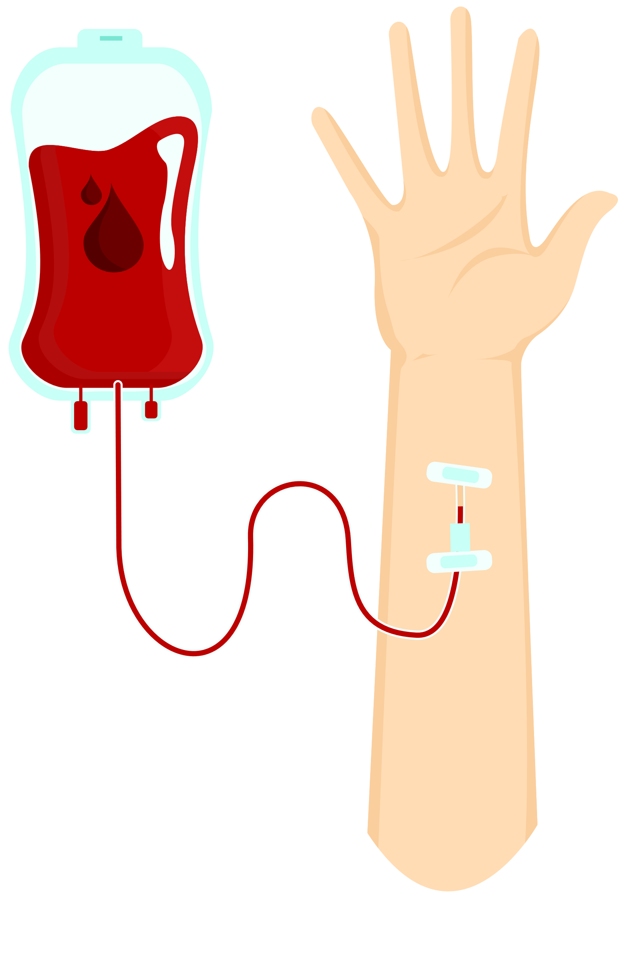





SYMPTOMS
Fatigue
Pallor
Shortness of breath
Dizziness
Tachycardia

Slide 5
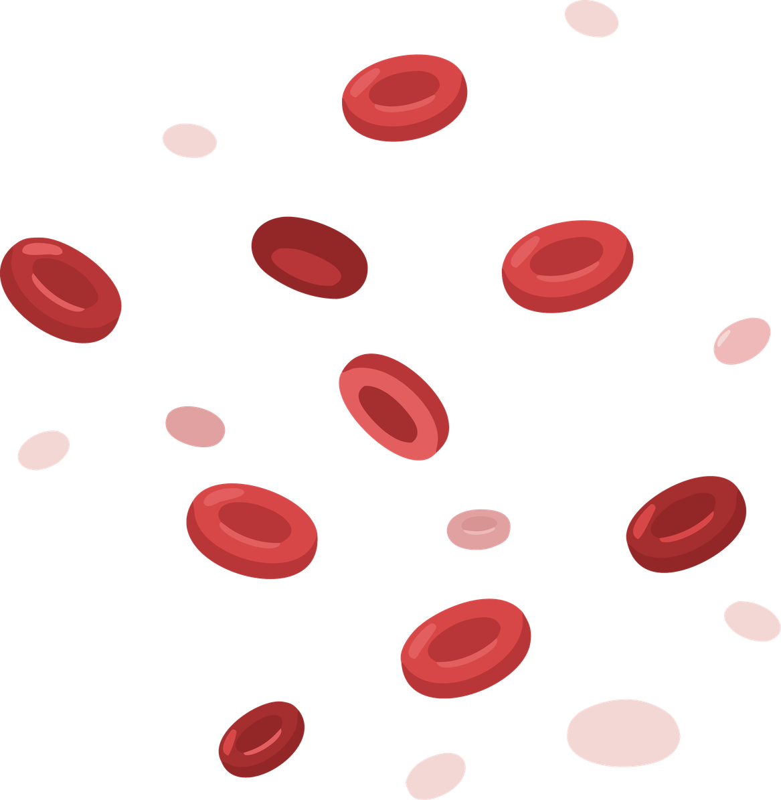
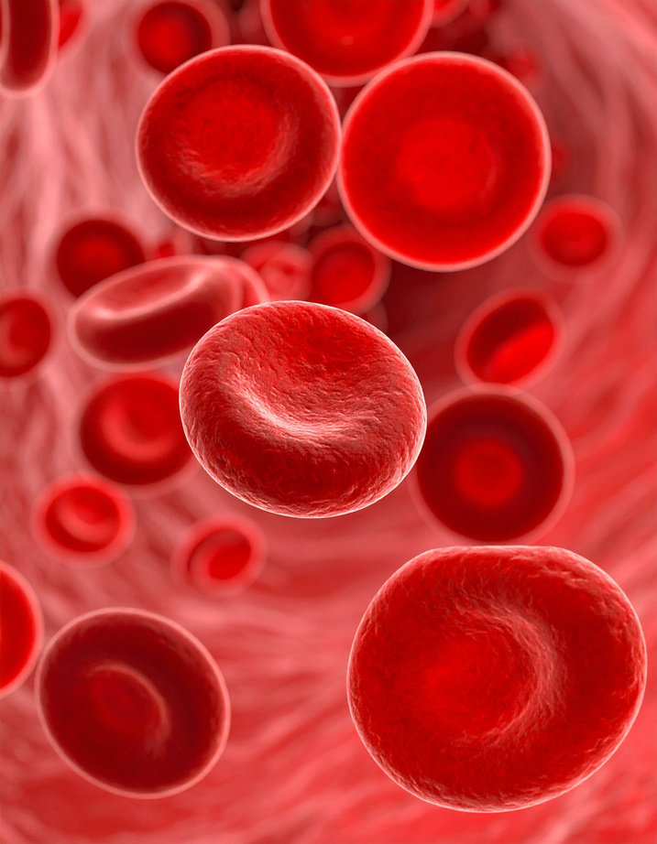
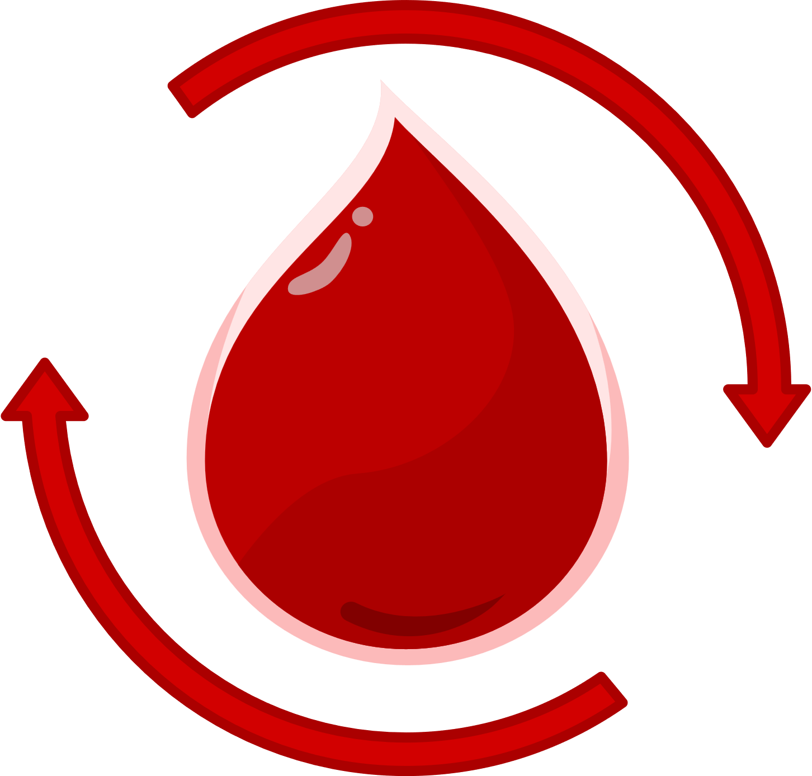

DIAGNOSIS
  Complete Blood Count (CBC)
  Hemoglobin (Hb), Hematocrit (Hct)
  RBC indices (MCV, MCH)

Slide 6

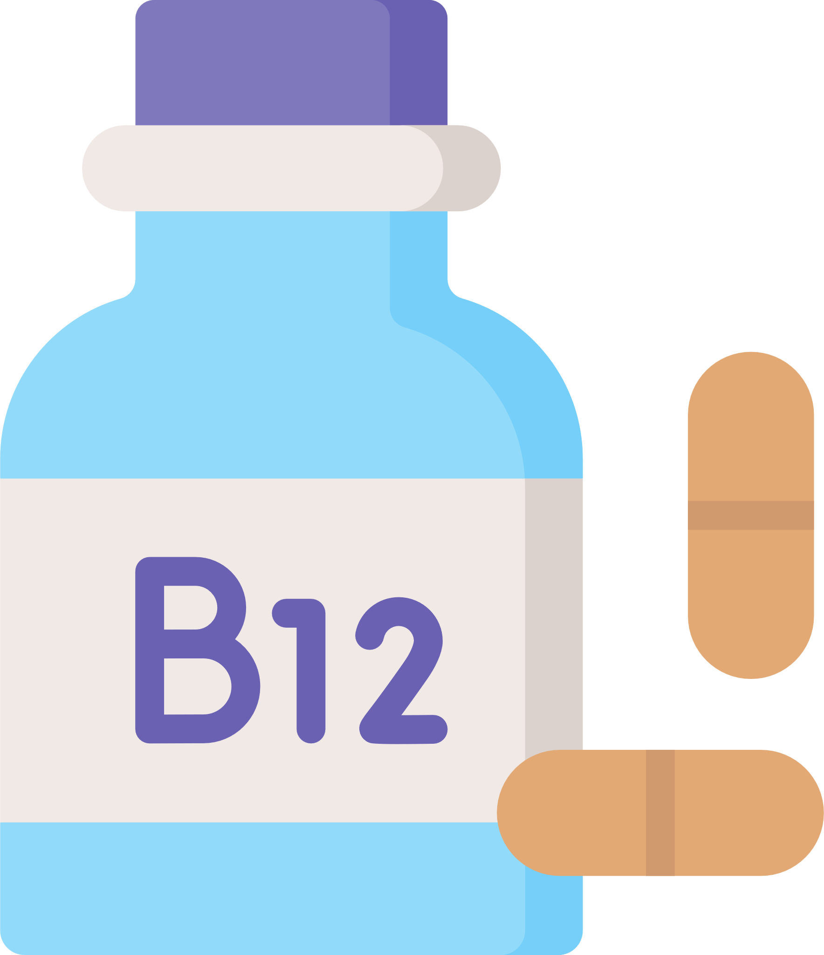
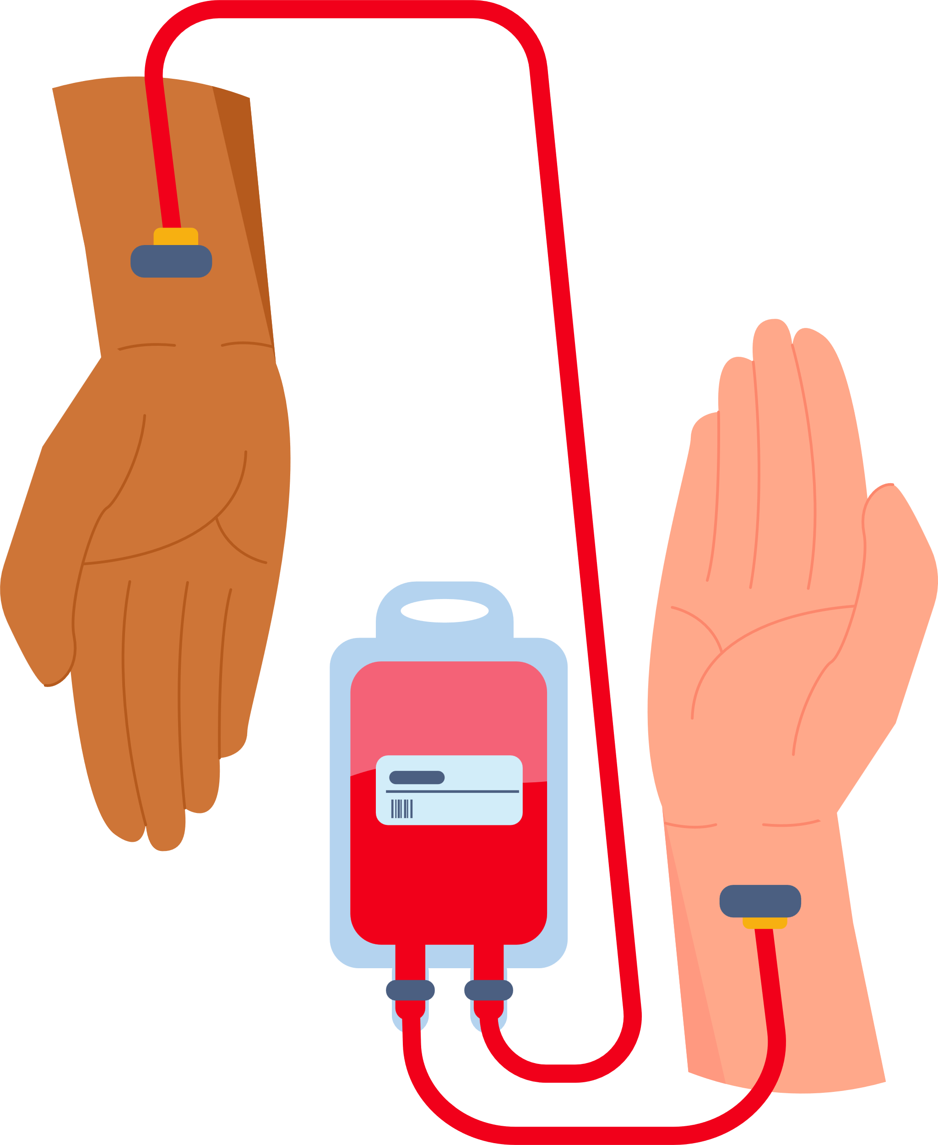
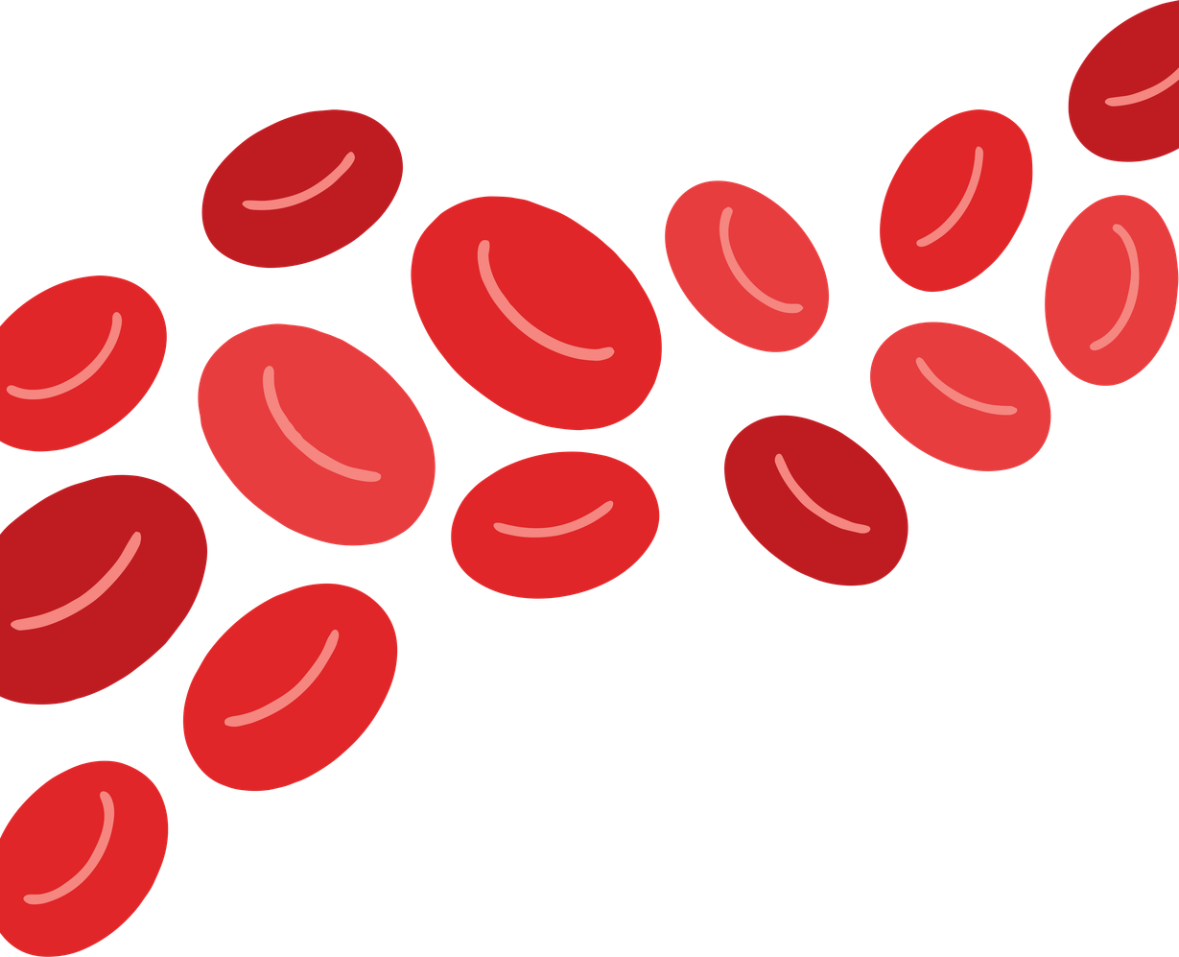
Treatment
Depends on cause:
Iron supplementation
Vitamin B12 or folate
Blood transfusion (severe cases)

Slide 7


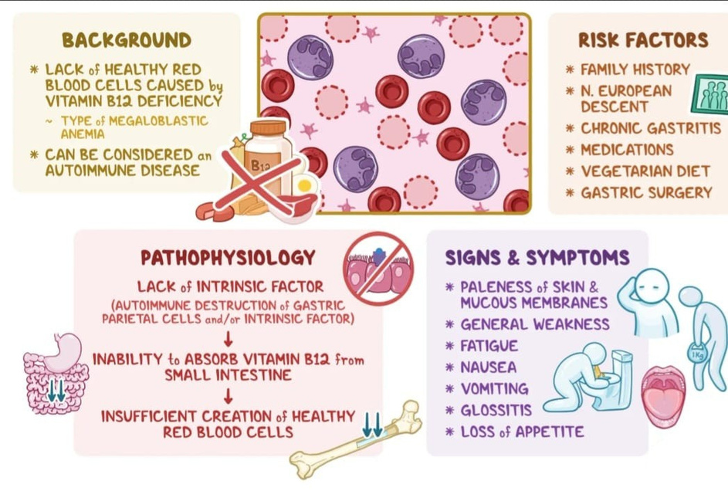
PERNICIOUS ANEMIA
Pernicious anemia is a type of megaloblastic anemia caused by vitamin B12 deficiency due to lack of intrinsic factor (IF).

Slide 8
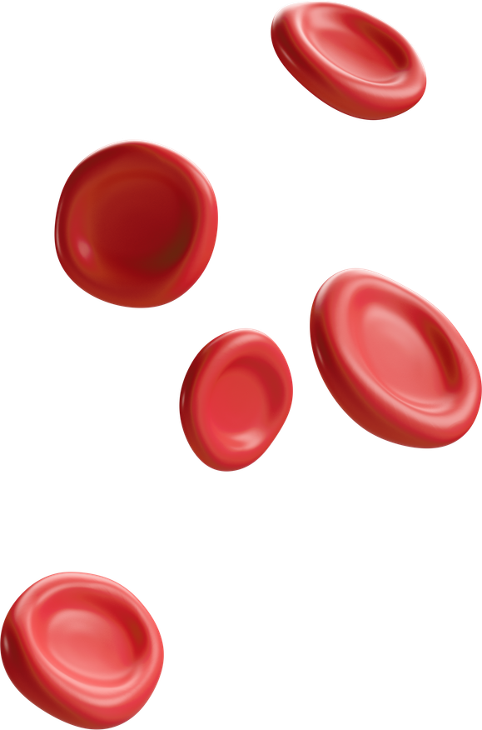

PATHOPHYSIOLOGY
Normally, intrinsic factor (from gastric parietal cells) binds vitamin B12 → allows absorption in the ileum
In pernicious anemia:
Decrease in Intrinsic factor
Decrease in Intrinsic factor
Decrease in Intrinsic factor

Slide 9
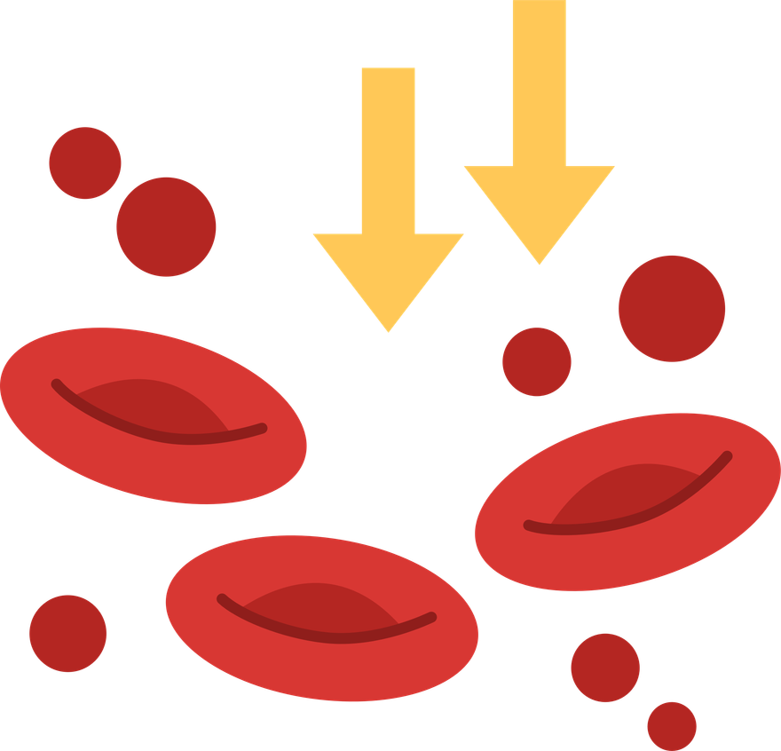


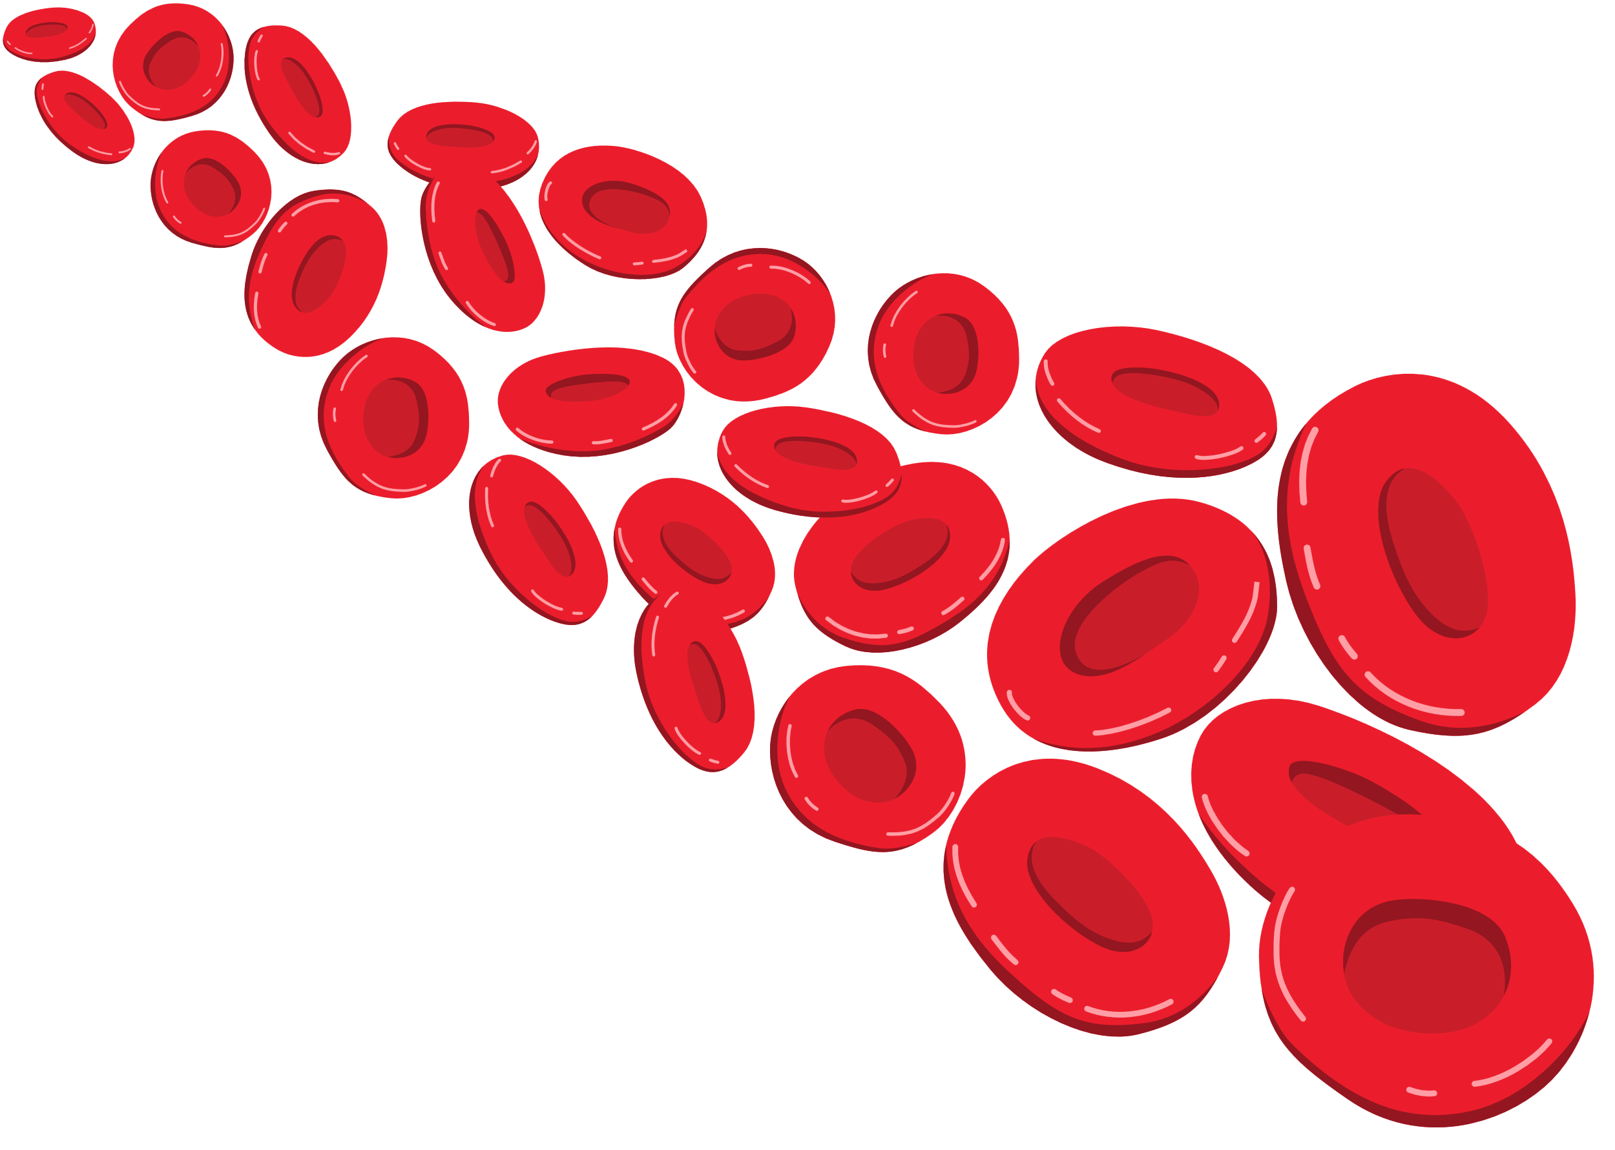
CLINICAL FEATURES
General anemia symptoms
Neurological symptoms:
General anemia symptoms
Neurological symptoms:
Glossitis (inflamed tongue)
  Numbness, tingling (paresthesia)
  Difficulty walking
  Memory problems

Slide 10
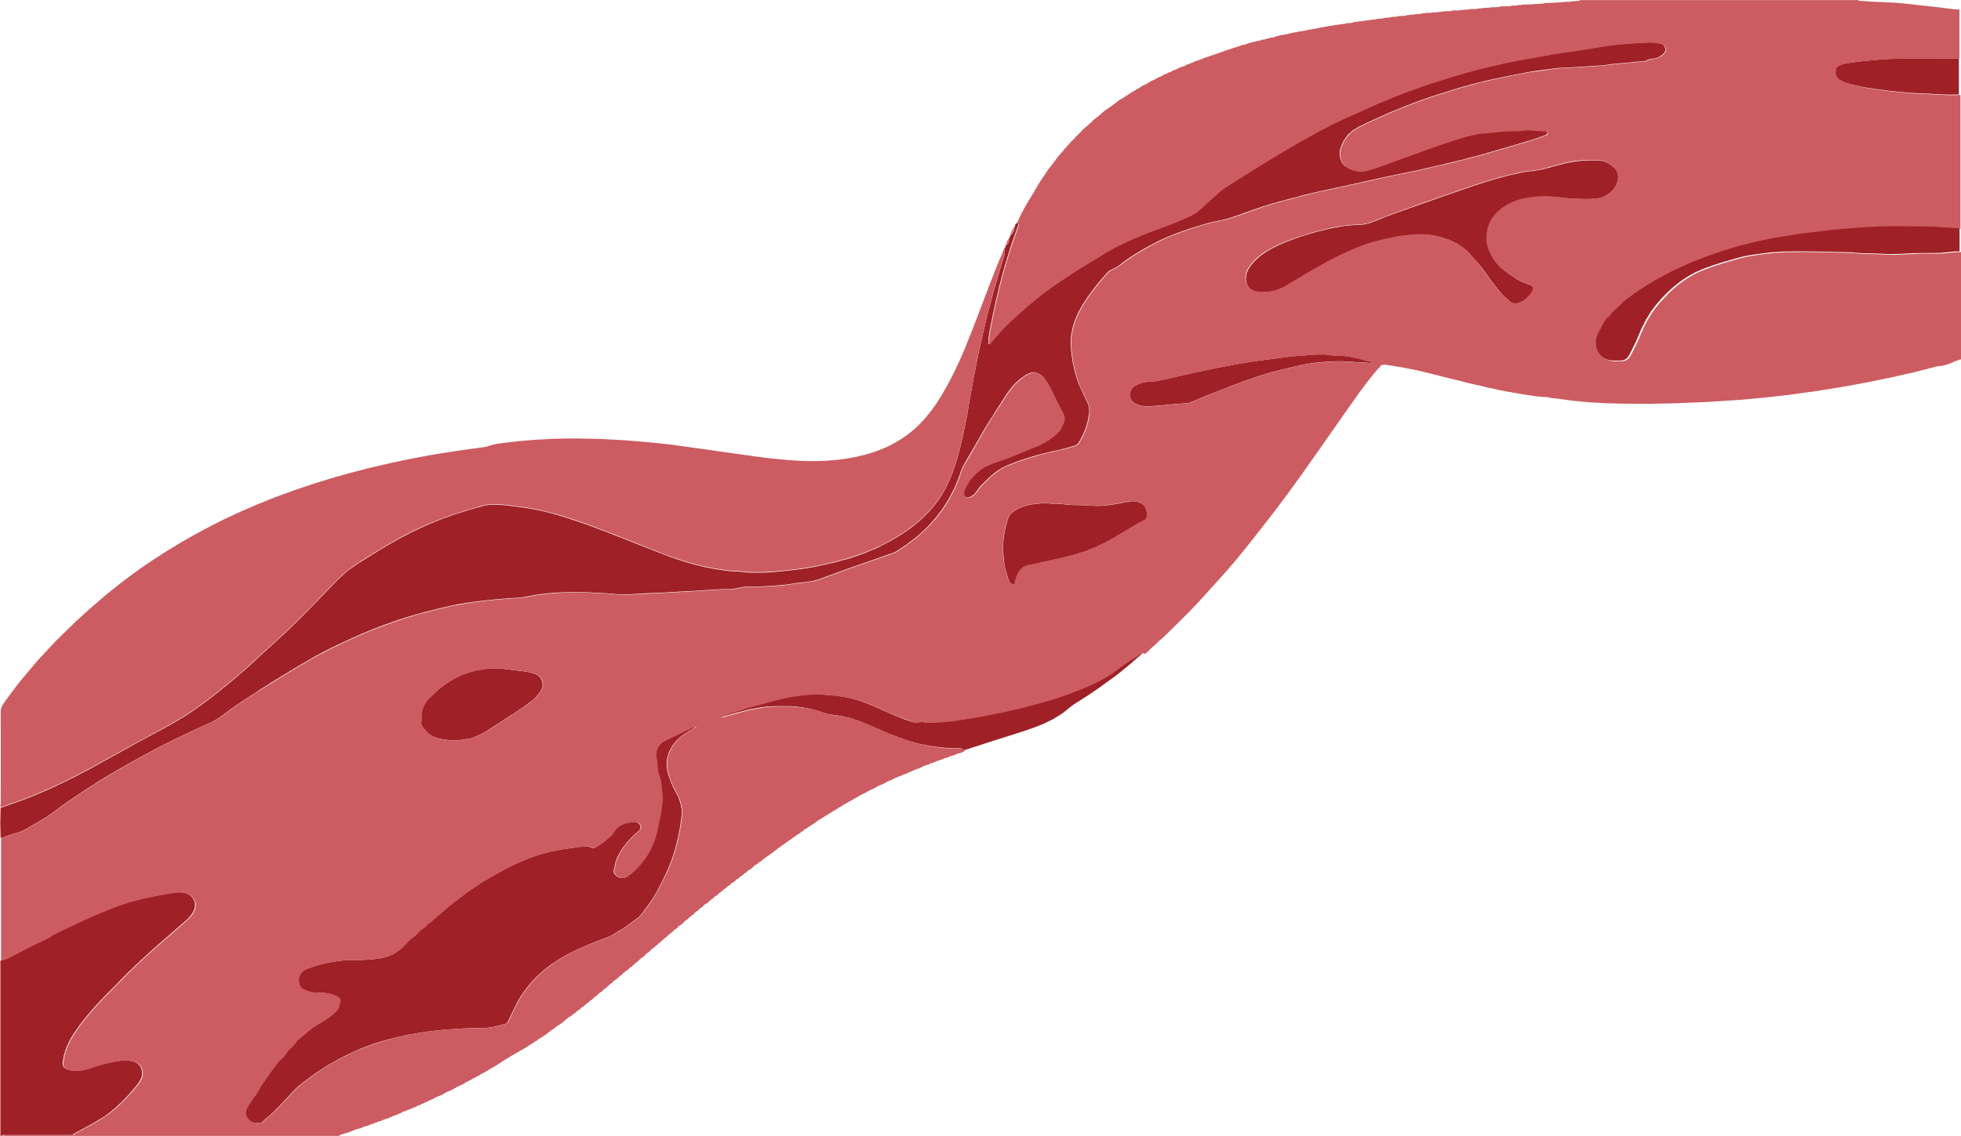



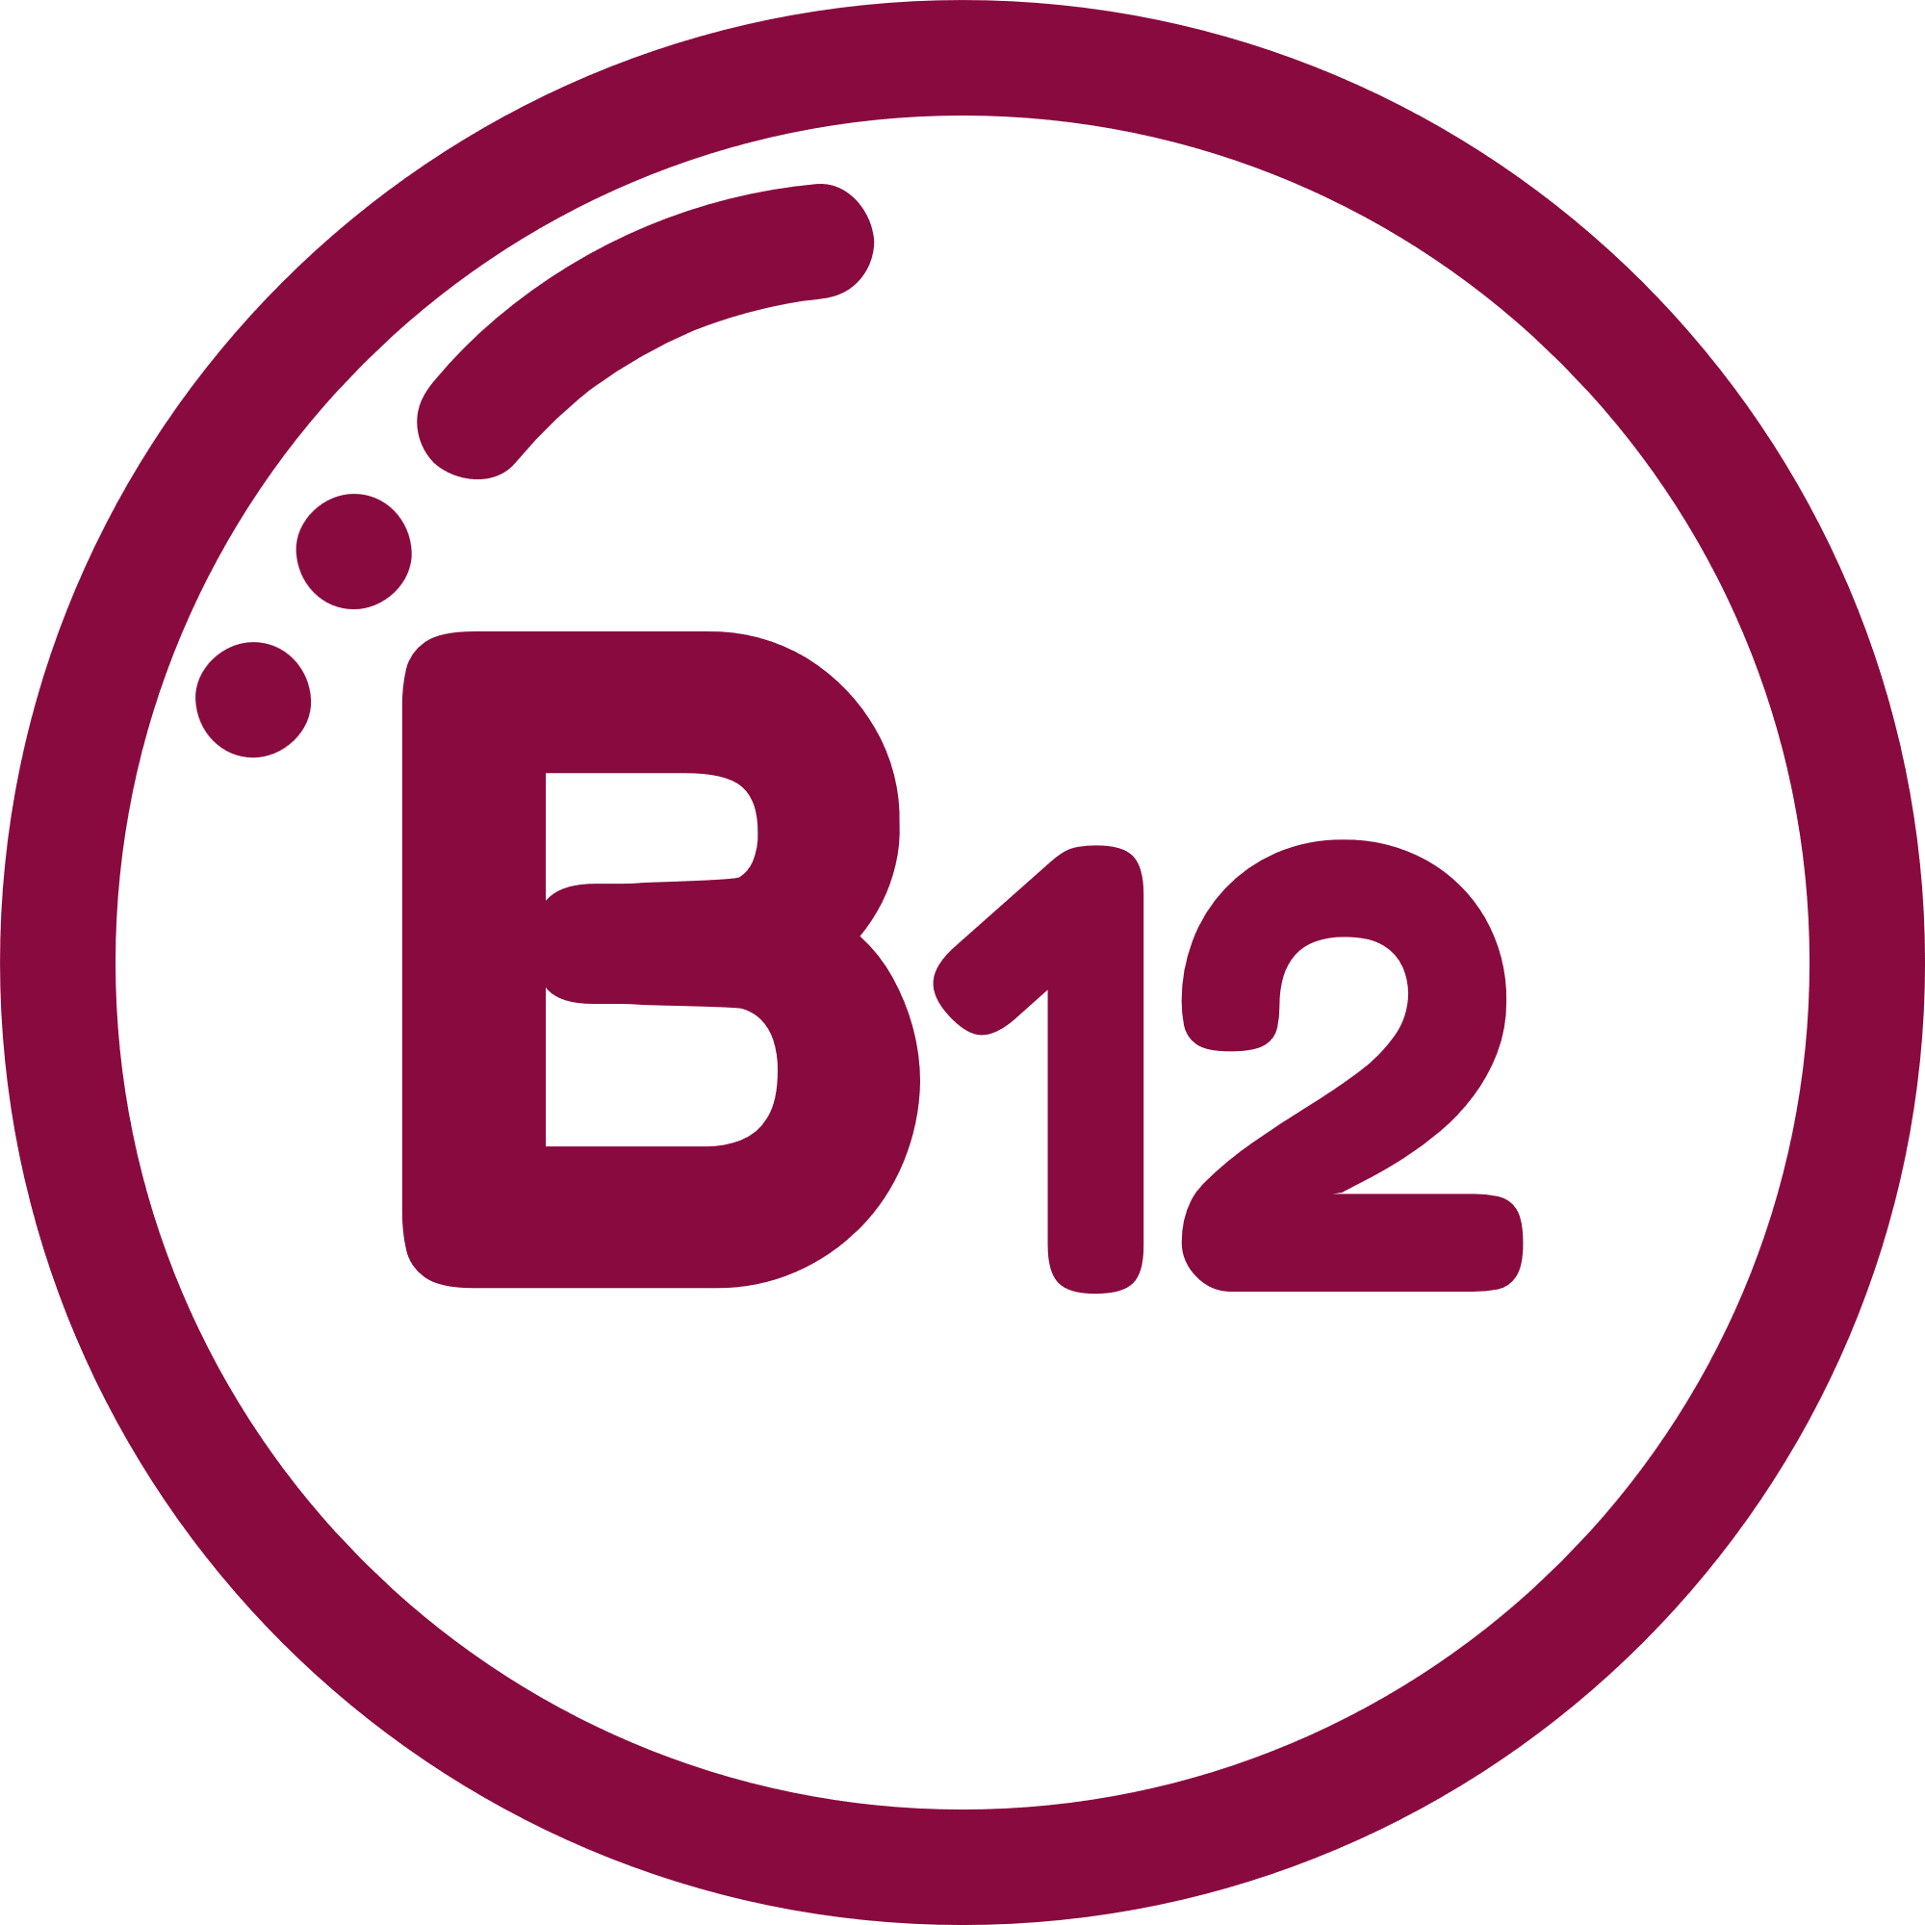
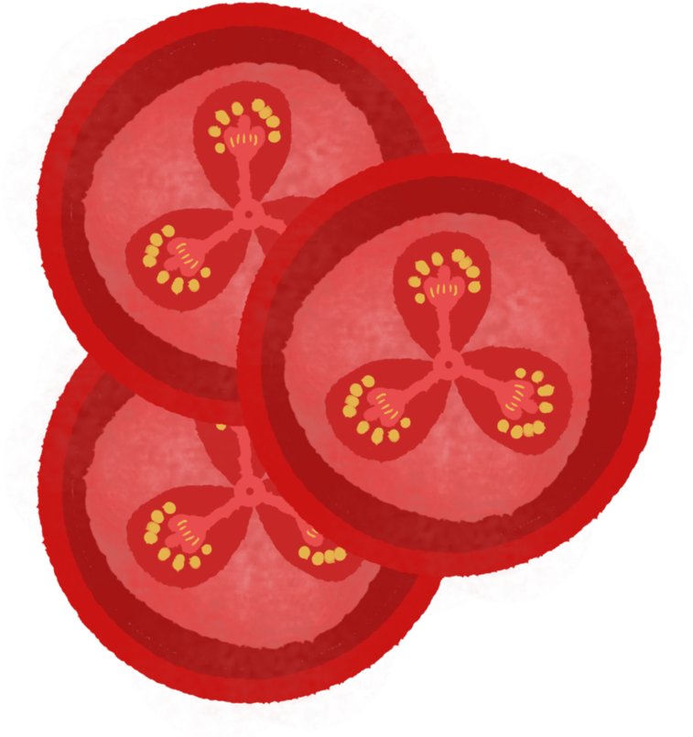



DIAGNOSIS
01
02
03
04
Low serum vitamin B12
High MCV (macrocytic anemia)
Anti-intrinsic factor antibodies
Blood smear: megaloblasts

Slide 11
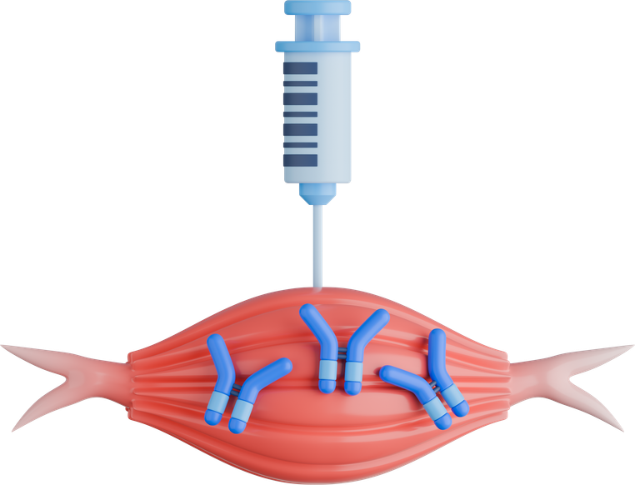
Treatment
Depends on cause:
Lifelong vitamin B12 replacement
Usually intramuscular injections

Slide 12
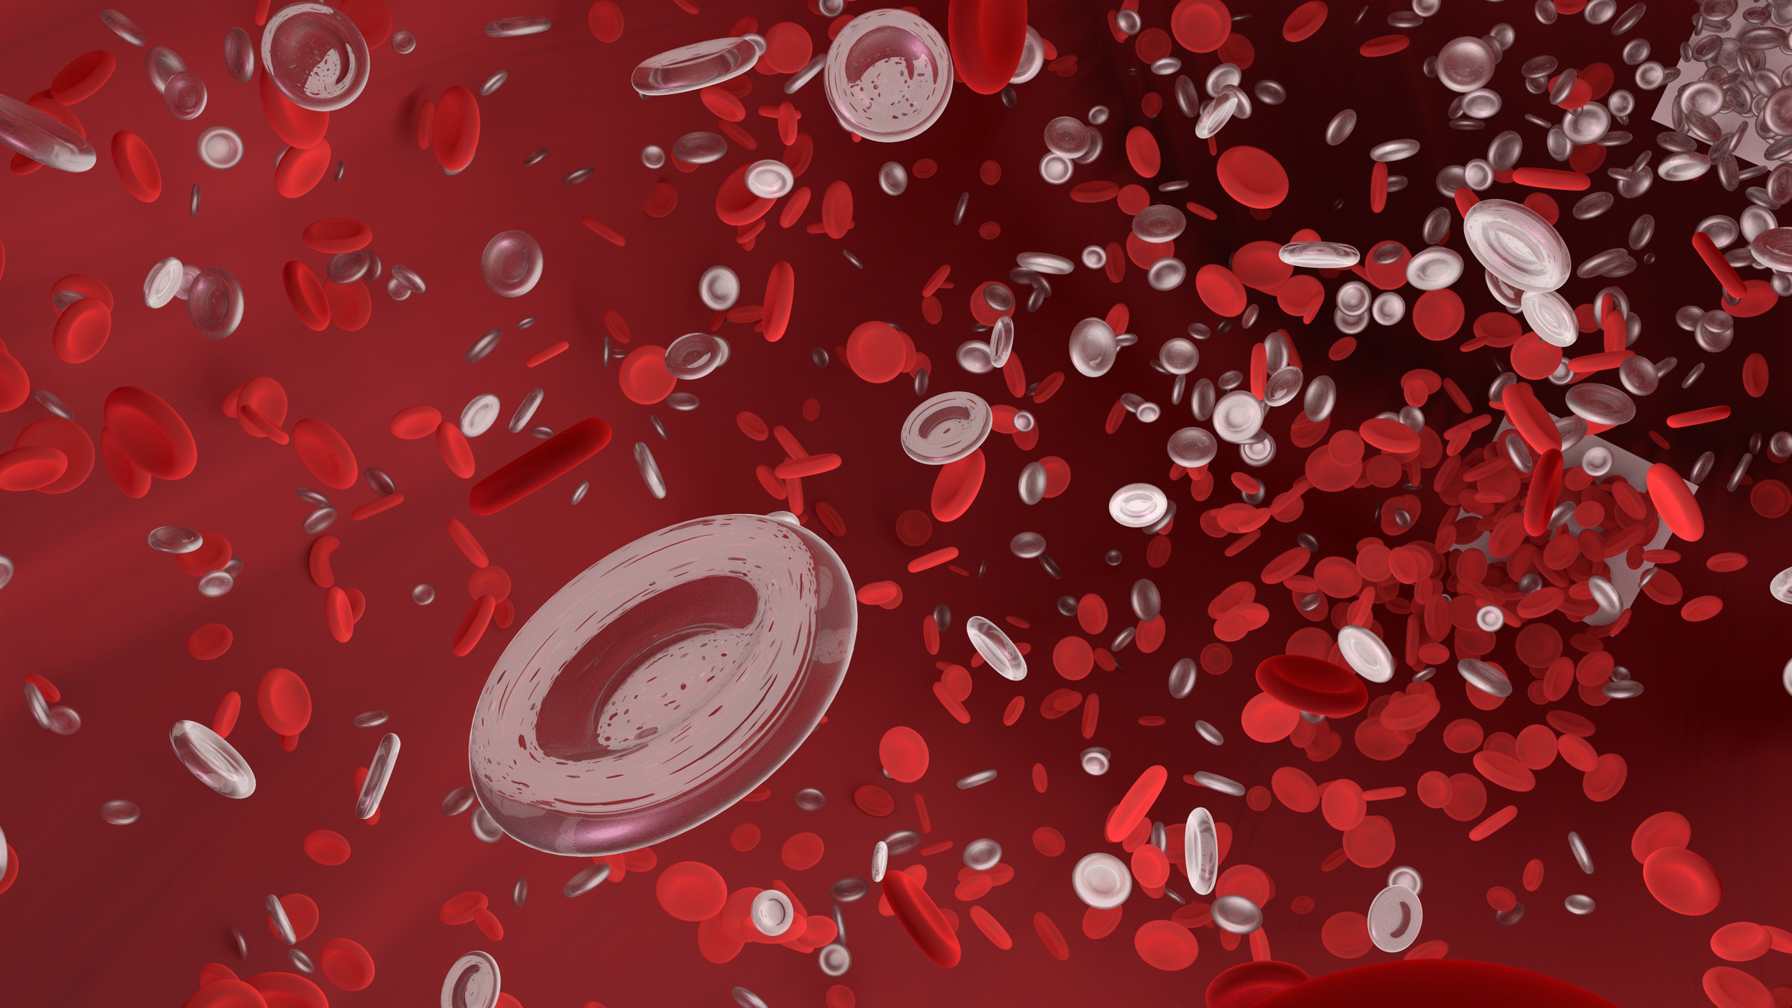

Thank You

