Slide 1
Pathogenic Aspects Of Antibiofilm compounds
ا.د.انعام بدر فالح
فرع الامراض و امراض الدواجن

Slide 2
Antibiofilm or Biofilm inhibitors are agents—including natural compounds, peptides, and nanoparticles—that prevent bacterial communities from adhering, communicating (quorum sensing), or creating protective matrices, often making them highly effective when combined with antibiotics to treat resistant infections ( so this inhibition of biofilm formation could be related to the ability of the biosurfactant to interfere with cell-to-cell communication, generally called quorum sensing, which is a key factor that contributes to biofilm formation by several microorganisms.

Slide 3
The biofilm developmental stages are referred to as reversible and irreversible attachment, biofilm maturation I and II involving cluster and microcolony formation, respectively, and dispersion

Slide 4
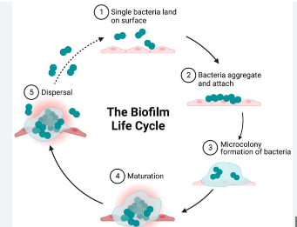
The three key physical features traditionally used to describe a biofilm are (i) a community of cells in close proximity, (ii) adhesion/attachment of cells to a biotic or abiotic surface, and (iii) aggregates encased in a self-produced or externally provided matrix.

Slide 5
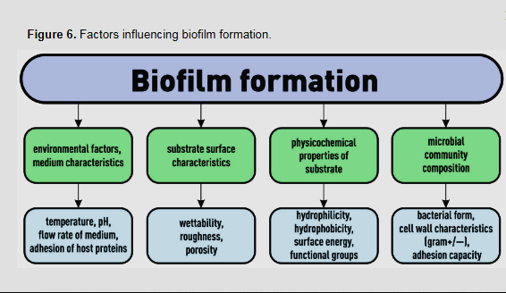
Figure:factors influencing biofilm formation

Slide 6
Examples of biofilm-producing bacteria include Staphylococcus aureus, Staphylococcus epidermidis, Enterococcus faecalis, and Pseudomonas aeruginosa, among others. A common example of biofilm infections is catheter-associated urinary tract infections (CAUTI) which occur in individuals with indwelling urinary catheters.

Slide 7
Table 1. Biofilm-producing microorganisms and associated infections.
Microorganism | Associated infections/environments | Reference
P. aeruginosa | Chronic respiratory infections, cystic fibrosis, wound infections, urinary tract infections | Bjarnsholt et al. (2013) Moreau-Marquis et al. (2008) Vani et al. (2023)
S. aureus | Device-related infections, endocarditis, osteomyelitis | Vani et al. (2023)
E. coli | Urinary tract infections, gastrointestinal infections | Vani et al. (2023) Bhowmik et al. (2025)
Klebsiella pneumoniae | Pneumonia, bloodstream infections, urinary tract infections; hypervirulent strains causing severe infections even in healthy individuals | Li et al. (2024)

Slide 8
Enterococcus faecium | Nosocomial infections, urinary tract infections, bloodstream infections | Ullah et al. (2023)
Acinetobacter spp. | Hospital-acquired infections, ventilator-associated pneumonia | Gedefie et al. (2023) Mendes et al. (2023)
Aeromonas spp. | Gastroenteritis, wound infections, septicemia; an emerging human pathogen with rising antibiotic resistance | El-Hossary et al. (2023)
Enterobacter spp. | Urinary tract infections, respiratory tract infections, bacteremia | Haque et al. (2024)
Bacillus spp. | Food spoilage, opportunistic infections | Haque et al. (2024)
Exiguobacterium spp. | Environmental contaminant, potential opportunistic pathogen | Haque et al. (2024)

Slide 9
Lactococcus spp. | Dairy product fermentation, rare opportunistic infections | Haque et al. (2024)
Kurthia spp. | Rarely associated with human infections, environmental isolate | Haque et al. (202

Slide 10
Fungal biofilm is a microbial community composed of fungal cells and extracellular polymeric substances (EPS). Many clinically relevant fungi have been shown to form biofilms, such as Candida spp., Aspergillus spp., Cryptococcus neoformans, Fusarium spp., Blastoschizomyces capitatus, Malassezia pachydermatis, Pneumocystis spp., Trichosporon asahii, Rhizopus spp., and Rhizomucor spp

Slide 11
Therefore, it is important to update and refine the formation process and regulatory mechanisms of bacterial & fungal biofilms to reduce or prevent harmful biofilm formation and provide strategies to control pathogenic fungal & bacterial biofilm infections, these strategies are particularly effective against chronic, device-related infections caused by Staphylococcus aureus, Pseudomonas aeruginosa, and Escherichia col

Slide 12
Key Types of Biofilm Inhibitors
Natural Compounds (Phytochemicals): Plant-derived compounds such as Zingerone, Baicalin, Curcumin, and Emodin have shown significant ability to reduce biofilm density and inhibit formation & and disperse mature biofilms also Polyphenols, Essential Oils.
Phages: Viruses that infect and lyse bacteria within the biofilm..
Bioengineered Agents : Antimicrobial Peptides (AMPs) Molecules like defensins target the structural integrity of the biofilm matrix.
Enzymes: Quorum-quenching enzymes (e.g., acylases) degrade signaling molecules, while others (Enzymes (e.g., DNase I, Dispersin B): Target and degrade the extracellular DNA (eDNA) and structural proteins within the matrix

Slide 13
Nanoparticles (NPs): Metal oxide nanoparticles (e.g., silver, zinc oxide) are used to penetrate and disrupt biofilms, often utilizing photodynamic therapy.
Small Molecules/Signaling Inhibitors: Compounds targeting c-di-GMP signaling reduce internal messengers, hindering biofilm development.
Microbial Products: Probiotic-derived molecules (e.g., lactic acid, bacteriocins) that compete with pathogens.

Slide 14
Key pathogenic aspects ( Mechanism )of antibiofilm compound activity include:
1. Disruption of Biofilm Architecture (Destruction)
EPS Matrix Degradation: Biofilms are protected by an Extracellular Polymeric Substance (EPS) matrix. Active compounds (e.g., enzymes like dispersin B) destroy this matrix, exposing embedded bacteria to immune defenses and antibiotics.
Matrix-Degrading Agents: Compounds such as cis-2-decenoic acid disperse mature biofilms by disrupting the protective layer.
Dispersal and Detachment: Some compounds trigger the detachment of biofilm cells, making them susceptible to treatment, but this also carries the risk of spreading bacteria.

Slide 15
2. Inhibition of Initial Adhesion and Formation
Surface Modification: Compounds (e.g., biosurfactants like rhamnolipids) can alter the physical-chemical properties of surfaces (such as medical devices) to prevent initial bacterial adhesion.
Interference with Adhesins: Compounds can inhibit surface proteins (e.g., adhesins, fimbriae) required for bacteria to attach to biotic or abiotic surfaces.
Anti-adhesion Activity: Plant-derived phenolic compounds and natural extracts have shown high effectiveness in preventing the initial attachment phase of pathogens like Staphylococcus aureus.

Slide 16
3-Interruption of Microbial Communication (Quorum Quenching)
Quorum Sensing (QS) Inhibition: Bacteria use chemical signals (autoinducers) to communicate and regulate biofilm formation based on population density. Antibiofilm agents can act as quorum quenchers to block these signals.
Downregulation of Virulence: By interfering with QS, these compounds reduce the expression of virulence factors (e.g., enzymes, toxins) that pathogens use to cause disease.

Slide 17
4. Metabolic and Structural Damage to Sessile Cells
Membrane Disruption: Certain compounds (e.g., cationic peptides, phenolic compounds) interact directly with the cytoplasmic membrane of bacteria in the biofilm, causing leakage of cellular material.
DNA/Protein Targeting: Some antibiofilm agents act on intracellular targets, disrupting DNA structure or causing protein denaturation.
Reduction of Metabolic Activity: These compounds reduce the metabolic activity of sessile cells, which are typically in a dormant state and thus highly resistant to antibiotics.

Slide 18
5. Synergy with Host Immunity and Antibiotics
Potentiation of Antibiotics: Antibiofilm agents are often used to make antibiotic-resistant bacteria (like MRSA or P. aeruginosa) susceptible again, increasing the effectiveness of treatment.
Immune System Clearance: By reducing the protective EPS, antibiofilm compounds allow the host’s immune system to clear the bacteria.

Slide 19
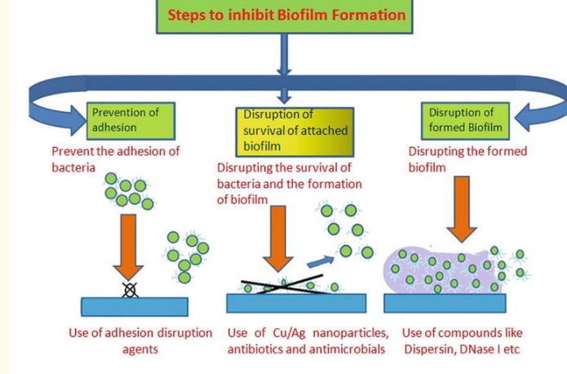

Slide 20
summary
َAntibiofilm refers to agents or strategies specifically designed to prevent or disrupt the formation of biofilms, which are multicellular, three-dimensional aggregates of microorganisms that exhibit significant resistance to conventional antibiotics.

Slide 21
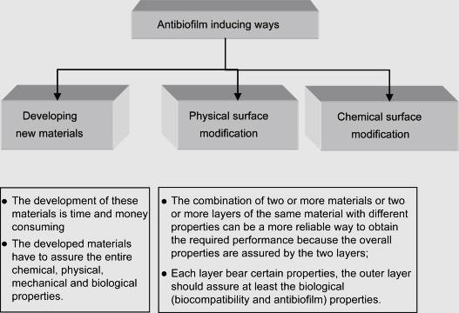
Figure: Ways of improving antibiofilm properties of the materials/devices.

Slide 22
Key Mechanisms and Agents
Quorum Sensing Inhibitors (QSIs): These agents block bacterial communication, preventing the initiation of biofilm formation (e.g., furanones, natural products like curcumin).
Enzymatic Disruptors: Enzymes like DNase I, Dispersin B, and proteases degrade the EPS matrix, making bacteria vulnerable to antibiotics.
Antimicrobial Peptides (AMPs): Peptides (e.g., LL-37) inhibit biofilm formation and can disrupt preformed biofilms.
Surface Modification: Coatings, such as silver nanoparticles (Ag NPs) or nitric oxide (NO) releasing polymers, are used to prevent initial adhesion.
Chelating Agents & Solvents: EDTA and DMSO are used to destabilize the biofilm structure by removing stabilizing cations or solubilizing the matrix

Slide 23
Impact of Inhibitors on Histopathology
Treatment with biofilm inhibitors results in observable changes, including:
Reduction in Thickness and Density: Noticeable decrease in the EPS matrix and cell population density.
Disruption of Architecture: Breakdown of the highly ordered, 3D community structure.
Increased Susceptibility: Enhanced penetration of antibiotics into the biofilm, leading to a higher death rate of embedded bacteria.
Decreased Virulence: Reduced production of virulence factors.

Slide 24
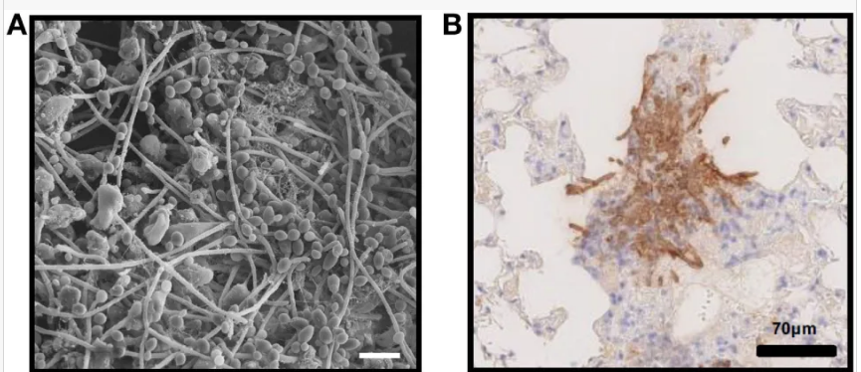
In vivo fungal biofilms. (A)Candida albicans biofilm growing on the luminal surface of a rat venous catheter for 24 h. Scanning electron microscopy reveals adherent organisms growing within in an extracellular matrix. (B) Immunohistochemistry of pulmonary tissue from an immunocompromised mouse infected with Aspergillus fumigatus and stained with an anti-galactosaminogalactan antibody. Brown indicates accumulation of galactosaminogalactan-containing biofilm matrix surrounding hyphae growing within pulmonary tissues.

Slide 25
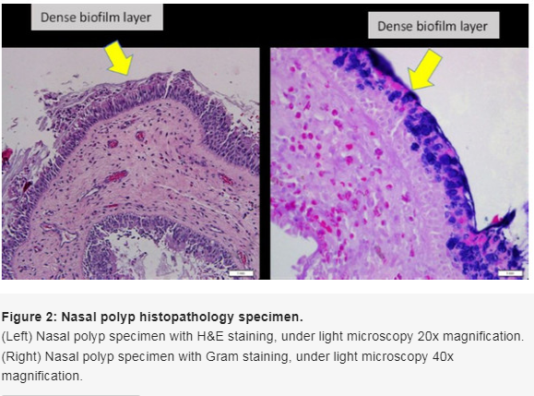

Slide 26
Presence of irregularly shaped groupings of small basophilic bacterial clusters, one the surrounding epithelial or inflammatory cells, a biofilm seen over the epithelial lining, not in or under the epithelial lining, biofilm seen tightly adherent to the surface epithelium or pulled away slightly; or a dense extracellular polysaccharide substance (EPS) material with embedded basophilic bacteria, occasionally entrapped erythrocytes, leukocytes and partially sheared from epithelial surface substance coating the epithelial surface, indicating biofilm-positive

Slide 27
Thanks for listening

