Slide 1
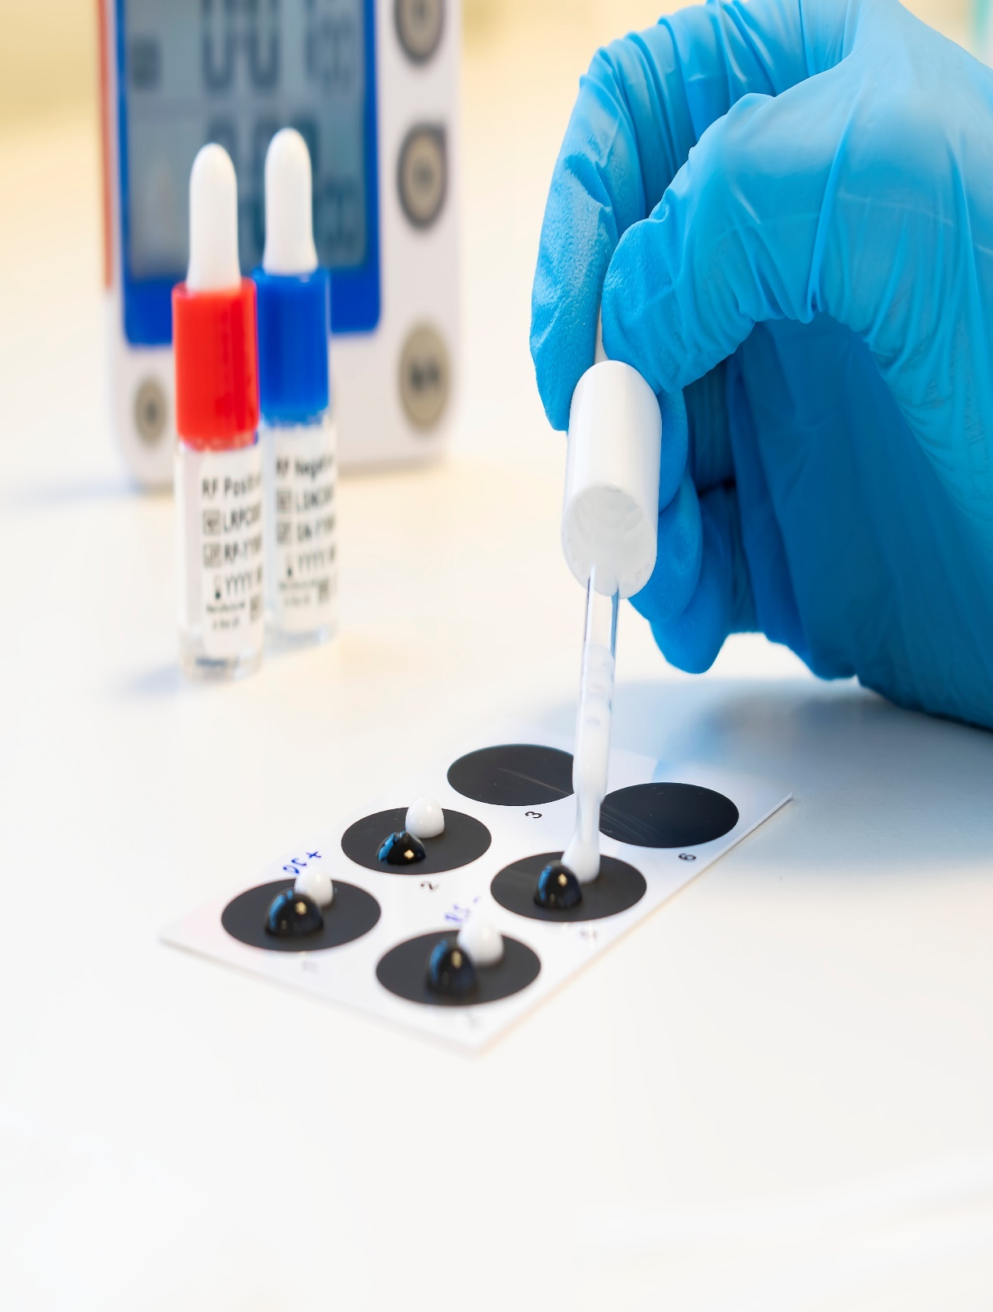
Agglutination, principle, technique and types
التلازن , المبدأ، التقنية والأنواع
Presented by
Lecturer Dr. Roua Jassim Mohammed
Department of Microbiology
University of Baghdad

Slide 2
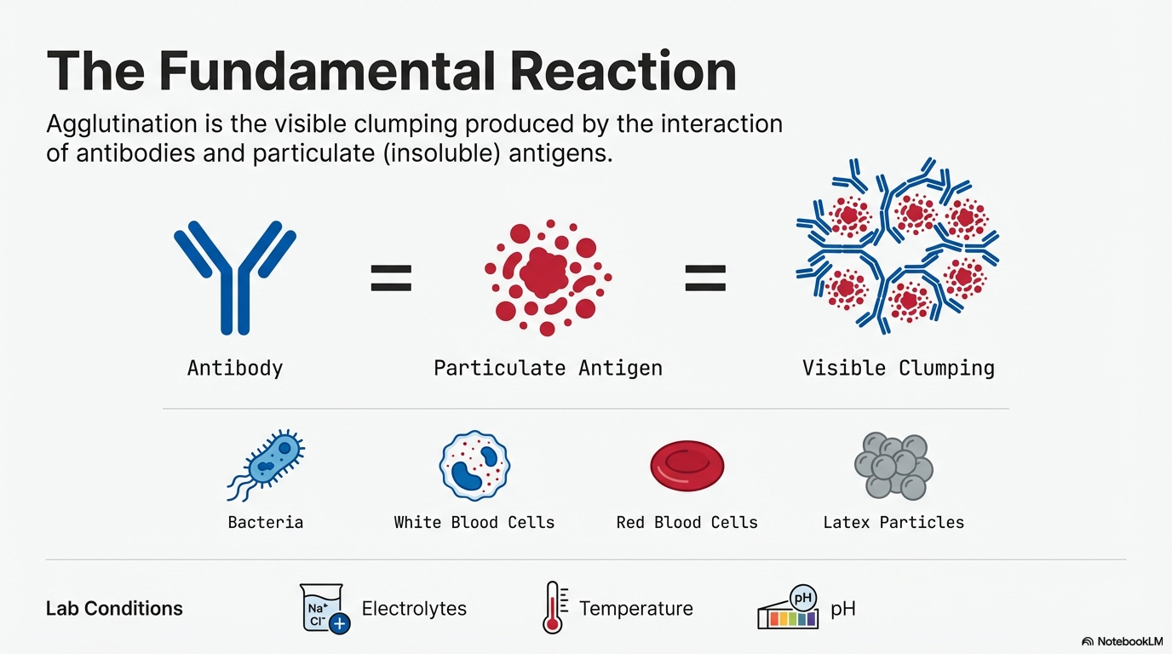

Slide 3
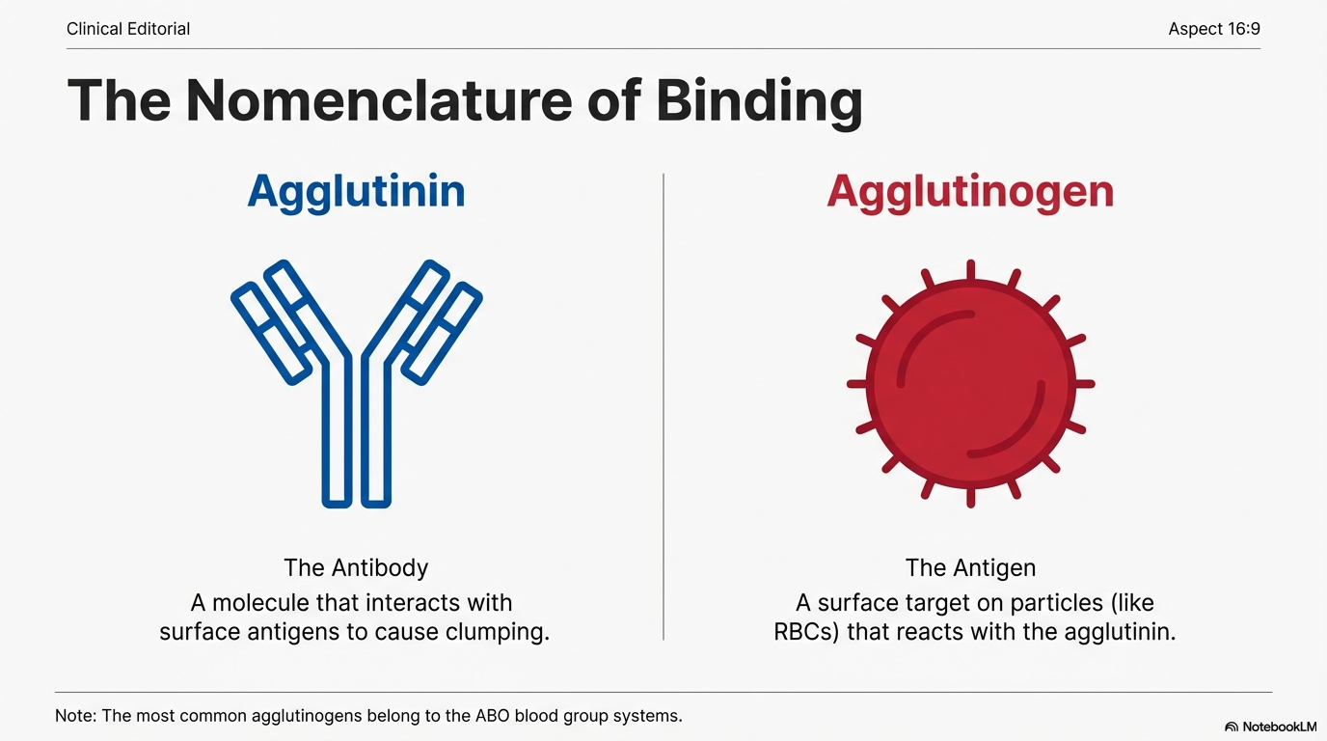

Slide 4
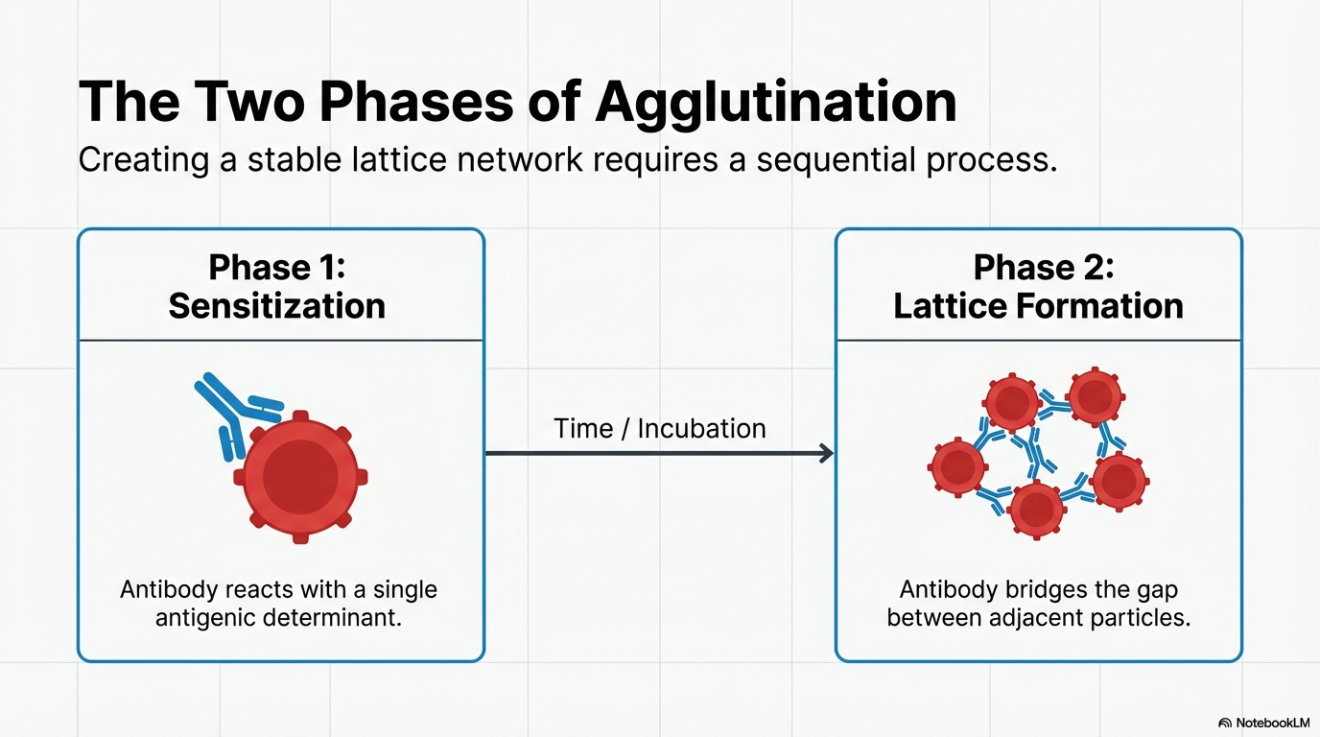

Slide 5
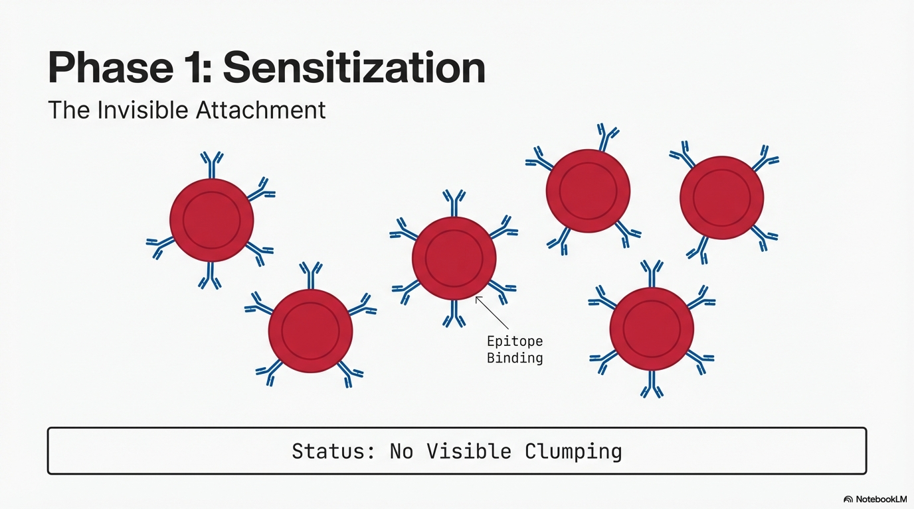

Slide 6
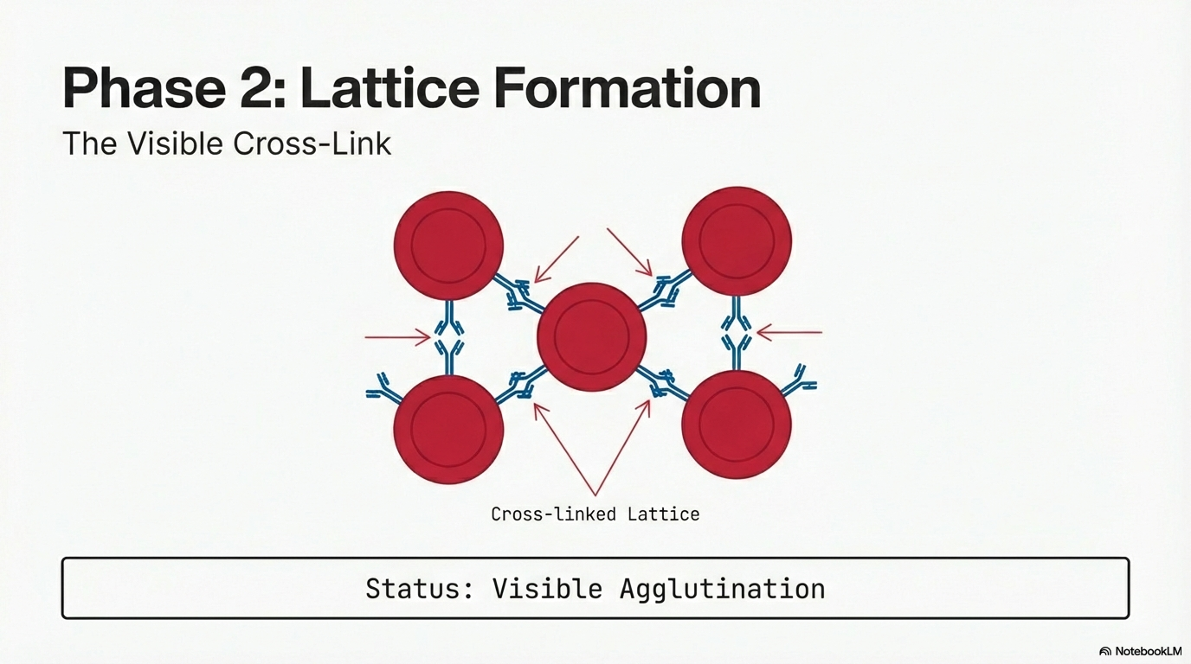

Slide 7
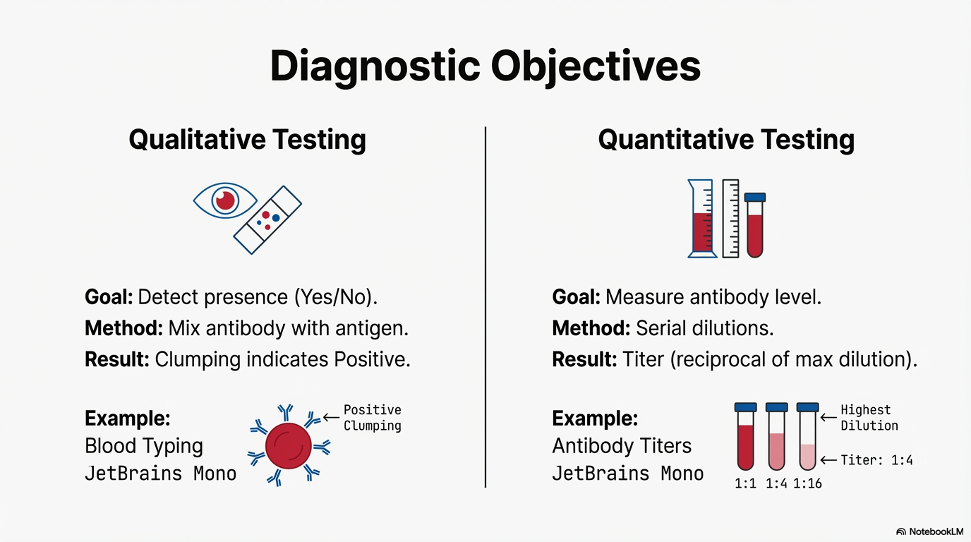

Slide 8
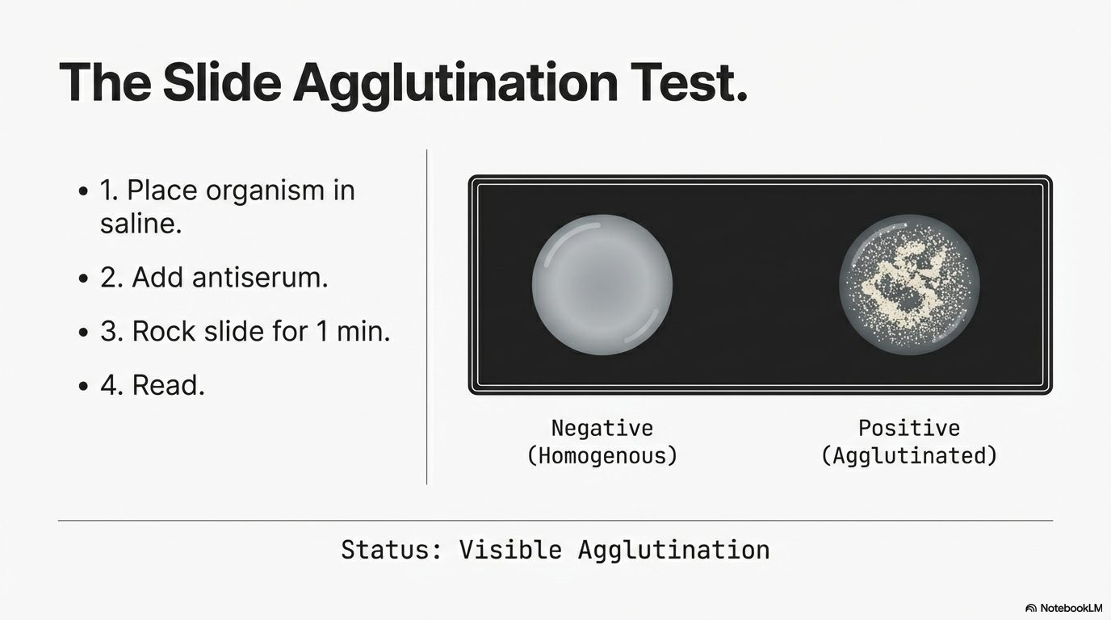

Slide 9
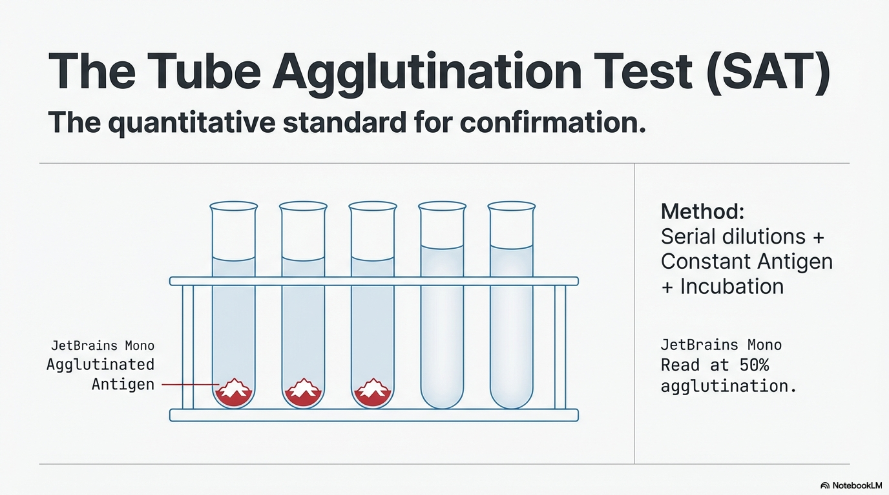
T

Slide 10
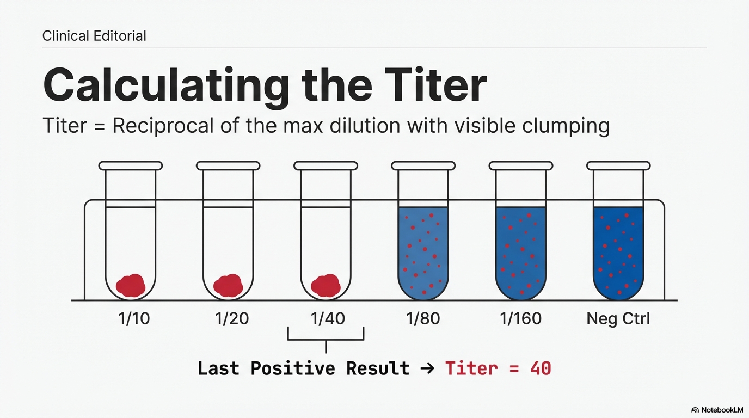

Slide 11
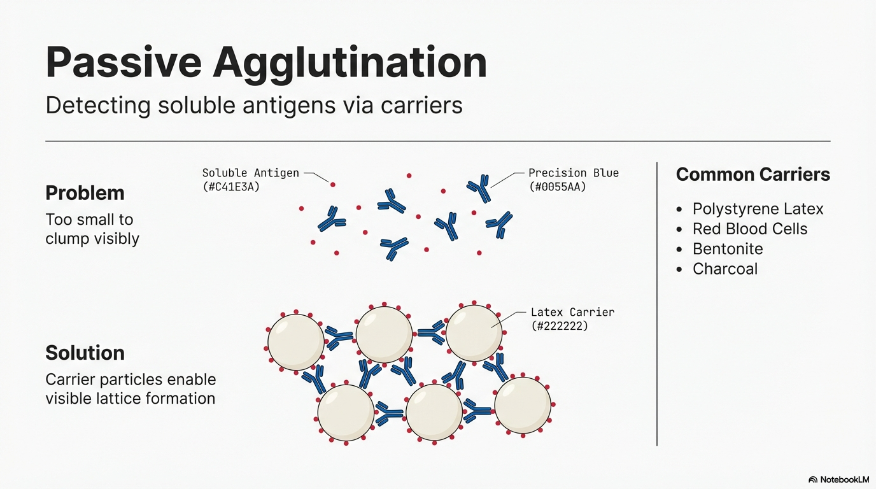

Slide 12
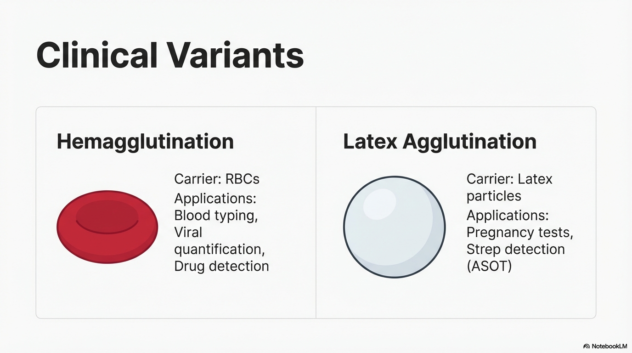

Slide 13
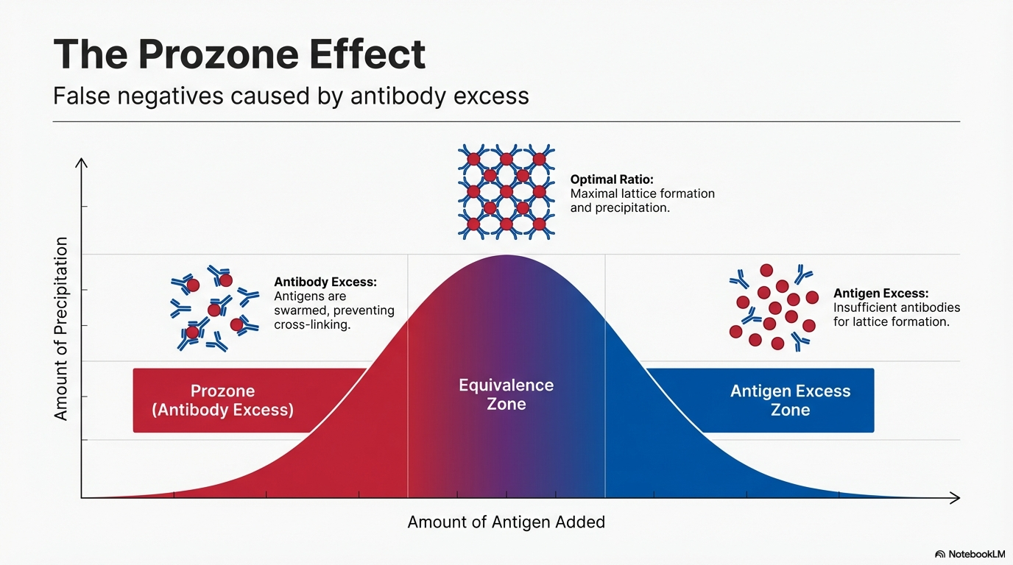

Slide 14
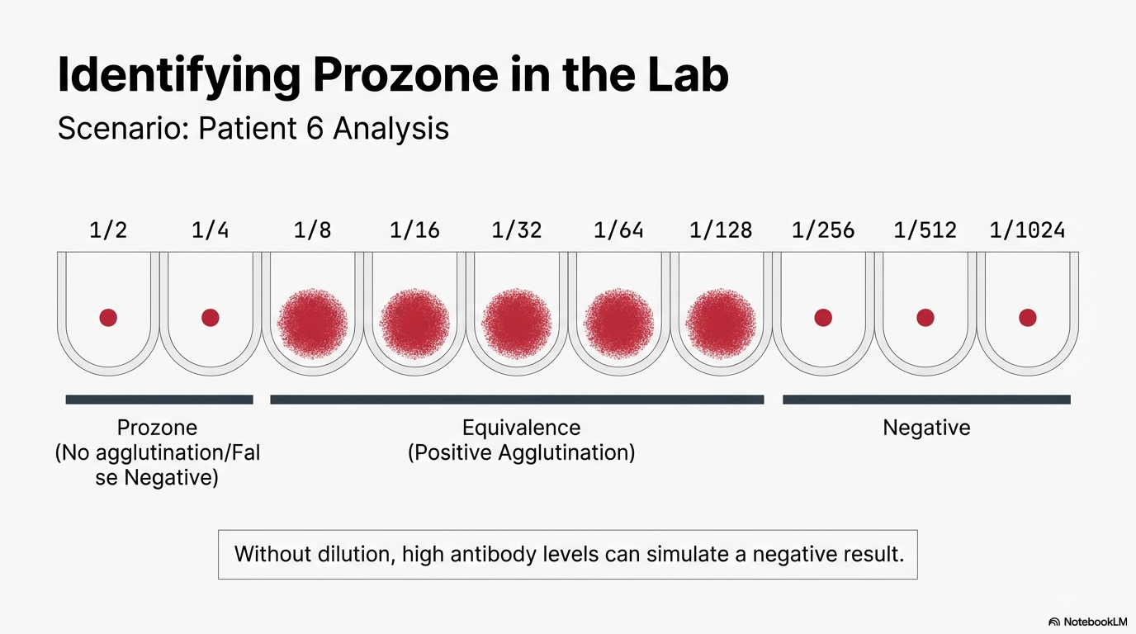

Slide 15
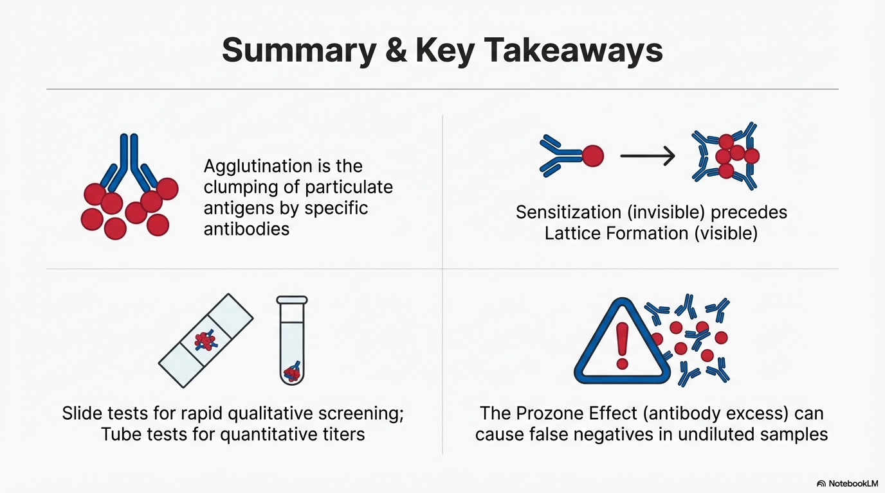

Slide 16




Another example on serial dillution :
100ul sample
100ul
From 1
100ul
From 2
1
2
3
sample
900ul saline
900ul saline
900ul saline
Total Dillution
1:10
1:100
= 1/10 * 1/10
1:1000
=1/10 * 1/100
Dillution of tube 1
Dillution of tube 2

