Slide 1
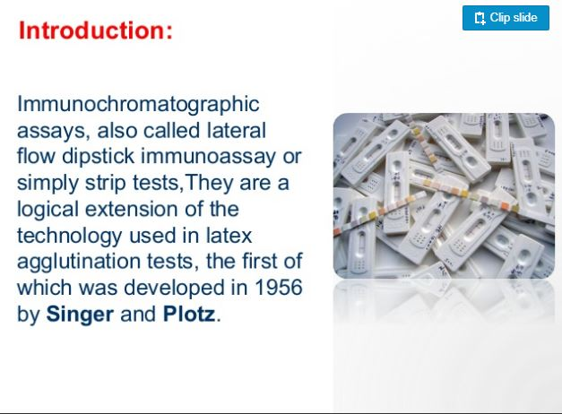
Immunochromatography assay (ICA)
Dr. Hind hamid abed

Slide 2
Introduction
Immunochromatography assay (ICA), is a simple device to detect the presence or absence of the target analyte.
The concept of immune-chromatography is a combination of chromatography (separation of components of a sample based on differences in their movement through a sorbent) and immunochemical reactions.
The most widespread immunochromatographic system is the test strip.

Slide 3
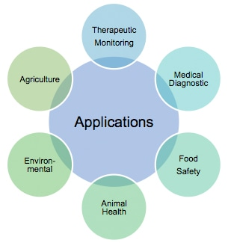

Slide 4
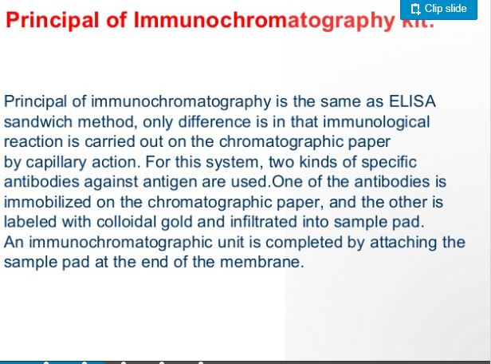

Slide 5
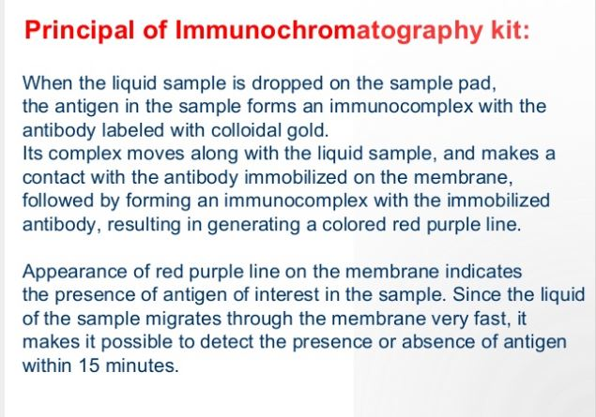

Slide 6
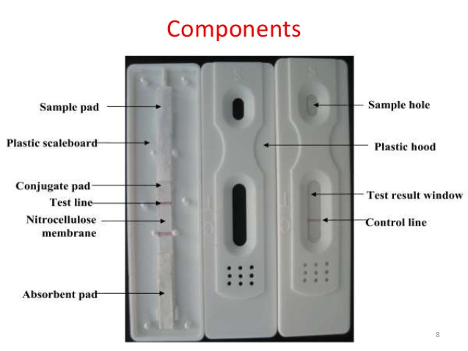

Slide 7
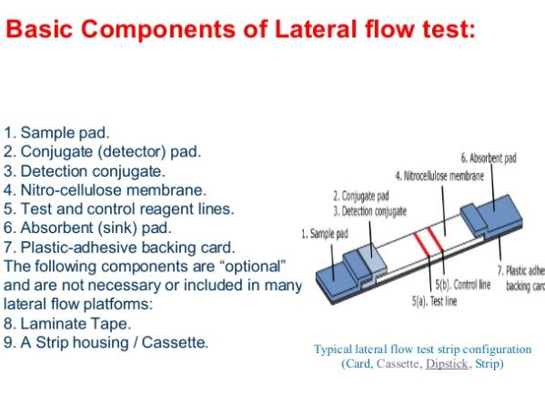

Slide 8
1- Sample Application Pad
It is made of cellulose and/or glass fiber and sample is applied on this pad to start the assay. Its function is to transport the sample to other components.
Sample pad should be capable of transportation of the sample in a smooth, continuous and homogenous manner.
This pretreatment may include separation of sample components, removal of interferences, adjustment of the pH, etc. analyte sample should be added to the sample application pad to start the test.

Slide 9
2.Conjugate Pad
It is the place where labeled bio-recognition molecules (labeled antibodies, usually nano-colloid gold particle) are dispensed.
Material of conjugate pad should immediately release labeled conjugate upon contact with moving liquid sample. Labeled conjugate should stay stable over entire life span of the lateral flow strip.
Any variations in dispensing, drying or release of conjugate can change the results of assay significantly. Poor preparation of labeled conjugate can adversely affect sensitivity of the assay. Glass fiber, cellulose, polyesters and some other materials are used to make conjugate pad.

Slide 10
. 3-Substrate(Nitrocellulose) Membrane
It is highly critical in determining sensitivity of ICA. Test and control lines are drawn over this piece of membrane. So an ideal membrane should provide support and good binding to capture probes (antibodies, etc.). Nonspecific adsorption over test and control lines may affect results of assay significantly, thus a good membrane will be characterized by lesser non-specific adsorption in the regions of test and control lines. Proper dispensing of bio-reagents, drying and blocking play a role in improving sensitivity of the assay.

Slide 11
.4- Adsorbent Pad
It works as sink at the end of the strip. It also helps in maintaining flow rate of the liquid over the membrane and stops back flow of the sample. Adsorbent capacity to hold liquid can play an important role in results of assay.
All these components are fixed or mounted over a backing card. Materials for backing card are highly flexible because they have nothing to do with ICA except providing a platform for proper assembling of all the components. Thus, backing card serves as a support and it makes easy to handle the strip.

Slide 12
Major steps in ICA are:
(i) Preparation of labeled antibody and capture antibody against target analyte;
(ii) Immobilizing the labeled antibody onto conjugate pad, and the capture antibody onto the strip membrane to form the Test/Control line.
(iii) Assembling of all components onto a backing card after dispensing of reagents at their proper pads.
(iv) Add samples and buffer onto sample pad.
(v) Wait the sample flow through the test and control line for 5-10min.
(vi) Read the result when the color reveal.

Slide 13
There are many types of ICAs based on detection format, which are:
1.Sandwich Assay
2. Competitive Assay

Slide 14
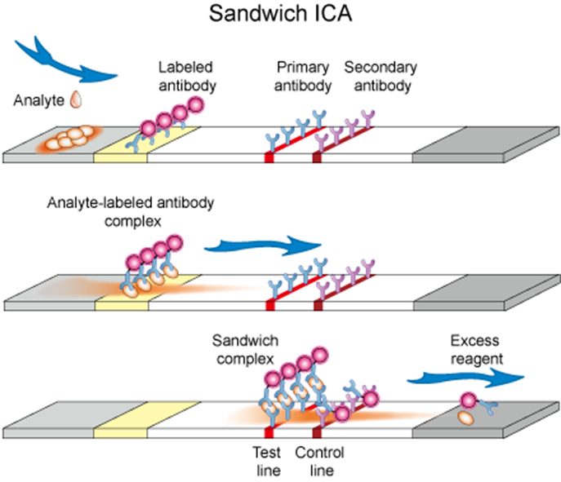

Slide 15
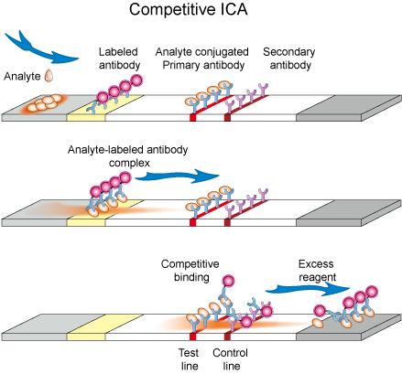

Slide 16
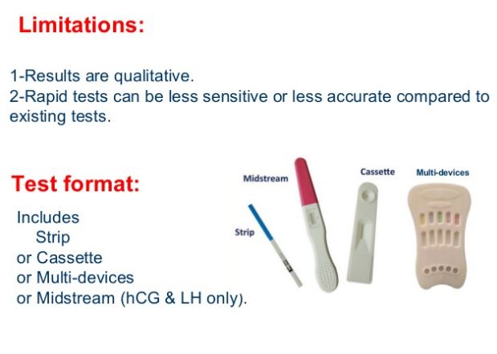

Slide 17
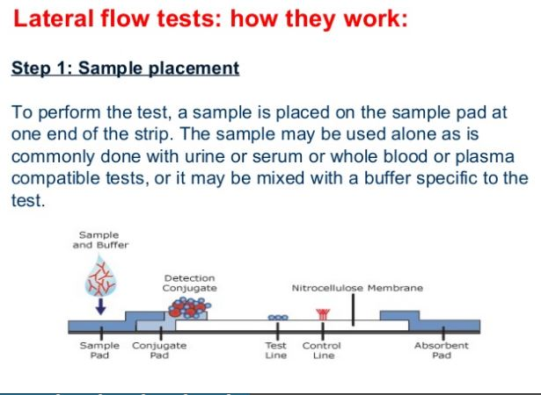

Slide 18
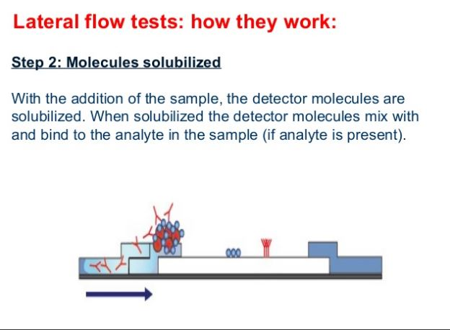

Slide 19
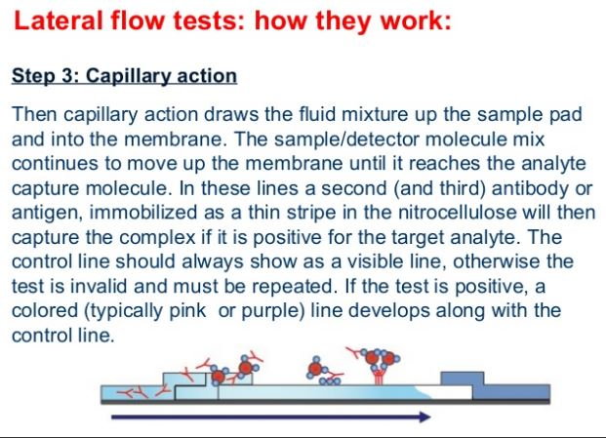

Slide 20
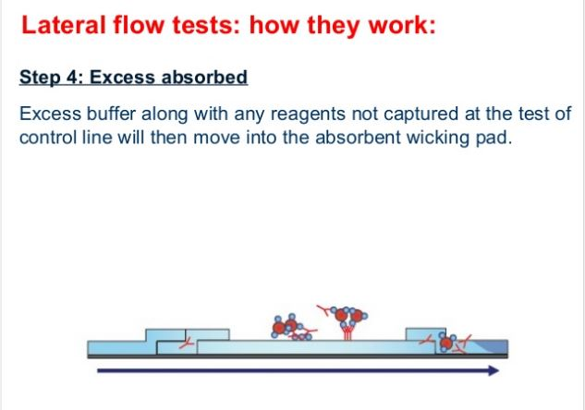

Slide 21
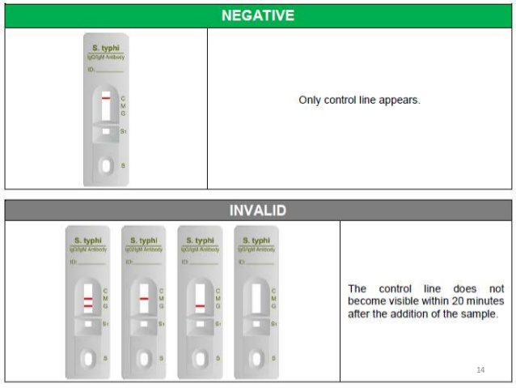

Slide 22
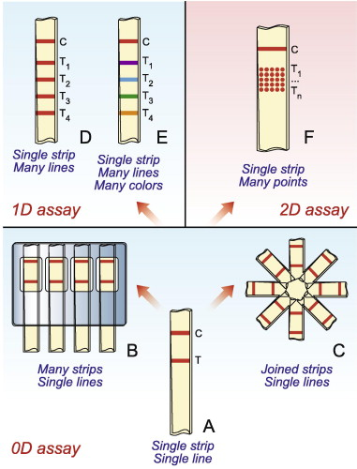
Multiplex Detection Assay

Slide 23
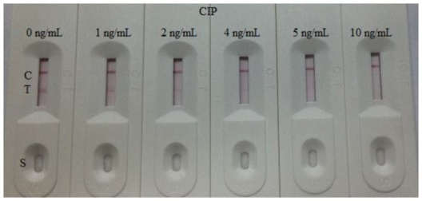

Slide 24
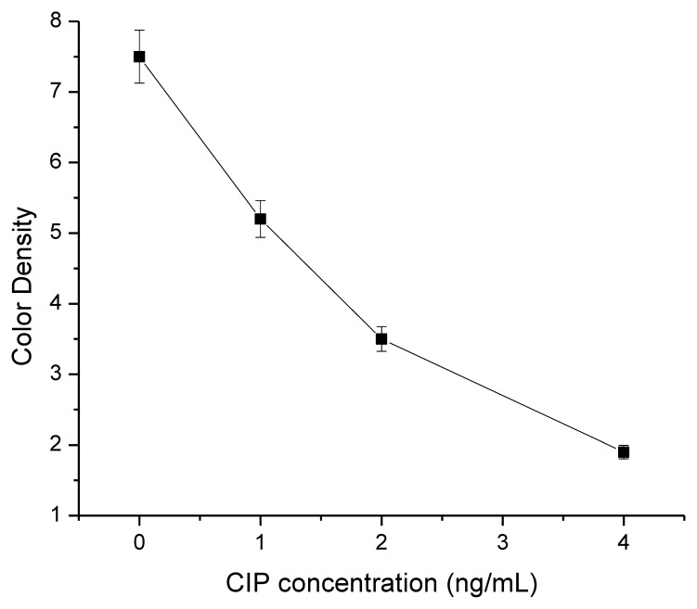

Slide 25
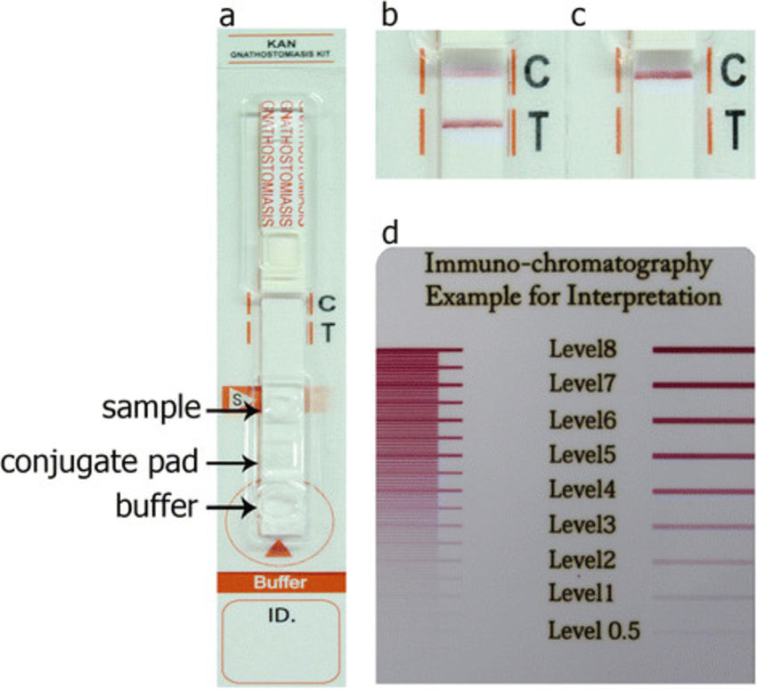

Slide 26
Multiplex Detection Assay
Multiplex detection format is used for detection of more than one target species and assay is performed over the strip containing test lines equal to number of target species to be analyzed. It is highly desirable to analyze multiple analytes simultaneously under the same set of conditions. Multiplex detection format is very useful in clinical diagnosis where multiple analytes which are inter-dependent in deciding about the stage of a disease are to be detected. Lateral flow strips for this purpose can be built in various ways, for example, by increasing length and test lines on conventional strip, making other structures like parallel threads, stars or T-shapes. Shape of strip for ICA will be dictated by number of target analytes.

Slide 27
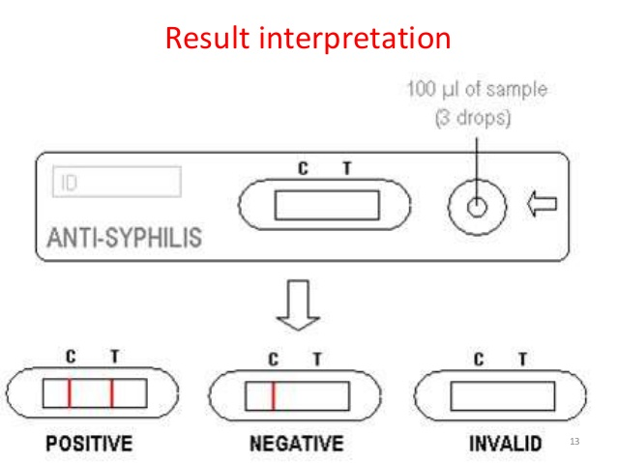

Slide 28
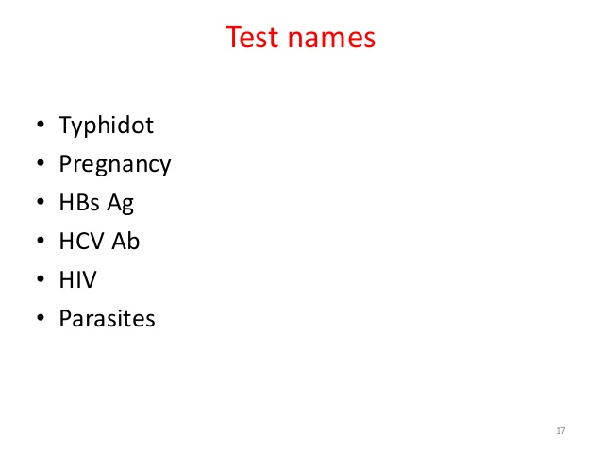

Slide 29
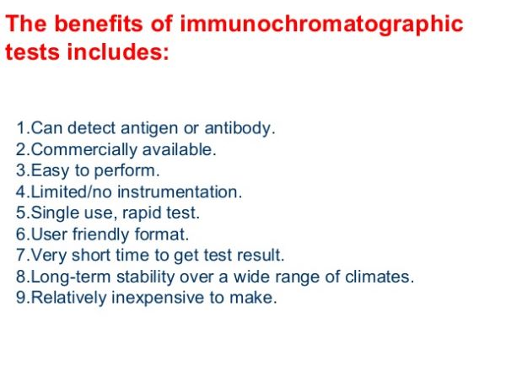

Slide 30
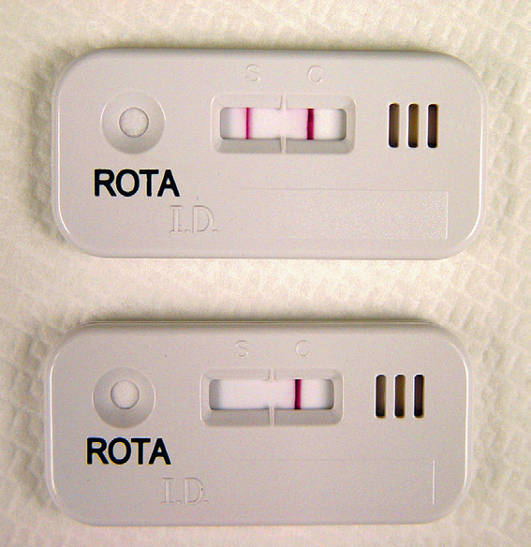
IMMUNOCHROMATOGRAPHIC TESTS
(ICG)
APPLICATIONS:
Antibody and Antigen detection in infectious diseases of:
HIV
HBV
HCV
DENGUE
VZV
Rota virus and etc.

Slide 31
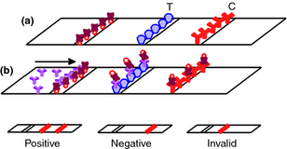
A rapid one‐step immunochromatographic test strip for rabies detection using canine serum samples
Letters in Applied Microbiology
Volume 59, Issue 2, pages 247-251, 2 JUN 2014 DOI: 10.1111/lam.12282
http://onlinelibrary.wiley.com/doi/10.1111/lam.12282/full#lam12282-fig-0003
Notes:
Schematic illustration of the components (a) and workflow (b) on the immunochromatographic test strip. () anti‐P; () colloidal gold; () SPA; () RV‐P and () anti‐SPA.
IF THIS IMAGE HAS BEEN PROVIDED BY OR IS OWNED BY A THIRD PARTY, AS INDICATED IN THE CAPTION LINE, THEN FURTHER PERMISSION MAY BE NEEDED BEFORE ANY FURTHER USE. PLEASE CONTACT WILEY'S PERMISSIONS DEPARTMENT ON PERMISSIONS@WILEY.COM OR USE THE RIGHTSLINK SERVICE BY CLICKING ON THE 'REQUEST PERMISSIONS' LINK ACCOMPANYING THIS ARTICLE. WILEY OR AUTHOR OWNED IMAGES MAY BE USED FOR NON-COMMERCIAL PURPOSES, SUBJECT TO PROPER CITATION OF THE ARTICLE, AUTHOR, AND PUBLISHER.

