Slide 1
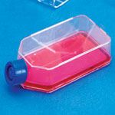
cell culture techniques
اعداد :- م.م. ضحى اسماعيل

Slide 2
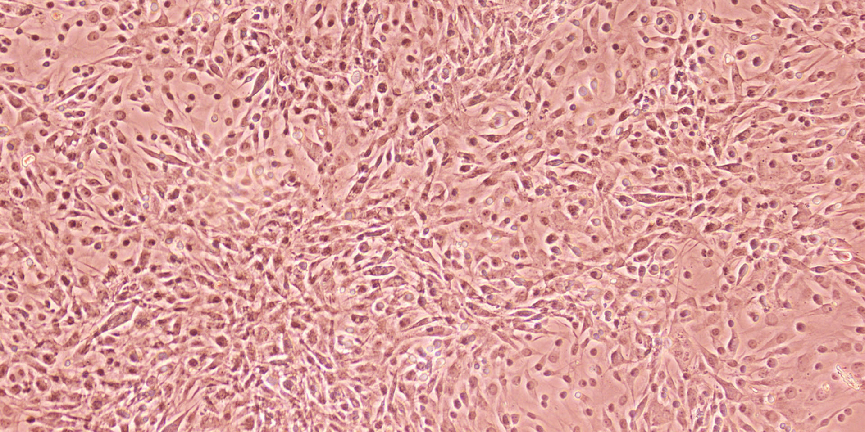
Cell culture
is the process of growing plant or animal cells in an artificial, controlled in vitro environment, isolating them from their natural tissue source.

Slide 3
Why is cell culture used for ?
Cell lines from different species and organs are available .
They are free from antibodies, hormones and similar other host factors
It used for isolation different viruses because Cell lines from different species and organs are available .
Different viruses produce specific metabolic and cytopathic changes.
used for preparation vaccines.

Slide 4
Many Types of cytopathogenic effects (CPE) caused by viruses.
Diagnosis limited viruses to grow such us Newcastle v. & influenza V with a heamagglutinin protein on their envelope.
TCID50 Tissue culture infective dose 50 virus ,titration is by quantal dose- response.

Slide 5
Detection of histological appearance (inclusion bodies).
Detection of viral antigen via shell vial assay and immuno-flourescence technique.

Slide 6
types of cell cultures
primary cell cultures
Initiated from tissues of animals or chicken embryos
Used for virus cultivation
Diploid cell cultures
Fetal bovine kidney, Fetal sheep kidney
Used for preparation of vaccines
Retain normal set of chromosomes and morphology
Serially transferred (20-50) passage
Permanent cell lines
Abnormal chromosomes number and morphology
Serial transfer (indefinitely in vitro)

Slide 7
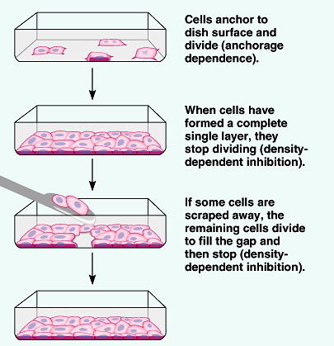


Slide 8
Culture media
It is the environment provided for the growth of the cells in laboratory, similar to those conditions that the cells have been exposed to in vivo.
Culture media consist of :
Physical media: a support or matrix
Chemical media: appropriate nutrients likes

Slide 9
Inorganic salts
Lacto albumin
Glucose
Vitamins
amino acids
Phenol red
Sodium bicarbonate

Slide 10
fetal calf serum:
The major functions of serum as a culture medium are: to provide nutrients, growth factors, attachment and spreading factors, binding proteins, vitamins, minerals, lipids, protease inhibitors and pH buffer.

Slide 11
There are three types of artificial culture media:
Minimum Essential Medium (MEM).
Hanks solution.
199 media.

Slide 12
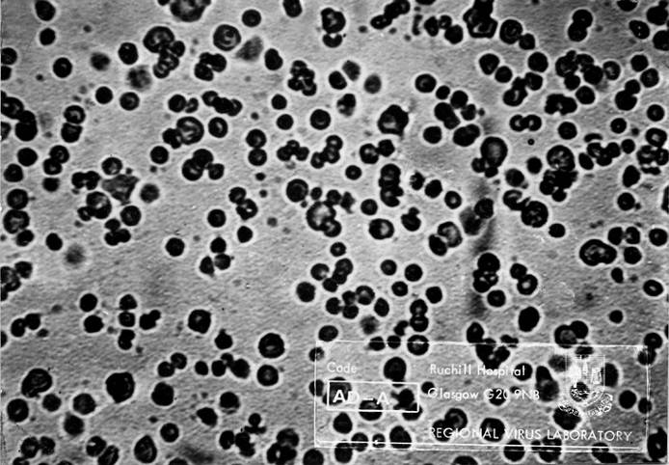
Types of cytopathogenic effects (CPE) caused by viruses:
Cell rounding, aggregation and dehydration.

Slide 13
Giant cells formation (syncytia type) as seen in paramyxoviruses.
Syncytium formation in cell culture caused by measles virus .

Slide 14
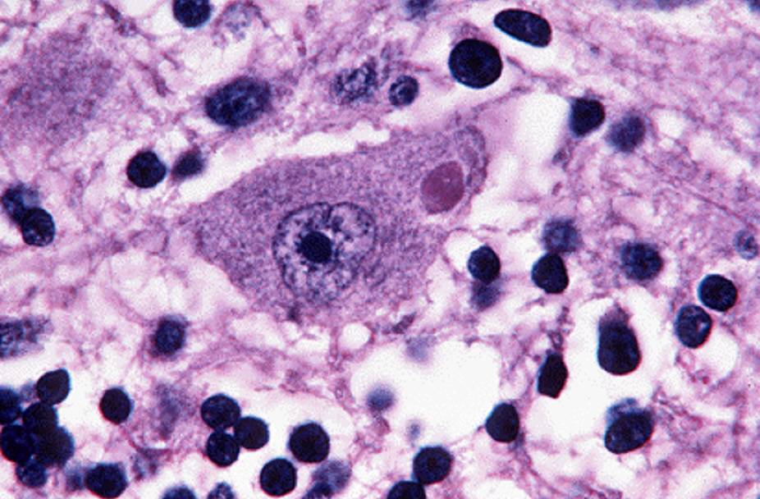
Formation of Inclusion bodies inside nucleus or in cytoplasm depending on site of virus multiplication.
Negri bodies

Slide 15
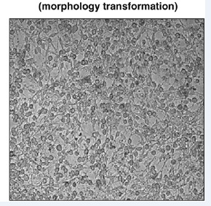
Cell transformation as in oncogenic viruses (Retro virus, papova virus).We can see multilayer of transform cells.

Slide 16
References
1.Hubrecht R.C., Carter E. The 3Rs and humane experimental technique: Implementing change. Animals. 2019;9:754. doi: 10.3390/ani9100754. [DOI] [PMC free article] [PubMed] [Google Scholar]
2.Pamies D., Leist M., Coecke S., Bowe G., Allen D.G., Gstraunthaler G., Bal-Price A., Pistollato F., de Vries R.B.M., Hogberg H.T., et al. Guidance document on Good Cell and Tissue Culture Practice 2.0 (GCCP 2.0) ALTEX. 2022;39:30–70. doi: 10.14573/altex.2111011. [DOI] [PubMed] [Google Scholar]
3.Horbach S.P.J.M., Halffman W. The ghosts of HeLa: How cell line misidentification contaminates the scientific literature. PLoS ONE. 2017;12:e0186281. doi: 10.1371/journal.pone.0186281. [DOI] [PMC free article] [PubMed] [Google Scholar]
4.Babic Z., Capes-Davis A., Martone M.E., Bairoch A., Ozyurt I.B., Gillespie T.H., Bandrowski A.E. Incidences of problematic cell lines are lower in papers that use RRIDs to identify cell lines. Elife. 2019;8:e41676. doi: 10.7554/eLife.41676. [DOI] [PMC free article] [PubMed] [Google Scholar]
5.International Cell Line Authentication Committee (ICLAC) [(accessed on 18 February 2023)]. Available online: https://iclac.org/
6.Wang Y., Chen S., Yan Z., Pei M. A prospect of cell immortalization combined with matrix microenvironmental optimization strategy for tissue engineering and regeneration. Cell Biosci. 2019;9:7. doi: 10.1186/s13578-018-0264-9. [DOI] [PMC free article] [PubMed] [Google Scholar]
7.Khurana A., Sayed N., Singh V., Khurana I., Allawadhi P., Rawat P.S., Navik U., Pasumarthi S.K., Bharani K.K., Weiskirchen R. A comprehensive overview of CRISPR/Cas 9 technology and application thereof in drug discovery. J. Cell. Biochem. 2022;123:1674–1698. doi: 10.1002/jcb.30329. [DOI] [PubMed] [Google Scholar]
8.Jeong Y.J., Cho J., Kwak J., Sung Y.H., Kang B.C. Immortalization of primary marmoset skin fibroblasts by CRISPR-Cas9-mediated gene targeting. Anim. Cells Syst. 2022;26:266–274. doi: 10.1080/19768354.2022.2151509. [DOI] [PMC free article] [PubMed] [Google Scholar]
9.Coecke S., Balls M., Bowe G., Davis J., Gstraunthaler G., Hartung T., Hay R., Merten O.W., Price A., Schechtman L., et al. Guidance on good cell culture practice. A report of the second ECVAM task force on good cell culture practice. Altern. Lab. Anim. 2005;33:261–287. doi: 10.1177/026119290503300313. [DOI] [PubMed] [Google Scholar]
10.Mao Z., Ke Z., Gorbunova V., Seluanov A. Replicatively senescent cells are arrested in G1 and G2 phases. Aging. 2012;4:431–435. doi: 10.18632/aging.100467. [DOI] [PMC free article] [PubMed] [Google Scholar]
11.Shen C.F., Guilbault C., Li X., Elahi S.M., Ansorge S., Kamen A., Gilbert R. Development of suspension adapted Vero cell culture process technology for production of viral vaccines. Vaccine. 2019;37:6996–7002. doi: 10.1016/j.vaccine.2019.07.003. [DOI] [PubMed] [Google Scholar]
12.Moreira A.S., Silva A.C., Sousa M.F.Q., Hagner-McWhirterc Å., Ahlénc G., Lundgren M., Coroadinha A.S., Alves P.M., Peixoto C., Carrondo M.J.T. Establishing suspension cell cultures for improved manufacturing of oncolytic adenovirus. Biotechnol. J. 2020;15:e1900411. doi: 10.1002/biot.201900411. [DOI] [PubMed] [Google Scholar]
13.Drescher H., Weiskirchen S., Weiskirchen R. Flow cytometry: A blessing and a curse. Biomedicines. 2021;9:1613. doi: 10.3390/biomedicines9111613. [DOI] [PMC free article] [PubMed] [Google Scholar]
14.Lai T.Y., Cao J., Ou-Yang P., Tsai C.Y., Lin C.W., Chen C.C., Tsai M.K., Lee C.Y. Different methods of detaching adherent cells and their effects on the cell surface expression of Fas receptor and Fas ligand. Sci. Rep. 2022;12:5713. doi: 10.1038/s41598-022-09605-y. [DOI] [PMC free article] [PubMed] [Google Scholar]
15.Schellenberger V., Schellenberger U., Mitin Y.V., Jakubke H.D. Characterization of the S’-subsite specificity of porcine pancreatic elastase. Eur. J. Biochem. 1989;179:161–163. doi: 10.1111/j.1432-1033.1989.tb14534.x. [DOI] [PubMed] [Google Scholar]
16.Stenn K.S., Link R., Moellmann G., Madri J., Kuklinska E. Dispase, a neutral protease from Bacillus polymyxa, is a powerful fibronectinase and type IV collagenase. J. Investig. Dermatol. 1989;93:287–290. doi: 10.1111/1523-1747.ep12277593. [DOI] [PubMed] [Google Scholar]
17.Tsuji K., Ojima M., Otabe K., Horie M., Koga H., Sekiya I., Muneta T. Effects of different cell-detaching methods on the viability and cell surface antigen expression of synovial mesenchymal stem cells. Cell Transplant. 2017;26:1089–1102. doi: 10.3727/096368917X694831. [DOI] [PMC free article] [PubMed] [Google Scholar]
18.Nowak-Terpiłowska A., Śledziński P., Zeyland J. Impact of cell harvesting methods on detection of cell surface proteins and apoptotic markers. Braz. J. Med. Biol. Res. 2021;54:e10197. doi: 10.1590/1414-431x202010197. [DOI] [PMC free article] [PubMed] [Google Scholar]
19.Jensen C., Teng Y. Is it time to start transitioning from 2D to 3D cell culture? Front. Mol. Biosci. 2020;7:33. doi: 10.3389/fmolb.2020.00033. [DOI] [PMC free article] [PubMed] [Google Scholar]
20.Berthois Y., Katzenellenbogen J.A., Katzenellenbogen B.S. Phenol red in tissue culture media is a weak estrogen: Implications concerning the study of estrogen-responsive cells in culture. Proc. Natl. Acad. Sci. USA. 1986;83:2496–2500. doi: 10.1073/pnas.83.8.2496. [DOI] [PMC free article] [PubMed] [Google Scholar]
21.Li W., Fan Z., Lin Y., Wang T.Y. Serum-free medium for recombinant protein expression in Chinese hamster ovary cells. Front. Bioeng. Biotechnol. 2021;9:646363. doi: 10.3389/fbioe.2021.646363. [DOI] [PMC free article] [PubMed] [Google Scholar]
22.Brunner D., Frank J., Appl H., Schöffl H., Pfaller W., Gstraunthaler G. Serum-free cell culture: The serum-free media interactive online database. ALTEX. 2010;27:53–62. doi: 10.14573/altex.2010.1.53. [DOI] [PubMed] [Google Scholar]
23.Yao T., Asayama Y. Animal-cell culture media: History, characteristics, and current issues. Reprod. Med. Biol. 2017;16:99–117. doi: 10.1002/rmb2.12024. [DOI] [PMC free article] [PubMed] [Google Scholar]

Slide 17


