Slide 1
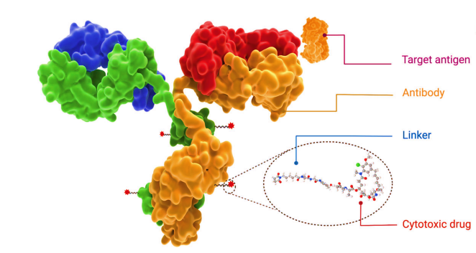
Antibody-Drug Conjugates for Targeted Cancer Therapy
م.د.محمد عبد الامير عليوي
فرع الكيمياء الصيدلانية

Slide 2
INTRODUCTION
Cancer has become the second greatest global health threat, accounting for approximately 10.0 million deaths from cancer occurred in 2020. Cytotoxic agents based chemotherapy has been the main approach for the treatment of a wide range of cancers for decades.
Most of these chemotherapy agents, however, show low therapeutic index, where severe side effects are generally attributed to non-specific drug exposure to off-target tissues. To address this issue, scientists have been working on the development of novel cancer therapeutics with higher targeting ability.

Slide 3
BRIEF HISTORY OF ADC
As early as the beginning of 20th century, Paul Ehrlich first proposed the concept of “magic bullets” and postulate that some compounds could directly access to some desired targets in cell to cure diseases. Theoretically, these compounds should be effective in killing cancer cells, but harmless to normal cells. One of the plausible ways is to identify some specifically overexpressed antigens to distinguish cancer cells from health cells, such as HER2 (human epidermal growth factor receptor 2) on the breast cancer and CD20 on the B cell lymphoma. Specific expression of these antigens provides the possibility of precision tumor targeting via monoclonal antibodies (mAbs), and this field was advanced greatly after the development of hybridoma technology since 1975.

Slide 4
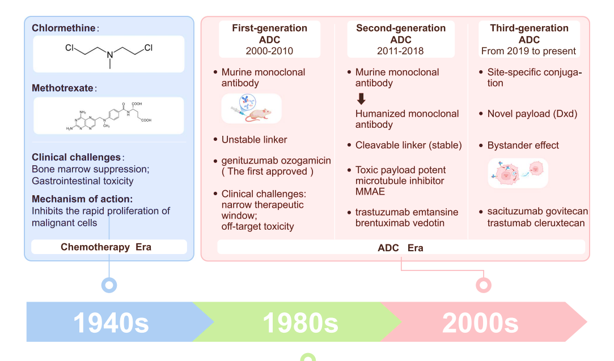
In recent decades, an increasing number of mAbs, such as avastin, trastuzumab, rituximab, and cetuximab, have been received approval worldwide for treatment of various solid tumors and hematological cancers.

Slide 5
KEY COMPONENTS OF ADC
An ideal ADC drug remains stable in blood circulation, reaches the therapeutic target accurately, and eventually releases the cytotoxic payloads in the vicinity of the targets (e.g. cancer cells).
Each element can affect the final efficacy and safety of ADC, and in general ADC development needs to take into account all these key components, including:

Slide 6
The selection of:
1.Target antigen
2.Antibody
3.Cytotoxic payload
4.Linker
5.Conjugation methods

Slide 7
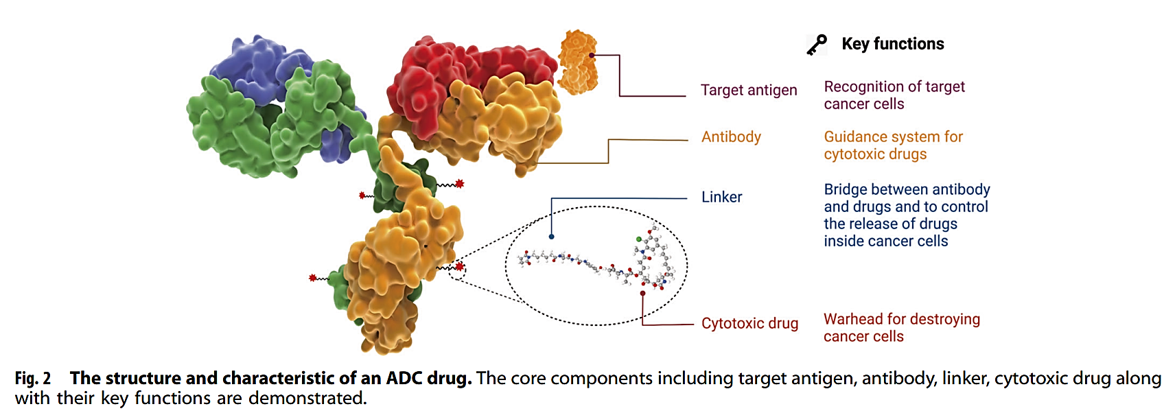

Slide 8
Target antigen selection
An appropriate selection of target antigen is the first consideration for the designation of ADC. In order to reduce off-target toxicity, the targeted antigen:
firstly should be expressed exclusively or predominantly in tumor cells, but rare or low in normal tissues. The antigen is ideally a surface (or extracellular) antigen rather than an intracellular one in order to be recognized by circulating ADCs. For example, the expression of HER2 receptor in certain types of tumors is approximately 100 times higher compared to normal cells.
Secondly, the target antigen should be non-secreted since secreted antigen in the circulation would cause the undesirable ADC binding outside tumor sites, resulting in the decreased tumor targeting and elevated safety concerns.
Thirdly, the target antigen is ideal to be internalized upon binding with the corresponding antibody, so that the ADC-antigen complex gain access into cancer cells, followed by appropriate intracellular transport route and avid release of cytotoxic payload

Slide 9
Antibody moiety
In addition to high binding affinity to the target antigen, an ideal antibody moiety should also facilitate efficient internalization, demonstrate low immunogenicity and preserve long plasma half-life.
At the early stage of the development of ADC drugs, mouse-derived antibodies were predominantly employed, where high failure rates were observed due to serious immunogenicity-related side effects. With the emergence of recombinant technology, murine antibodies was mostly replaced with chimeric antibodies and humanized antibodies. At present, ADCs increasingly employed fully humanized antibodies with significantly reduced immunogenicity.

Slide 10
Cytotoxic payloads
The cytotoxic payload is the warhead that exerts cytotoxicity after internalization of ADCs into cancer cells. Because only approximately 2% of ADC could reach targeted tumor sites after intravenous administration, high potency (IC50 in nanomolar and picomolar range) is required for the compounds to be used as payloads in ADC.
Moreover, these compounds should keep stable in physiological conditions and have available function groups for conjugation with the antibody. At present, the cytotoxic payloads used for ADCs mainly include potent tubulin inhibitors, DNA damaging agents, and immunomodulators.

Slide 11
Linkers
Linker in ADC bridges the antibody with the cytotoxic drug. It is one of the key factors related to the stability of ADC and payload release profiles, and is therefore important for the ultimate therapeutic index of ADCs.
An ideal linker should not induce ADC aggregation, and it is expected to limit premature release of payloads in plasma and to promote active drugs release at desired targeted sites. Depending on the metabolic fate in cells, two types of linkers including cleavable and non-cleavable linkers have been employed in most of ADC drugs.

Slide 12
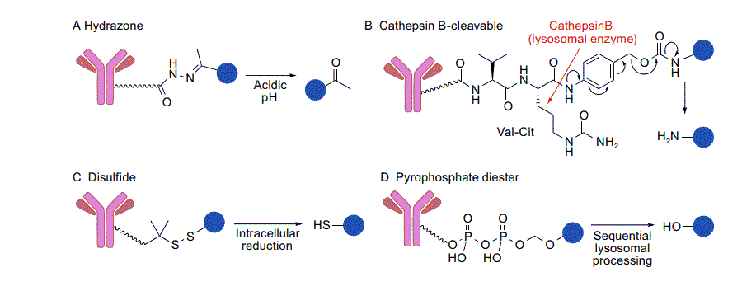
Cleavable linkers
A major class of ADC linkers is the cleavable linker. Cleavable linkers are designed to be cleaved by responding to an environmental difference between the extracellular and intracellular environments (pH, redox potential, etc.) or by specific lysosomal enzymes. In most cases, the linkers in this class are designed to release parental payload molecules after bond cleavage.

Slide 13
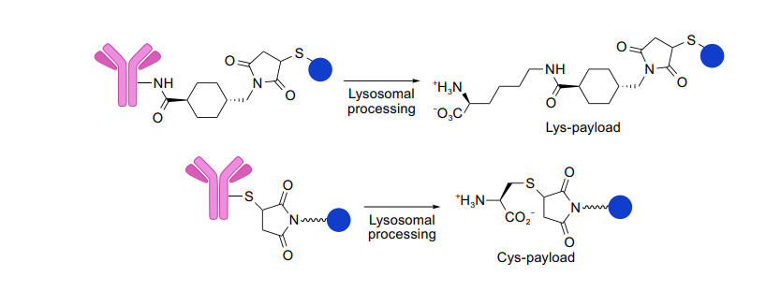
Non-cleavable Linkers
Non-cleavable linkers consist of stable bonds that are resistant to proteolytic degradation, ensuring greater stability than that of cleavable linkers. Non-cleavable linkers rely on complete degradation of the antibody component of ADC by cytosolic and lysosomal proteases, which eventually liberates a payload molecule linked to an amino acid residue derived from the degraded antibody. As such, when coupled with a non-cleavable linker, the payload structure must be carefully selected and designed so that payload can exert comparable or even better anti-tumor potency in such a modified form.

Slide 14
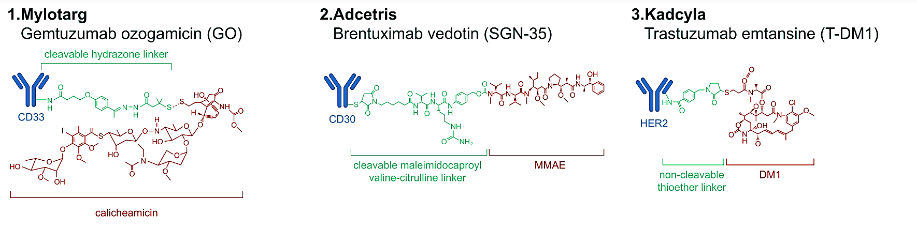

Slide 15
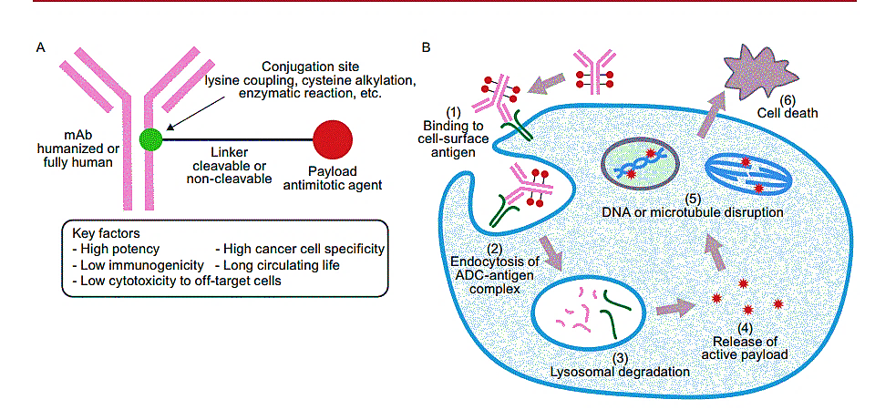
STRUCTURE AND MECHANISM OF ACTION OF ADC
.

Slide 16
THANK YOU

