Slide 1
Practical Extraction and Immunological Evaluation of Lotus Seed Extracts
Presented by
Prof. Dr. Ikram Abbas Aboud Al-Samarraae
Department of Microbiology
University of Baghdad

Slide 2
Overview of Lotus seed
Key bioactive compounds:
Polysaccharides
Flavonoids and polyphenols
Alkaloids (e.g., neferine)

Slide 3
Summary of immunological effects
Innate immunity activation
Adaptive immunity modulation
Anti-inflammatory and anti-allergic actions

Slide 4
Extraction Techniques of Lotus Seed
Aqueous Extraction
Uses distilled water as solvent
Mainly extracts:
Polysaccharides
Water-soluble proteins and peptides

Slide 5
Procedure:
Drying and grinding lotus seeds
Mixing with distilled water
Heating at 60–80 °C
Filtration
Concentration and drying

Slide 6
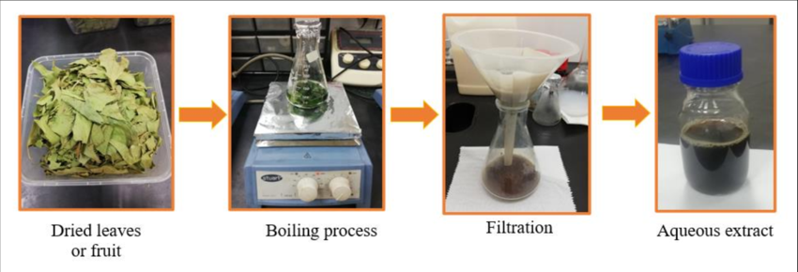
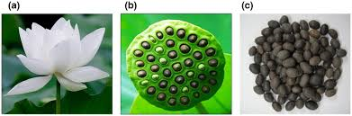
Lotus seed was grinding then boiling

Slide 7
Advantages:
Safe and non-toxic
Suitable for immunological studies
Limitations:
Lower efficiency for phenolic compounds

Slide 8
B. Alcoholic Extraction (Ethanol or Methanol):
Efficient for extracting:
Flavonoids
Polyphenols
Alkaloids

Slide 9
Alcoholic Extraction of lotus seed (Ethanol or Methanol):
Comparison of Solvents
Ethanol: Widely used because it is safe for human consumption and effective for extracting total phenolics, flavonoids, and proanthocyanidins. Studies often use 50% to 95% ethanol for optimal recovery of bioactive constituents from various seed parts
Methanol: Generally more efficient for extracting lower molecular weight polyphenols and alkaloids. In comparative studies, 50% methanol has shown higher extraction efficiency for target compounds like flavonoids than high-concentration ethanol.

Slide 10
Procedure:
Preparation: Seeds or specific parts (like the embryo/plumule) are dried (often at 50°C) and ground into a fine powder.
Maceration/Extraction: The powder is soaked in an alcohol-water solution (e.g., 60–80% ethanol) with constant shaking or ultrasonic assistance.
Filtration & Concentration: The mixture is filtered, and the solvent is removed using a rotary evaporator under reduced pressure to obtain a concentrated crude extract

Slide 11
Phytochemical and Quality Evaluation
A. Phytochemical Screening
Total Phenolic Content (TPC)
Total Flavonoid Content (TFC)
Purpose:
Standardization of extracts
Correlation between chemical content and immunological activity

Slide 12
Phytochemical and Quality Evaluation
B. Antioxidant Activity Assays
DPPH Radical Scavenging Assay:
Measures free radical neutralization capacity
Higher scavenging percentage = stronger antioxidant effect
Immunological relevance:
Oxidative stress impairs immune cell function
Antioxidants protect macrophages, lymphocytes, and NK cells

Slide 13
Immunological Experimental Applications
A. Cytokine Modulation
Lotus seed extracts have been shown to:
↓ IL-4 ↓ IL-6 ↓ TNF-α
Restore Th1/Th2 balance
B. Anti-Allergic and Anti-Asthmatic Effects
Reduction of IgE production
Inhibition of mast cell degranulation
Suppression of Th2-dominant immune responses

Slide 14
Immunological Experimental Applications
Mechanistic Pathway:
Lotus seed compounds → NF-κB inhibition → ↓ Pro-inflammatory cytokines → Immune homeostasis

Slide 15
Experimental Design in Immunological Studies
Lotus Seed Extract in Combination with Bacteria or Vaccine
1- Aim of the Experimental Design:
To evaluate the immunomodulatory effect of lotus seed extract when used:
As an immune enhancer (adjuvant-like effect)As a protective agent during bacterial infection

Slide 16
Experimental Design in Immunological Studies
2- Study Rationale Lotus seed contains bioactive compounds (polysaccharides, flavonoids, alkaloids) that may:
Enhance innate immune activation
Improve vaccine-induced adaptive immunity
Reduce excessive inflammation during bacterial challenge

Slide 17
Experimental Design in Immunological Studies
3- Experimental Models
Lotus Seed + Bacterial Infection
Model Common examples:
Escherichia coli
Staphylococcus aureus
Salmonella spp.
Purpose:
To assess protective and immunomodulatory effects during infection.

Slide 18
Experimental Design in Immunological Studies
3- Experimental Models
B. Lotus Seed + Vaccine Model
Examples:
Inactivated bacterial vaccine
Protein subunit vaccine
Model antigens (e.g., OVA)
Purpose:
To determine whether lotus seed extract enhances vaccine efficacy.

Slide 19
Experimental Design in Immunological Studies
4- Experimental Groups (Typical Design)
Group Allocation
Negative Control (No treatment, no bacteria/vaccine)
Lotus Seed Extract Only(Evaluates baseline immunomodulation)
Bacteria or Vaccine Only(Standard immune response)
Bacteria/Vaccine + Lotus Seed (Low Dose)
Bacteria/Vaccine + Lotus Seed (High Dose)

Slide 20
Experimental Design in Immunological Studies
5- Immunological Parameters Evaluated
Innate Immune Markers
Total and differential WBC count
Macrophage phagocytic activity
Nitric oxide (NO) production
B. Adaptive Immune Markers
Cytokines:
IL-4 (Th2), IFN-γ (Th1)IL-6, TNF-α,
Antibody levels:
Total IgG Antigen-specific ,IgG, IgE (if allergic model)

Slide 21
Experimental Design in Immunological Studies
5- Immunological Parameters Evaluated
C. Tissue and Histopathology
Spleen and lymph node architecture
Lung or liver inflammation (bacterial models)

Slide 22
Conclusion
Participants gain:
Understanding of extraction techniques
Ability to evaluate immunological biomarkers
Skills to design and interpret experimental studies

Slide 23
Thank You For Listening

