Slide 1
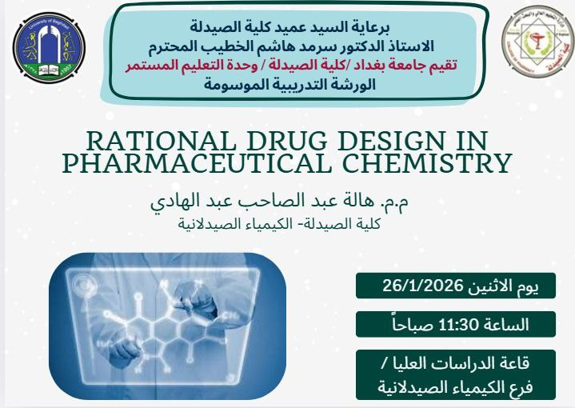


Slide 2
Rational Drug Design in Pharmaceutical Chemistry
Overview:
Introduction to rational drug design
Drug Discovery steps
Case study: HDAC inhibitors
Notes:
→ Introduce rational drug design concept.
→ Outline seminar sections and learning goals.
→ Emphasize integration of chemistry, biology, and pharmacology.

Slide 3
Rational Drug Design?
Definition: Design of drug molecules based on knowledge of biological targets.
Advantages:
Improves target selectivity.
Reduces discovery cost and time.
Facilitates optimization of potency and safety.

Slide 4
Traditional vs Rational Approach
Traditional discovery:
relies on random screening of large chemical libraries to identify biologically active compounds, without prior structural or mechanistic knowledge of the target.
Low hit rate and high cost.
Rational design:
Guided by structural and mechanistic insight biological target.
Notes:
Hit rate = the percentage of tested compounds that are identified as “hits.” Example:
150 selected compounds from 3,000 docked → 5% hit rate

Slide 5
Drug Discovery steps
1. Target Identification
2. Hit Identification
3. Lead Optimization (SAR studies)
4. Preclinical evaluation
5. Clinical trials
Notes:
→ Walk through discovery pipeline stages.
→ Mention feedback between computational and experimental steps.
→ Give examples: Imatinib, Oseltamivir.

Slide 6
1. Target Identification & Validation
Purpose: Find and confirm biomolecules essential to disease mechanism.
Techniques:
- Genomic and proteomic profiling
- Structural bioinformatics
- mutagenesis studies
Notes:
→ Define target identification and validation.
→ Explain genomic/proteomic tools.
→ Use HDAC2 as example of cancer-related epigenetic enzyme.

Slide 7
2. Hit Identification Methods
Approaches:
High-throughput screening (HTS)
Fragment-based screening
ligand-based screening
Goal: Discover initial compounds (hits) with measurable bioactivity.
Notes:
Fragments bind to the target with low affinity but high ligand efficiency. These fragments are then chemically optimized or linked to generate more potent and selective compounds.
Advantages:
Higher hit rates
Improved selectivity
----Virtual and ligand-based screening are computational approaches used to prioritize compounds before experimental testing.
Explanation: Virtual screening predicts how compounds interact with the target using molecular docking, while ligand-based screening identifies compounds with similar features to known active molecules. These methods reduce time, cost, and experimental workload.

Slide 8
3. Concept of SAR: Structure–Activity Relationship
Definition: Relationship between a compound’s structure and its biological activity.
Purpose:
Identify functional groups responsible for activity.
Optimize molecular features for improved potency.
Approach:
Systematic modification of substituents and evaluation of activity changes.
Notes:
→ Define SAR concept.
→ Explain why understanding structural influence is key.
→ Note relation to lead optimization process.

Slide 9
SAR Workflow in Drug Optimization
Steps:
1. Identify lead compound.
2. Modify functional groups.
3. Evaluate biological response.
4. Refine substituents to balance potency, selectivity, and ADME.
Notes:
→ Describe iterative SAR workflow: modify–test–analyze.
→ Emphasize systematic approach and property balancing.

Slide 10
Principles of SAR Studies
1. Electronic Effects: Influence of donor/withdrawing groups on reactivity and binding.
2. Steric Effects: Shape and bulk affecting fit in the binding pocket.
3. Hydrophobic/Hydrophilic Balance: Affects solubility and membrane permeability.
4. Conformational Flexibility: Determines binding efficiency and stability.
Notes:
→ Highlight four SAR factors: electronic, steric, hydrophobic, conformational.
→ Relate to how substituent changes affect potency.

Slide 11
Example

Slide 12
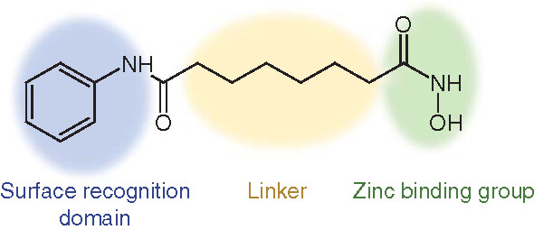
SAR in HDAC Inhibitor Design
HDAC inhibitors consist of three key regions:
1. Zinc-binding group (ZBG)
2. Linker
3. Cap group
Each region contributes to selectivity and activity toward HDAC isoforms.
Notes:
→ Introduce HDAC inhibitor pharmacophore model.
→ Explain why each region matters (ZBG, linker, cap).

Slide 13
Binding Interaction Overview
Interactions:
- Zn²⁺ coordination by ZBG
- H-bonding with Asp and His residues
- π–π stacking with phenylalanine and tyrosine
- Hydrophobic channel occupancy by linker.
Notes:
→ Describe binding interactions inside HDAC pocket.
→ Note key residues (Asp, His, Tyr, Phe).
→ Emphasize Zn2+ coordination and hydrophobic fit.

Slide 14
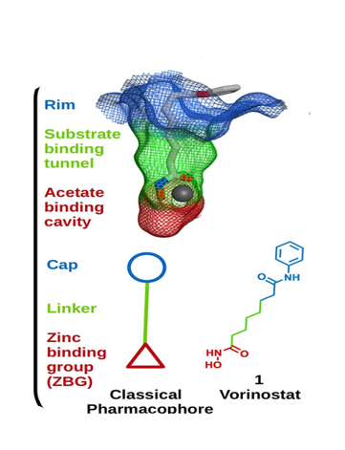

Slide 15
SAHA (Vorinostat) Overview
FDA-approved HDAC inhibitor for cutaneous T-cell lymphoma.
Features:
- Hydroxamate ZBG
- Flexible aliphatic linker
- Aromatic cap group
Limitation: Non-selective and prone to metabolic instability.
Notes:
→ Present SAHA’s structure and features.
→ Note hydroxamate ZBG advantage and drawback.
→ Highlight non-selectivity problem.

Slide 16
Zinc-Binding Group (ZBG) Optimization
Common ZBGs:
- Hydroxamate: Strong Zn²⁺ chelator (used in SAHA)
- Benzamide: Selective for class I HDACs
- Oxadiazole and thiol: Alternative ZBGs improving metabolic stability
Example: Replacing hydroxamate with oxadiazole enhances selectivity and reduces toxicity.
Notes:
→ Discuss common ZBG types and their selectivity.
→ Mention oxadiazole as stable alternative to hydroxamate.
→ Highlight structure–activity trade-offs.

Slide 17
Linker Region in HDAC Inhibitors
The linker determines the distance between ZBG and cap group.
SAR Notes:
- Aliphatic linkers improve flexibility.
- Aromatic linkers enhance π–π stacking.
Optimal length ensures correct positioning of ZBG near Zn²⁺ site.
Notes:
→ Explain linker’s role in geometry and binding orientation.
→ Compare aliphatic vs aromatic linkers.
→ Stress optimal distance for Zn2+ coordination.

Slide 18
Cap Group Modification
Cap group interacts with the rim of the HDAC active site.
- Example: Incorporating heteroaromatic rings increases isoform selectivity.
Notes:
→ Cap group drives isoform selectivity.
→ Mention bulky caps favor HDAC6.
→ Example: heteroaromatic caps improve binding surface complementarity.

Slide 19
SAR Trends Across HDAC Isoforms
• Class I (HDAC1,2,3): Prefer planar aromatic caps and polar ZBGs.
• Class IIa (HDAC4,5,7,9): Require bulky hydrophobic caps.
• Class IIb (HDAC6,10): Need long linkers and flexible scaffolds.
• Class IV (HDAC11): Limited data but sensitive to lipophilicity.
Notes:
→ Summarize SAR preferences by HDAC class.
→ Emphasize design rules for each isoform.
→ Mention importance of physicochemical balance.

Slide 20
SAR Summary – HDAC Example
Optimized design achieves:
- Strong Zn²⁺ coordination
- Favorable hydrophobic and hydrogen-bonding contacts
- Balanced solubility and permeability
- Enhanced selectivity (HDAC2 or HDAC6)
Notes:
→ Recap SAR outcomes: potency, selectivity, ADME.
→ Reinforce the goal of rational structural tuning.

Slide 21
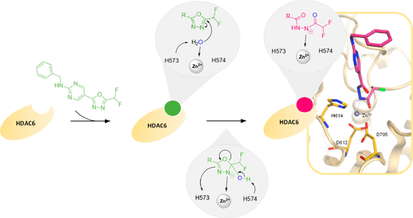
Design of Oxadiazole-Based HDAC Inhibitors
Objective: Replace hydroxamate with 1,3,4-oxadiazole or its trifluoromethyl analogs.
Benefits:
- Improved metabolic stability
- Reduced toxicity
- Better HDAC selectivity

Slide 22
ADME ,Toxicity and In Vitro Validation
ADME Evaluation:
- Lipinski’s Rule of Five
Toxicity:
- Mutagenicity and hepatotoxicity screening using in silico tools.
In Vitro Validation
- HDAC inhibition assay (colorimetric/fluorometric)
- IC₅₀ determination
- Ki estimation from enzyme kinetics
- Cytotoxicity assay on cell lines.
Notes:
→ Outline ADME assessment.
→ Mention Lipinski criteria, logP, TPSA.
→ Discuss early toxicity prediction importance.

Slide 23
Conclusion
• Rational design integrates biology with chemistry.
• SAR is key to optimizing drug selectivity and potency.
Notes:
→ Summarize presentation.
→ Highlight SAR’s central role.
→ Reinforce HDAC inhibitors as case study of rational design.

Slide 24
References
1. Itoh Y, Takada Y, Yamashita Y, Suzuki T. Curr Opin Chem Biol. 2022;67:102130.
2. Pei H, et al. Eur J Med Chem. 2023;252:115907.
3. König B, Hansen F.K. J Biol Chem. 2023;299(5):104857.
4. Millán-Zambrano G, et al. Nat Rev Genet. 2022;23(9):563-580.
5. Fernandes MF, Vinolo MA. Digest Med Res. 2024;7.
6. Seto E, Yoshida M. Cold Spring Harb Perspect Biol. 2014;6:a018713.
7. Li G, et al. Sci Rep. 2025;15:12034.
Notes:
→ Cite real references.
→ Encourage further reading for detailed mechanisms.

