Slide 1
م.م مصطفى سليم كاظم
جامعة بغداد \ مركز بحوث ومتحف التاريخ الطبيعي

Slide 2

Forensic Entomology: Insects as Nature’s Crime Scene Investigators
Forensic entomology is the scientific study of insects and their arthropod relatives to aid legal investigations, primarily in criminal cases. These tiny creatures serve as invaluable, silent witnesses, providing critical clues to solve complex mysteries.

Slide 3
HISTORICAL CONTEXT
FIRST CASE
The Origins of Forensic Entomology
1235 AD: Sung Tz'u's "The Washing Away of Wrongs"
Flies Expose a Murderer
Centuries of Insight
This ancient account laid the groundwork for using insects to understand the circumstances of death, proving that nature's processes hold keys to justice long before formal scientific disciplines emerged.
Villagers were gathered, and a specific sickle attracted flies, leading to a confession. The flies, drawn to residual traces of blood invisible to the human eye, pinpointed the weapon and its owner, establishing a foundational concept for insect evidence.
The earliest recorded case of forensic entomology is detailed in Sung Tz'u's seminal text, where a murder was solved using insect behaviour, demonstrating remarkable deductive reasoning centuries ahead of its time.

Slide 4


METHODOLOGY
What Forensic Entomologists Do
Identify Insects
Careful identification of insects at all stages—eggs, larvae, pupae, and adults—found on or near remains. This precision is vital for accurate analysis.
Collect & Preserve Evidence
Meticulous collection and preservation of insect specimens directly from crime scenes ensures the integrity and scientific value of the evidence.
Estimate Postmortem Interval (PMI)
Using insect development rates and environmental data, entomologists accurately estimate the time elapsed since death, a critical aspect of investigations.
Provide Expert Testimony
Presenting and explaining complex insect evidence in court, making scientific findings accessible and understandable to legal professionals and juries.

Slide 5

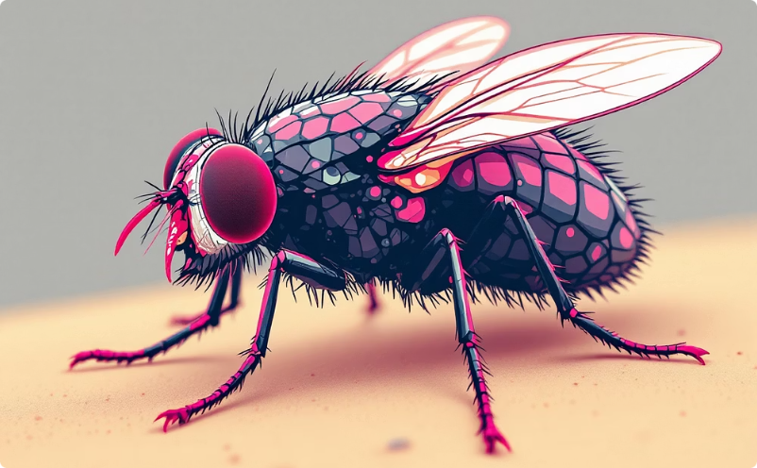
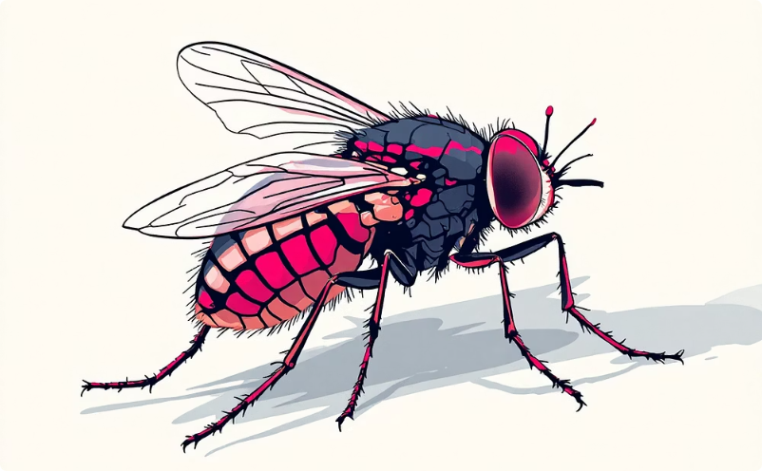
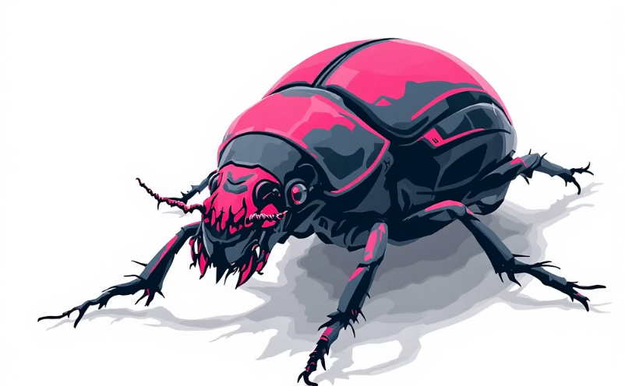
KEY SPECIES
Key Insect Players in Forensic Investigations
Blow Flies (Calliphoridae)
Flesh Flies (Sarcophagidae)
Cheese Skippers (Piophilidae)
Carrion Beetles (Silphidae)
Often the first responders to a body, their metallic blue-green bodies are drawn to fresh, moist flesh within minutes or hours of death.
These flies deposit live larvae directly into wounds, playing a significant role during the initial stages of decomposition.
Identified by their distinctive jumping larvae, these insects typically appear months after death, associated with the butyric fermentation stage.
These beetles arrive during later decay stages, often feeding on fly larvae and contributing to the breakdown of remains.

Slide 6

BIOLOGICAL CLOCK
The Blow Fly Life Cycle: A Biological Clock
Eggs (0-1 Day)
1
Laid in natural orifices or wounds within minutes to hours post-mortem, hatching into larvae typically within 12-24 hours, depending on temperature.
2
Larval Stages (4-5 Days)
Comprises three instar stages (L1, L2, L3) where maggots feed voraciously on tissue, growing rapidly. The third instar is the largest and most active.
Pupation (6-8 Days)
3
Larvae migrate away from the body to pupate in soil or concealed areas, transforming into pupae within a hardened casing.
4
Adult Emergence
Adult flies emerge from the pupal cases, ready to mate and restart the cycle. The entire process provides a reliable indicator for PMI.

Slide 7
DECOMPOSITION
Stages of Decomposition and Insect Succession
Fresh
From the moment of death, bacteria begin to break down tissues, attracting blow flies and flesh flies within minutes.
Bloat
Gases produced by bacteria cause the body to swell. Fly activity peaks, with large numbers of maggots feeding on the remains.
Decay
The body deflates as skin breaks and maggots consume tissue. Predatory beetles and other insects arrive to feed on larvae and remaining flesh.
Post-Decay
Most flesh is gone, leaving primarily skin, hair, and bones. Beetle species, particularly dermestids, become dominant as they feed on dry tissues.
Dry
Only bones and hair remain. The ecosystem returns to a more natural state, with soil fauna and other scavengers replacing insect species directly associated with the body.

Slide 8

FACTORS
Environmental and Other Factors Affecting PMI Estimates
Temperature
Ambient, ground, and maggot mass temperatures are critical. Insect development rates are highly dependent on thermal energy, influencing the accuracy of PMI calculations.
Body Location & Condition
Whether a body is exposed or enclosed (e.g., buried, inside a car) significantly impacts insect access and colonisation, thereby affecting PMI.
Drugs & Toxins
The presence of substances in the body can alter insect metabolic rates, accelerating or decelerating their development, which must be accounted for in estimations.
Species Succession
The predictable sequence of insect species arriving at a body provides additional crucial timing clues, especially over longer post-mortem intervals.

Slide 9
IMPACT
Real-World Applications and Case Studies
Accurate Time of Death
Toxin Analysis via Maggots
When conventional methods are no longer viable, often after 72 hours, insect evidence becomes the primary tool for pinpointing the time of death, crucial for criminal investigations.
Maggots feeding on a body ingest any drugs or poisons present, allowing toxicological analysis of their tissues to identify substances and their potential role in the death.
Linking Suspects to Crime Scenes
Detecting Corpse Movement
Insect evidence (e.g., insect fragments, eggs) found on a suspect's clothing or weapon can provide direct links to the crime scene, corroborating other evidence.
Discrepancies in insect species found on a body compared to those naturally occurring at the discovery site can indicate that a corpse has been moved, altering the crime narrative.

Slide 10



LEGAL RAMIFICATIONS
Forensic Entomology in the Courtroom
Expert Testimony
Corroborating Evidence
Forensic entomologists serve as expert witnesses, translating complex scientific findings into clear, concise evidence for judges and juries. Their testimony can be pivotal in determining guilt or innocence.
Insect evidence often supports or refutes witness statements and alibis, building a more complete picture of events surrounding a death.
Pivotal Cases
Numerous high-profile cases have seen forensic entomology play a decisive role, securing convictions or leading to exonerations by precisely dating events.

Slide 11

FUTURE OUTLOOK
Conclusion: The Silent Witnesses of Crime Scenes
Reliable Timelines
Advancing Accuracy
Insects consistently provide a unique and remarkably reliable timeline for death investigations, offering insights where other methods fall short.
Ongoing research and technological advancements continue to enhance the precision and scope of forensic entomology, making it an even more powerful tool.
Aiding Justice
These tiny detectives reveal truths hidden from human eyes, ensuring that even the smallest organisms contribute significantly to the pursuit of justice.

Slide 12
الاهداف :
توعية الباحثين حول اهمية الحشرات
حث الباحثين لاجراء دراسات وبحوث حول الحشرات وفوائدها

Slide 13
التوصيات :
اخذ النظر باستخدام الحشرات لحل جرائم القتل
اعداد دورات تدريبية او توعوية لاهمية الحشرات

