Slide 1
Training Course
Scope of Linguistics

Slide 2
Introduction
-Linguistics is the scientific and systematic study of language.
-The scope of linguistics refers to the wide range of areas in which linguistics studies language—its sounds, structure, meaning, use, mental processing, social role, and technological applications.

Slide 3
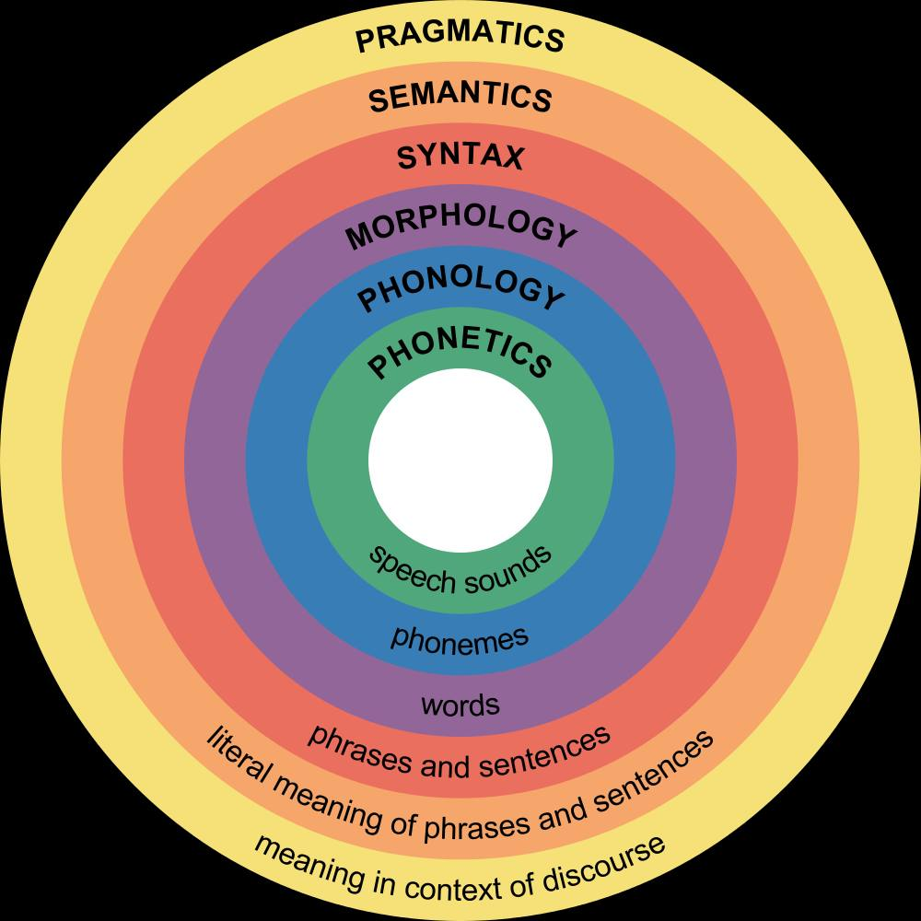

Slide 4
Areas of Linguistics
1. Phonetics
It studies the physical nature of speech sounds.
Types of Phonetics:
• Articulatory phonetics – how sounds are produced by speech organs
• Acoustic phonetics – sound waves and frequencies
• Auditory phonetics – how sounds are heard and interpreted
Examples:
• /p/ in pen is produced by closing the lips and releasing air.
• /b/ in bat involves vocal cord vibration, unlike /p/.

Slide 5
2. Phonology
It studies how sounds function within a language system.
Key Concepts:
• Phonemes
• Sound patterns
• Rules of sound distribution
Examples:
• pin vs bin → difference in one phoneme changes meaning.
• English allows str- in street but not rtst-.
• Plural –s is pronounced differently:
• cats /s/
• dogs /z/
• buses /ɪz/

Slide 6
3. Morphology
It studies how words are formed from smaller units called morphemes.
Types of Morphemes:
-Free morphemes: are the smallest units of meaning that can stand alone as words (e.g., book, run, happy).
-Bound morphemes: are the smallest units of meaning that cannot stand alone and must be attached to another morpheme (e.g., un-, -ed, -s).
Examples:
• unbelievable = un + believe + able
• replayed = re + play + ed
• children → irregular plural formation

Slide 7
4. Syntax
It studies how words are arranged to form grammatical sentences.
Focus Areas:
• Word order
• Sentence patterns
• Agreement
Examples:
• Correct: She is writing a letter.
• Incorrect: Writing letter a she is.
• Active vs passive:
• The teacher explained the lesson.
• The lesson was explained by the teacher.

Slide 8
5. Semantics
It deals with literal and abstract meaning in language.
Key Topics:
• Synonyms, antonyms
• Ambiguity
• Sense and reference
Examples:
• Bank → river bank / financial bank
• Light → not heavy / illumination
• Sentence ambiguity: Visiting relatives can be annoying.
The sentence is ambiguous because “visiting relatives” has two meanings:
1. Relatives who visit are annoying.
2. The act of visiting relatives is annoying.

Slide 9
6. Pragmatics
It studies how meaning is influenced by context, situation, and speaker intention.
Key Concepts:
• Speech acts
• Implicature
• Politeness
Examples:
• “It’s hot here.” → a request to open a window.
• “Can you help me?” → polite request, not a question of ability.
• Saying “Nice job!” sarcastically changes meaning.

Slide 10
7. Sociolinguistics
It is the branch of linguistics that studies the relationship between language and society—how language varies and is used in different social contexts.
Examples:
• Formal vs informal speech
(e.g. Good morning, sir. (formal) vs. Hi! (informal))
• Dialects and accents
• Language differences based on age, gender, or social class

Slide 11
8. Psycholinguistics
It is the branch of linguistics that studies how language is acquired, processed, and produced in the human mind. It focuses on the mental processes involved in understanding, speaking, and learning language.
Examples:
• Children saying goed instead of went (language acquisition)
• Pauses or hesitations while speaking (speech processing)
• Understanding sentences instantly while reading or listening
.

Slide 12
Conclusion:
The scope of linguistics is extensive and multidisciplinary, examining language from its sounds and structure to meaning, use, and social impact. It not only helps us analyze and understand languages scientifically but also has practical applications in education, communication, technology, and healthcare. By studying linguistics, we gain insight into how humans think, interact, and express themselves through language.

Slide 13
Thank You for Your Attention

