Slide 1
Possible Protective Effects of Two Doses of biochanin A compared to Vitamin E against Methotrexate-induced Nephrotoxicity and Jejunal Mucositis in Male Rats
Presented by:
Ban Waleed
Pharmacology and Toxicology PhD Candidate

Slide 2
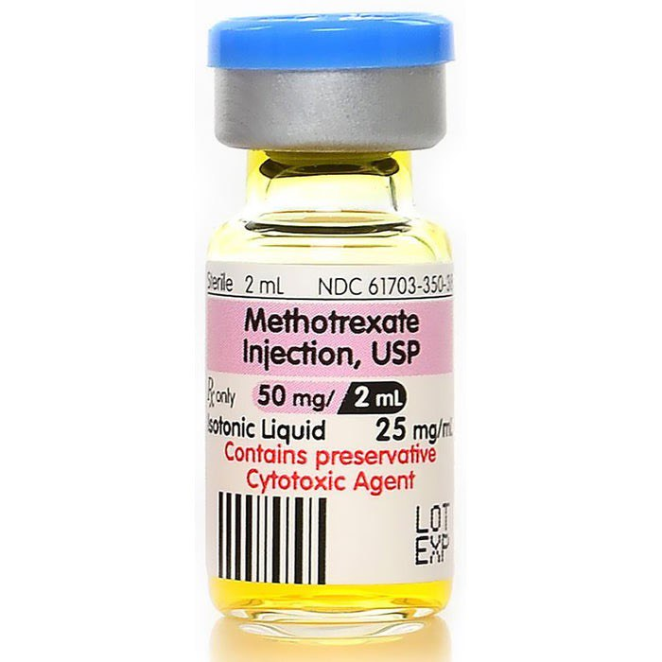
Methotrexate (MTX), an antineoplastic agent that is used for the treatment of acute lymphoblastic leukemia, osteosarcoma, and cancers of lung, head, and neck; and, it exerts its anticancer effects through competitive inhibition of the dihydrofolate reductase enzyme; where, it blocking the conversion of dihydrofolate to its active form/tetrahydrofolates and ultimately inhibiting DNA synthesis. However, MTX treatment produced negative effects on multiple organs including brain, liver, lung, GIT, and kidneys which restricts its clinical uses.

Slide 3
Biochanin A is a 4′-methoxy-5, 7-dihydroxy isoflavone that isolated from red clover, soy, chickpea, and from other plants; and, it exhibits significant biological activities including anticancer, anti-inflammatory, and antioxidant.
Vitamin E, a potent lipid-soluble antioxidant that is present in higher concentration in immune cells, and it is one of the most effective nutrients known to modulate immune function directly by impacting the integrity of the T cell membrane, signal transduction, and cell division, and indirectly by affecting inflammatory mediators, which are generated from other immune cells.

Slide 4
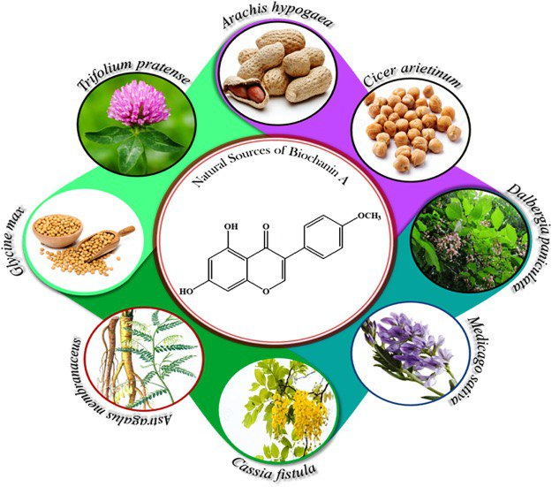

Slide 5
Aims of the study
This study will investigate the effects of two doses of Biochanin A compared to vitamin E, each orally-administered prior to and with an IP injection of MTX (7mg/kg)-induced nephrotoxicity and jejunal mucositis via the estimation of selected parameters of -oxidative stress (OS), -levels of inflammatory, the anti-inflammatory markers; and, -apoptosis process.

Slide 6
Animals
Forty-nine (49) apparently-healthy adult Wistar male rats weighing 120-150g will obtain from the Animal House of College of Pharmacy, University of Baghdad and to be maintained in the College of Pharmacy/University of Baghdad under normal conditions of temperature, humidity and light/dark cycle. Rats to be fed commercial pellets and tap water/ad libitum throughout the experimental period. But they will bring pellets-free (fasting) 24 hours after the last administration to empty portions of GIT to get clear results and the experimental animals will randomly-allocate into 7 Groups (7 rats each) as follows:

Slide 7
Experimental Design
Group I/Negative Control: Rats will administer propylene glycol (2ml/kg B.W) orally once daily via rats’ oral gavage for 5 days.
Group II. (The toxicant group): Rats will orally administer propylene glycol daily via rats 'oral gavage for 5 days, and rats will IP inject daily with methotrexate (MTX) 7 mg/kg on [3, 4, and 5 days].
Group III/Positive Control: Rats will orally-administer Biochanin A (alone) (10mg/kg BW), which to be dissolved in propylene glycol (to be given according to the weight of each rat) daily for 5 days.

Slide 8
Group IV-Positive Control 2: Rats will orally-administer Biochanin A (alone) (20mg/kg B.W), which to be dissolved in propylene glycol (to be given according to the weight of each rat) daily for 5 days.
Group V: Rats will orally-administer Biochanin A (10mg/kg B.W), which to be dissolved in propylene glycol (to be given according to the weight of each rat) daily for 5 days; and, rats will IP inject daily with 7mg/kg MTX on [days 3, 4, and 5].

Slide 9
Group VI: Rats will orally-administer Biochanin A (20mg/kg/day B.W), which to be dissolved in propylene glycol (to be given according to the weight of each rat) daily for 5 days; and, rats will IP inject daily with 7mg/kg MTX on [days 3, 4, and 5].
Group VII: Rats will orally-administer vitamin E at a dose 100mg/kg/day dissolve in propylene glycol once daily for 5 days via rats' oral gavage and will then IP inject daily with 7mg/kg MTX on [days 3, 4, and 5].

Slide 10
Twenty-four hours (24hr) after the end of the treatment duration (i.e., at day 6); anesthesia will induce by IP injection of a ketamine/xylazine cocktail (50mg/kg ketamine + 10mg/kg xylazine) to ensure a surgical plane of anesthesia for painless procedures ⁽¹⁹⁾; then rats to be sacrificed by cervical dislocation (separation of the cervical vertebrae from the skull) and after that, blood will be obtained by intra-cardiac puncture and to be collected in tubes with anticoagulant to measure BUN; and without anticoagulant to obtain serum for the measurement of creatinine levels. Furthermore, one kidney and part of the jejunum of each rat to be quickly-excised, rinsed with phosphate buffer saline (PBS) (pH 7.4) at 4ºC and taken for biochemical, qRT-PCR, Western blot, and histopathological analyses by the utilization of the second kidney.

Slide 11
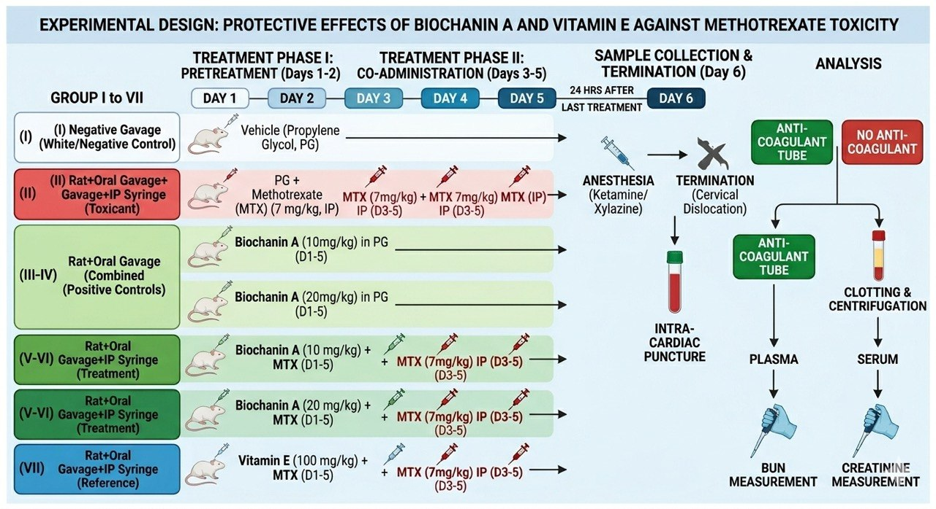

Slide 12
Measurements
Biochemical parameters of kidney function tests BUN, and serum creatinine.
2- Preparation of (one kidney) and part of jejunum tissues homogenate sample for the measurement of:
Levels of OS parameters in kidney and jejunum tissues homogenates by commercially available kits for the determination of [MDA, and reduced glutathione (GSH) level] by the Enzyme Linked Immunosorbent Assay (ELISA).
The level of the inflammatory marker [Tumour necrosis factor-alpha (TNF-α)] by Western Blot analysis.

Slide 13
C- The level of the anti-inflammatory markers [interleukin-1beta (IL-1ß), and IL-6] by ELISA.
D- The mRNA expression of the Myeloperoxidase (MPO) enzyme level by Reverse-Transcriptase Quantitative Polymerase Chain Reaction (qRT-PCR).
E- The Nrf2/HO-1 pathway is a central regulator of the cellular antioxidant and cytoprotective response [Nrf2 (NFE2L2)] and its downstream target heme oxygenase-1 (HO-1 / HMOX1) enzyme at the mRNA level by quantitative real-time PCR (qRT-PCR).
F- The Nuclear Factor kappa B (NF-κB) level by qRT-PCR.

Slide 14
G- The cleaved Caspase-3 (CASP-3) activity level, the protein BCL2 level by Western Blot (W.B) Analysis.
H- Measurement of Mucin level in the Jejunal tissue by ELISA.

Slide 15
4- Evaluation of the Diarrhea Score
The diarrhea scores to be estimated at day 5 of MTX injection; and, the intensity of diarrhea to be recorded as follows:
Extent of diarrhea Manifestations score
Normal Normal stool or absent 0
Slight Slightly wet and soft stool 1
Moderate Wet and unformed stool with moderate peri-anal staining of the coat 2
Severe Watery stool with severe peri-anal staining of the coat
3

Slide 16
5- The histopathological study of the (second kidney) and part of the jejunum tissue of each rat; and by the utilization of histopathological scoring of the kidney and the Jejunum injury severity; and to ascertain the histological alterations in the affected tissues; where, a structured numerical scoring system was employed:
– Score (-): Indicates unaltered, normal histology.
– Score (+): Indicates the presence of mild histological alterations.
– Score (++): Indicates moderate histological alterations.
– Score (+++): Indicates severe histological alterations.

Slide 17
Thank you

