Slide 1


Methotrexate induced hepatotoxicity
By: Aseel Shihab Hamad

Slide 2
What is Methotrexate (MTX)
MTX is a folate analogue that competitively inhibits Dihydrofolate Reductase (DHFR), halting the conversion of dihydrofolate to tetrahydrofolate [1, 2].
By depleting tetrahydrofolate, MTX arrests the de novo synthesis of thymidylate and purines, thereby inhibiting DNA synthesis and cellular proliferation [1].
it is an essential drug for Rheumatoid Arthritis, psoriasis and osteosarcoma yet it acts as a persistent metabolic stressor in the liver [2].

Slide 3
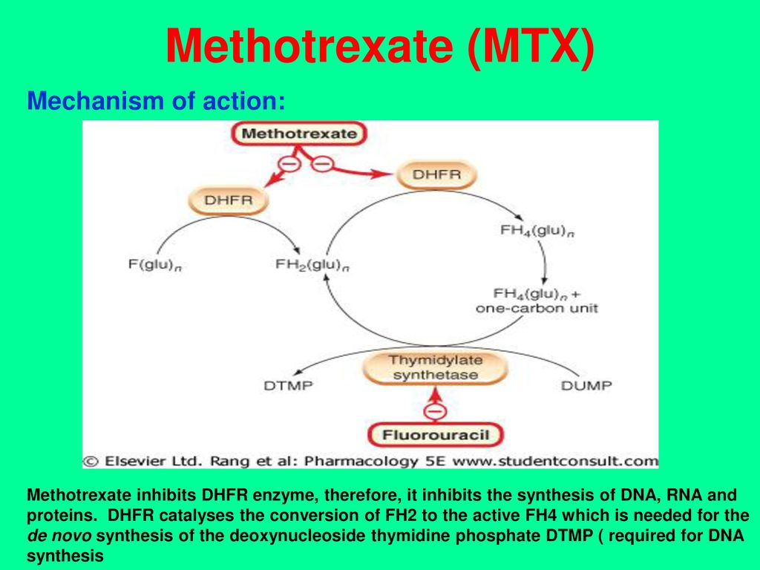

Slide 4
Molecular pathogenesis: oxidative stress
MTX inhibits NADPH-dependent dehydrogenase, causing a severe reduction in Reduced Glutathione (GSH) pools within hepatocytes [1, 2].
This loss of antioxidant defense allows for the accumulation of Reactive Oxygen Species (ROS), which attack the lipid bilayer of hepatic cell membranes [1, 3].
ROS-induced damage leads to mitochondrial membrane permeabilization, releasing Cytochrome C and activating the Caspase-3/Caspase-9 apoptotic pathway [2, 3].

Slide 5
Molecular pathogenesis: fibrosis
MTX inhibits the enzyme 5-Aminoimidazole-4-carboxamide Ribonucleotide (AICAR) Transformylase.
This inhibition leads to the intracellular accumulation of AICAR, which subsequently increases the release of Adenosine into the extracellular space [1, 2].
Extracellular Adenosine binds to A2A G-protein-coupled receptors located on the surface of Hepatic Stellate Cells (HSCs).
While this adenosine signaling is anti-inflammatory in the joints, it is profibrotic in the liver [1, 2, 4].

Slide 6
Molecular pathogenesis: fibrosis cont.
The binding activates quiescent HSCs, transforming them into Myofibroblasts.
These myofibroblasts are characterized by the expression of α-Smooth Muscle Actin (α-SMA), a protein that gives the cells contractile properties [2].
The activated myofibroblasts secrete excessive amounts of Type I Collagen, the primary structural protein in scar tissue.
Over time, this collagen deposition replaces healthy hepatocytes, leading to Perisinusoidal Fibrosis and eventual cirrhosis [2, 4].

Slide 7
STING-induced ferroptosis
Recent evidence identifies Ferroptosis an iron-dependent, lipid peroxidation-driven cell death, as a key driver of MTX injury [2, 5].
MTX-induced mitochondrial DNA (mtDNA) leakage activates the cGAS-STING (Stimulator of Interferon Genes) pathway [5].
STING activation facilitates the degradation of GPX4 (the inhibitor of ferroptosis), leading to lethal accumulation of lipid hydroperoxides [5, 6].

Slide 8
Guggulsterone as a protective agent
Guggulsterone (GS) is a bioactive phytosteroid, and a potential inhibitor of this pathological axis.
Guggulsterone mitigates hepatotoxicity by:
Inhibiting the STING Axis: Suppressing the inflammatory cascade and downstream pro-ferroptotic signaling [6].
Rescuing GPX4 Expression: Directly preventing iron-dependent cell death by maintaining the cell’s antioxidant capacity [6].

Slide 9
References
Schmidt, S. et al. (2022). "Methotrexate-Induced Liver Injury Is Associated with Oxidative Stress, Impaired Mitochondrial Respiration, and Endoplasmic Reticulum Stress In Vitro." International Journal of Molecular Sciences, 23(23), 15116. https://doi.org/10.3390/ijms232315116
Mahmoud, N. M. et al. (2024). "Nitazoxanide mitigates methotrexate hepatotoxicity in rats: role in inhibiting apoptosis and regulating endoplasmic reticulum stress." Frontiers in Pharmacology, 15, 1491249.https://doi.org/10.3389/fphar.2024.1491249
Al Kury, L. T. et al. (2020). "Ginkgo biloba Extract Protects against Methotrexate-Induced Hepatotoxicity by Attenuating Oxidative Stress, Inflammation and Apoptosis." Molecules, 25(11), 2540. https://doi.org/10.3390/molecules25112540
Tomaszewski, M. et al. (2021). "Hepatic steatosis as measured by the computed attenuation parameter predicts fibrosis in long-term methotrexate use." Canadian Liver Journal, 4(4), 370–380. https://pmc.ncbi.nlm.nih.gov/articles/PMC8654519/
Zhang, Y. et al. (2024). "Ferritinophagy-mediated ferroptosis facilitates methotrexate-induced hepatotoxicity." Liver International, 44(3). https://doi.org/10.1111/liv.15814
Lv, H. et al. (2024). "Guggulsterone attenuates liver injury by inhibiting inflammation and ferroptosis via the STING/GPX4 axis." Journal of Ethnopharmacology, 319, 117145. https://doi.org/10.1016/j.jep.2023.117145

