Slide 1


Therapeutic Drug Monitoring of
Mycophenolate Mofetil in Kidney Transplant Recipients
By : Pharmacist Sarah Waheed Mawlood

Slide 2
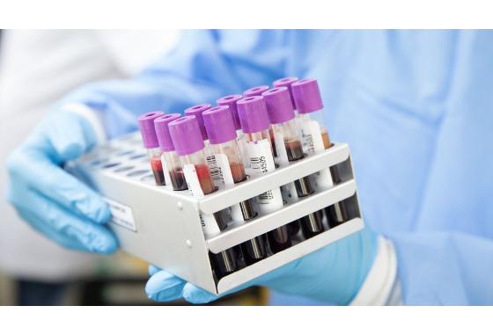

Mechanism & Prodrug Bioactivation
Mycophenolate Mofetil (MMF)
MMF is an ester prodrug developed to enhance oral bioavailability. After ingestion, it is rapidly hydrolyzed in vivo to its active moiety, Mycophenolic Acid (MPA).
Mechanism of Action
MPA non-competitively inhibits inosine monophosphate dehydrogenase (IMPDH), blocking the de novo purine synthesis pathway required for T and B lymphocyte proliferation.

Slide 3
Pharmacokinetics & Inter-Individual Variability
Historically MMF is administered using a fixed-dose "one-size-fits-all" strategy (e.g., 2 g/day).
Growing evidence highlights high inter-individual variability in MPA exposure, prompting the evaluation of Therapeutic Drug Monitoring (TDM).
At a standard fixed dose of 2 g/day MMF, patient MPA area-under-the-curve (AUC 0-12h exposure can vary drastically from 15 to 115 mg·h/L.

Slide 4






Pharmacokinetic Variability Drivers
Enterohepatic Circulation
Plasma Protein Binding
Drug-Drug Interactions
MPA is glucuronidated in the liver to 7-O-MPA-glucuronide (MPAG), excreted into bile, and converted back to MPA by gut bacteria—creating a secondary concentration peak at 6–12 hours.
MPA is >97% bound to plasma albumin. Renal impairment or hypoalbuminemia increases the pharmacologically active free MPA fraction, raising risk of toxicity.
Cyclosporine inhibits biliary excretion of MPAG, lowering MPA levels by ~30–50%. Tacrolimus does not inhibit this transport, yielding higher relative MPA exposure.

Slide 5
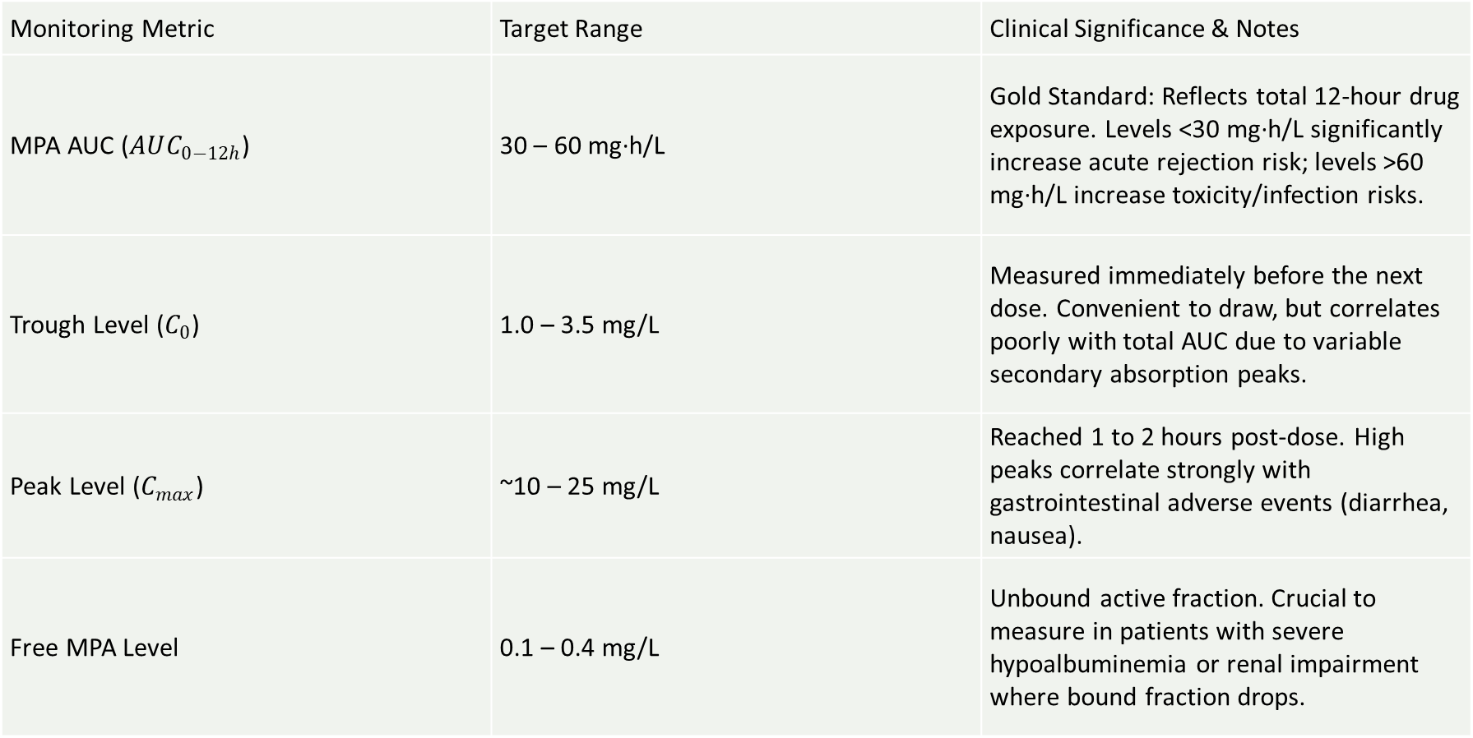
Target Metrics: AUC vs Trough
Monitoring Metric | Target Range | Clinical Significance & Notes
MPA AUC ($AUC_{0−12h}$) | 30 – 60 mg·h/L | Gold Standard: Reflects total 12-hour drug exposure. Levels <30 mg·h/L significantly increase acute rejection risk; levels >60 mg·h/L increase toxicity/infection risks.
Trough Level ($C_{0}$) | 1.0 – 3.5 mg/L | Measured immediately before the next dose. Convenient to draw, but correlates poorly with total AUC due to variable secondary absorption peaks.
Peak Level ($C_{max}$) | ~10 – 25 mg/L | Reached 1 to 2 hours post-dose. High peaks correlate strongly with gastrointestinal adverse events (diarrhea, nausea).
Free MPA Level | 0.1 – 0.4 mg/L | Unbound active fraction. Crucial to measure in patients with severe hypoalbuminemia or renal impairment where bound fraction drops.

Slide 6
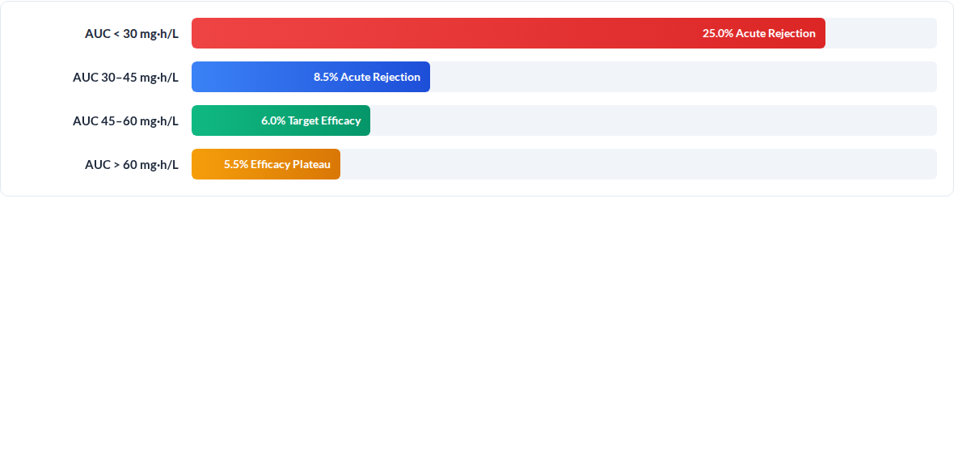
Efficacy & Therapeutic Window
Therapeutic Target:
30 mg·h/L
30 and 60 mg·h/L
Ref: Le Meur Y et al. Am J Transplant. 2007;7(11):2496-2503. van Gelder T. Am J Transplant. 2009;9:1495-1499.

Slide 7


Balancing Efficacy and Toxicity
Under-Dosing Risks (<30 mg·h/L)
Inadequate MPA exposure leads to acute cellular graft rejection, formation of de novo donor-specific antibodies (DSA), and long-term graft failure.
Over-Dosing Risks (>60 mg·h/L)
Excessive exposure causes severe bone marrow suppression (leukopenia, anemia), gastrointestinal complications (diarrhea), and opportunistic viral infections (CMV, BKV).

Slide 8
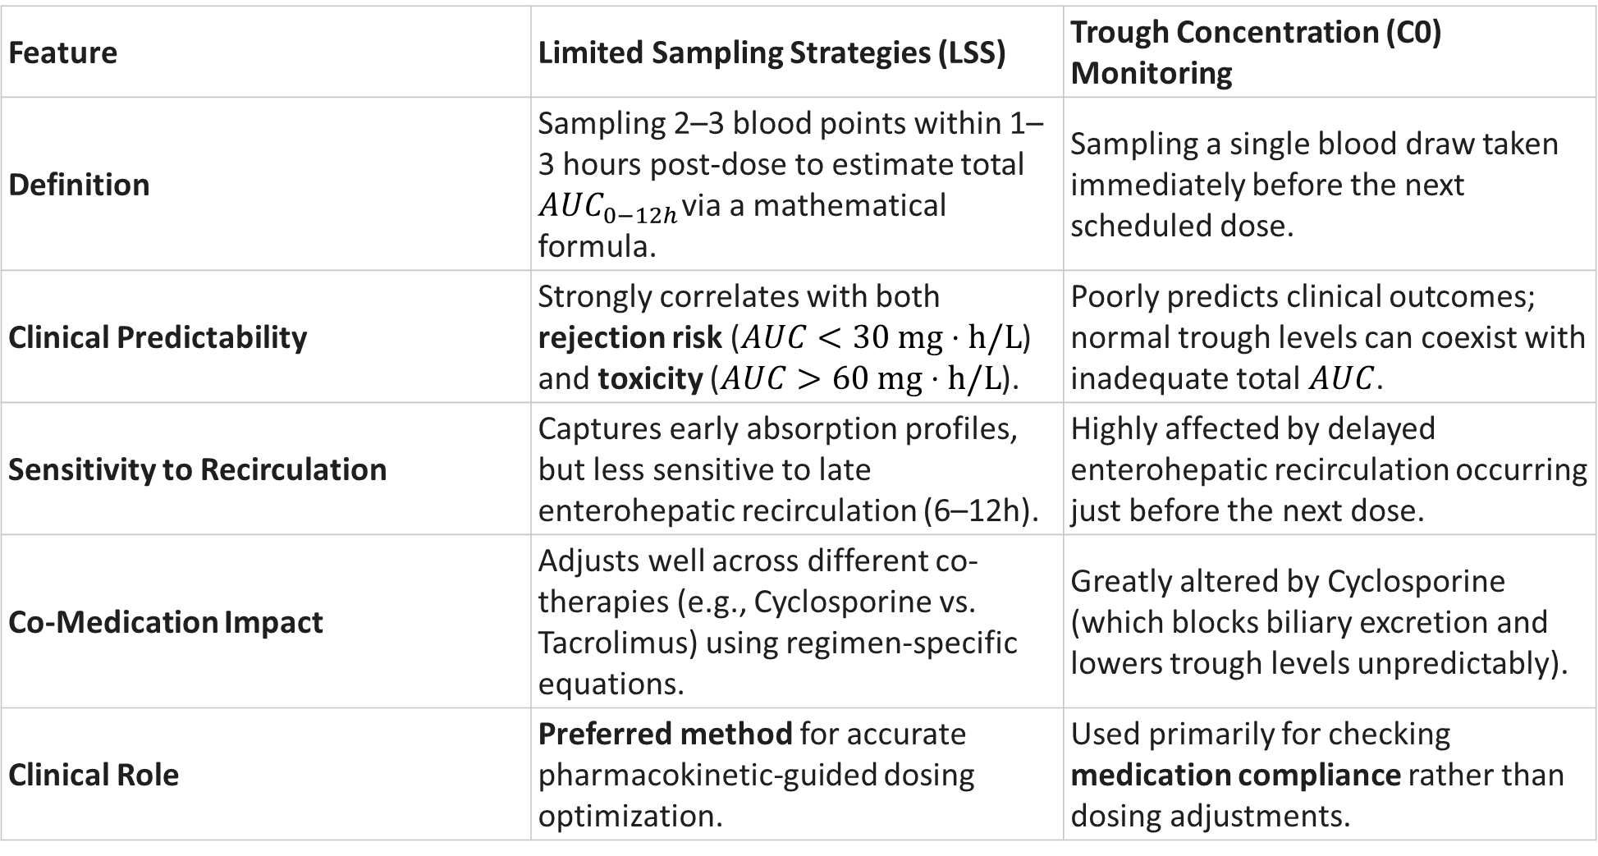
Monitoring Strategies in Practice
Feature | Limited Sampling Strategies (LSS) | Trough Concentration (C0​) Monitoring
Definition | Sampling 2–3 blood points within 1–3 hours post-dose to estimate total $AUC_{0−12h}$via a mathematical formula. | Sampling a single blood draw taken immediately before the next scheduled dose.
Clinical Predictability | Strongly correlates with both rejection risk ($AUC<30\text{ mg}⋅\text{h/L}$) and toxicity ($AUC>60\text{ mg}⋅\text{h/L}$). | Poorly predicts clinical outcomes; normal trough levels can coexist with inadequate total $AUC$.
Sensitivity to Recirculation | Captures early absorption profiles, but less sensitive to late enterohepatic recirculation (6–12h). | Highly affected by delayed enterohepatic recirculation occurring just before the next dose.
Co-Medication Impact | Adjusts well across different co-therapies (e.g., Cyclosporine vs. Tacrolimus) using regimen-specific equations. | Greatly altered by Cyclosporine (which blocks biliary excretion and lowers trough levels unpredictably).
Clinical Role | Preferred method for accurate pharmacokinetic-guided dosing optimization. | Used primarily for checking medication compliance rather than dosing adjustments.

Slide 9





Post-Transplant TDM Protocol
Month 6+: Maintenance
Week 2: First TDM
Targeted TDM during CNI reduction/withdrawal, unexplained graft dysfunction, or toxicity.
Perform LSS Bayesian AUC or C0 . Adjust dose if AUC < 30 mg·h/L or C0 < 1.6mg/L
Week 1: Initiate
Month 1–3: Re-assess
Start MMF 1000 mg BID. High clearance phase. Monitor renal function and albumin closely.
Repeat TDM as GFR improves and corticosteroid taper occurs. Target AUC 30–60 mg·h/L.
Ref: van Gelder T. Am J Transplant. 2009;9:1495-1499. Borrows R et al. Am J Transplant. 2006;6:122-131.

Slide 10

Seminar Summary & Takeaway
"Fixed-dose MMF results in up to 10-fold variability in drug exposure among kidney transplant recipients. Therapeutic Drug Monitoring targeting an MPA AUC of 30–60 mg·h/L bridges the gap between efficacy and safety—maximizing graft survival while minimizing toxicity."

Slide 11
Thank you

