Slide 1
Methotrexate-induced
Hematological Toxicities
Presented by: Gring Kadir Mustafa
(master’s student / pharmacology and toxicology)

Slide 2
Methotrexate (MTX)
Methotrexate (4-amino-4-deoxy-10-methylpteroyl-L-glutamic acid), is also known as amethopterin
synthetic analogue of folic acid and belongs to the class of antifolate antimetabolites.
It was developed in the early 1950s as a more stable and less toxic derivative of aminopterin.
MTX is structurally similar to folic acid, differs at two molecular sites and differs from aminopterin only by the addition of a methyl group at the N¹⁰ position.

Slide 3
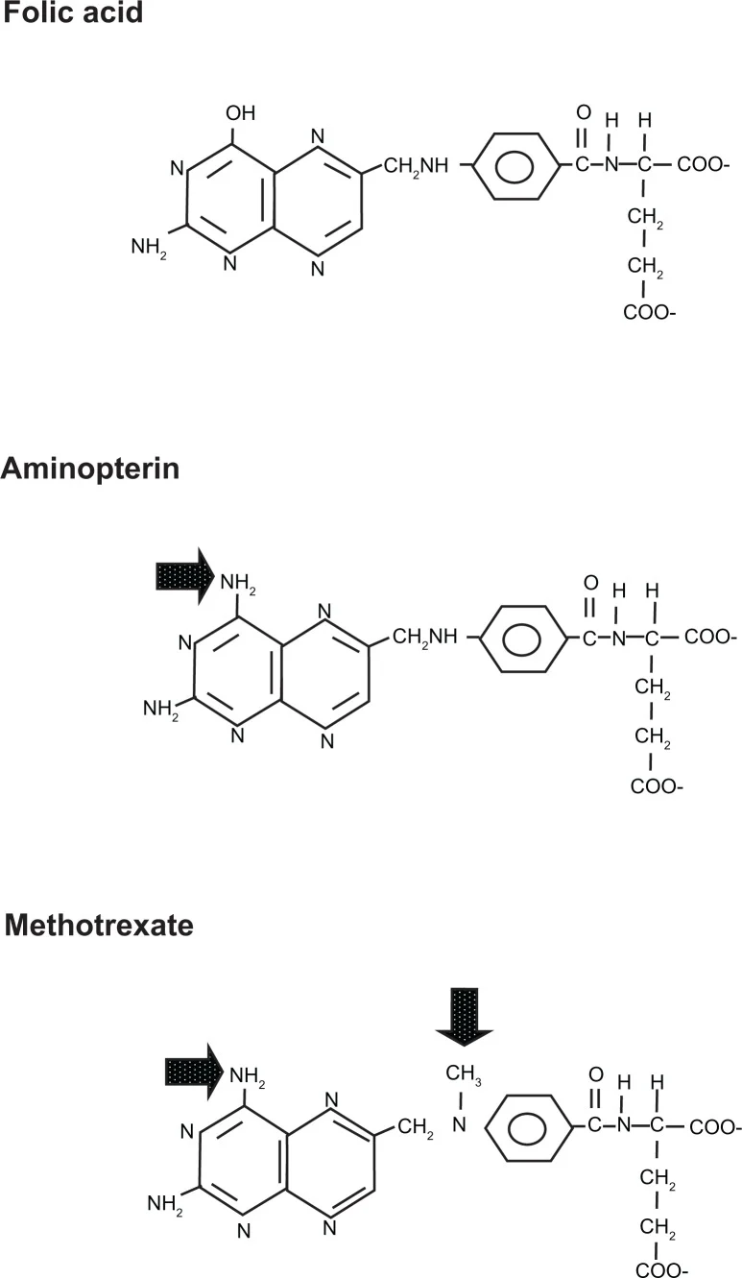

Slide 4
It was first successfully used to induce remission in childhood acute lymphoblastic leukemia (ALL)
In1971, the U.S. Food and Drug Administration officially approved MTX for the treatment of severe psoriasis, and later for rheumatoid arthritis (RA) in the late 1980s.
Today, MTX is used across oncology, rheumatology, dermatology, and gynecology (for medical abortion), making it one of the most versatile medications in clinical medicine.

Slide 5
Pharmacokinetics
MTX can be administered via oral, subcutaneous, intramuscular, intravenous, and intrathecal routes.
Its absorption is dose-dependent, mediated by the saturable transporter reduced folate carrier 1 (RFC1).
At doses greater than 15 mg, absorption becomes increasingly variable due to saturation of this carrier, and at the high doses used in oncology (>1 g/m²), the oral bioavailability declines substantially.

Slide 6
In the circulation, approximately 50% of MTX is bound to plasma proteins. MTX distributes poorly into the cerebrospinal fluid (CSF). Achieving cytocidal concentrations in the CNS requires either high-dose IV administration or direct intrathecal injection
MTX undergoes two critical types of metabolism: intracellular and hepatic: It is converted intracellularly by folylpolyglutamate synthetase into MTX-polyglutamates which have prolonged half-life, and in liver it is converted by aldehyde oxidase into 7-OH-MTX.
MTX is primarily eliminated via the kidneys, more than 80% of the drug is excreted unchanged in urine. A smaller fraction undergoes biliary excretion and enterohepatic recirculation.

Slide 7
Mechanism of Action
MTX competitively inhibit DHFR enzyme , preventing the reduction of DHF to THF.
THF is essential for nucleotide synthesis such as purine and thymidylate that are needed for DNA & RNA synthesis.
The depletion of purines and thymidylate halts DNA synthesis.
Rapidly proliferating cells, particularly hematopoietic progenitor cells in bone marrow are susceptible to this S-phase arrest and subsequent apoptosis.

Slide 8
Adverse Effects and Toxicities
Gastrointestinal Toxicity
Hepatotoxicity
Neurologic Toxicity
Urogenital Toxicity
Pulmonary Toxicity
Renal Toxicity
Hematologic Toxicity
Death: Cases of death to due to severe adverse effects have been reported , especially associated with severe cytopenia , infection and pneumonitis .

Slide 9
Hematologic Toxicity
Myelosuppression is one of the most clinically significant toxicities of MTX.
It is acute and life-threatening toxicity that characterized by sudden pancytopenia, requiring aggressive, time-sensitive rescue protocols to prevent fatal opportunistic infections or hemorrhage.
At high doses used in oncology, MTX causes profound bone marrow depression through inhibition of DNA synthesis in rapidly dividing hematopoietic precursor cells.
However, even at low doses used for RA and psoriasis, significant myelosuppression can occur, particularly with risk factors.

Slide 10
Hematologic Manifestations
Neutropenia & Leukopenia
The most common and life-threatening hematologic toxicity.
Neutrophils have a short half-life (6-8 hours in blood). Suppression of precursors leads to rapid drop in absolute neutrophil count (ANC) drops.(< 500/μL).
Patients face severe risk of opportunistic infections, sepsis, and febrile neutropenia, often requiring immediate broad-spectrum antibiotics.

Slide 11
Thrombocytopenia: Megakaryocyte suppression results in platelet depletion, risking mucosal petechiae or catastrophic internal hemorrhage.
Anemia: Often presents as megaloblastic macrocytic anemia , due to impaired DNA synthesis but intact RNA/protein synthesis in RBC precursors. It leads to large, structurally abnormal red blood cells (Elevated MCV).
Pancytopenia: The simultaneous failure of all three myeloid lineages (WBCs, RBCs, Platelets) indicating complete marrow aplasia.

Slide 12
Critical Patient Risk Factors
Renal Impairment: Because MTX is 80-90% renally excreted unchanged, even mild Acute Kidney Injury (AKI) or CKD dramatically prolongs exposure, shifting normal dosing into toxic ranges.
Hypoalbuminemia: MTX is ~50% bound to serum albumin. Low albumin levels (common in chronic inflammation or malnutrition) increase the unbound, pharmacologically active fraction of the drug.
Advanced Age: Older adults naturally have decreased eGFR (often masked by normal serum creatinine) and reduced bone marrow reserve, heightening susceptibility.
Folate Deficiency: Failure to prescribe supplemental folic acid (typically 5-10 mg/week) with low-dose oral MTX regimens is a major preventable cause of cytopenias.
Dosing errors: Accidental daily ingestion instead of the prescribed once-weekly dose for autoimmune conditions.

Slide 13
High-Risk Pharmacologic Interactions
NSAIDs & Salicylates: significantly delay MTX excretion and causing acute marrow toxicity.
Trimethoprim-Sulfamethoxazole (Bactrim): Causes synergistic marrow toxicity. Trimethoprim is a weak DHFR inhibitor, while sulfamethoxazole displaces MTX from albumin and inhibits its renal excretion.
Co-administration can be fatal!
Proton Pump Inhibitors (PPIs): decrease MTX elimination and prolonging plasma levels, particularly in High-Dose MTX protocols.
Penicillins & Probenecid: Directly compete for the same transporters in the renal proximal tubule, leading to sharp reductions in MTX clearance and subsequent bone marrow accumulation.

Slide 14
Monitoring Guidelines
CBC: baseline, then periodically
Renal Function: baseline & with dose changes
Liver Function: alongside CBC

Slide 15
Management & Treatment
Discontinuation: Immediately hold or discontinue methotrexate.
Antidote Therapy: Administer leucovorin (folinic acid) rescue
Supportive Care: Provide blood or platelet transfusions, intravenous hydration, and broad-spectrum antibiotics if fever or infection occurs.
Growth Factors: Granulocyte colony-stimulating factors (G-CSF like filgrastim) may be used to accelerate white blood cell recovery.

Slide 16
First-Line Rescue: Leucovorin
Leucovorin (Folinic Acid or 5-formyl-THF) is an active derivative of folic acid that does not require the enzyme DHFR for its conversion.
Administering Leucovorin directly resupplies the intracellular pools of active folate, immediately resuming purine and thymidylate synthesis in healthy bone marrow precursors.
Crucial Timing: For High-Dose MTX, rescue must begin within 24-42 hours of infusion. Delaying rescue beyond 48-72 hours leads to irreversible cellular damage and profound toxicity regardless of the Leucovorin dose applied.

Slide 17
Advanced Management Strategies
Glucarpidase (Voraxaze)
A recombinant bacterial enzyme (carboxypeptidase G2) that rapidly cleaves extracellular MTX into inactive metabolites (DAMPA and glutamate).
It is Used in cases of delayed MTX clearance due to acute renal failure. It can reduce plasma MTX levels by >97% within 15 minutes.
Note: (Leucovorin is a substrate for Glucarpidase and should not be administered within 2 hours before or after the enzyme).

Slide 18
Advanced Management Strategies
Hematopoietic Support
Growth Factors: Granulocyte colony-stimulating factor (G-CSF/Filgrastim) is deployed to accelerate neutrophil recovery during severe neutropenia. (ANC < 500/μL).
Transfusions: Packed RBCs for symptomatic anemia and platelet transfusions for bleeding or prophylactic triggers. (Plt < 10,000/μL).
Infection Control: Immediate initiation of empiric broad-spectrum IV antibiotics for febrile neutropenia.

Slide 19
Summary
Methotrexate-induced hematologic toxicity is a severe, life-threatening complication driven by DHFR inhibition and intracellular polyglutamation.
Prevention relies on diligent monitoring, avoiding drug interactions, and prompt execution of Leucovorin rescue protocols.

Slide 20
Thank You

