Slide 1
Spanlastics: A Smart Carrier for Nose-to-Brain Drug Delivery
حنين عبد الهادي
Department of Pharmaceutics
2026

Slide 2
Introduction
Neurological disorders are major causes of global disability and are the second leading cause of death after cardiovascular diseases.
Efficient drug delivery across the blood–brain barrier (BBB) remains a significant obstacle in treating central nervous system (CNS) disorders.
these barriers that exclude approximately 98 % of small-molecule and nearly all large molecule and therapeutics are also those that safeguard the brain’s integrity.

Slide 3
Drug molecules and therapeutic agents can be delivered to the brain non-invasively through the nasal passages via intranasal drug delivery.
the intranasal cavity has two different routes for drug delivery, the olfactory and trigeminal pathways, allowing for immediate access to the brain.
The olfactory system is the sole portion of the body where the central nervous system (CNS) has direct touch with the outside world.
Olfactory and trigeminal nerve routes are particularly effective at transporting active compounds from the olfactory region to the brain.

Slide 4
Intranasal route provides an excellent site for rapid absorption of centrally acting drugs.
In addition, nasal application circumvents first-pass elimination, degradation and irritation in GIT, and may be employed routinely without any pain.
It is noninvasive, it reduce the risk of infection compared to IV administration.
Nanoparticles have been considered as suitable carriers for maximizing the brain targeting potential of many CNS active drugs such as spanlastics.

Slide 5
Spanlastics
Novel drug delivery system called spanlastic which combines vesicular and nanoparticulate characteristics.
The name "Spanlastic" is derived from "span add to elastic," in which the hydrophobic or hydrophilic medication can be contained in the outer lipid layer or inner hydrophilic core, respectively.
Spanlastics are surfactant-dependent, malleable nanocarriers. Most spanlastics consist of edge activator (EAs) and non-ionic surfactants.

Slide 6
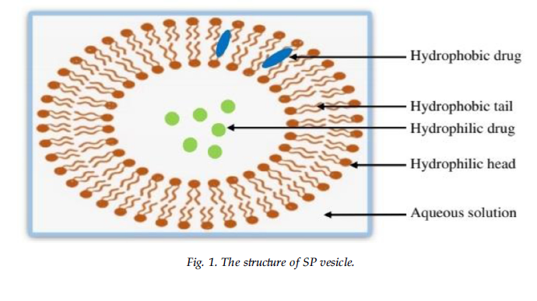

Slide 7
EAs destabilize the nanocarriers’ vesicular membranes by squeezing through various biological layer pores without breaking, increasing their permeability and flexibility across biological membranes.
The EA is single chain surfactant which are hydrophilic wetting agent, like tweens, polyvinyl alcohol, and Brij.
which can reduce interfacial tension to stabilize vesicular bilayer, thus promote spanlastics elasticity and flexibilty leading to easy of vesicles deformation which can help penetration through skin layers

Slide 8
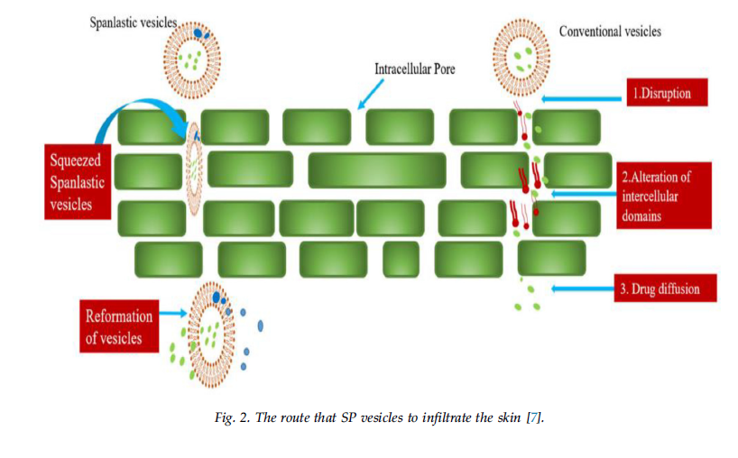

Slide 9
Non-ionic surfactants are widely utilized as wetting agents while making vesicles due to their many advantages.
Compared to anionic, amphoteric, or cationic surfactants, they offer better stability, compatibility, and less toxicity.
The fact that nonionic surfactants have both polar and non-polar portions contributes to their high interfacial activity.
Non-ionic surfactant used such as span 40 , span 60 and span 80 .
The mostly used non ionic surfactant is span 60 (HLB value 4.7) which exhibit more stability, likely to be less disturbed and aggregated than those based primarily on span 80 (HLB value 4.3).

Slide 10
SLs can be used to deliver both hydrophilic and hydrophobic drugs which are encapsulated in interior hydrophiliccompartment and outer lipid layer, respectively.
They are structurally similar to traditional liposomes but are more chemically stable.
Spanlastics or modified niosome, are biodegradable, nonimmunogenic, flexible, and deformable walled nano-vesicular systems that differ from ordinary niosomes in that they only contain nonionic surfactants.

Slide 11
Characteristics of Spanlastics Nanovesicles
1.Targeted drug delivery: Spanlastics serve as drug delivery systems that target specific body areas precisely.
2.Flexibility: These vesicular carriers are adaptable and capable of delivering hydrophilic andlipophilic drugs.
3.Improved drug effectiveness: By enhancing drug stability and bioavailability while reducing degradation rates, Spanlastics improve drug efficacy
4.Wide range of applications: Spanlastics help deliver drugs to various body parts, including the brain ,eyes, mouth, skin, nose, and nails.

Slide 12
Preparation of SPs vesicles
There are several methods used in preparation :
1_Ethanol injection method
2_Thin-film hydration method
4_Hand shaking method
5_Extrusion method

Slide 13
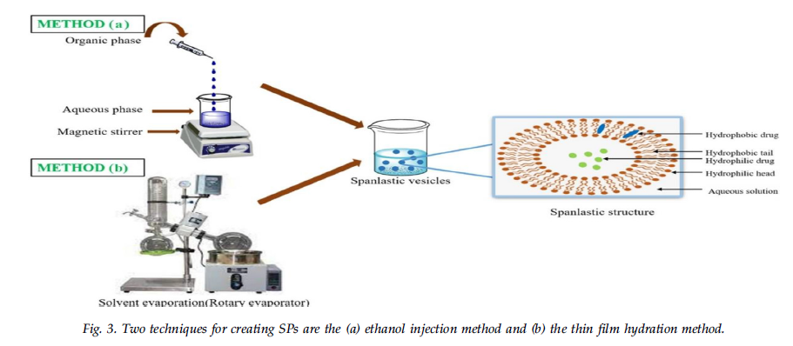

Slide 14
Applications of SPs as carrier for drug delivery
Numerous studies have shown that SPs have the potential to significantly improve therapeutic efficacy, increase drug bioavailability, promote patient compliance, and decrease adverse effects.
Example Drugs:
1.Rasagiline used to treat Parkinson's disease.
2. Zolmitriptan used to treat Migraine.
3. Celecoxib used for their anti-Inflammatory effect.
And several others

Slide 15
Conclusion
The development of the nose-to-brain route professes to be a promising technique to bypass the blood-brain barrier (BBB) and directly transport medicinal compounds to the brain.
Nanovasicular systems like Spanlastics, can be recruited for the nose to the brain drug delivery system.
They prevent first-pass metabolism and address the problems associated with the limited brain bioavailability of medicines.
By using these vesicular systems, lipophilic and hydrophilic medications can provide site-specific effects.

Slide 16


