Slide 1


Possible Nephroprotective Effects of TND1128 in comparison to Lutein against Daunorubicin-induced Nephrotoxicity in Male Rats
Aysha Husam Khudair
College of Pharmacy / University of Baghdad

Slide 2
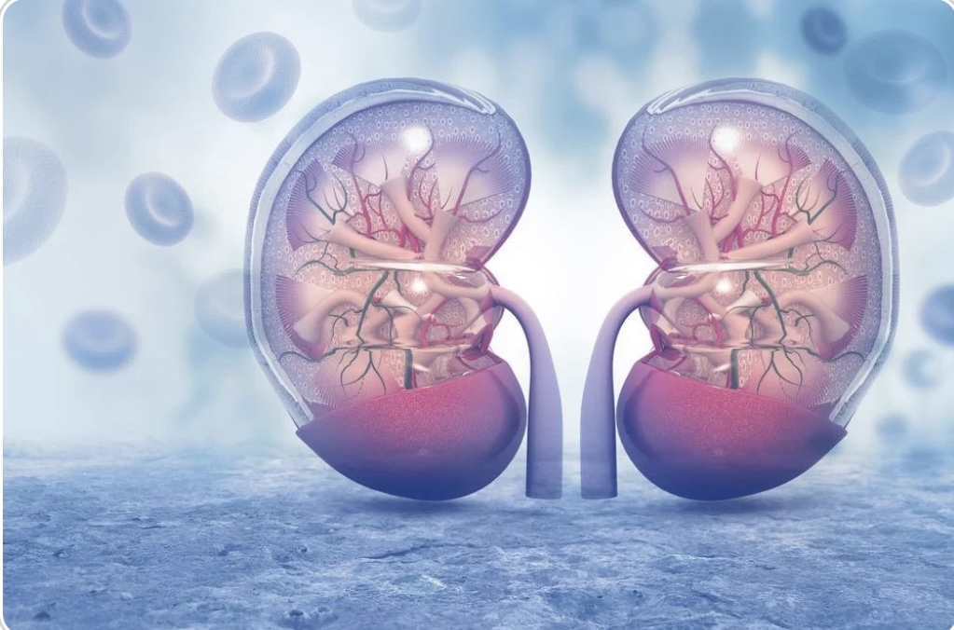
Introduction
Daunorubicin is an effective anthracycline anticancer drug.
Its use is limited by nephrotoxicity.
Oxidative stress and mitochondrial injury are major mechanisms.
Nephroprotective strategies are needed.

Slide 3
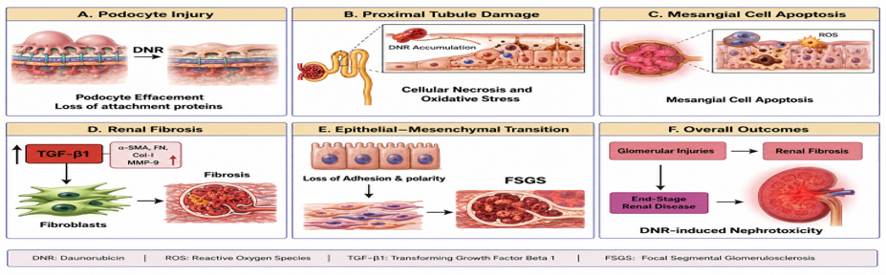
DNR Nephrotoxicity
ROS generation
Oxidative stress
Mitochondrial dysfunction
Inflammation
NAD+ depletion
Apoptosis
Autophagy dysregulation

Slide 4
Oxidative Stress & Mitochondria
Lipid peroxidation
DNA and protein damage
ETC impairment
ATP depletion
Cytochrome c release

Slide 5
Inflammation & NAD+
NF-κB activation
IL‑6 and TNF‑α increase
PARP‑1 activation
NAD+ depletion
Energetic failure

Slide 6
TND1128 as a Potential Nephroprotective Agent
5‑deazaflavin derivative
Preserves NAD+
Stabilizes mitochondria
Reduces ROS
Improves cellular survival

Slide 7
Lutein as a Reference Nephroprotective Agent
Natural carotenoid
Antioxidant activity
Anti-inflammatory effect
Anti-apoptotic effect
Enhances GSH

Slide 8
Aim of Study
Investigate and compare the nephroprotective effects of TND1128 and Lutein against Daunorubicin-induced nephrotoxicity in rats.

Slide 9
Experimental Design
36 Male Rats
6 Groups (n=6)
Negative Control
Positive Control (DNR)
TND1128
Lutein
TND1128 + DNR
Lutein + DNR

Slide 10
Timeline
14 days treatment
DNR during last 3 days
Day 15: blood and kidney collection

Slide 11
Parameters Measured
ELISA: BUN, sCr, KIM‑1, GSH
qRT‑PCR: NF‑κB, IL‑6
Western Blot: Caspase‑3, Nrf2
Histopathology: H&E

Slide 12
Expected Results
↓ BUN, sCr, KIM‑1
↓ NF‑κB, IL‑6, Caspase‑3
↑ GSH, Nrf2
Improved kidney histology

Slide 13
Significance
Novel nephroprotective strategy against chemotherapy-induced AKI.

