Slide 1


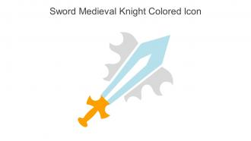
Inflammation: A double edge sword in wound healing
Prepared by
PH.D. student israa falah Hassan
Supervised by
prof. Dr. Sarmed Hashim Kathem

Slide 2
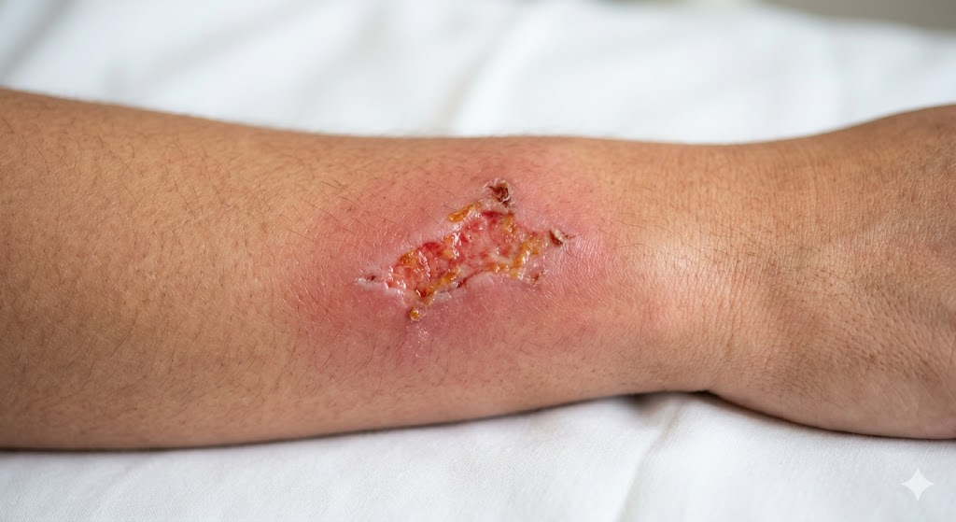
Introduction
What is Inflammation?
The body's immediate innate immue response to injury, infection, or tissue damage.
It is eliminate the initial cause of cell injury, clear out necrotic cells/damaged tissues, and initiate tissue repair.
It is a "double-edged sword" because while it is vital for survival, an uncontrolled response can cause self-inflicted damage.

Slide 3
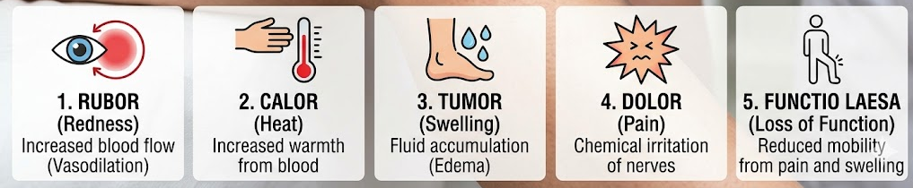
the Five Cardinal Signs (The "Pillars")
Visible indicators that inflammation is active:
Rubor (Redness): Caused by increased blood flow to the site.
Calor (Heat): Resulting from localized blood accumulation.
Tumor (Swelling): Fluid buildup (edema) as vessels become permeable.
Dolor (Pain): Chemical mediators stimulating nerve endings.
Functio Laesa (Loss of Function): Temporary impairment due to pain or swelling.

Slide 4
Edge 1 – The Protective Side (Acute Inflammation)
Recruits neutrophils and macrophages to engulf and destroy bacteria.
Limits the spread of pathogens from the injury site to the rest of the body.
Wound Preparation: Removes dead cells and debris to create a clean for new tissue growth.
Releases growth factors that trigger the proliferative phase of healing.

Slide 5
Edge 2 – The Destructive Side (Chronic or Dysregulated)
Tissue Destruction: Persistent inflammation can lead to the release of enzymes that degrade healthy extracellular matrix.
Chronic Wounds: Failed resolution of the inflammatory phase is a primary cause of non-healing ulcers (e.g., diabetic or venous ulcers).
Fibrosis & Scarring: Overactive fibroblasts can cause excessive collagen deposition , leading to keloids or internal scarring.
Systemic Risk: Severe "inflammatory storms" can cause multi-organ failure or chronic diseases like cancer

Slide 6
The Pivot Point – Macrophage Polarization
Successful healing depends on macrophages switching from a pro-inflammatory (M1) state to a reparative (M2) state.
M1 (The Warrior): Dominant in the first 1–3 days; focuses on killing bacteria and clearing debris.
M2 (The Builder): Emerges around day 4–6; focuses on collage deposition collagen, angiogenesis, and closing the wound.
In chronic wounds (like diabetic ulcers), macrophages get "stuck" in the M1 phase, leading to continuous tissue breakdown instead of building

Slide 7
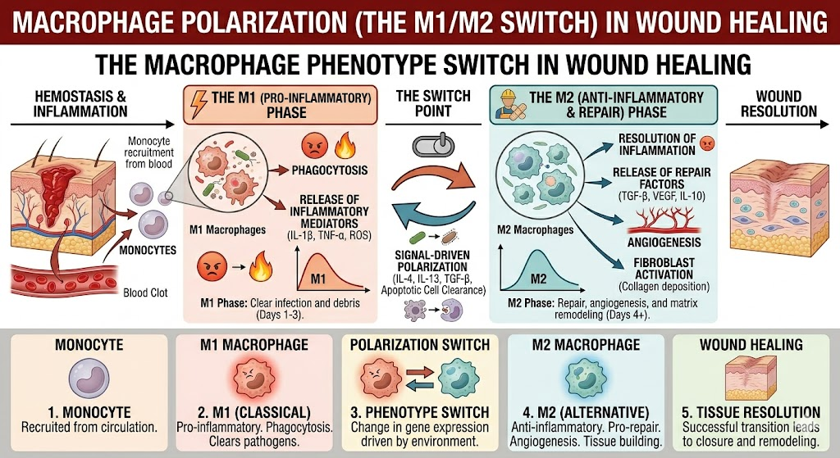

Slide 8
Factors That Dull the "Good Edge“ (Delayed Healing)
Why some wounds stay inflamed and fail to heal???
1-Biofilms: Bacteria form protective "cities" that resist the immune system and keep the wound in a perpetual state of high inflammation.
2-Hypoxia: Inflammation requires energy; without enough oxygen (due to poor circulation or diabetes), the "cleanup" cells can't function properly.
3-Hyperglycemia: High blood sugar creates oxidative stress and damages the chemical signals needed to end the inflammatory phase.
4-Protease Overload: Too much inflammation leads to an excess of enzymes (MMPs) that eat away at new tissue before it can stabilize.

Slide 9
Specialized Pro-Resolving Mediators (SPMs)
The Resolution Phase: Recent science shows that ending inflammation is an active process, not just a "fading away".
Nature's "Stop" Signal: The body produces lipoxins, resolvins, and protectins to actively "turn off" the fire.
Functions:
Stop new neutrophils from entering the wound.
Trigger "efferocytosis" (macrophages eating dead immune cells).
Stimulate tissue regeneration without suppressing the overall immune system.

Slide 10
Advanced Therapies – Sharpening the Right Edge
Modern medicine uses "immunomodulation" to guide the body back to healing:
Regenerative Biomaterials: Smart dressings and hydrogels that release growth factors or SPMs directly into the wound bed.
Stem Cell Therapy: Mesenchymal stem cells (MSCs) act as "conductors“ that signal M1 macrophages to switch to the M2 reparative state.
Negative Pressure Wound Therapy (NPWT): Uses suction to physically pull out excess inflammatory fluid and stimulate blood flow.
Hyperbaric Oxygen: Floods the tissue with oxygen to re-energize the immune cells and kill anaerobic bacteria.

Slide 11


