Slide 1


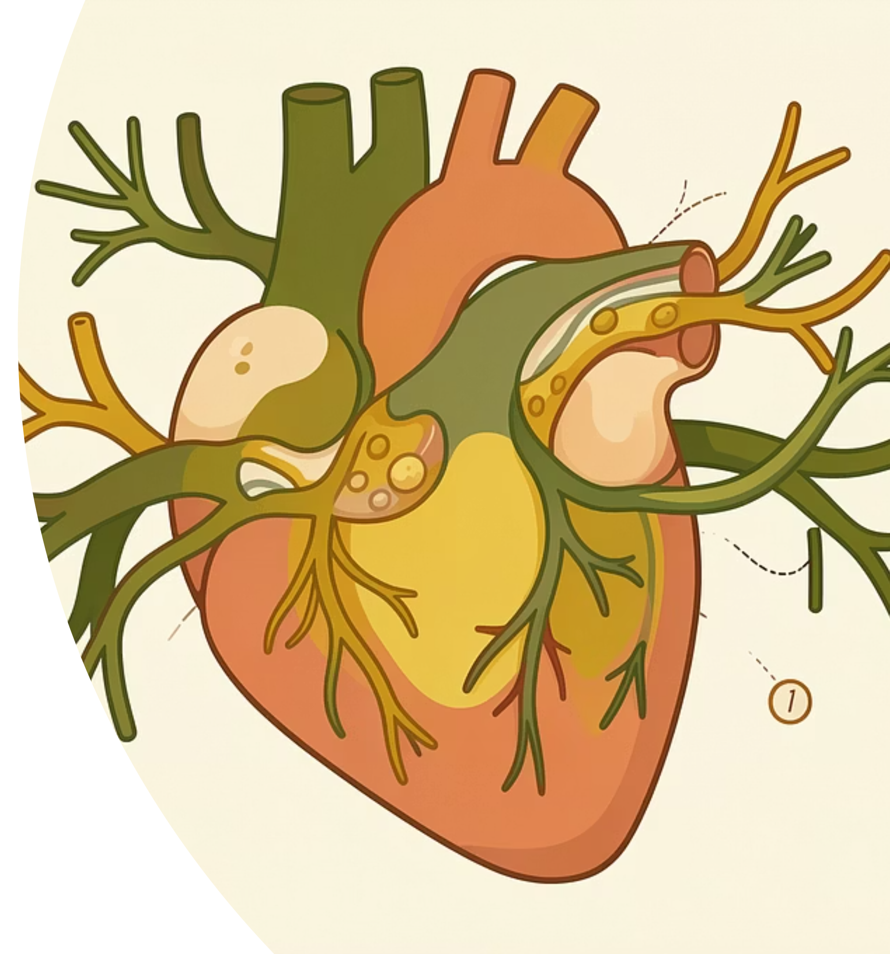
The Role of Autophagy in Myocardial Infarction
By
Hiba Zaki Hammoodi
26-4-2026

Slide 2
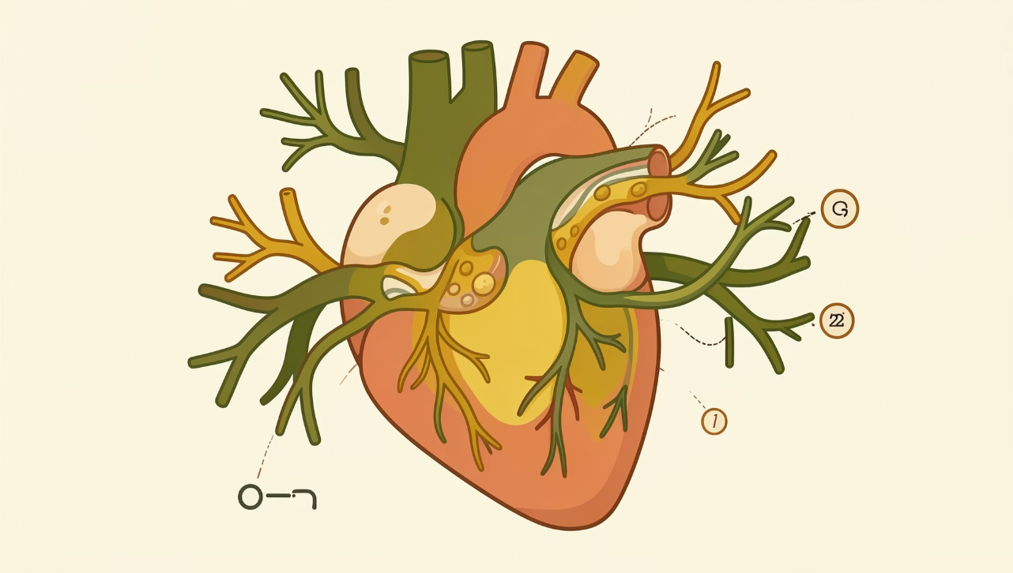
Acute Myocardial Infarction: A Global Health Crisis
Acute myocardial infarction (AMI), commonly known as acute heart attack, represents a sudden and catastrophic death of cardiomyocytes resulting from the abrupt blockade or occlusion of a major coronary artery branch. This occlusion triggers immediate ischemia and infarction of cardiac muscle cells, leading to significant mortality worldwide.
The cardiac damage in AMI arises primarily through ischemic injury and ischemia/reperfusion injury mechanisms, producing detrimental effects on both cardiomyocyte viability and overall cardiac function.

Slide 3

Types of Myocardial Infarction
Myocardial infarction (MI) is broadly categorized into distinct types based on underlying pathology, helping guide diagnosis and treatment strategies. Understanding these classifications is crucial for pinpointing the primary cause and tailoring interventions.
Type 1 MI: Spontaneous
Type 2 MI: Secondary
Other Types
This is the most common form, typically caused by the rupture or erosion of an atherosclerotic plaque in a coronary artery, leading to thrombus formation and complete occlusion, resulting in myocardial ischemia and necrosis.
Occurs due to an imbalance between myocardial oxygen supply and demand, unrelated to plaque rupture. Factors like severe anemia, arrhythmias, hypotension, or extreme hypertension can induce this type of MI.
Less common types include Type 3 (sudden cardiac death suggestive of MI), Type 4a (PCI-related MI), Type 4b (stent thrombosis-related MI), and Type 5 (CABG-related MI).

Slide 4

Cellular Mechanisms of Myocardial Injury
Calcium Dysregulation
Mitochondrial Disturbance
Increased cytosolic Ca²⁺ accumulation via inhibition of Na⁺/K⁺-ATPase
Loss of mitochondrial membrane potential
and function
Protease Activation
Structural Damage
Activation of various proteolytic enzymes
Cleavage of cytoskeletal proteins and increased membrane permeability
Under irreversible ischemic stress, these interconnected mechanisms create a cascade of cellular damage that progressively compromises cardiomyocyte integrity and function.

Slide 5
Autophagy:
Autophagy serves as a vital metabolic process activated in
response to nutrient starvation or metabolic stress, maintaining tissue homeostasis
and cellular function through continuous renewal.

Slide 6
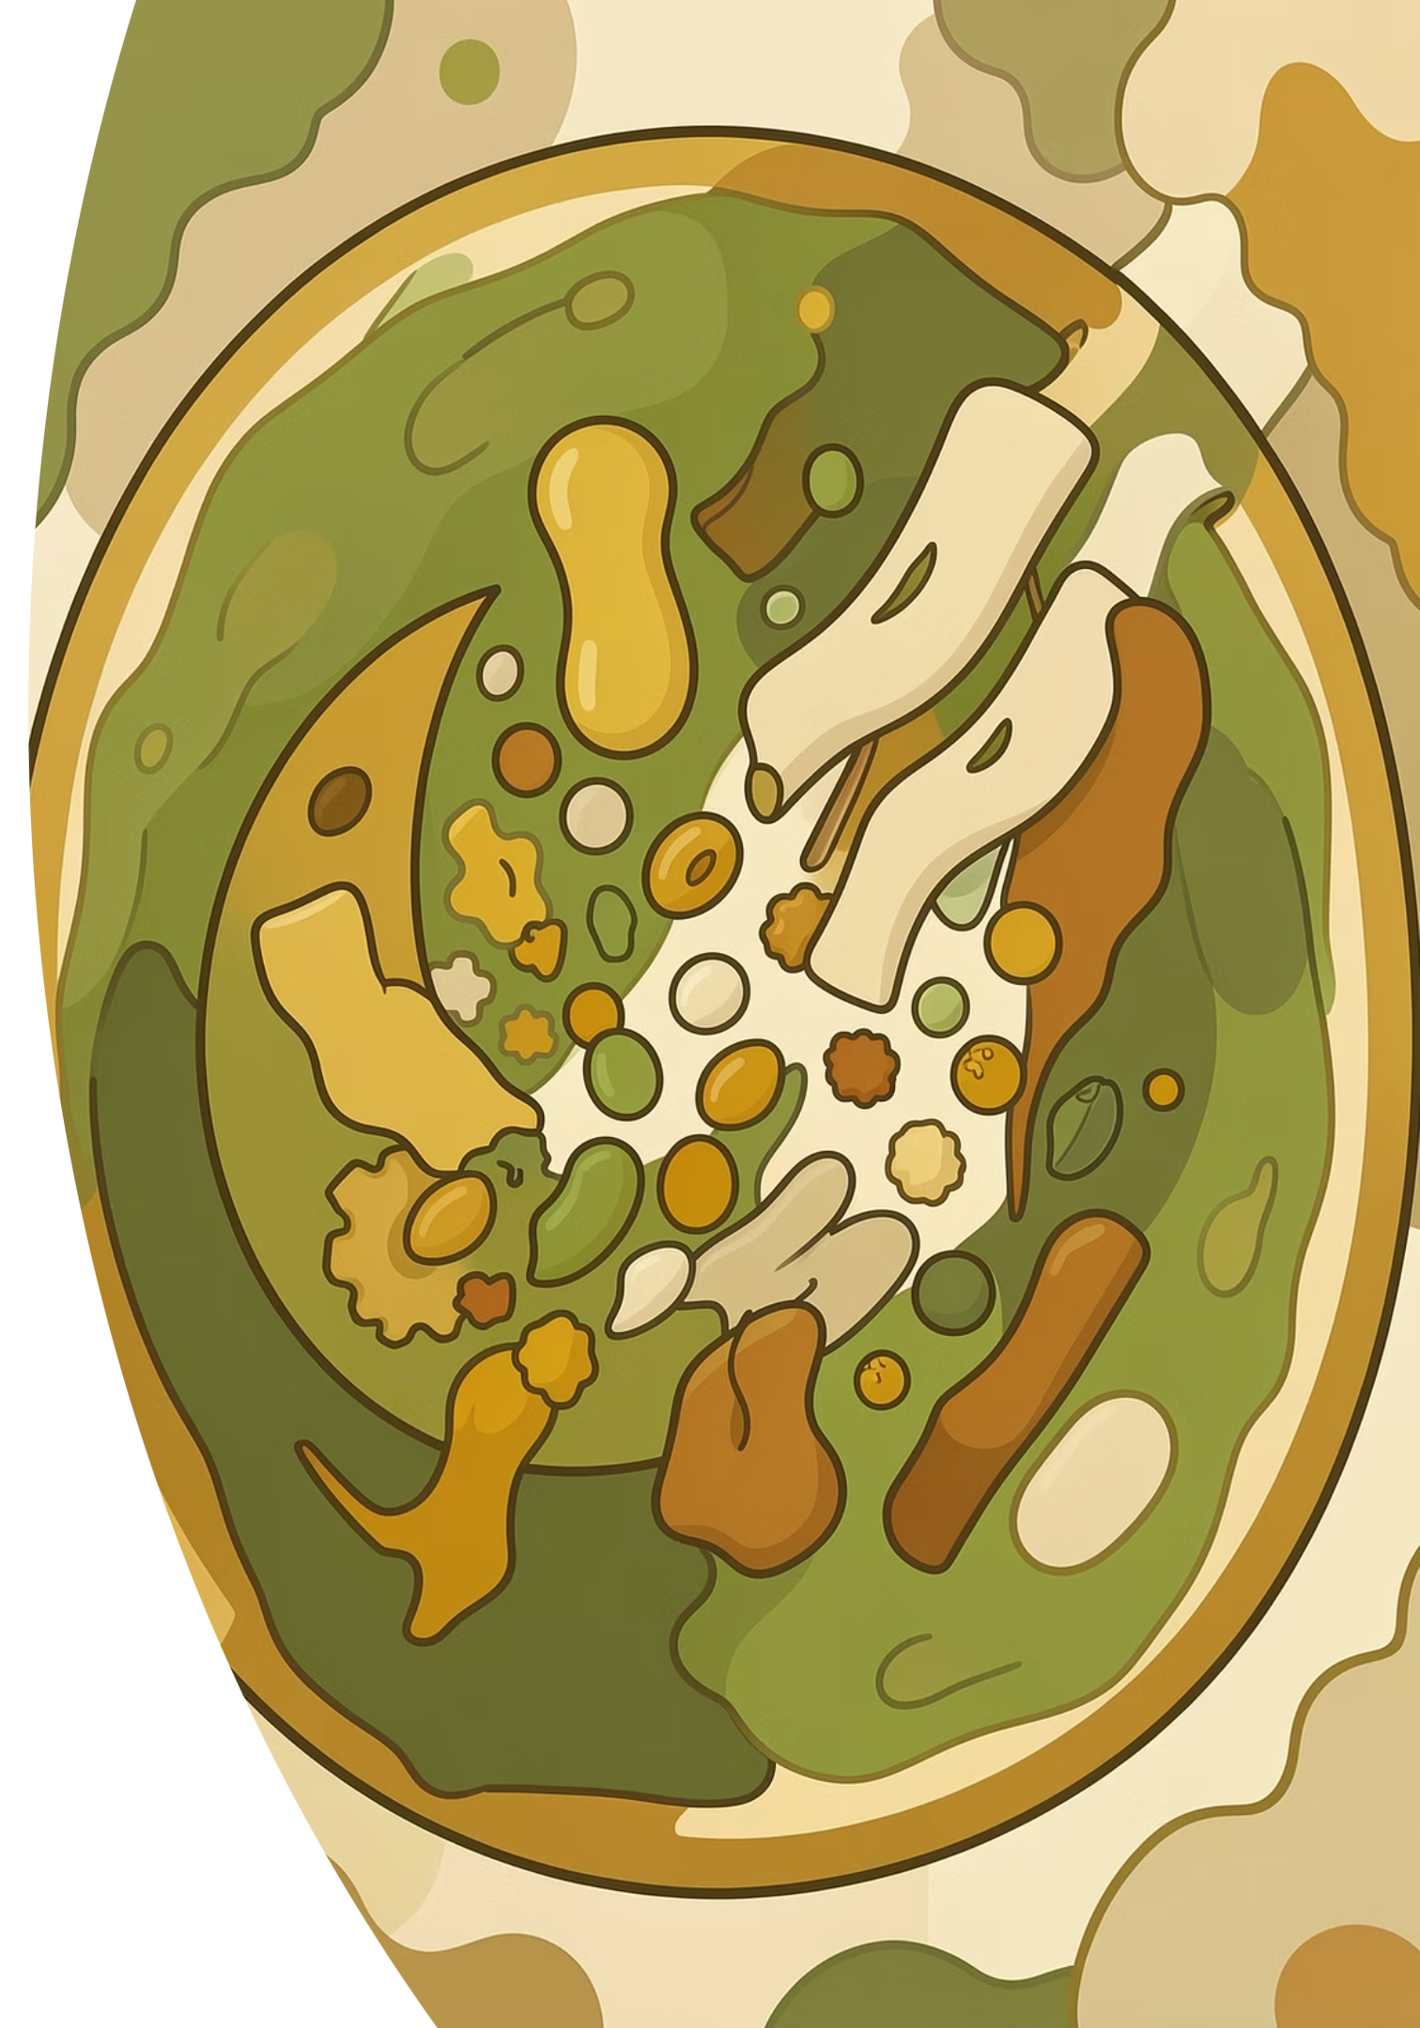
Autophagy: The Cellular Recycling System
01
Recognition & Sequestration
Damaged proteins and organelles are identified and encapsulated
02
Formation of Autophagosome
Double-membrane vesicles engulf cellular debris
03
Fusion with Lysosome
Autophagosome merges with lysosome for degradation
04
Recycling & Energy Production
Breakdown products converted to amino acids and fatty acids for reuse

Slide 7
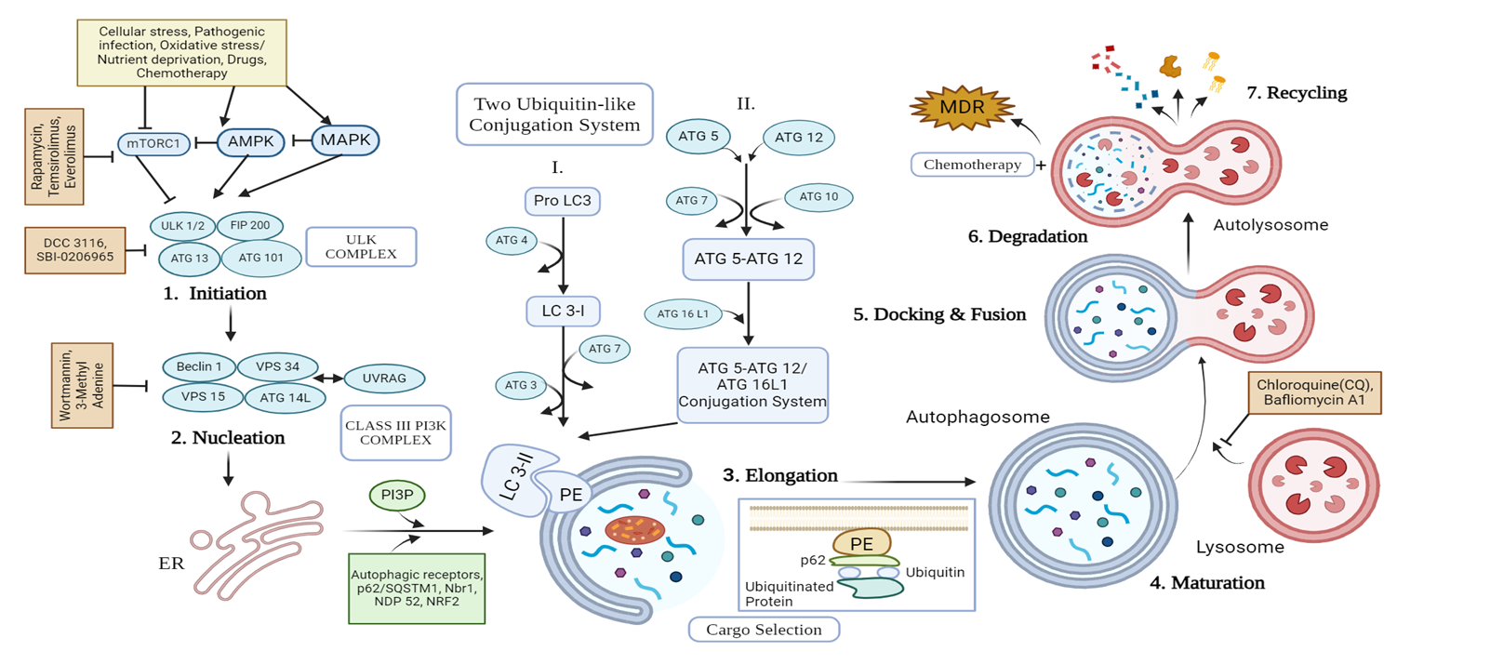
Autophagy Pathway in Cardiomyocytes
The autophagic cascade in cardiac cells involves initiation, elongation, and completion phases, with specific molecular markers including LC3-II conversion and p62 degradation that serve as indicators of autophagic flux.

Slide 8
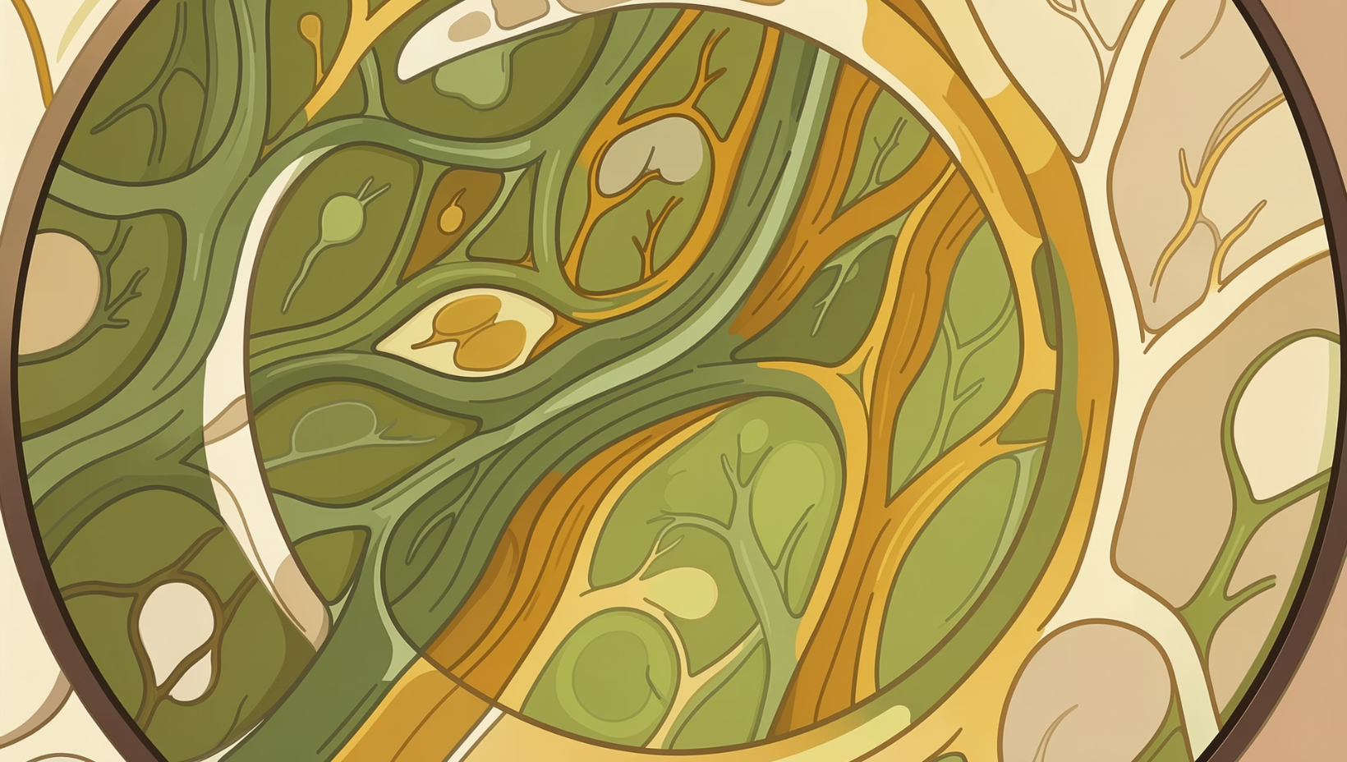

Autophagy: A Protective Response to Ischemia
Cardioprotective Effects
Protection against ischemic injury through removal of damaged components
Alleviation of ischemia/reperfusion injury through cellular cleanup
Inflammatory suppression reducing secondary damage
Maintenance of energy homeostasis during stress
However, excessive autophagy activation may produce detrimental effects during reperfusion and other stress conditions, highlighting the controversial nature of autophagy in cardiac ischemia.

Slide 9
Beneficial Effects of Autophagy in Ischemic Injury
Cellular Homeostasis Maintenance
Adaptive Response to Ischemia
Pathogenesis Prevention
Continuous degradation of long-lived proteins and damaged organelles prevents cytotoxic aggregate accumulation, preserving cellular function during stress.
Baseline and induced autophagy produce protective effects against ischemic injury through selective removal of damaged components.
Impaired autophagy contributes to heart failure progression, emphasizing its essential role in cardiac health maintenance.

Slide 10

Evidence for Cardioprotective Autophagy
Mitophagy's Role
Specialized mitochondrial autophagy maintains organelle homeostasis and provides cardioprotection during ischemic injury
Animal Model Evidence
Autophagy reduced infarct size after left anterior descending coronary artery ligation in rat models
Inhibition Studies
Bafilomycin A1 administration significantly increased infarct size, confirming autophagy's innate cardioprotective capacity
These findings establish autophagy as an innate and potent protective mechanism against ischemic injury during acute myocardial infarction.

Slide 11
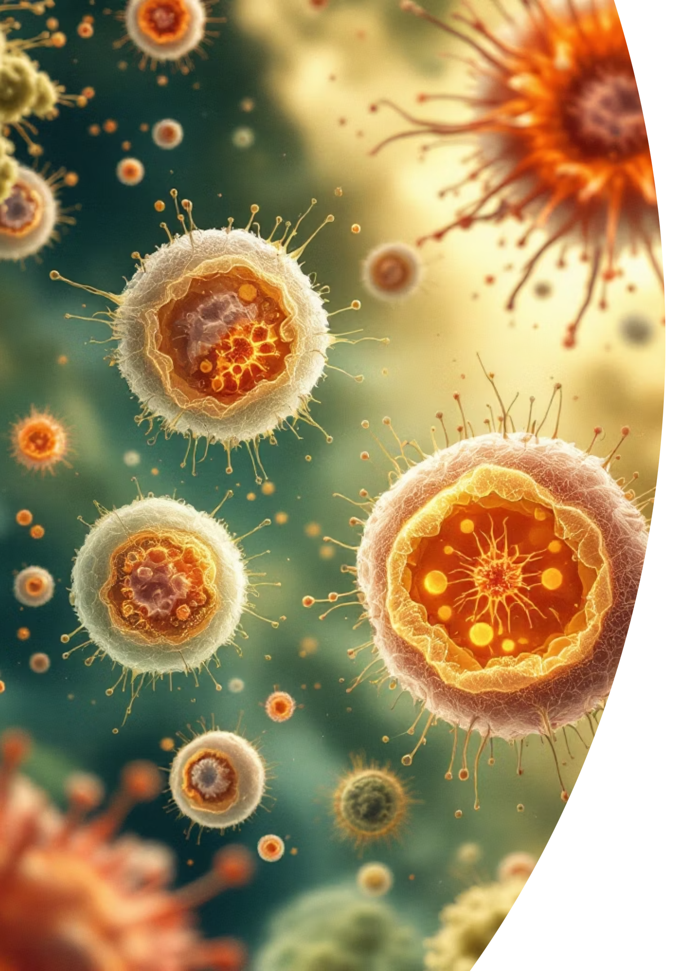
Detrimental Effect of Cardiac Autophagy in Ischemic Injury
While autophagy can be cardioprotective, severe ischemic conditions can lead to an overwhelming induction of this process. This excessive autophagy has been reported to paradoxically promote cardiomyocyte cell death, exacerbating myocardial damage and ultimately worsening overall cardiac performance. This delicate balance underscores the complexity of autophagy's role in cardiac pathology.

Slide 12


Autophagy: A Double-Edged Sword
Ischemia Phase
Reperfusion Phase
Autophagy provides essential survival mechanisms during nutrient deprivation and oxygen shortage
Excessive autophagy contributes to cell death during re-oxygenation and restoration of blood flow
This dual role necessitates precise therapeutic targeting to harness protective autophagy while preventing excessive activation during different phases of myocardial infarction.

Slide 13
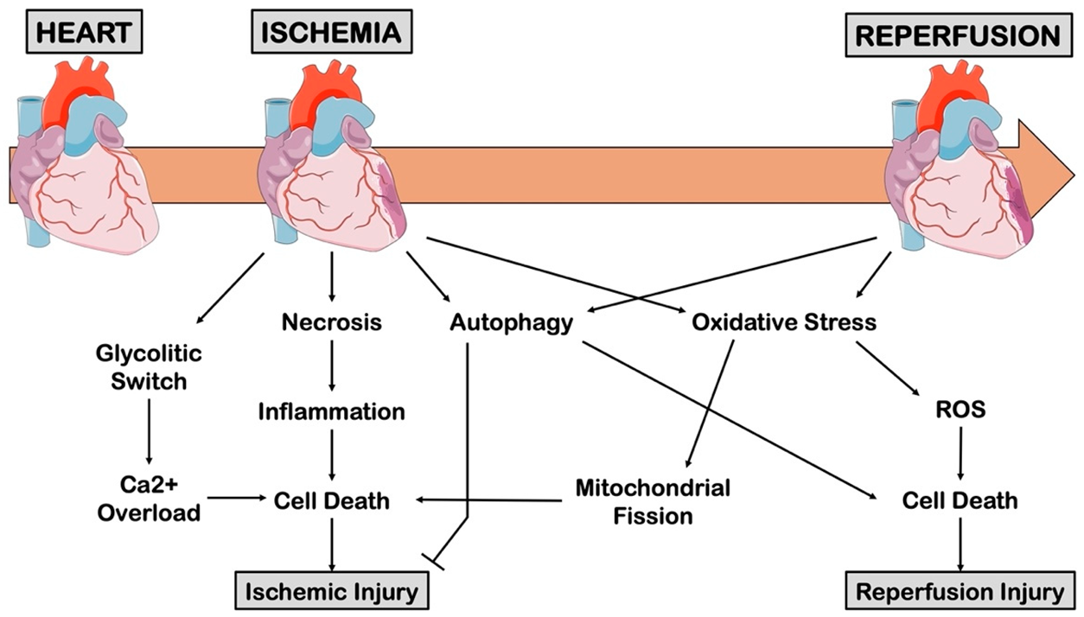
Phases of Autophagy in Myocardial Infarction
1
Baseline
Constitutive autophagy maintains cellular homeostasis
2
Ischemia
Adaptive autophagy induction provides protection
3
Reperfusion
Excessive autophagy may cause damage
4
Recovery
Restoration of balanced autophagy

Slide 14
Targeting Autophagy: A Phase-Specific Strategy
Controlling autophagy to maximize benefit involves a temporal approach, precisely timed to the specific phases of myocardial infarction. Stimulating autophagy during the early ischemic phase can prevent cell death, while inhibiting its excess during the late reperfusion phase helps prevent "autophagic death" (autosis).
Ischemia (Early)
1
Action: Induce Autophagy
Goal: Cell Survival
Interventions: Metformin, Rapamycin, Berberine
2
Reperfusion (Late)
Action: Inhibit Excess Autophagy
Goal: Prevent Autosis
Interventions: 3-MA, Bafilomycin A1, Mdivi-1

Slide 15


