Slide 1
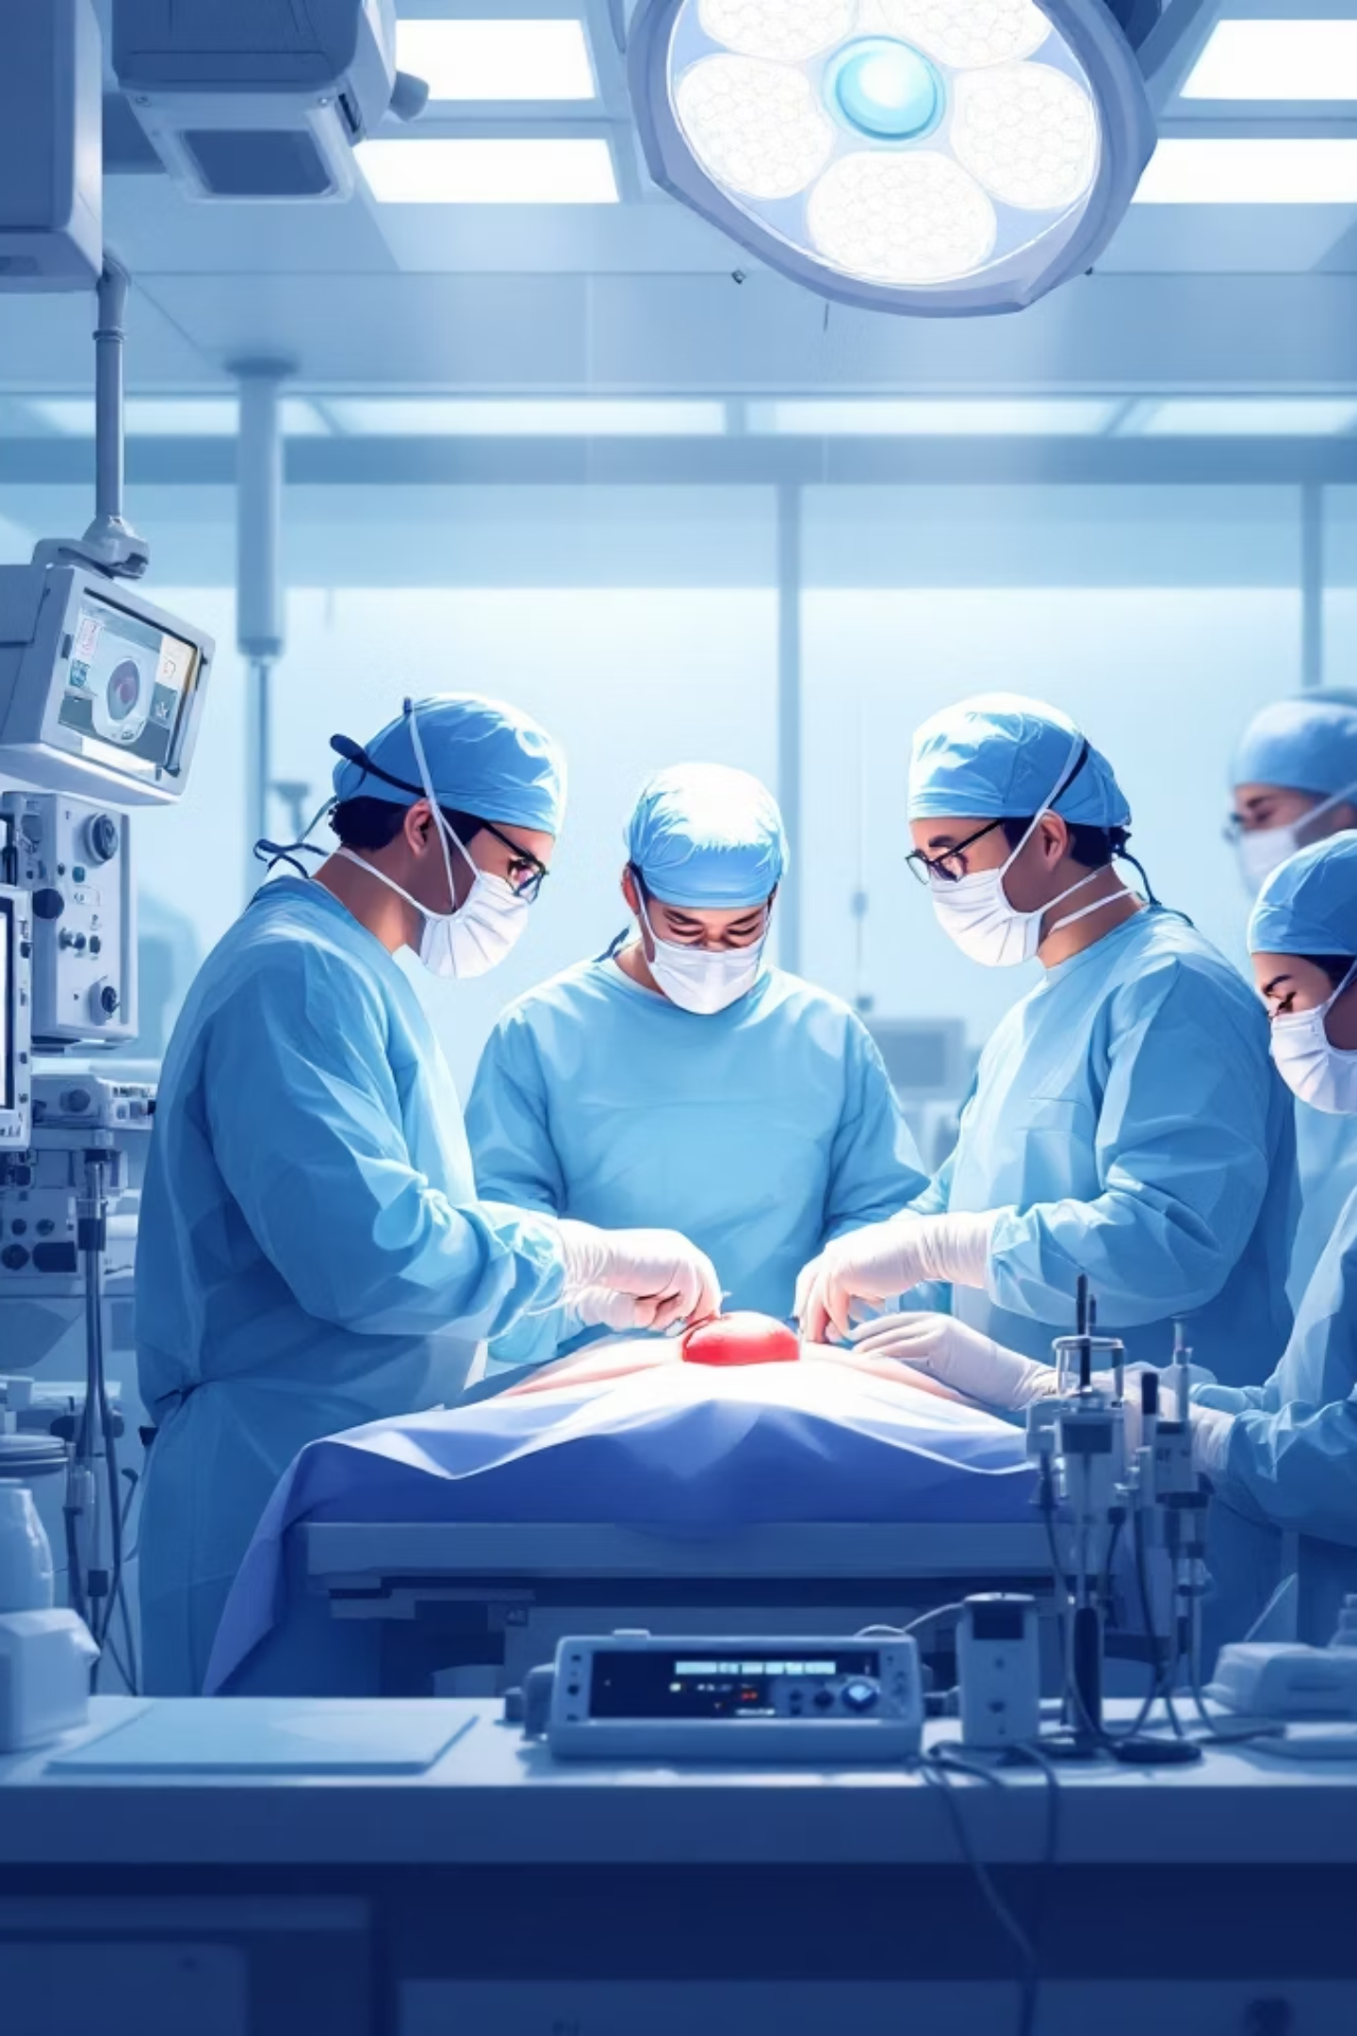
From Guidelines to Precision Medicine in Kidney Transplant Care: Current Status and Future Directions
Presented by:
Sarah Monther Faisal

Slide 2
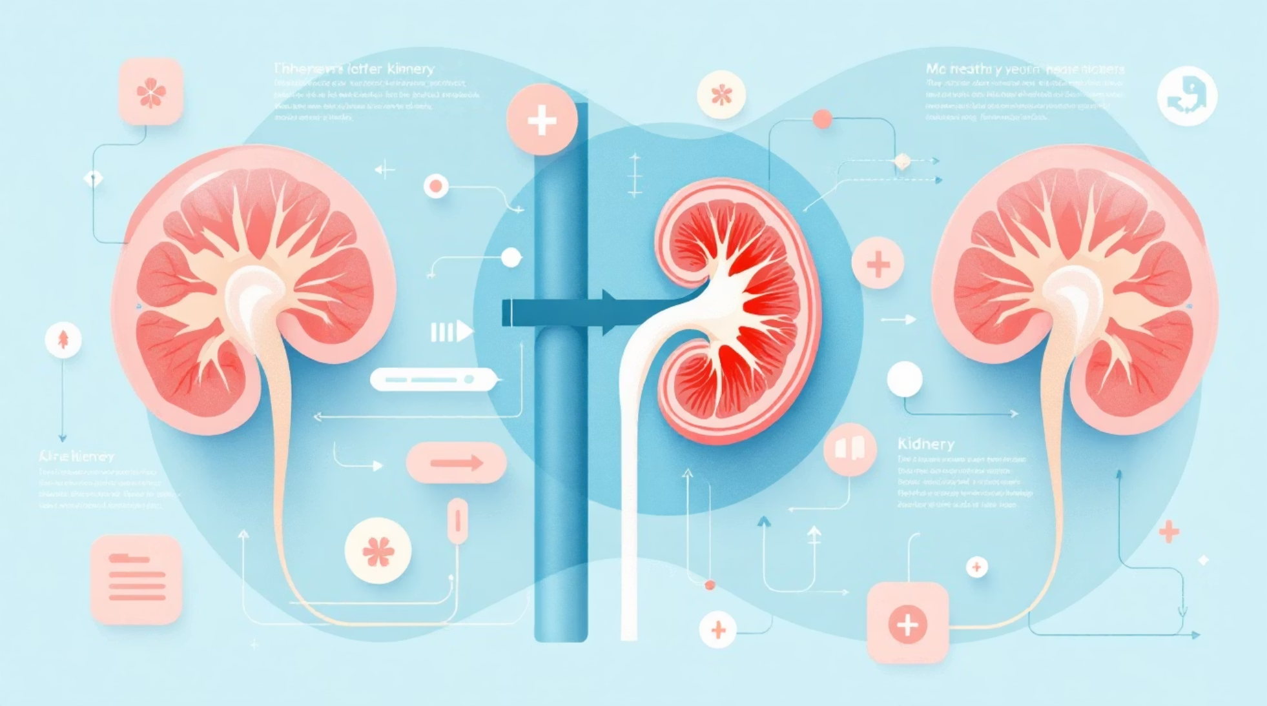
The Optimal Treatment for End-Stage Renal Disease
Kidney transplantation represents the optimal treatment for patients with end-stage renal disease, offering superior survival outcomes and quality of life compared to long-term dialysis. Over the past decades, significant advances in surgical techniques and immunosuppressive therapy have markedly improved short-term graft survival.
However, despite these improvements, long-term graft outcomes remain suboptimal, with rejection, drug toxicity, and chronic graft dysfunction continuing to pose major challenges.

Slide 3
Current Post-Transplant Care: Guideline-Driven Approaches
Current post-transplant care is largely based on standardized, guideline-driven approaches developed by leading organizations such as Kidney Disease: Improving Global Outcomes (KDIGO) and American Society of Transplantation (AST).
Standardized Protocols
Evidence-Based Recommendations
Patients are managed using fixed immunosuppressive protocols—most commonly a combination of tacrolimus, mycophenolate, and corticosteroids—along with routine clinical and laboratory monitoring.
Structured guidelines provide evidence-based recommendations for immunosuppressive regimens, monitoring strategies, and long-term follow-up.

Slide 4
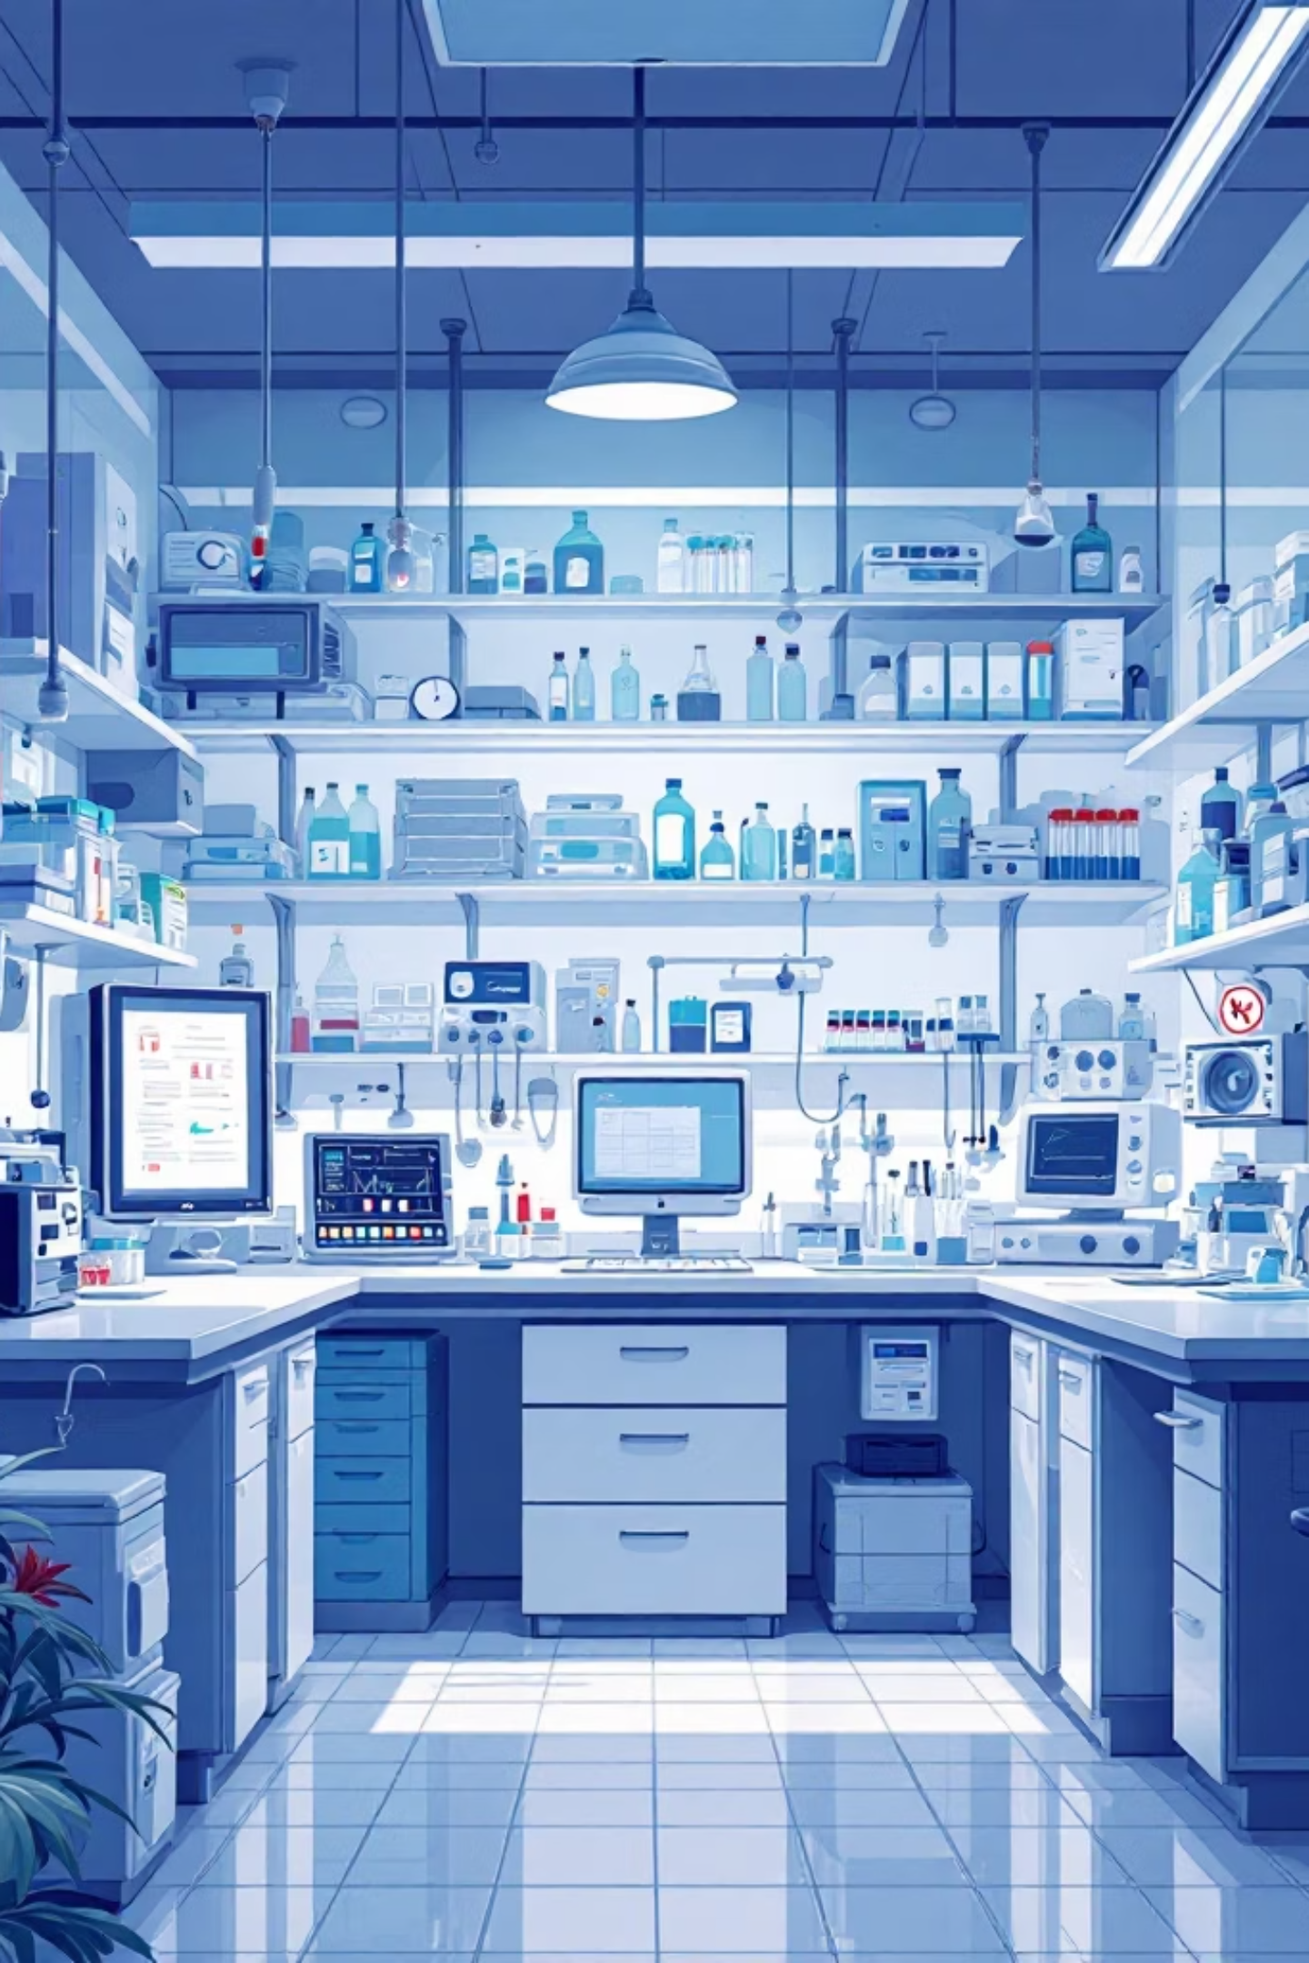
Therapeutic Drug Monitoring: A Step Toward Individualized Therapy
A key component of current practice is therapeutic drug monitoring (TDM), particularly for calcineurin inhibitors such as tacrolimus. TDM allows clinicians to adjust drug dosing based on measured blood concentrations, thereby reducing the risk of toxicity and improving efficacy.
This approach represents an important step toward individualized therapy and is widely implemented as a standard of care across transplant centers worldwide.

Slide 5
The Challenge of Inter-Individual Variability
Despite these structured approaches, significant variability in patient outcomes persists. Patients receiving similar immunosuppressive regimens often exhibit markedly different responses, including variations in drug exposure, risk of rejection, and susceptibility to adverse effects.
Pharmacokinetic Factors
Pharmacodynamic Differences
Drug absorption, metabolism, and clearance
Variability in immune response
Genetic Polymorphisms
Patient-Related Factors
Inherited genetic variations
Adherence and comorbidities
This phenomenon, known as inter-individual variability, arises from a complex interplay of these factors.

Slide 6
Limitations of Current Guideline-Based Care
The "Average Patient" Problem
Reactive Monitoring Strategies
One of the major limitations of current guideline-based care is that it is largely designed around the concept of an "average patient." While this approach ensures consistency and safety at a population level, it does not adequately account for individual variability.
Current monitoring strategies are predominantly reactive. For example, serum creatinine, a commonly used marker of graft function, often rises only after significant injury has already occurred. Similarly, TDM provides information about drug exposure but does not directly reflect the biological response of the patient's immune system.

Slide 7
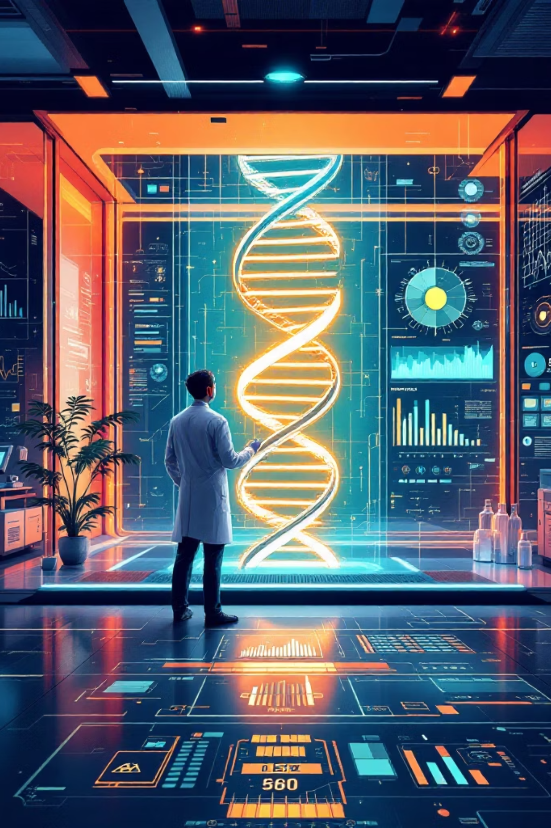
Precision Medicine: A More Advanced Approach
These limitations have driven increasing interest in precision medicine as a more advanced approach to transplant care. Precision medicine aims to tailor treatment strategies to the individual patient by integrating multiple sources of data, including drug exposure, genetic information, and biological markers of disease activity.
The ultimate goal is to move from a reactive model of care toward a predictive and proactive one, where complications such as rejection can be anticipated and prevented rather than simply treated after they occur.

Slide 8
Advanced Biomarkers: Moving Beyond Traditional Markers
A central component of this evolving approach is the use of biomarkers. In the context of kidney transplantation, biomarkers are measurable indicators that reflect underlying biological processes, particularly immune activation and graft injury. Traditional biomarkers such as serum creatinine and proteinuria remain widely used but are limited by their lack of sensitivity and specificity, as well as their delayed response to injury.
01
02
03
Donor-Derived Cell-Free DNA (dd-cfDNA)
Gene Expression Profiling
Urinary Biomarkers
Measures the proportion of circulating DNA originating from the transplanted organ. Elevated levels have been associated with graft injury and acute rejection.
evaluate patterns of immune-related gene activity to assess the risk of rejection or immune quiescence, aiming to identify patients who are stable and may not require invasive procedures such as biopsy.
Chemokines such as CXCL9 and CXCL10 are being investigated as non-invasive tools for detecting early immune activation within the graft.

Slide 9



The Continuum of Kidney Transplant Care
Overall, the current global landscape of kidney transplant care can be viewed as a continuum.
Traditional Guideline-Based Care
Partially Individualized Approaches
Fully Integrated Precision Medicine
Remains the foundation of clinical practice
TDM and selective use of pharmacogenetics and advanced biomarkers
Treatment dynamically tailored to each patient based on comprehensive, real-time data
Despite the promise of these technologies, most remain either partially implemented or confined to research and specialized centers. Their integration into routine clinical practice is limited by factors such as cost, lack of standardization, and the need for specialized laboratory infrastructure.
In parallel, predictive models incorporating clinical data, biomarkers, and computational methods—including machine learning—are being developed to stratify patients according to their risk of rejection or other complications. These models represent a further step toward fully realizing precision medicine; however, they are not yet widely implemented in routine care.

Slide 10
Implementation Challenges and Future Directions
The transition toward this advanced model requires more than just new technologies. It depends on the availability of robust healthcare infrastructure, including advanced laboratory capabilities, integrated data systems, and effective communication between multidisciplinary teams.
Trained Healthcare Professionals
Financial Considerations
Healthcare Infrastructure
Advanced laboratory capabilities, integrated data systems, and effective communication between multidisciplinary teams
Capable of interpreting complex data and translating it into clinical decision-making
Many of these technologies are resource-intensive

Slide 11


Slide 12
In conclusion…
while current transplant care has achieved substantial progress through guideline-based standardization and therapeutic drug monitoring, it remains limited by its inability to fully account for individual variability. Precision medicine offers a promising pathway toward more effective and personalized care by incorporating biomarkers, genetic data, and predictive modeling. However, its widespread implementation remains a work in progress, requiring coordinated advances in technology, clinical systems, and healthcare infrastructure.

