Slide 1


The Role of ferroptosis in cholestasis
Pharmacology PhD student
Shahad Amaar Hussein
20 – 4 -2026

Slide 2
Introduction to Ferroptosis
What is the ferroptosis?
A type of regulated cell death distinct from apoptosis or necrosis.
Ferroptosis is an iron-dependent lipid peroxidation cell death.
It is a key factor in organ failure and chronic tissue damage.

Slide 3
Cholestasis: An Overview
Cholestasis is a clinical syndrome that characterized by impaired bile flow and retention of bile acids in the liver and body.
Cholestasis resulting from mechanical or functional obstruction of the hepatobiliary system.

Slide 4
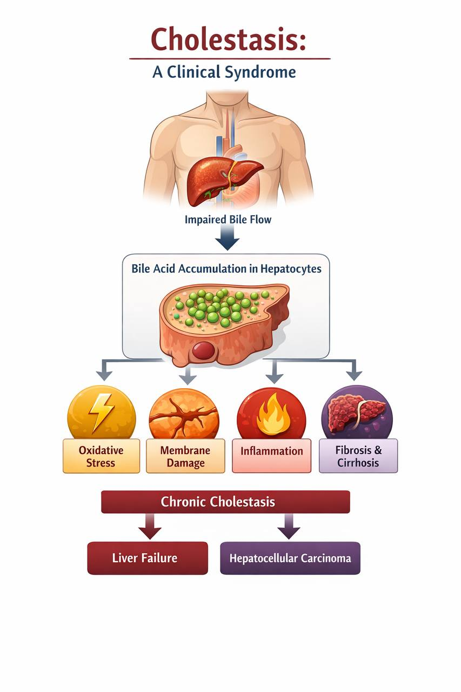
The Condition: Impaired bile flow from the liver to the duodenum.
Primary Stressor: Accumulation of bile acids (BAs) inside the liver.
Consequences: Inflammation, tissue damage, and eventually liver fibrosis.

Slide 5
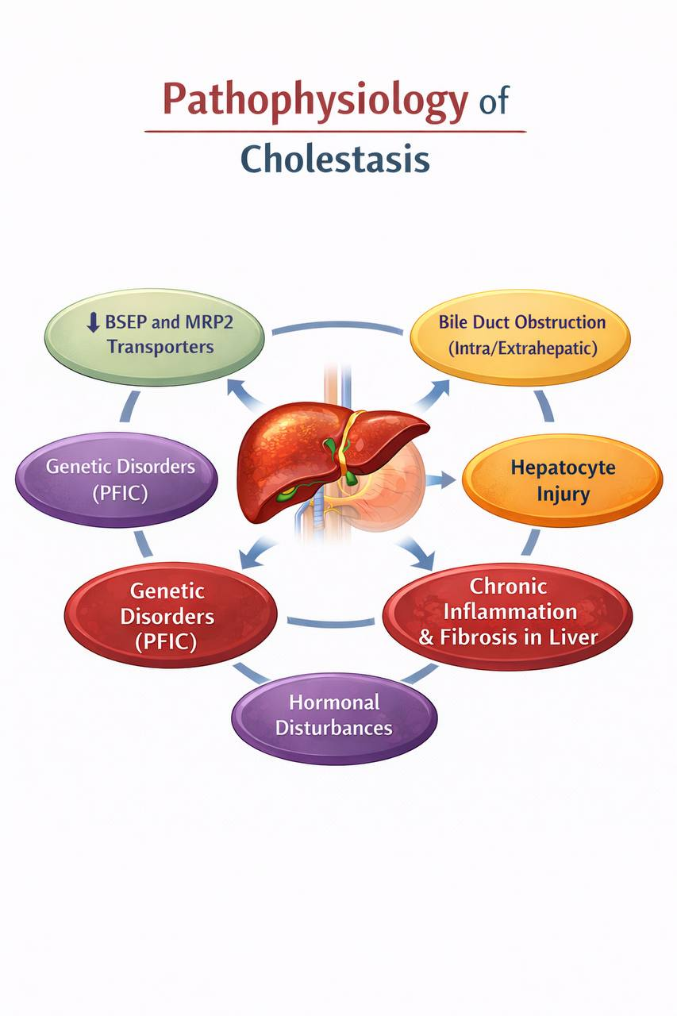
The pathophysiology of cholestasis
Reduced expression or function of bile acid transport proteins BSEP and MRP2 transporters.
Bile duct obstruction (intra/extrahepatic).
Hepatocyte injury.
Chronic inflammation and fibrosis in liver.
Genetic disorders (PFIC).
Hormonal disturbances as in pregnancy.

Slide 6
Linking Cholestasis to Ferroptosis
The Trigger: Bile acid toxicity causes severe cellular stress.
Key Finding: Cholestasis creates the ideal "ferroptotic environment" by disrupting iron metabolism and antioxidant defenses.

Slide 7
Key Mechanisms of Ferroptosis in Cholestasis
1. Iron Overload
Mechanism: cholestasis injury can lead to :
the accumulation of toxic bile acids within hepatocytes.
These bile acids can disrupt iron homeostasis.
increase Labile Iron Pool: Excess free iron accumulates inside the hepatocyte, which is is the primary catalyst for ferroptosis
The Danger: Iron acts as a catalyst for the Fenton reaction.

Slide 8
The Fenton Reaction
The excess intracellular free iron facilitates the Fenton reaction.
Where iron reacts with hydrogen peroxide to produce highly reactive hydroxyl radicals .
These free radicals attack polyunsaturated fatty acids (PUFAs) in cell membranes, causing massive lipid peroxidation.

Slide 9
2. Lipid peroxidation
The hallmark of ferroptosis is the oxidation of polyunsaturated Fatty acids (PUFAS) in the cell membrane, leading to membrane damage and cell death.
In cholestasis , the enzyme ACSL4 is often upregulated, which enriche the membranes with sensitive fatty acid, making them fuel for ferroptosis.

Slide 10
3. Failure of the GPX4 Defense system
A. GSH Depletion:
cholestasis severly depletes GSH, : The inflammatory environment associated with cholestasis consumes GSH, which is necessary for GPX4 to neutralize lipid peroxides.
GPX4: The "Master Guard" enzyme that neutralizes lipid peroxides.
B. System X-C inhibition : The transporter that imports cystine for Glutathione (GSH) production.
Outcome;without GSH,Gpx4 can not neutralize lipid peroxides, leading to membrane rupture and cell death

Slide 11
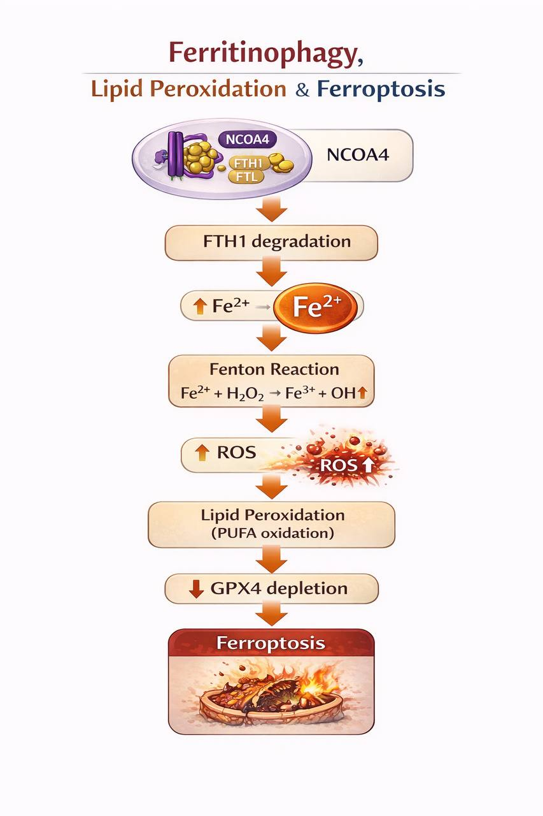
Ferroptosis and Ferritinophagy
Ferroptosis Triggered by:
  ROS accumulation
  GPX4 reduction

Slide 12
The Vicious Cycle
As hepatocytes undergo ferroptosis, they release damage-associated molecular patterns (DAMPs) and free iron into the extracellular environment. This process:
A.Promotes Inflammation: Recruits immune cells that produce even more reactive oxygen species (ROS), creating further oxidative stress for neighboring healthy cells

Slide 13
B. Activates Hepatic Stellate Cells (HSCs): The release of free iron and ROS from dying hepatocytes stimulates HSCs, which drives liver fibrosis—a common and severe progression of chronic cholestasis.

Slide 14
Pathological Significance
Disease Progression: Hepatocyte ferroptosis is now considered a key driver in the transition from initial cholestatic injury to more severe fibrosis and cirrhosis.

Slide 15
Therapeutic Potential: Because ferroptosis is a regulated process, it is a druggable target. Research in experimental models has shown that:
Iron chelators (e.g., deferoxamine) can mitigate liver injury by sequestering excess iron.
Ferroptosis inhibitors (e.g., ferrostatin-1) have demonstrated the ability to prevent hepatocyte death and improve liver function in cholestatic settings.

Slide 16
THANK YOU

