Slide 1
Evaluation of Carvone and Citronellol as Protective Agents against Cisplatin-induced Nephrotoxicity in Mice.
​by : Mohammed Maher Tawfiq (Pharmacology & Toxicology M.Sc. Student).
Supervisor: Prof. Dr. Sarmed Hashim Kathem.
​ College of Pharmacy, University of Baghdad.

Slide 2
Clinical Significance of Cisplatin efficacy
A platinum-based therapy for ovarian, testicular, and bladder cancers.
​The Constraint: Dose-limiting nephrotoxicity affects 20–40% of patients.
​OCT2 Transporter: Cisplatin enters proximal renal tubule cells via Organic Cation Transporter-2.
​DNA Damage: Forms intra-strand cross-links, inhibiting DNA synthesis and leading to cell death.

Slide 3
Pathophysiology of Nephrotoxicity (CIN)
​Oxidative Stress (OS): Rapid generation of reactive oxygen species (ROS) depletes cellular antioxidants like GSH and SOD.
​Inflammatory Response: Activation of NF-κB triggers the release of pro-inflammatory cytokines such as TNF-α and IL-1β.
​Mitochondrial Dysfunction: Disruption of the mitochondrial membrane potential triggers the intrinsic apoptotic pathway.

Slide 4
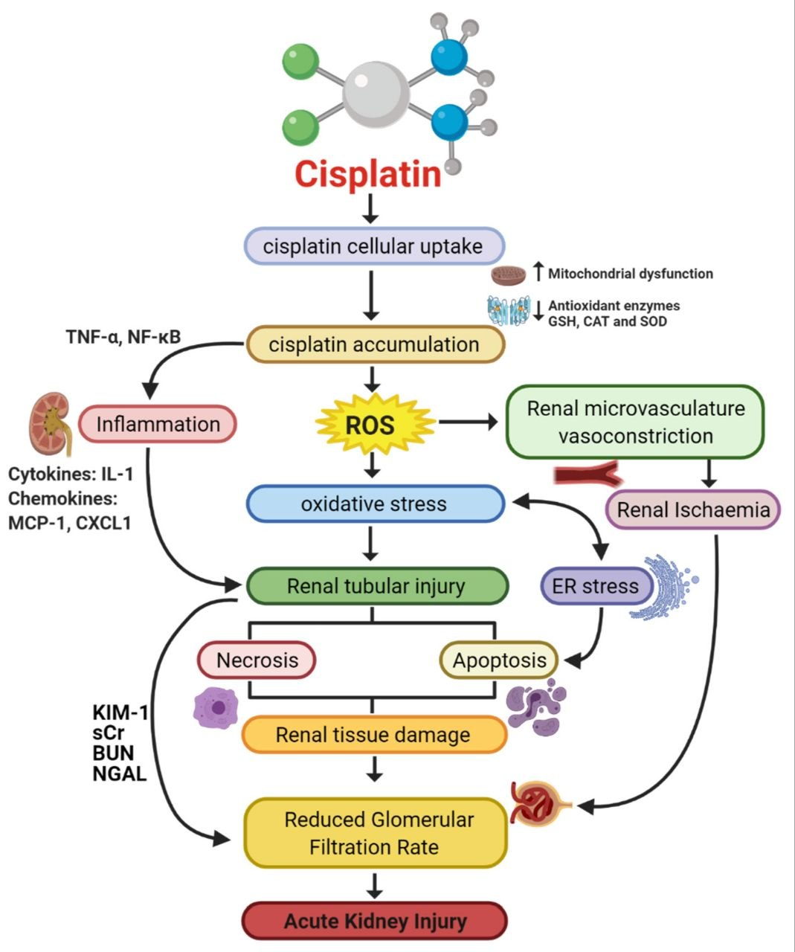

Slide 5
Protective Mechanism of Monoterpenes
​Carvone (Spearmint/Caraway Extract):
​Acts as a potent antioxidant and anti-inflammatory agent.
​Targeted to interfere with ROS-mediated pathways and inflammatory cycles.
​Citronellol (Rose/Citronella Extract):
​Proven to augment antioxidant enzymes in renal environments.
​Shown to suppress NF-κB and TNF-α expression in diverse mouse models of acute kidney injury.

Slide 6
Study Objectives
​Primary Goal: Verify the renoprotective potential of Carvone and Citronellol against CIN in Swiss albino mice.
​Secondary Goals:
​Dose Comparison: Evaluate 50 mg/kg vs. 100 mg/kg efficacy.
​Molecular Analysis: Measure impact on oxidative stress, apoptosis (Caspase-3), and cytokine balance (IL-10 vs. IL-17).

Slide 7
Methodology – Experimental Design
​Animal Model: Adult male Swiss albino mice (Total n=36, 6 per group).
​Prophylactic Regimen: * Days 1–4: Oral administration of test compounds or vehicle (Corn Oil).
​Day 5: Single Intraperitoneal (i.p) injection of Cisplatin (12 mg/kg).
​Day 8: Euthanasia and sample collection 72 hours post-insult.

Slide 8
Comprehensive Evaluation Parameters
​Renal Function Indicators:
​Serum Creatinine and BUN.
​KIM-1 (Kidney Injury Molecule-1) – an early biomarker for tubular damage.
​Histopathology:
​H&E staining to score tubular necrosis, proteinaceous casts, and interstitial edema.
​Kidney Weight/Body Weight (KW/BW) ratio to quantify edema.

Slide 9
Advanced Molecular Assays
Apoptosis Profiling:
​Caspase-3: The executioner protease measured via Western Blot.
​Bcl-2/Bax Ratio: Evaluates the balance between pro-apoptotic (Bax) and anti-apoptotic (Bcl-2) signals.
​Inflammatory & Immune Markers:
​NF-κB & TNF-α: Key drivers of renal inflammation measured via PCR.
​IL-10 & IL-17: Measuring the balance between anti-inflammatory (IL-10) and pro-inflammatory (IL-17) status.

Slide 10
References
​Abdelghany S, et al. Protective role of citronellol on antioxidant enzymes... J Biochem Mol Toxicol. 2024.
​Hassan M, et al. Molecular mechanisms underlying cisplatin-induced nephrotoxicity... Oxid Med Cell Longev. 2024.
​Li XK, et al. Protective effects of tanshinone I against cisplatin-induced nephrotoxicity... J Clin Pharmacol. 2022.
​Zhang Y, et al. Hydrogen sulfide protects against cisplatin-induced experimental nephrotoxicity

Slide 11


