Slide 1



برعاية أَلسيد عميدُ كليةِ أَلصيدلة
أَلأَستاذ أَلدكتور سرمد هاشم أََلخطيب أَلمحترم
تقيمُ جامعة بغداد/ كلية أَلصيدلة / شعبة أَلشؤون أَلعلميةِ
الحلقة النقاشية أَلموسومة
Is Inflammation Associated with Renin Angiotensin System in PCOS?
By
Alameen Jamal Ahmed
Supervised by
Lecturer Dr. Seenaa Sadiq Amin
يوم الثلاثاء
المصادف 10/3/2026
في قاعة الدراسات العليا / فرع العلوم المختبرية السريرية

Slide 2
Background
Polycystic Ovary Syndrome (PCOS) is one of the most common endocrine disorders affecting of reproductive age women, characterized by hyperandrogenism, ovulatory dysfunction, and polycystic ovarian morphology.
Affecting 8% to 18% of reproductive age women.
In 2019, an estimated 66 million individuals worldwide were affected by PCOS.
The incidence and prevalence of PCOS differ by age and region, but overall, both have been gradually increasing.

Slide 3
Background
PCOS is mainly defined by three core features: ovarian cysts, elevated androgen levels, and menstrual cycle irregularity.
Symptoms may be present as early as menarche, while in some cases, the syndrome is only identified later due to excessive weight gain or infertility issues.
PCOS typically occurs in women of reproductive age, between 15 and 44 years, yet up to 70% of cases remain undiagnosed.
Despite its prevalence, no medications and/or diagnosis biomarker have been specifically approved for PCOS.
Treatments, such as metformin, letrozole, clomiphene, and oral contraceptives, are prescribed off-label and mainly address symptoms.

Slide 4
Background
With advancing age, the syndrome gradually shifts from primarily a reproductive disorder to one with predominant metabolic complication. Alongside insulin resistance and impaired energy regulation, PCOS significantly increases the risk of type 2 diabetes mellitus and cardiovascular diseases later in life.
Therefore, a clear understanding of the epidemiological characteristics of PCOS is important to guide healthcare policies and support clinical research.

Slide 5
The etiology of PCOS
The etiology of PCOS is multifactorial and not fully understood involving genetic predispositions and environmental/lifestyle factors.
In recent years, chronic low-grade inflammation has been identified as an important feature of PCOS pathophysiology. Circulating pro-inflammatory cytokines, such as interleukin-6 (IL-6) and tumor necrosis factor-alpha (TNF-α), are elevated in women with PCOS and are believed to contribute to insulin resistance and other metabolic abnormalities linked to the syndrome.
These cytokines may also interact with the hypothalamic–pituitary–ovarian axis, potentially disrupting ovarian function and promoting hyperandrogenemia and anovulation.

Slide 6
The etiology of PCOS
Another system that may connect the metabolic and reproductive features of PCOS is the renin–angiotensin system (RAS). In addition to its well-known role in regulating blood pressure, the RAS is also present in ovarian tissue and is believed to influence follicular development and steroid hormone production.
Angiotensin II (Ang II), is the main active peptide of the RAS, can increase oxidative stress and inflammation through the angiotensin type-1 receptor activity. Some studies have found higher Ang II levels in women with PCOS, which are associated with insulin resistance.

Slide 7
The etiology of PCOS
Angiotensin-(1–7) (Ang (1–7)), formed from Ang II by angiotensin-converting enzyme 2 (ACE2), acts in the opposite way by providing anti-inflammatory, vasodilatory, and insulin-sensitizing effects.
Therefore, an imbalance between the harmful effects of Ang II and the protective effects of Ang (1–7) may play a role in the chronic inflammation and metabolic disturbances seen in PCOS

Slide 8
Methods
This case–control study was conducted between December 2024 and March 2025 at Fallujah Teaching Hospital for Women and Children.
Ninety reproductive-aged women (18–40 years) were enrolled, including 45 newly diagnosed PCOS patients based on the Rotterdam criteria and 45 healthy controls.
Anthropometric, metabolic, and reproductive parameters were evaluated. Serum levels of Renin, Ang II, Ang (1–7), IL-6, and TNF-α were measured.

Slide 9
Methods
PCOS was diagnosed according to the Rotterdam 2003 criteria , requiring at least two of the following: oligo/anovulation, clinical and/or biochemical hyperandrogenism, or polycystic ovarian morphology on ultrasound.
Controls had regular menstrual cycles, no clinical hyperandrogenism, and normal ovarian morphology.

Slide 10
Methods
Women were excluded if:
they are pregnant, menopausal, had endocrine disorders that could mimic PCOS (e.g., Cushing’s syndrome, thyroid dysfunction, congenital adrenal hyperplasia),
diabetes mellitus, patients with chronic hypertension, chronic inflammatory diseases, or had used hormonal or insulin-sensitizing medications.

Slide 11
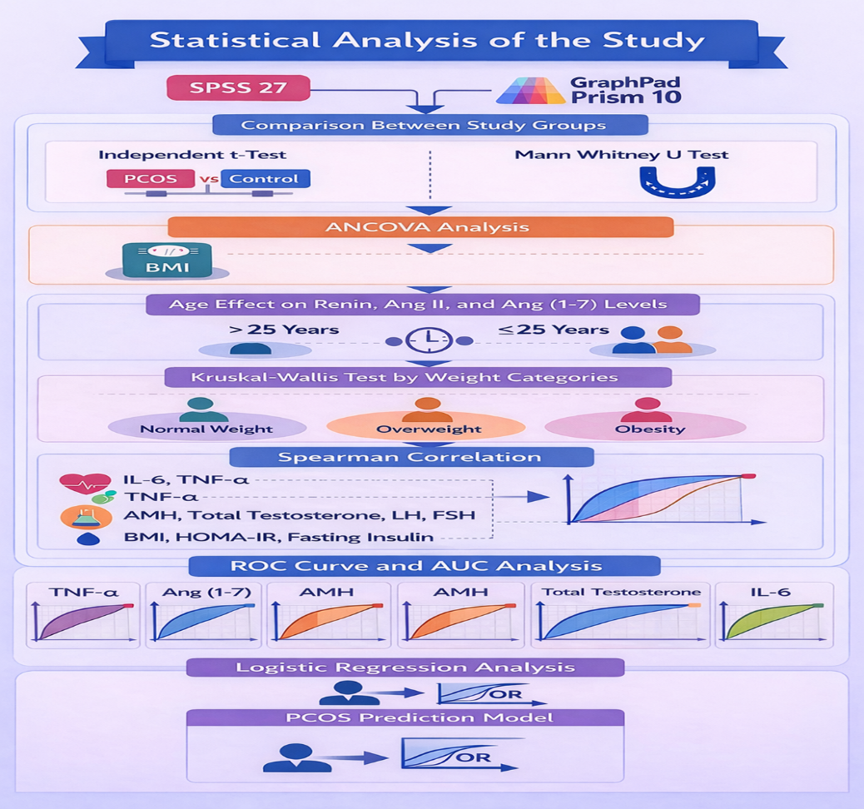
Statistical analysis

Slide 12
Findings of The Present Study
Women with PCOS will show significantly higher BMI, waist circumference, fasting insulin, HOMA-IR, LH/FSH ratio, total testosterone, and AMH compared to healthy controls, reflecting the combined metabolic and hormonal disturbances characteristic of PCOS.
Levels of Ang (1–7) will be significantly lower in women with PCOS compared to healthy controls, indicating dysregulation of the protective arm of the renin–angiotensin system, whereas renin and Ang II will not show significant differences.

Slide 13
Findings of The Present Study
Pro-inflammatory cytokines (IL-6 and TNF-α) will be elevated in PCOS patients; however, this association will be reduced after adjusting for BMI, suggesting obesity contributes to the inflammatory profile in PCOS.
AMH will show the best diagnostic accuracy for PCOS, followed by total testosterone supporting their potential role as diagnostic biomarkers.
TNF-α will correlate positively with gonadotropins (LH and FSH), indicating a link between inflammation and reproductive hormone dysregulation in PCOS.

Slide 14
Findings of The Present Study
AMH, TNF-α, and LH/FSH ratio will show as independent predictors of PCOS in multivariable regression analysis, highlighting their combined diagnostic and pathophysiological Importance.

Slide 15
Conclusion
This study shows altered renin–angiotensin system components in women with PCOS, evidenced by lower Angiotensin (1–7) levels compared with controls.
The associations observed between inflammatory markers and reproductive hormones highlight a potential interplay between immune and endocrine pathways in the syndrome.
While traditional biomarkers such as AMH and total testosterone showed superior diagnostic performance, inflammatory markers may offer complementary value in the clinical evaluation of PCOS.

Slide 16
Conclusion
Overall, these findings reinforce the concept of PCOS as a multifactorial condition characterized by interconnected metabolic, hormonal, and inflammatory disturbances. Further large-scale prospective studies are required to confirm these associations and to better define their clinical Importance.

