Slide 1

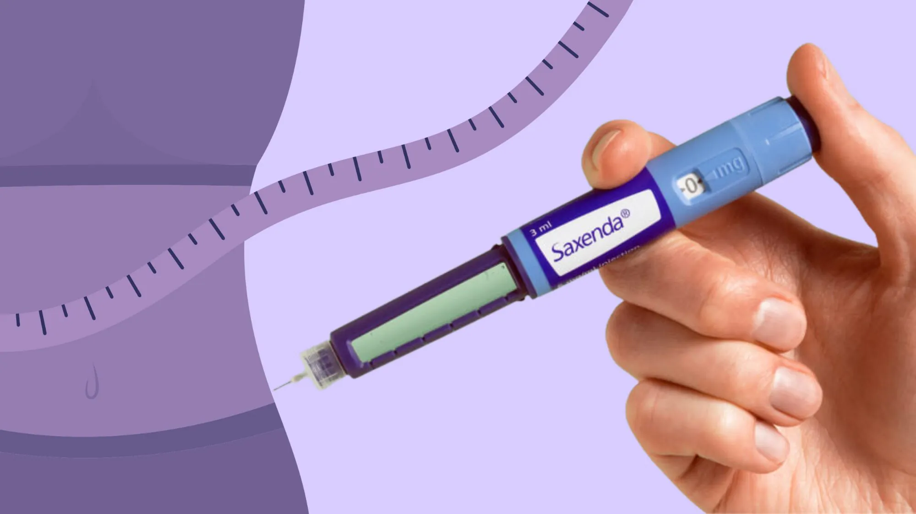

Pharmacist-Led Patient Education for GLP-1 Agonists: Optimizing Obesity Management
Abdullah Saad Turki
MSc Candidate
Clinical Pharmacy Department

Slide 2
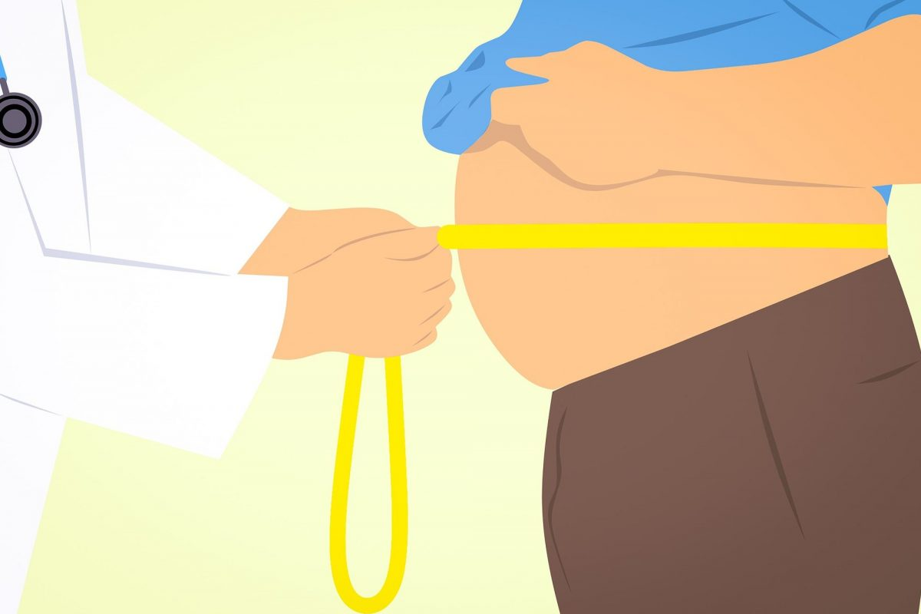
Defining the Challenge
Excessive Adiposity: Defined as fat accumulation stored globally, regionally, or within organs that increases negative health outcomes.
A Growing Epidemic: Over one billion people worldwide lived with obesity in 2022.
The Middle East Context: This region has the highest rates of obesity globally.
Iraq Statistics: National prevalence shows 33.9% of Iraqis are obese and 31.8% are overweight

Slide 3
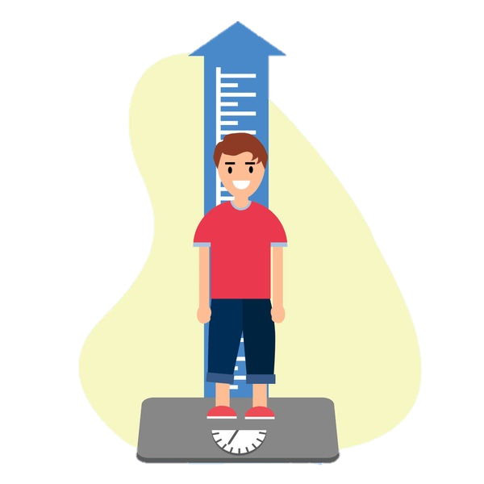
BMI & Classification
BMI Calculation: Weight (kg) divided by height squared (m²).
Standard Ranges:
Normal: 18.5–24.9 kg/m²
Overweight: 25–29.9 kg/m²
Obese: ≥30 kg/m²
Obesity Classes:
Class 1: 30–34.9 kg/m²
Class 2: 35–39.9 kg/m²
Class 3: ≥40 kg/m²

Slide 4
Beyond BMI: Obesity Phenotypes
Normal Weight Obesity: Individuals with normal BMI but high body fat percentages (≥23.5% for men and ≥29.2% for women).
Metabolically Healthy Obese (MHO): High BMI but lacks insulin resistance or systemic inflammation; however, this is often a temporary state.
Sarcopenic Obesity: Coexistence of excess fat and deficiency in skeletal muscle mass or function.
Central Obesity: Men with waist circumference > 102 cm and women > 88 cm are at higher risk for diabetes and CVD regardless of BMI.

Slide 5

Clinical Impact & Complications
Metabolic Pathways: Obesity increases non-esterified fatty acids and pro-inflammatory cytokines, leading to insulin resistance and beta-cell decline.
Systemic Risks: Significantly elevates risk for Type 2 Diabetes, sleep apnea, osteoarthritis, and CVD.
Cardiovascular Changes: Triggers endothelial dysfunction, small vessel remodeling, and cardiomyocyte toxicity.
Specific Outcomes: Increases risks of arrhythmias, cardiomyopathy, and congestive heart failure.

Slide 6
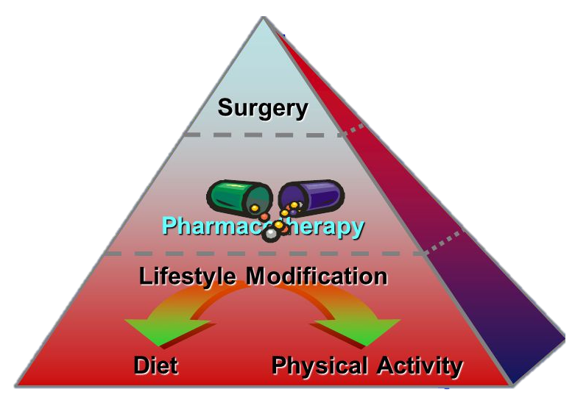
Therapeutic Goals & Tiers
Lifestyle First: Aiming for a 10% loss of initial body weight through diet, activity, and behavior changes.
Medication Indications:
BMI 27–29.9 kg/m² with comorbidities.
BMI ≥30 kg/m² as a standard recommendation.
Intensive Therapy: Bariatric surgery is universally recommended when BMI exceeds 40 kg/m².

Slide 7

GLP-1 Receptor Agonists
The Incretin Effect: Emulates endogenous hormones to boost insulin secretion and inhibit glucagon.
Weight Loss Mechanisms: Prolonging gastric emptying and promoting satiety to reduce cravings for calorie-dense foods.
Market Leadership: GLP1-RAs are the most effective medical treatments currently available for obesity.

Slide 8
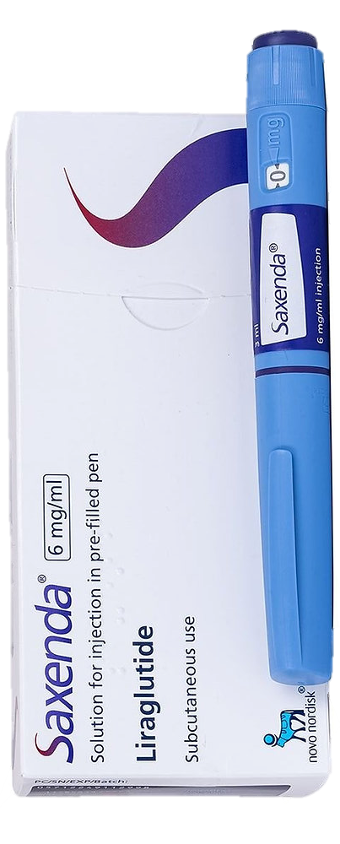
Detailed Profile: Liraglutide (Saxenda®)
Approval: FDA-approved for adults in 2014 and adolescents (12+) in 2020.
Dosing: Daily subcutaneous injection; titrated weekly starting at 0.6 mg up to 3 mg.
Efficacy: In trials, 76% of participants lost > 5% of body weight.
Metabolic Benefits: Improves blood pressure and reduces progression from prediabetes to Type 2 Diabetes by 80%.

Slide 9
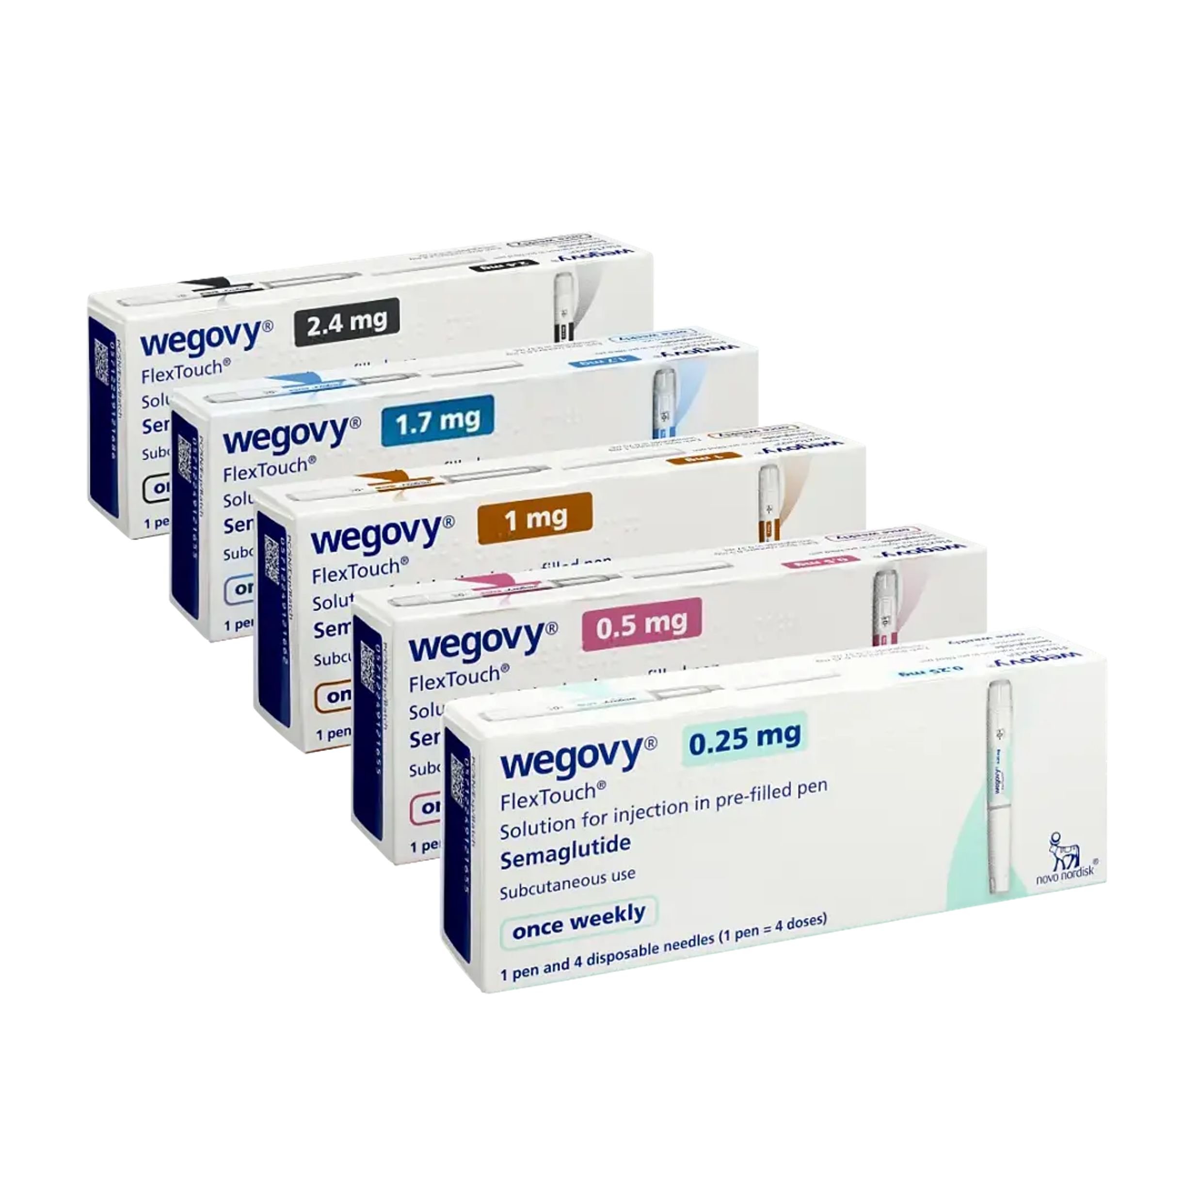
Detailed Profile: Semaglutide (Wegovy™)
Dosing: Weekly subcutaneous injection; titrated every 4 weeks up to 2.4 mg.
Superiority: The STEP 8 trial showed semaglutide achieved -15.8% weight loss compared to -6.4% for liraglutide.
Adherence: Discontinuation rates were lower for semaglutide (13.5%) compared to liraglutide (27.6%).

Slide 10
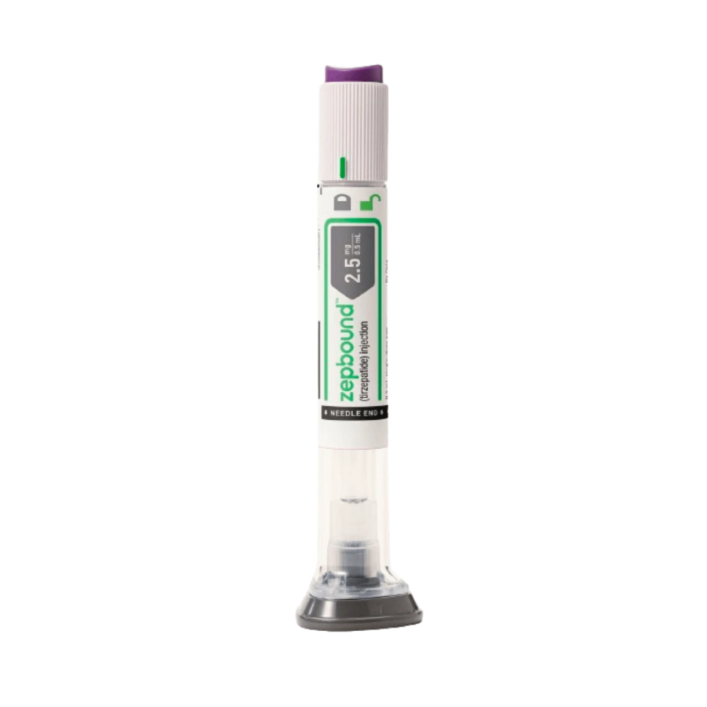
Tirzepatide (Zepbound®) & New Frontiers
Tirzepatide: A multi-target analog showing mean weight loss of -15.3% at 12 months, outperforming semaglutide's -8.3%.
CagriSema: Combination of semaglutide and the amylin analogue cagrilintide; REDEFINE 1 trial showed a massive -20.4% weight loss at 68-week mark.

Slide 11
Common Gastrointestinal Adverse Events
The GI Profile: Nausea, vomiting, diarrhea, and constipation are the most prevalent symptoms.
Agent-Specific Risks:
Tirzepatide: Highest risk for nausea and diarrhea.
Semaglutide: Significantly associated with constipation.
Liraglutide: Moderate GI effects but high impact on appetite suppression.
Mitigation: Most GI side effects peak during dose escalation and can be managed through gradual titration.

Slide 12

Serious Safety Considerations
Black Box Warning: Potential risk for thyroid C-cell tumors.
Pancreatic Health: Associated with risks of acute pancreatitis and pancreatic cancer.
Other Risks: Gallbladder disease and elevated heart rate.

Slide 13

Patient education about Saxenda®

Slide 14
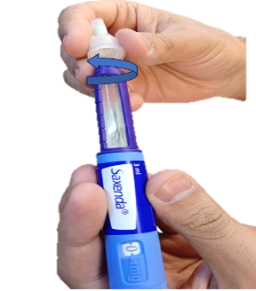
Step 1: Preparation
Wash hands with soap and water.
Clean the injection site.
Inspect the Pen: Check for damage; the solution must be clear, colorless, and free of particles.
New Needle Every Time: Use a fresh needle for every injection to prevent contamination and blockage.

Slide 15
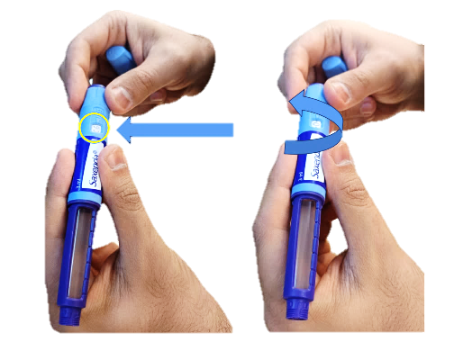
Step 2: Priming and Dose Selection
Check Flow: For a new pen, ensure the solution flows correctly before the first use.
Dial the Dose: Turn the dose selector until the prescribed amount (e.g., 0.6 mg, 1.2 mg) appears in the dose counter window.
Hold the pen so you can clearly see the dose counter during the process.

Slide 16
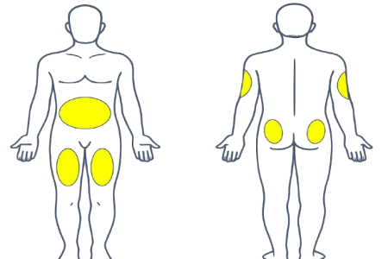
Step 3: Where to Inject
Approved Zones: Back of the upper arm, abdomen, front of the thighs, or buttocks.
Site Condition: Only inject into healthy skin—avoid areas with wounds, scars, or lumps under the skin.
Rotation: Use a different injection site each time to maintain skin health.

Slide 17
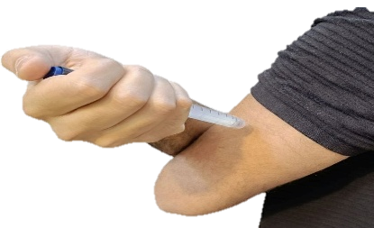
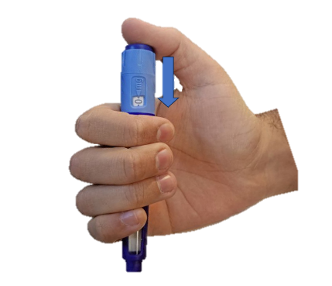
Step 4: The Injection Process
The Angle: Insert the needle straight into the skin at a 90-degree angle.
The Click: Press and hold the dose button until the dose counter returns to "0“ and wait 6 second before withdrawing.
Withdrawal: Pull the needle out at the same 90-degree angle used for entry.

Slide 18
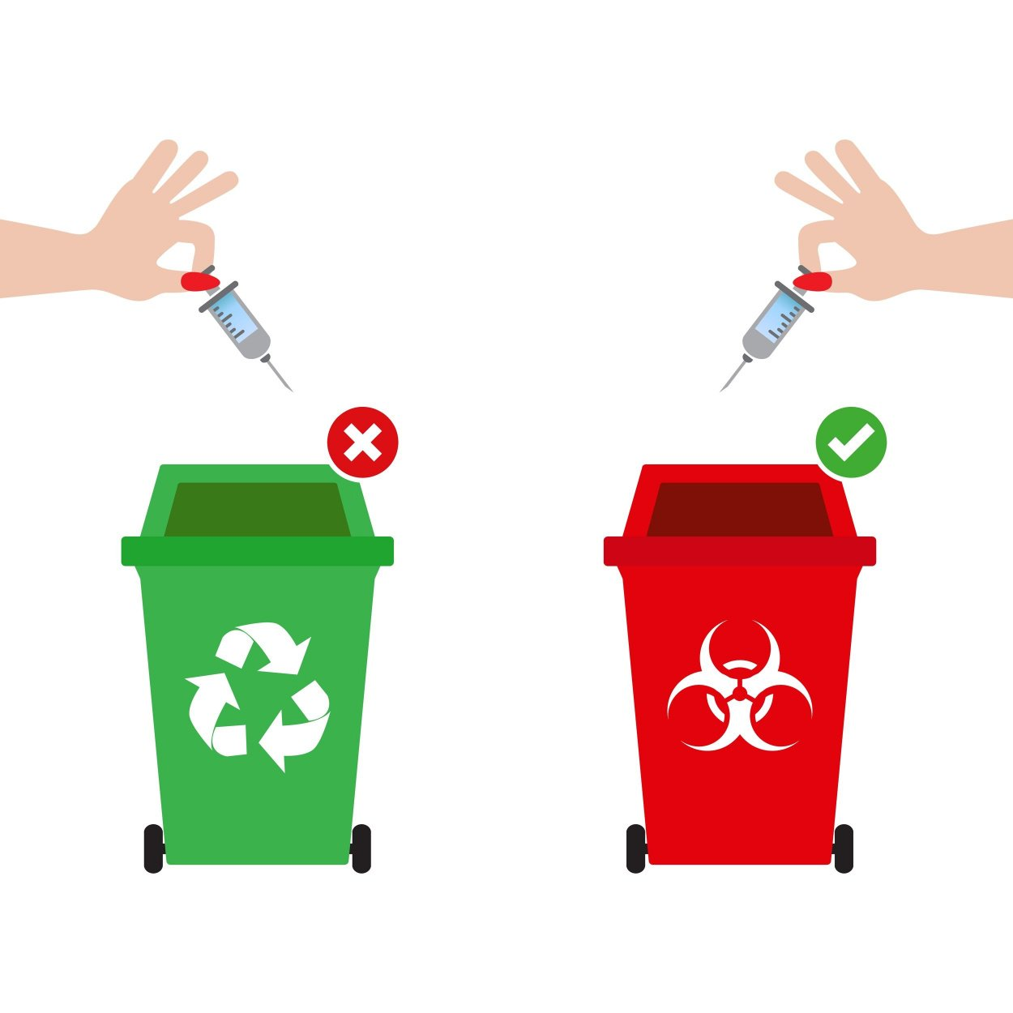
Step5: Post-Injection & Disposal
Carefully remove the needle from the pen after use.
Safe Disposal: Never throw needles in regular household trash.
Always use a designated puncture-proof sharps container

Slide 19
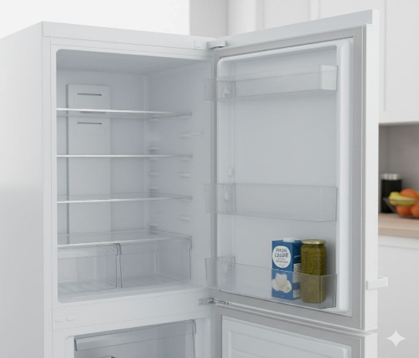
Storage & Timing
Unused Pens: Must be stored in the refrigerator.
In-Use Pens: Can stay in the fridge or at room temperature (below 30°C).
Light Protection: Keep the pen cap on after every use to protect the medicine from light.
Daily Timing: Inject once daily at the same time, regardless of meals.
If a dose is more than 12 hours late, the missed dose should not be taken and the next dose should be taken at the normal time

Slide 20
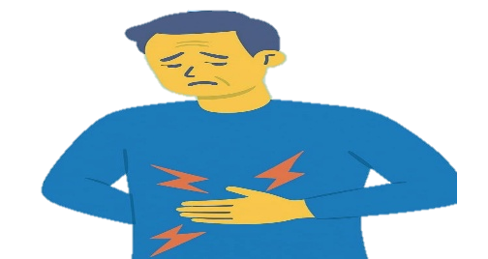
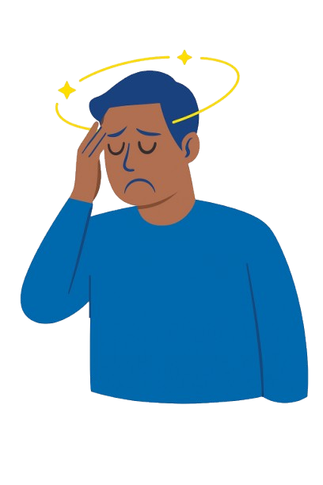
Safety Red Flags
Severe Pain: Stop use and seek help for persistent, severe abdominal pain (potential pancreatitis).
Systemic Signs: Seek urgent care for jaundice (yellowing of skin/eyes) or pain under the right ribs.
Vitals: Monitor for an increased resting heart rate.
Hydration & Focus: Drink plenty of water to avoid dehydration; be cautious while driving if you feel dizzy.

Slide 21

The Iraqi Pharmacists: Current Knowledge
Technical Proficiency: Community pharmacists in Iraq show high knowledge of pen storage (4.31/5) and proper pen usage (4.08/5).
Priority Gaps: Side effect counseling received the lowest priority (3.66/5).
Experience Paradox: Interestingly, age and pharmacy experience were negatively correlated with GLP-1 knowledge in some Iraqi cohorts.

Slide 22

The Iraqi Pharmacists: Current Practice
In our current work we found that patient education about Saxenda® was insufficient and generally poor
Proactive educators 43%
Preparation step 6.8%
The injection process 12.1%
Missed dose management 0%
Injection site rotation 4.5%
Counselling about side effects 4.5%

Slide 23

Barriers to education identified

Slide 24

Conclusion
The Pharmacist is a Safety Net: Beyond dispensing, pharmacists ensure safety and therapeutic success for obesity patients.
Addressing structural and knowledge gaps will transform community pharmacists into recognized weight management providers.

Slide 25
Thank you
Q&A

